Slide 1
Antitrust for Digital Platforms and Services
Susan Athey, Stanford
disclosures: former chief economist, antitrust division, US DOJ; Former consulting chief economist, Microsoft
Former Boards: Expedia, lending club, rover, turo, ripple
Expert for DOJ in AT&T/Time warner, for epic in epic vs. apple
Consultant on advertising technology regulation

Slide 2
Policy Questions
Crack down on “junk fees”?
Ban fake reviews?
Ban noncompetes?
Require Apple and Google to allow games and apps to link to their own website for buying subscriptions, or have their own store-within-a-store?
Allow Google to pay Apple for exclusivity, to prevent Apple sponsoring an entrant/competitor in search?
Self-preferencing on platforms?
Allow chip-makers to penalize customers who also buy chips from competitors?
Allow chip-makers to purchase middleware that enables multi-homing across chips?
Impose AI safety regulations on AI firms?
Ban open source AI?
Regulate payments for authors and creators?
Allow cloud platforms to invest in generative AI providers? To have exclusive deals with them?

Slide 3
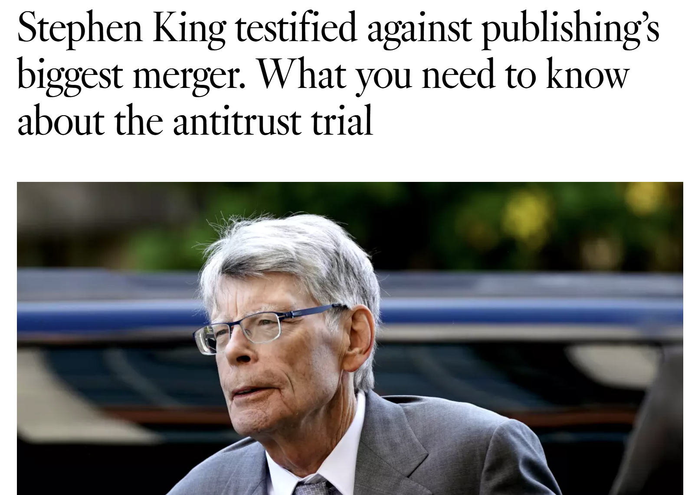

Slide 4
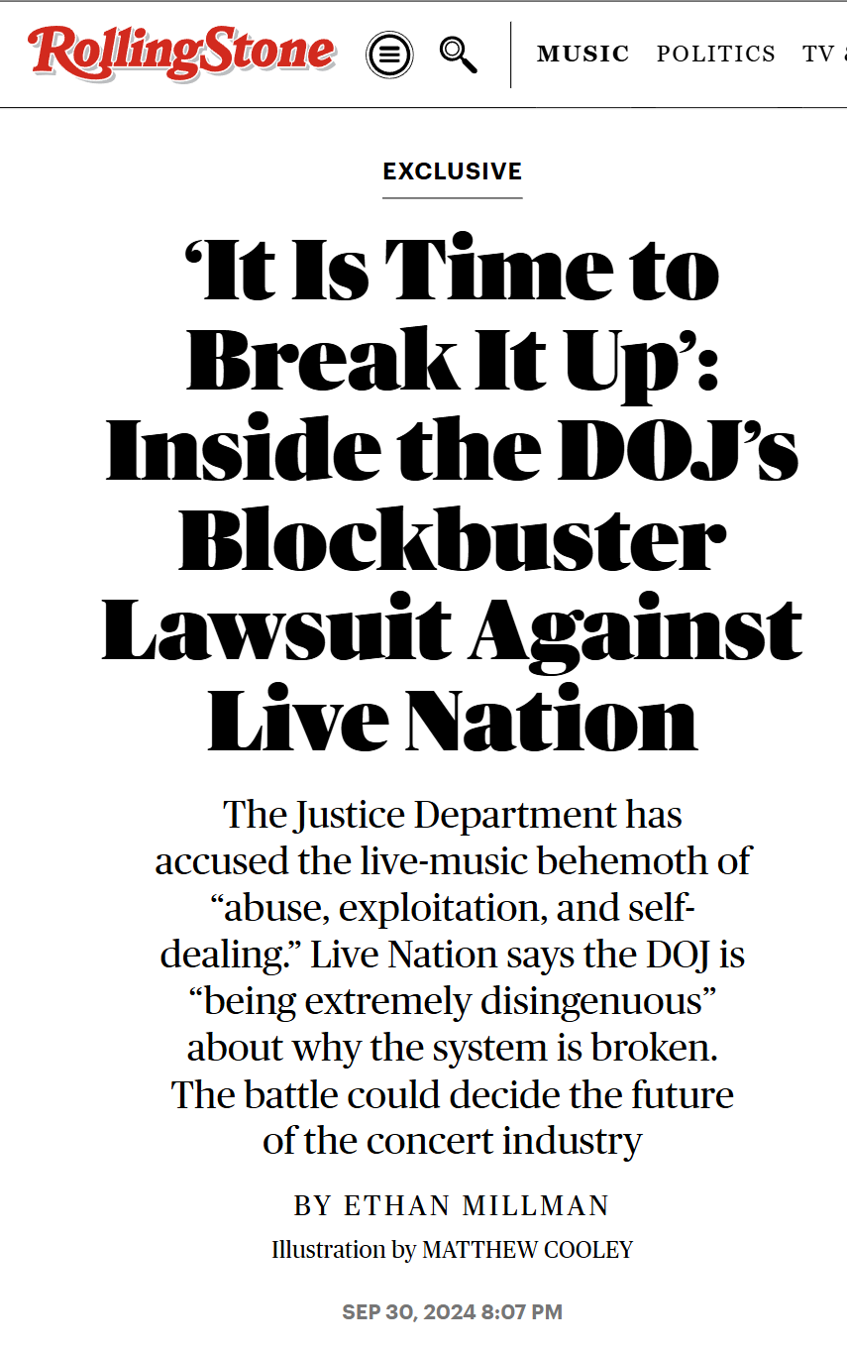

Slide 6
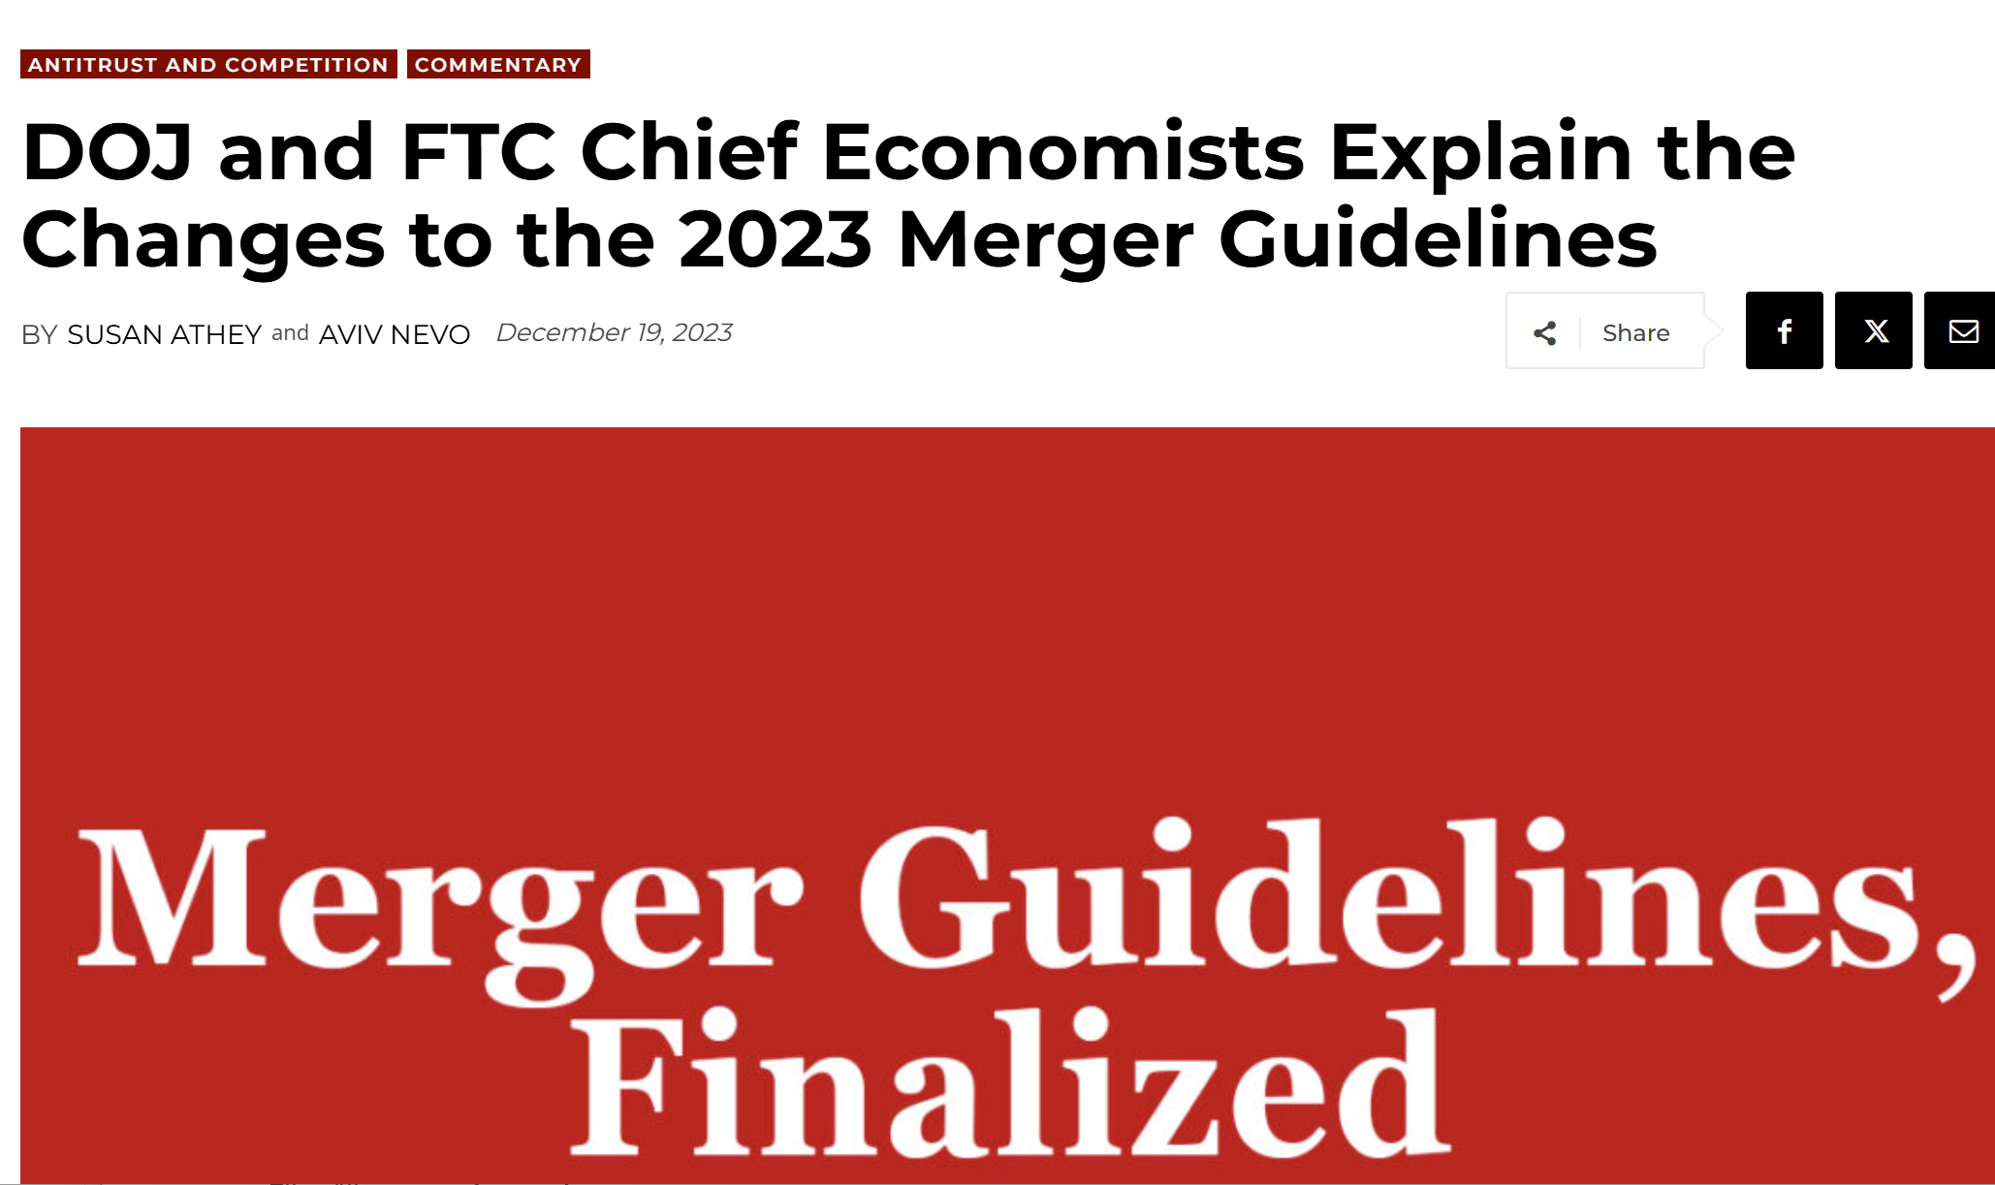

Slide 7
The mission: What is antitrust about?

Slide 8
Profit Motive: The Good & Bad
Firms seek profit.
Good:
Firm / manager creates a great product that consumer want, leading to high profits.
Firms aim for efficient production, keeping costs down & allow lower prices
Profits NOT prohibited by antitrust laws.
Incentive to attract consumers
Offer that is better (price, quality, innovation)
Core to markets and capitalism.
PROBLEM:
Firm profits from industry structure that enables exploitation of market power.
Profit ALSO incentivizes anticompetitive behaviors that create market power, harm consumers through less choice and worse offers
Choices that get in the way of competitive process
E.g. create artificial barriers to entry, lock up supply
Which does a firm choose when threatened?
Make product better?
Take away something rival needs to compete (buy a critical input, distribution channel, etc & withhold)
Manipulate regulatory process

Slide 9
The monopoly quantity is lower than the competitive quantity
Monopoly price
MC
Competitive price
Qm
Qc

Slide 10
Profit gained for monopolist that would be consumer surplus under competition
Monopoly price
MC
Competitive price
Qm
Qc

Slide 11
Distributional impact
Distributional consequences of antitrust enforcement:
A dollar of monopoly profit becomes a dollar of lower prices for consumers
Who loses? The owner of the corporation, e.g. stockholder
84% of stocks are owned by the top 10% of households
Who gains? The consumers of the product.
Consumption is much more evenly spread than stock ownership
Antitrust enforcement redistributes. Reduces inequality
And does this with efficiency gains, not losses
Only recently has attention been drawn to benefit of lowering inequality & helping the vulnerable

Slide 12
Concentration beyond competition
Resilience is a public good
Each customer wants the best deal in short term, but shortages or disruptions have broader impacts
Large purchasers often multi-source to maintain benefits of competition and resilience in input markets
“Too big to fail”
Variety & experimentation
Concentration and democracy
See history of post-Soviet Russia
Surveillance and government control
Governments trade favors with large firms
“Too big to regulate”
Regulatory capture & lobbying
Creation of artificial entry barriers
Companies can threaten government to withhold goods or services

Slide 13
The History
Price fixing (collusion) was mostly legal
Consolidation wave in late 1800s
Steel and oil trusts in the late 1800s kept the names and operations of the original firms but placed them in a central holding structure, e.g. Standard Oil, US Steel, American Tobacco.
The trusts concealed the consolidation but enabled price coordination
1890 Sherman Act created
Prohibits “monopolization” and price fixing
Congress creates exemptions: agricultural coops, baseball, labor unions, ocean shipping

Slide 14
Sherman Act Section 1: “Contracts, combinations and conspiracies in restraint of trade” are illegal
Agreement is key
Cartels, price-fixing, division of customers or territories, bid-rigging
This behavior is per se illegal; no inquiry into the consequences
Criminal penalties = JAIL for manager
Personal fines, corporate fines, and treble damages to customers
Private enforcement incentivized by treble damages
Parallel movements, tacit collusion, etc. are not good, but not illegal
Court is not concerned if price is high / low / reasonable, etc.
Biden admin: criminal prosecution for wage fixing (see Athey et al RIO 2024)

Slide 15
Sherman Act Section 2 prohibits “monopolization”
Leading examples:
Standard Oil (1911), AT&T (1974), Microsoft (1997), Google (EU neverending), Google (US DOJ now)
FTC Qualcomm 2018
Government lost badly
Very hard to win S2 cases in the US
Must distinguish success due to a good product from exercise of market power
Courts are cautious about antitrust enforcement so agencies historically afraid
Change in late Trump I beginning investigations, Biden admin bringing several cases to trial. Trump II announced plans to continue.
Ongoing litigation for big tech and others
DOJ Search (DOJ won in district court, now remedies)
DOJ Ad Tech
DOJ vs RealPage
FTC: Amazon
Private cases against Apple and Google app stores (Epic won against Google) and against Amazon
Ticketmaster
Lessons: good facts make good law, even when the cases seem “too complicated.” Economics must match facts.
Section 1 and 2 can both be present
DOJ vs. RealPage: Price fixing algorithms, monopolization

Slide 16
Antitrust & Big Tech in Trump Admin
Axios: But the president's new FTC chair, Andrew Ferguson, is an outspoken Big Tech critic on X and is signaling the panel won't be stacked with pro-industry quislings. The FTC is still moving forward with cases against Amazon and Meta, and it's investigating Microsoft.
Appointments at FTC:
“I am thrilled Dan is joining the FTC as Director of the Bureau of Competition,” said Chairman Ferguson. “He has tremendous experience litigating antitrust cases in critical markets, including agriculture and Big Tech. Few lawyers in America have as much experience taking on Big Tech as Dan. He also has experience using the antitrust laws to promote competition in labor and healthcare markets—two of my top priorities. Under Dan’s leadership, the Bureau of Competition will do its part to fulfill President Trump’s promise to lower the cost of living for all Americans, to promote innovation, and to protect the interests of American workers.”
Guarnera joins the Commission from the U.S. Department of Justice Antitrust Division, where he served as chief of the Civil Conduct Task Force. During his tenure, the task force filed monopolization suits against Google and Apple, as well as multiple cases involving agriculture and labor markets.

Slide 17
What is anticompetitive exclusionary conduct?
Exclusion – non-consenting competitors are weakened or driven out
Single-firm conduct
Multi-product firm: withholding inputs, outputs, or distribution from competitor; using control of one product to interfere with market functioning
Agreement with a customer or supplier of a competitor (“vertical agreement”)
Merger with a customer or supplier of a competitor (“vertical merger”)
There is no settled definition that encompasses all such conduct
The conduct must exclude, or weaken and thus impair the competitive significance of, actual or potential competitors
If the conduct excludes competitors and provides no efficiency benefits, it is anticompetitive
If the conduct both excludes competitors and has some efficiency benefits,
One interpretation: the conduct is anticompetitive if
The harm from exclusion outweighs the efficiency benefits, or
The conduct would not be profitable unless it excludes competitors and causes an increase in the firm’s market power
Decisions rarely acknowledge both exclusion and efficiency benefits in practice
For mergers: effect may be substantially to lessen competition
2023 merger guidelines refer to concept of exclusion from conduct cases, but legal standard relates to the risk of harm.
Merger enforcement is preventative, since conduct is much harder to enforce

Slide 18
Clayton Act Section 7, 1914: regulates mergers
Prohibits mergers where the effect may be “substantially to lessen competition or tend to create a monopoly”
Problem with Sherman Act is that firms could evade by merging…
Analysis is inherently forward-looking, predictive, probabilities not certainties

Slide 19
Competition and Market Power: 2023 Merger Guidelines
Competition is a process of rivalry that incentivizes businesses to offer lower prices, improve wages and working conditions, enhance quality and resiliency, innovate, and expand choice, among many other benefits.
Mergers that substantially lessen competition or tend to create a monopoly increase, extend, or entrench market power and deprive the public of these benefits.
Mergers can lessen competition when they diminish competitive constraints, reduce the number or attractiveness of alternatives available to trading partners, or reduce the intensity with which market participants compete.

Slide 20
2023 Merger Guidelines
Guideline 1: Mergers Raise a Presumption of Illegality When They Significantly Increase Concentration in a Highly Concentrated Market
Guideline 2: Mergers Can Violate the Law When They Eliminate Substantial Competition Between Firms
Guideline 3: Mergers Can Violate the Law When They Increase the Risk of Coordination
Guideline 4: Mergers Can Violate the Law When They Eliminate a Potential Entrant in a Concentrated Market
Guideline 5: Mergers Can Violate the Law When They Create a Firm That May Limit Access to Products or Services That Its Rivals Use to Compete

Slide 21
2023 Merger Guidelines
Guideline 6: Mergers Can Violate the Law When They Entrench or Extend a Dominant Position
Guideline 7: When an Industry Undergoes a Trend Toward Consolidation, the Agencies Consider Whether It Increases the Risk a Merger May Substantially Lessen Competition or Tend to Create a Monopoly
Guideline 8: When a Merger is Part of a Series of Multiple Acquisitions, the Agencies May Examine the Whole Series
Guideline 9: When a Merger Involves a Multi-Sided Platform, the Agencies Examine Competition Between Platforms, on a Platform, or to Displace a Platform
Guideline 10: When a Merger Involves Competing Buyers, the Agencies Examine Whether It May Substantially Lessen Competition for Workers, Creators, Suppliers, or Other Providers

Slide 22
What is an anticompetitive horizontal merger?
At a high level, it is one that is expected to reduce output of the merged firms in the market in which those firms do or might compete, compared to no merger
Take Facebook/Instagram, for example:
Did the merger improve Facebook and/or Instagram (by, e.g., economies of scope and combining complementary assets) – efficiency based? or
Did the merger prevent Instagram from being developed by a firm that did not have a social network franchise to protect and that would have made Instagram more valuable to consumers and/or stimulated more competition or the development of a new, welfare-enhancing social network paradigm – anticompetitive?

Slide 23
Themes in the 2023 Merger Guidelines
Tools
Framing of competition
Uncertainty and risk assessment
Support theories of harm grounded in economic theory with flexible approach to evidence
Recognize modern realities: e.g. non-price competition, multi-product firms
Labor markets
Dynamics
Frameworks for non-horizontal mergers (e.g. mergers of complements)
Entrenchment
Ecosystems
Platforms
Niche/nascent competitors
Potential competition
Serial acquisitions

Slide 24
Uncertainty – the driver of much antitrust law
Antitrust cases often involve
Unknowable future events (e.g., innovation)
Unobservable facts (e.g., marginal costs)
For several decades antitrust doctrine embodied a judgment that false positives are worse than false negatives and thus puts the burden of uncertainty on the antitrust plaintiff
E.g., predatory pricing law explicitly permits some kinds of anticompetitive pricing on the ground that a rule that attempted to identify such conduct in specific cases would be too likely to result in false positives
But, with barriers to entry or if merger creates barriers to entry, may not be self-correcting
Clayton Act vs. Sherman Act
Whether mergers of start-ups and other nascent competitors, or single-firm conduct that handicaps smaller rivals, will be found to be illegal depends on the willingness of enforcers and courts to find violations even with substantial uncertainty
Merger enforcement (Clayton act: “may be substantially to lessen competition”)
Many scenarios after the merger. Each generates a distribution of prices/quality/etc.
MG: “examine the totality of the evidence available to assess the risk the merger presents” in order to determine if the merger poses a “reasonable probability” of substantially lessening competition or tending to create a monopoly
Not an average—likelihood of a bad outcome

Slide 25
Risk Assessment
“May be” – an elaboration
In essence, the 2023 describe the Agencies as:
Examining the totality of the evidence available to assess the risks the merger presents in order to determine if the merger has a reasonable probability of substantially lessening competition or tending to create a monopoly.
Benefits
Align economic evidence and expert testimony more closely with best research practice
Essential for grappling with dynamic theories of harm
Merger may leads to withdrawal of interoperability, increase in switching costs
Identities of future entrants and their potential quality and innovations not known
But reasonable probability that entry is deterred
Variety of evidence may support the economic theory

Slide 26
Non-horizontal mergers (Guideline 5): Limiting Access to Products/Services Rivals Use to Compete
The 2023 MG essentially ask four questions (phrased in terms of input foreclosure):
Are there few alternative input suppliers that rivals could turn to if the merged firm stopped supplying them, or offered worse terms?
Is the parties’ input important, such that rivals would lose significant sales or would face significantly higher costs if their access to it were curtailed?
Are the rivals that use the input important for maintaining competition?
Is there significant competition between the merged firm and the rivals that use its input?
Dynamic competition perspective
Consider entering a market where your rival controls a key input, with limited alternatives
Variety of choices merged firm might make to influence future market structure
Creates the possibility of carrots & sticks to soften competition, deter entry or induce exit
May be difficult to predict the precise tactics
Example: health insurer buys data processing/analytics firm that serves other health insurers
Efficiencies need to be merger-specific (and verifiable): can’t be accomplished w/ contract

Slide 27
Entrench/Extend Dominant Position (Guideline 6):
How to distinguish anticompetitive entrenchment from making a better product? Rely on concepts/terminology from monopolization.
Distinguish anticompetitive entrenchment from growth or development as a consequence of increased competitive capabilities or incentives.
Prevent mergers that would entrench or extend a dominant position through exclusionary conduct, weakening competitive constraints, or otherwise harming the competitive process
Need a coherent theory of sources of dominance/entry barriers:
Consider mergers involving dominant firms in the context of evidence about the sources of that dominance
Focusing on the extent to which the merger relates to, reinforces, or supplements these sources.
Examples
Artificial switching costs, reducing multi-homing
Removing interoperability
Controlling middleware
Distorting access to distribution channels
Dynamic concepts
Creating or preserving dominance and the profits it brings can be an important motivation for a merger, as well as a driver of post-acquisition behavior
Firm may be willing to undertake costly short-term strategies in order to increase the chance that it can enjoy the longer-term benefits of dominance.
Entry barriers affect the merged firm’s longer-term incentives to improve its products and services.
Agencies consider the (often longer term) impact of the merger on market power and industry dynamics

Slide 28
Entrenchment guideline: Reflects modern theory and antitrust practice
Visa-Plaid in 2020
DOJ alleged that the merger would entrench monopoly power by increasing barriers to entry
Theory not stated in either HMG or VMG
Adobe-Figma in 2023
Theory for the impact on Adobe core markets
Hypotheticals/Scenarios
What if Microsoft had bought Netscape?
Deficiencies of underenforcement become apparent
Challenges faced by modern business customers & end consumers who lack meaningful choice
Considerations of entry, innovation of millions of small/new businesses

Slide 29
Ecosystems and Dynamics: How Niche Competitor Threatens Dominant Firm
A nascent threat may be able to add features or serve additional customer segments
Grow into greater overlap of customer segments or features over time
“Ecosystems”
Customers may aggregate additional products and services from multiple providers, serve as a partial alternative to dominant firm
In this way, the nascent threat supports what may be referred to as “ecosystem” competition
Idea: an individual product can serve as a complement to the competitors of dominant firms

Slide 30
Platforms: Mergers may affect…
Large
supply-side
users
Small
supply-side users
Extent of multi-homing and switching (affects buyer and supplier power, which are connected; also affects competition with rivals)
Substitution
(e.g., from a platform following a niche strategy)
Competition between platforms
Competition to displace a platform
Competition on the platform
Aggregator/tool
Substitute platform
Incumbent platform
Entering platform
Entry from new rivals (requires solving chicken & egg problem)
Disintermediation (often facilitated by aggregators/tools)
Aggregator/tool
Large
buy-side
users
Small
buy-side users

Slide 31
Example Threats to a Dominant Platform May motivate acquisition or “squashing” of threat
Niche entrant: more focused platform rival solves chicken and egg in a narrow category, steals share, and grows from there into horizontal competitor
A service provider/application grows so relevant to consumers that they connect directly with the provider, expand from there
Another intermediary aggregates a large set of consumers, can steer them to another platform, shifting scale dynamics
Large intermediary can extract rents
Could be a collection of focused rivals that together constrain incumbent
Tools help participants multi-home on both sides of the market, removing differentiation and decreasing take rates
If two platforms are similar in other respects and both sides flexibly multi-home (comparing prices and offers), take rates are competed away
Source of profit for platform is exclusive access to a meaningful set of participants on one side of market. Can attract the other side, charge for access.
Nascent threat

Slide 32
A Dynamic Theory of Self-Preferencing
Platform tradeoff post-merger
Improve participant search & selection vs.
Steer consumers to own product & profit from sales
Harm competition on the platform (from steering) and off the platform (less entry, competition in market for participant’s product)
Doesn’t competition between platforms discipline the platform?
Few participants will leave if, for example, the switching costs are relatively high or if the advantaged product is a small component of the overall set of services those participants access on the platform.
Long run:
Few participants will leave if scale economies, network effects, or entry barriers enable the advantaged product to eventually gain market power of its own, with rivals of the advantaged product exiting or becoming less attractive.
After these dynamics play out, competing platform does not have superior offering from improving search for this product
Dominant firm gains more dominance by going exclusive, which makes rival platforms less attractive, harming competition between platforms
What happens to the merging firms’ incentives when:
Platform with substantial market power buys a platform participant
There are scale economies or entry barriers for the participant’s product

Slide 33
Implications of Partial Multi-homing
Supply-side
Platforms / Intermediaries
Demand-side
Endogenous homing model sketch:
Participants face some costs to join and engage with each platform
Participants have heterogeneous costs and value to participation
Some participants on one side single home (here, take as given)
?
X
Platform that has exclusive access to one set of constituents gains by
Using price discrimination to charge for access to this group
Some constituents on the other side of the market may (endogenously) single home, choose the platform with exclusive access
Advantaged platform higher take rate; forces towards unraveling
Note: theory literature is underdeveloped

Slide 34
What interferes with multi-homing?
Common impediments
Platform actions to reduce multi-homing
Long purchase cycle
Using platform requires complementary investment
E.g. hardware (device/console) purchased alongside software platform
Time, location, context-sensitive demand/supply
Mobile activities
Limiting access to users through long-term exclusive contracts or technical provisions
Loyalty programs/non-linear pricing
Artificial switching costs
Platform expands or contracts into adjacent areas or tools and takes actions to self-preference or create friction for participant multi-homing

Slide 35
Platform Annexation
Platforms / Intermediaries
Supply-side
tools
Demand-side
tools
?
X
A practice where a platform takes control of adjacent tools, products, or services and operates them in a way that interferes with efficient multi-homing among platform users.
Users steered to integrated platform and away from rivals.
Deprive rival platforms of access to constituents
Deter entry, reduce competition in both tools and platforms
Maintain/enhance ability of platform to extract surplus from constituents
Impacts of platform annexation on platform
Harms competition in the short and long run

Slide 36
Platform Annexation
Why don’t participants switch to better tools?
Short run, participant sticks w/ tools because:
Why don’t new tools enter?
Tools have switching costs, scale economies
Large platform has threat to withdraw/reduce interoperability with new entrant tools
Long run, participant sticks w/ tools because:
e.g., large platform forces competing tools to continue to advantage its platform if tools desire access to large platform (contractual provisions)
Larger platform provides access to most participants on other side of mkt
Incremental value to a participant of accessing smaller platform low
Smaller platform deteriorates, multi-homing less important
Platform may degrade access to any competing tool
Platform may offer exclusive access to set of users on other side of mkt
Competing tools can’t attract new customers, less incentive to invest
But then, entering tools can’t differentiate on basis of fair access
Information/transparency/denial
Uncertainty/ability of platform to “pull the plug” if new tool successful
Value added of tools is multi-homing; diminished without competing platforms
This affects tool investment and customer adoption of tool
A practice where a platform takes control of adjacent tools, products, or services and operates them in a way that interferes with efficient multi-homing among platform users.
Users steered to integrated platform and away from rivals.

Slide 37
Platform Annexation
Externalities from multi-homing and tools
Benefits from competing platforms accrue to all participants
Individual participant bears costs from multi-homing
Entry and investment in tool provider creates positive externalities for marketplace participants whether or not individual buys tools
Value of tool to individuals for comparing platforms can be reduced when platforms are competitive
If competing platform is strong enough to reduce take rate, induce innovation, etc.
Risks, effort in adopting tools
A practice where a platform takes control of adjacent tools, products, or services and operates them in a way that interferes with efficient multi-homing among platform users.
Users steered to integrated platform and away from rivals.

Slide 38
Platform Annexation
More like horizontal than classic vertical conduct
Creates conflicts of interest rather than resolves them
Conditions where it is more likely to hurt welfare
Strong indirect network effects and scale economies in core platform market
Undertaken by leading firm, especially if that firm has some market power
Note: similar to horizontal policy, actions taken by lagging firms can be pro-competitive while similar actions taken by leading firm can be anti-competitive
Barriers to entry in tools
Examples of Potential Remedies
Prevent merger/require divestiture
Interoperability and non-discrimination
Avoid exclusive/exclusionary practices
Welfare impacts
Increased take rate of platform, reduces output for participants on both sides
Reduced innovation
Reduced efficiency in matching through artificial segmentation
Enables platform to increase take rate (not a case of cross-subsidization across sides of market)
A practice where a platform takes control of adjacent tools, products, or services and operates them in a way that interferes with efficient multi-homing among platform users.
Users steered to integrated platform and away from rivals.

Slide 39
Tying/Bundling
Polar case:
2 goods consumed in fixed proportion
Market power in one
Charging more for one reduces price can be charged for the other.
Implies no harm to tying.
When applied to platform annexation
Tools and platform not consumed in fixed proportion
Consumers of tied product (tools) also consume complementary products of other firms
Market power and entry for both tools & platforms affected by tying
“Incomplete complementarity”
Using a tool for manipulation changes the long-run ability of the platform to extract the surplus from transactions.
Tool manipulation creates a negative externality
See, e.g. Farrell and Weiser (2003) for delineation of common violations of assumptions for SMP theory
Platform doesn’t internalize negative impact of behavior on constituents’ utility from other platforms in either short or long run.
See also Whinston (1990), Carlton and Waldman (2002), Choi & Stefanadis (2001)
Chicago critique:
Tying/Bundling: not a problem
“Single monopoly profit”

Slide 40
“Old” Antitrust View on Integration
Horizontal
Possible efficiency benefits
e.g. scale economies could lead merger of weak rivals to strengthen competition
Double marginalization
Reduces competition in most cases
Vertical
In principle, RESOLVES conflict between supplier and retailer/manufacturer for profit, aligning them with customers
Aligns incentives for investment
Hold-up problems/uncertainty/long-term
Platform Annexation
CREATES conflict between tool and its customers
Negative impact on horizontal competition, entry, etc.
Horizontal has clear anticompetitive effect
Vertical gains efficiency, increases competition

Slide 41
Modern Antitrust View: Related Literature
Raising rivals’ costs/Barriers to entry
vertical manipulation
If a supplier (upstream) and manufacturer (downstream) merge
The supplier charges higher price to competing manufacturer
Upstream firms indirectly support competition between downstream firms
When there are, e.g., scale economies or entry barriers:
Foreclosing a rival can have anticompetitive effects
See Steve Salop, literature that followed
Platform annexation has similar economic effect where rival customer base reduced
Similar theory to raising rivals’ costs, depriving them of user base
May not hurt welfare if downstream firm is competitive/low entry barriers
Can be anticompetitive if there are scale economies and/or entry barriers
Downstream firm may be nascent competitive threat
Complement today that grows into a substitute tomorrow
Recent attention in literature to this specific issue
Annexed tool may engage in manipulation

Slide 42
Extra Material

Slide 43
Startup Company Economics
Quality of product depends on investment, size of customer base
E.g. marketplace, review site (network effects), algorithmic learning for search, etc.
Expected lifetime value (LTV(Q)) of a customer increasing with size of customer base Q, expected future size
Attract consumers through marketing and other distribution
Increasing marginal cost of acquiring consumers in each channel: CAC(Q) increases in the number of consumers firm attempts to acquire
Potential for “free” traffic: search engines/search services of a platform
Funding/operation
Let Q be target customer base, r be the R&D investment
Compute expected value of customer over moderate horizon (e.g. one year) when pricing optimally: LTV(Q,r)
Choose marketing inves to target Q,
Raise capital; need to grow as fast as possible to cover fixed costs before run out of capital
Vertical manipulation and ad market inefficiencies have huge effect on customer acquisition costs for a given desired customer base
Firms reduce R&D or cannot raise funds
Great consumer products don’t get created
Investment also effects LTV
max_{Q} (LTV(Q,r) - CAC(Q,r))Q – K(r).

Slide 44
Platforms Questions and Concepts
Do platforms tend towards monopoly?
When are platforms profitable
Is it possible to enter and succeed against established incumbents?
Platform economics
Economies of scale
Market structure & Profitability
Getting started
Scaling and growth
Horizontal v. vertical expansion
Entry: the startup v. the incumbent
Regulation and impact on society

Slide 45
Threats to a Dominant Platform
A more focused platform rival solves chicken and egg in a narrow category, steals share, and grows from there into horizontal competitor
A service provider grows so relevant to consumers that they connect directly with the provider, expand from there
Amazon & Google search
YouTube & search
Another intermediary aggregates a large set of consumers, can move them to another platform, shifting scale dynamics
Large intermediary can extract rents
Google search & mobile OS, browser, etc.
Could be a collection of focused rivals that together constrain incumbent

Slide 46
Example Threats by Platform Type
E-commerce
If consumers need to compare on search engines, ecommerce firms must yield most of profit back to search engines
With sufficient competition, strong incentive to provide value proposition
Ridesharing, other service marketplaces
Competitor rides the coattails of first mover’s supply acquisition, takes advantage of user and supplier multihoming
Incumbent advantages in customer acquisition
OS
New hardware format breaks consumer habits
Niche general player solves chicken & egg, grows
Consumers access services directly, don’t care about OS
Search engine
OS, device, service sends searches to competing provider
Combination of verticals have consumers bypass search
Vertical competitor grows into horizontal one
General competitor grows advertiser base sufficiently to compete for business deals
General competitor gets enough scale to make high enough quality service to threaten consumer base
Social network
Consumers lose interest
Alternative social network becomes popular
Less threat from advertising side

Slide 47
Profitability/Success/Market Structure
How important are cross-side network effects?
How differentiated are buyer needs/seller products in space, time, and product?
Is there room for platform differentiation on either or both sides?
Network effects within niches
Multi-home on one or both sides of market
Switching costs
How important is crowding?
Scale economies in digital markets
ML in search & matching, personalization
Other R&D
Vertical v. Horizontal
Easiest to grow/enter new market in a vertical
Horizontal vulnerable to competition from vertical players
Expand horizontally on buy side
Distribution deals
Entrants: find large source of customers on one side of the market that can be used to seed the market
Incumbents: block entrants from business deals on either or both sides of the market through long-term exclusive contracts, cross-product or cross-geography contracts, or acquisitions
Will the platform get cut out?
Do buyers and sellers develop relationship with one another, not platform?
Is the reputational information/matchmaking provided by platform valuable?
Is matching hard and time-sensitive?
Do sellers need platform’s business, and thus respond to incentives to transact on platform?

Slide 48
Platforms and Disintermediation
Referring Service
Dependent Service
Examples
PC OS | Browser, Media Player, Search Engine, Apps | Windows -> IE v. Chrome Apple -> Safari
Mobile OS | Browser, Entertainment, Search Engine, Mapping, Key Apps | Android -> Search, Maps All -> Amazon shop, Kindle
App Store | Apps
Browser | Search Engine, Other Services | Chrome -> Google Search
Search Engine | Vertical search, websites | Google -> Shopping, Maps, Finance…
Mobile Carrier | Mobile platform, pre-installed services/apps, search defaults | AT&T -> Apple v. Android; Navigation Services; TV
Social Network | Internet news media, social apps | Facebook -> News, Zynga

Slide 49
…the Justice Department was one month into a preliminary antitrust investigation to determine if "computerized scheduling and reservation services might have been manipulated" as to give a crucial advantage to the system operators, a Justice spokesman said.

Slide 50
Crandall said that the best guarantee that the Sabre system does not unfairly favor American Airlines is the fact that travel agents buy the system, "so it must accurately represent what is available" on all airlines.
However, American builds what Crandall calls a "bias" into the computer program. For example, he said, if a potential customer wants to go to Chicago at 9 a.m., the travel agent asks Sabre for the flights. The first list on the terminal will include the best service, regardless of airline, but if American has a flight within 30 minutes of the desired time, and another airline is closer, American's flight is listed first.
American, he said, had invested $110 million in Sabre and spends $25 million annually to run it. It was built, he said, "with our dollars, at great risk."

Slide 51
Issues in Sabre Case
Manipulation softened price competition, misled consumers
Manipulation was not sufficient to induce travel agents to switch
Manipulation probably led to exit of some low-cost airlines, made it less profitable to enter and compete against American
Counterfactual: airlines must compete on price; low-cost airline gets a toe-hold, grows into a competitor
Vertical integration helped American airlines maintain profits

Slide 52
Platform Responses to Existential Threat from Vertical Service
Welfare-enhancing responses
Welfare-harming responses
Create a superior vertical service to compete with threat
Create a better platform to ensure that
Consumers don’t bypass platform
Vertical service can’t grow into full-fledged platform competitor
Make or buy an adequate vertical service
Promote/advantage it to take away customers from competing vertical services
When is this particularly harmful?
Innovative services
Scale-driven services
Services with network effects

Slide 53
Platforms, the supply side, and welfare
Supermarkets sell generics at lower price
Walmart ensures suppliers is competitive, low-margin
AirBnb ranks more highly hosts who respond quickly, maintain calendar availability
eBay rewards sellers with good feedback, ship quickly
Price comparison engines facilitate consumer search, penalize obfuscation
Search engines demote irrelevant ads
Integration of security software into OS

