Slide 1
Discussion of
Pollution and Health,
Du & Taylor, and
Rubin & Saulnier
Matthew Neidell, Columbia University, NBER, IZA

Slide 2
Journal Articles by 5-Year Period
(pollution or ozone or particulate matter) & (health or mortality or morbidity) & (causal or experiment or identification)

Slide 3
What have economists contributed?
Quasi-experimental techniques to address pollution endogeneity
  Residential sorting
  Measurement error
Role of avoidance behavior
  Welfare costs
  Wedge between dose-response and concentration-response
Explore beyond traditional health outcomes
  Latent impacts → human capital
  Subtle impacts → labor market, cognition
→ Impact of short-run pollution exposure, including specific policies, well established

Slide 4
Where can economists still contribute?
Effects from long-term exposure
  Harder to identify causal impact
  (Often) harder to measure long-term exposure
Valuation of impacts
  VSL for mortality
  #@!$ for morbidity
Continued focus on non-traditional outcomes and avoidance behavior
  Welfare impacts
  Often non-market behaviors: time use? cellphone data?

Slide 5
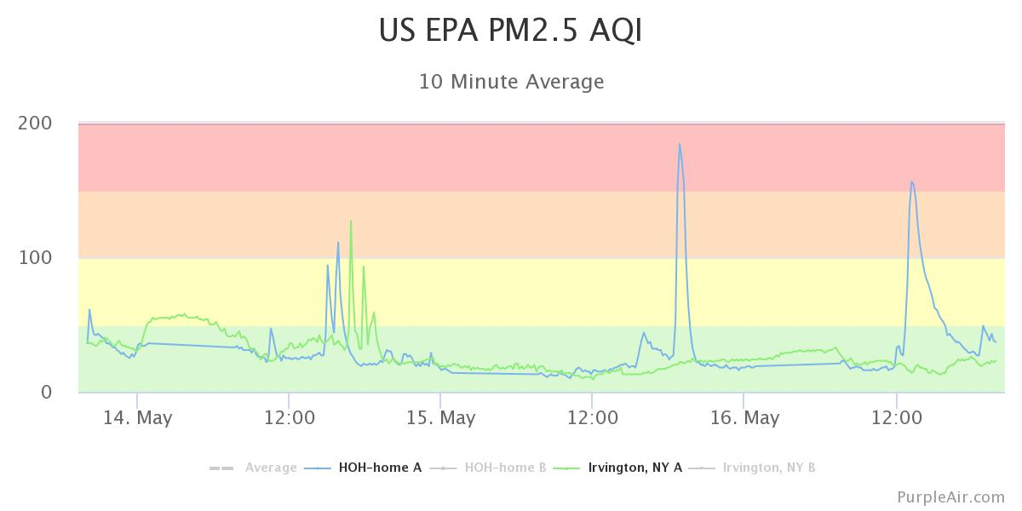
Where can economists still contribute?
Factors that moderate relationship (external validity)
  Health insurance, race/ethnicity, hospital crowding, treatment technology
  Cross-country comparisons
Indoor pollution
  PurpleAir provides incredible information, but major sample selection issues
  Different policy implications
(Focus on specific pollutants)
  “Pollution” used as catchall term
  Regulations focus on particular pollutants
  (PM_{2.5}, ozone, etc.)

Slide 6
“Airlines, Pollution, and Health” by Du & Taylor
QE approach: airline cruising path
  Completely buy exogeneity (for changes in cruising paths)
    Changes in flight paths around Russia?
  Interesting new externality: change in attainment status
  Global IV
Comments
  Use van Donkelaar data for US sample as comparison
  Fertility part behavioral (Becker Q-Q tradeoff)
Next steps: “studying pollution’s impact across a range of outcomes…providing useful insights into how pollution impacts differ by … demographics and other characteristics”
  Great opportunity to explore moderators, external validity (Dehejia et al.)
  Many potential non-traditional outcomes
  Do new paths affect market behaviors? Housing prices

Slide 7
“Glyphosate Exposure and GM Seed Rollout Unequally Reduced Perinatal Health” by Rubin & Saulnier
Different story for pesticides
  Air pollution is byproduct from production; pesticide use is risk-risk tradeoff
  Exposure route differs dramatically, more complex to assign
    E.g. GLY applications per square km of county
  Much less QE evidence on pesticide impacts on health (AFAIK)
    Geographic suitability and technology timing are plausibly exogenous
Comments
  Geospatial modeling: pesticide applied → water runoff → drinking water → place of residence
    Does IV solve this measurement error issue?
    Is it an “ecological fallacy” if (group) treatment arises through drinking water?
  Possible to test increased exposure? E.g. NHANES
  “Infants .. less prone to endogenous responses to health and environmental shocks” → except parents make decisions
    E.g. water filtration or consumption decisions

