Slide 1
SES Disparities in Mortality
Discussion - Ellen Meara
NBER Conference on Mortality, January 9, 2025

Slide 2
David & Adriana’s request
Summarize the state of knowledge
Put papers in context
Describe the frontier

Slide 3
David & Adriana’s request
Summarize the state of knowledge
Put papers in context
Describe the frontier
…in 20 minutes

Slide 4
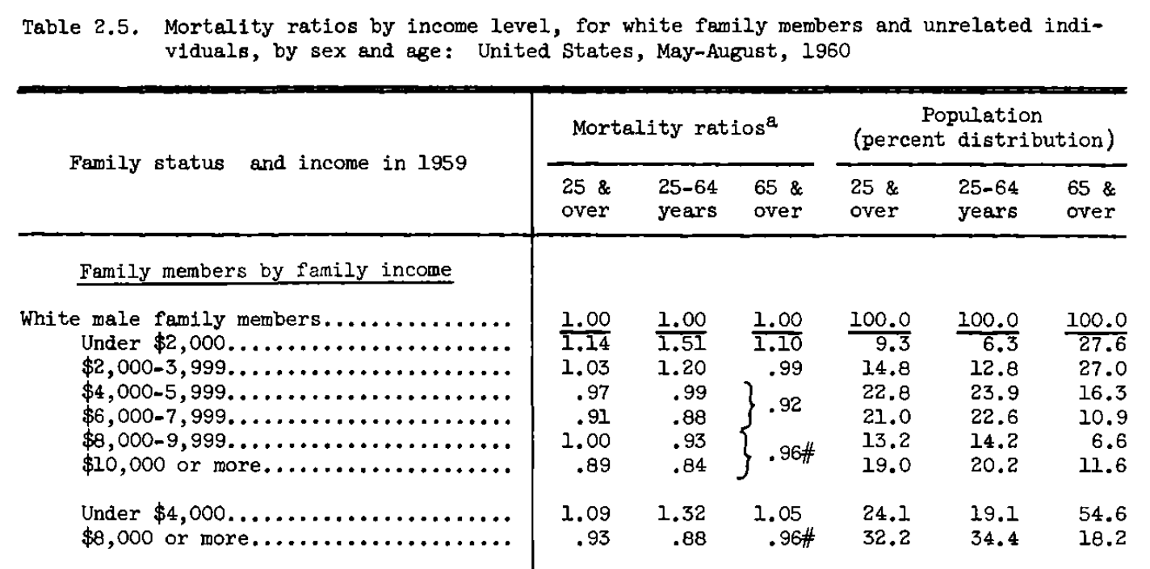
Kitagawa & Hauser, 1973

Slide 5
The State of Knowledge: In 50 years since Kitagawa and Hauser, we learned
Adults with higher SES live longer.
Gradients are steepest at low levels of SES.
Gradients by SES are getting steeper.
Place matters (for individuals with low, but not high SES)
Mortality gradients are mutable.
It’s still unclear exactly why or how to respond.
Chetty et al. 2025 & Bellemare et al 2025
Note: My synthesis draws heavily from excellent summaries in Galama et al. 2018; Lleras-Muney 2022 & Lleras-Muney, Schwandt and Wherry 2024
Notes:
My synthesis here draws heavily from several excellent summaries:
Galama TJ, Lleras-Muney AA, van Kippersluis H. 2018. The Effect of Education on Health and Mortality: A Review of Experimental and Quasi-Experimental Evidence. Oxf. Res. Encycl. Econ. Finance. 1–99
Lleras-Muney A. 2022. Education and income gradients in longevity: The role of policy. Can. J. Econ. Can. Déconomique. 55(1):5–37
Lleras-Muney A. Schwandt H, Wherry L. 2024. Poverty and Health. NBER WP 32866.
Income (e.g. Kitagawa & Hauser 1973, Chetty et al. 2016)
Education (Kitagawa & Hauser 1973, Case and Deaton 2015, 2023)
Class (Whitehall II study of British Civil Servants, Michael Marmot et al., various)

Slide 6
The State of Knowledge: In 50 years since Kitagawa & Hauser, we’ve learned
Adults with higher SES live longer.
Gradients are steepest at low levels of SES.
Gradients by SES are getting steeper.
Place matters (for individuals with low, but not high SES)
Mortality gradients are mutable.
It’s still unclear exactly why or how to respond.
Chetty et al. 2025 & Bellemare et al 2025
Notes:
This is generally true no matter how, where, when one measures it. It’s why the wide-ranging program today is such an excellent springboard for our collective work.
Income (e.g. Kitagawa & Hauser 1973, Chetty et al. 2016)
Education (Kitagawa & Hauser 1973, Case and Deaton 2015, 2023)
Class (Whitehall II study of British Civil Servants, Michael Marmot et al., various)
In every decade since 1960, but also present in historical studies of, e.g. landowners vs. others in 1800s.

Slide 7
The State of Knowledge: In 50 years since Kitagawa & Hauser, we’ve learned
Adults with higher SES live longer.
Gradients are steepest at low levels of SES.
Gradients by SES are getting steeper.
Place matters (for individuals with low, but not high SES)
Mortality gradients are mutable.
It’s still unclear exactly why or how to respond.
Chetty et al. 2025 & Bellemare et al 2025
Notes:
True in the paper by Chetty et al. presented today

Slide 8
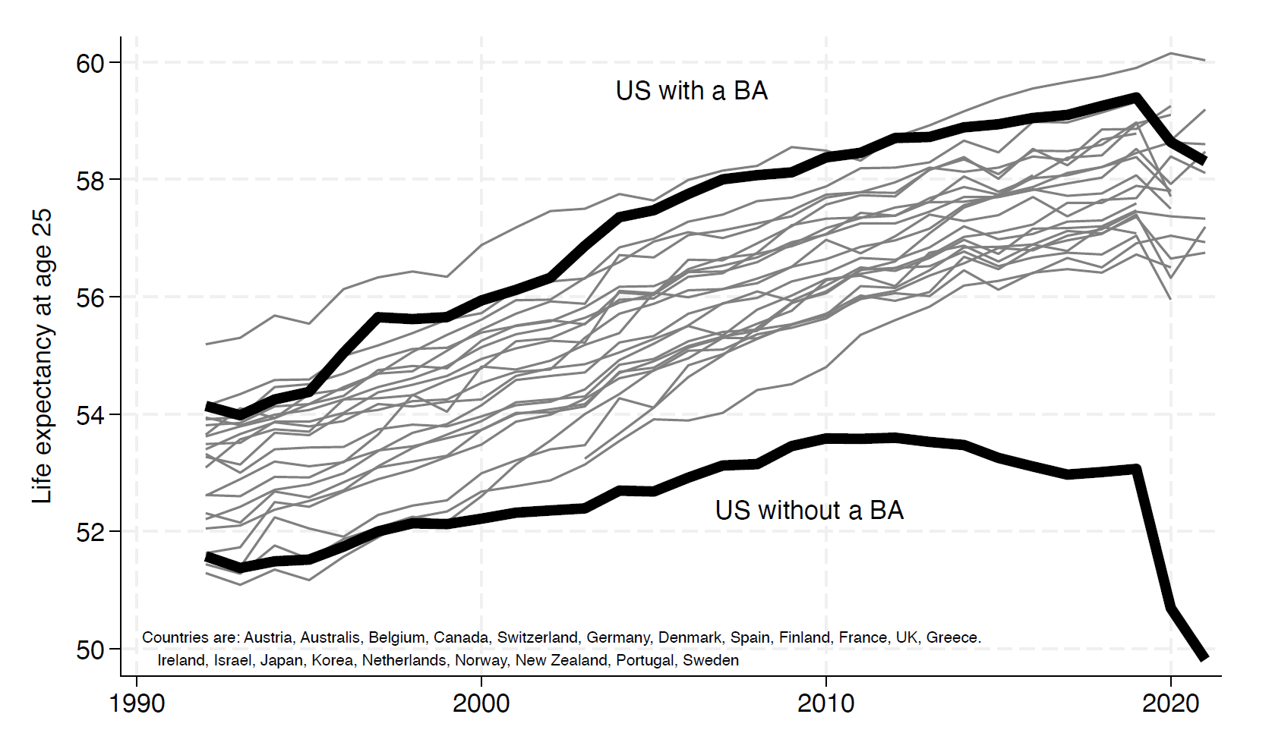
Education-Longevity Gradients Getting Steeper Adult Life Expectancy for Americans by College Degree & in 21 Rich Countries
(Case and Deaton, 2023)
6.3 Years
2.6 Years
Welfare cost of steeper gradient is $39 Trillion = midlife non-college pop x 3.7 year gain x $100k/life year
Notes:
Conservative estimate of welfare cost of growing gradients is $39 Trillion = midlife non-college pop x 3.7 year gain x $100k/life year

Slide 9
The State of Knowledge: In 50 years since Kitagawa & Hauser, we’ve learned
Adults with higher SES live longer.
Gradients are steepest at low levels of SES.
Gradients by SES are getting steeper since 2000.
Place matters (especially for low SES individuals)
Mortality gradients are mutable.
It’s still unclear exactly why or how to respond.
Chetty et al. 2025 & Bellemare et al 2025
Notes:
Income (e.g. Kitagawa & Hauser 1973, Chetty et al. 2016)
Education (Kitagawa & Hauser 1973, Case and Deaton 2015, 2023)
Class (Whitehall II study of British Civil Servants, Marmot et al., various)
GRADIENTS ARE STEEPEST DURING PRIME WORKING YEARS. LOWER FOR CHILDREN, POST WORKING YEARS.

Slide 10
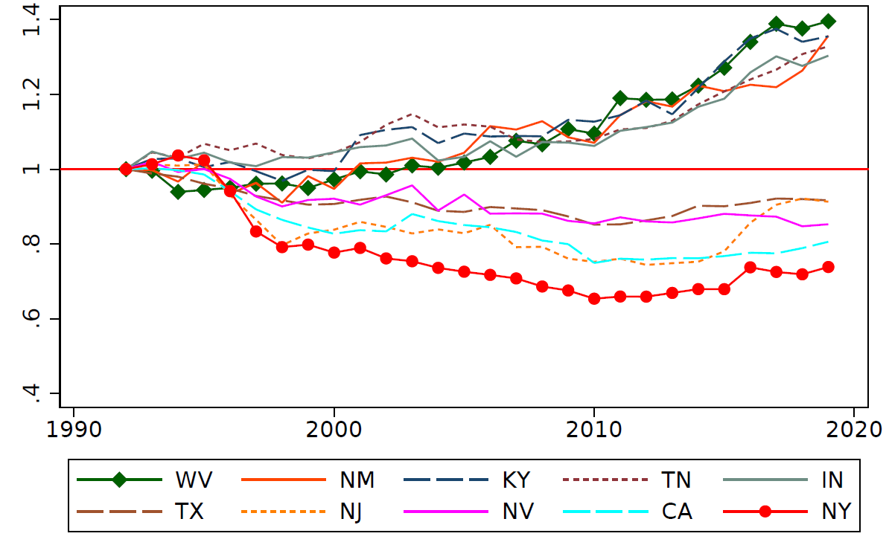
Midlife Mortality (Relative to 1992) for Selected US States Adults 25-64 without a (4-year) College Degree
WV
KY,
NM
TN
IN
TX
NJ
NV
CA
NY
West Virginia, Kentucky, New Mexico, Tennessee, and Indiana had the greatest rise in mortality since 1992. New York, California, Nevada, New Jersey, and Texas had the greatest decline in mortality since 1992.
Source: Data from Couillard et al. 2021. "Rising Geographic Disparities in US Mortality." Journal of Economic Perspectives, 35 (4): 123–46. extended through 2019

Slide 11
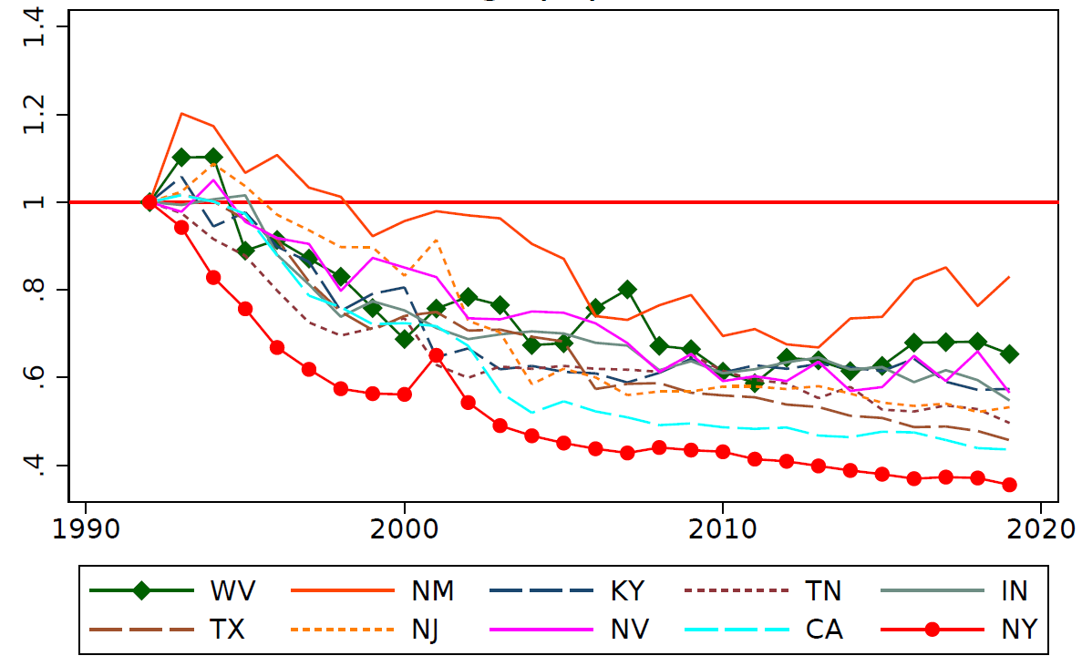
Midlife Mortality (Relative to 1992) for Selected States: Adults 25-64 with a (4-year) College Degree
NM
WV
NV
KY
IN
NJ
TN
TX
CA
NY
West Virginia, Kentucky, New Mexico, Tennessee, and Indiana had the greatest rise in mortality since 1992. New York, California, Nevada, New Jersey, and Texas had the greatest decline in mortality since 1992.
Source: Data from Couillard et al. 2021. "Rising Geographic Disparities in US Mortality." Journal of Economic Perspectives, 35 (4): 123–46. extended through 2019

Slide 12
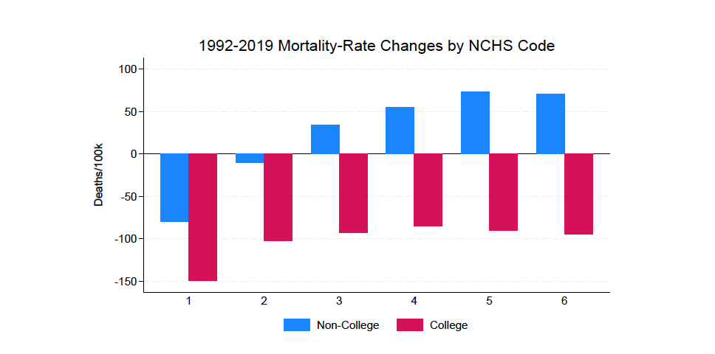
Relative Rise in Rural Mortality is Larger among Less Educated
Mortality at Midlife for Residents of Urban vs. Rural Counties
One reason Bellemare et al. on commodity prices and rural areas is so relevant.
Large Central Metro Large Fringe Metro Medium Metro Small Metro Micropolitan Noncore
Source: Calculations from Foote et al. (2025) “Geography, Education, and the Widening Divide in U.S. Midlife Mortality”
Rural/Urban county designation is based on 6 NCHS-defined groups. NCHS = National Center for Health Statistics

Slide 13
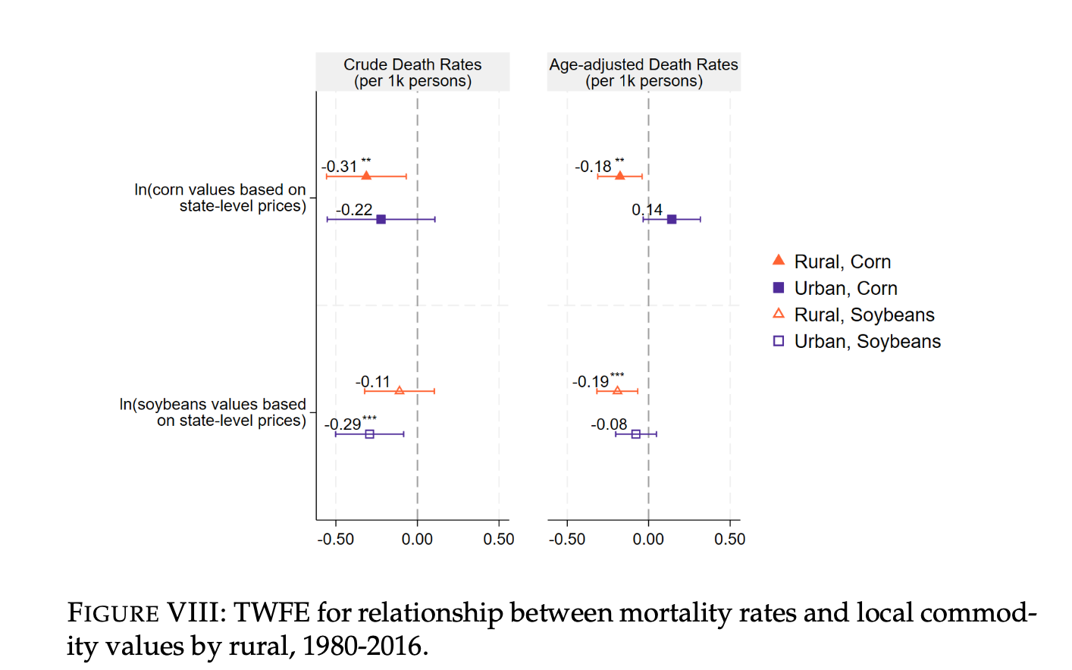
Place matters for SES-mortality gradients

Slide 14
The State of Knowledge: In 50 years since Kitagawa & Hauser, we’ve learned
Adults with higher SES live longer.
Gradients are steepest at low levels of SES.
Gradients by SES are getting steeper since 2000.
Place matters (for individuals with low, but not high SES)
Mortality gradients are mutable.
It’s still unclear exactly why or how to respond.
Chetty et al. 2025 & Bellemare et al 2025
Notes:
Chetty et al. 2025 show that race gaps (adjusting for income) have been eliminated since 2001 (as of 2019)
At the same time, class gaps have risen.

Slide 15
The State of Knowledge: In 50 years since Kitagawa & Hauser, we’ve learned
Adults with higher SES live longer.
Gradients are steepest at low levels of SES.
Gradients by SES are getting steeper since 2000.
Place matters (for individuals with low, but not high SES)
Mortality gradients are mutable.
It’s still unclear exactly why or how to respond.
Chetty et al. 2025 & Bellemare et al 2025 can help!

Slide 16
The State of Knowledge: In 50 years since Kitagawa & Hauser, we’ve learned
Adults with higher SES live longer.
Gradients are steepest at low levels of SES.
Gradients by SES are getting steeper since 2000.
Place matters (for individuals with low, but not high SES)
Mortality gradients are mutable.
It’s still unclear exactly why or how to respond.

Slide 17
Conclusion from the two papers
Commodity Prices and Death
A rise in commodity prices reduces mortality in midwestern states where agriculture is prominent
Reductions are prominent in rural counties and for suicide and cardiovascular disease
Race and Class Gaps in Longevity
Race gaps are shrinking as class gaps widen
Cancer and cardiovascular disease deaths are most common drivers of these trends
There is no “monocausal” story to explain divergent trends in mortality and longevity
Best approach likely to vary across areas and subgroups: § In some places, key issue may be a lack of access to care, in others may be upstream risk factors. Disease mix may also differ across places.

Slide 18
Some ways to push the frontier
Build novel descriptive evidence by linking/creating new data
Study policies that may change/mediate SES & mortality
Identify or create opportunities to randomize education, income, or plausible mediators.
Notes:
Hawkins AA, Hollrah CA, Miller S, Wherry LR, Aldana G, Wong MD. 2024. The long-term effects of income for at-risk infants: evidence from Supplemental Security Income. National Bureau of Economic Research
Miller S, Johnson N, Wherry LR. 2021. Medicaid and mortality: new evidence from linked survey and administrative data. Q. J. Econ. 136(3):1783–1829
Wyse A, Meyer B. 2023a. Saved By Medicaid: New Evidence on Health Insurance and Mortality from the Universe of Low-Income Adults
Ludwig J, Duncan GJ, Gennetian LA, Katz LF, Kessler RC, et al. 2012. Neighborhood effects on the long-term well-being of low-income adults. Science. 337(6101):1505–10
Cesarini, D., Lindqvist, E., Östling, R., & Wallace, B. (2016). Wealth, health, and child development: Evidence from administrative data on Swedish lottery players. The Quarterly Journal of Economics, 131(2), 687-738.
Lindahl 2006 etc.
Deryugina, T., & Molitor, D. (2020). Does when you die depend on where you live? Evidence from Hurricane Katrina. American economic review, 110(11), 3602-3633.
Jacob Goldin & Ithai Z Lurie & Janet McCubbin, 2020. "Health Insurance and Mortality: Experimental Evidence from Taxpayer Outreach," The Quarterly Journal of Economics, vol 136(1), pages 1-49.
Bartik et al. 2024. NBER WP 32784 “The Impact of Unconditional Cash Transfers on Consumption and Household Balance Sheets: Experimental Evidence from Two US States.
Josh Angrist, David Autor and Amanda Pallais, 2022. Maringal Effects of Merit Aid for Low-income Students, Quarterly Journal of Economics 137: 1039-1090.

Slide 19
Three Ways to Push the Frontier
Build novel descriptive evidence by linking/creating new data
Chetty et al. 2025; Hawkins et al. 2024; Wyse & Meyer 2023
Study policies/events that change/mediate SES & mortality
Bellemare et al. 2025; Miller et al. 2021; Connelly 2021; Deryugina & Molitor 2020
Identify or create opportunities to randomize education, income, or plausible mediators.
Agarwal et al. 2024; Bartik et al. 2024; Angrist et al. 2022; Goldin et al. 2020; Lindahl et al. 2006; Ludwig et al. 2012; The Oregon HIE. Baicker, Finkelstein various.
Notes:
Hawkins AA, Hollrah CA, Miller S, Wherry LR, Aldana G, Wong MD. 2024. The long-term effects of income for at-risk infants: evidence from Supplemental Security Income. National Bureau of Economic Research
Miller S, Johnson N, Wherry LR. 2021. Medicaid and mortality: new evidence from linked survey and administrative data. Q. J. Econ. 136(3):1783–1829
Wyse A, Meyer B. 2023a. Saved By Medicaid: New Evidence on Health Insurance and Mortality from the Universe of Low-Income Adults
Ludwig J, Duncan GJ, Gennetian LA, Katz LF, Kessler RC, et al. 2012. Neighborhood effects on the long-term well-being of low-income adults. Science. 337(6101):1505–10
Cesarini, D., Lindqvist, E., Östling, R., & Wallace, B. (2016). Wealth, health, and child development: Evidence from administrative data on Swedish lottery players. The Quarterly Journal of Economics, 131(2), 687-738.
Lindahl 2006 etc.
Deryugina, T., & Molitor, D. (2020). Does when you die depend on where you live? Evidence from Hurricane Katrina. American economic review, 110(11), 3602-3633.
Jacob Goldin & Ithai Z Lurie & Janet McCubbin, 2020. "Health Insurance and Mortality: Experimental Evidence from Taxpayer Outreach," The Quarterly Journal of Economics, vol 136(1), pages 1-49.
Bartik et al. 2024. NBER WP 32784 “The Impact of Unconditional Cash Transfers on Consumption and Household Balance Sheets: Experimental Evidence from Two US States.
Marginal Effects of Merit Aid for Low-Income Students
Quarterly Journal of Economics, Vol.137 (2), 1039-1090
Josh Angrist, David Autor and Amanda Pallais
May 2022
Including the initial shock, the hurricane improved eight-year survival by 2.07 percentage points. Migration to lower-mortality regions explains most of this survival increase.

Slide 20
Conclusion
The welfare losses of rising gradients are massive and require an “all hands on deck” approach.
Learning from varied settings, policies, time periods, subgroups will be crucial to moving ahead

