Slide 1
Policy Determinants of Mortality
Sherry Glied

Slide 2
Today’s Papers
Berman and Hovland
Szklo, Clarke, Rocha
UK
Changes in public expenditures on social welfare and health at the local authority level
Mortality and life expectancy
Effects on drug-related poisonings and ambulance times
MVPF
Brazil
Mandatory change in share of municipal expenditure on health
Changes in expenditures on infrastructure, personnel, mgmt.
Infant mortality outcomes
Mgmt quality/corruption measures

Slide 3
More broadly:
Commodity price insurance
Air routes
Pesticides
Cash transfers
Austerity
Public health spending
Indirectly – social security
How can this research inform policy?
Policy is forward-looking; research is backward looking

Slide 4
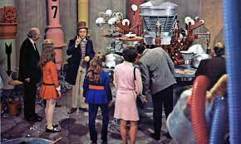
Given what is known now, what will happen if policy X is implemented?

Slide 5
Grossman Model (1972)
Individual health at a point in time is a flow derived from the stock of health_{t=x}
Stock of health_{t=x} is a function of
Prices of health producing (and diminishing) and non-health goods
Individual (education) technology
Wage
Depreciation rate (increasing function of age)
For all t<=x
Public Goods

Slide 6
Cohort
Period
Age
Theory of production – non-linearities throughout
Depreciation – age
Effects vary at margin

Slide 7
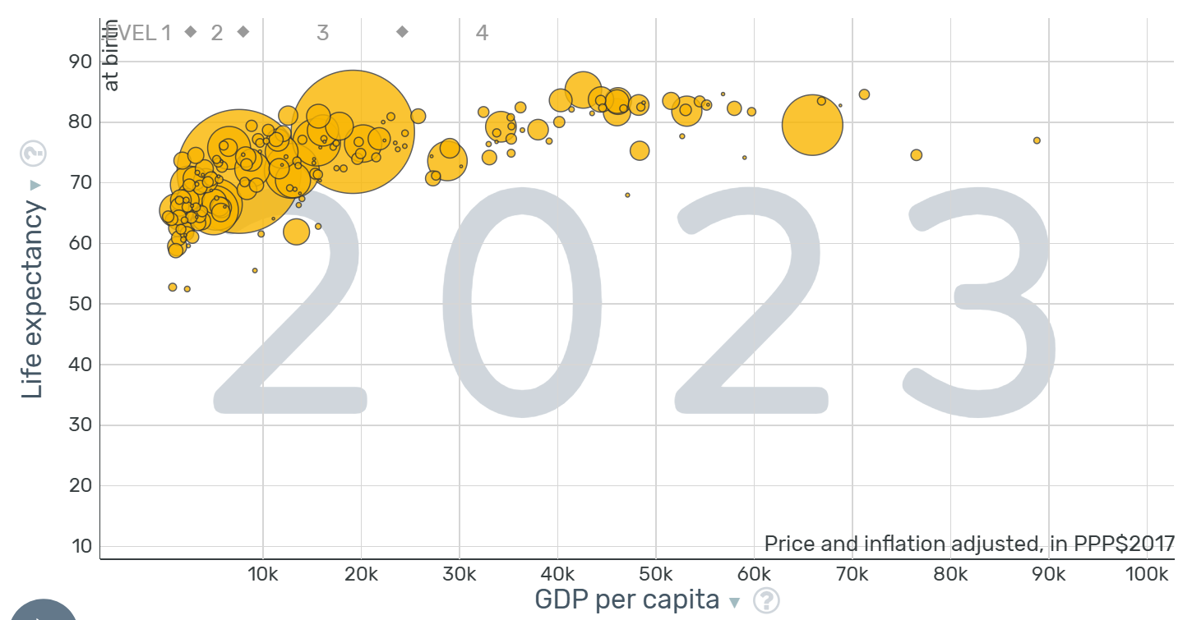
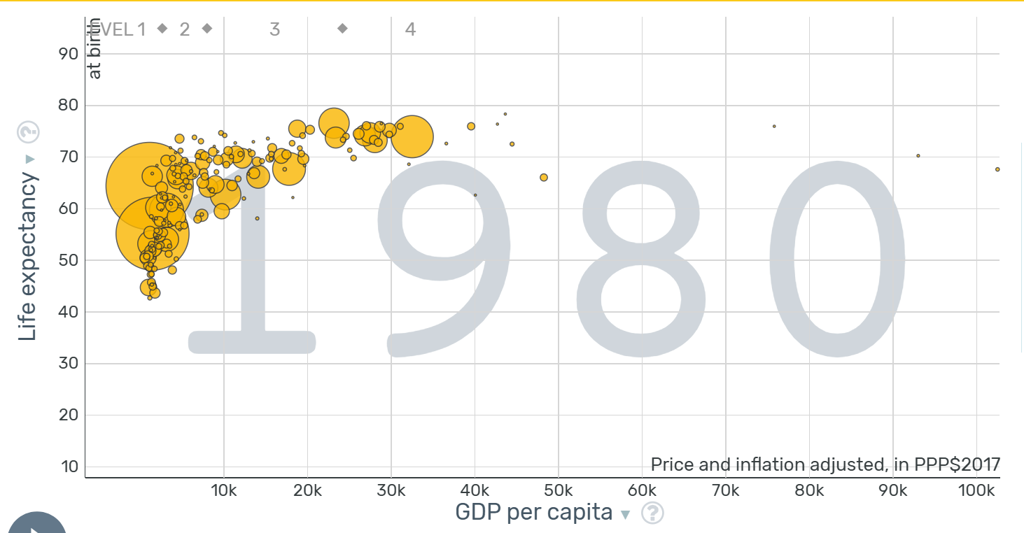
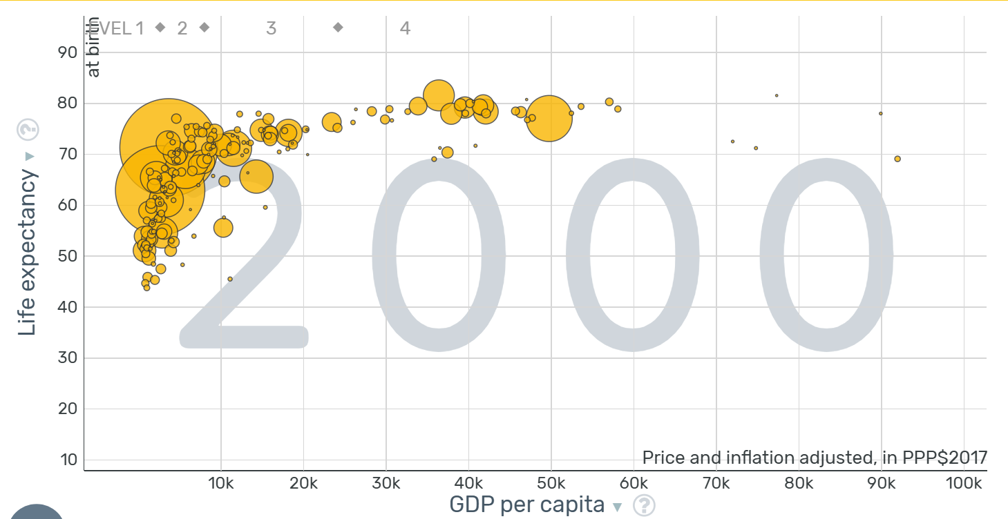

Slide 8
Grossman Model (1972)
Individual health at a point in time is a flow derived from the stock of health_{t=x}
Stock of health_{t=x} is a function of
Prices of health producing (and diminishing) and non-health goods
Individual (education) technology
Wage
Depreciation rate (increasing function of age)
For all t<=x
Public Goods
Technological Frontier (Newhouse, 1992)

Slide 9
Age*Period*Cohort
Health flow at a point in time:
Age effects – via depreciation rate
Period effects – via measures of prices, technologies, etc. at time = t
Cohort effects – via stock (influenza, smoking, LBW tech)
Impact of policy at time t on health depends on stock
Affects health consumption and investments differently by age
Depends on the technologies and all prices at time = t
Depends on all previous info re stock
Interactions among all these effects (e.g., HIV)
Technology at t responds differentially to different health stocks

Slide 10
Implications for Research Design
Robust research designs are needed to address multiple endogeneity risks
Policy and behavior respond to the same factors as does health – identification – predicted by the model
Policy happens at a point in time, given a set of technologies, health stocks etc.
Most analyses of policy impact face external validity challenges – predicted by the model
Effects of health insurance on health outcomes are surely greater now than at RAND HIE

Slide 11
What can be done?
Improve comparability of study results
Pay close attention to mechanisms
Clearly describe counterfactuals
Compare estimates across study types

Slide 12
Improve comparability: Input, Outcome, and Relationship Measures
Mortality
Death rates at a given age
Age-adjusted death rates (but how to age-adjust?)
Life expectancy at x
Income
absolute
Relative
Cost-of-living adjusted (how?)
Wage income vs. total income (farm proprietors?)
Measures
Coefficients
Elasticities
Odds ratios [NO]
Percentage point changes

Slide 13
Mechanisms
Medical care
Access to care (for disease j, at time t, at time <t)
Technological frontier
Quality of care
Social determinants
Consumption of Health +, Health - goods
Time investments
Grossman model framework suggests results are most robust the closer the intervention is to the mechanism.

Slide 14
State- and Period-dependent Counterfactuals
Education – work
Housing/neighborhoods – alt conditions
MTO effects are likely smaller today (NYC: 1994-1600 homicides; 2023 – 386)

Slide 15
Compare effect sizes
Income changes
UBI studies?
Health spending changes
Medicaid expansion
BBA
…. conditional on period, cohort, age etc.

Slide 16
What is the Effect of Income on Health?
- e.g., ∆ EITC?
0%
100%

