Slide 1
the production of health

Slide 2
Plan
How is health produced? The Grossman Model insights
Building on Grossman:
The Race Between Technology and Crisis
Dimensions of Health
Role of Government

Slide 3
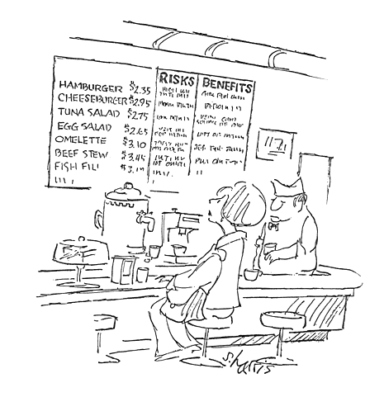
Who invests in health? “Most (if not all) deaths are to some extent suicides” - Becker (1974)

Slide 4
The Basics of the Grossman Model
Consumers choose health investment subject to a budget constraint in money, a time constraint, and the production function for health.
Health is a consumption good and an investment good.
Particular focus on the link between education and health.

Slide 5
Model: consumer optimization
Max $U= \sum_{t=0}^{T}{{\left(1+ρ\right)}^{−t}v(c_{t}, H_{t})}$ s.t.
$H_{t+1}= θm_{t}+ \left(1−δ_{a}\right)H_{t}$
$$\sum_{t=0}^{T}{\frac{c_{t}}{{(1+r)}^{t}}+ }\sum_{t=0}^{T}{\frac{p_{m}m_{t}}{{(1+r)}^{t}} = A_{0}+ }\sum_{t=0}^{T}{\frac{y_{t}(H_{t})}{{(1+r)}^{t}} }$$
(Ignore the time constraint for now).

Slide 6
Solution
$\frac{v_{H_{t}}}{v_{c_{t}}} = [\frac{p_{m}}{θ}\left(ρ+δ_{a}\right)− y_{H_{t}}]$
Demand for health
Rises with income / wealth
Ambiguous in wages (Income and substitution effects)
Responds to prices
Information & education might affect θ and possibly δ.
MU of health, in $
Price, in efficiency units
Reduction in price from earning more

Slide 7
The model has many successes
Demand for health products declines with prices
Lengthy literature on health behaviors and medical services, all showing negative own price elasticities.
Preston Curve: life expectancy rises with GDP pc.
Consumers respond to information about health and health products.
Smoking literature, etc.
Education strongly correlated with health, health behaviors and LE.
True for every measure of health examined (except for ever having used illegal drugs and moderate alcohol consumption)

Slide 8
And yet…
There are a ton of preventable deaths
People die from health behaviors that are preventable.
Smoking, overeating (rich countries)*
Not using oral rehydration therapy, not visiting dr for delivery (low-income countries)
Health trends are not uniform
Big divisions used to be by race, now by class.
Black-white death rates are converging
Death rates by education are widening
*Every pack of cigarettes has an internal health cost of ~$30, yet people still smoke.

Slide 9
The Race Between Technology and Economic Crisis
Two aspects of the Grossman model that are not well considered: technology and the economy
Technology
Medical technology
Pollution reduction technology
Economic crisis

Slide 10
Incorporating technology
Max $U= \sum_{t=0}^{T}{{\left(1+ρ\right)}^{−t}v(c_{t}, H_{t})}$ s.t.
$H_{t+1}= θ_{t}m_{t}+ \left(1−δ_{a,t}\right)H_{t}$
$$\sum_{t=0}^{T}{\frac{c_{t}}{{(1+r)}^{t}}+ }\sum_{t=0}^{T}{\frac{p_{m}m_{t}}{{(1+r)}^{t}} = A_{0}+ }\sum_{t=0}^{T}{\frac{y_{t}(H_{t})}{{(1+r)}^{t}} }$$
$$\frac{v_{H_{t}}}{v_{c_{t}}} = [\frac{p_{m}}{θ_{t}}\left(ρ+δ_{a,t}\right)− y_{H_{t}}]$$
Medical technology and pollution-reduction technology
Both lead to health improvement

Slide 11
Economic Crisis
Max $U= \sum_{t=0}^{T}{{\left(1+ρ\right)}^{−t}v(c_{t}, H_{t})}$ s.t.
$H_{t+1}= θ_{t}m_{t}+ \left(1−δ_{a,t}\right)H_{t}$
$$\sum_{t=0}^{T}{\frac{c_{t}}{{(1+r)}^{t}}+ }\sum_{t=0}^{T}{\frac{p_{m}m_{t}}{{(1+r)}^{t}} = A_{0}+ }\sum_{t=0}^{T}{\frac{{πy}_{t}(H_{t})}{{(1+r)}^{t}} }$$
$$\frac{v_{H_{t}}}{v_{c_{t}}} = [\frac{p_{m}}{θ_{t}}\left(ρ+δ_{a,t}\right)− {πy}_{H_{t}}]$$
Positive or negative economic shock
Investment effect: Lower return → lower eq^{m} health
Stress may increase depreciation
Large short-run U hit may increase value of temporary pleasure or create high rate of present-bias (withdrawal)

Slide 12
Evidence on the Psychological Impacts of Economic Change
Lit review by Frasquilho et al. (2015) concludes
“The evidence was consistent that economic recessions and mediators such as unemployment, income decline, and unmanageable debts are significantly associated with poor mental wellbeing, increased rates of common mental disorders, substance-related disorders, and suicidal behaviours.”
Effects on physical health likely observed with a delay
Different effects among children/adolescents and adults
Contrasts with short term effects of recessions on objective mortality measures
Schwandt and von Wachter (2020) conclude
“We find that cohorts coming of age during the deep recession of the early 1980s suffer increases in mortality that appear in their late 30s and further strengthen through age 50, driven by behavior-related causes such as heart disease, lung cancer, and liver disease, as well as drug overdoses.”

Slide 13
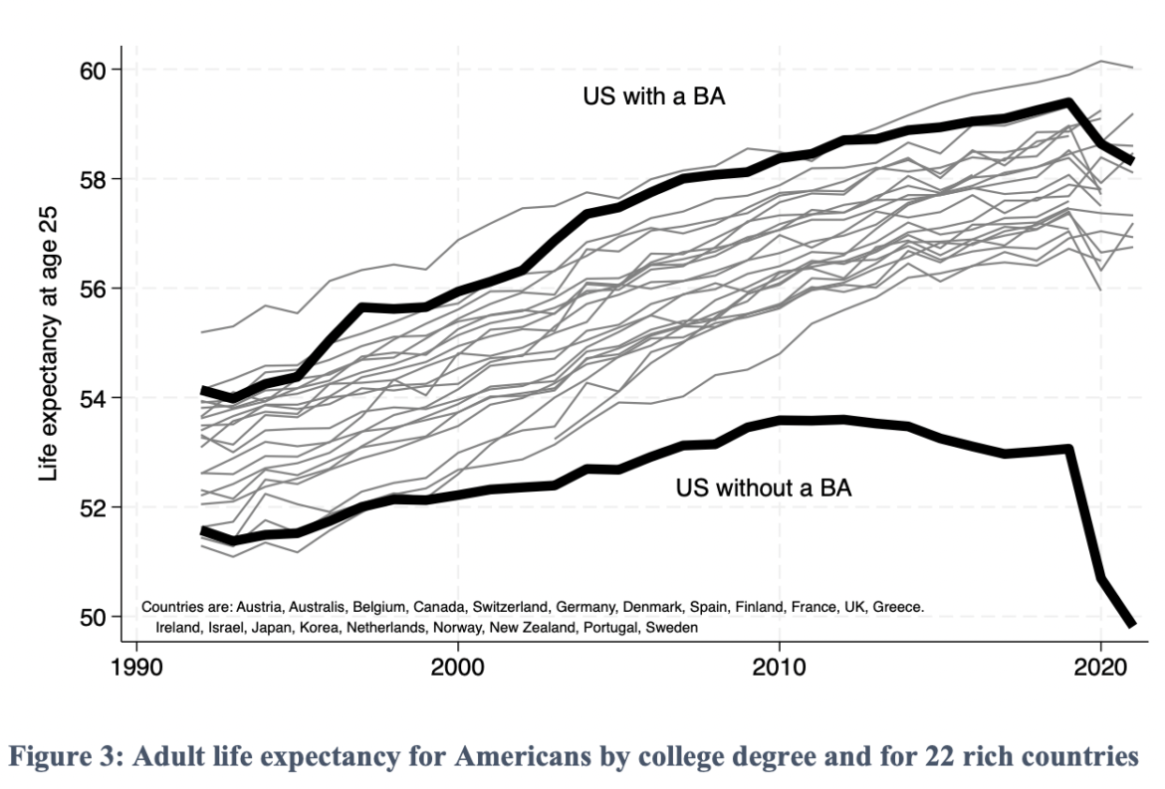
Evidence on the Psychological Impacts of Economic Change
Case and Deaton’s deaths of despair work argue that persistently poor economic conditions and prospects led to chronic pain and substance abuse
Consistent with evidence that shows contemporary employment declines do not fully explain recession induced mental health declines

Slide 14
The race between technology and economic crisis
Age groups where technology likely a bigger driver: young and old – health has improved
Age groups where economic crisis more important: older middle age – health has worsened

Slide 15
Building on Grossman: Technology
Who uses new technologies?
Information is not neutral (eg COVID vaccines). Who delivers information/ offers services matters (e.g. Alsan 2019, Pornpitakpan 2004).
There is discrimination in access to resources beyond prices (eg Tuskegee, Alsan 2018). There are also disparities by sex and race in what diseases are researched and thus in the nature of innovation (e.g., Cutler et al., 2012; Michelman and Msall 2022)
Important peer/network effects in tech diffusion and use (e.g Centola 2010, review by Zhang and Centola 2019). What others do and believe matter – model of decision making in not individual.
Market structure (e.g. insurance, physician practice styles) results in differential access for seemingly identical individuals.

Slide 16
Dimensions of non-fatal health
Physical health (walking, climbing stairs, lifting)
Mental health (mood disorders, psychosis)
Pain
Energy
Cognition (dementia)
Health interfering with life/work

Slide 17
What is different from Grossman’s H?
Mental health, cognition, substance abuse affect quality of decision making: can we assume a fully rational actor?
Mental health and cognition feed into physical health, likely with delays (eg economic conditions)– there isn’t a single H!
Increases in depression an anxiety among youth today likely bad for future physical health
Important social effects not in Grossman: loneliness and social capital have direct and indirect effects on mental and physical health.
Social dimension of eg suicide noted since famous work of Durkheim (1897)
Other people, and other people’s H matters for the production of H and U

Slide 18
Understanding aging (rate of health deterioration)
New research in 2 areas
Creating a composite of health using administrative data sets to study its evolution
Aging clocks: predicting “biological/physical” age (instead of chronological age)
With these constructs, understanding of factors that affect aging will improve.
Note: traditional identification strategies looking at immediate effects of events likely not useful.
Learn about the impact of stress, chronic pollution exposure, etc.
How to link these new health measures to our models?
Lleras-Muney and Moreau (2022) provide a possibility by linking health shocks to mortality rates.

Slide 19
Role of government
Mental health
Role of guns, availability of services, consumer protection role especially among elderly
Regulation of social media
Prevention
Social diffusion of infectious disease & health behaviors (through information, pressure, role model), as well as direct effects of social connections
Regulate diffusion of harmful behavior
Leverage social structures for design of successful health campaigns
Improve social interactions: creation of social living spaces
Discrimination and inequities in space
Technologies as public goods: role for government to support development and diffusion particularly of products that benefit minorities, poor etc (like Orphan Drug Act)
Market imperfections

