Slide 1
The critical role of economic statistics
David Wilcox
Bloomberg Economics and the Peterson Institute for International Economics
November 13, 2025

Slide 2
A collapse in willingness to participate
Note: The blue line shows the number of employers selected to participate in the establishment survey who agree to do so and prove capable of doing so.

Slide 3
Once signed up, firms still come through (eventually)
The three lines show the percent of initiated firms that provide data for the establishment survey by the time of the first, second, and third closings.

Slide 4
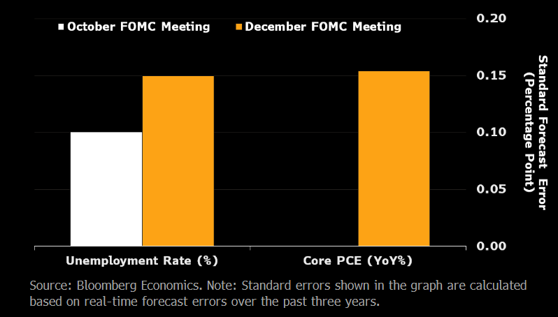
Data drought is increasing uncertainty

