Slide 1

ADVANCING ECONOMIC MEASUREMENT: LESSONS FROM RECENT UK EXPERIENCE Rebecca Riley (King’s College London and ESCoE) NBER Advancing Economic Measurement, Fall 2025 November 13, 2025 Washington, DC

Slide 2
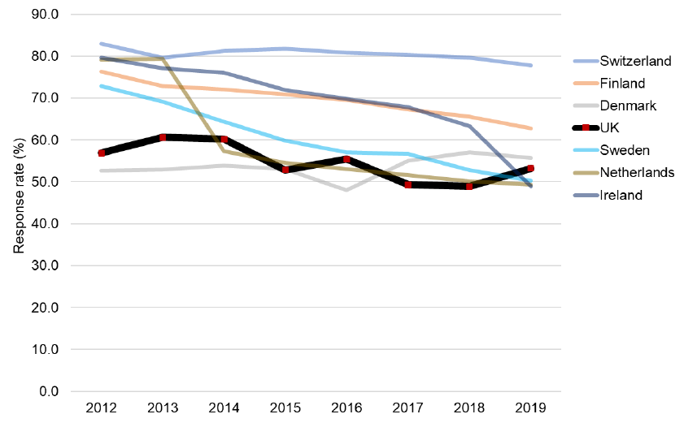
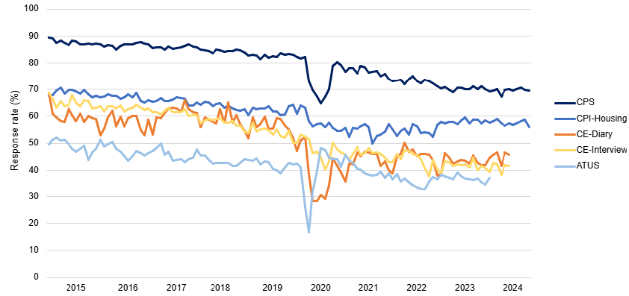
Falling response rates to surveys
… to some extent a common trend across countries and surveys
EU-LFS response rates
Response rates for US household surveys
Source: Eurostat
Note: Data may not be fully comparable across countries and may differ from the nationally reported results.
Source: Bureau of Labor Statistics
Source: Office for Statistics Regulation (2025), Systemic Review of ONS Economic Statistics: Interim Report, 7 April.

Slide 3
Temporary suspension of key UK labour market data and increased data uncertainty
… following post-pandemic drop in LFS response rates
Response rate for the UK Labour Force Survey
The UK ONS suspended standard publication of LFS data from October 2023 to January 2024
Experimental headline statistics were published using alternative data sources, including administrative data from Pay as You Earn Real Time information (PAYE) and claimant count data
Missing data and increased data uncertainty
Source: Office for National Statistics

Slide 4
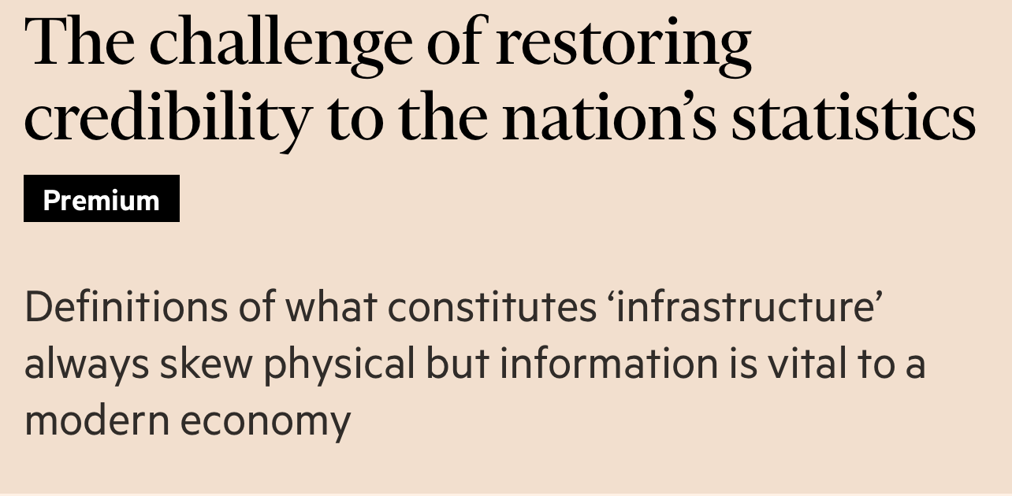
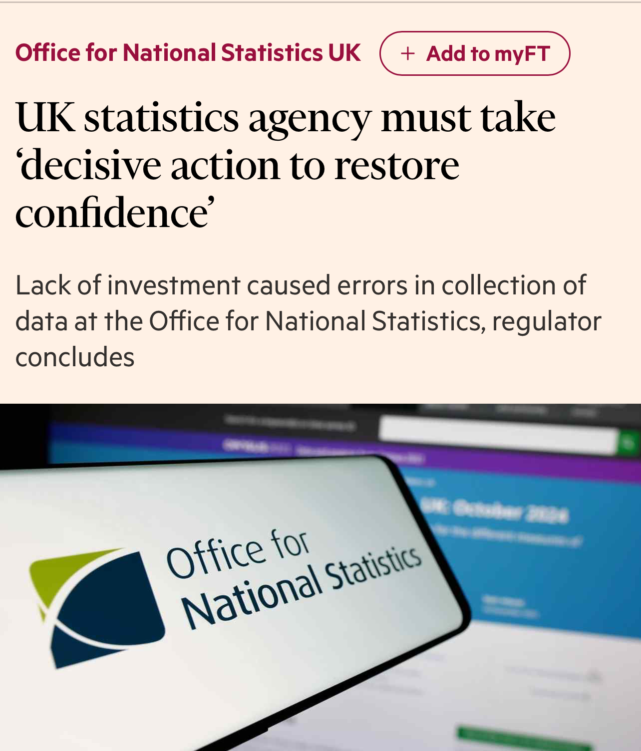
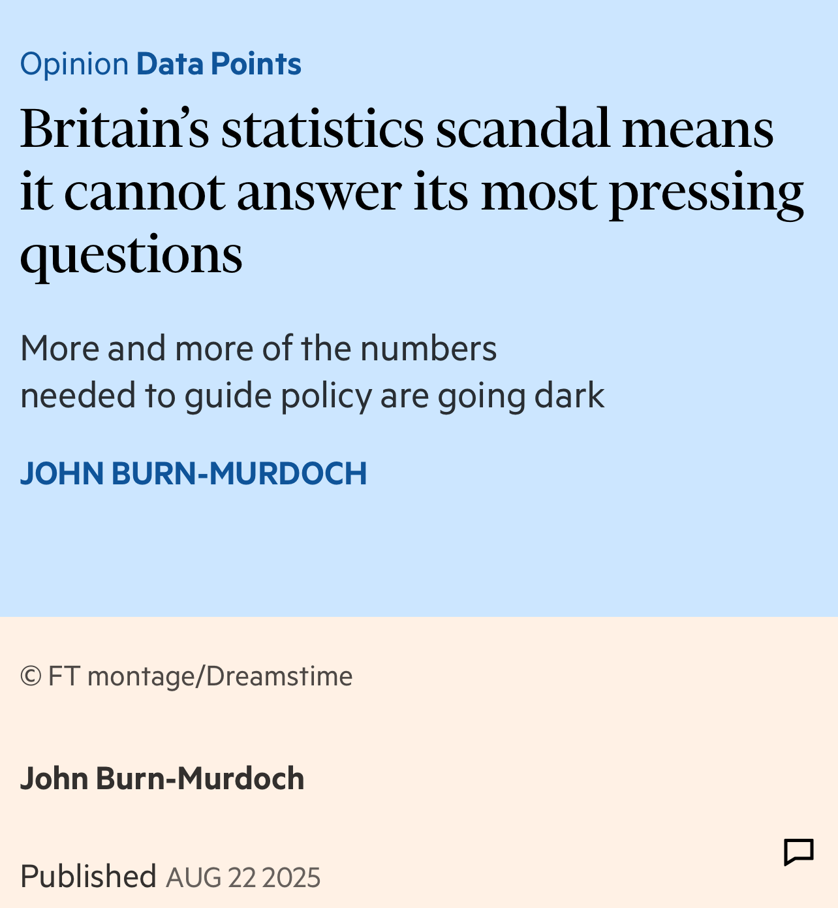
National statistics
… from backwater to newsworthy
Systemic Review of ONS Economic Statistics, Office for Statistics Regulation, April 2025
Devereux Review of the Office for National Statistics, June 2025
Inquiry into the Work of the UK Statistics Authority, PACAC, ongoing
ONS Survey Improvement and Enhancement Plan for Economic Statistics
Sustainable Field Operations
Refreshed Citizen Relationship
Improved Survey and Statistical Design
Technology Improvement
The plan for ONS economic statistics
Maintain real-terms funding for core economic statistics
Progress with administrative data and address legacy IT
Ensure adequate expertise in production teams
Act upon early warnings of emerging quality concerns

Slide 5
Labour market statistics recovery … admin data & better surveys
LFS
Increased interviewer capacity and incentives
ONS advise users to continue to apply caution in use
TLFS
Core Survey & Plus Survey
Timing of transition from LFS to TLFS to be evidence-led
Cross-over survey with LFS
Improved accessibility
Increasing the role of administrative data
Linking HMRC data to TLFS and LFS
LEED development to produce complementary indicators
LFS response rates, GB
Source: Office for National Statistics (2025), Labour market transformation – update on progress and plans, July.
Source: Office for National Statistics, Labour Force Survey performance and quality monitoring report: July to September 2025.

Slide 6
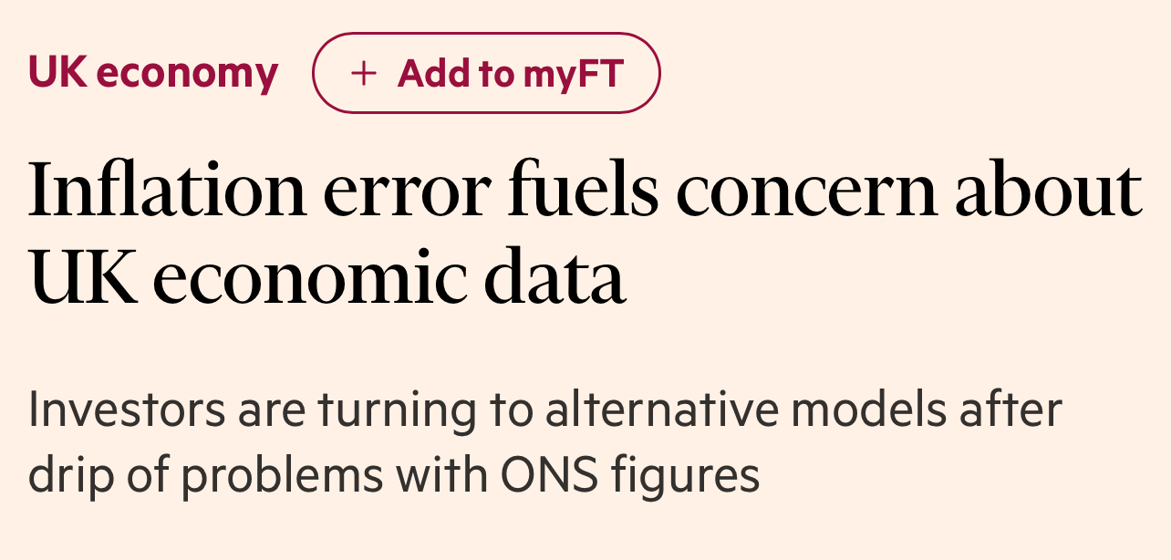
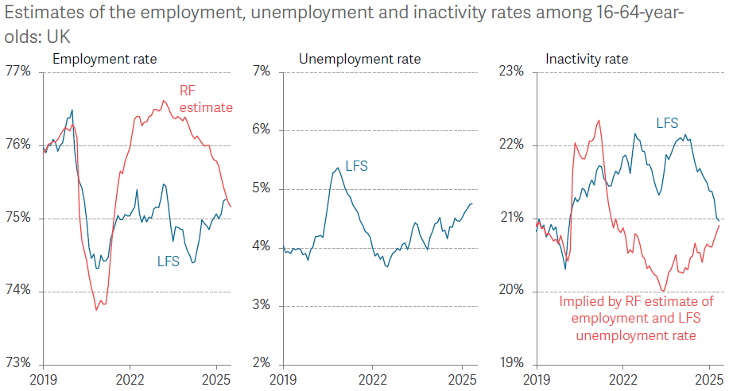
What did stakeholders do?
… economic statistics as a collective endeavour
Stakeholder Advisory Panel on Labour Market Statistics
Chair Jonathan Portes (KCL)
Bank of England, HMT, DWP, LPC, OBR, Cabinet Office, Devolved Administrations
Academic experts and think tanks (Exeter, IFS, LSE, Resolution Foundation, Royal Holloway, Stirling)
Collaboration with academia
ESCoE projects on labour market topics: LEED, Labour Accounts, Time-Use, Bayesian approach to employment rates, assessing non-response bias using linked admin data
Source: Resolution Foundation, Labour Market Outlook, Quarterly Briefing Q3 2025

Slide 7
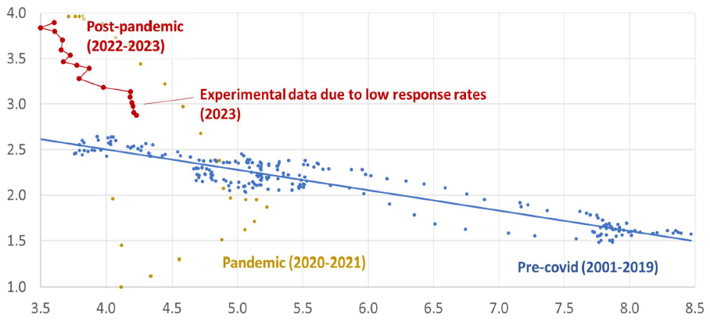
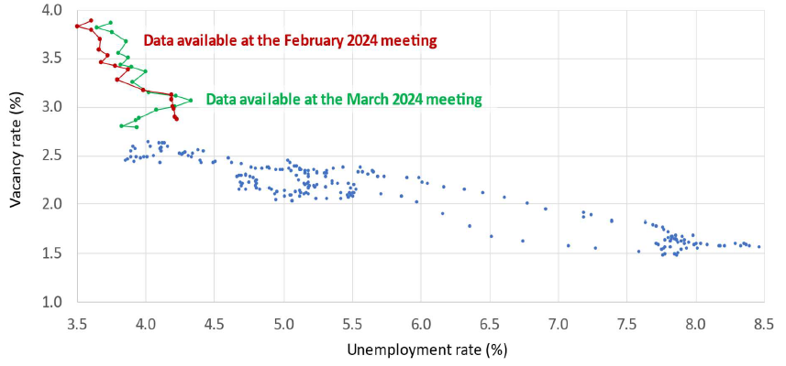
Consequences for policymakers
… complicating decision-making in real-time
Data available at MPC meeting February 2024
Data available at MPC meeting March 2024 and comparison with earlier data
Travelling down an outwardly-shifted Beveridge curve (impaired matching between vacancies and unemployment)
higher interest rates all else equal
A strikingly different picture indicative of travelling down the steep portion of the pre-pandemic Beveridge curve
less hawkish stance
Source: UK inflation: What's done and what's to come – speech by Jonathan Haskel given at King’s College London with the ESCoE, 8 July 2024.

Slide 8
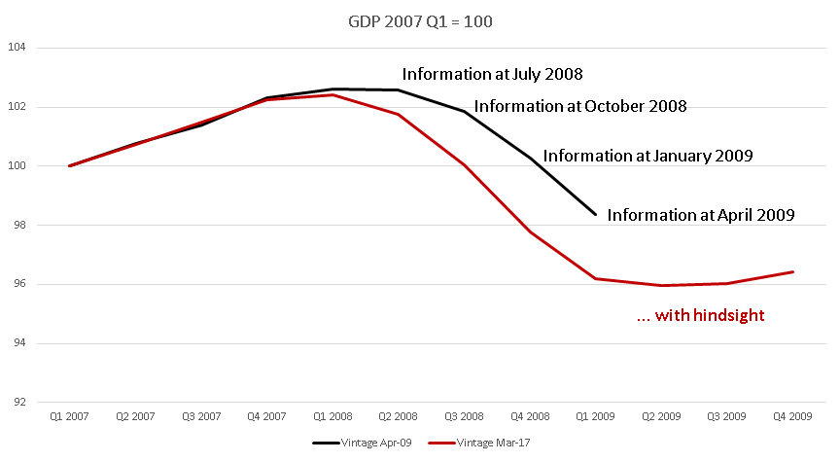
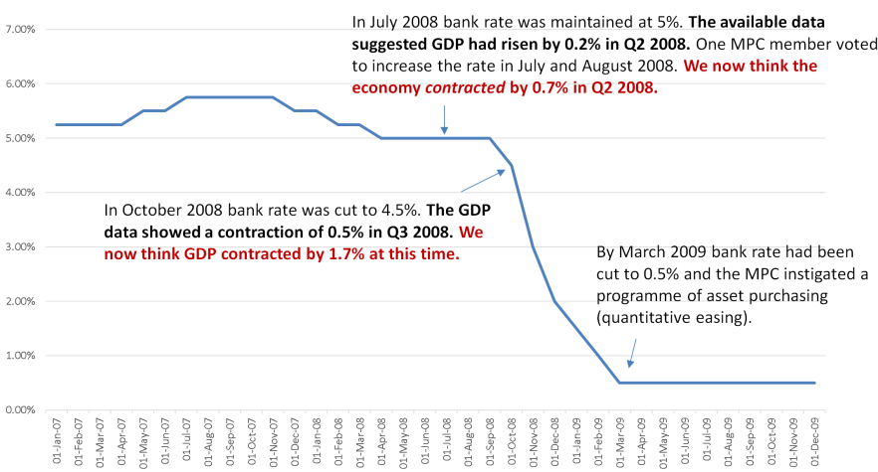
Quantifiable value of accurate and timely economic statistics
… from incidences like this
GDP during the Great Recession
Bank Rate during the Great Recession
“Real GDP would have been 0.8 per cent higher and 150,000 more people would have been employed during the Global Financial Crisis because the Monetary Policy Committee would, as modelled, have lowered Bank Rate quicker. What’s more, nominal GDP would have been some £12 billion larger.”
illustrative example from Kara & Lennard (2020) “Valuing Economic Statistics: A Case Study”, ESCoE OP 02

Slide 9
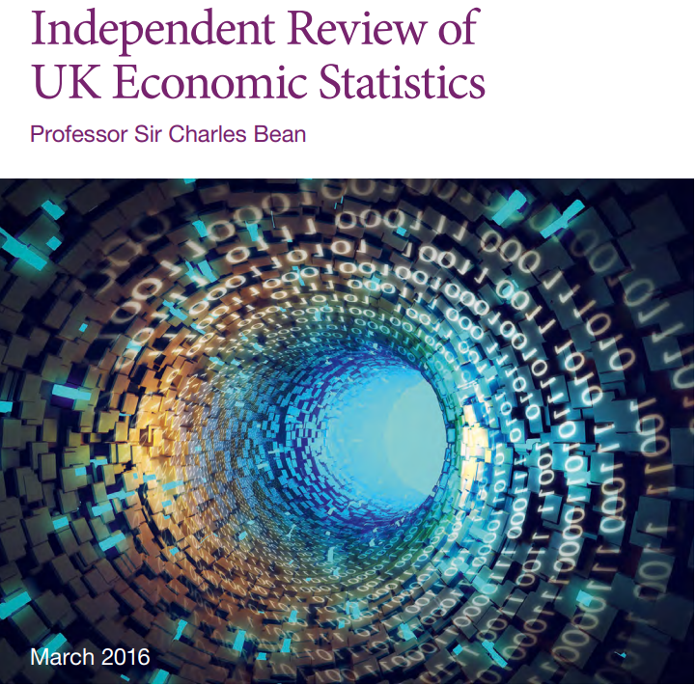
An environment for continuous improvement
… some ingredients
Resourcing
Data sharing
Technology improvements
Revisions or updates?
Fixing mistakes or continuous improvement?
Culture of curiosity
Collaboration with academia

Slide 10
Thank you for your attention!
rebecca.riley@kcl.ac.uk

