Slide 1

Measuring Output with Private Sector Data: Opportunities, Challenges, and Outlook
Chris Wheat, JPMorgan Chase Institute
Advancing Economic Measurement
National Bureau of Economic Research
November 13, 2025

Slide 2







The JPMorgan Chase Institute is a global think tank dedicated to delivering data-rich analyses and expert insights for the public good
RESEARCH THEMES
DATA
HOUSEHOLD INCOME & SPENDING
Research focused on the income and expense dynamics of US consumers.
THE JPMORGAN CHASE INSTITUTE LEVERAGES
DE-IDENTIFIED DATA FROM:
$
3.7
+
TRILLION
BALANCE
SHEET
7.3
+
MILLION
SMALL
BUSINESSES
HOUSEHOLD DEBT
Research focused on the various forms of household debt, including credit cards and mortgages.
209
300
+
MILLION
RETAIL
CUSTOMERS
+
THOUSAND
INSTITUTIONAL INVESTORS
LABOR MARKETS
Research focused on income from labor including labor market trends, growth of the Online Platform Economy, and the financial impacts of job loss.
INDIVIDUAL TRANSACTIONS
Information on amount, day and time, zip code, channel, and counterparty characteristics (2007 – one month prior to present)
FINANCIAL MARKETS & HOUSEHOLD WEALTH
Research focused on investor (institutional and household) behavior.
ACCOUNT LEVEL INFORMATION
Accounts held, activity frequency, and monthly balances (including deposit accounts, savings accounts, money market, credit card, mortgage and home equity loans, and auto loans)
CITIES & LOCAL COMMUNITIES
Research focused on local commerce, resident spending, and the economic vibrancy of cities and local communities.
DEMOGRAPHIC CHARACTERISTICS On an entirely deidentified sample: gender, banded age, and geography
SMALL & MEDIUM-SIZED BUSINESS
Research focused on the financial volatility of business cash flow management, inflow and net flow, and overall health of US small & medium sized businesses.
INSTITUTIONAL INVESTORS
All types of institutional investors across all asset classes and regions globally
HEALTHCARE
Research focused on out-of-pocket healthcare spending among US households to analyze the relationship between cash flows and healthcare expenditures.
For more, visit jpmorganchase.com/institute
1

Slide 3
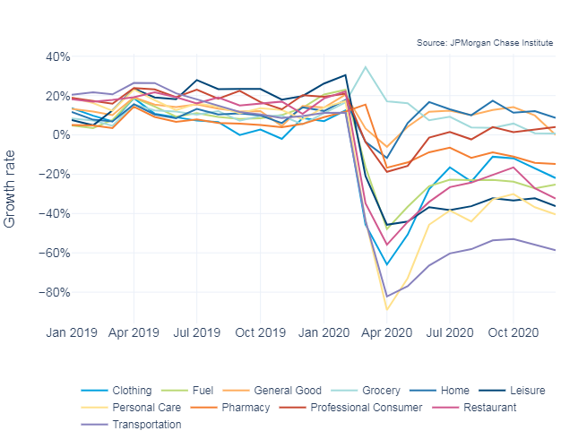
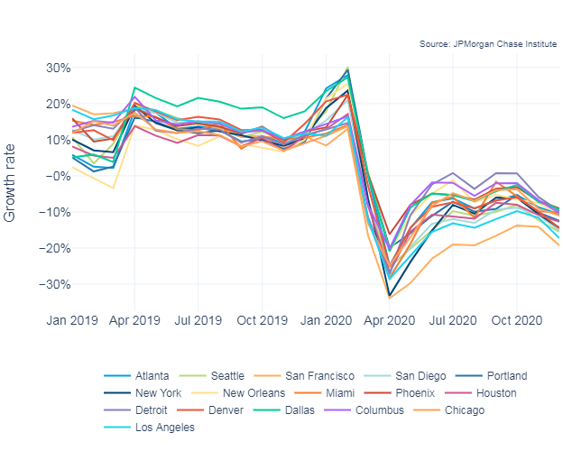
Debit and credit card data could provide a granular and timely view of many (but not all) relevant components of consumer spending
Despite rapid growth during the summer of 2020, spending on general goods (e.g., department stores, large online retailers) declined notably in Q4 2020
With spending growth continuing to decline after October 2020, cities are seeing their lowest growth rates since before July 2020

Slide 4
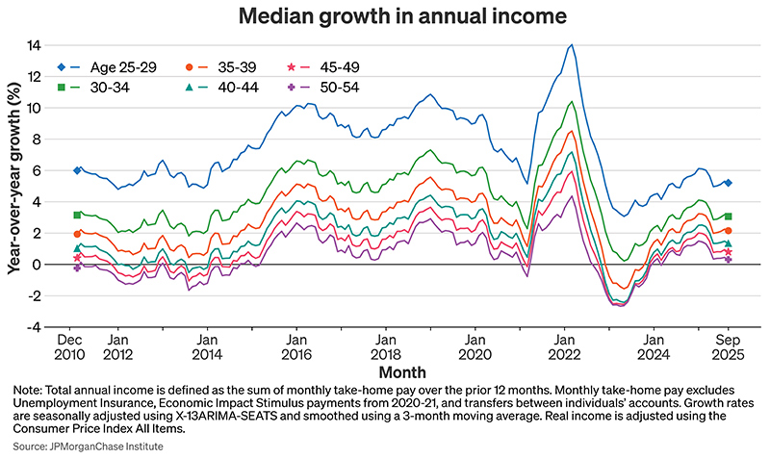
Deposit accounts offer a granular view of individual income, and some information about jobs

Slide 5
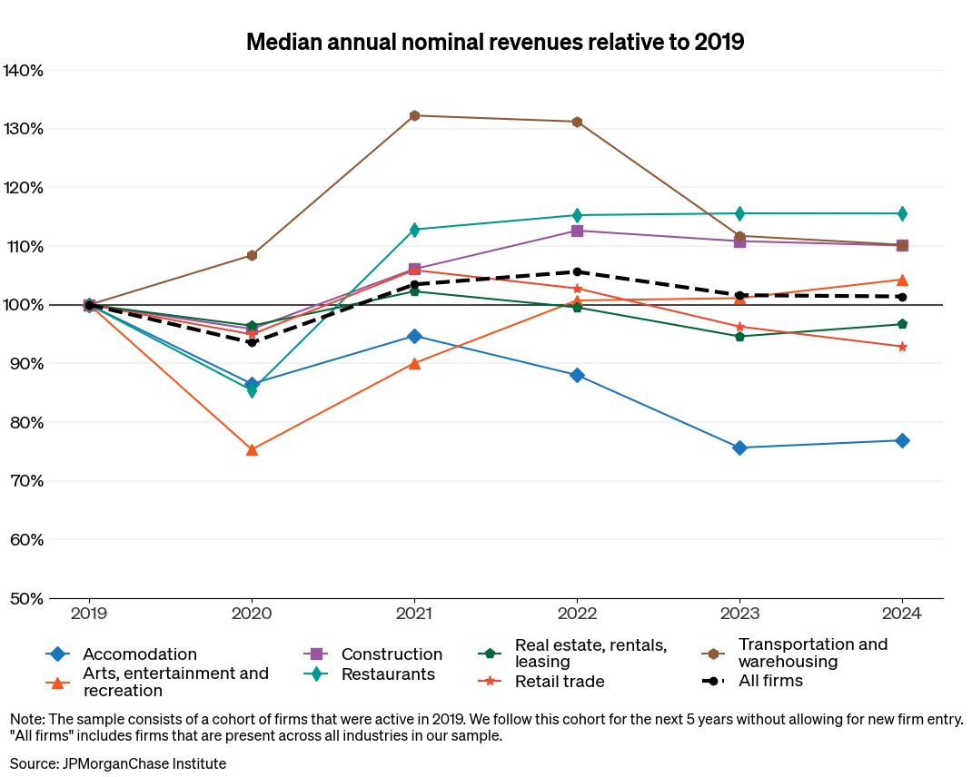
Payments data provide a view of other output-relevant components of economic activity (e.g., small business expenses and revenues)
Small restaurants rebounded in 2021 after being hit hard in 2020, while transportation and warehousing boomed in 2020 and later declined
3

Slide 6
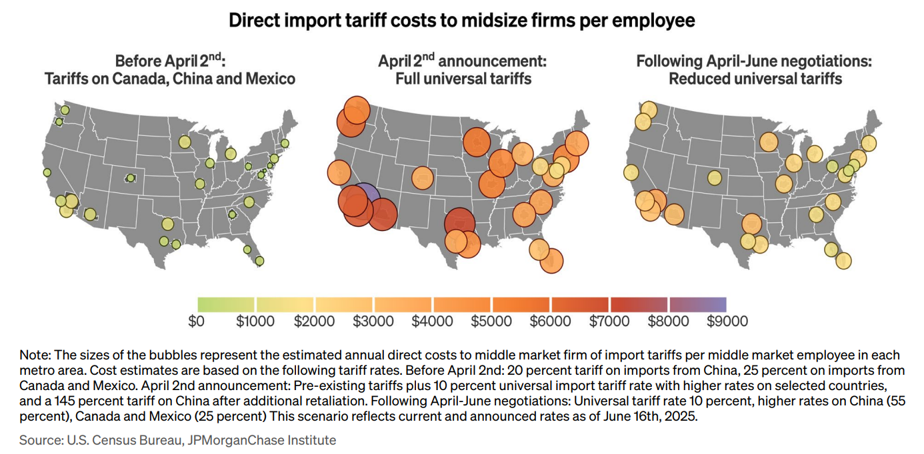
Payments data provide a view of other output-relevant components of economic activity (e.g., exports of midsize firms)

Slide 7
While private sector data have notable limitations, there are still relevant questions about their role in a future system of public statistics
Limitations of Private Sector Data
Considerations / Questions
Private data will likely always provide an incomplete view of the full US economy:
Individual businesses do not have operating needs to measure all economically relevant constructs (total dollars spent vs. price & quantity)
Coverage will be limited to the specific markets and segments consistent with business strategy
Operational considerations will limit the time coverage of available data and the consistency of data over time
Data sharing must be consistent with private-sector profit objectives:
Private sector data owners are at best willing share data in ways that limit risks to their core business
Data sharing could also
Secular decreases in survey response and real declines in fiscal allocations could cause challenges to traditional economic statistics that outweigh the limitations of private sector data
Food for thought: In a world where publicly economic statistics ceased to (materially) exist, what kinds of questions could economic planners answer with only private sector data?
Could private data provide a relatively more useful view of local output / GDP, at least in some areas?
What would happen if there were only higher quality data for denser & wealthier geographies, and limited data for rural / poor geographies?
Would economic planners focus on different outcomes with access to private sector data that measures different constructs?

