Slide 1


Measuring the
Labor Market
with LinkedIn Data
Karin Kimbrough, PhD
Chief Economist, LinkedIn
Kory Kantenga, PhD
Head of Economics, Americas, LinkedIn
NBER, 13 November 2025
Notes:
Biography (for external introducer): Dr. Karin Kimbrough is the Chief Economist for LinkedIn where she leads a team devoted to surfacing thought leadership on the world of work. Prior to joining LinkedIn in 2020, she served as the Assistant Treasurer for Google and the Head of Macroeconomic Policy at Bank of America. In addition, Kimbrough worked at the Federal Reserve Bank of New York in the Markets Group for nearly a decade and as an Economist and FX Strategist at Morgan Stanley in London and NY. She serves on the board of directors for Fannie Mae, the National Bureau of Economic Research, and the San Francisco Federal Reserve Bank of San Francisco. She holds a Bachelor’s from Stanford University, a Master’s from Harvard University, and a Ph.D. in economics from the University of Oxford.

Slide 2






















69M
COMPANIES
14M
JOBS
1.2B
MEMBERS
LinkedIn
Economic Graph
41K
SKILLS
5M+
UPDATES/MINUTE
22K
COURSES
2
Notes:
The LinkedIn Economic Graph is all of our data.
It draws from 1.2 billion members, 70 million company pages, and many more nascent startups and founders.
Every second, members and customers log in, generating over 5 million updates a minute—signals about schools, skills, job transitions, and interests.
We aggregate these signals in a members‑first way, protecting privacy while producing insights that help everyone understand the global economy.

Slide 3
Our Data
Profile Data (Job Title, Experience, Skills)
The LinkedIn ecosystem provides data on a variety of labor market activities
Recruiting Activity (Job Postings, InMail)
Job Seeking Activity (Views, Applications)
Surveys (Workforce Sentiment)
The Feed
Notes:
Our ecosystem draws on diverse signals that track shifts in labor market activity.
Member profiles reveal workers’ roles, skills, and experience. Combined across networks, they expose patterns in individual and aggregate outcomes. Though self-reported, profiles align closely with US macroeconomic benchmarks. Our trust team continually removes fake accounts and bad actors to keep the data authentic and high quality.
Recruiting activity—job postings and InMail outreach—signals shifts in labor demand.
Job-seeking behavior—views and applications—shows how workers respond to changing opportunities.
Member surveys capture confidence trends—from career advancement to hiring plans—adding context to platform signals. We regularly conduct survey of our members to understand their confidence in everything from finance to whether their businesses plan to spend and on what.
Finally, the LinkedIn feed offers a mountain of activity and sentiment, with untapped potential for insights. We have not even scratched the surface of what we can learn from the LinkedIn feed.
LinkedIn US data is broadly representative at the industry level with some overrepresentation among industries like Technology, Information and Media which is around 7 percent of membership for the US on LinkedIn versus closer to 3 to 4 percent of workers according to BLS data.
At the occupational level, LinkedIn data screws to office roles as you would expect given that it is an online platform. Though the signals for workers outside the office are noisier, they do exist on LinkedIn. Around 1 in 5 US job postings on LinkedIn do not require a college degree, which attracts ”blue collar” workers to LinkedIn. [Over 20% of LinkedIn US members do not have a Bachelor’s degree].

Slide 4
Job Postings (Job Postings Indices)
Our Indicators
Hiring (LinkedIn Hiring Rate)
The Economic Graph Research Institute turns LinkedIn data into tracked measures of labor market activity to assess the state of the labor market in the US and globally
Quits (LinkedIn Separation Rate)
Slack (LinkedIn Labor Market Tightness)
Job Seeking Activity (Applications, Open-to-Work)
Seeker Sentiment (Layoff Mentions, Confidence)
Notes:
I lead the Economic Graph Research Institute. We turn LinkedIn’s data into measures of labor market activity, combining expertise from economics, data science and disciplines to track trends over time and reveal patterns in aggregate and individual outcomes.
We track key indicators that reveal shifts in labor market dynamics:
1. Job postings which signal changes in labor demand
2. Hiring to understand demand-driven labor market conditions
3. Quits to understand how well the job market is supporting job seekers in taking on new opportunities
4. Labor market slack or tightness to assess the balance of supply and demand—a critical gauge for policymakers focused on employment mandates.
5. We also monitor job-seeking activity and sentiment among workers and employers.
For this talk, I am going to focus on three key indicators: The LinkedIn Hiring Rate, The LinkedIn Separation, and the LinkedIn Labor Market Tightness at the national level for the US. But our data is global and granular, so all these indicators can be viewed at the industry, occupation, and even job title level in some cases.

Slide 5
LinkedIn Hiring Rate
The LinkedIn Hiring Rate measures hiring through
the pace at which members add new positions to their LinkedIn profile
Count of added positions (hires) at new companies each month adjusted for…
  Platform Effects: Divide by member count to control for scale effect of more members
  Profile Update Lag: Mitigate by limiting to positions added during the month position starts
Indexed to the average of 2016 (beginning of tracking)
  Highlight shifts in momentum over time rather than scale
Seasonally adjusted
  X-13-AMIRA-SEATS
Notes:
Let’s start with the hiring rate, because it tends to lead quits and labor market tightness.
We measure hiring on LinkedIn by looking at the pace at which members add new positions with new companies to their LinkedIn profile.
We adjust that measure by member count to account for platform scaling effects, of course, more members mechanically results in more hires.
A key challenge of dealing with any kind of self-reported data is that members may not update their profiles immediately. To mitigate this lag, we limit our hires counts to positions where the position starts during the month of the update. Of course, this method is not perfect and does not account for selection bias in who may update their profile, but as you will see it still does quite well in enabling us to track macroeconomic conditions.
We limit the use of our hiring data back to 2015 because of major changes to LinkedIn.com prior to 2015 that lead to structural breaks in our data due to how members used the platform then versus now.
Finally, we seasonally adjust using the US Census Bureau’s preferred method to limit divergence from BLS measures.

Slide 6
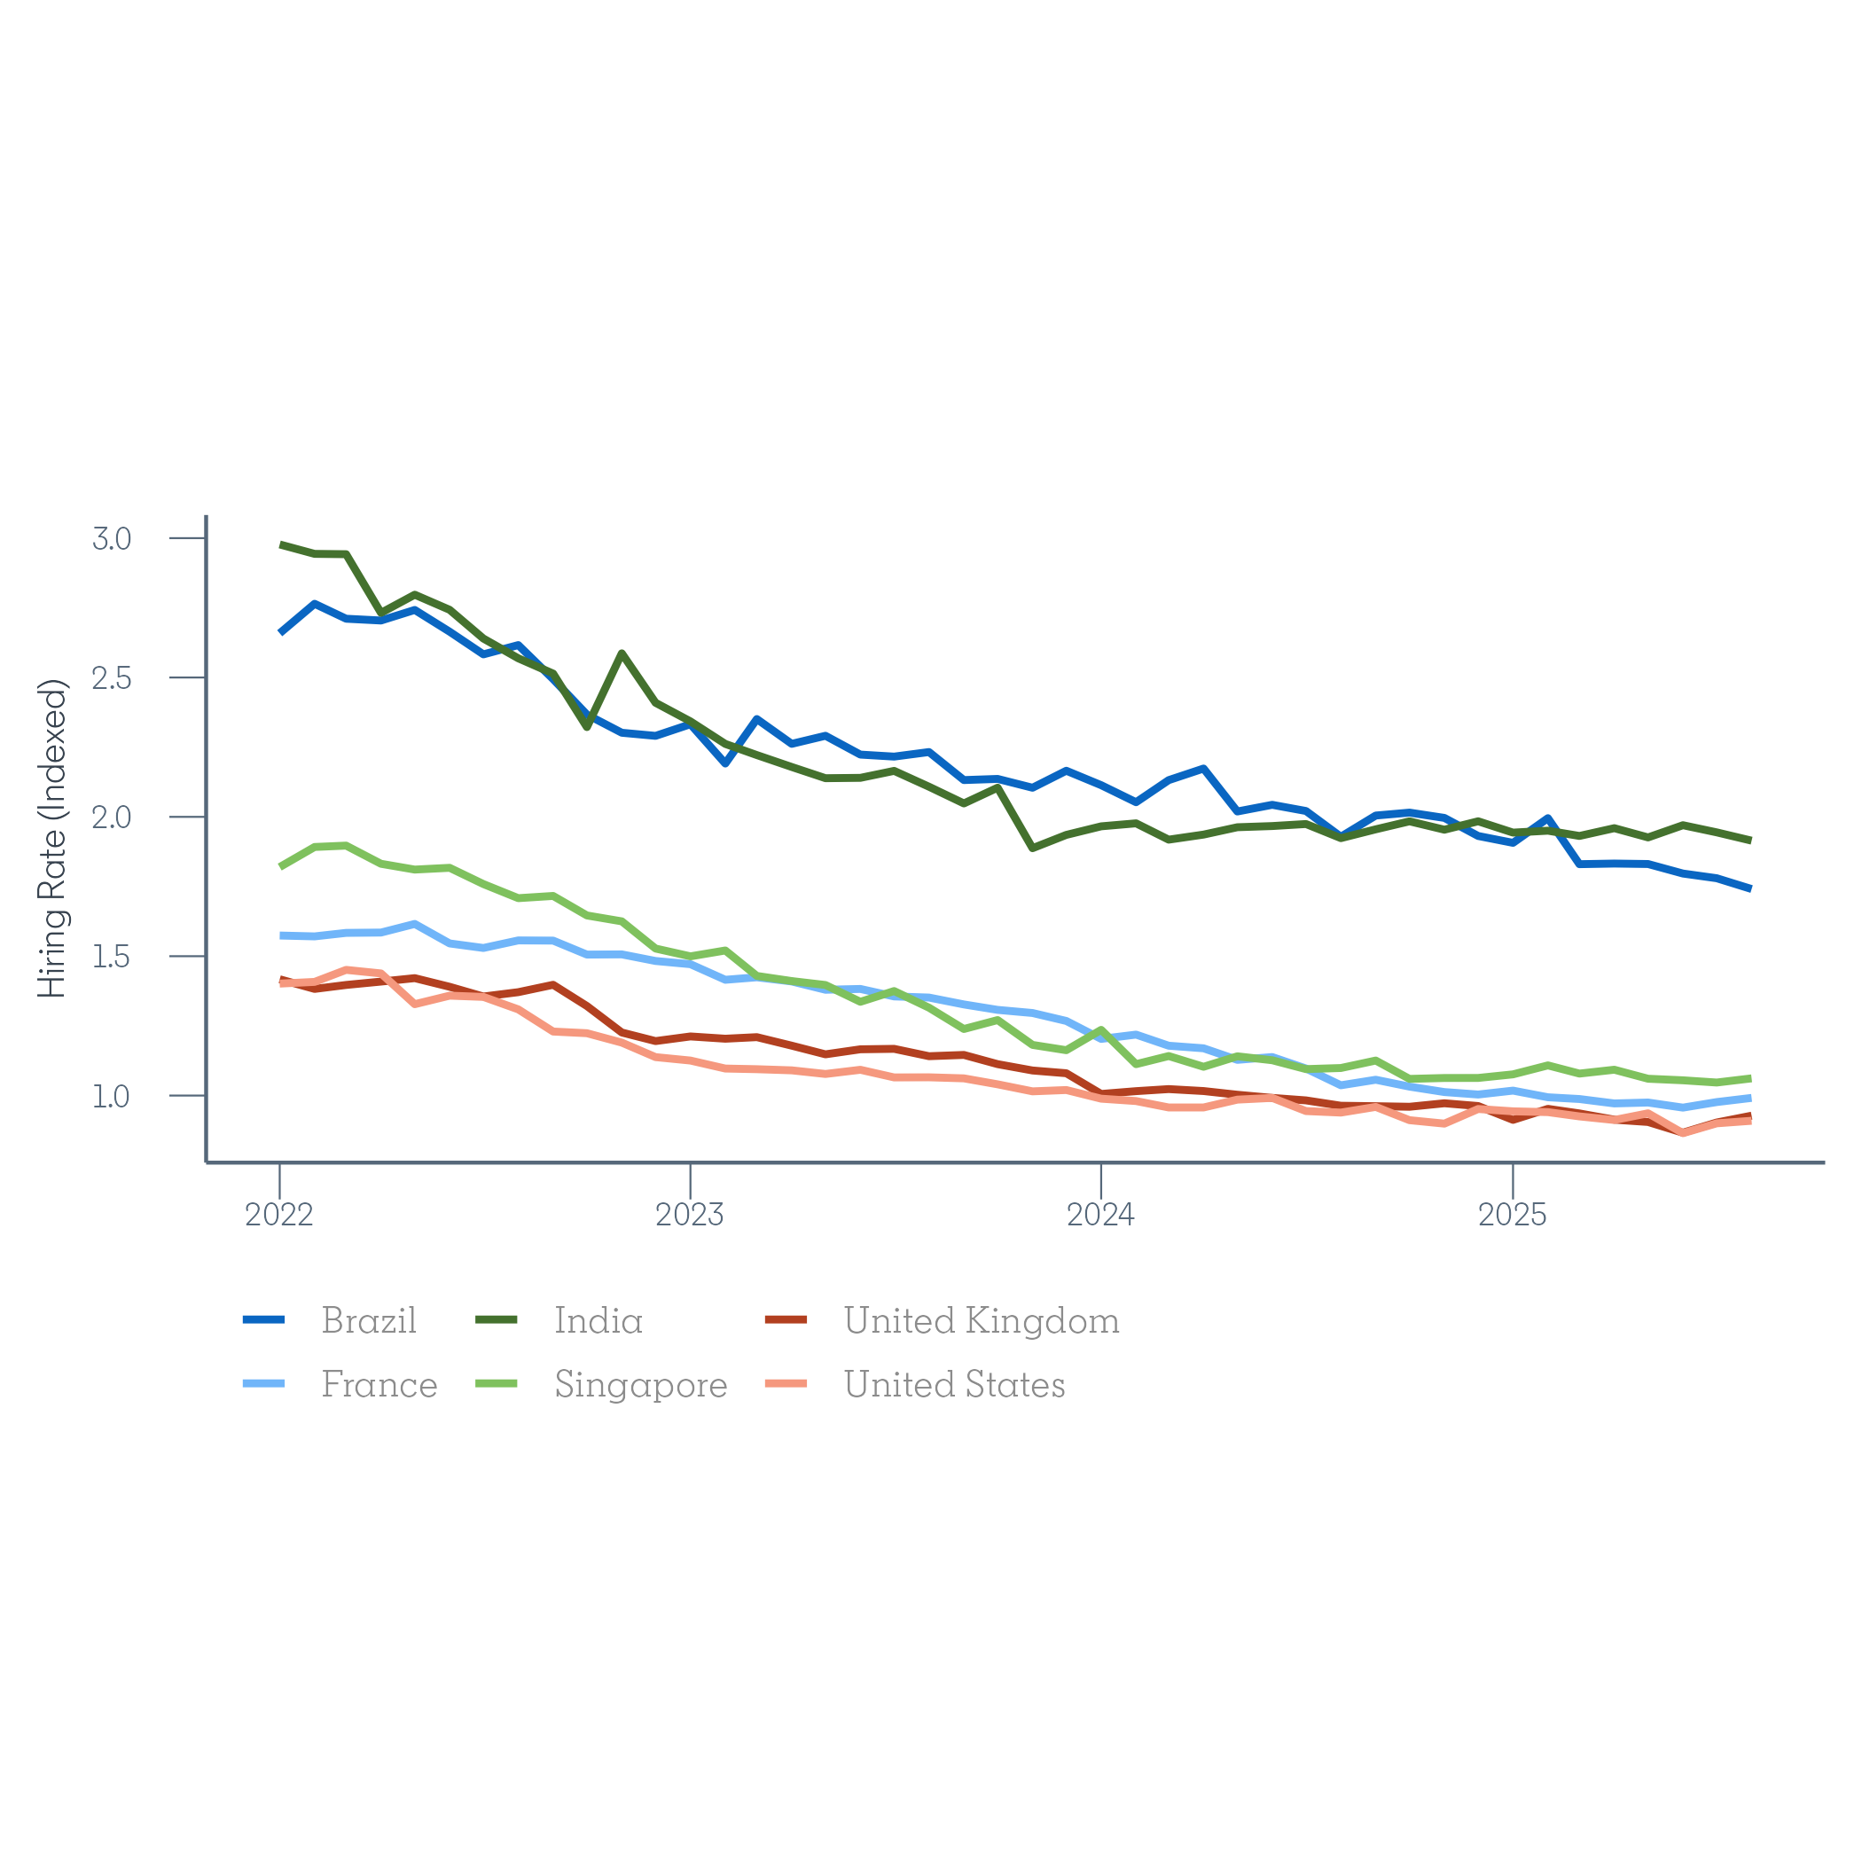
LinkedIn Hiring Rate tracks JOLTS Hiring Rate
Source: Bureau of Labor Statistics, Job Openings and Labor Turnover Survey (JOLTS); LinkedIn Economic Graph
Notes:
Apart from the pandemic rebound, the LinkedIn Hiring Rate tracks the Job Openings and Labor Turnover Survey (JOLTS) hiring rate over time. These time series are cointegrated and even more so when we exclude the onset of the pandemic.
An obvious limitation of our profile-based hiring rate is that we are unlikely to capture sharp, short-term disruptions like the onset of the pandemic. Our signal comes from members updating their profile, and they have no incentive to change their profile if they expect the disruption to be temporary.
However, when we do see sharp changes like the onset of the pandemic, the lack of a sharp change in profile data might still be informative. It tells us that a meaningful share of workers perceive the disruption to be temporary, which in itself may be informative.

Slide 7
LinkedIn Hiring Rate tracks JOLTS Hiring Rate
Source: Bureau of Labor Statistics, Job Openings and Labor Turnover Survey (JOLTS); LinkedIn Economic Graph
Notes:
As you can see, except for the pandemic, we see tight movement between our hiring rate and the JOLTS hiring rate. That allows us to deploy models like a Vector Error Correction Model to nowcast the JOLTS hiring rate.

Slide 8
LinkedIn Separation Rate
The LinkedIn Separation Rate measures quits through
the pace at which members depart positions based on their LinkedIn profile.
Count of positions ended each month adjusted for…
  Platform Effects: Divide by member count to control for scale effect of more members
  Profile Update Lag: Mitigate by limiting to positions where members updated their profile that month
Indexed to the average of 2016 (beginning of tracking)
  Highlight shifts in momentum over time rather than scale
Seasonally adjusted
  X-13-AMIRA-SEATS
Notes:
As we constructed the hiring rate, we can similarly construct a separation rate.
We measure separations on LinkedIn by looking at the pace at which members end positions on their LinkedIn profile.
Again, we adjust that measure by member count to account for platform scaling effects and limit to positions where members have updated their profile the month of the job update.
Because we limit to timely updates, the separation rate primarily reflects quits as workers move to new jobs. Workers do not tend to update their profile due to a layoff when it happens. Layoffs are major, unplanned shocks to many workers, so we expect and see them taking time to process that shock before updating their position to reflect that the role as ended. And of course, some members do not update their profile, possibly due to the belief that being laid off sends a negative signal to potential employers.
Again, we limit the use of our hiring data back to 2015 because of major changes to LinkedIn.com prior to 2015 and seasonally adjust.

Slide 9
LinkedIn Separation Rate consistent with JOLTS Quit Rate
Source: Bureau of Labor Statistics, Job Openings and Labor Turnover Survey (JOLTS); LinkedIn Economic Graph
Notes:
Though not cointegrated in a statistically detectable way, we do see consistency over time in how our Separation Rate reflects cyclical conditions compared to the JOLTS quit rate.
And though our separation rate is not cointegrated with the JOLTS quit rate, we do see Granger causality between our Separation Rate and the JOLTS quit rate at recent lags, especially when excluding the onset of the pandemic. So, the LinkedIn Separation Rate contains information that allows us to nowcast the JOLTS quit rate.

Slide 10
LinkedIn Separation Rate predicts changes in the JOLTS Quit Rate
Jul 2020
Source: Bureau of Labor Statistics, Job Openings and Labor Turnover Survey (JOLTS); LinkedIn Economic Graph
Notes:
The relationship between contemporaneous month-to-month changes is noisy, but we do still see some information to exploit in predicting the JOLTS Quit Rate which publishes with significant lag (over a full month elapses between the period that Job Openings and Labor Survey Turnover covers and when the data is published).

Slide 11
LinkedIn Labor Market Tightness
LinkedIn Labor Market Tightness measures labor market slack through
the ratio of sponsored job postings to applicants
Count of jobs postings divided by count of unique applicants imposing…
  Applicants and job postings must be in the same country
  Job postings must be sponsored (paid or freemium) to demonstrate recruiting effort (active) and attract at least one application (attractive)
Indexed to V/U in July of 2019 (beginning of data availability)
  Highlight shifts in momentum over time rather than scale
Notes:
Between 2022 and 2023, labor market tightness became a key indicator of interest as the FOMC undertook a tightening cycle and remains consistently mentioned in FOMC meeting minutes.
We measure labor measure tightness as the ratio oof sponsored job postings to applicants. We limited to sponsored job postings that attracted at least one applicant to filter out low quality job postings where recruiting effort is low or uncertain. We also limit to applicants in the same country as the job posting, though we also have versions of this metric that relax that assumption.
This availability of this data goes back to mid-2019.

Slide 12
LinkedIn’s measure of slack differs from the canonical measure
Source: Bureau of Labor Statistics, Job Openings and Labor Turnover Survey (JOLTS), Current Population Survey (CPS); LinkedIn Economic Graph
Notes:
Though our measure of labor market tightness broadly reflects the non-pandemic cyclical of the canonical measure of tightness (the vacancy-to-unemployment ratio), it differs meaningfully from the vacancy-to-unemployment ratio.
First, we do not pick up on the sharp rise in slack during the pandemic. We do see some additional slack but not remotely to the degree shown by V/U due to the sharp rise in unemployment.
Second, our measure of labor market tightness peaks slightly before V/U and stabilizes well before V/U. We saw later market tightness stabilize in late 2023 – suggesting an ongoing balance of supply and demand over the last two years. V/U began to stabilize a full year later.
Of course, some of this difference is due to compositional differences between job postings on LinkedIn versus overall, but the difference remains stark.
LinkedIn’s measure has the advantage of picking up on on-the-job search unlike V/U which only considers unemployed job seekers.

Slide 13
LinkedIn data: V/U systematically under(over) estimates extent of changes in slack during periods of rapid ac(de)celeration
First 50bps hike in last tightening cycle
45°
Source: Bureau of Labor Statistics, Job Openings and Labor Turnover Survey (JOLTS), Current Population Survey (CPS); LinkedIn Economic Graph
Notes:
Taking LinkedIn’s measure of slack at face value suggests that the canonical measure of V/U systematically underestimates the extent of change in slack during periods of rapid acceleration like in 2021 and systematically overestimates the extent of change in slack during periods of rapid deceleration like in 2023.
If true, that suggests that there was a significant lag in the time central bankers figured out the extent to which labor market tightness had risen in 2022 and fallen in 2023. This could be a blind spot in how central bankers assess labor market conditions, delaying the timing of more deft policy making decisions. Of course, this could just be an artefact of LinkedIn data and labor market tightness may not have been pivotal to monetary policy decisions but still a question worth asking.
Part of this gap is certainly due to the inclusion of on-the-job searchers in LinkedIn’s measure which considers applicants rather than unemployed workers.
On-the-job searchers have more flexibility to adjust their search effort and have been shown to have countercyclical search effort.
So, they search less as labor markets tighten, compounding tighter labor markets and search more as labor market loosen, exacerbating the rise in labor market slack.
Ignoring these workers by focusing on unemployed workers leads to underestimating the degree of distress in the labor market from the side of workers and ignores an important aspect of a healthy labor market – worker reallocation or churn.

Slide 14
LinkedIn’s measure of slack tracks aggregate churn
Source: Bureau of Labor Statistics, Job Openings and Labor Turnover Survey (JOLTS); LinkedIn Economic Graph
Notes:
Churn focuses on the reallocation of workers across jobs, rather than changes due to addition or subtraction of workers to the workforce. Even without adding or losing jobs, we can experience efficiency gains by reallocating workers to where they are more productive, making churn important not only to individual opportunities to take on new roles but productive efficiency at large.
Our measure of labor market tightness is cointegrated with aggregate churn measured in JOLTS data.
NOTE: Aggregate Churn = 2*min{Total Hires, Total Quits} / Average Employment this month and last month

Slide 15
Worker reallocation may be a better indicator of slack than V/U
Source: Bureau of Labor Statistics, Job Openings and Labor Turnover Survey (JOLTS); LinkedIn Economic Graph
Notes:
If it is the case that LinkedIn’s measure of labor market tightness provides a better signal on labor market conditions than the canonical vacancy-to-unemployment ratio, then worker reallocation (or the lack thereof) is surely a better indicator of slack than V/U as well.

Slide 16
Nowcasting
Cointegrated time series and Granger-causal connections allow us to predict…
LinkedIn Nowcast of Key Federal US Labor Market Indicators*
Indicators |  | Aug (Prelim) | Sep | Oct*
JOLTS Hiring Rate |  | 3.2 | 3.2 | 3.3
JOLTS Quit Rate |  | 1.9 | 1.9 | 1.9
JOLTS Layoff Rate |  | 1.1 | 1.1 | 1.1
CES Change in Nonfarm Payroll |  | +22K | +12K** | +6K**
CPS Unemployment Rate (%) |  | 4.32 | 4.32 | 4.34
* does not fully account for the temporary impact of the government shutdown on October data. ** elastic net nowcast
Source: Bureau of Labor Statistics, Job Openings and Labor Turnover Survey (JOLTS), Current Population Survey (CPS), Current Establishment Survey (CES); LinkedIn Economic Graph
Notes:
Given the cointegrating and Granger-causal relationships we see between LinkedIn data and BLS data, we can exploit these to predict key labor market indicators. This is especially useful for JOLTS, which publishes with a significant lag.
Right now, we do not expect JOLTS to reveal any major shifts in hiring, quits or layoffs.
We can also make nowcasts of more prominent labor market health indicators like nonfarm payrolls and the unemployment rate. Nonfarm payrolls gains and losses are increasingly hard to predict and assess, because they are now disproportionately influenced by a slowdown in labor supply.
So perhaps a more useful indicator to nowcast currently is the unemployment rate, which we do not expect to have undergone much deterioration so far this fall.
NOTE: Nowcast is a nowcast using the ML regression technique elastic net. It’s OLS plus a penalty term on less informative regressors (a linear combination of Ridge + LASSO). This is NEW and EXPERIMENTAL. We usually nowcast with OLS on percent changes.

Slide 17
State of the US labor market today
LinkedIn data indicates mild deceleration from September to October,
with a much slower labor market compared to late 2010s dynamics
LinkedIn US Labor Market Indicators, October 2025 vs.
Indicators |  | Last Month | Last Year | Pre-COVID
Hiring Rate |  | –1% | –6% | –24%
Separation Rate |  | –1% | 1% | –25%
Labor Market Tightness (Jobs per Applicant) |  | –1% | –8% | –7%
Job Seeking Intensity (Applications per Applicant) |  | –9% | –2% | 84%
Source: LinkedIn Economic Graph
Notes:
Looking purely at LinkedIn Labor Market Indicators, we see a labor market that slowed mildly so far through the fall and is running much slower than what we saw in the late 2010s. Constraints in labor supply growth are keeping unemployment contained, but the US labor market is increasingly fragile.

Slide 18
Thank You.

