Slide 1
The Special Challenges of Measuring Output: Blending and Coordination
Jed Kolko, PIIE and JPMCI (but these are personal views only)

Slide 2
Punchline
The private sector can fill gaps
in official statistics
for single-origin data products
but not
blended data products
or coordination activities

Slide 3
Single-origin vs blended data products
 | Single-origin | Blended
Ingredient | One primary survey or dataset | Multiple inputs
Examples* | Each half of jobs report | GDP Price indices (CPI and PCE)
Agency with leading expertise | Census and BLS | BEA
My preferred skills metaphor | Farming | Cooking
* Single-origin vs blended is continuous not binary

Slide 4
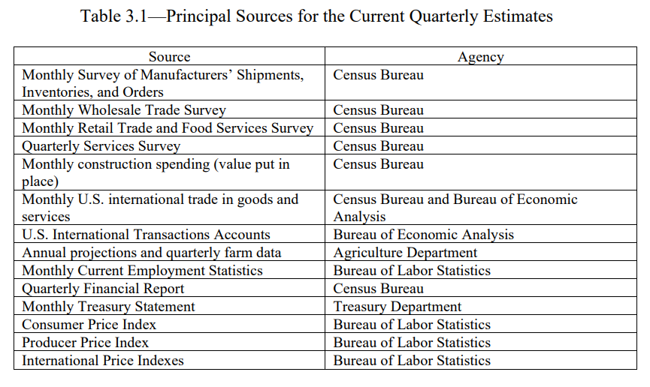
GDP: the ultimate blended data product

Slide 5
Essential statistical coordination activities
Taxonomies and definitions
Geography
Industry and occupation
Race and ethnicity
Accounting harmonization (count once and only once)
Dates
Boundaries
Engagement, production, and publication processes
Coordination happens:
Across US agencies
Internationally

Slide 6
What blending and coordination require
Deep and broad expertise about data sources and standards
“Cooking” skills for harmonizing, aligning, and combining data
Credibility and independence to make unbiased methodological decisions
Convening and enforcement power
The right incentives
Positive externalities
Public goods

Slide 7
Coordination and alignment institutions
Within statistical system
BEA
Chief Statistician’s team in OMB / OIRA
Census technical and standards teams (geography; X-13)
Outside statistical system, public/non-profit/NGO
Fed, including regional banks
National Academies / CNSTAT
UN / OECD / World Bank / IMF
Academia, NBER
Unclear how far private sector could or would go

