Slide 1
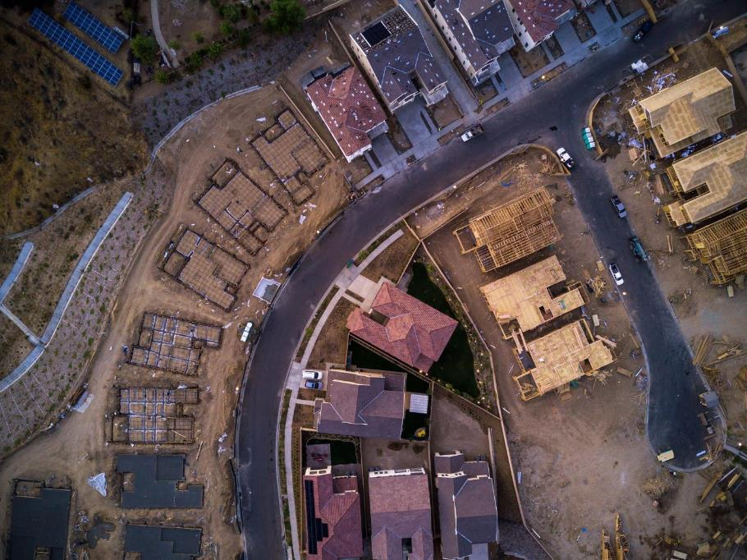
A Blended Data Approach to Measuring Monthly Housing Starts:
Satellite Imagery, Survey Data and More!
Nikki Czaplicki
U.S. Census Bureau
Any opinions and conclusions expressed herein are those of the authors and do not reflect the views of the U.S. Census Bureau.

Slide 2
Meet the team
U.S. Census Bureau
Nikki Czaplicki
Aidan Smith
Scott Springer
Reveal Global Consulting
Hector Ferronato
Dwarakh V. Nayam
Lei Peng
Colin Shevlin
Doren Walker

Slide 3




Re-engineering housing start estimation
Goal: Combine traditional survey collected data with estimates derived from satellite imagery to produce a blended estimate of monthly single-family housing starts
The Census Bureau has reviewed this product to ensure appropriate access, use, and disclosure avoidance protection of the confidential source data (Disclosure Review Board (DRB) approval number: CBDRB-FY25-0086).

Slide 4
Current Construction Indicator
New Residential Construction (NRC)
  commonly referred to as “Housing Starts”
  provides monthly national and regional estimates of housing units started, authorized but not started, under construction and completed.
  sources data from Survey of Construction (SOC)
    Sampling of building permits authorizing new, privately-owned residential construction
    Physical canvassing of areas not requiring building permits
Data Users
  BEA, Federal Reserve, Council of Economic Advisors, Department of Housing and Urban Development, Manufacturers, Insurance Companies, Financial Institutions

Slide 5


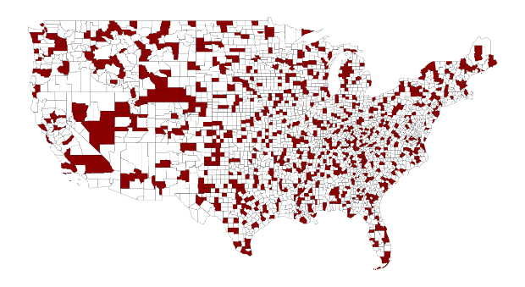




Current Design: Three Stage Sampling
Selection of Permit/Non-Permit Areas
Subsample of Current Population Survey Primary Sampling Units (PSUs)
Monthly Selection of Permits
*Note: Map for illustrative purposes and does not reflect SOC sample

Slide 6


Satellite Collection: Eliminate Third Stage of Sampling
Selection of Permit/Non-Permit Areas
Subsample of Current Population Survey PSUs
Monthly Selection of Permits
*Note: Map for illustrative purposes and does not reflect SOC sample

Slide 7
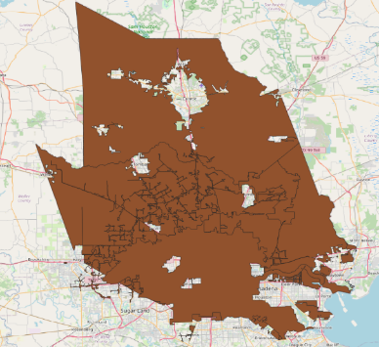
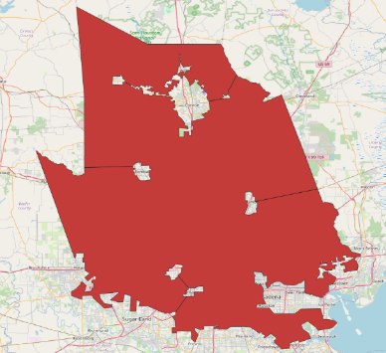
Satellite Areas of Interest (AOIs)
Select AOIs that are dense in new residential housing starts.
Identify boundaries using Census TIGER*/Line shapefiles.
Provide image broker with augmented shapefiles.
  Simplify
  Combine
  Exclude
Images captured in 10-day window (End of month ±5 days)
*Topologically Integrated Geographic Encoding and Referencing system

Slide 8
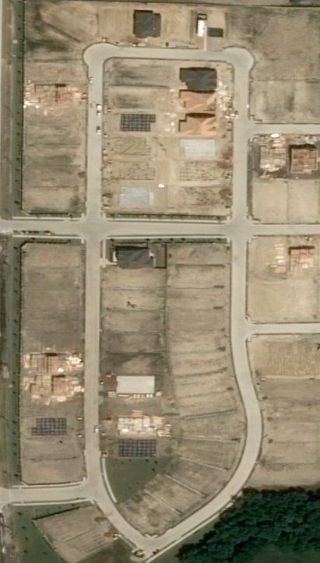

Developing a Construction Stage Model
Identify construction stages present in satellite imagery
Background
Land
Vegetation
Excavation
Foundation
Framing
Unfinished Roof
Finished Roof

Slide 9
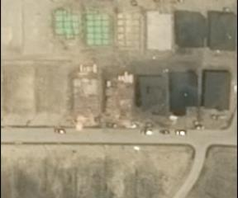
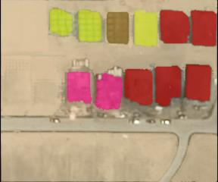
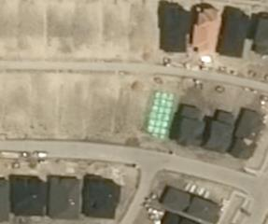
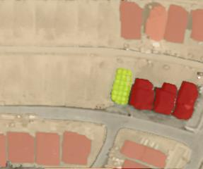
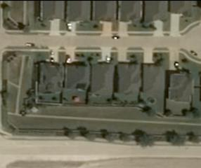
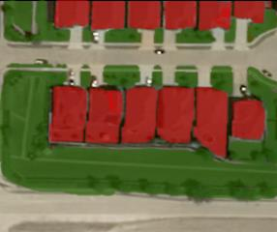
Construction Stage Labeling

Slide 10
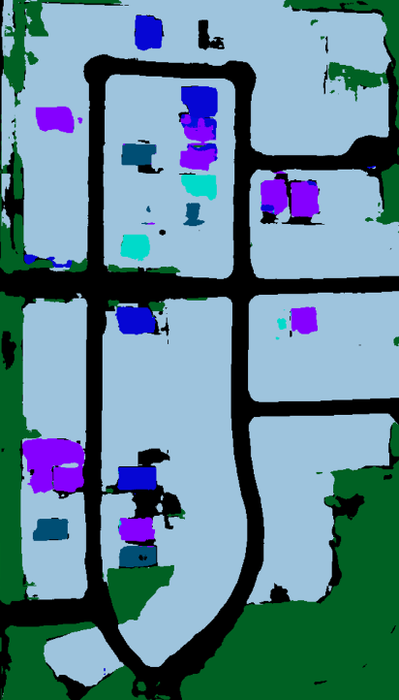


Construction Stage
Predictions
LAND
VEGETATION
EXCAVATION
FOUNDATION
FRAMING
ROOF

Slide 11
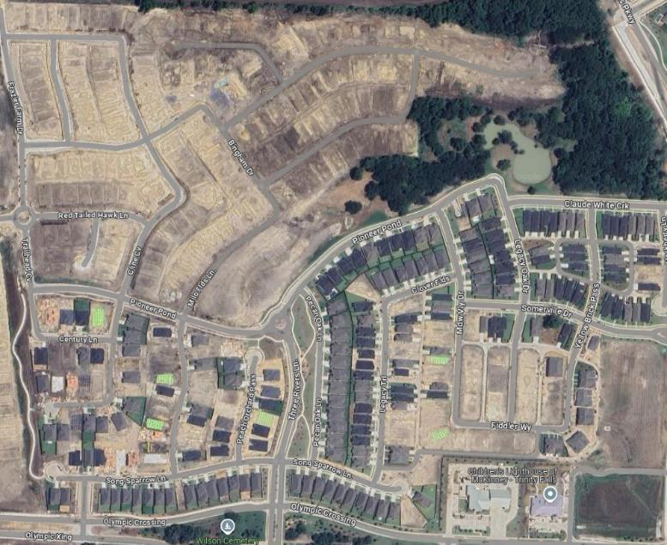
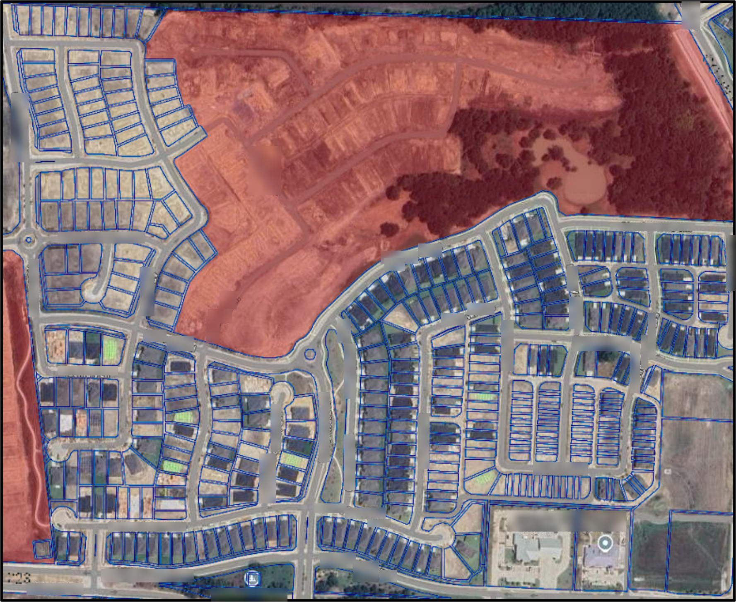
Parcel Limitations
Outdated geometry
Incomplete data
Inaccurate zoning information

Slide 12
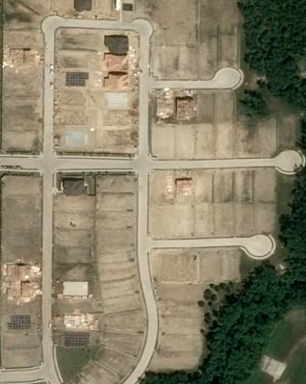
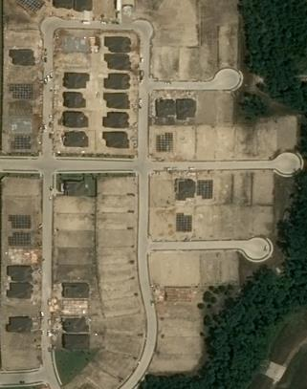
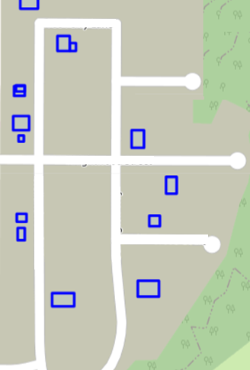
Identifying Starts Through Blob Search

Slide 13
Interpreting Starts With Business Rules
 |  | Current Month Prediction
 |  | Background | Land | Vegetation | Excavation | Foundation | Framing | Unfinished Roof | Roof
Previous Month Prediction | Background | Unknown | Land | Land | Start | Start | Start | Start | Start Completion
 | Land | Land | Land | Land | Start | Start | Start | Start | Start Completion
 | Vegetation | Land | Land | Land | Start | Start | Start | Start | Start Completion
 | Excavation | Image Error | Land | Land | In Progress | In Progress | In Progress | In Progress | Completion
 | Foundation | Image Error | Misclassified Backwards | Misclassified Backwards | In Progress | In Progress | In Progress | In Progress | Completion
 | Framing | Image Error | Misclassified Backwards | Misclassified Backwards | In Progress | In Progress | In Progress | In Progress | Completion
 | Unfinished Roof | Image Error | Misclassified Backwards | Misclassified Backwards | In Progress | In Progress | In Progress | In Progress | Completion
 | Roof | Image Error | Misclassified Backwards | Misclassified Backwards | Start Reconstruction | Start Reconstruction | Start Reconstruction | Start Reconstruction | Exist

Slide 14
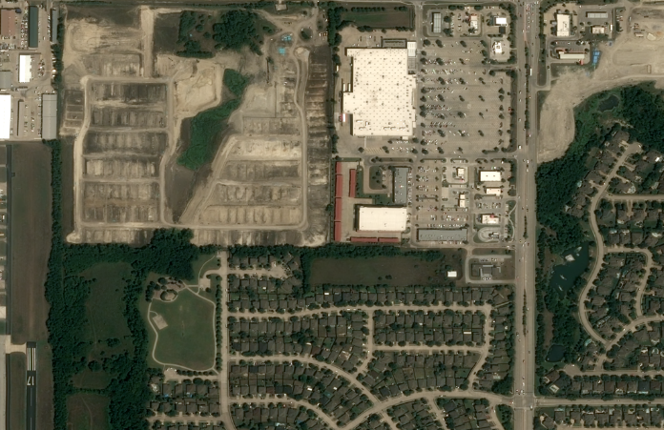
Developing a Building Type Model
Classify areas by likely building type
Single-family detached
Single-family attached
Multi-family
Non-residential
Background

Slide 15
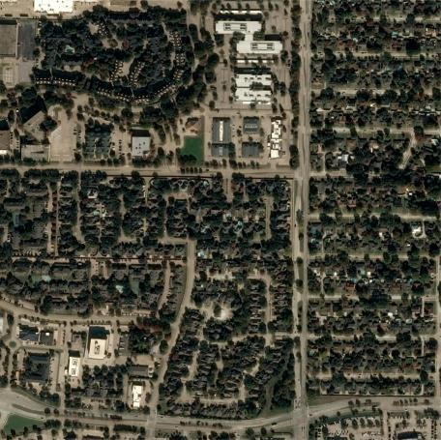
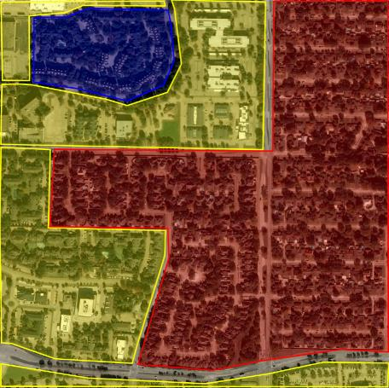
Building Type Labeling

Slide 16
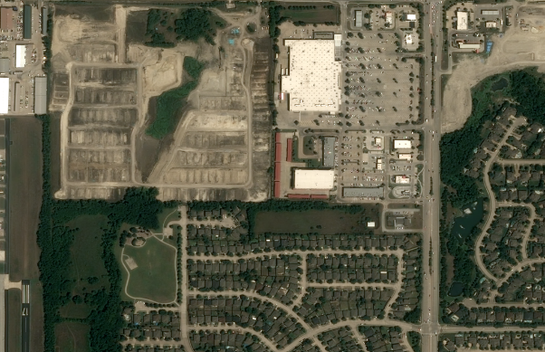


Building Type
Model Predictions
Background
Single Family Detached
Non-Single Family

Slide 17
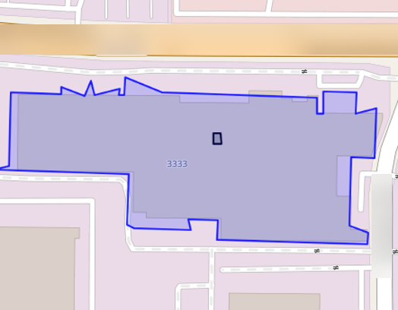
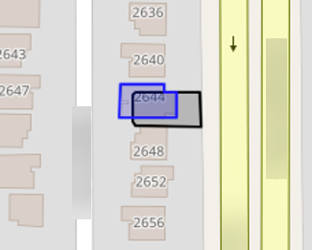
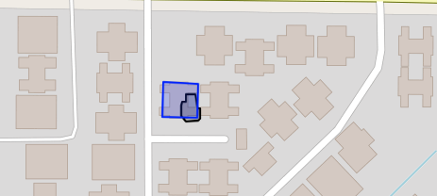
Building Footprint Exclusion
Utilize open-source building footprint data to reduce noise.
Overlay start blobs on footprint shapes and exclude overlaps as probable noise.
Similar procedure performed using TIGER/Line road data.
Blue shape indicates a building footprint
Black shape indicates a start prediction

Slide 18
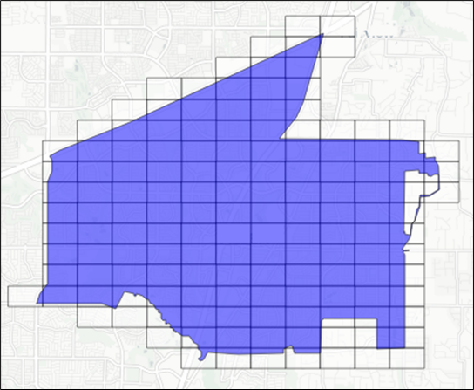
Imputation of satellite data
Missing data in the satellite image due to cloud cover
Construction is not evenly distributed across the AOI – place level missing data adjustment not appropriate
Divide the AOI into its component 7-character Geohashes (153m x153m) and impute/adjust at the Geohash level

Slide 19
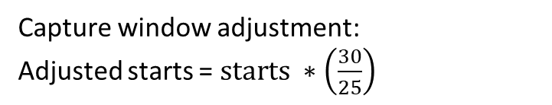
Capture Window Adjustment
Ideal scenario
Possible real-world scenario
April
Sun | Mon | Tue | Wed | Thu | Fri | Sat
31 | 1 | 2 | 3 | 4 | 5 | 6
7 | 8 | 9 | 10 | 11 | 12 | 13
14 | 15 | 16 | 17 | 18 | 19 | 20
21 | 22 | 23 | 24 | 25 | 26 | 27
28 | 29 | 30
April
Sun | Mon | Tue | Wed | Thu | Fri | Sat
31 | 1 | 2 | 3 | 4 | 5 | 6
7 | 8 | 9 | 10 | 11 | 12 | 13
14 | 15 | 16 | 17 | 18 | 19 | 20
21 | 22 | 23 | 24 | 25 | 26 | 27
28 | 29 | 30
30 days between images
25 days between images
Prior month image obtained
Capture window adjustment:
Adjusted starts = $starts ∗\left(\frac{30}{25}\right)$
Current month image obtained

Slide 20
Satellite data process flow
Obtain satellite images
Predict construction stages and building type
Include only areas predicted as single family by the building type model
Exclusions based on building and road footprint overlap
Imputation for obscured areas
Capture window adjustment
Final place level satellite estimate
$$s_{p,t}$$
Final place level satellite estimate
𝑠_(𝑝,𝑡)
Apply business rules to identify starts
Blob search

Slide 21
Survey Estimate
Satellite Estimate
Blended Estimate

Slide 22
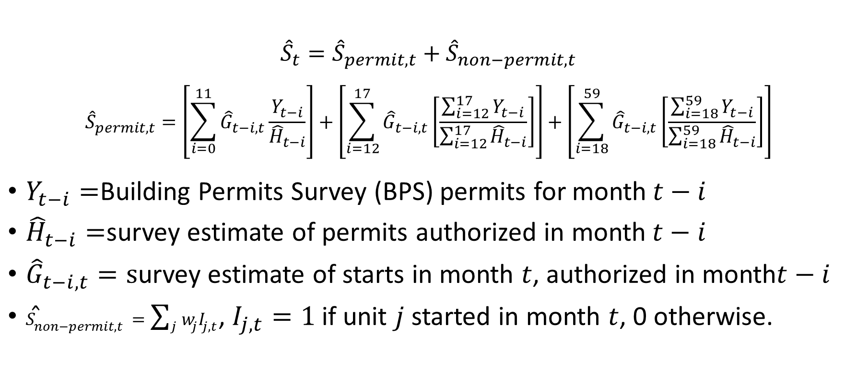
Estimation – current state
$${\hat{S}}_{t}={\hat{S}}_{permit,t}+{\hat{S}}_{non−permit,t}$$
$${\hat{S}}_{permit,t}=\left[\sum_{i=0}^{11}{{\hat{G}}_{t−i,t}\frac{Y_{t−i}}{{\hat{H}}_{t−i}}}\right]+\left[\sum_{i=12}^{17}{{\hat{G}}_{t−i,t}\left[\frac{\sum_{i=12}^{17}{Y_{t−i}}}{\sum_{i=12}^{17}{{\hat{H}}_{t−i}}}\right]}\right]+\left[\sum_{i=18}^{59}{{\hat{G}}_{t−i,t}\left[\frac{\sum_{i=18}^{59}{Y_{t−i}}}{\sum_{i=18}^{59}{{\hat{H}}_{t−i}}}\right]}\right]$$
$Y_{t−i}=$Building Permits Survey (BPS) permits for month$t−i$
${\hat{H}}_{t−i}=$survey estimate of permits authorized in month$t−i$
${\hat{G}}_{t−i,t}=s$urvey estimate of starts in month $t$, authorized in month$t−i$
${\hat{S}}_{non−permit,t}=\sum_{j}{w_{j}I_{j,t}}$, $I_{j,t}=1$ if unit $j$ started in month $t$, 0 otherwise.
https://www.census.gov/construction/soc/methodology.html

Slide 23
Current State: Sample of permits from a place
 | Authorization Month
Start Month | Jan | Feb | Mar | Apr | May | Jun | July
Feb | Starts: 50 Auths: 100 | Starts: 50 Auths: 150
Mar | Starts: 50 Auths: 100 |  | Starts: 100 Auths: 200
Apr |  | Starts: 50 Auths: 150
May |  |  | Starts: 100 Auths: 200 | Starts: 50 Auths: 50 | Starts: 50 Auths: 200
Jun |  |  |  |  | Starts: 100 Auths: 200 | Starts:100 Auths: 250
Jul |  | Starts:50 Auths: 150 |  |  |  | Starts: 150 Auths: 200
Aug |  |  |  |  | Starts:50 Auths: 200 |  | Starts: 50 Auths: 250

Slide 24
Satellite estimate of starts from a place
 | Authorization Month
Start Month | Jan | Feb | Mar | Apr | May | Jun | July | All Auth Months
Feb |  |  |  |  |  |  |  | 90
Mar |  |  |  |  |  |  |  | 160
Apr |  |  |  |  |  |  |  | 110
May |  |  |  |  |  |  |  | 250
Jun |  |  |  |  |  |  |  | 200
Jul |  |  |  |  |  |  |  | 190
Aug |  |  |  |  |  |  |  | 220

Slide 25
Survey based estimate
Satellite estimate
Total estimate

Slide 26
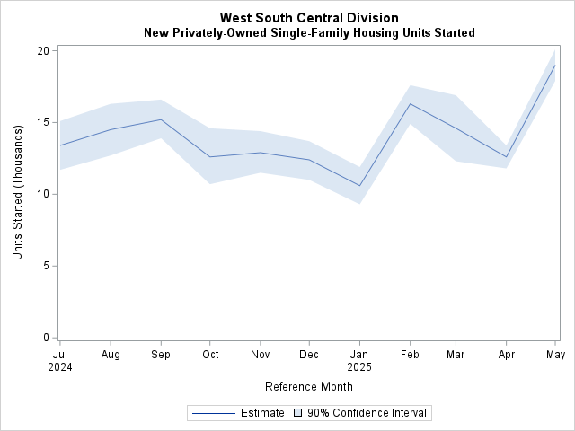
Published Estimates
Survey Month | Experimental Data Product Release 11:00 am
July- November 2024 | December 19, 2024
December 2024 | January 21, 2025
January 2025 | February 20, 2025
February 2025 | March 19, 2025
March 2025 | April 18, 2025
April 2025 | May 19, 2025
May 2025 | June 20, 2025
June 2025 | July 21, 2025
July 2025 | August 20, 2025
August 2025 | September 18, 2025
https://www.census.gov/construction/nrc/data/satellitestarts.html

Slide 27
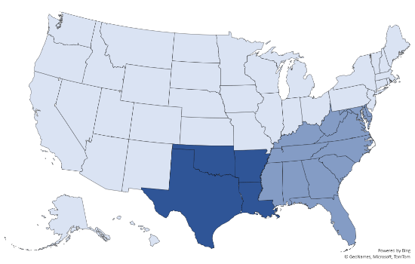

Research & Development
Geographic Expansion
Currently tasking additional AOIs to construct an estimate for South region.
Improved Single-Family Attached
Develop techniques to better quantify single family attached vs detached starts.

Slide 28
Questions?
Contact us at:
Nicole.Czaplicki@census.gov
eid.nrc.satellite@census.gov

