Slide 1
The Effect of Hearing Aid Coverage Mandates on Cognitive Decline
NBER, October 30, 2025

Slide 2
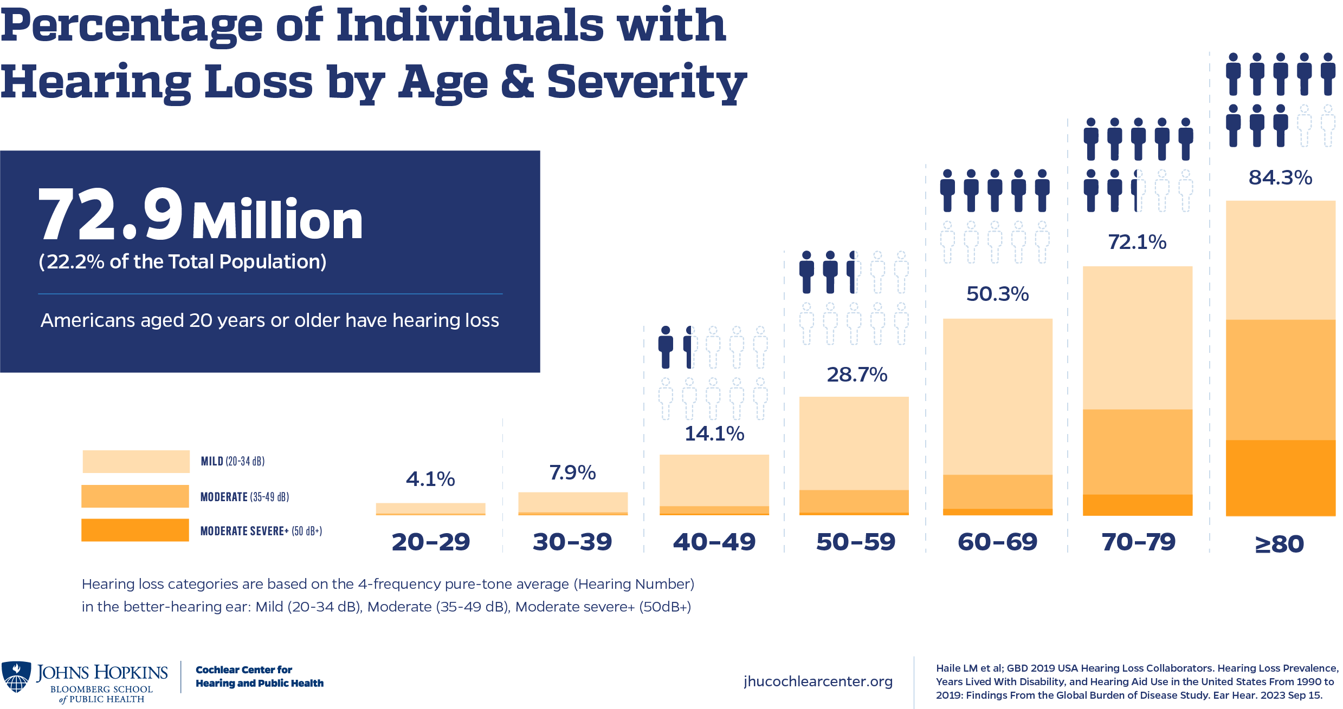
A large number of individuals live with hearing loss
Notes:
https://imasummit.com/hearing-loss-and-hearing-test/

Slide 3
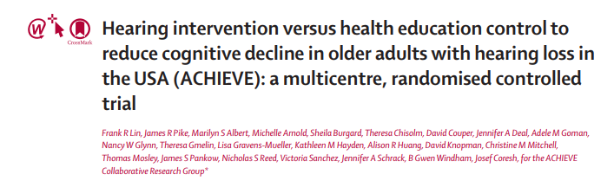
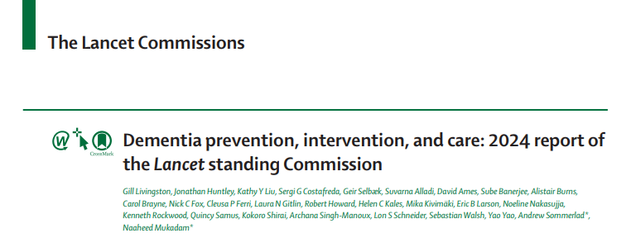
Hearing aid use reduce dementia onset
Notes:
(2) why is this question important?
Among participants who were older and had more risk factors for cognitive decline, the hearing intervention reduced cognitive change by 48% over 3 year
https://publichealth.jhu.edu/2023/hearing-aids-may-slow-dementia-onset

Slide 4
This project
First study to look at whether Medicaid insurance coverage policy covering hearing aids might improve cognitive health
Cognitive test on orientation, memory, and executive function
  Categorized into groups of having probable dementia (cognitive impairment), possible dementia, and no dementia.
Exploring mechanisms of lifestyle changes
Notes:
(1) what question are you trying to answer?
treatments for hearing loss - like hearing aids are not generally covered in Medicaid or Medicare

Slide 5
Difference in Differences Approach
Difference-in-differences model:
Y_{ist} = α₀ + α₁covrequire_{st} + α₃State_{s} + α₄time_{t} + α₅X_{i} + ε_{ist}
Y_{ist} is an outcome of interest for sample person (or caregiver) i living in state s at year-by-month t.
Covrequire_{st} is a state s Medicaid hearing aid coverage requirement at time t.
  Maryland 2018, Michigan 2018, and Washington 2019
Notes:
(3) how will you go about answering it?

Slide 6

Data
2011-2023 sample of Medicare beneficiaries 65 and older
  With annual interviews of the respondents
The NHATS includes several questions pertinent to hearing, cognitive impairment, and activities
Hearing aid Medicaid state policy data
Medicaid hearing aid coverage mandates Includes dates of adoption, eligibility criteria for the covered population, and covered services

Slide 7
Current perspective on project
Are cognition outcomes sufficient?
Can secondary outcomes be plausible mechanisms?
Sample size concerns to detect effect (limited to dual eligible sample)?
Other NHATS components that can support the work?

Slide 8
Cognitive Outcomes
Memory
Now I will read a set of 10 words and ask you to recall as many as you can
Orientation
Without looking at a calendar or watch, please tell me today's date
Name the President and Vice president
Executive function
Please draw a clock on the piece of paper
Dementia classification: A cut-point of < 1.5 SDs below the mean in 1 domain was used for cognitive impairment indicating possible dementia. Probable dementia if in two domains or all
Other Self-Rated Memory
Compared to 1 year ago, how would you rate your memory?

Slide 9
Potential Mechanism Hearing
Hearing
Can hear well over the phone
Can converse in a room with noise from TV/radio easily
Can converse in a quiet room
Hearing aid use
Paid for hearing aid in the last 12 months
In the last month, have you used a hearing aid or other hearing device?

Slide 10
Potential Mechanism Activity
Activity
Do you ever visit friends or family
Do you ever attend religious services
Do you ever attend clubs/classes/group activities?
Do you ever go out for enjoyment?
Do you ever do volunteer work?
How big is your social network?
Mobility
In the last month, when you left your home to go outside, how often did you do this by yourself?

Slide 11
Potential Mechanism Self-Care
Self-care
In the last month when you ate, how often did you do this by yourself?
Household Activities
In the last month, did you ever do your laundry by yourself?
In the last month, did you ever do your shopping by yourself?
In the last month, did you ever make hot meals by yourself?
In the last month, did you ever handle your bills and banking by yourself?

Slide 12
Preliminary Sample Size (Public Use File) 2011-2023
Notes:
2011-2023

Slide 13
NHATS Caregivers data
Quantifying the type of care
Household chores, personal care, mobility, physical assistance, and transportation assistance
Amount of time caregivers provide
From the duration of care questions
Caregivers experience of care provided
Intensity level of providing care
Caregivers non-care taking activity
If caregivers' life is meaningfully impacted, such as visiting family and employment
Time spend traveling and whether caregiver lives with sample person

Slide 14
Current perspective on project
Are cognition outcomes sufficient?
Can secondary outcomes be plausible mechanisms?
Sample size concerns to detect effect (limited to dual eligible sample)?
Other NHATS components that can support the work?

Slide 15
Next Steps
Gain access to data (expected by November)
Perform main analysis (dementia outcome)
Perform mechanism analysis
Explore caregiver data

Slide 16
Appendix

Slide 17
Methods
Difference in Differences approach
Regressions account for demographic controls including gender, race, marital status, and education.
We also account for state-level variables, including ACA Medicaid expansion, state Medicaid Managed Care penetration rate, state Medicare Advantage penetration rate, and state-level unemployment rate

Slide 18
Mechanism Outcomes

