Slide 1
Access to High-Quality SNF Care for Medicare Advantage Enrollees with Dementia
Presenter: Mingyu Qi
Collaborators: R. Tamara Konetzka, PhD (PI); Betsy Q. Cliff, PhD, Nadia Ghazali
The University of Chicago

Slide 2

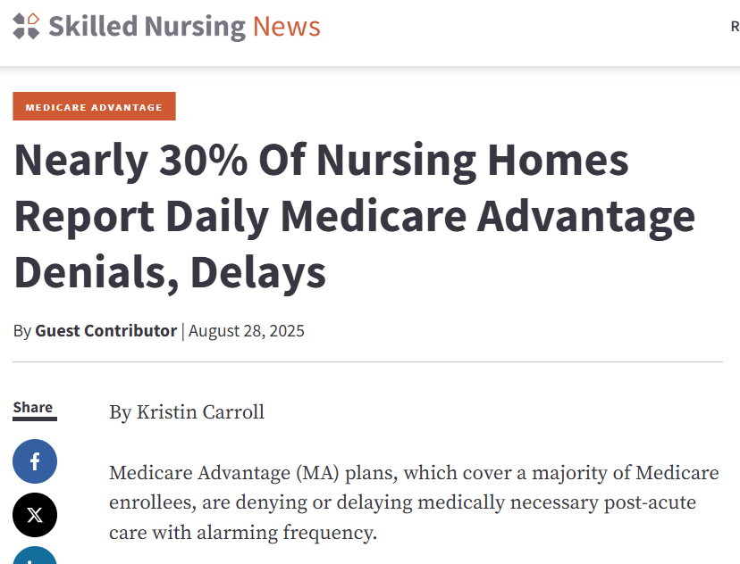
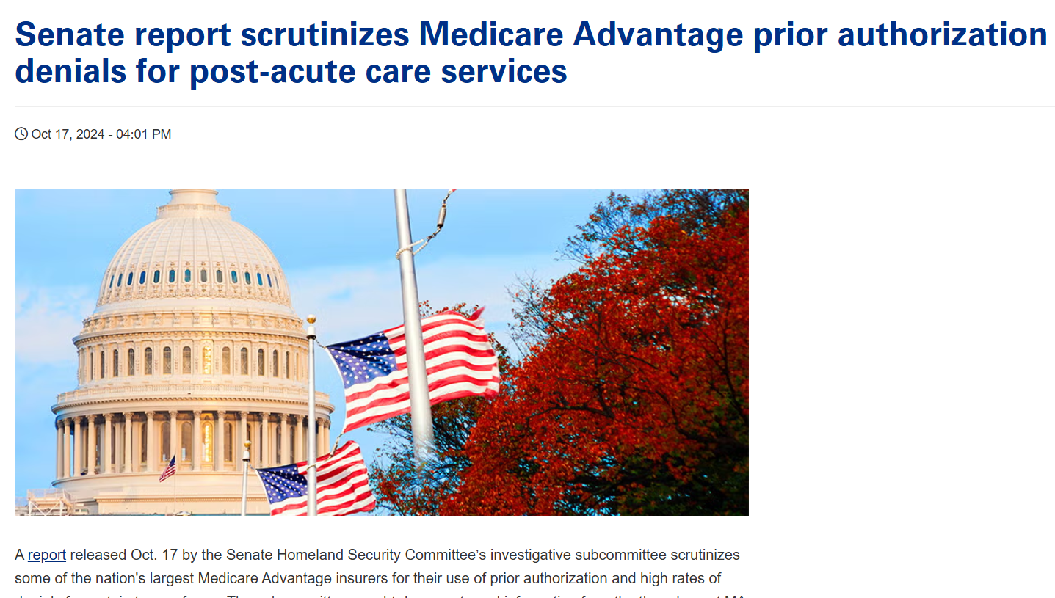
Notes:
The motivation for our study starts with the anecdotal evidence that has attracted increased attention in recent years: Like in many alternative payment models, Medicare Advantage plans appear to be cutting costs by denying coverage of post-acute care services for enrollees, especially SNF care. If SNF care is approved, a second concern arises in that MA plans may send patients to lower-quality SNFs.
MA plans receive capitated per-enrollee payments from Medicare; therefore, they have a financial incentive to restrict PAC use, particularly the use of institutional PAC (e.g., SNF).

Slide 3
Motivation
Post-acute care is a focal point for concerns about access to high-quality care under Medicare Advantage (MA), especially in Skilled Nursing Facilities (SNFs).
May be especially salient for beneficiaries with ADRD (who use post-acute care at twice the rate of those without ADRD).
Limited/mixed evidence overall on utilization and quality.
Notes:
Restricted access to high-quality SNFs might be particularly problematic for beneficiaries with ADRD due to a higher level of need and complexity as well as diminished ability to advocate for themselves and navigate appeals processes.

Slide 4
Existing Evidence
Access to care:
Park et al. (2020) find that utilization of many services is lower for Medicare beneficiaries with ADRD enrolled in MA than in TM.
Quality of care:
Meyers et al. (2018) examine the SNFs used by MA enrollees during 2012-2014, finding them to be of lower quality than those used by Traditional Medicare (TM) enrollees, even in highly rated MA plans.
MA enrollment among beneficiaries with ADRD:
Medicare beneficiaries with ADRD have increasingly enrolled in MA, in proportion to beneficiaries without ADRD (James et al., 2023).
Notes:
Park et al. (2020)
- This study does not look specifically at PAC or at SNF quality.
Meyers et al. (2018)
- In the analysis, the authors control for patients’ clinical, demographic, and residential neighborhood effects (zip-code fixed effects).
- A choice model is used to assess whether the relationship between SNF characteristics and enrollees’ choice of facilities varies across the three enrollee categories (FFS, high-quality MA, and lower-quality MA).
- This study does not differentiate SNFs used for post-acute care from those used for long-term care and does not specifically examine beneficiaries with ADRD.

Slide 5
Research Questions
Among Medicare beneficiaries with ADRD who are discharged from an acute-care hospital, how does MA enrollment affect SNF utilization relative to other options (other or no post-acute care)?
Among Medicare beneficiaries with ADRD who are discharged from an acute-care hospital to a SNF, how does MA enrollment affect the quality of SNF the beneficiary is admitted to?
Notes:
In this study, we aim to examine both the extensive and intensive margins of how MA enrollment affects SNF utilization among Medicare beneficiaries with ADRD.

Slide 6
Contributions
Newer data reflecting higher MA penetration over time, 2016-2022
(In process of adding more years!)
Attention to extensive margin effects as well as intensive margin
Marginal patient using SNF may be different over time in sickness or demographics
Attention to market characteristics and choice set
If high-MA areas only have low-quality SNFs, connection between MA enrollment and SNF quality may be spurious
The level of MA plan competition and SNF competition may influence SNF quality
Focus on enrollees with ADRD
Notes:
Prior study of SNF quality under MA used 2013 data, before the dominance of MA emerged.
Attention to extensive margin may be important in order to avoid selection biases in who uses SNF over time.

Slide 7
Exploratory Market-level Analysis
Goal: Explore the landscape of the association between MA penetration and SNF quality at the Hospital Service Area (HSA) level
Data: Nursing Home Compare and Medicare Master Beneficiary Summary File (MBSF), 2016-2019
Methods:
Unadjusted descriptive analysis
Multivariable regressions with HSA and year fixed effects
Notes:
To examine the relationship between the choice set of SNFs and MA enrollment, we first conduct a market-level analysis, defining the SNF market at the HSA level.
Note that we are not examining which SNFs the MA plans contract with, rather the SNFs available in the plan’s market.

Slide 8
MA Penetration
Proportion of all Medicare beneficiaries in an HSA enrolled in MA
Calculated each year from MBSF

Slide 9
HSA-level SNF Quality Measures
All drawn from CMS Nursing Home Care Compare
5-star ratings, where 1=lowest and 5=highest quality
Three quality measure ratings: short-stay, long-stay, and overall
Short-stay: length of stay <= 100 days or covered under Medicare SNF benefit
Long-stay: length of stay > 100 days
Overall rating combines the short-stay and long-stay quality ratings
Notes:
The Nursing Home Care Compare gives each nursing home a rating of between 1 and 5 stars
Short-stay residents often are those recovering from surgery or being discharged from a hospital stay. Example of quality measures: % who were re-hospitalized, % successful return to home
Long-stay residents are usually not healthy enough to leave a nursing home and can't live at home or in a community setting. Example of quality measures: % experiencing one or more falls with major injury, # of hospitalizations per 1,000 long-stay resident days
The overall rating is calculated based on the overall quality score, which sums the total long-stay score and the total adjusted short-stay score

Slide 10
HSA-level SNF Quality Measures
Overall SNF quality in the HSA
Median number of overall stars
Total number of star levels available (range)
Probability that only low-quality SNFs available (1-2 stars)
Short-stay SNF quality in the HSA
Median number of overall stars
Total number of star levels available (range)
Probability that only low-quality SNFs available (1-2 stars)

Slide 11
Unadjusted Statistics 1
On average, the SNF short-stay quality rating increases as MA penetration rises.

Slide 12
Unadjusted Statistics 2
Both the ranges of overall and short-stay quality ratings appear to widen as MA penetration rises.

Slide 13
Unadjusted Statistics 3
On average, HSAs with higher MA penetration are less likely to have exclusively low-quality SNFs.

Slide 14
Unadjusted Statistics 4
On average, both MA plan competition and SNF competition increase with higher MA penetration.
Notes:
Of course, the descriptive analysis results may be affected by potential confounding factors. For instance, we find that the number of beneficiaries in an HSA also increases with the HSA-level MA penetration, i.e. markets with higher MA penetration are larger. We therefore conduct regression analyses to examine the association between MA penetration and SNF quality, conditional on observed confounders.

Slide 15
HSA and Year Fixed Effect Regression
 | Overall Quality Rating |  | Short-stay Quality Rating
 | Median Overall Stars | Number of Star Levels | Median Overall Stars | Number of Star Levels
MA Penetration | 0.0832 | -0.0370 | -1.807*** | 0.501
 | (0.393) | (0.262) | (0.459) | (0.290)
MA plan HHI | -0.0888 | 0.178 | -0.365* | 0.247*
 | (0.156) | (0.104) | (0.182) | (0.115)
Bene Count | -0.00351 | 0.00394 | 0.00402 | -0.00946*
 | (0.00579) | (0.00386) | (0.00677) | (0.00428)
SNF HHI | 0.215 | -1.718*** | 0.0545 | -1.472***
 | (0.249) | (0.166) | (0.291) | (0.184)
Proportion of FFS Bene with ADRD | -0.720 | 1.021 | -3.902** | 0.153
 | (1.130) | (0.754) | (1.321) | (0.836)
Note: (1) Standard errors in parentheses. (2) * p<0.05, ** p<0.01, *** p<0.001.
Notes:
In all regressions, we control for proportion of HSA population below poverty line and weighted median household income.

Slide 16
HSA and Year Fixed Effect Regression
 | Overall Quality Rating |  | Short-stay Quality Rating
 | Median Overall Stars | Number of Star Levels | Median Overall Stars | Number of Star Levels
MA Penetration | 0.0832 | -0.0370 | -1.807*** | 0.501
 | (0.393) | (0.262) | (0.459) | (0.290)
MA plan HHI | -0.0888 | 0.178 | -0.365* | 0.247*
 | (0.156) | (0.104) | (0.182) | (0.115)
Bene Count | -0.00351 | 0.00394 | 0.00402 | -0.00946*
 | (0.00579) | (0.00386) | (0.00677) | (0.00428)
SNF HHI | 0.215 | -1.718*** | 0.0545 | -1.472***
 | (0.249) | (0.166) | (0.291) | (0.184)
Proportion of FFS Bene with ADRD | -0.720 | 1.021 | -3.902** | 0.153
 | (1.130) | (0.754) | (1.321) | (0.836)
Note: (1) Standard errors in parentheses. (2) * p<0.05, ** p<0.01, *** p<0.001.
Notes:
MA penetration is negatively associated with the SNF short-stay quality rating.

Slide 17
HSA and Year Fixed Effect Regression
 | Overall Quality Rating |  | Short-stay Quality Rating
 | Median Overall Stars | Number of Star Levels | Median Overall Stars | Number of Star Levels
MA Penetration | 0.0832 | -0.0370 | -1.807*** | 0.501
 | (0.393) | (0.262) | (0.459) | (0.290)
MA plan HHI | -0.0888 | 0.178 | -0.365* | 0.247*
 | (0.156) | (0.104) | (0.182) | (0.115)
Bene Count | -0.00351 | 0.00394 | 0.00402 | -0.00946*
 | (0.00579) | (0.00386) | (0.00677) | (0.00428)
SNF HHI | 0.215 | -1.718*** | 0.0545 | -1.472***
 | (0.249) | (0.166) | (0.291) | (0.184)
Proportion of FFS Bene with ADRD | -0.720 | 1.021 | -3.902** | 0.153
 | (1.130) | (0.754) | (1.321) | (0.836)
Note: (1) Standard errors in parentheses. (2) * p<0.05, ** p<0.01, *** p<0.001.
Notes:
When MA market becomes more competitive, the SNF short-stay quality rating increases and the range of ratings decreases.

Slide 18
HSA and Year Fixed Effect Regression
 | Overall Quality Rating |  | Short-stay Quality Rating
 | Median Overall Stars | Number of Star Levels | Median Overall Stars | Number of Star Levels
MA Penetration | 0.0832 | -0.0370 | -1.807*** | 0.501
 | (0.393) | (0.262) | (0.459) | (0.290)
MA plan HHI | -0.0888 | 0.178 | -0.365* | 0.247*
 | (0.156) | (0.104) | (0.182) | (0.115)
Bene Count | -0.00351 | 0.00394 | 0.00402 | -0.00946*
 | (0.00579) | (0.00386) | (0.00677) | (0.00428)
SNF HHI | 0.215 | -1.718*** | 0.0545 | -1.472***
 | (0.249) | (0.166) | (0.291) | (0.184)
Proportion of FFS Bene with ADRD | -0.720 | 1.021 | -3.902** | 0.153
 | (1.130) | (0.754) | (1.321) | (0.836)
Note: (1) Standard errors in parentheses. (2) * p<0.05, ** p<0.01, *** p<0.001.
Notes:
When SNF market becomes more competitive, the range of SNF quality ratings increases.

Slide 19
HSA and Year Fixed Effect Regression
 | Overall Quality Rating |  | Short-stay Quality Rating
 | Median Overall Stars | Number of Star Levels | Median Overall Stars | Number of Star Levels
MA Penetration | 0.0832 | -0.0370 | -1.807*** | 0.501
 | (0.393) | (0.262) | (0.459) | (0.290)
MA plan HHI | -0.0888 | 0.178 | -0.365* | 0.247*
 | (0.156) | (0.104) | (0.182) | (0.115)
Bene Count | -0.00351 | 0.00394 | 0.00402 | -0.00946*
 | (0.00579) | (0.00386) | (0.00677) | (0.00428)
SNF HHI | 0.215 | -1.718*** | 0.0545 | -1.472***
 | (0.249) | (0.166) | (0.291) | (0.184)
Proportion of FFS Bene with ADRD | -0.720 | 1.021 | -3.902** | 0.153
 | (1.130) | (0.754) | (1.321) | (0.836)
Note: (1) Standard errors in parentheses. (2) * p<0.05, ** p<0.01, *** p<0.001.
Notes:
The SNF short-stay quality rating is lower in markets with a higher proportion of beneficiaries with ADRD.

Slide 20
HSA and Year Fixed Effect Weighted Regression
 | Overall Quality Rating |  | Short-stay Quality Rating
 | Median Overall Stars | Number of Star Levels | Median Overall Stars | Number of Star Levels
MA Penetration | -0.330 | -0.876 | -1.499* | 0.728
 | (0.642) | (0.506) | (0.667) | (0.578)
MA plan HHI | -0.0288 | 0.351 | -0.337 | 0.669*
 | (0.290) | (0.253) | (0.313) | (0.276)
Bene Count | -0.00216 | 0.00179 | 0.00198 | -0.00792
 | (0.00353) | (0.00152) | (0.00556) | (0.00576)
SNF HHI | -0.0672 | -1.963*** | -0.773 | -1.767***
 | (0.448) | (0.212) | (0.410) | (0.241)
Proportion of FFS Bene with ADRD | -1.920 | 1.533 | -1.118 | -0.0467
 | (2.304) | (1.615) | (2.679) | (1.960)
Note: (1) Standard errors in parentheses. (2) * p<0.05, ** p<0.01, *** p<0.001.
Notes:
Because the regression analysis is conducted at the HSA level, the results may be influenced disproportionately by larger HSAs with more beneficiaries and skilled nursing facilities. To address this concern, we estimate an additional set of regressions weighted by the number of beneficiaries in each HSA-year. This specification gives more weight to HSAs with more beneficiaries, shifting the interpretation toward individual-level effects.
Findings from the weighted regressions are generally consistent with those from the unweighted regressions, except for the proportion of FFS beneficiaries with ADRD.

Slide 21
Main Findings
MA penetration is associated with the choice set of SNFs in the market.
When MA market becomes more competitive, the SNF short-stay quality rating increases and the range of ratings decreases.
When SNF market becomes more competitive, the range of SNF quality ratings increases, and the likelihood of having only low-quality SNFs decreases.
The SNF short-stay quality rating is lower in markets with a higher proportion of beneficiaries with ADRD. Although this correlation is not statistically significant in the regressions weighted by HSA size.
Notes:
These results suggest that MA beneficiaries are more likely to face a choice set of SNFs with lower short-stay quality, even before they consider the network of SNFs included in their MA plan. Moreover, both MA competition and SNF competition appear to influence SNF short-stay quality in the market.
Beneficiaries with ADRD are more likely to face a set of SNFs with lower short-stay quality.
These results highlight the importance of controlling for market-level MA penetration, as well as for competition among MA plans and SNFs in the patient-level analysis.

Slide 22
Next Step: Patient-level Analysis
Data: Medicare claims and assessment data, 2016-2022
Broad sample and “switcher” sample
Econometrics:
Main treatment is MA, with interactions/stratification by ADRD
Patient-level discrete choice models + matching + mortality adjustment
Berry (1994) discrete choice models of product differentiation
Particular attention to selection and to market characteristics
Notes:
Broad sample: Medicare beneficiaries nationally age 65 or older who are discharged from a short-term, acute-care hospital and have a diagnosis of ADRD.
Switcher sample: those with TM in at least one year of our data who subsequently enrolled in MA, matched to similar beneficiaries who did not switch:
Allow defining ADRD in a uniform way.
A more uniform set of comorbidity measures.
Allow direct estimation of unmeasured selection by MA.
We use Berry (1994) to estimate the consumer utility of choosing a SNF of a particular level of quality while accounting for the presence of an “outside option” of foregoing PAC or being admitted to a different type of PAC

Slide 23
Q & A

