Slide 1
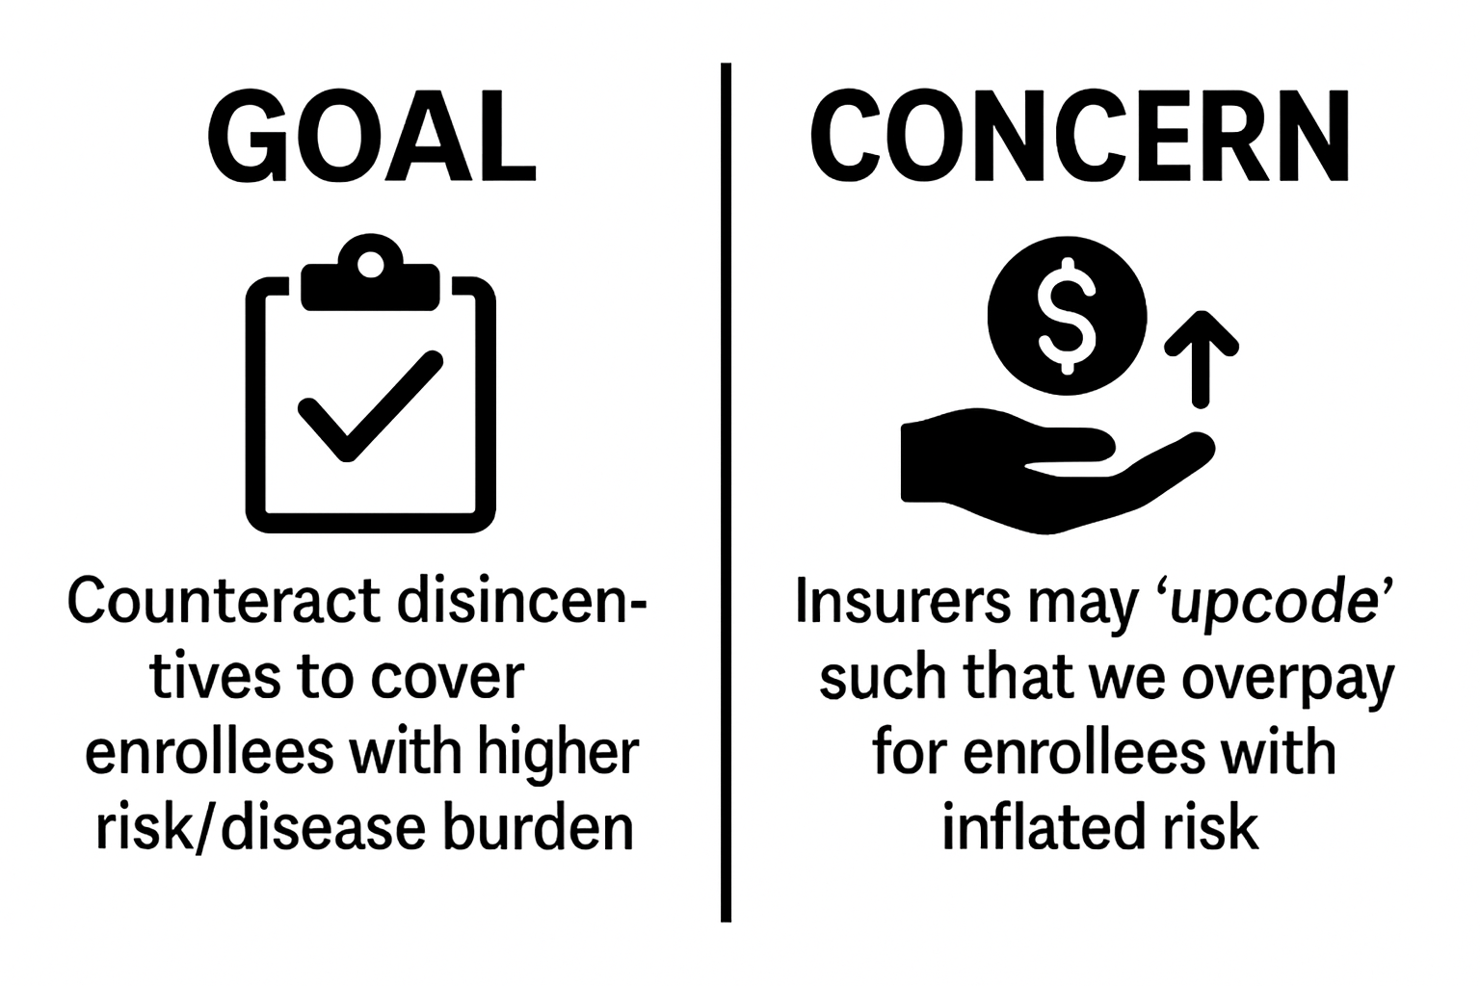
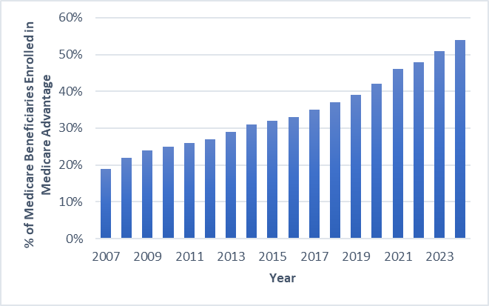
The Impact of Increasing Payments to Insurers for Covering Individuals with AD/ADRD on Enrollment, Access, and Use in Medicare Advantage Mark K. Meiselbach
Over half of Medicare beneficiaries are enrolled in Medicare Advantage (MA) and a growing share of beneficiaries with AD/ADRD
Insurers are paid in capitated risk-adjusted payments to manage enrollee’s coverage
Risk-adjustment is intended to compensate insurers fairly for the enrollees they cover
Research is often focused on upcoding concerns, but rarely seeks to understand whether risk-adjustment achieves its intended goal

Slide 2
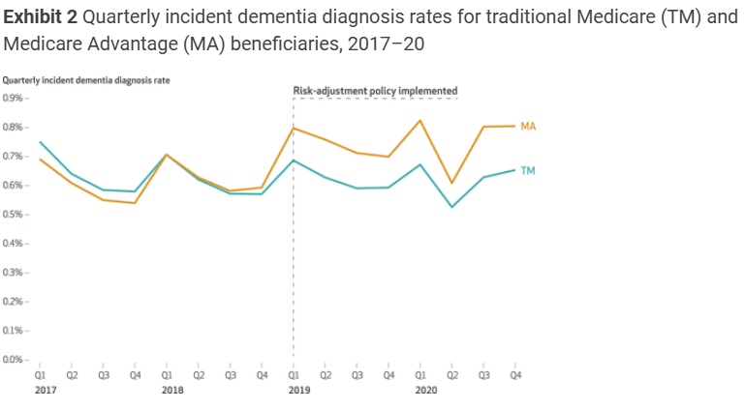
The Impact of Increasing Payments to Insurers for Covering Individuals with AD/ADRD on Enrollment, Access, and Use in Medicare Advantage Mark K. Meiselbach
In 2020, AD/ADRD was added to MA’s risk-adjustment formula
Prior work shows that the change had the expected effect on upcoding
But did the change result in any plan-driven improvements for enrollees with AD/ADRD?
This will tell us: can risk-adjustment incentives improve access to providers and care for enrollees with AD/ADRD in MA?
Aim 1: Investigate the impact of expanded plan payments for AD/ADRD on enrollment in MA among individuals with existing AD/ADRD.
Plan attractiveness.
Aim 2: Investigate the impact of expanded plan payments for AD/ADRD on provider network inclusion of AD/ADRD specialists.
Plan provider network design.
Aim 3: Investigate the impact of expanded plan payments for AD/ADRD on utilization of AD/ADRD services.
Access to services.
Source: Haye S, Jacobson M, Joyce G, Zissimopolous JM. After Risk-Adjustment Change, Dementia Diagnoses Increased In Medicare Advantage Relative To Traditional Medicare. Health Affairs. January 2025.

Slide 3
The Impact of Increasing Payments to Insurers for Covering Individuals with AD/ADRD on Enrollment, Access, and Use in Medicare Advantage Mark K. Meiselbach
Using 2016-2023 Medicare enrollment and claims data and three distinct difference-in-differences approaches, this project:
Aim 1: Investigate the impact of expanded plan payments for AD/ADRD on enrollment in MA among individuals with existing AD/ADRD.
Empirical strategy: compare enrollment in MA among individuals who already had an AD/ADRD diagnosis prior to the policy change to individuals who did not have an AD/ADRD diagnosis before and after the 2020 risk-adjustment change.
Aim 2: Investigate the impact of expanded plan payments for AD/ADRD on provider network inclusion of AD/ADRD specialists.
Empirical strategy: compare the MA network inclusion rate of AD/ADRD specialists to the inclusion rate of non-AD/ADRD specialists before and after 2020.
Aim 3: Investigate the impact of expanded plan payments for AD/ADRD on utilization of AD/ADRD services.
Empirical strategy: compare the number AD/ADRD office, outpatient, and home health visits among individuals with previously diagnosed AD/ADRD in MA vs. traditional Medicare before and after 2020.

Slide 4
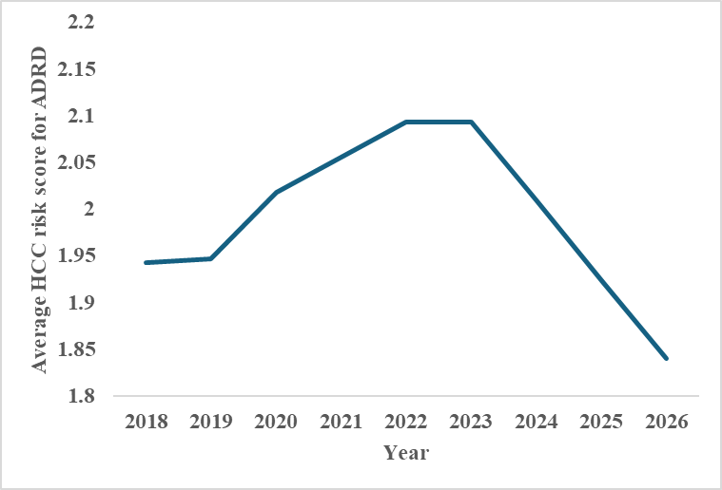
The Impact of Increasing Payments to Insurers for Covering Individuals with AD/ADRD on Enrollment, Access, and Use in Medicare Advantage Mark K. Meiselbach
First, important to understand the first stage impact on risk scores and profitability
MA risk scores updated over time across blends of HCC risk-adjustment version
How did the v24 update to reintroduce dementia diagnoses to risk-adjustment impact the average risk score and profitability?
Using fixed 2018 population of beneficiaries with traditional Medicare, estimated risk scores across versions for people with AD/ADRD
Version | 2018 | 2019 | 2020 | 2021 | 2022-23 | 2024 | 2025 | 2026
V22 | 100% | 75% | 50% | 25% | 0% | 0% | 0% | 0%
V23 | 0% | 25% | 0% | 0% | 0% | 0% | 0% | 0%
V24 | 0% | 0% | 50% | 75% | 100% | 67% | 33% | 0%
V28 | 0% | 0% | 0% | 0% | 0% | 33% | 67% | 100%
Notes:
Risk scores for other beneficiaries until 2024

Slide 5
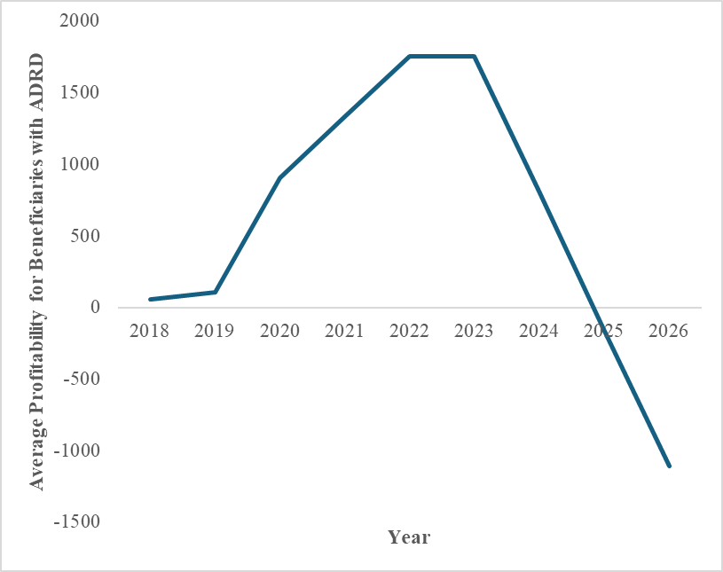
The Impact of Increasing Payments to Insurers for Covering Individuals with AD/ADRD on Enrollment, Access, and Use in Medicare Advantage Mark K. Meiselbach
Then, estimate “profitability” comparing observed costs in 2019 to county benchmarks with 5% quality bonus
Increases in risk scores incorporating HCC v24 led to large increase in potential profitability of beneficiaries with ADRD
HCC v28 reverses this changes, leading to lower potential profitability even compared to pre-v24

Slide 6
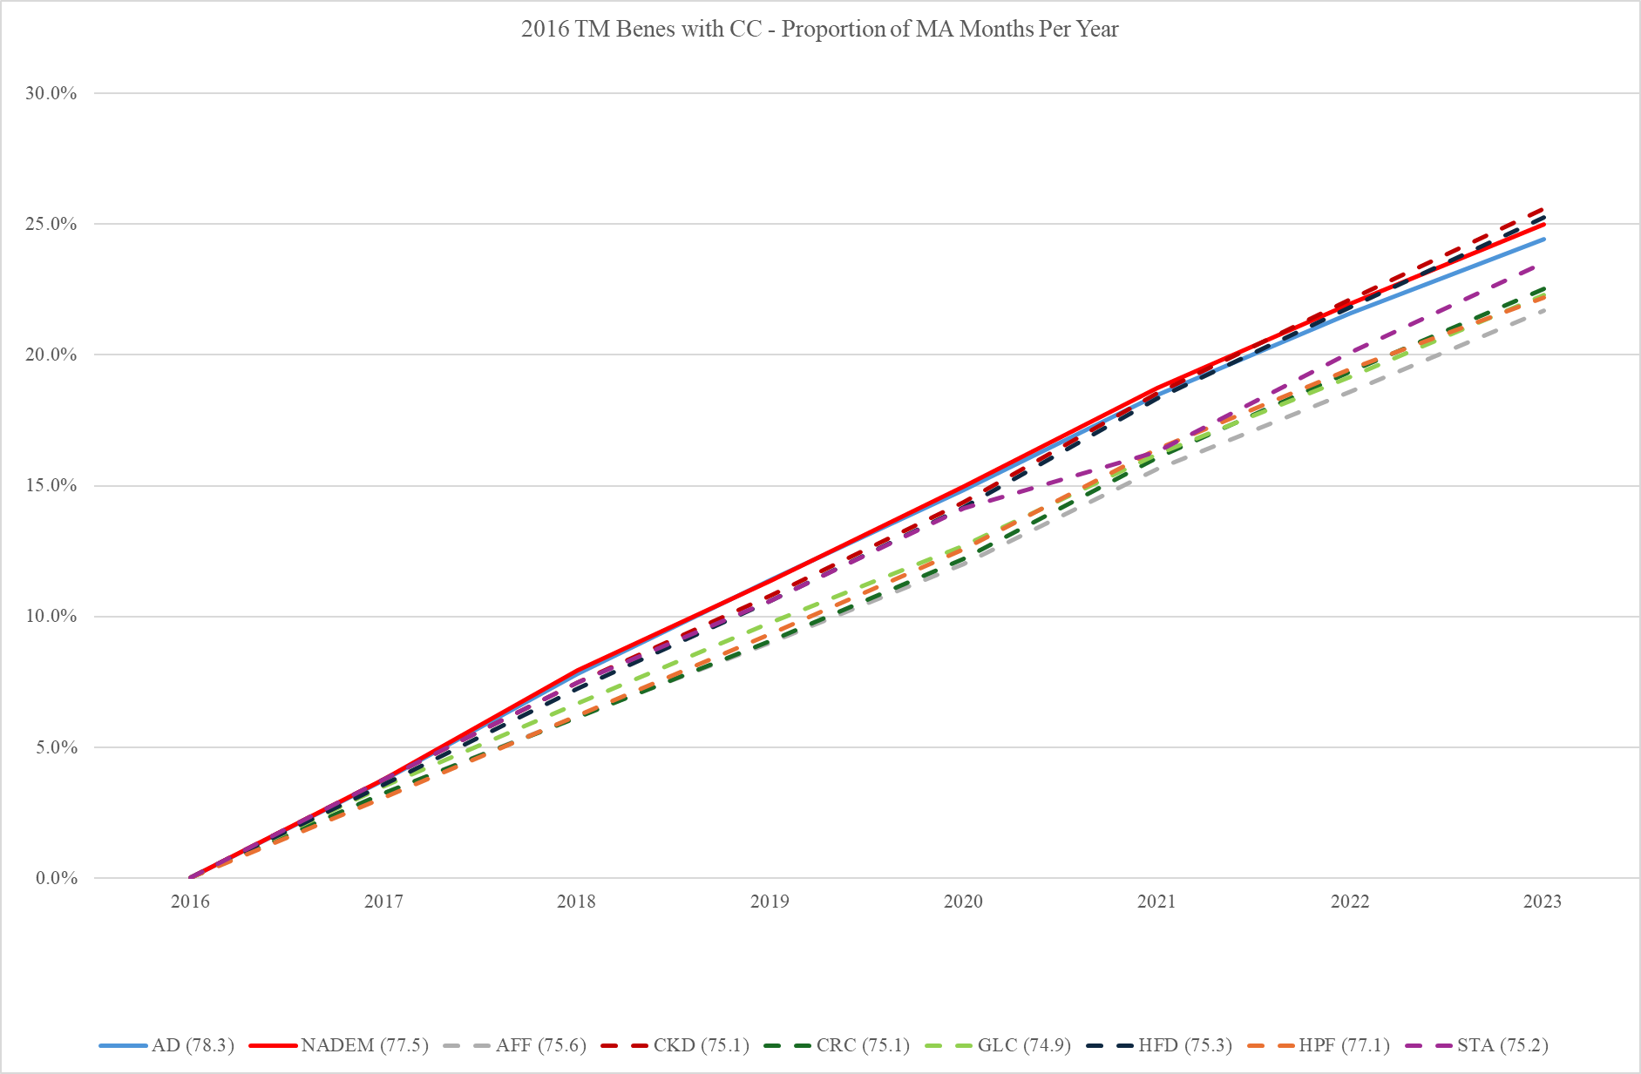
The Impact of Increasing Payments to Insurers for Covering Individuals with AD/ADRD on Enrollment, Access, and Use in Medicare Advantage Mark K. Meiselbach
Aim 1: Investigate the impact of expanded plan payments for AD/ADRD on enrollment in MA among individuals with existing AD/ADRD
Identified 30 cohorts of people with a specific CCW chronic condition in 2016 and tracked enrollment in MA from 2016 – 2023
But, beneficiaries with AD/ADRD are older, on average, even compared with other chronic condition groups
No evidence of increased enrollment post-2020
Notes:
GLC= glaucoma, HFD = heart failure, HPF = hip fracture, STA = stroke
Regression analysis controlling for differences in baseline age, limiting to those alive through entire period, etc.
Take suggestions for 1) different control groups, 2) disenrollment effects

Slide 7
The Impact of Increasing Payments to Insurers for Covering Individuals with AD/ADRD on Enrollment, Access, and Use in Medicare Advantage Mark K. Meiselbach
Aim 2: Investigate the impact of expanded plan payments for AD/ADRD on provider network inclusion of AD/ADRD specialists
Defining an “AD/ADRD” specialist:
Starting with all providers with at least 20 traditional Medicare patients in 2016 (N=563,728 NPIs)
Examine distribution of the percentage of their patients that have an AD/ADRD diagnosis
Identify providers ≥75th percentile as specialists and ≤25th percentile as non-specialists (from NPPES)
Compare distribution of provider specialties to give intuition around empirical definition
Then, track network inclusion over time
Notes:
~140k each

Slide 8
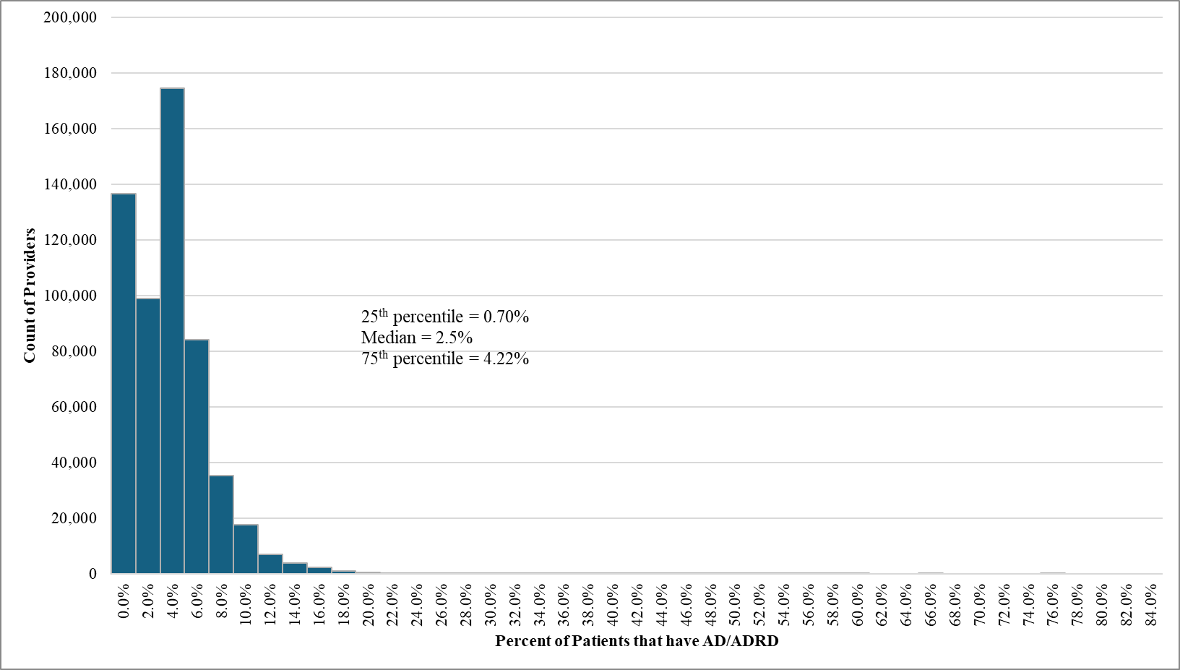
The Impact of Increasing Payments to Insurers for Covering Individuals with AD/ADRD on Enrollment, Access, and Use in Medicare Advantage Mark K. Meiselbach

Slide 9
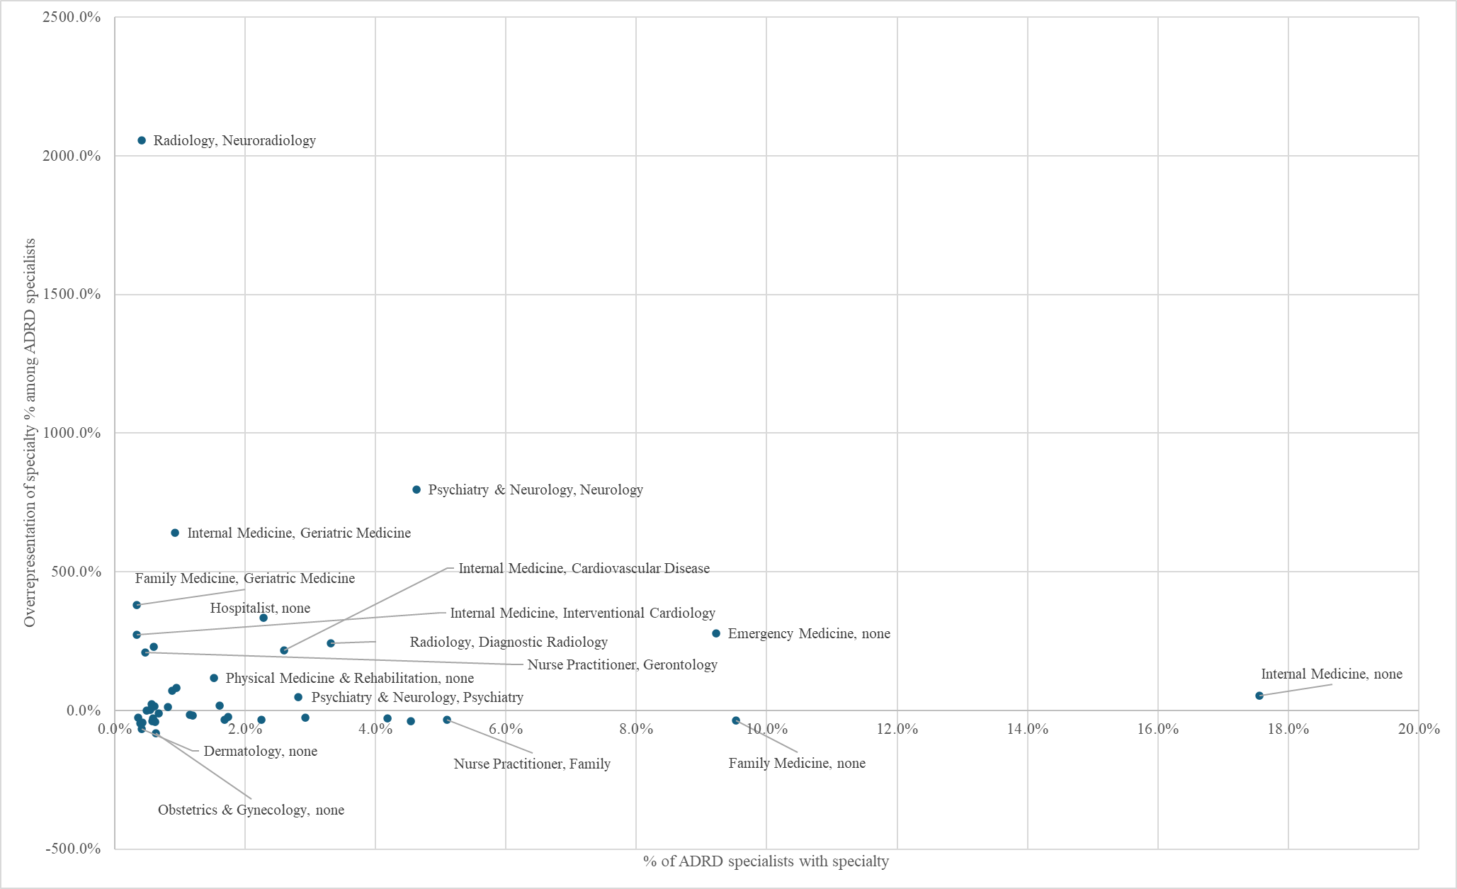
The Impact of Increasing Payments to Insurers for Covering Individuals with AD/ADRD on Enrollment, Access, and Use in Medicare Advantage Mark K. Meiselbach
Notes:
Feedback on these specialties and the approach (possibly conditioning on primary care, excluding emergency medicine)
next steps: iterate on definition of specialists, examine MA participation (in data and potentially Ideon)

Slide 10
The Impact of Increasing Payments to Insurers for Covering Individuals with AD/ADRD on Enrollment, Access, and Use in Medicare Advantage Mark K. Meiselbach
Aim 3: Investigate the impact of expanded plan payments for AD/ADRD on utilization of AD/ADRD services.
Proposed empirical strategy: compare the number AD/ADRD office, outpatient, and home health visits among individuals with previously diagnosed AD/ADRD in MA vs. traditional Medicare before and after 2020.
Questions:
Which services most relevant to examine?
Other coverage decisions that might be especially important to enrollees with AD/ADRD?

