Slide 1
The Financial and Health Consequences of Spousal Loss in the Context of ADRD
Gopi Shah Goda, Joanne Hsu, Lauren Nicholas

Slide 2
Prior Literature
Research has documented significant adverse financial consequences of ADRD for family members, often manifesting years prior to clinical diagnosis (Nicholas et al. 2020; Chu et al. 2021; Harris et al., 2021; Li et al., 2023), with consequences for health due to stress and mental health, poor nutrition and difficulty obtaining medical care.
Evidence of declines in health and living standards for widows generally (Holden, 1986; Hurd and Wise, 1989; Sevak, Weir and Willis, 2004; Poterba and Venti, 2017)

Slide 3
Specific Aims
How does diagnosis of ADRD prior to a spouse’s death impact the surviving spouse’s health and mortality compared to the death of a spouse without ADRD?
How does diagnosis of ADRD prior to a spouse’s death impact the surviving spouse’s financial outcomes? Are widowed spouses of ADRD left with more financial problems than widows of non-ADRD spouses?
What are the disparate impacts of an ADRD patient’s death across race/ethnicity, gender, age of the surviving spouse, income, and time between ADRD diagnosis and death?
Notes:
– but how do health and financial consequences of ADRD continue to impact surviving spouses after death of ADRD patient? And how do effects differ from sudden (non ADRD-related) deaths?
On one hand, the combination of dementia-linked financial losses and extensive care needs prior to death could leave the surviving spouse especially vulnerable to additional health and financial problems following the emotional loss. On the other hand, a gradual decline in the ADRD patient’s ability to manage financial matters and provide companionship may result in less pronounced negative health and financial consequences relative to a sudden or unexpected death.

Slide 4
Contributions
Explore consequences of spousal loss using credit records
Most prior research examines effects of spousal loss on changes in wealth/asset holdings, income and health care spending
Explore how consequences vary by cause of death/prior diagnoses
Limited work that compares deaths following ADRD diagnoses relative to deaths from other causes
How do spouses adapt following an ADRD patient’s death?

Slide 5
Data Snapshot
Novel data linkage of Medicare claims to Experian credit report data including single/married couples over an 18-year period
Medicare claims data include administrative billing data for all Medicare beneficiaries + demographics (age/sex/race/ethnicity); ADRD diagnosis identified by the presence of at least two outpatient or one inpatient visit with a dementia diagnostic code
Credit data is provided quarterly for a 5% sample of U.S. consumers plus others living at their addresses between 2006 and 2023
Notes:
Other health conditions, including acute events such as heart attacks and hip fractures and slow onset conditions such as arthritis and glaucoma, will be identified in the data using previously validated algorithms from the Chronic Conditions Data Warehouse.

Slide 6
Data Snapshot
Linked data includes 37,616 married couples with credit data and Medicare claims data for both individuals, and 337,969 married couples with Medicare claims data for one member of the couple but credit data for both.
Dataset contains 311,783 spousal deaths that allow for the identification of ADRD diagnosis in the 13 years prior to death.

Slide 7
Overview of Methodology
Determine baseline impact of death of one spouse on surviving spouse’s health/mortality and adverse financial events
Compare impact of spousal death among decedent spouses with and without a prior diagnosis of ADRD
Examine disparities across race/ethnicity, gender, age of surviving spouse, time between ADRD diagnosis and death, high/low-income census tracts

Slide 8
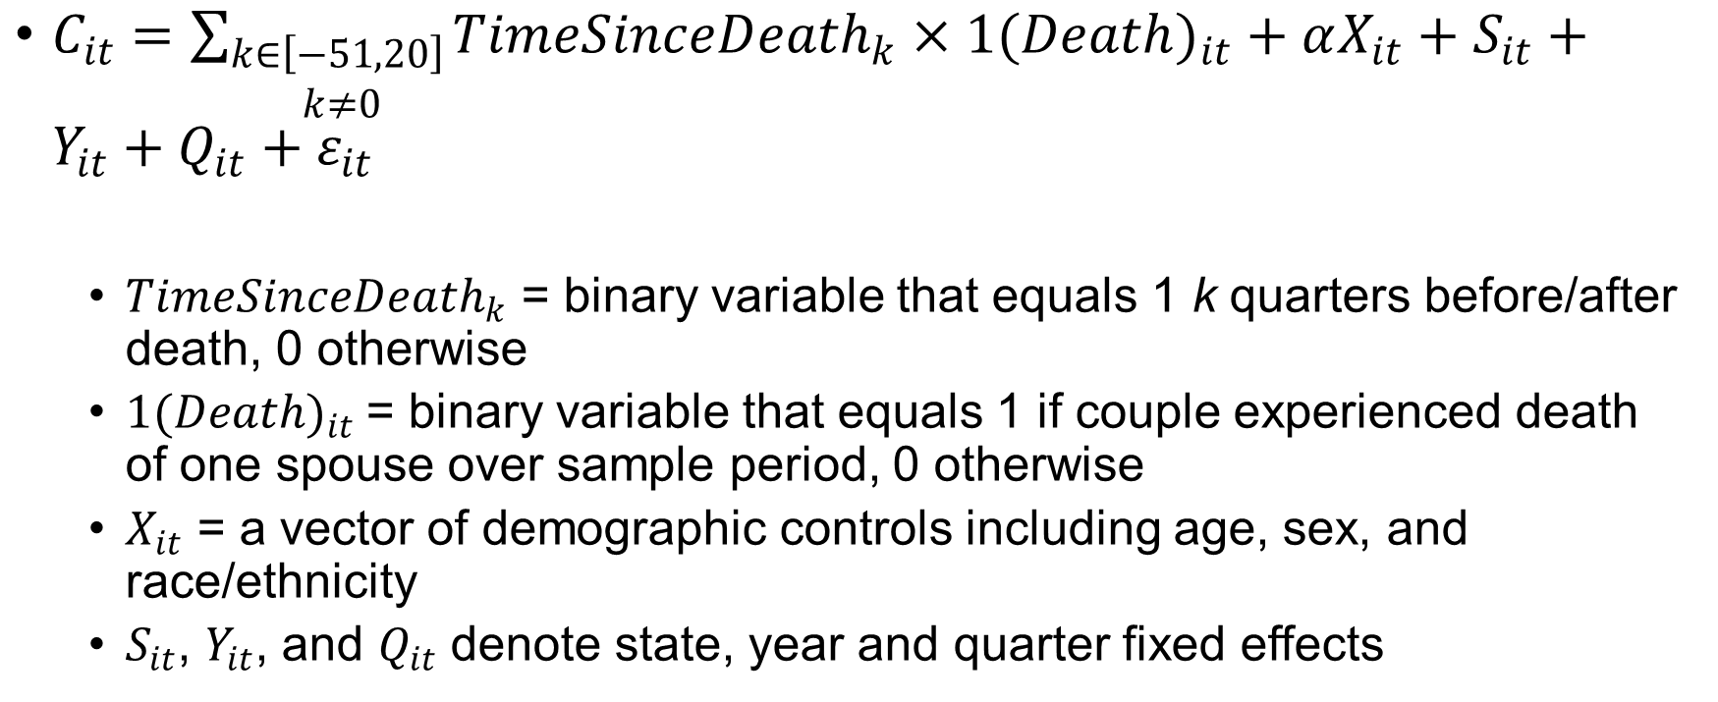
Baseline Impact of Spousal Death
$C_{it}=\sum_{\begin{aligned}k∈\left[−51,20\right] \\ k≠0\end{aligned}}{{TimeSinceDeath}_{k}×{1(Death)}_{it}}+αX_{it}+S_{it}+Y_{it}+Q_{it}+ε_{it}$
${TimeSinceDeath}_{k}$ = binary variable that equals 1 k quarters before/after death, 0 otherwise
${1(Death)}_{it}$= binary variable that equals 1 if couple experienced death of one spouse over sample period, 0 otherwise
$X_{it}$ = a vector of demographic controls including age, sex, and race/ethnicity
$S_{it}$, $Y_{it}$, and $Q_{it}$ denote state, year and quarter fixed effects

Slide 9
Outcomes
Health-related indicators in Medicare claims data, including emergency hospitalization, ER visits and death
Financial indicators in credit data, including indicators of missed payments, other financial delinquencies, or the presence of a subprime credit score for accounts held by the decedent spouse, the surviving spouse, or joint accounts held by both spouses.

Slide 10
ADRD vs. non-ADRD Deaths
Split our sample based on whether the decedent spouse had a prior diagnosis of ADRD by including an interaction term that indicates the presence of this prior diagnosis.
The resulting event study coefficients will trace out the evolution of adverse events before and after the death of spouses with and without a prior ADRD diagnosis.
Notes:
The resulting event study coefficients will trace out the evolution of adverse events before and after the death of spouses with and without a prior ADRD diagnosis.

Slide 11
Identifying subpopulations at greater risk
Examine heterogeneity by:
race/ethnicity, gender, and age of the surviving spouse
time between ADRD diagnosis and death
high/low-income census tracts
The results from this aim will identify subpopulations who are at greater risk of financial distress and accompanying health consequences, which can inform interventions to mitigate these negative outcomes.

