Slide 1
Timing of Dementia Diagnosis: Implications for Medicaid Enrollment and Financial Planning
Fangli Geng, Assistant Professor, Brown University School of Public Health
- Guiding Question:
How does the timing of Alzheimer’s Disease and Related Dementias (AD/ADRD) diagnosis impact long-term care transitions, Medicaid enrollment, and financial decision-making?
We focus on the timing of diagnosis rather than just whether someone is diagnosed.
Delays in diagnosis may lead to reactive care transitions, premature Medicaid enrollment, and missed financial planning opportunities.

Slide 2
Why It Matters
- Problem & Importance:
  6.7M Americans live with AD/ADRD; diagnosis often comes late, during hospitalization or nursing home admission.
  Early diagnosis enables care planning, reduces crisis-driven decisions, and can delay costly institutional care.
  Disadvantaged populations (by race, income, geography) are especially at risk for delayed diagnosis, deepening inequities.
- Policy Relevance:
  Earlier diagnosis could generate Medicaid savings by supporting community-based care longer.
  Understanding disparities is critical for targeting interventions and improving equity in dementia care access.

Slide 3
Previous Study
Substantial diagnostic delays persist in the United States (Amjad et al. 2018).
Racial and ethnic minority groups, individuals with lower socioeconomic status, and residents of rural areas are disproportionately affected (Lin et al. 2022; Amjad et al. 2018; Hurd et al. 2013).
Early detection of cognitive decline led some to take actions like financial planning, but these often reflected more advanced decline and correlated with worse overall outcomes. However, such actions showed some benefits, particularly for depression and wealth. (Hurd et al. 2024)

Slide 4
Our Approach
- Data & Methods:
  Data: Health and Retirement Study (HRS), NHATS, and Medicare claims (2010–2022).
  Aim 1: Quantify time from probable dementia (via cognitive assessments) to clinical diagnosis, identifying subgroup disparities.
  Aim 2: Assess how timing of ADRD diagnosis impact critical decisions, including:
    Medicaid enrollment
    Seeking financial help from family
    Long-term care arrangements
    Unmet needs and receive financial help from the family
- Expected Impact:
Evidence to guide early diagnosis strategies
Insights into financial and policy implications of improving diagnostic timeliness

Slide 5
Current Progress
Data: NHATS annual survey data, Round 1-13, spanning 2011-2023, focused on Cohort 2011 (older adults in the baseline years of 2011, who were followed through 2023)
Definitions
  ADRD diagnosis (awareness): Ever told by doctor that had dementia or Alzheimer’s since the time of the last interview
  ADRD onset: NHATS-designed probable ADRD classification
    Criteria for probable dementia: (1) an AD8© score of ≥2, or (2) a score of ≥1.5 standard deviations (SD) below the mean in at least two of three cognitive domains (memory, orientation, executive function). // (3) Ever told by doctor

Slide 6
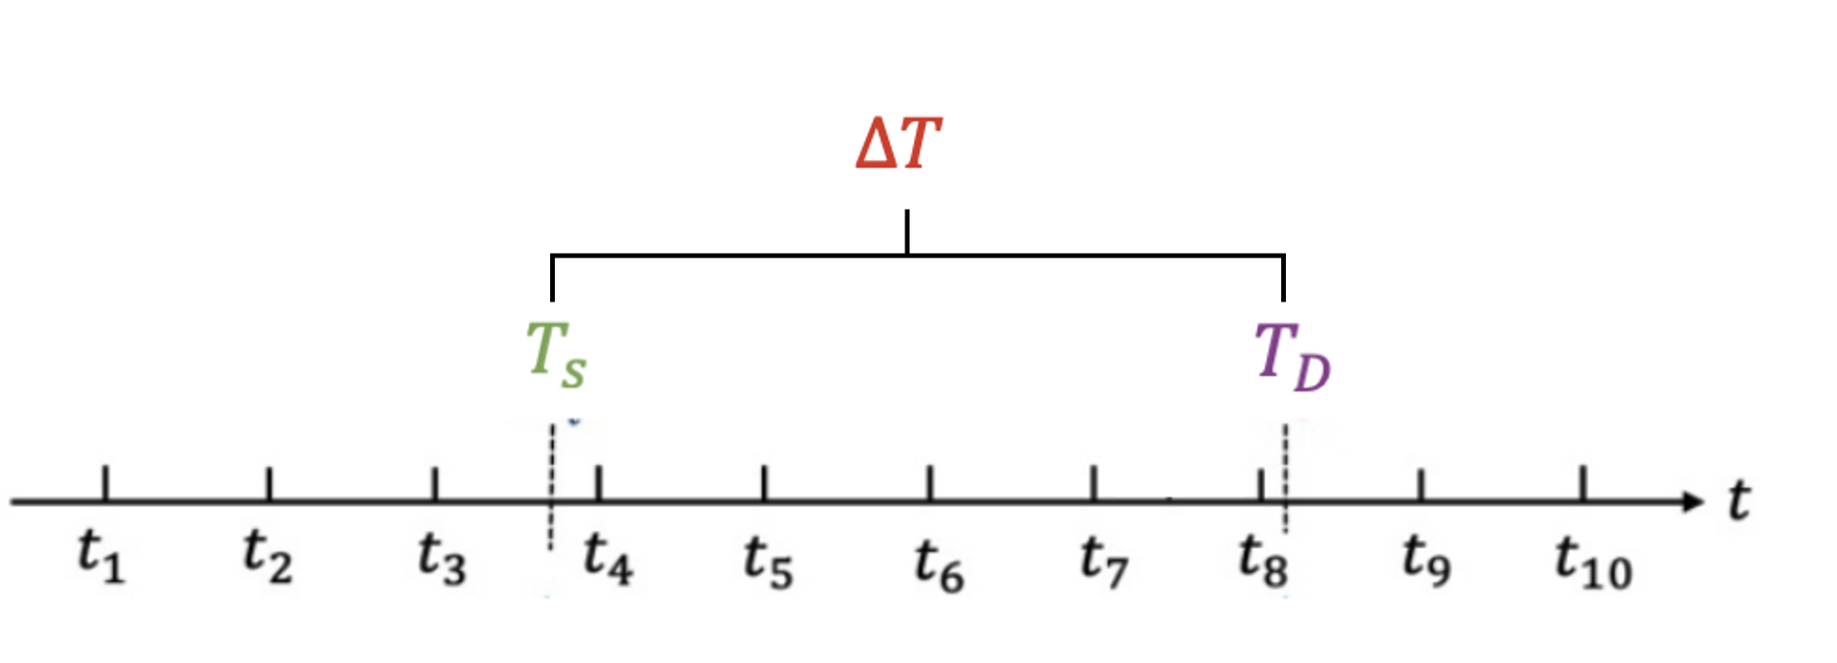


Definitions: Diagnosis status, four categories
Timely diagnosed: ADRD onset and diagnosis in the same round/year
No ADRD: neither onset or diagnosis
Delayed diagnosed: ADRD onset but no diagnosis
Misdiagnosed: has diagnosis but no onset
  Delay in diagnosis:
  Duration in misdiagnosis:

Slide 7
Diagnosis Algorithm
ADAMS’ full neuropsychological exam: gold-standard
HCAP: cognitive tests and an informant interview lasting about 20 minutes
  Criteria for dementia: at least 2 out of 5 cognitive domains were below thresholds for impairment (>1.5 SDs below the mean or a t score of 35) and an informant report of functional impairment.
3. NHATS: cognitive tests and AD8 score
  Criteria for probable dementia: (1) an AD8© score of ≥2, or (2) a score of ≥1.5 standard deviations (SD) below the mean in at least two of three cognitive domains (memory, orientation, executive function). // (3) Ever told by doctor

Slide 8
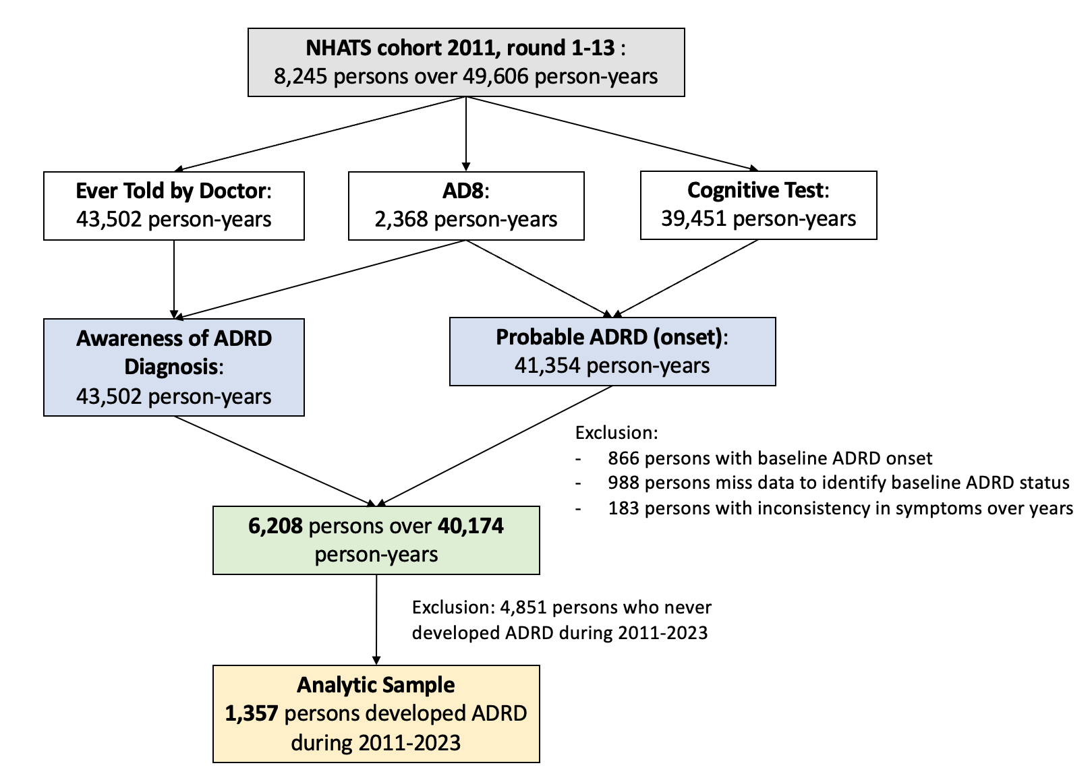
Analytic Sample
1,357 individuals with diagnosis status (timely, delayed and misdiagnosis)

Slide 9
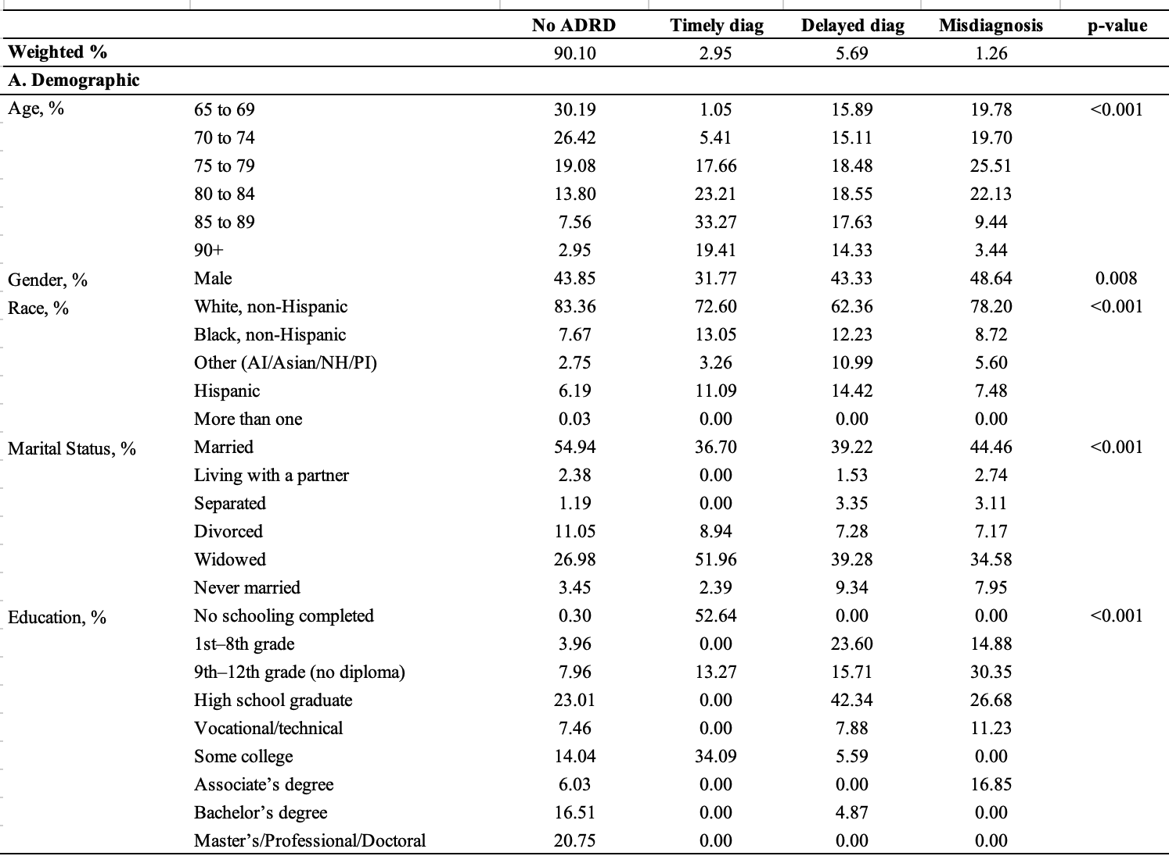
Descriptive statistics for cohort 2011, in year 2011
Adults with ADRD were older, more often women, Black or Hispanic, less educated, and less likely to be married than individuals without ADRD.

Slide 10
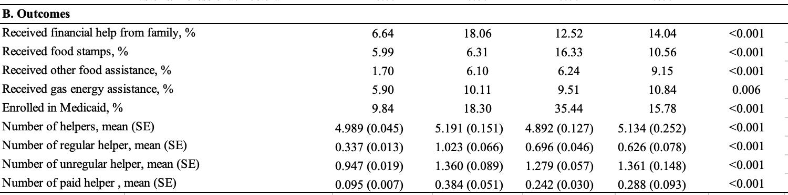
Descriptive statistics for cohort 2011, in year 2011
Individuals with ADRD showed substantially higher dependence on Medicaid and family or public financial assistance, as well as greater care needs with more helpers and higher use of paid and regular caregiving support compared to those without ADRD

Slide 11
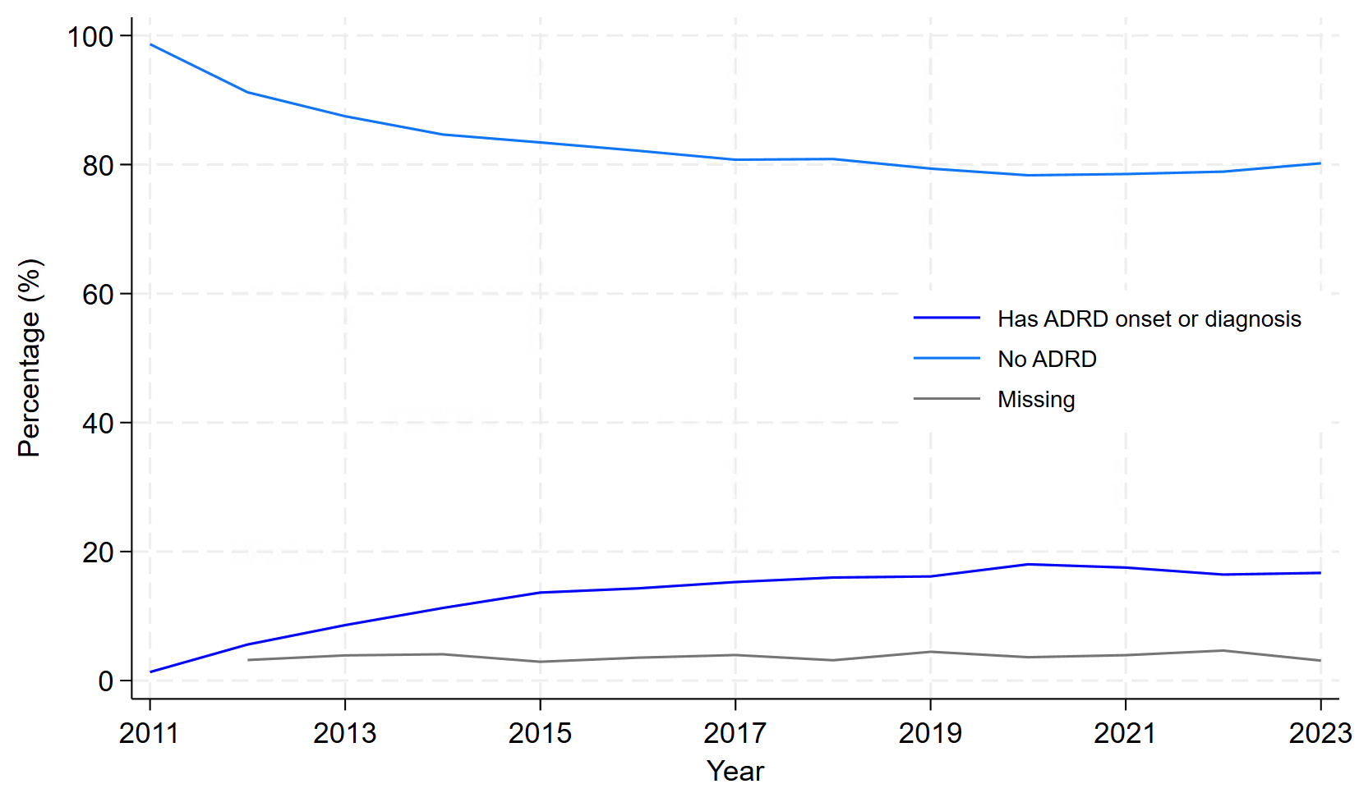
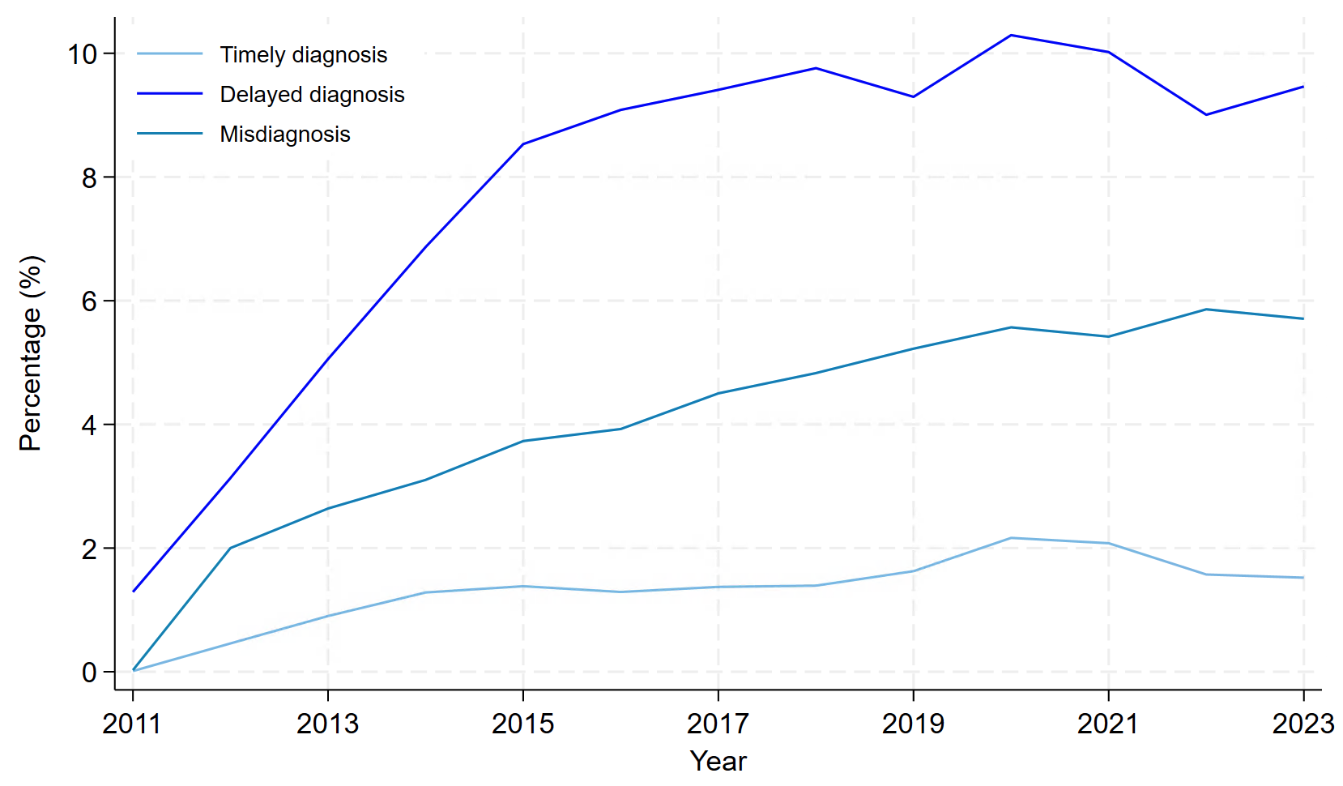
Descriptive statistics for cohort 2011, 2011-2023
Panel A: Development of ADRD for cohort 2011
Panel B: Diagnosis status among people who developed ADRD

Slide 12
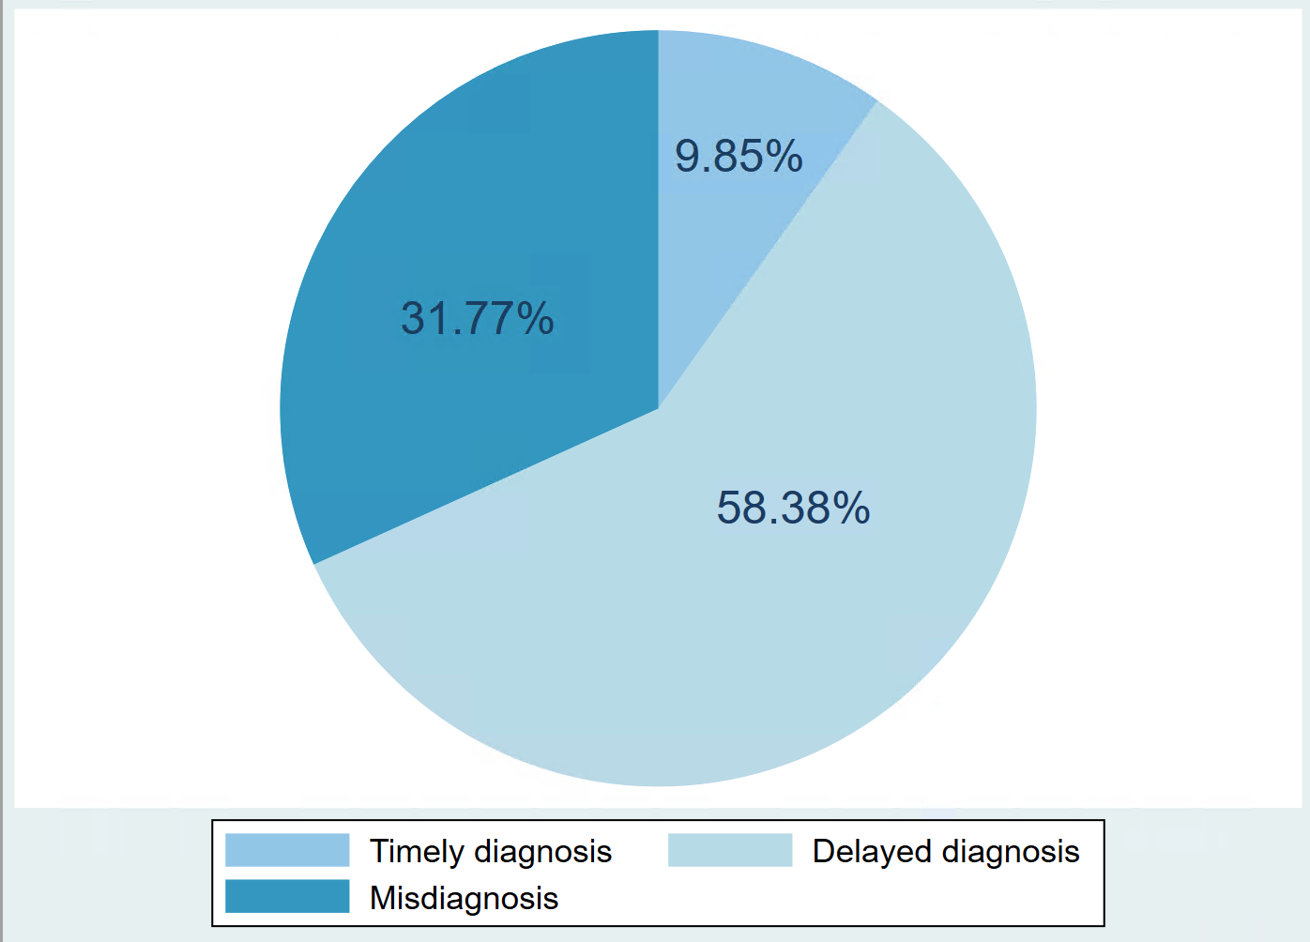
Descriptive statistics for cohort 2011, 2011-2023
Figure: Cumulative distribution of diagnosis status among people had ADRD onset or diagnosis over 13 years

Slide 13
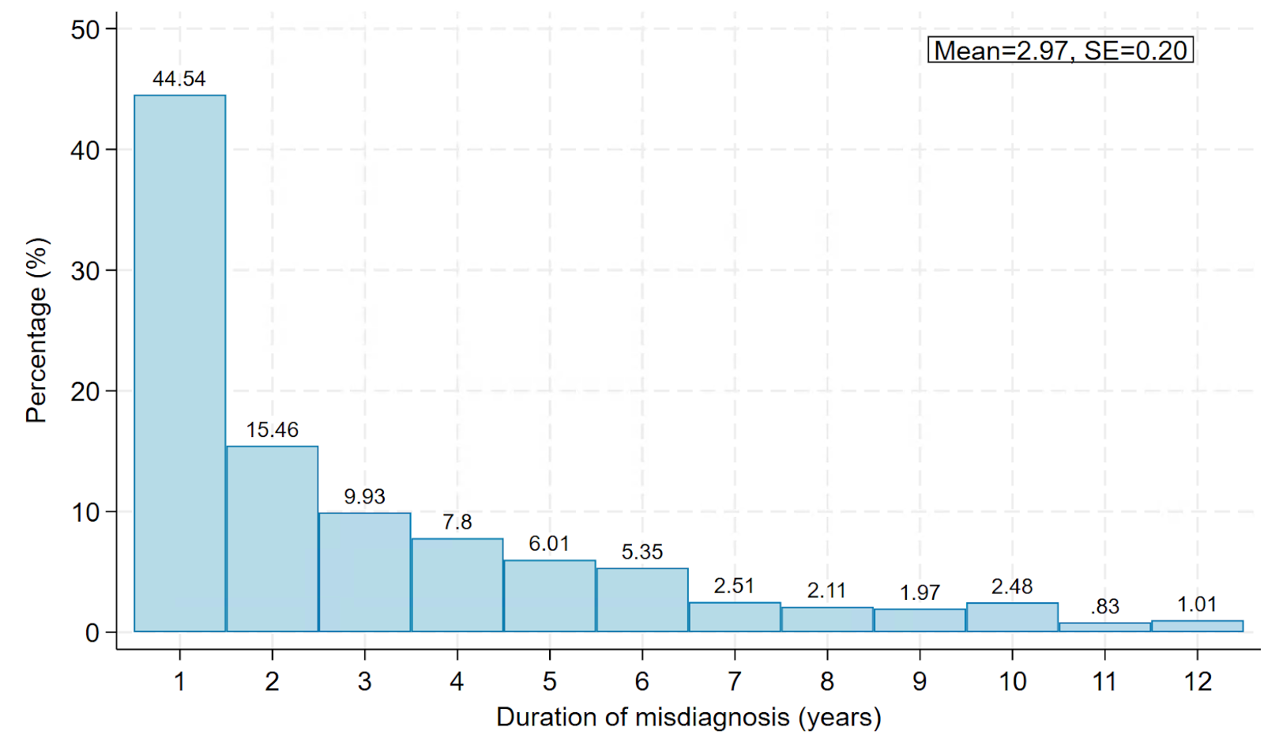
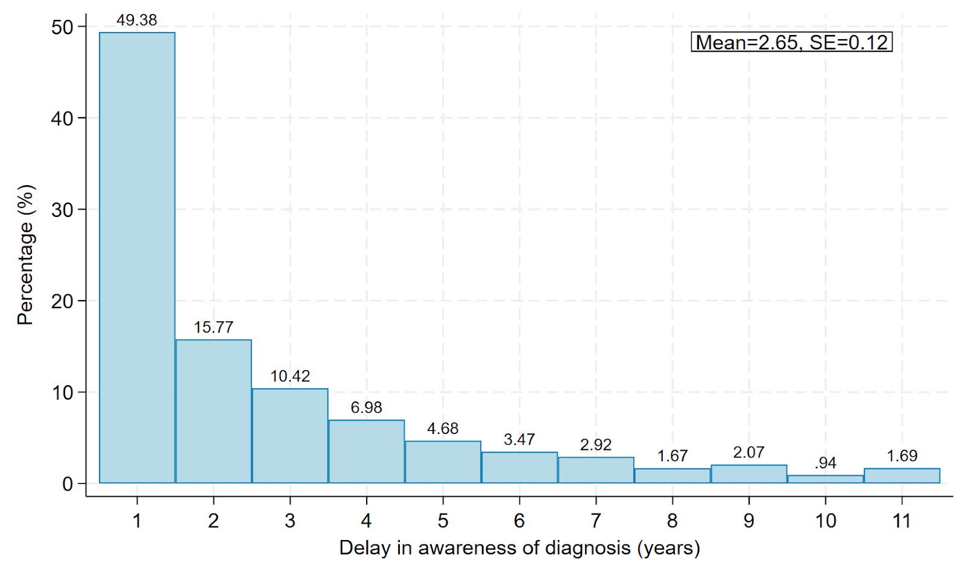
Descriptive statistics for cohort 2011, 2011-2023
Figure: Number of years between disease onset and diagnosis status among people developed ADRD over 13 years
Panel A. Delay in diagnosis
Panel B. Duration of misdiagnosis

Slide 14
Preliminary Analysis 1
Association between diagnosis categories/duration of delay or misdiagnosis and demographic and socioeconomic factors
Black and Hispanic participants were more likely to experience delayed diagnosis, and those with higher education, particularly college graduates, had a greater relative risk of both delayed diagnosis and misdiagnosis, compared to timely diagnosis.
Black and Hispanic individuals had longer diagnostic delays, and those with higher education were diagnosed earlier and spent fewer years misdiagnosed.

Slide 15
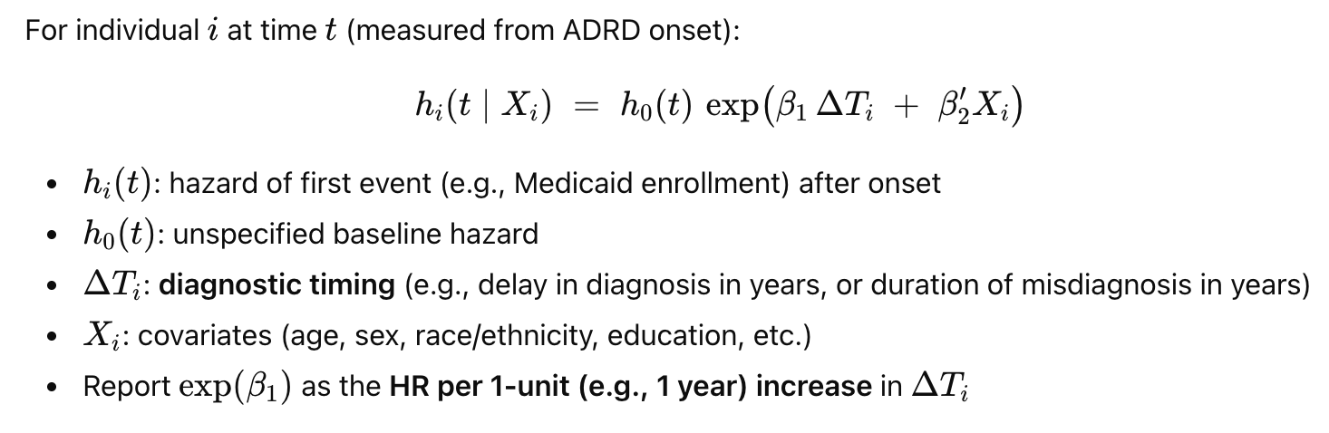
Preliminary Analysis 2
Association between diagnosis categories/duration of delay or misdiagnosis and years to receive financial help and enrolled in Medicaid after ADRD onset/diagnosis

Slide 16
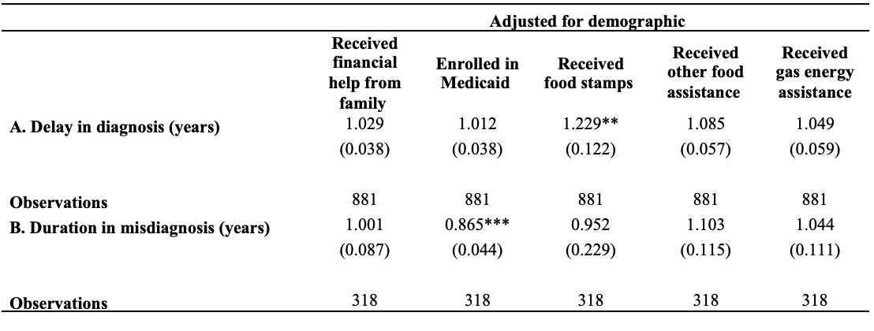
Preliminary Analysis 2
Table: Hazards ratio of receiving financial help and Medicaid enrollment by an additional year in delay or misdiagnosis
Longer diagnostic delay was associated with a quicker uptake of food assistance.
Longer misdiagnosis were linked to slower enrollment in Medicaid.

Slide 17
Next steps
Link with claims data
  Refine ADRD onset definition using clinical diagnosis records.
  Add new outcomes: unmet medical needs, self-care limitations, mobility, and receiving help with financial management.
Alternative diagnosis timing categories
  Reclassify diagnostic delay into short vs. long delay groups to test the effects.
Enhanced covariate adjustment
  Incorporate health conditions (from survey and claims data) and insurance status to control for confounding.
Causal analysis
  Estimate causal effects of ADRD diagnosis timing on outcomes using robust modeling strategies.

