Slide 1
Lead Exposure and Cognitive Impairment Throughout the Lifecycle
Brian Beach, Vanderbilt & NBER
Joe Ferrie, Northwestern & NBER
Aaron Reuben, University of Virginia
Martin Saavedra, Rutgers & NBER

Slide 2
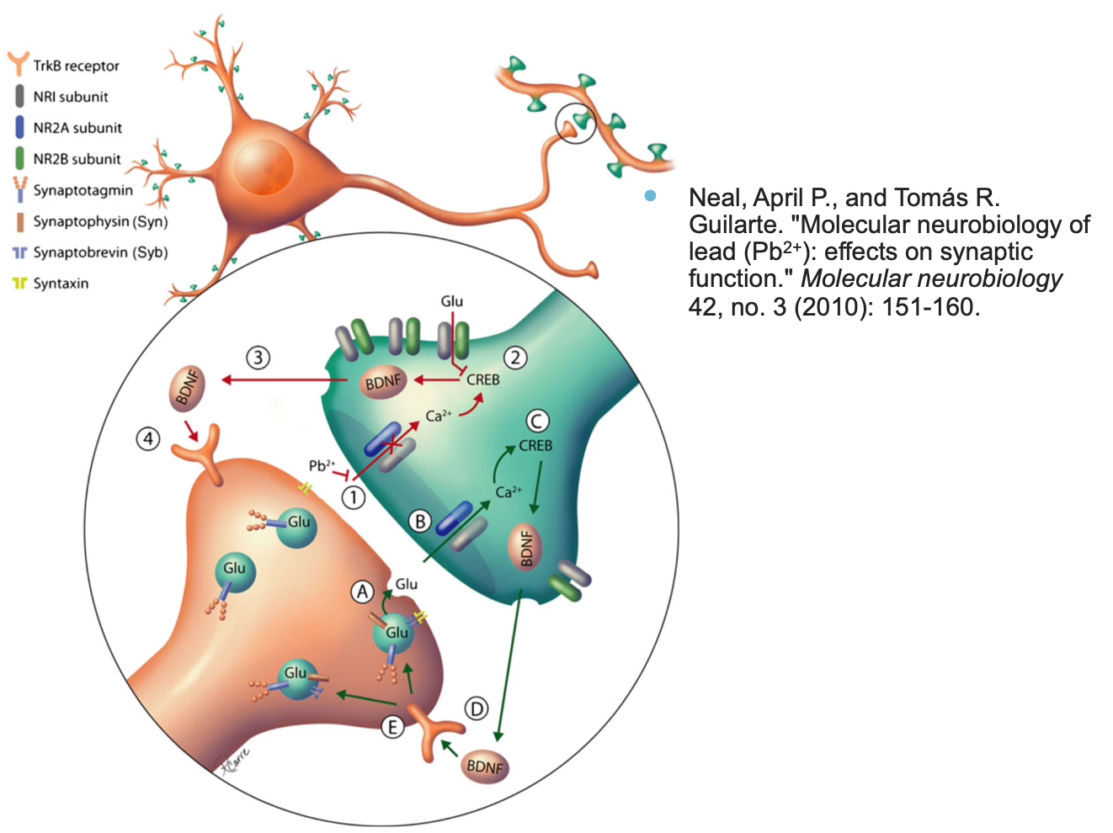
Consequences of Lead Exposure
Lead and Calcium have the same valence.
Lead lodges in synapses where calcium is needed.
Lower cognition.
Diminished prefrontal cortex functioning (impulse control).

Slide 3
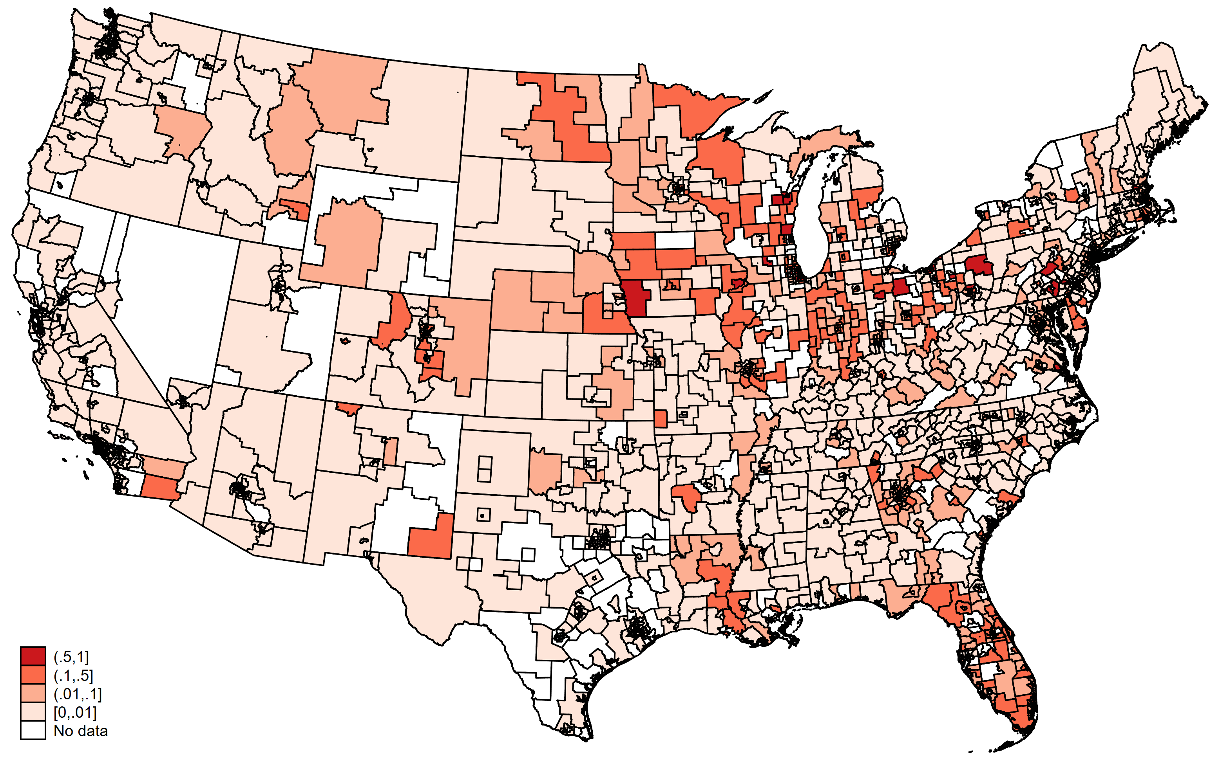
Households with Lead Service Lines (2024)

Slide 4
Childhood Exposure Harms Children & Adults
Children with high lead exposures exhibit decreased:
Cognitive ability
Fine motor skills
Emotional and behavioral regulation capacity
Adults with childhood exposure:
Lower cognition
Mental health problems
Biological aging

Slide 5
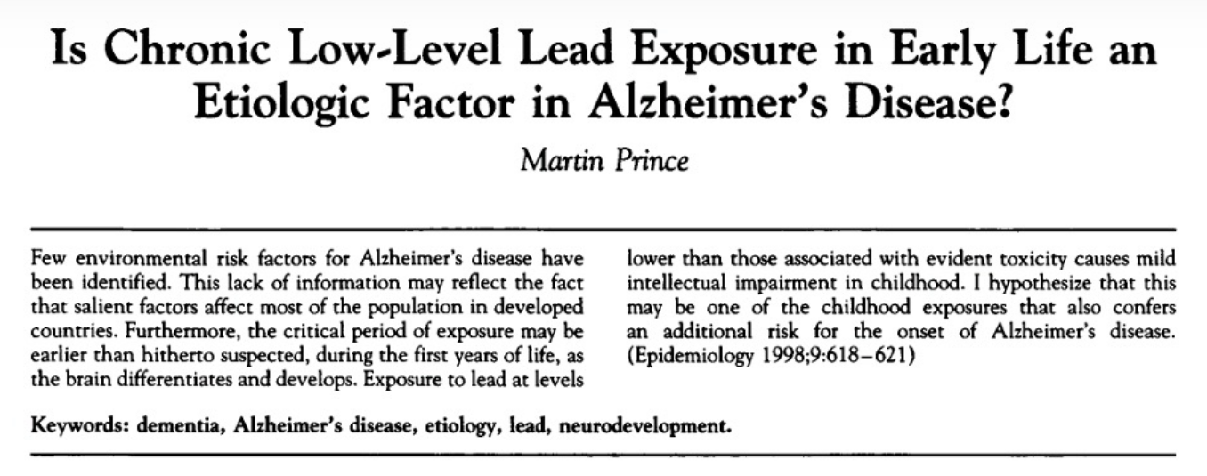
What About Effects After Age 65?
What about effects at even later ages?
Martin Prince (Epidemiology, 1998):

Slide 6
How Can We Examine a Lead/ADRD Link?
We need two pieces:
early-life lead exposure, and
late-life ADRD diagnosis or proxies
Exposure comes from lead water service line prevalence by city/town (Baker, Manual of American Water Works, and EPA 2024)

Slide 7
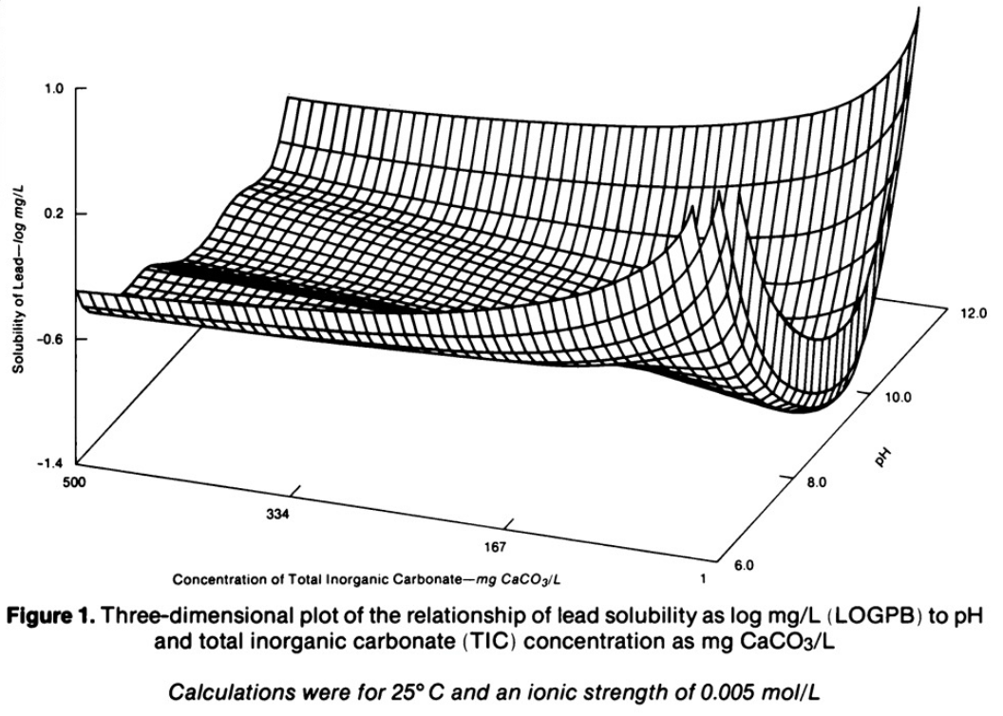
How Can We Examine a Lead/ADRD Link?
Causal inference is provided by the known relationships between pH and lead solvency.
Schock, Michael R., and Marvin C. Gardels. "Plumbosolvency reduction by high pH and low carbonate—solubility relationships." Journal of the American Water Works Assoc. 75, no. 2 (1983): 87-91.

Slide 8
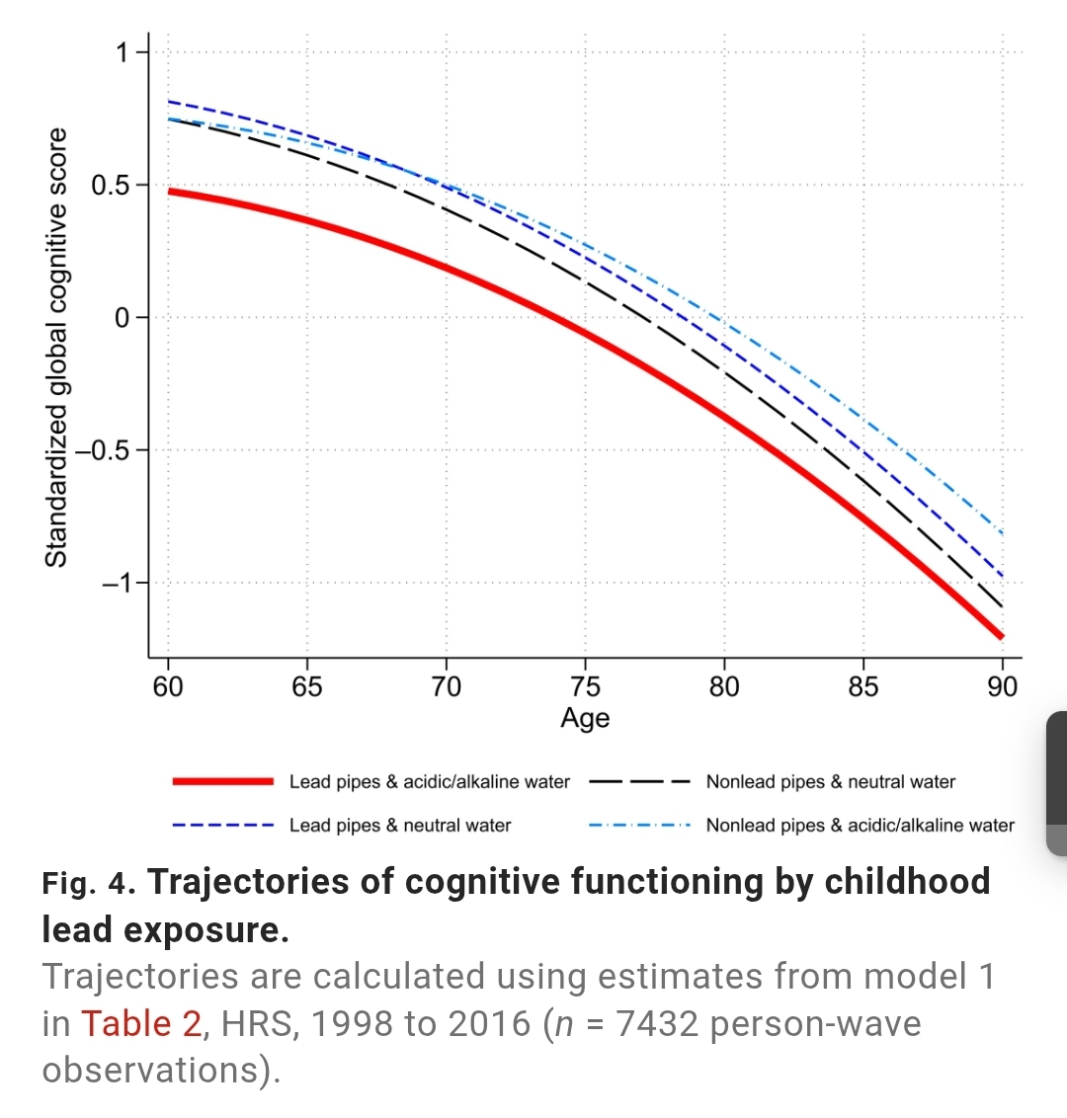
How Can We Examine a Lead/ADRD Link?
Two recent studies are suggestive.
1. Lee, Haena, Mark W. Lee, John Robert Warren, and Joseph Ferrie. "Childhood lead exposure is associated with lower cognitive functioning at older ages." Science Advances 8, no. 45 (2022) link HRS cognitive tests to early lead exposure

Slide 9
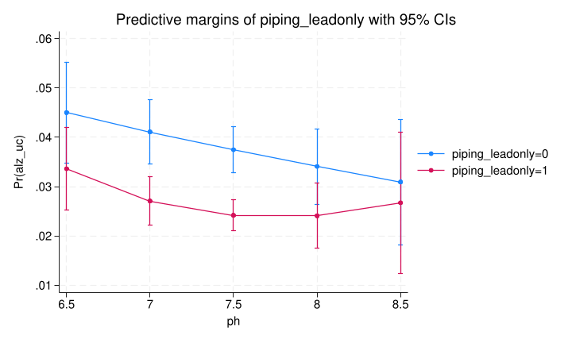
How Can We Examine a Lead/ADRD Link?
Two recent studies are suggestive.
2. Ferrie, Joseph, and Jahn Hakes, “Lead & LOAD: Plumbing the etiology of Late-Onset Alzheimer’s Disease” (2025) link Numident, CPS, NDI, and Medicare, showing lead Alzheimer’s death for males & diagnosis for females.

Slide 10
Lead Service Lines & Cognitive Impairment
The American Community Survey (ACS) identifies individuals with a “cognitive difficulty”:
The question: "Because of a physical, mental, or emotional problem, does the respondent have difficulty remembering, concentrating, or making decisions?“.
We have used this data for 2.8 million ACS respondents 2000-2020 together with the water service line piping material

Slide 11
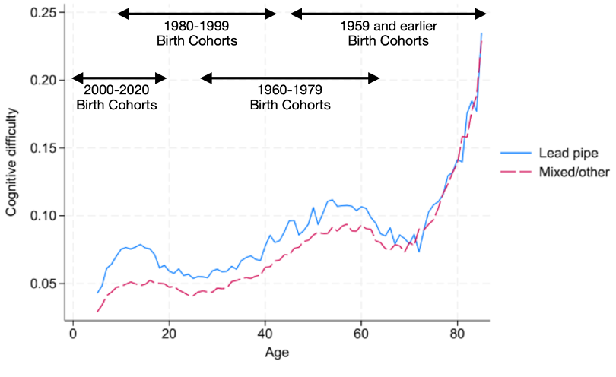
Lead Service Lines & Cognitive Impairment
Data: American Community Survey, 2005-2022 (N=2.6 million).
Data are not adjusted for migration or selective mortality.

Slide 12
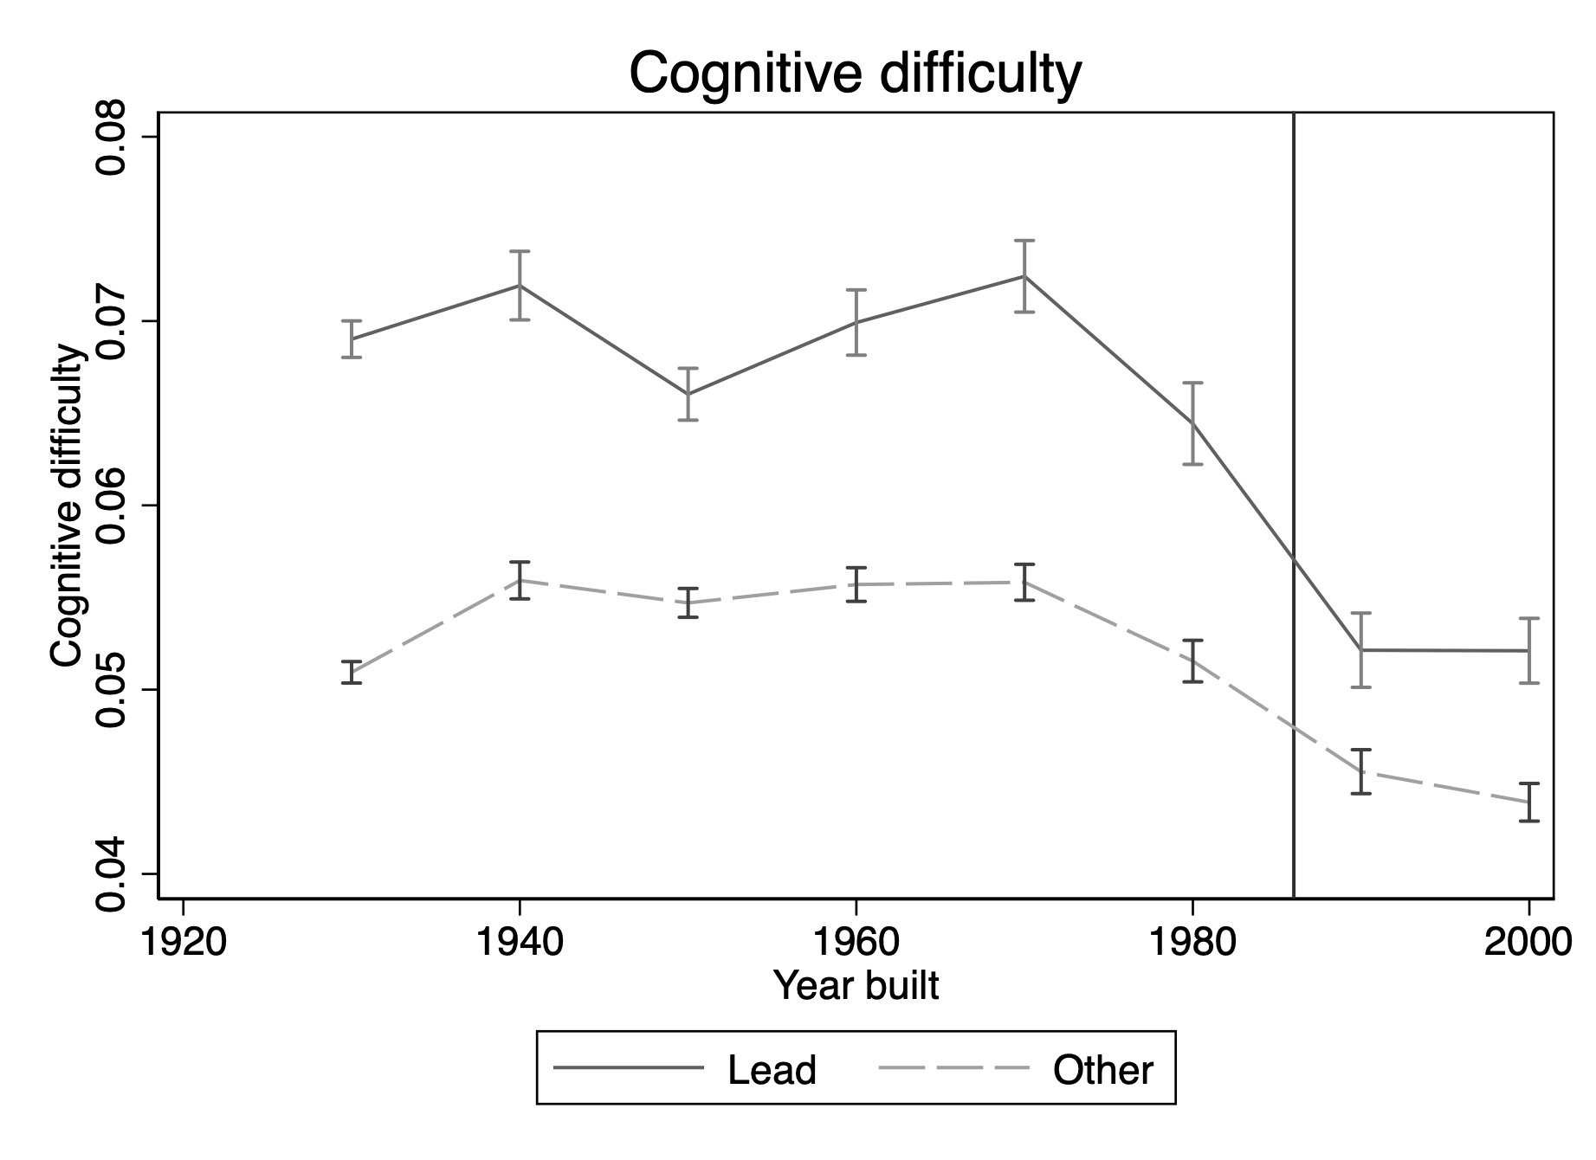
Cognitive Difficulty by Year Dwelling Built

Slide 13
From pH to Lead Solubility
We have information on municipal water chemistry in addition to pH from 1952 and, when available, 1962.
We calculate lead solubility using the pbsol R package as a non-linear function of pH, alkalinity, sulfate, magnesium, and calcium. We use only finished water samples and collapse solubility measures to the city level.
Lead solubility in 1952 and 1962 are positively correlated. This suggests that a single-year measure of solubility captures persistent differences in solubility rather than noise.

Slide 14
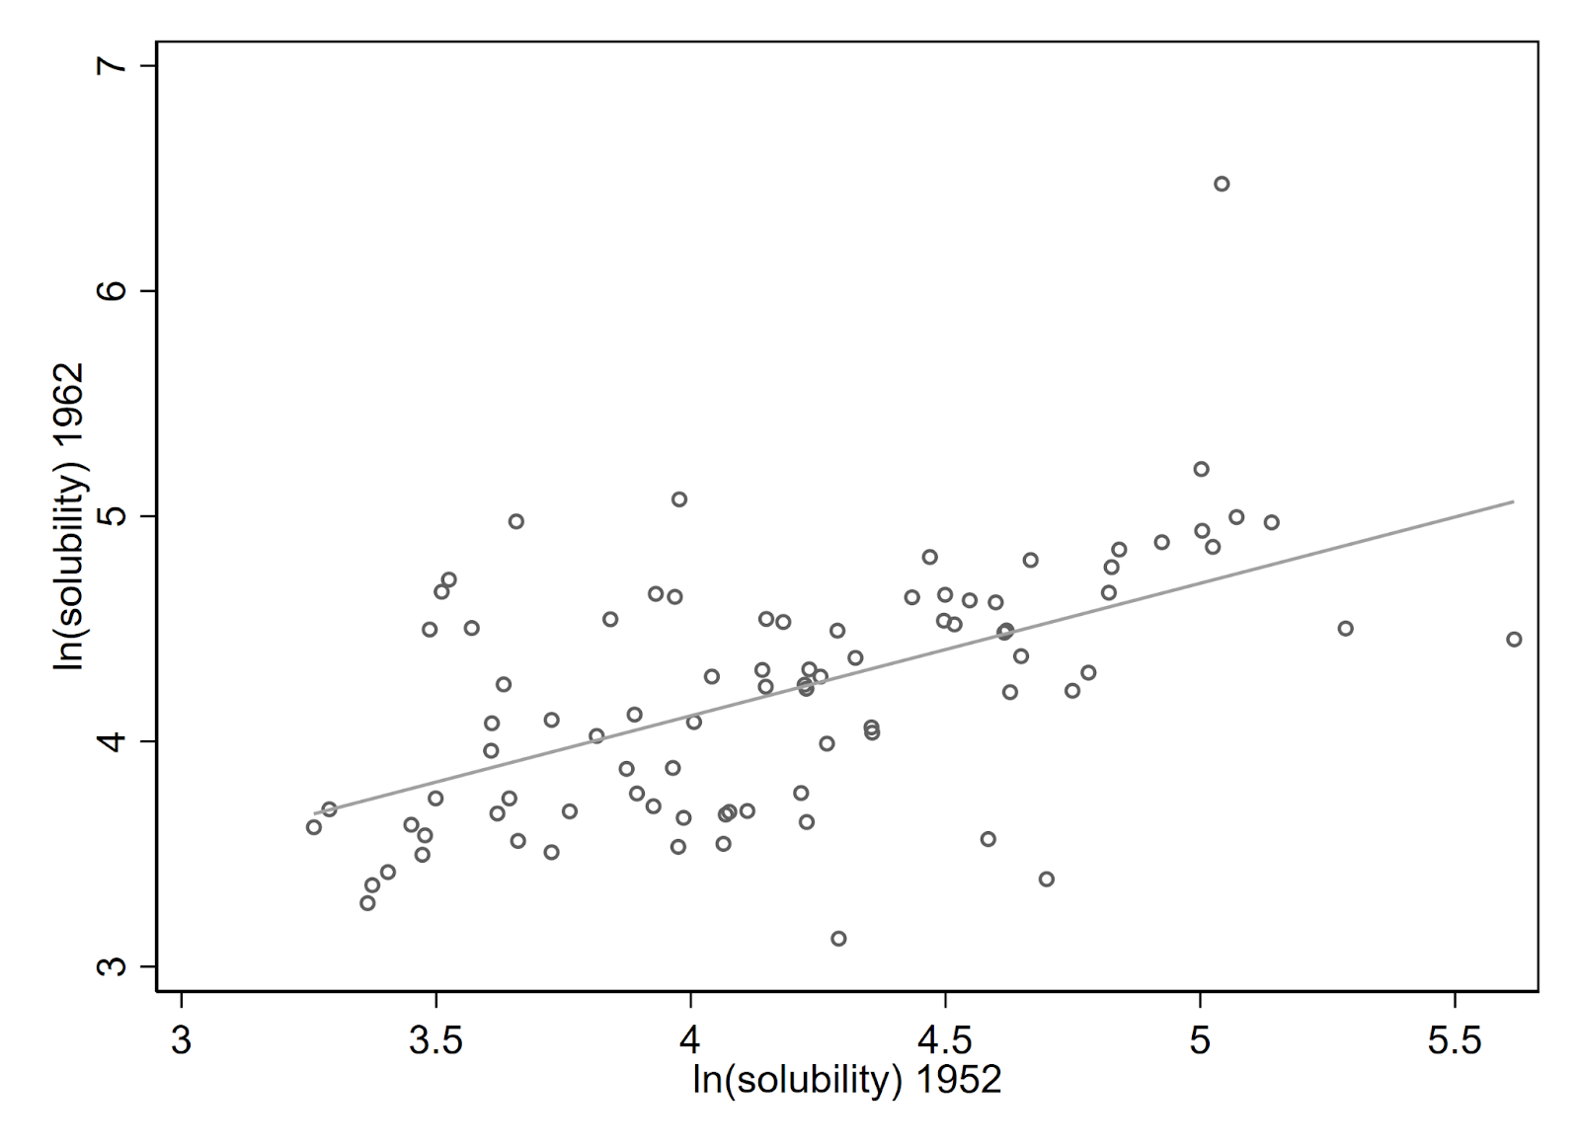
From pH to Lead Solubility

Slide 15
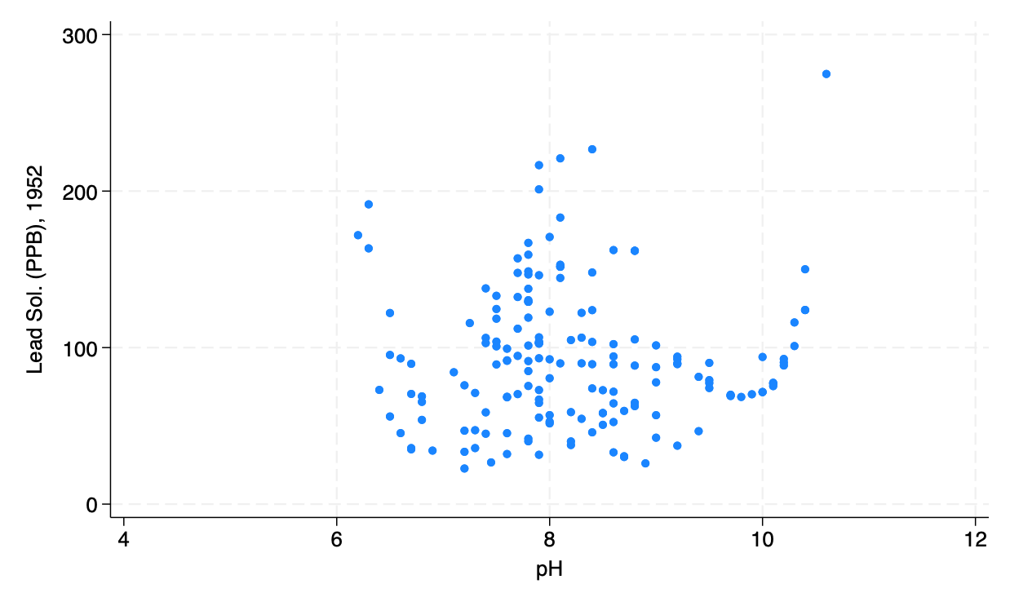
From pH to Lead Solubility
Substantial variation in lead exposures based on water chemistry.
Figure includes ~200 cities.
Final sample: ~2000 cities covering 90% of urban population.
Goal: Use variation in lead solubility to isolate causal effect of lead exposure on cognition.

Slide 16
Next Steps
Estimate contribution of waterborne lead to cognitive decline throughout the lifecycle.
Gain access to Medicare claims data & NDI to explore ADRD incidence.
Update cohort-level estimates of ADRD risk based on knowledge of pre-existing lead exposures.

