Slide 1
Incorporating Air and Water Pollution into the National Income and Product Accounts
Maureen L. Cropper
University of Maryland, College Park, RFF
Yongjoon Park
University of Massachusetts, Amherst
CRIW NBER Meeting
March 16, 2023

Slide 2
Overview
Why air and water emissions accounts are important
Accounts for Local Air Pollutants
Muller, Mendelsohn, and Nordhaus Approach
EPA’s Estimates of Damage per Ton of Pollutant
Accounts for Greenhouse Gases
Accounts for Water Pollution Emissions
Conclusion

Slide 3
Why Are Pollution Satellite Accounts Important?
Researchers have shown that the externalities associated with air and water pollution are significant—as are the expenditures undertaken to reduce pollution flows
Examining trends in both emissions and expenditures to reduce emissions important for understanding how the nation is progressing
Trends in emissions will be more useful if the damages associated with emissions can be monetized
I will focus on the damage associated with air and water pollution, with an emphasis on air pollution

Slide 4
Measuring Emissions to Air by Emitting Sector
The first step in measuring damages is measuring emissions to air by emitting sector.
The next slide shows the format of the UN Core Air Emissions account, including both local and global pollutants
Local air pollutants (e.g., CO, NOx, SO2, PM2.5) shown above the line, are provided by sector in EPA’s National Emissions Inventory (NEI), every three years.
Greenhouse gas emissions (e.g., CO2, methane), shown below the line, are provided by EPA annually, by sector.

Slide 5
Core Air Emissions Account (tons)

Slide 6
Going from Emissions to Monetized Damages: Local Air Pollutants
Use air quality modeling to translate emissions into ambient air quality.
Estimate change in ambient air quality due to current emissions
Will require emissions by detailed geographic location
Estimate impacts of the spatially disaggregated change in ambient air quality on health, agricultural output, other endpoints
Monetize the changes in health outcomes and other endpoints
Trace damages back to pollution emissions by sector and pollutant

Slide 7
Muller, Mendelsohn, and Nordhaus Approach

Slide 8
Muller, Mendelsohn and Nordhaus (AER, 2011)
Used the 2002 NEI and an integrated assessment model to estimate the Gross Economic Damages (GED) from air pollution, by sector
Provided guidance for future efforts to determine the marginal value of damages by pollutant and sector
Made clear the key pollution outcomes that drive estimates of air pollution damages, viz.
The impacts of PM2.5 and Ozone on adult mortality and how deaths are valued

Slide 9
Muller, Mendelsohn and Nordhaus Approach
Using the NEI, ran an air quality model to reproduce baseline concentrations of ambient PM2.5 and Ozone throughout the US
Estimated a source-receptor matrix linking a marginal increase in emissions of each of 6 pollutants on PM2.5, Ozone
Impact depends on the county and stack height at which the pollutant is emitted
Done for each of 6 pollutants x 3110 counties x 3 stack heights
Evaluate increase in PM2.5, Ozone in each county on health and other endpoints using damage functions
Value marginal damages

Slide 10
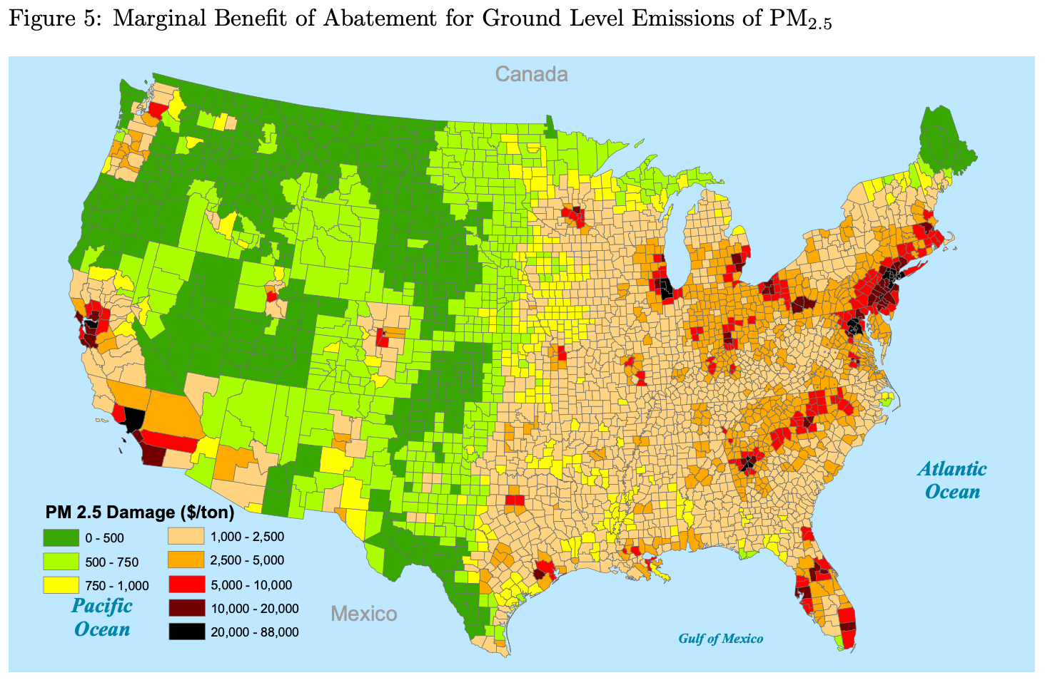
Marginal Damages from Ground Level PM2.5

Slide 11
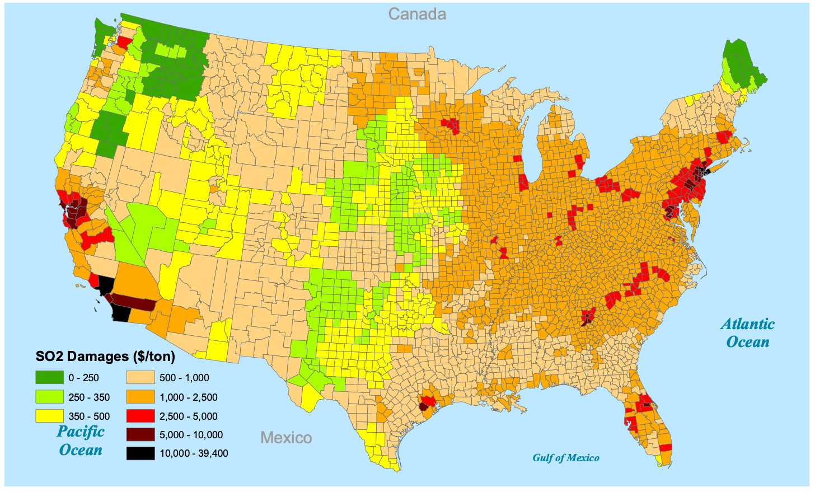
Marginal Damages from Ground Level SO2

Slide 12
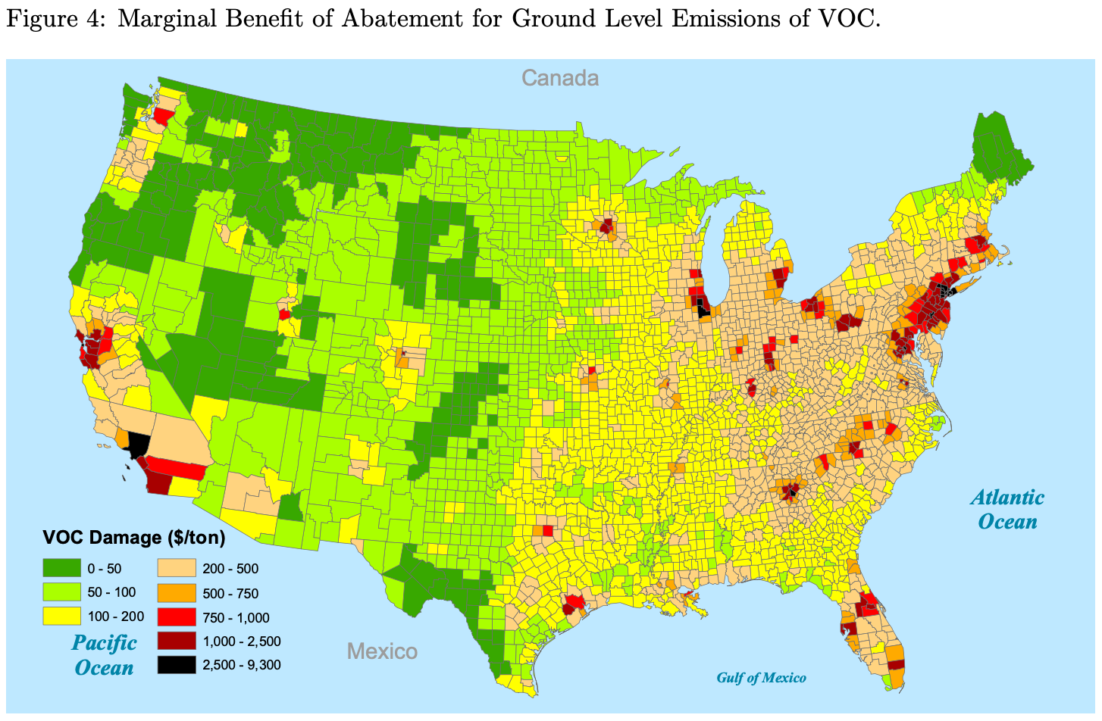
Marginal Damages from Ground Level VOCs

Slide 13
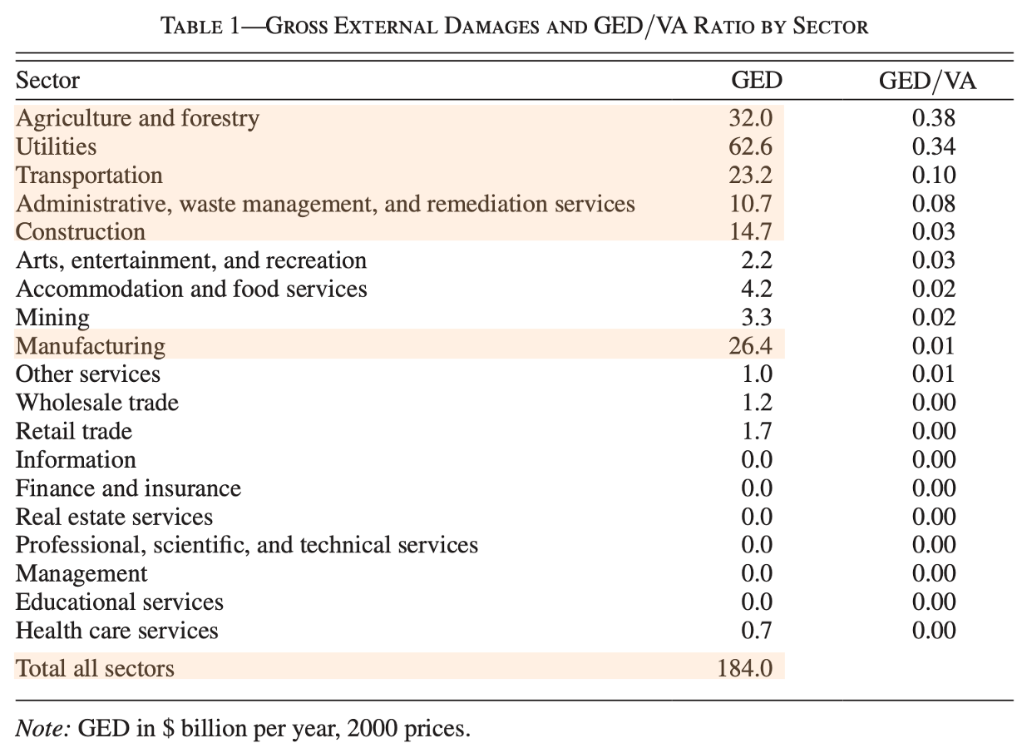
Muller, Mendelsohn and Nordhaus Estimates of GED

Slide 14
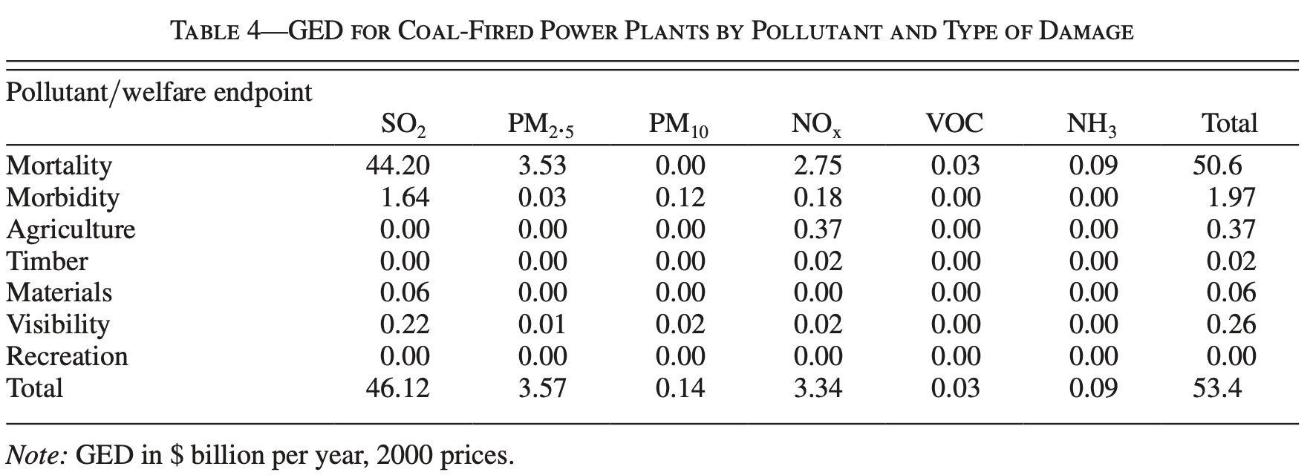
MMN Damage Estimates by Pollutant for EGUs

Slide 15
How Is Premature Mortality Valued?
MMN estimates of GED use EPA’s Value per Statistical Life (VSL)
VSL = amount that people would pay to reduce their risk of death by a small amount, aggregated over risks that sum to one statistical life
If each of 10,000 people would pay $200 to reduce their risk of death by .0001,
The VSL = 10,000 x $200 = $2 million
VSL estimated by compensation for risk of death on the job using hedonic labor market studies
VSL in 2000 dollars = $6.3 million

Slide 16
Sensitivity of GED Results to Mortality Valuation
MMN’s base case takes EPA’s VSL but uses the Value per Life Year Saved – the VSL is divided by discounted remaining life expectancy of a 40-year-old to generate the VSLY
Value of premature deaths = life years lost x VSLY
Using VSLY: total GED = $184 billion (1.8% of 2002 GDP)
Using VSL: total GED = $460 billion (4.4% of 2002 GDP)
Results also sensitive to exposure response functions for PM2.5, O3

Slide 17
EPA’s Estimates of Damage per Ton of Pollutant

Slide 18
EPA’s Estimates of Damage per Ton of Emissions
In 2022 EPA released estimates of cost per ton of pollutant for 21 sectors and 5 pollutants using the 2017 emissions inventory
Sector-based PM2.5 Benefit Per Ton Estimates | US EPA
Air quality modeling used to estimate source-receptor matrices for each sector-pollutant combination at a 12km x 12km resolution
Impact of ambient PM2.5 and ozone on health estimated at a 12km x 12km resolution using BenMAP
Mortality effects of PM2.5 and Ozone constitute 98% of monetized damages, using a 2016 VSL of $10.7 million

Slide 19
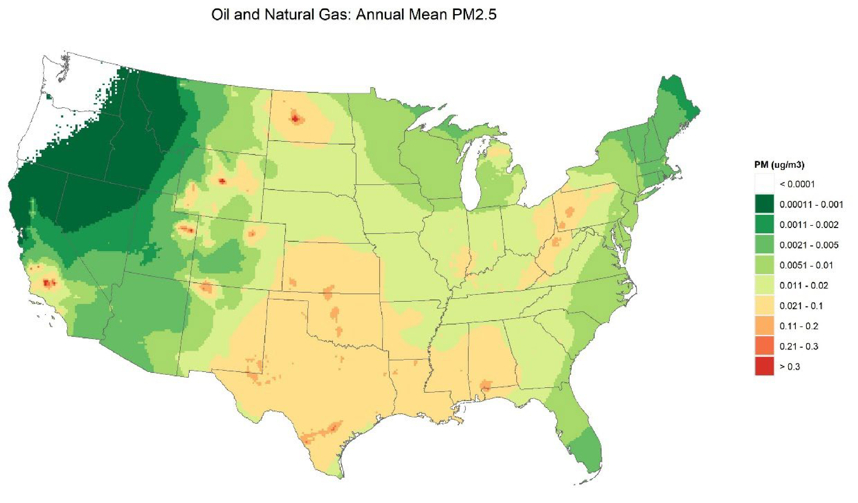
Impact on Ambient PM2.5 of Oil and Gas Extraction

Slide 20
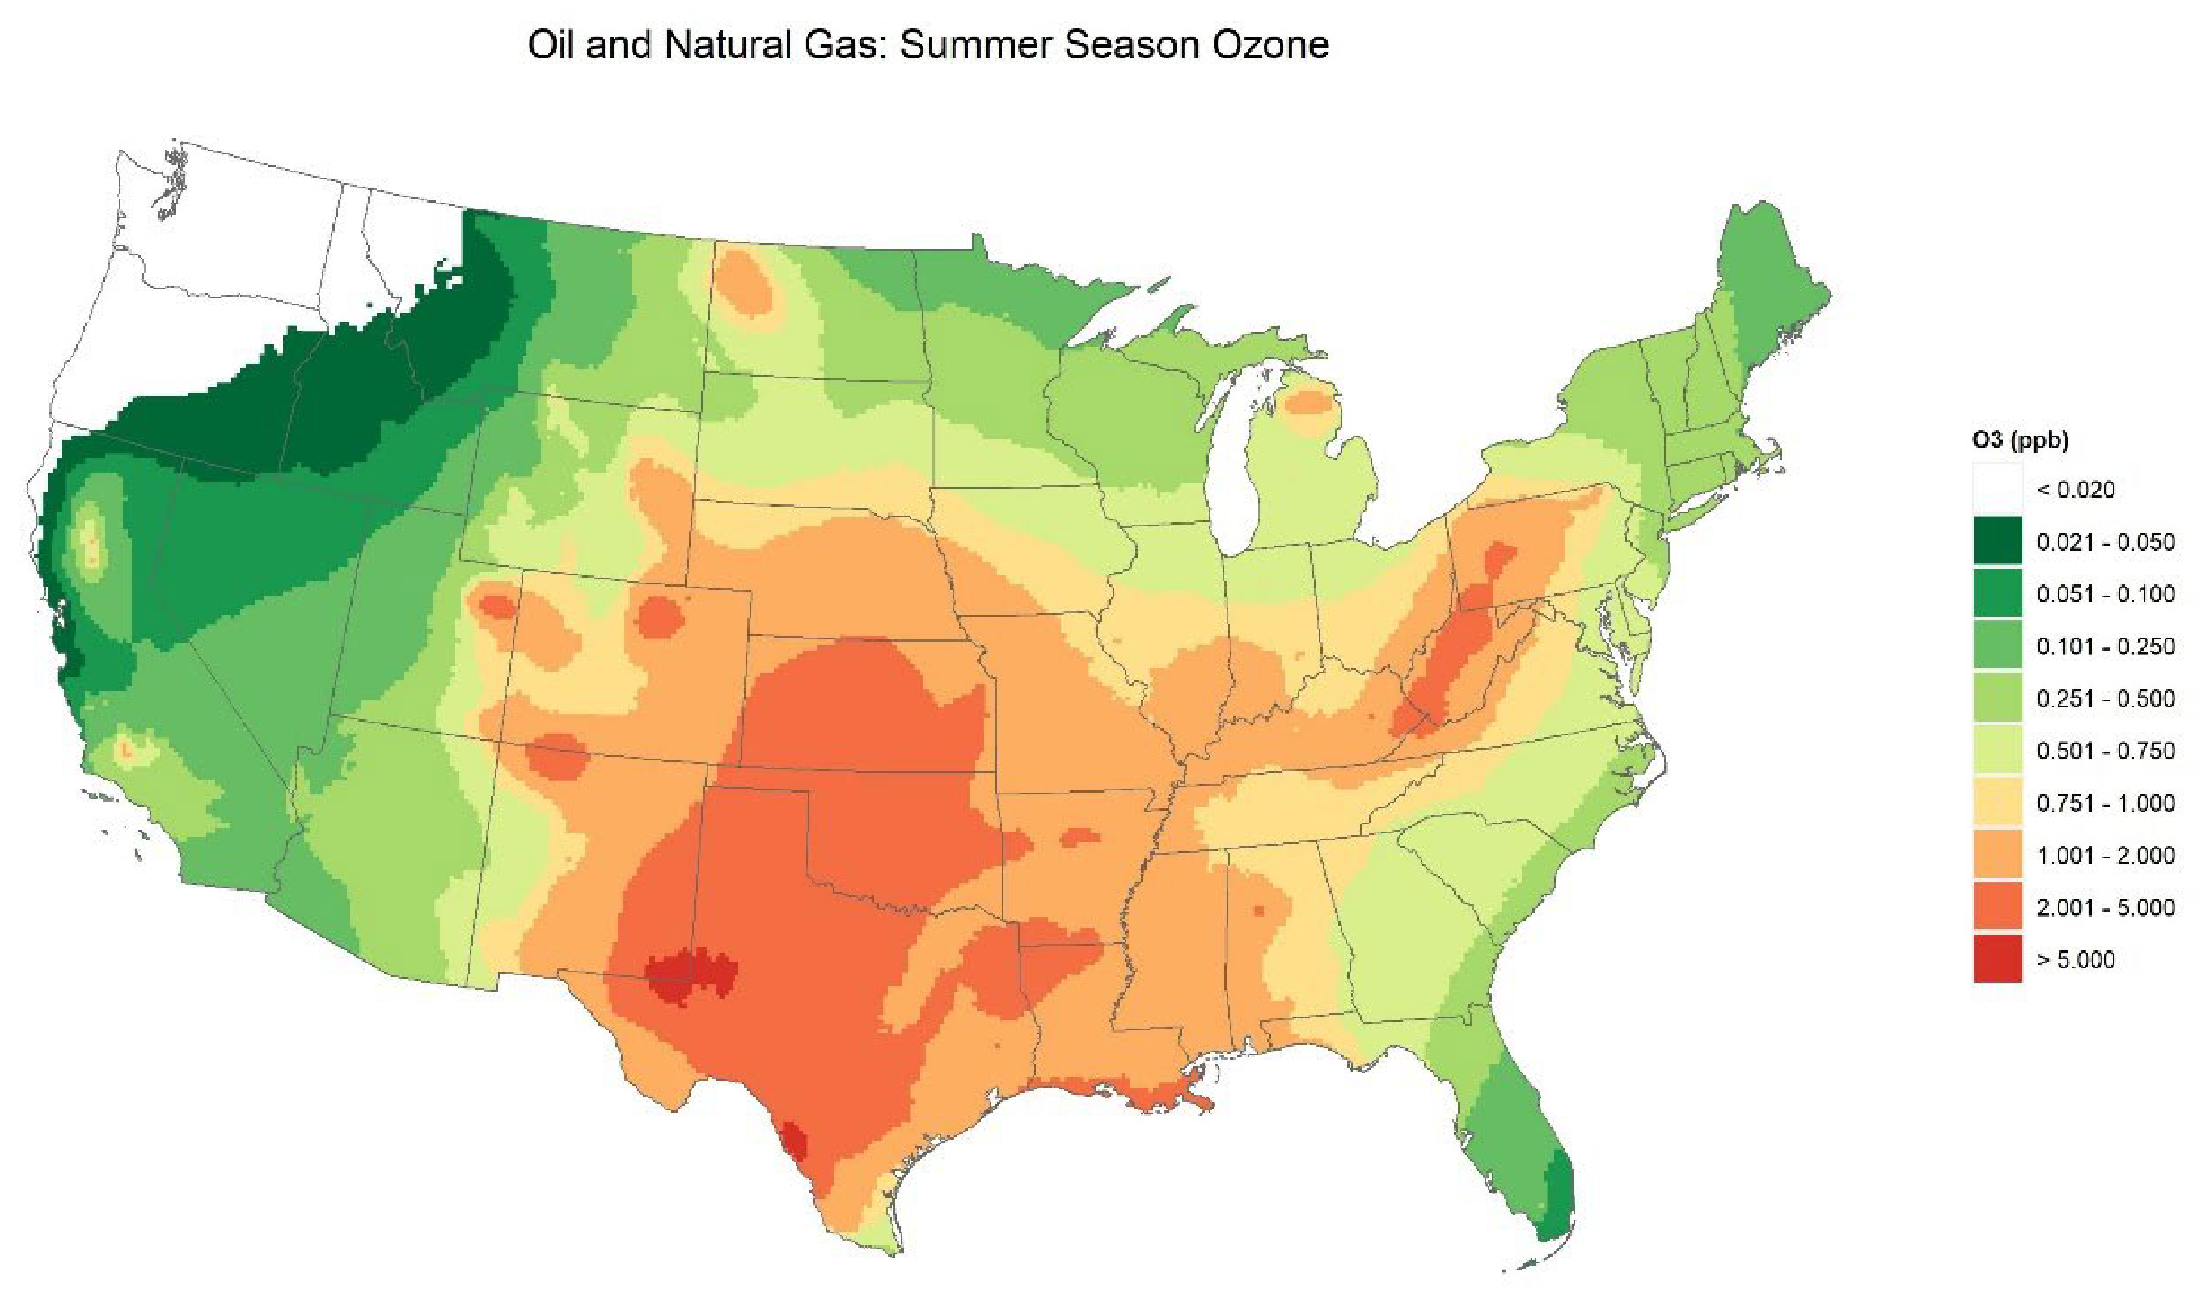
Impact on Ambient Ozone from Oil and Gas Extraction

Slide 21
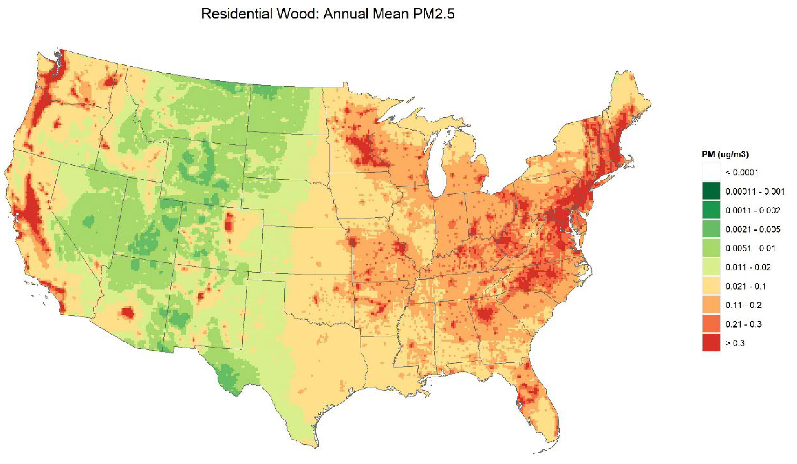
Impact on Ambient PM2.5 from Woodburning Stoves

Slide 22
Average Pollution Damage per Ton, By Sector

Slide 23
Average Pollution Damage per Ton, By Sector

Slide 24
Can EPA’s Approach Be Used to Compute Satellite Accounts for Local Air Pollution?
Issues with the National Emissions Inventory
Frequency
Residential v. territorial nature of emissions
EPA emissions will need to match NIPA sectoral descriptions
Valuation Issues
Approaches described value marginal impacts of emissions
Would focus on mortality impacts of PM2.5 and Ozone
EPA’s current VSL is based on hedonic labor market studies—so an acceptable market price

Slide 25
Accounts for Greenhouse Gases

Slide 26
Satellite Accounts for Greenhouse Gases (GHGs)
EPA reports emissions of GHGs by sector, annually
BEA has constructed pilot supply and use tables for 2017
Can these be valued using EPA’s Social Cost of Carbon (SCC)?
The SCC measures the present value of net damages from emitting an addition ton of CO2 in a particular year, including the value of:
Changes in net agricultural productivity
Energy use
Human health
Property damage from increased flood risk

Slide 27
2017 Supply and Use Table for GHGs (Million Tons)
Sector | Total GWP | Sector | Total GWP
Agriculture | 611.83 | Professional | 15.79
Mining | 300.02 | Management | 9.79
Utilities | 2152.34 | Administrative | 180.61
Construction | 46.49 | Education | 7
Manufacturing | 1028.84 | Health Care | 22.85
Wholesale | 67.66 | Entertainment | 2.54
Retail | 91.91 | Hospitality | 34.64
Transportation | 657.49 | Other Services | 18.88
Information | 8.1 | Government | 33.25
Finance | 9.61 | Households | 1108.21
Real Estate | 24.03 | Total Supply | 6431.87

Slide 28
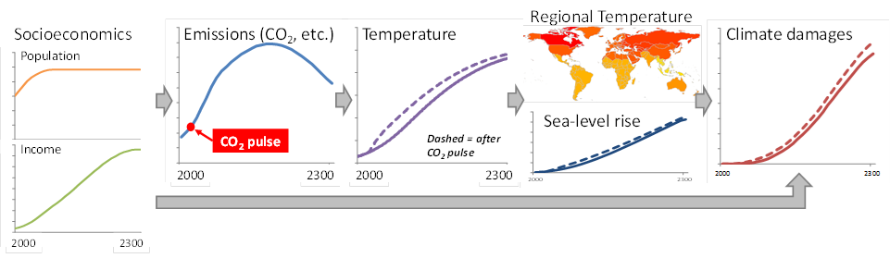
The 4 Steps of SCC Estimation
Projections of future population & GDP generate a CO₂ emissions path
CO₂ emissions path leads to predictions of mean global temperature change
Temperature change leads to damages, which are monetized and aggregated
Damages persist for many decades: discounting is used to sum them into a single present value
- This 4-step procedure is done with both baseline emissions and with a small additional amount (a pulse) of CO₂ emissions in a particular year.
- SCC is the per-ton difference in present value of damages due to the pulse.

Slide 29
US Government Calculation of the SCC
Inter-agency Working Group began in 2009 and continued through 2016, until disbanded by Trump in 2017
Combined results from 3 IAMs: DICE, FUND and PAGE
Using 5 equally weighted socio-economic scenarios
Using a common distribution over climate sensitivity
Preserving uncertainty in damage (and other) parameters in FUND and PAGE
150,000 Monte Carlo runs for each of 3 discount rates
2.5%, 3.0%, 5.0%
Next slide shows distribution of results for all discount rates

Slide 30
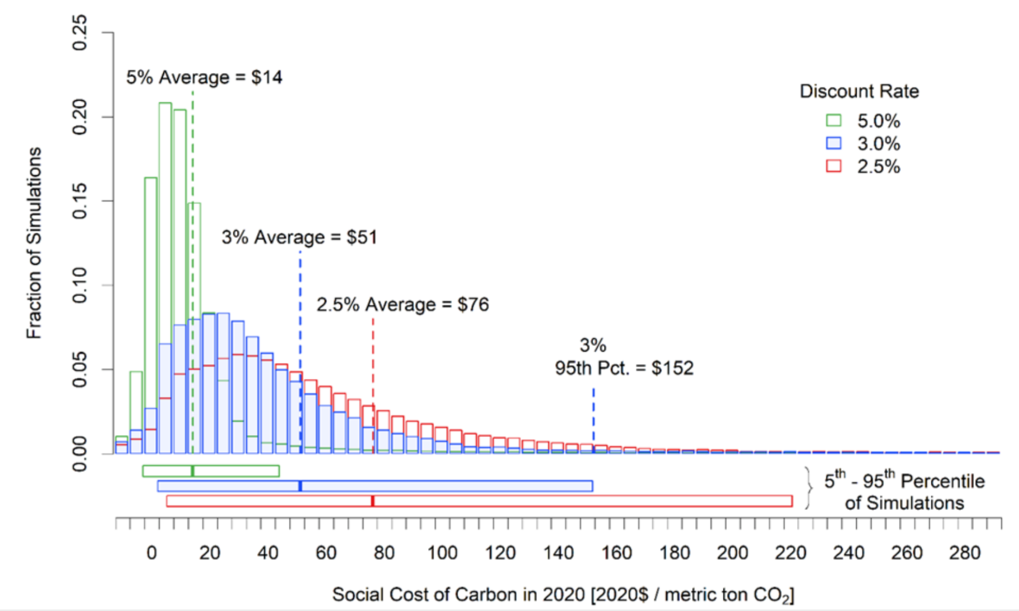
Frequency Distribution of Interim SCC Estimates in 2020$

Slide 31
How to Improve Estimates of the SCC? (2017 NRC Report)
“Unbundle” SCC estimation into 4 modules
Socioeconomic Module
Climate Module
Damages Module
Discounting Module
Each module to be developed based on expertise within the relevant disciplines
Uncertainty at each stage to be quantified and combined to generate a distribution of SCC values

Slide 32
Recommendations of the NRC Report
Statistical methods and expert elicitation should be used to project distributions of GDP, population growth and emissions into the future
Link between emissions and climate should use a simple Earth system model that satisfies well-defined diagnostic tests
Damage calculations should improve and update existing damage functions, drawing on recent scientific literature
Future damages should be discounted at a rate reflecting rate of economic growth underlying damage projections
Ramsey discounting will achieve this and allow correlation between climate damages and the discount rate

Slide 33
Improvements in Recent EPA SCC Estimates
EPA’s November 2022 release of SCC estimates satisfies all NRC recommendations:
Uses RFF’s probability distributions over socio-economic pathways (Nature 2022) and the FAiR Earth Systems model
Incorporates 3 new sets of damages:
RFF’s GIVE model (Nature 2022)
Captures Mortality, Agriculture, Energy, Coastal Damages
The Climate Impact Lab’s DSCIM model
Captures Mortality, Agriculture, Energy, Coastal Damage, Labor supply
Meta-analysis of damages by Howard and Sterner (2017)

Slide 34
USEPA SCC Estimates, November 2022
Social Cost of CO2, 2020 - 2050 (in 2020 dollars per metric tons of CO2) Near-Term Ramsey Discount Rate = 2%
 | Damage Module
Emission Year | DSCIM | GIVE | Meta-Analysis
2020 | 190 | 190 | 200
2030 | 230 | 220 | 240
2040 | 280 | 250 | 270
2050 | 330 | 290 | 310

Slide 35
SCC Issues from a National Accounting Perspective
Can damages to other countries be included in the SCC?
Exports are included in the National Income and Product Accounts
The SCC measures damages from exports of pollution
Valuation Approaches Used in EPA’s SCC
Mortality is valued using EPA’s VSL, based on hedonic wage studies. It is transferred to other countries using an income elasticity of 1.
Additional energy consumption, agricultural impacts and sea level rise valued using market prices

Slide 36
Accounts for Water Pollution Emissions

Slide 37
Physical supply table for gross releases of substances to water

Slide 38
Availability of Water Pollution Emissions Data
Point Source Emissions Data
National Pollutant Discharge Elimination System (NPDES) covers emissions from point sources, including:
Animal feeding operations; Fish farms; Pesticide permitting
Industrial operations, including mining, oil and gas drilling
Municipal wastewater; Storm water Discharges
Data are reported in Discharge Monitoring Reports
Non-Point Source Data
NPS data (e.g. agricultural runoff ) usually modeled using HAWQS

Slide 39
EPA’s Modeling of Ambient Water Pollution
HAWQS Model
Models river, stream water quality at the watershed level
Simulates effects of crops, soils, and land uses on sediment, pathogens, nutrients, BOD, DO and pesticides
Possible for point source loads to be added by the user
Provides estimates of:
Dissolved oxygen
Total suspended solids
BOD
Nitrogen
Phosphorus
Fecal coliform

Slide 40
EPA’s Valuation of Water Pollution Damages
Possible benefit categories to value:
Impacts on housing values
Recreation benefits
Non-use values
BenSPLASH
Quantifies and monetizes water quality improvements
Six pollutants—DO, Fecal Coliform, N, P, BOD, TSS—combined into a water quality index (WQI)
Meta-regression of stated preference valuation studies are used to value the WQI

Slide 41
Conclusions
Sufficient data exist for Air Emissions Satellite Accounts
Definitely for GHGs
Also for local air pollutants, although frequency an issue
Both must be adjusted to meet sectors used by BEA
Should be able to monetize air pollution damages
Using EPA’s current approaches for damage per ton of local pollutants
Using the Social Cost of Carbon for GHGs
Accounts for water emissions possible but monetization of damages still in the future

