Slide 1
Data on Early Career Doctorates presentation at the National Bureau of Economic Research conference “Investments in Early Career Scientists: Data and Research Gaps Spring 2021”
Jaquelina Falkenheim, Ph.D.
March 19, 2021

Slide 2














National Center for Science and Engineering Statistics
We provide policy-neutral policy-relevant statistical data on the U.S. science and engineering enterprise

Slide 3
Mission of NCSES
To be the federal clearinghouse for data that provides key insights on the American economy:
Science and engineering (S&E) education
S&E workforce
Research and development (R&D)
U.S. competitiveness in S&E

Slide 4









The NCSES Surveys Cover Key Populations
Establishments
Businesses
Universities
Nonprofits
Federally funded research & development centers
Federal & state government
People
S&E graduate students
S&E college graduates
Doctorate recipients
Early-career doctorates

Slide 5

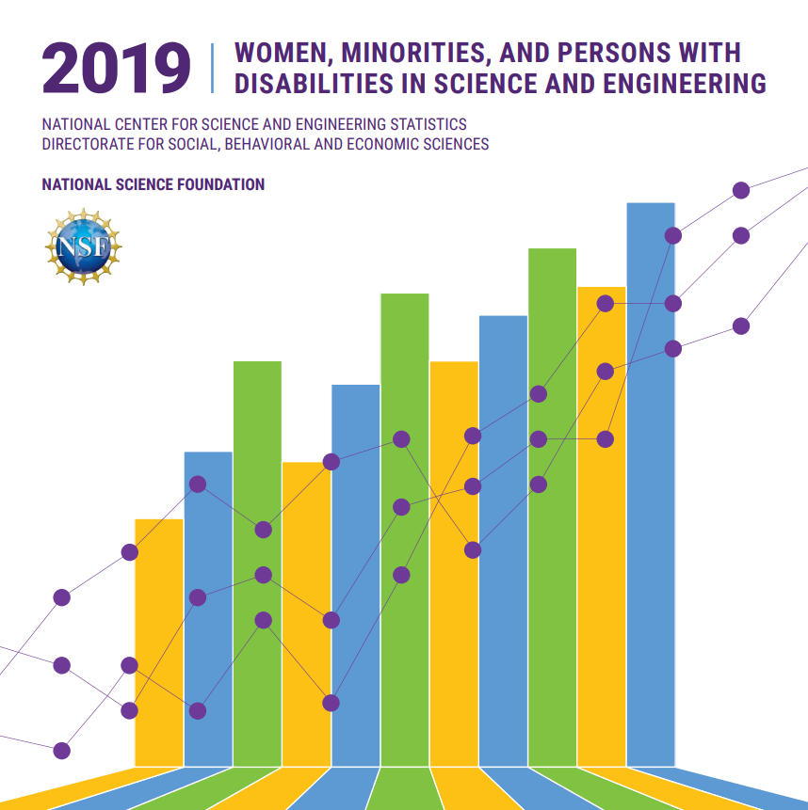
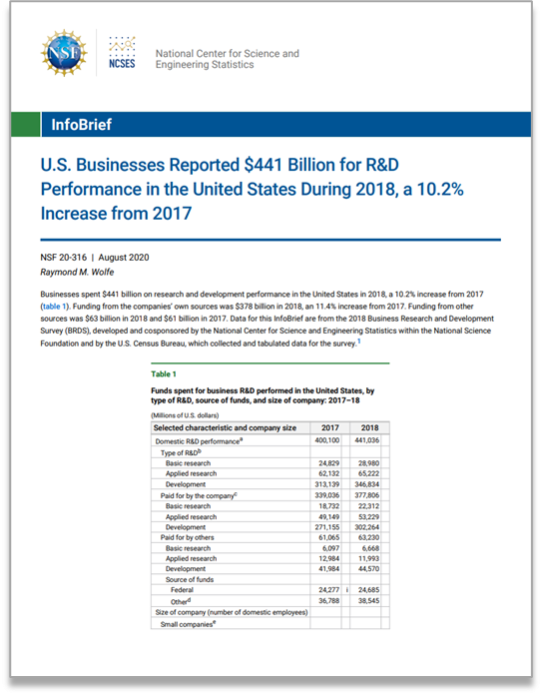
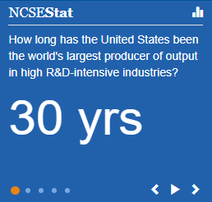
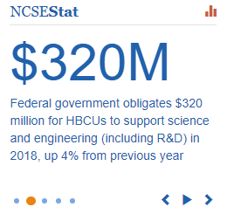
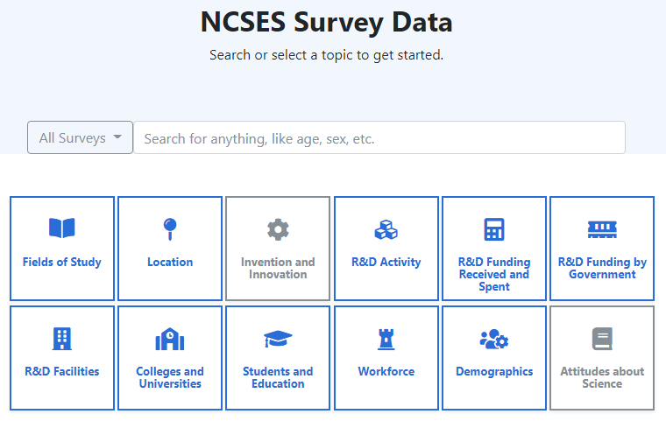
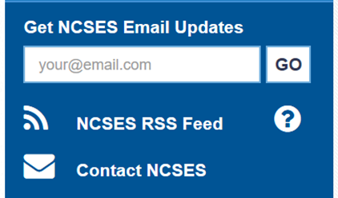
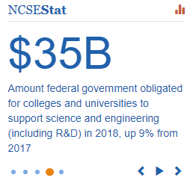
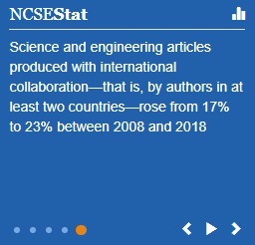
NCSES Data Products
Indicators, WMPD, and SED Digest
InfoBriefs, Infographics, and 1-pagers
NCSEStats and Tweets
Upcoming releases
Data Tool – https://ncsesdata.nsf.gov/
https://www.nsf.gov/statistics/next-releases.cfm

Slide 6
NCSES Surveys with data on early career doctorates
Surveys with data on early career doctorates | Frequency
Survey of Earned Doctorates (SED) | Annual
Survey of Doctorate Recipients (SDR) | Biennial
Survey of Graduate Students and Postdoctorates in S&E (GSS) | Annual
Early Career Doctorates Survey (ECDS) | TBD

Slide 7


Unique Contributions of the ECDS
Surveys with data on early career doctorates | Type of doctorate |  | Field of study |  | Country of Doctorate
 | Research | Professional | S&E | Non-S&E | U.S. | Other
Survey of Earned Doctorates (SED)
Survey of Doctorate Recipients (SDR)
Survey of Graduate Students and Postdoctorates in S&E (GSS)
Early Career Doctorates Survey (ECDS)

Slide 8
ECDS Target Population
Individuals who earned their first doctorate or equivalent degree within the last 10 years, including:
Postdocs
Faculty
Non-faculty researchers, research scientists
Administrators, other staff
Individuals working in the United States in:
Master’s degree- and doctorate-granting academic institutions
Federal funded research and development centers
National Institutes of Health Intramural Research Program

Slide 9

ECDS Survey Content
Topics covered
Educational history
Demographics
Professional activities
Employment
Work and personal life
Career development and planning
Questionnaires available here: Early Career Doctorates Survey | NCSES | NSF

Slide 10
ECDS Data
2015 ECDS pilot study
Sample size: 6,827
Results were released in an InfoBrief available here: https://nsf.gov/statistics/2017/nsf17313/
2017 Women, Minorities, and Persons with Disabilities in Science and Engineering (WMPD) Report
Restricted-use data
2017 ECDS full-scale survey
Sample size: 21,742
InfoBrief and data tables (April 2021)
2021 WMPD report (April 2021)
Restricted-use data (After April 2021)

Slide 11
How to obtain access to our data
Visit http://ncses.nsf.gov to view data products
Visit https://ncsesdata.nsf.gov/ to access our public-facing data tool
ECDS: Restricted data access through a licensing agreement
Information on how to obtain a license for any of our restricted data sets is available here: https://nsf.gov/statistics/license/index.cfm

Slide 12
Jaquelina Falkenheim, Ph.D.
jfalkenh@nsf.gov, 703-292-7798
Notes:
.

