Slide 1
The Taxation of Business Income in the Global Economy
Alan J. Auerbach
Martin Feldstein Lecture
July 28, 2021

Slide 2
Feldstein on International Taxation

Slide 3

Feldstein on International Taxation
“The point of this analysis is more modest; we want to show that the common belief that a VAT is a kind of disguised protectionist policy is based on a misunderstanding.”

Slide 4
G-7 Corporate Tax Rates
Source: OECD

Slide 5
Top Five US Companies
1971:
IBM
GENERAL MOTORS
AT&T
EXXON MOBIL
EASTMAN-KODAK

Slide 6
Top Five US Companies
1971:
IBM
GENERAL MOTORS
AT&T
EXXON MOBIL
EASTMAN-KODAK
2021:
APPLE
MICROSOFT
AMAZON
ALPHABET
FACEBOOK

Slide 7
A Changing Economic Setting
In last half century,
Share of IP in US nonfinancial corporate assets more than doubled (Fed FOF)
Share of before-tax US corporate profits coming from overseas operations nearly quintupled (BEA)
Share of cross-border equity ownership has steadily increased

Slide 8
Implications for Tax Policy
Increased pressure on tax systems based on corporate residence
With greater multinational activity and foreign ownership, easier to engage in inversion (change in corporate residence resulting from corporate reorganization)

Slide 9
Implications for Tax Policy
Increased pressure on tax systems based on where companies produce
Location of production easier to change because of internal multinational supply chains and lower transportation costs (e.g., microchips and pharmaceuticals vs. autos and steel)

Slide 10
Implications for Tax Policy
Increased pressure on tax systems based on where companies report profits (as distinct from where they produce)
Profit-shifting easier when companies already have foreign operations and are developing, locating, and valuing IP
  How much profit shifting now exists may have been significantly overstated by some studies, but still an important issue

Slide 11
The Need for Reform
Traditional approach to taxing multinationals based on location of production and corporate residence appears to be unstable. What are the options for reform?

Slide 12
1. Anti-Avoidance Rules
Tighten tax rules to limit profit shifting
  Works to reduce tax avoidance
  But has adverse effects on other margins (e.g., investment)
Tighten tax rules to limit inversions
  Increasingly complex

Slide 13
2. Patent Boxes
Try to limit tax competition to more mobile income, e.g., through the enactment of patent boxes
  A lower tax rate on intellectual property income
  Also justified as encouraging activities with positive spillovers

Slide 14
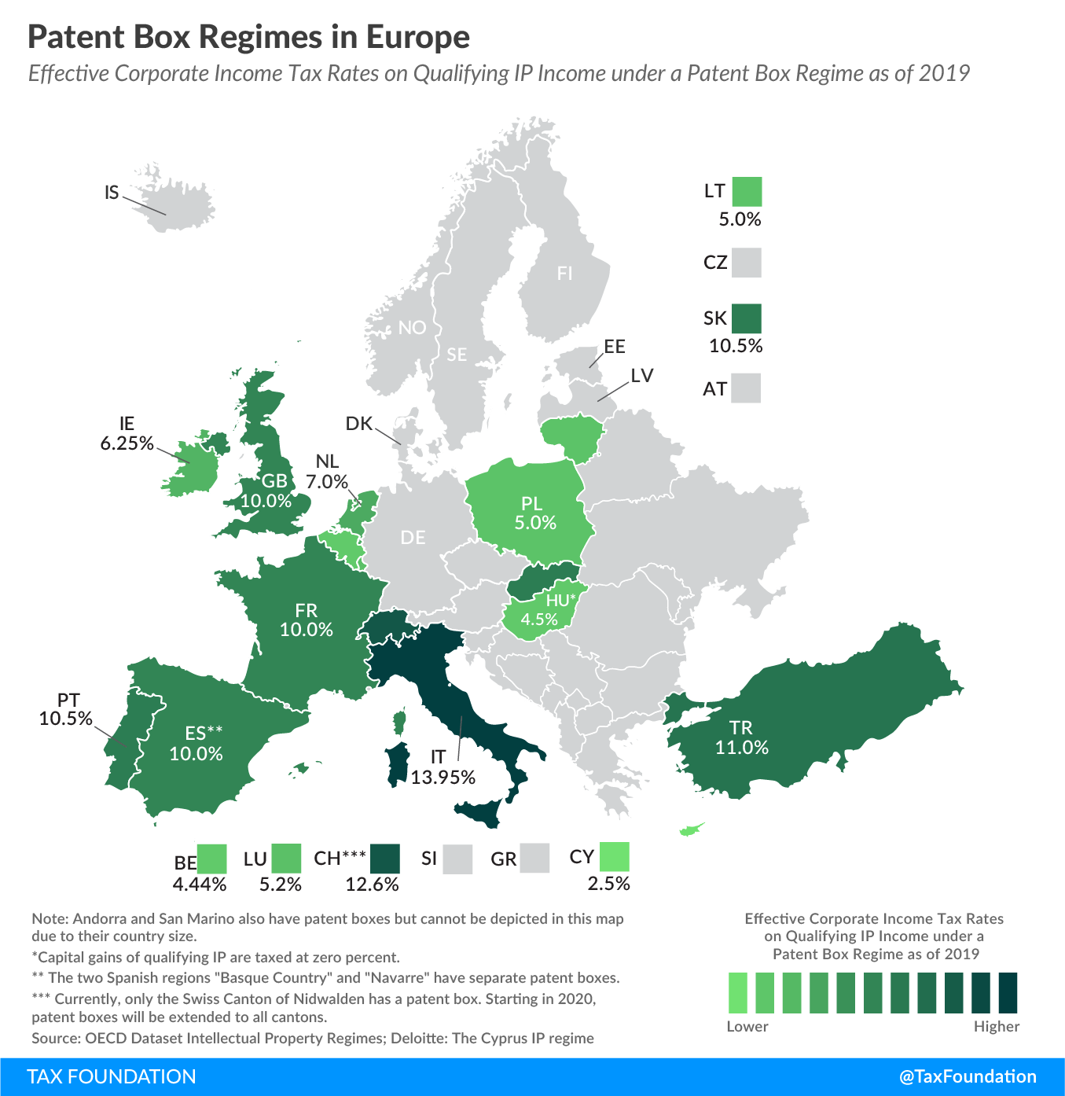

Slide 15
2. Patent Boxes
Try to limit tax competition to more mobile income, e.g., through the enactment of patent boxes
  A lower tax rate on intellectual property income
  Also justified as encouraging activities with positive spillovers
  But still promotes profit-shifting and may have little impact on the location of innovative activity

Slide 16
3. Digital Services Taxation
Target big, primarily US companies (e.g., Google, Facebook) with a new, separate tax on gross receipts, based on where their users are, even if the companies have little or no activity there (“nexus”), as defined by income tax rules
Several individual countries, starting in Europe, have adopted digital service taxes (DSTs)

Slide 17
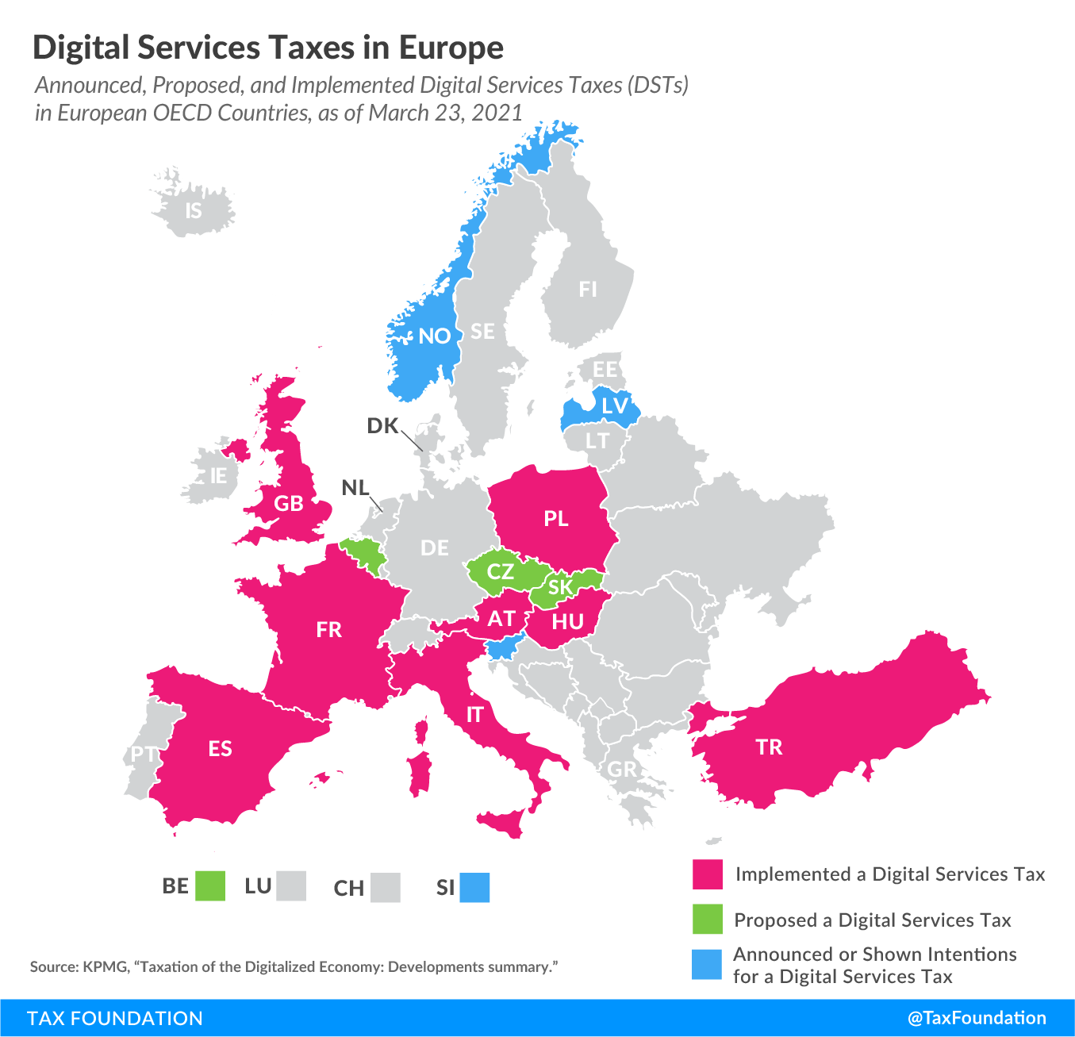

Slide 18
4. Destination-Based Taxation
Focus tax base on destination, i.e., location of consumers
Since this tax base is relatively immobile, less susceptible to competition over tax rates
  E.g., the main existing tax based on location of consumption – VAT – shows little susceptibility to tax-rate competition, unlike the corporate income tax

Slide 19
G-7 Value Added Tax Rates
Source: OECD

Slide 20
4. Destination-Based Taxation
Focus tax base on destination, i.e., location of consumers
Since this tax base is relatively immobile, less susceptible to competition over tax rates
  Because of reduced focus on residence or location of production, unilateral adoption might induce adoption by other countries
  A form of tax competition, but over tax systems, not tax rates
  Reflects an additional objective of tax design (efficiency, equity, administrability, etc.): incentive compatibility

Slide 21

Download the full book for free

Slide 22
Two Approaches to Reform
Residual Profit Allocation by Income (RPAI) – Incremental
Destination-Based Cash Flow Taxation (DBCFT) – Big

Slide 23
RPAI
Allocate earnings on “routine” operations as under current system, based on location of production
Allocate residual earnings (including earnings attributable to intellectual property) based on location of net sales revenue
US states have moved over time toward the use of apportionment based on sales (rather than payroll or assets), confirming the incentive for governments acting independently for this type of shift

Slide 24
DBCFT
Would impose
  a cash flow tax on domestic operations
  border adjustments eliminating import deduction & export tax
Border adjustment would
  Shift location of tax from production to consumption
  Eliminate profit shifting opportunities
Equivalent to a VAT with wage component excluded, so just a tax on profits
  Also equivalent to one-time tax on residents’ wealth

Slide 25
DBCFT
Proposed in US in 2016; not implemented in 2017 because of concerns including
  Short-run effects associated with exchange rate adjustment
  Possible WTO reaction
  General lack of understanding of the plan’s operation, incidence, and economic impact

Slide 26
5. The Kitchen Sink
US Tax Cuts and Jobs Act (2017)
  Reduced tax rate, continuing tax competition
  Global minimum tax on US companies, aimed at tax avoidance (GILTI)
  Investment expensing and targeted provisions reducing tax on exports and reducing deduction for imports, like the DBCFT
Not a stable situation, for the US or the world
  US tax revenue loss
  Discourages US residence (to avoid GILTI)
  No measures to deal with digital services

Slide 27
The OECD and the Two Pillars

Slide 28


Slide 29


Slide 30
Pillars 1 and 2
Pillar 1: Allocation to market countries of a fraction (20-30%) of profits above a threshold (> 10% of revenues) of extremely large multinationals (> €20B annual revenues)
  Pillar 1 would replace existing and proposed DSTs
  Excludes financial services companies & those in extractive industries

Slide 31
Pillars 1 and 2
Pillar 1: Allocation to market countries of a fraction (20-30%) of profits above a threshold (> 10% of revenues) of extremely large multinationals (> €20B annual revenues)
  Pillar 1 would replace existing and proposed DSTs
  Excludes financial services companies & those in extractive industries
Pillar 2: A global minimum tax of at least 15% imposed on profits above a threshold (> 7.5% of tangible assets plus payroll) for large multinationals (> €750M annual revenues)
  Pillar 2 also includes provisions to tax domestic payments to related parties in noncomplying or low-tax countries

Slide 32
Pillar 1
Like the DSTs, essentially a tax on large US multinationals providing digital services, with estimates that
  around 64% of global tax revenues generated by US companies
  half of this from Apple, Microsoft, Alphabet, Intel & Facebook
Like RPAI, but much more limited
  Applies only to a small number of extremely large tech companies
  Allocates only 20-30% of excess profits, rather than all

Slide 33
Pillar 2
Like existing US GILTI provision, but at a higher tax rate
Like Biden proposal, but at a lower tax rate and with a rate-of-return threshold for taxable profits

Slide 34
Can the Agreement Work? Should It?
Many immediate, significant challenges, including
  Can the US get treaty approval for Pillar 1?
  Can the US get the minimum tax through reconciliation?
  Can Europe achieve unanimity?

Slide 35
Can the Agreement Work? Should It?
But also a more fundamental challenge, arising from the attempt to preserve a system based on two concepts that are increasingly ill-defined and endogenous
  Corporate residence
  Location of production and profits (i.e., “value creation”)
System can be viable only if countries adopt and adhere to similar rules that lessen incentives to shift production, profits, or residence

Slide 36
What is Required?
Similar minimum tax rates and bases across home countries, to lessen incentives for companies to shift corporate residence

Slide 37
What is Required?
Similar minimum tax rates and bases across home countries, to lessen incentives for companies to shift corporate residence
Similar corporate tax rates and tax bases across countries, to lessen incentives for companies to shift production and profits

Slide 38
What is Required?
Similar minimum tax rates and bases across home countries, to lessen incentives for companies to shift corporate residence
Similar corporate tax rates and tax bases across countries, to lessen incentives for companies to shift production and profits
Similar regular and minimum corporate tax rates and tax bases for any given country, to lessen incentives for resident companies to shift production and profits abroad

Slide 39
What Should These Values Be?
Limiting tax competition is not the only government objective; other objectives push different countries in different directions
With a destination-based approach, governments could pursue different policy objectives without worrying about tax competition

Slide 40
Conclusions

