Slide 1
The Real Effects of Capital Controls: Credit Constraints, Exporters, and Firm Investment
Laura Alfaro Harvard Business School | Anusha Chari University of North Carolina Chapel Hill | Fabio Kanczuk University of Sao Paulo

Slide 2
The Rationale for Capital Controls
Macro-prudential Concerns: Mitigate the volatility of foreign capital inflows.
Protectionism: Prevent currency appreciation.
"The US printed a lot of money, so there's a lot of hot money flowing around. We see hot money in Taiwan and elsewhere in Asia… These short-term capital flows are disturbing emerging economies.”
-Perng Fai-Nan
Notes:
Renewed debate in academic and policy circles about the merits of international capital mobility: benefits potential risks.
Massive foreign capital inflows that emerging markets following the global financial crisis of 2008-2009 due to expansive monetary policy in rich countries (Q.E.); IMF (2012).
Policymakers from emerging Asia and Latin America have expressed concerns that massive inflows can lead to appreciation of the exchange rate and loss of competitiveness.

Slide 3
Macro-Micro Level Analysis
An extensive empirical literature has focused on the aggregate effects of capital controls. (Magud, Reinhart, and Rogoff, 2011).
Macroeconomic analysis do not shed light on the channels through which capital controls can affect the economy at the micro-level.
Studies about the effects of capital controls on firm-activity are relatively scarce (Forbes 2007a, b).
Data availability for emerging markets being an obvious constraint.

Slide 4
Firm-Level Analysis Using Brazilian Data
Evaluate the effects of capital controls on firm-level stock returns & real investment using data from Brazil.
Brazil has implemented a series of controls on capital flows in the last 5 years.
The stock market in Brazil is relatively well developed:
Value stocks traded above 40% and 65% market cap. % GDP, 2007-2012 (WDI, WB).
Firm-level and export data:
Firm-level response to capital flows as well as the impact of capital controls on exporting firms, (Datastream, Secex).
Event-study methodology around the dates when the various capital control measures were announced using stock prices and firm level data.
Notes:
ADD

Slide 5
Table 1: Capital Controls in Brazil, 2008-2012

Slide 6
The Imposition of Capital Controls Constitutes a Move Away from Financial Openness.
Changes in expected returns will depend on changes in firm-specific systematic risk
Expected returns will rise for firms whose exposure to systematic risk increases and fall for those whose exposure decreases following capital controls announcements.
The change in expected returns will be reflected in stock prices. How?
Required Rates of Return
Expected Future Cash Flows
All else equal, stock prices will fall if the market imputes an increase in expected returns or the firm-specific cost of capital or a decrease in expected future cash flows.
Notes:
The risk-free and the firm-specific systematic risk may rise following the imposition of capital controls, and the expected return (or cost of capital) may go up and stock prices fall.

Slide 7
Real Effects at the Firm-Level
Credit constraints at the firm level are more likely to bind for firms that are more dependent on external finance (Chaney (2008), Rajan & Zingales (1998)).
Frequent changes to capital controls can increase uncertainty while reducing the availability and increase the cost of external finance, which can lower investment at the firm-level.
Notes:
If production and exporting are associated with fixed costs and dependent on external finance, credit constraints at the firm level become relevant (Chaney, 2008).
Firms with easier access to external finance or greater access to low cost of funds may be able to overcome the barriers associated with these fixed costs (Rajan and Zingales, 1998, etc.).

Slide 8
Event-Study Methodology
Announcement effect of capital controls news:
If capital markets are semi-strong form efficient to public information, stock prices will quickly following an announcement (Andrade et al., 2001).
Two-day window: most stringent test to capture the announcement effect of the capital controls with less concern about other confounding news events.
Notes:
If production and exporting are associated with fixed costs and dependent on external finance, credit constraints at the firm level become relevant (Chaney, 2008).
Firms with easier access to external finance or greater access to low cost of funds may be able to overcome the barriers associated with these fixed costs (Rajan and Zingales, 1998, etc.).

Slide 9
Results
Significant decline in cumulative abnormal returns following changes in capital controls.
Controls on equity flows are associated with significantly more negative returns.
Firm characteristics:
Large firms and exporting firms are less affected by the controls.
The largest exporting firms (>$100 million) are less affected.
Firms that are more dependent on external finance are more adversely affected by the imposition of capital controls.
Investment declines significantly for small, non-exporting firms that are dependent on external finance. Exporters increase investment.
Notes:
WE CAN TEST THOSE HYPOTHESIS—exporters are larger not sign for all sample, but sign for manuf. And are less dependent on external finance (double check).

Slide 10
Roadmap
Theoretical underpinnings
Event study methodology
The Data
Results
Conclusion

Slide 11
Capital Controls Reduce International Diversification Opportunities
Complete financial market integration implies that::
Assume a country imposes capital controls segmenting its stock market from the rest of the world.
Assume also that expected future cash flows remain unchanged.
Market segmentation will reduce the diversification opportunities for foreign investors (effects magnified if domestic investors are limited in ability to invest abroad).
The relevant pool of investors will tilt towards domestics. For any individual stock:
Depending on the level of controls the change in expected returns will reflect a range from complete to partial segmentation.
Alternatively, controls create a price wedge in the expected returns or a tax that drives up the expected return relative to the benchmark return under full integration.
Notes:
E[$\tilde{R}$_{i}]: required rate of return on firm i stock, r_{f} : risk-free rate in the domestic market, B_{im}: beta coefficient of firm with the domestic market portfolio before liberalization, r_{i}: expected return on the domestic market.

Slide 12
Capital Control & Stock Prices
Risk-free rate effect.
Firm-specific risk premium effect.
Expected cash flow effect.
If some firms benefit from the protectionism, expected cash flows could increase more than the rise in the required rate of return such that stock prices rise.
Notes:
capital controls drive up the domestic interest rate if they are effective in keeping capital out or driving capital outflows.
If the risk-free rates and the firm specific risk premium both rise:
The required rate of return for a given firm will go up and its stock price will fall.
Reflected in negative cumulative abnormal returns in the event windows.

Slide 13
Data
Stock price data from Datastream.
Data about firm characteristics are taken from Worldscope.
BOVESPA (most common index in Brazil).
For robustness use other indices such as IBRA.
We use quarterly data from Q1 2006-Q4 2012.
Proxy for size: the (log) of total assets (sales).
Proxy liquidity: debt to total assets and short term debt to total debt.
Lagged one year deflated by CPI.
The firm level information was matched to export status and the range of exports using data from the Brazilian Secretary of External Trade (Secretaria de Comercio Exterior, Secex).
The export range is in US$ (FOB) and includes firm exporting less than $1million, between $1 million and $100 million, and above $100 million.

Slide 14
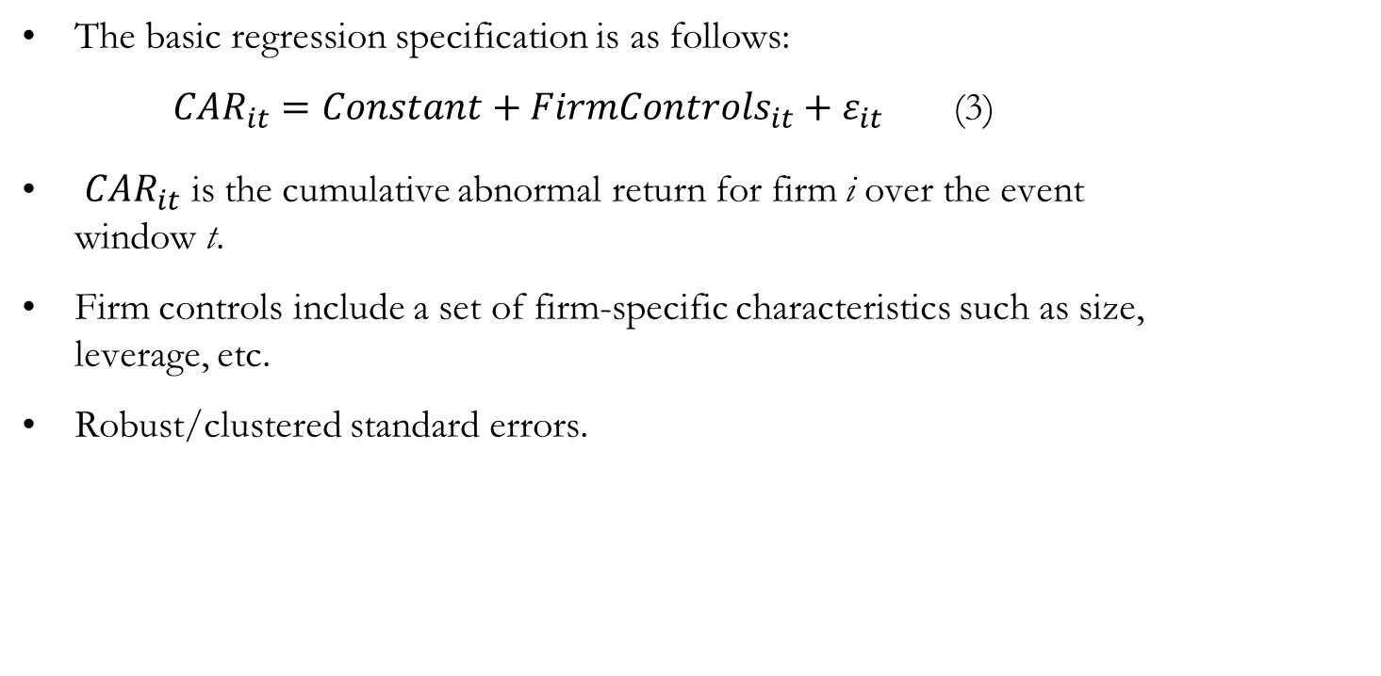
Main Specification
The basic regression specification is as follows:
${CAR}_{it}=Constant+{FirmControls}_{it}+ε_{it}$ (3)
${CAR}_{it}$ is the cumulative abnormal return for firm i over the event window t.
Firm controls include a set of firm-specific characteristics such as size, leverage, etc.
Robust/clustered standard errors.

Slide 15
Cumulative Abnormal Returns are Negative & Significant when Capital Controls are Announced (Table 4)

Slide 16
Debt vs. Equity Events
Similar pattern of results holds with highly significant negative cumulative abnormal returns (Table 5).
Controls on equity flows in Panel B display a more negative announcement effect (Columns 2-4, 6-7) compared to controls on debt flows in Panel A. T-tests of means confirm differences.
For equity related announcements the short term debt ratio is negative and significant→ overall -4.8% decline (Panel B, Column 4)
Firms with higher levels of short-term debt are perhaps more dependent on external finance in the form of short-term debt or equity and therefore the imposition of controls on equity flows has an even more negative effect on firm returns.
Notes:
returns when capital control measures are announced with slightly muted effects when we control for firm size. The overall announcement effect however remains negative and statistically significant.
The market views controls on debt and equity as distinct and controls on equity flows are assessed more negatively than controls on debt flows.
We examine the hypothesis of credit constraints and external finance dependence in the next subsection.

Slide 17
Table 6: External Finance Dependence Drives Abnormal Returns
The constant is negative & significant ranging from -2.3% to -3.68%.
External finance dependence drives down abnormal returns further in alternative specifications.
-(CE-CF)/CE (continuous)
-(CE-CF)/CE > mean (dummy)
-(CE-CF)/CE (manufacturing dummy)
Large firms and exporters are somewhat shielded—firm size and export coefficients are positive & significant.
Coefficient on small exporter variable is negative & significant.

Slide 18
Investment: Before and After Regime Change (Table 7)

Slide 19
Robustness Checks and Additional Tests
Different windows and different methodologies for computing returns (raw returns, CAPM).
Two-way clustered standard errors.
Firms on the alternative IBRA stock exchange.
Dropped the event with the most negative abnormal returns on 10/22/2008 which also coincides with the global financial crisis.
IPO of OGX (June-2008).
Share of debt to bank (negative and significant); and sales as an alternative proxy of size.
Quantile (median) regressions for our main specifications.
Easing and tightening events separately.

Slide 20
Discussion
The evidence in this paper suggests that capital controls can:
increase market uncertainty
reduce the availability of external finance
lower investment at the firm-level.
Implications for macro models that focus on aggregate variables to examine the optimality of capital controls & abstract from heterogeneity at the firm-level.
In particular, the evidence suggests that capital controls disproportionately affect small, non-exporting firms especially those more dependent on external finance.
Notes:
The rationale for capital controls policy measures range from macro-prudential efforts to reduce the volatility of foreign capital inflows to a protectionist stance to maintain the competitiveness of the external sector.

