Slide 1
Education, Congestion and Pollution:
Evidence from Traffic and Environmental Impacts of Cross-district Schooling
Siqi ZHENG
Tsinghua University
Cong SUN
Tsinghua University
Ming LU
Shanghai Jiaotong University & Fudan University
February 14, 2014

Slide 2
Outline
Background & main findings
“School district” policy and the patterns of driving children to/from school in Beijing
Empirical strategy and data
Empirical results
Conclusions

Slide 3
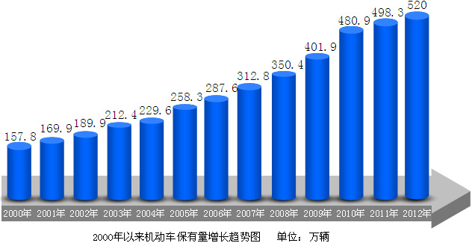
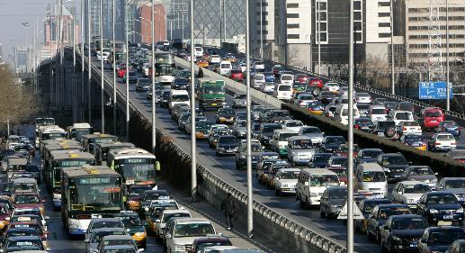
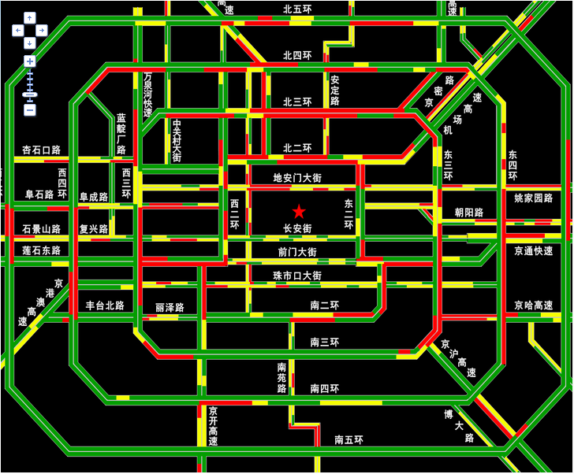
Serious traffic congestion in Beijing
Number of motor vehicles
in Beijing (million)
5.20
4.81
4.98
4.02
3.13
3.50
2.58
2.88
2.12
2.30
1.70
1.90
1.58
2000
2001
2002
2003
2004
2005
2006
2007
2008
2009
2010
2011
2012
Source: Beijing Traffic Management Bureau
In 2010, the average one-way commute time in Beijing was 43.6 minutes (Meng et al., 2011), higher than almost all the cities in the United States.

Slide 4
Vehicle Emission and Air Pollution
22.0%
The vehicle emission is suspected to be one of the major causes for the haze in Beijing in early 2013.

Slide 5
Non-commute travel contributes significantly to traffic flow
The share of home-to-work commuting in the total traffic flow is declining.
  less than 40% in 2010 (Beijing Municipal Institute of City Planning & Design).
“Non-commute travel” is more important
  Shopping, social activities…
  Driving children to/from school
    On the first school day in September 2012 in Beijing, the morning rush-hour traffic flow jumped by about 25% over the previous week.
    Average speed of vehicles: 20.4 km/h; Congestion level: severe congestion

Slide 6
Key variable: Transportation Performance Index
Monthly TPI (December 2006 to June 2011), during peak hours, from Beijing Transportation Authority, aggregate number for the whole city

Slide 7
Preview of main findings
Parents drive long distances (much longer than the usual distances within a school district) to send their children to schools, suggesting that they may live far away from their school district (“cross-district schooling”).
All else equal, the TPI in the workdays during school-holidays is 20-30% lower than that in the workdays during non-school-holidays, which decreases the concentration of incumbent particles PM₁₀ by about 20μg/m³ (equivalent to 16% of the mean of PM₁₀).
A more decentralized supply of schools can mitigate such costs.

Slide 8
Outline
Background & preview of main findings
“School district” policy and the patterns of driving children to/from school in Beijing
Empirical strategies and data
Empirical results
Conclusions

Slide 9
Comparison between the supply of schools in the US and China
Tiebout sorting and the decentralized supply of schools in the US → Households choose their houses and their children’s schools (as an amenity) simultaneously.
There is no property tax in Chinese cities. The school supply decision is centralized at the city level. → Households cannot vote for and pay for the supply of school quantity/quality in their neighborhood. → One place cannot satisfy a household’s housing demand and school demand simultaneously.
  Though a so-called “school district policy” exists, many rich people do not really live in their school district. (buy a small unit and rent it out, or just pay a high admission fee without buying a unit at all.)

Slide 10
Population suburbanization vs. fixed school supply
District | “key junior high schools” | Population share (2000) | Population share (2010)
Xicheng | 8 | 9.09% | 6.34% ↓
Dongcheng | 5 | 6.50% | 4.69% ↓
Haidian | 5 | 16.51% | 16.73%
Chaoyang | 1 | 16.88% | 18.08% ↑
Shijingshan | 1 | 3.60% | 3.14%
Fengtai | 1 | 10.09% | 10.77% ↑
Other peripheral counties | 4 | 37.34% | 40.26% ↑
Total | 25 | 100% | 100%
central
72%
28%

Slide 11
Cross-district schooling
Yu and Liu (2011) surveyed three key primary schools in Beijing:
  53.3% of students live outside the 2km radius of their schools. (The average radius of school district <= 2km).
  They also estimate that 20% of the students in Beijing’s primary schools and junior high schools are driven to schools by their parents.
  Less than 3% of students take school bus in Beijing
A rough estimation
  The number of students in Beijing’s primary schools and junior high schools was about 1.51 million in Beijing in 2010 (Statistical Yearbook)
  About 0.3 million students take private cars, which account for 10% of the overall motor vehicles on the road during the morning rush hours.

Slide 12
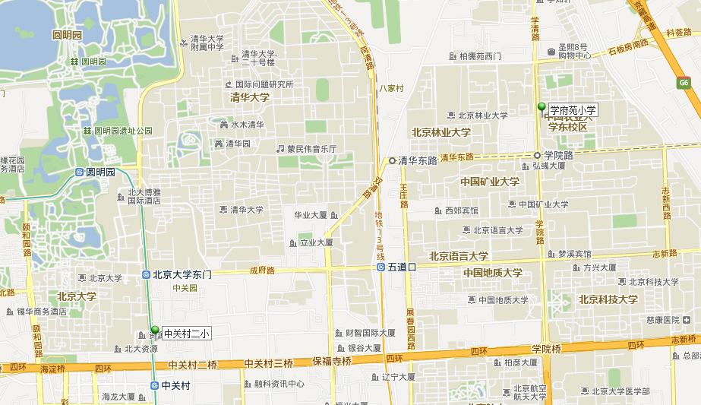
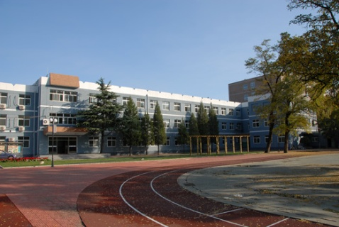
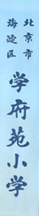
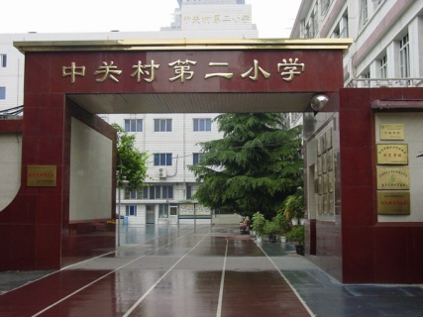
A small-scale survey we did in Beijing
Two primary schools; Similar location; Same day; ~40 parents for each
Xuefuyuan Primary School
(Non-key school)
Zhongguancun No.2 Primary School
(Key school)

Slide 13
A small-scale survey in Beijing
School | Homes outside the school district (>2km)
Zhongguancun | ~80% (15/18)
Xuefuyuan | ~20% (5/22)
5.5km → 0.9km
Zhongguancun No.2 Primary School
(Key school)
Xuefuyuan Primary School
(Ordinary school)

Slide 14
Outline
Background & preview of main findings
“School district” policy and the patterns of driving children to/from school in Beijing
Empirical strategies and data
Empirical results
Conclusions

Slide 15
Specifications
Cross-district schooling → Traffic congestion → Air pollution
Traffic Model (Regression Discontinuity in time series):
  Transportation Performance Index (TPI) = f (HOLIDAY, weather condition, driving restriction, workday fixed effects, year-and-month fixed effects)
  HOLIDAY = 1 for school holidays, 0 otherwise
Air Quality Model (IV regression):
  PM₁₀ concentration= g (TPI, PM₁₀ concentration yesterday, weather condition, year-and-month fixed effects)
  Using IV to take care of possible endogeneity – in dirty days people choose to stay inside and not drive.

Slide 16
Key variable: Holiday Discontinuity HOLIDAY
Summer and winter holiday schedule of primary and secondary schools in Beijing from 2007 to 2012.
Year | Holiday | Start date | End date
2007 | Winter | 1/27/2007 | 2/27/2007
2007 | Summer | 7/14/2007 | 8/31/2007
2008 | Winter | 1/26/2008 | 2/24/2008
2008 | Summer | 7/12/2008 | 8/31/2008
2009 | Winter | 1/17/2009 | 2/15/2009
2009 | Summer | 7/11/2009 | 8/31/2009
2010 | Winter | 1/23/2010 | 2/22/2010
2010 | Summer | 7/13/2010 | 8/31/2010
2011 | Winter | 1/22/2011 | 2/20/2011
2011 | Summer | 7/14/2011 | 8/31/2011
2012 | Winter | 1/14/2012 | 2/12/2012
2012 | Summer | 7/13/2012 | 8/31/2012

Slide 17
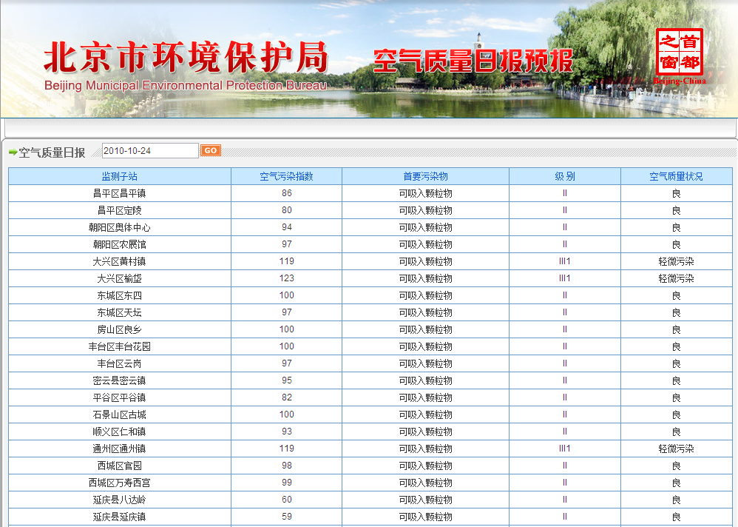
Key variable: Daily PM₁₀ concentration
The mean value of PM₁₀ concentration in Beijing’s central urban area.
Source: Beijing Municipal Environmental Protection Bureau

Slide 18
Variable definitions and summary statistics
Variable | Definition | Obs. | Mean | Std. Dev.
TPI | Morning peak Traffic Performance Index | 552 | 0.499 | 0.143
pm10 | Daily average PM₁₀ concentration (in mg/m³) | 552 | 0.125 | 0.070
holiday | 1=winter/summer holidays, 0=otherwise | 552 | 0.214 | 0.410
summer | 1=summer holidays, 0=otherwise | 552 | 0.130 | 0.337
winter | 1=winter holidays, 0=otherwise | 552 | 0.080 | 0.271
temperature | Daily mean temperature (℃) | 552 | 11.349 | 11.829
humidity | Daily mean humidity (%) | 552 | 49.607 | 20.856
wind | Daily mean wind speed (m/s) | 552 | 11.380 | 5.781
rain | 1=rainy day, 0=otherwise | 552 | 0.217 | 0.413
snow | 1=snowy day, 0=otherwise | 552 | 0.025 | 0.157
fog | 1=foggy day, 0=otherwise | 552 | 0.036 | 0.187
num4_9 | 1=no driving during the day if plate number ends with 4 or 9, 0=otherwise | 552 | 0.199 | 0.400
num3_8 | 1=no driving during the day if plate number ends with 3 or 8, 0=otherwise | 552 | 0.194 | 0.396

Slide 19
Outline
Background & preview of main findings
“School district” policy and the patterns of driving children to/from school in Beijing
Empirical strategies and data
Empirical results
Conclusions

Slide 20
Traffic model (full sample)
Dependent variable: TPI | (1) | (2) | (3) | (4) | (5) | (6)
holiday | -0.157*** | -0.151*** | -0.148***
 | (0.0181) | (0.0170) | (0.0160)
summer |  |  |  | -0.195*** | -0.183*** | -0.183***
 |  |  |  | (0.0248) | (0.0228) | (0.0214)
winter |  |  |  | -0.0772*** | -0.0798*** | -0.0731***
 |  |  |  | (0.0218) | (0.0227) | (0.0198)
num4_9 |  |  | 0.0905*** |  |  | 0.0915***
 |  |  | (0.00900) |  |  | (0.00894)
num3_8 |  |  | -0.0285*** |  |  | -0.0285***
 |  |  | (0.00855) |  |  | (0.00839)
Constant | 0.480*** | 0.397*** | 0.381*** | 0.507*** | 0.404*** | 0.388***
 | (0.0236) | (0.0372) | (0.0343) | (0.0283) | (0.0386) | (0.0355)
weather variables | Yes | Yes | Yes | Yes | Yes | Yes
workday fixed effects | Yes | Yes | Yes | Yes | Yes | Yes
year-and-month fixed effects | Yes | Yes | Yes | Yes | Yes | Yes
Obs. | 552 | 552 | 552 | 552 | 552 | 552
R² | 0.594 | 0.622 | 0.701 | 0.598 | 0.625 | 0.705
Note: weather variables include temperature, humidity, wind (and their quadratic forms) and dummy variables (rain, snow and fog).

Slide 21
Traffic Model (short time windows)
Dependent variable: TPI | Half month before and after the start (end) date of school holidays |  |  | One week before and after the start (end) date of school holidays
 | summer and winter | winter | summer | summer and winter | winter | summer
 | (1) | (2) | (3) | (4) | (5) | (6)
summer | -0.200*** | -0.175*** |  | -0.107*** | -0.0687**
 | (0.0226) | (0.0234) |  | (0.0318) | (0.0335)
winter | -0.146*** |  | -0.122*** | -0.105*** |  | -0.101**
 | (0.0277) |  | (0.0304) | (0.0393) |  | (0.0464)
num4_9 | 0.0639*** | 0.0576 | 0.0682** | 0.0788** | 0.0265 | 0.0726
 | (0.0212) | (0.0356) | (0.0304) | (0.0317) | (0.0310) | (0.0545)
num3_8 | -0.0272 | -0.0283 | -0.0327 | -0.00543 | -0.0273 | -0.00462
 | (0.0202) | (0.0306) | (0.0339) | (0.0290) | (0.0402) | (0.0494)
Constant | 0.613*** | 0.649*** | 1.034*** | 0.543*** | 0.209 | 1.170***
 | (0.0311) | (0.101) | (0.130) | (0.0506) | (0.178) | (0.215)
weather variables | Yes | Yes | Yes | Yes | Yes | Yes
workday fixed effects | Yes | Yes | Yes | Yes | Yes | Yes
Obs. | 197 | 109 | 88 | 97 | 54 | 43
R² | 0.593 | 0.571 | 0.647 | 0.581 | 0.646 | 0.664

Slide 22
Traffic Model (short time windows)
Dependent variable: TPI | Half a month before and after the start (end) date of the holidays |  |  | One week before and after the start (end) date of the holidays
 | summer and winter | winter | summer | summer and winter | winter | summer
 | (1) | (2) | (3) | (4) | (5) | (6)
summer | -0.200*** | -0.175*** |  | -0.107*** | -0.0687**
 | (0.0226) | (0.0234) |  | (0.0318) | (0.0335)
winter | -0.146*** |  | -0.122*** | -0.105*** |  | -0.101**
 | (0.0277) |  | (0.0304) | (0.0393) |  | (0.0464)
num4_9 | 0.0639*** | 0.0576 | 0.0682** | 0.0788** | 0.0265 | 0.0726
 | (0.0212) | (0.0356) | (0.0304) | (0.0317) | (0.0310) | (0.0545)
num3_8 | -0.0272 | -0.0283 | -0.0327 | -0.00543 | -0.0273 | -0.00462
 | (0.0202) | (0.0306) | (0.0339) | (0.0290) | (0.0402) | (0.0494)
Constant | 0.613*** | 0.649*** | 1.034*** | 0.543*** | 0.209 | 1.170***
 | (0.0311) | (0.101) | (0.130) | (0.0506) | (0.178) | (0.215)
weather variables | Yes | Yes | Yes | Yes | Yes | Yes
workday fixed effects | Yes | Yes | Yes | Yes | Yes | Yes
Obs. | 197 | 109 | 88 | 97 | 54 | 43
R² | 0.593 | 0.571 | 0.647 | 0.581 | 0.646 | 0.664
About 0.3 million students take private cars, which account for 10% of the overall motor vehicles on road during the morning rush hours.

Slide 23
Air Quality Model (OLS vs. IV)
Dependent variable: pm10 | Full sample |  |  |  | Half month before and after the start (end) date of summer/winter holidays
 | (1) | (2) | (3) | (4) | (5) | (6) | (7)
 | OLS | IV | IV | IV | OLS | IV | IV
TPI | -0.0377 | -0.0666 | -0.0137 | -0.0222 | -0.0239 | 0.0445 | 0.0354
 | (0.0235) | (0.0550) | (0.0407) | (0.0312) | (0.0276) | (0.0440) | (0.0271)
Lag pm10 |  |  |  | 0.594*** |  |  | 0.732***
 |  |  |  | (0.0312) |  |  | (0.0437)
Constant | 0.295*** | 0.00400 | -0.0245 | -0.0300 | 0.166*** | 0.129*** | 0.0244
 | (0.0233) | (0.0371) | (0.0312) | (0.0239) | (0.0203) | (0.0277) | (0.0192)
weather variables | Yes | Yes | Yes | Yes | Yes | Yes | Yes
workday fixed effects | Yes | Yes | Yes | Yes | Yes | Yes | Yes
year-and-month fixed effects | Yes | Yes | Yes | Yes | Yes | Yes | Yes
Instrumental variables | — | num4_9, num3_8 | winter, summer, num4_9, num3_8 |  | — | winter, summer, num4_9, num3_8
weak IV (F-test) | — | 57.22 | 63.87 | 63.73 | — | 30.92 | 31.84
Sargan N*R-sq test | — | 0.466 | 2.706 | 2.239 | — | 6.153 | 2.448
Basmann test | — | 0.430 | 2.498 | 2.061 | — | 5.771 | 2.240
Obs. | 552 | 552 | 552 | 522 | 197 | 197 | 197
R² | 0.479 | 0.477 | 0.478 | 0.695 | 0.315 | 0.292 | 0.730

Slide 24
Air Quality Model (short time windows)
Dependent variable: pm10 | Half month before and after the start (end) date of the holidays |  | One week before and after the start (end) date of the holidays
 | winter | summer | winter | summer
 | (1) | (2) | (3) | (4) | (5) | (6)
TPI | 0.0393 | 0.134** | 0.0608 | 0.168* | 0.151* | 0.148**
 | (0.0419) | (0.0596) | (0.188) | (0.0975) | (0.0894) | (0.0736)
Lag pm10 | 0.636*** | 0.515*** | 0.487*** | 0.417* | 0.430** | 0.748***
 | (0.0593) | (0.119) | (0.112) | (0.231) | (0.183) | (0.159)
Constant | 0.109** | -0.109 | 0.127 | -0.180 | -0.153 | -0.0587
 | (0.0520) | (0.0840) | (0.0879) | (0.169) | (0.151) | (0.0521)
weather variables | Yes | Yes | Yes | Yes | Yes | Yes
workday fixed effects | Yes | Yes | Yes | Yes | Yes | Yes
Instrumental variables | winter, num4_9, num3_8 | summer, num4_9, num3_8 | winter, num4_9, num3_8 | summer, num4_9, num3_8 | summer | summer
weak IV (F-test) | 21.14 | 8.470 | 1.639 | 2.477 | 5.277 | 9.073
Sargan N*R-sq test | 0.169 | 1.989 | 0.850 | 0.456 | — | —
Basmann test | 0.143 | 1.642 | 0.592 | 0.279 | — | —
Obs. | 109 | 88 | 54 | 43 | 54 | 43
R² | 0.798 | 0.607 | 0.844 | 0.502 | 0.844 | 0.502

Slide 25
Air Quality Model (short time windows)
Dependent variable: pm10 | Half a month before and after the start (end) date of the holidays |  | One week before and after the start (end) date of the holidays
 | winter | summer | winter | summer
 | (1) | (2) | (3) | (4) | (5) | (6)
TPI | 0.0393 | 0.134** | 0.0608 | 0.168* | 0.151* | 0.148**
 | (0.0419) | (0.0596) | (0.188) | (0.0975) | (0.0894) | (0.0736)
Lag pm10 | 0.636*** | 0.515*** | 0.487*** | 0.417* | 0.430** | 0.748***
 | (0.0593) | (0.119) | (0.112) | (0.231) | (0.183) | (0.159)
Constant | 0.109** | -0.109 | 0.127 | -0.180 | -0.153 | -0.0587
 | (0.0520) | (0.0840) | (0.0879) | (0.169) | (0.151) | (0.0521)
weather variables | Yes | Yes | Yes | Yes | Yes | Yes
workday fixed effects | Yes | Yes | Yes | Yes | Yes | Yes
Instrumental variables | winter, num4_9, num3_8 | summer, num4_9, num3_8 | winter, num4_9, num3_8 | summer, num4_9, num3_8 | summer | summer
weak IV (F-test) | 21.14 | 8.470 | 1.639 | 2.477 | 5.277 | 9.073
Sargan N*R-sq test | 0.169 | 1.989 | 0.850 | 0.456 | — | —
Basmann test | 0.143 | 1.642 | 0.592 | 0.279 | — | —
Obs. | 109 | 88 | 54 | 43 | 54 | 43
R² | 0.798 | 0.607 | 0.844 | 0.502 | 0.844 | 0.502
It is difficult to identify changes in air pollution a week before and after the start (end) date of winter holidays.
Air pollution is always aggravated since people do fireworks during the Chinese Spring Festival.

Slide 26
Outline
Background & preview of main findings
“School district” policy and the patterns of driving children to/from school in Beijing
Empirical strategies and data
Empirical results
Conclusions

Slide 27
Conclusions (I)
The short time window results show that, all else equal,
  Traffic Performance Index (TPI) in workdays in school holidays is 20 to 30% lower than non-school-holiday workdays.
  The reduced traffic congestion further decreases PM₁₀ concentration by 20μg/m³ per day (equivalent to 16% of the mean PM₁₀ concentration) in school holidays, especially in summer holidays.
Possible omitted variables
  Teachers may also drive to work.
  School holidays may overlap with some companies’ vacation time.

Slide 28
Conclusions (I)
Policy implications:
Decentralize the supply of schools by establishing the property-tax system
Encourage the private sector (e.g., developers of large-scale residential complexes) to supply schools

Slide 29
Thanks!
Comments?

