Slide 1

Comments on “Stock Market Bubbles and Unemployment”
Mark M Spiegel
Vice President
Federal Reserve Bank of San Francisco
NBER EASE Conference, Taipei, Taiwan, June 14, 2012. My views are our own and do not necessarily represent those of the Federal Reserve Bank of San Francisco or the Board of Governors of the Federal Reserve

Slide 2
Credit constraints allow multiple “self-fulfilling beliefs
Positive feedback feeds stock market bubble
  Optimism increases desired borrowing and lending, generating higher firm value
  Bubble is in stock market
  Increased firm value implies more collateral for borrowing
Pessimism limits borrowing
  Results in low firm values
  Confirms expectations of low output values

Slide 3
Equilibria influence labor market conditions
In “bubbly” equilibrium firms can hire more workers
  Leads to tighter labor market conditions
Collapse of bubble leads firms to cut investment and hiring
  Results in persistent unemployment
  Matches empirics that stock markets fall and unemployment rises in recessions

Slide 4
Model yields policy implications
Bubble derives from credit constraints
  Improved financial conditions can preclude bubble formation
Unemployment insurance may lengthen average unemployment spells
  Reduces incentive of worker to engage in costly search
Hiring subsidies can speed recovery
  Does not address credit constraint inefficiency
  Steady state unemployment higher

Slide 5
STOPPED HERE
Bubble derives from credit constraints
  Improved financial conditions can preclude bubble formation
Unemployment insurance may lengthen average unemployment spells
  Reduces incentive of worker to engage in costly search
Hiring subsidies can speed recovery
  Does not address credit constraint inefficiency
  Steady state unemployment higher

Slide 6
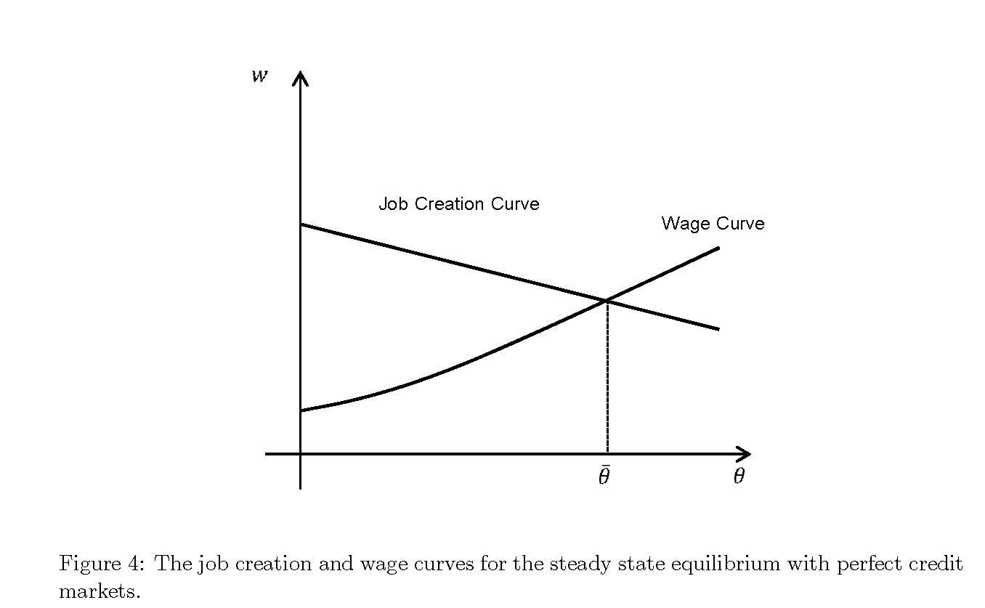
Slide title

Slide 7
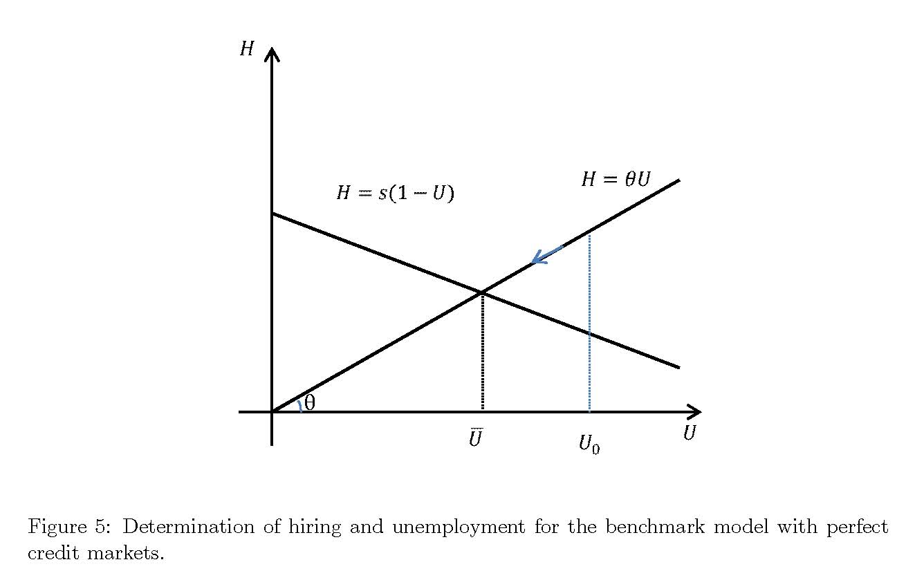
Slide title

Slide 8
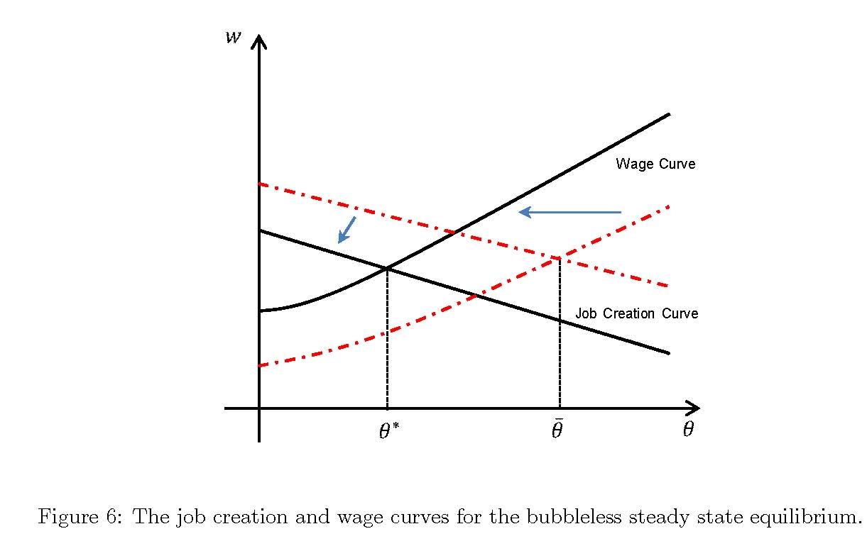
Slide title

Slide 9
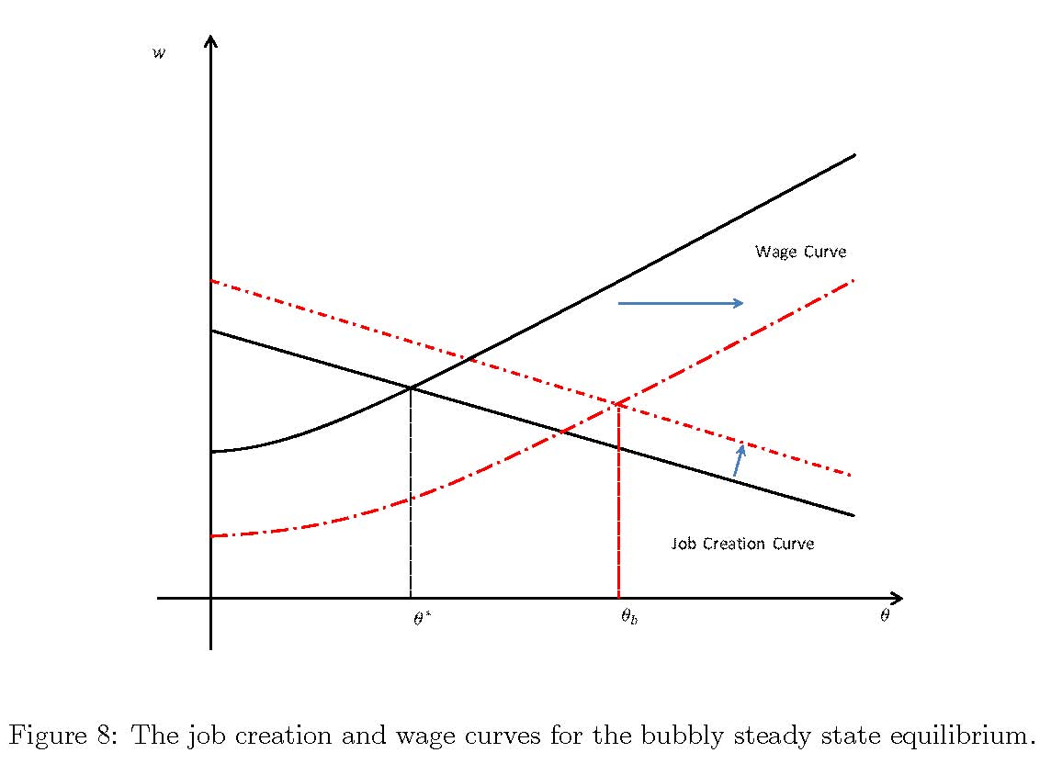
Slide title

Slide 10
Slide title

Slide 11
Slide title

Slide 12
Slide title

Slide 13
Slide title

Slide 14
Slide title

Slide 15
Slide title

