Slide 1
The Role of Mortgage Brokers in the Subprime Crisis Berndt, Hollifield, Sandas
Amit Seru
University of Chicago
Booth School of Business
NBER: Market Institutions and Financial Market Risk
June 18, 2010

Slide 2
The Story

Slide 3
Question
Do mortgage brokers make profits?
What are the magnitudes?
Do these vary with loan, borrower and broker characteristics?
Is there a relationship between broker profits and loan performance?
Policy relevant
Regulator for consumer protection
What types of borrowers more likely to be swayed?
Costs vs. Benefits…need magnitudes!

Slide 4
What the paper finds
Use a stochastic frontier estimation to get a loan by loan measure of broker profits
Broker profits vary with loan characteristics
Larger loans, loans with higher interest rates
Loans with prepayment penalties
Loans to low-doc borrowers
Loans with high broker profits have higher ex post delinquency rates

Slide 5
Overall Impression
Very interesting paper
Clever
Plausible results
Policy relevant (almost)
Extensions
Estimation
Inferences and Policy

Slide 6
Estimation: Stochastic Frontier
Idea
A deviation from “frontier” captured by u
Assumptions critical for identification
Distributional assumptions on u and v allow for explicit solution
This paper:
Back out loan-level profits using distributional assumptions on u (profits) and v
Examine cross-sectional variation in profits

Slide 7
Estimation
Cost Function estimated from data
Crucial that estimated accurately
Why could there be errors?
Skewness in Revenues - “parametric CF” gives identification
Guard against the view that revenues might be high for loans that are costly to originate and costs are “misestimated”
Baseline specification and robust specification seem simplistic

Slide 8
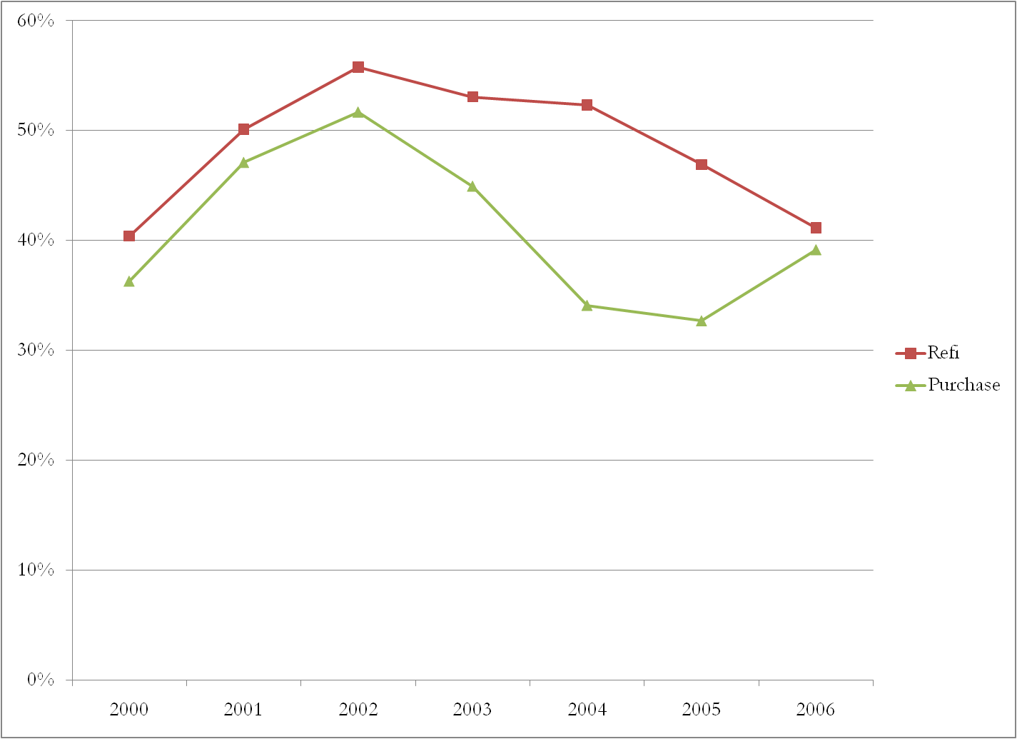
Estimation
New Century and IndyMac

Slide 9
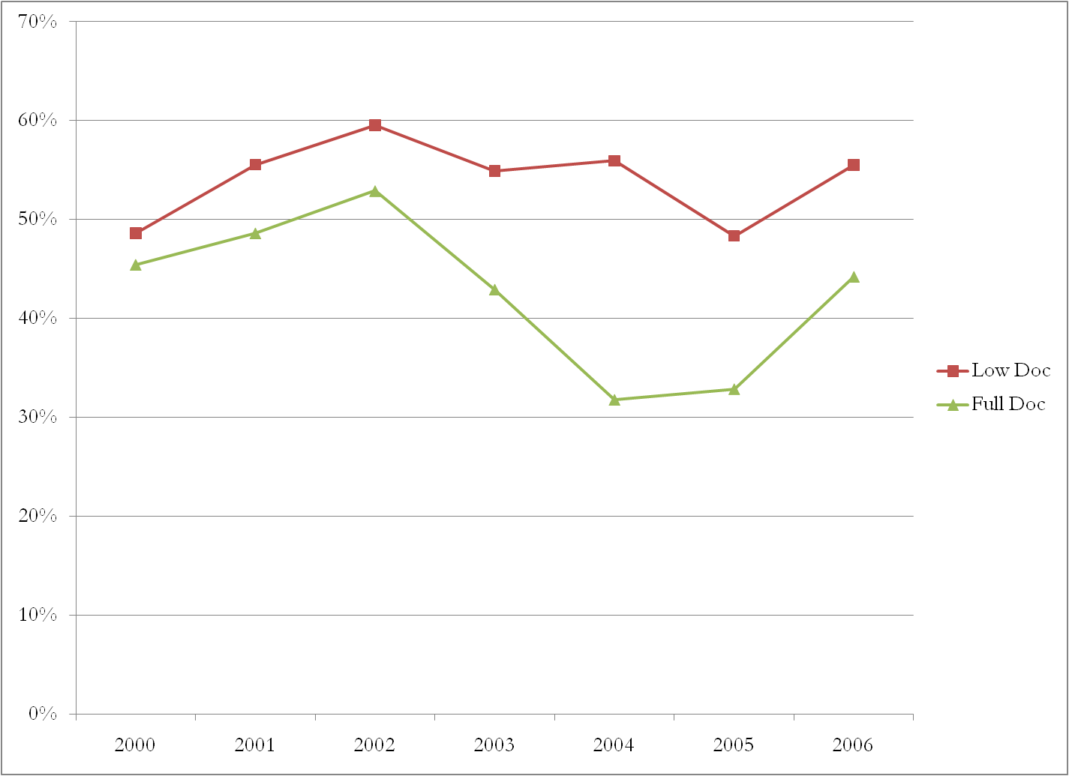
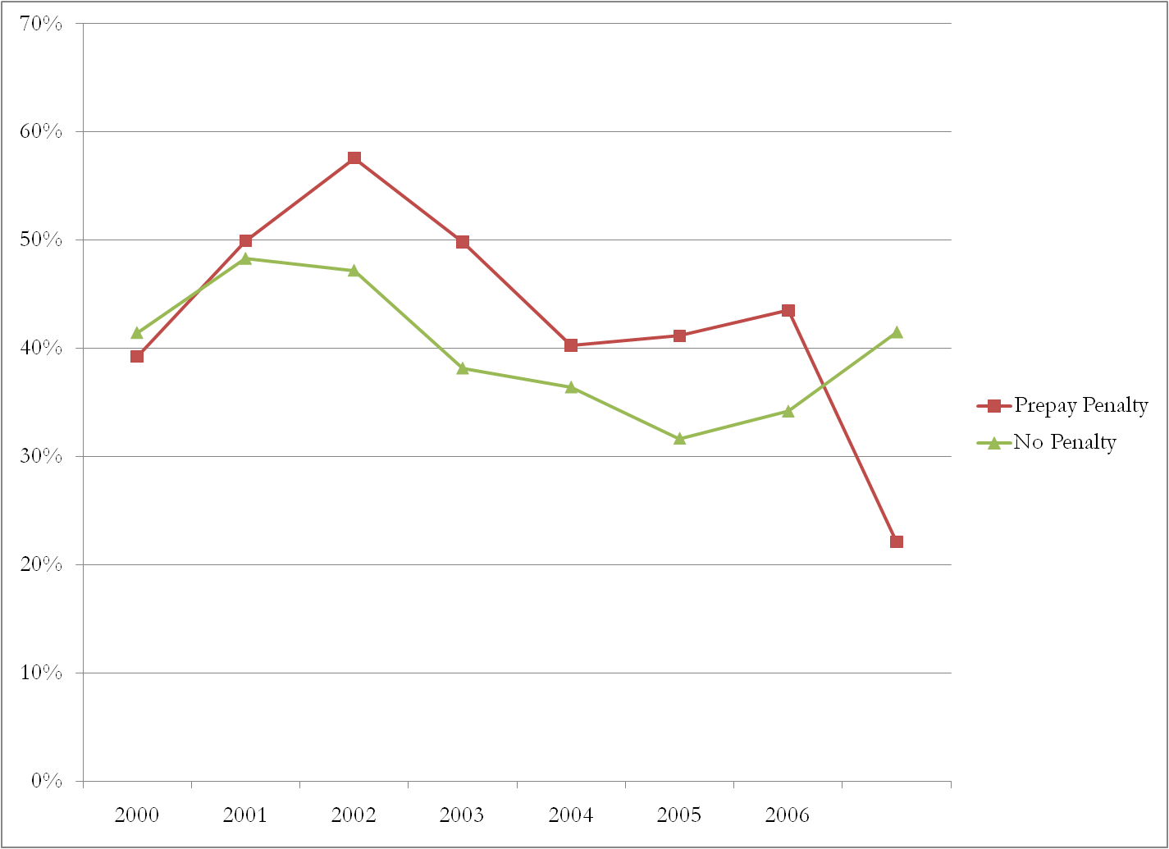
Estimation
New Century and IndyMac

Slide 10
Estimation
New Century and IndyMac

Slide 11
Estimation
Why could there be errors in the Cost Function?
Acceptance/ Rejections
Vary with loan characteristics AND time
How should we think about profits without
Costs on loans that are rejected (pre-approval)
Fixed costs
Regulatory environment?/Macro factors?
Bargaining between bank and broker surely impacted
Search costs of borrowers impacted
Recommend using a much more flexible cost function
Even Robust specification seems very simplistic

Slide 12
Estimation
Main Equation
Micro-found bargaining a bit more
What is the bargaining about?
Relationship specific subprime loan (not house) between a broker and a borrower
Is this like search? Need to model “other broker” offers
Where is the bank?
YSP exogenous: Bargaining between bank and broker
Broker FE in Frontier model may help a bit
Unusual YSP result could be because assumed exogenous
Where are broker incentives to originate “stuff”?
Selection of borrowers across loan types?
Modify Frontier model to allow for selection (see Greene 2005)

Slide 13
Inferences and Policy
Not sure how to think about the default-profit results
How does this fit in the bargaining game (what is a default?)
Expect “profitable” loans to default more anyway (e.g., low doc)
Overall Welfare
Borrowers derive a benefit from the relationship
“Predatory”? Can it be measured and separated from bargaining?
Counterfactuals?
Oversight/Regulation
Alter Quality of borrower-broker-bank match?
Alter Broker Entry and Exit?
Broker Bargaining power with bank?
Competition
Want to say something on inefficiency due to monopolist…but
…hard to draw welfare inferences – Fees and YSP have opposite effects on defaults

Slide 14
Conclusion
Brokers make profits on accepted loans
Profits vary with loan characteristics
Loans with high broker profits default more ex post
Not sure how to think about this (predatory?)
More on
Identification and Estimation
Link default analysis to structural model
Counterfactuals to make it policy relevant
Also comment on external validity
How representative is New Century of bank and broker practices

