Slide 1
Hotchkiss, Smith and Stromberg
Private Equity and the Resolution of Financial Distress
Discussant:
Antoinette Schoar, MIT and NBER

Slide 2
Quick Summary
PE backed deals versus non PE backed deals between 1997-2010
  More likely to experience default
  Default is more sensitive to cycle (short time series!)
  Conditional on default they are
    less likely to go into Chapter 11 (45% vs 62%)
    more likely to go through a prepack (26% vs 14%)
  Spend less time in default
  Conditional on default resolution outcomes are similar (acquired, liquidated, independent firm)
    More likely to be acquired (3%); stay independent (5%)
    Less likely to be liquidated (-5%)

Slide 3
The BIG question
Do PE investors increase the efficiency of the firms they invest in?
  Restructuring operations of under-performing firms
  Improving financial discipline and governance by levering up capital structure
  This paper: Facilitating distress resolution
Do PE firms make corporations more fragile?
  Does excess leverage push firms into financial distress and ultimately “cause” economic distress
  Once firm is in distress more push for liquidation rather than concerning firm as a going concern
  Cost of financial vs. economic distress?

Slide 4
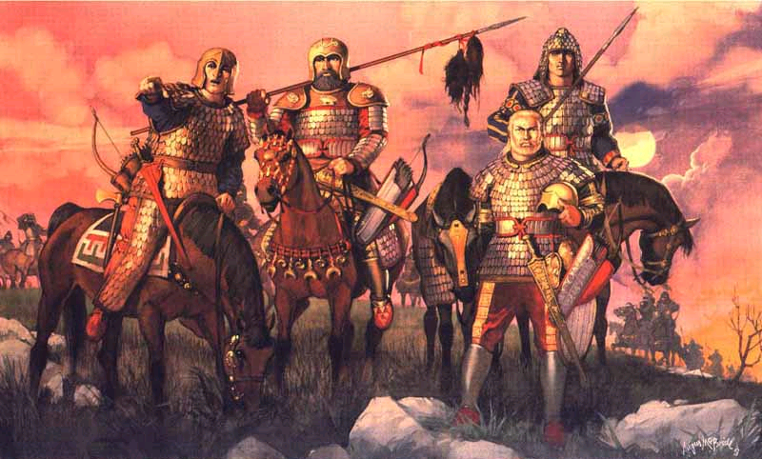
Barbarians – Always misunderstood?

Slide 5
The Irony!
Merriam Webster history of the word barbarian:
The word comes into English from the ancient Greek word “Bar-bar”. It is onomatopoeic, the bar-bar representing the impression of random hubbub produced by hearing a spoken language that one cannot understand. It was first used to describe the Persian troops that attacked Greece in the 5th century BC and had a pejorative meaning: a person who is sub-human and uncivilized.
➔ Even though at the time the Persian civilization was at least as developed as the Greeks

Slide 6
Cost of financial distress
PE backed firms might be investing in firms that have lower cost of financial distress and thus can be more easily levered up
  See difference in observables going into the deal
Are these firms able to go through distress without much economic impact
  GM versus Airlines
  Kaplan and Andrade (1997) show only 10-20% loss in economic value for LBO firms
PE firms might go into default earlier and not “fight” the filing of bankruptcy
  Jialan Wang (2010) for human capital intensive firms

Slide 7
Implications for PE
Is this is a sign of better management through distress or better underlying factors?
PE backed firms are more likely to be bought by financial or strategic buyer after going into distress compared to non-PE deals
  Sign of PE firms manage the sales process well?
  Or a sign of the underlying characteristics of the deal that PE firms invest in?

Slide 8
Sample Selection
2161 “leveraged loan” borrowers rated by Moody’s between 1997 and 2010
  Below investment grade firms that issue debt in private markets, mostly syndicated loan or private placement of notes
  Half are PE backed and half are non-PE deals
Firms with investment grade debt are not included in the sample
  Not captured ex ante and deals are removed from sample if a firms becomes investment grade ex post

Slide 9
Is the selection into the sample biased?
Are firms with a PE sponsor more likely to get below investment grade funding holding constant credit risk versus a firm without PE backing?
  PE back firms are smaller, higher AAA-BBB spread, less likely public, lower asset-liability ratio
Do firms that have a PE sponsor more easily get a rating than non-PE firms conditional on the same performance?
  “Ratings agency takes track record o sponsor into account”

Slide 10
What to do?
Show full transition matrix of the rate at which PE and non PE backed deals move in and out of the sample
  Include moving up into higher debt rating classes
Analyze if there is differential selection into below investment grade debt
  Hopefully you can get this from Moody’s

Slide 11
No wonder it is called private equity
Only 44% of firms have data on pre-default characteristics such as financial information
  60% of non-PE deals but only 30% of PE backed firms
  No data on private firms
The coverage is not too atypical for PE and VC
  In line with other papers on characteristics of PE backed firms, e.g. Gompers and Lerner (2000), Axelson et al (2009), Chang and Schoar (2009)
  But difference in coverage is concerning if non-PE have systematic bias in who reports

Slide 12
Selecting on 20% PE stake
Selecting on a minimum PE stake of 20%, but no screen on ownership concentration for non-PE
  Combines impact of PE vs. concentrated ownership
  Might affect governance during and prior to distress
  Affects the risk profile of investments
Paper excludes hedge funds, investment management companies etc
  Lines between some of these are blurry
  Comparing across these groups could help differentiate if PE firms are good at managing in distress or picking firms that are distress-proof

Slide 13
Sadly, we need more data
Capital structure: Difference in debt levels between PE and non-PE backed deals
  PE deals have more debt and likely more unsecured creditors. Have incentives to preserve firms as a going concern.
  If PE debt is held more concentrated, it could be easier to restructure
  Axelson et al (2010) show that debt levels of PE in particular vary with the economy wide cost of capital (!)
Covenants
  If PE firms have “light” covenants they might be able to delay filing for bankruptcy? Would make findings more stark

Slide 14
Measures of efficiency?
Time in default
  Also a measure of the severity of the case
  PE backed firms are smaller, which usually means quicker bankruptcies
  EBITDA going into the deal is higher for PE backed firms
Does company stay an independent firm, acquired etc.
  No clear ranking which solution is best for debt holders
  Surprisingly low difference in outcomes given default (Table 5)
    Independent firm: 67% versus 62%
    Liquidation: 11% versus 16%

Slide 15
Dividend recapitalization
The occurrence of dividend recaps prior to default is low in the sample: 4.7% for PE deals versus 1.2% for non VC backed firms
  Not likely that PE firms are pushing firms into default by ”looting” them
  Caveat: This is the sample of firms that are heading into trouble. The incentives and amount of money that can be taken out of these firms might be low to start with

Slide 16
Uniqueness of the current crisis
Data shows strong increase of default for both PE and non PE deals during the crisis, 2007-09
Compare distress outcomes for PE and non-PE deals inside and outside this crisis
  Severity of crisis might make everyone look the “same”
  Value added of PE might be more important in the crisis

