Slide 1
Financial Connections and Systemic Risk
Comments by
Mark Flannery
NBER Project on Financial Institutions and Market Risk
June 17, 2010

Slide 2
Main Contribution
Banks are not one another’s creditors – hence not the usual sort of contagion.
Banks co-invest and hence share exposures. (Think syndicated lending or prop trading.)
One bank’s failure does not affect other banks per se.
Failures are related through asset payoffs.
Notes:
Re: first two points: this paper broadens and re-focuses much of the recent literature about financial stability.

Slide 3
Lots going on
Privately optimal diversification may reduce social welfare.
Potential for concurrent (“systemic”?) failures
  Could have α increase with number of failures
Maturity mismatch
Mechanics:
  Bankruptcy costs
  Tradeoff between α and r_{f}
  Early liquidation closes down bankers’ option.
Notes:
Why would alpha increase with # failures?
1. Schleifer-vishny
2. Brunnemeier-Pedersen
Tradeoff: Rf is important relative to pRH + (1-p)RL. Might be worth expressing Figures 3 and 4 in terms of latter, which measures the excess expected value of the project – which is akin to bankers’ equity capital.
Early liquidation has no cost to depositors, but eliminates bankers’ option to benefit from payoffs.

Slide 4
Main Result: Proposition 5
Welfare associated with a particular network arrangement (U, C) depends on the model’s parameters (α, r_{f}).
Notes:
Intro to this slide:
I’ve got
two main comments/perspectives
two less central suggestions
At end of this slide: seque into question of WHAT IS the market failure policy is to address?

Slide 5
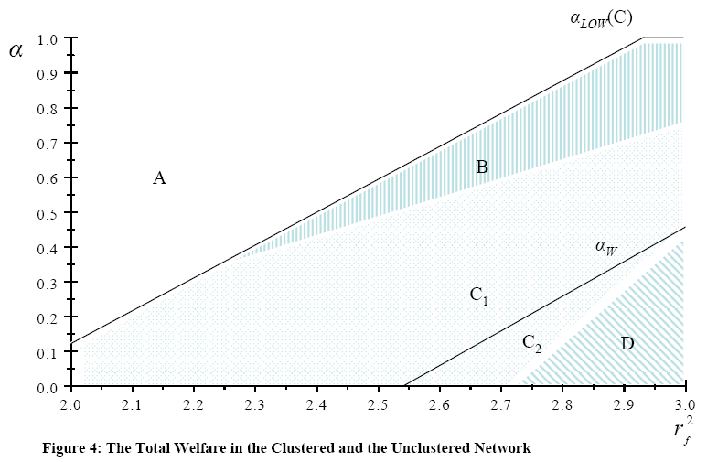

Slide 6
Main Result: Proposition 5
Welfare associated with a particular network arrangement (U, C) depends on the model’s parameters (α, r_{f}).
Policy implications
  Limited and vague
  Would forbidding s.t. liabilities assure highest expected welfare?
  Government policy usually aimed at a market failure.
Notes:
Intro to this slide:
I’ve got
two main comments/perspectives
two less central suggestions
At end of this slide: seque into question of WHAT IS the market failure policy is to address?

Slide 7
Where’s the market failure?
Wouldn’t bankers choose better network, based on known parameters (α, r_{f})?
  Depositors always get r_{f} in expectation
  Bankers get residual
  Therefore, bankers’ welfare seems to be ordered the same as aggregate welfare in Prop. 5.
  Knowing model parameters, bankers would prefer network U or network C.
If not, why not?
Notes:
“Bankers get residual”: they lose opportunity to gain if a bank cannot secure rollover funding. Another way to make failure to roll over costly would be to have a liquidation cost, which would give bankers back some of this option value to continuing the project.
“Knowing model parameters…”
1. Perhaps Ana Babus has dealt with difficulties of forming one or the other sort of network ex ante.
2. The bankers in this model care about the number of linkages, and seem to have no preference over type of linkages.
3. But they know model parameters, and hence should have a preference between C and U.
4. Likewise, should have a preference between s.t. and l.t. funding.
As the authors say (page 22, in Conclusion): Without understanding this problem, it’s particularly hard to make policy recommendations, because you don’t know what you need to correct.

Slide 8
The Signal
Atypical.
Reflects both project payoffs AND banks’ network structure.
“B” occurs more often for unclustered network.
Expected losses following “B” differ across networks.
Notes:
This is not the sort of signal one usually sees.

Slide 9
The Signal (2)
Relevant only for mismatched maturities.
Reflects both project payoffs AND bank market structure.
Other plausible signals would seem to have different, perhaps network-neutral, implications.
  “all projects have lower p”.
  Real sector N is more likely to fail.
Question: is the model’s signal special?
Notes:
This is not the sort of signal one usually sees.

Slide 10
Short-term Liabilities
Welfare (value added) does not vary with network when banks match maturities.
Why mismatch?
  Several plausible reasons
  In the model, s.t. funding reduces expected payout to bankers.
  A quibble: “cheaper s.t. liabilities” seems inconsistent with constant depositors’ opportunity cost.
Notes:
Now turn to my two less-general suggestions/comments.
Take s.t. liabilities out of the model does not reduce welfare. There’s no value to s.t. liabilities for either banks or depositors, I don’t think.
Conclusion from slide: But, mismatched funding gives all the interesting results here. And it could be more fully justified even though it isn’t.
I don’t think it has qualitative effect on model’s conclusions.

Slide 11
“Concentrated” = “Systemic”?
“Concentrated” initially seems like a criticism.
Same # of banks fail under either network design. Number of concurrent failures varies.
“Concentrated” may be worse if bankruptcy costs rise with # of concurrent failures -- but that’s not here.
Think more about definition and why “concentrated” is bad.
Notes:
15 default states in C (out of 64 states)
25 default states in U
Possible failures is same (48) in C, U. Therefore, average # banks actually failing in each default state is lower for U network.

Slide 12
Summary
New, interesting perspective.
Frames an important set of issues well.
Generalizing will be hard, but worthwhile.

