Slide 1

CMBS Subordination, Ratings Inflation, and the Crisis of 2007-2009 by Richard Stanton and Nancy Wallace
18 June 2010
Discussion by Viral V Acharya
NYU-Stern, CEPR and NBER

Slide 2

Idea behind the paper
Analyze the CMBS market before and during the crisis
Falling subordination levels of AAA-rated tranches (Figure 1)
Somewhat surprisingly, (almost) no substantial changes in the quality of underlying CRE loans (Table 1)
Also document Basel risk weights and calculate capital “savings” ($3.54bln on $650.5bln outstanding CMBS)
Conclusion: Most likely, an implicit or explicit capture of rating agencies by institutional investors (mainly, Basel-regulated banks) to create “capital-efficient” financial securities
Unlike RMBS, and somewhat surprisingly, no (strong) evidence for the failure of originate-and-distribute model

Slide 3
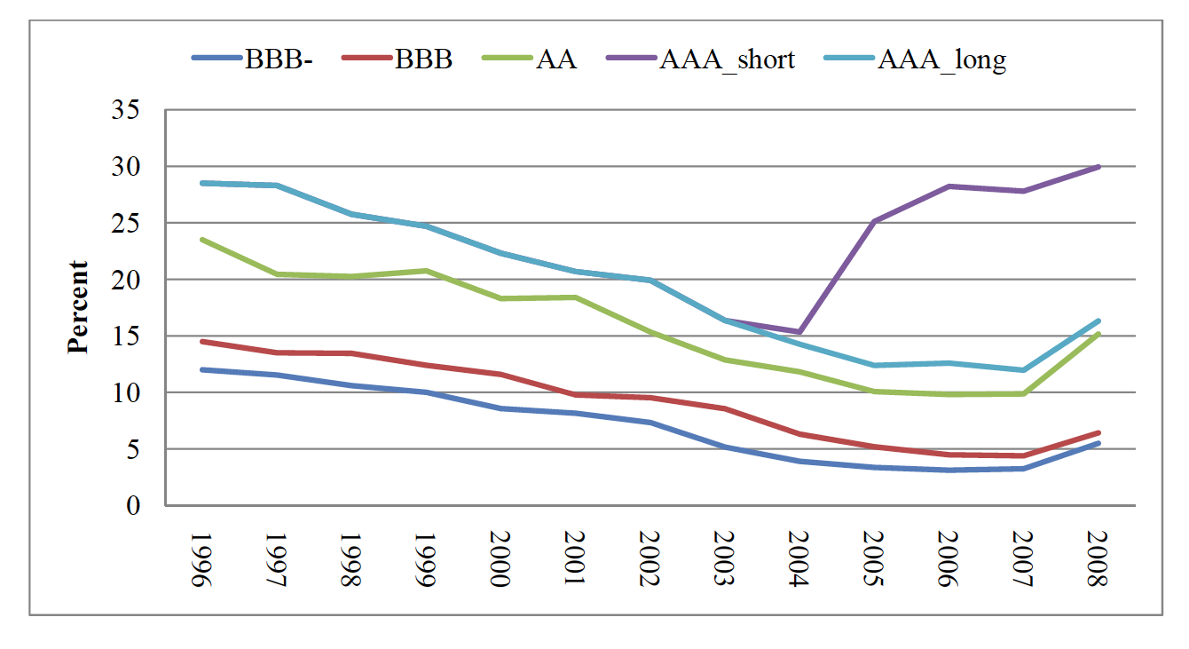
Declining subordination levels in CMBS
Figure 1: CMBS Weighted Average Subordination Levels: Plots the annual average percentage of subordination by bond class for the universe of 531 fusion and conduit CMBS deals originated in the United States from 1996 through 2008.

Slide 4
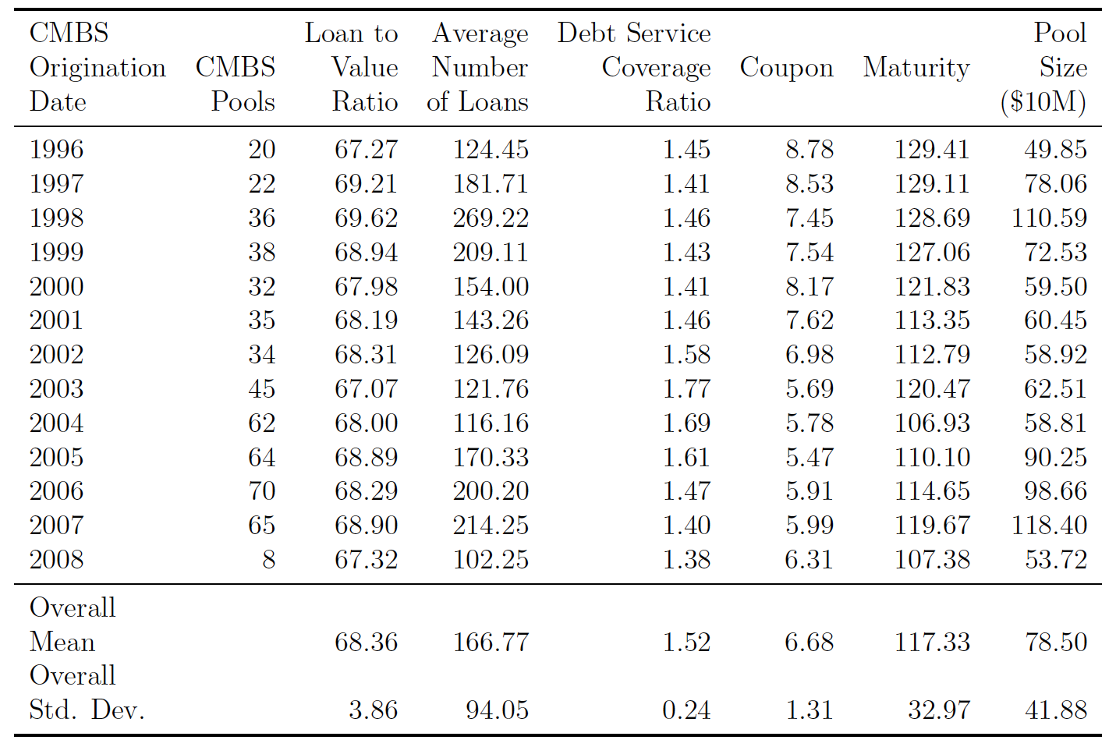
Little change in underlying loan quality
Table 1: The table presents summary statistics for the loan-underwriting characteristics for 90,103 loans that were securitized into the universe of 531 conduit or fusion CMBS pools in the United States from 1996 through 2008.

Slide 5
What I like about the paper
We know much less about CMBS market than RMBS
RMBS: Originator -> Repackaging -> Rating -> End investor
(Problem) (YES) (?) (YES) (YES)
CMBS: Originator -> Repackaging -> Rating -> End investor
(Problem) (NO!) (?) (YES) (YES)
Consistent with my (NYU Stern: Restoring Financial Stability)’s prior: the crisis was primarily caused by risk-seeking incentives of large, complex financial institutions (likely TBTF) who used securitization to get around regulatory capital requirements,
and concentrate, rather than disperse, risks

Slide 6
Some issues to consider - I
Figure 1
  Subordination levels trending downward since 1996 (steady in 2005-07)
  Inconsistent with timing of Basel RWA changes (January 2002)
  Perhaps other factors at work too? (see Rajan’s Fault Lines)
    Low interest rates
    General mis-pricing of risk in banking sector due to GSEs, TBTF, etc.
    Table 2: Spreads on 2003-04 originations lower by 40-50 bps
Table 1: Surprised at any lack of loan quality deterioration
  Within-pool standard deviations in loan quality?
  Table 1: some fall in interest coverage of CMBS pool loans in 2005-07
  “Soft” information issues (relevant in CRE loans?)
  Is the second sample (14,041 non-seasoned fixed-rate mortgages underlying 206 public CMBS pools between 1997-2004) “representative”?

Slide 7
Some issues to consider - II
  Even if loan quality is constant, if the leverage of (TBTF) institutions holding loans is greater, we have a problem
    One, they are vulnerable to smaller shocks
    Two, the “deposit/money” multiplier is greater, so larger quantity of assets to deal with when shock hits
    Table 1: rising quantity of CMBS pool loans in 2005-07
RMBS end-investors were largely institutional investors (ABN AMRO, IKB, most large banks…)
  Any data on CMBS investors?
    Differences in CMBS/RMBS attributable to something else?
      Likely to be at the end of borrowers – the “demand” for assets
      2001-02 “fresh” in memory of corporations
      Is CRE loan non-recourse to borrower assets (RE in some states)?
      No GSE’s!

Slide 8
Raises deep issues about securitization
Clearly reasonable to transfer and parcel risks
BUT Evidence suggests not all securitization is for this purpose
Significant part seems for the somewhat-boring, but privately-lucrative, “regulatory arbitrage” or “capital efficiency” at LCFI’s
Let me make an unambiguous case for this being rife
ABCP conduits: Commercial banks + Cognitively captured regulatory treatment of conduits
Creating available for sale (AFS) securities: Banks + Regulatory treatment + Rating agencies
Third-party protection of tranches: Banks + AIG + OTS
Problem: Originate-distribute-hold/buy-back/AIG rather than (just) originate-and-distribute

Slide 9
I. Securitization w/o Risk Transfer
(Acharya, Schnabl and Suarez, 2009)
Bank Balance Sheet
Assets
Liabilities
Deposits
Loans
Guarantees
Capital
Conduit
Assets
Liabilities
Asset-Backed
Commercial Paper (ABCP)
Loans

Slide 10
New Model+: Less Capital For Guarantees
Bank
Asset/Commitment
Capital Requirement
Loans
1.6% - 8%
Guarantees
0% - 0.8%
Conduit
Asset
Capital Requirement
Loans
0%

Slide 11
ABCP Growth: Jan 2001 – Aug 2007

Slide 12
II. Asset Buy Back
Bank Balance Sheet
Assets
Liabilities
Deposits
Loans
Capital
Structured Purpose Vehicle
Assets
Liabilities
Loans
Asset-Backed
Securities (ABS)

Slide 13
Banks did not transfer credit risk
(Lehman Brothers, June 2010)
 | Loans | HELOC | Agency MBS | Non-Agency AAA | CDO Subord | Non CDO Subord | Total
Banks & Thrifts | 2,020 | 869 | 852 | 383 | 90 |  | 4,212 | 39%
GSEs & FHLB | 444 |  | 741 | 308 |  |  | 1,493 | 14%
Brokers/dealers |  |  | 49 | 100 | 130 | 24 | 303 | 3%
Financial Guarantors |  | 62 |  |  | 100 |  | 162 | 2%
Insurance Companies |  |  | 856 | 125 | 65 | 24 | 1,070 | 10%
Overseas |  |  | 689 | 413 | 45 | 24 | 1,172 | 11%
Other | 461 | 185 | 1,175 | 307 | 46 | 49 | 2,268 | 21%
Total | 2,925 | 1,116 | 4,362 | 1,636 | 476 | 121 | 10,680
 | 27% | 10% | 41% | 15% | 4% | 1%

Slide 14
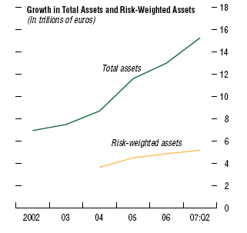
Low growth in pre-crisis RWA
Source: IMF GFSR, April 2008

Slide 15
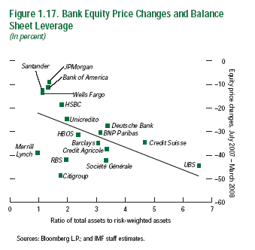
Low RWA: Low leverage or high MBS risk?
Stock Price Sensitivity to Regulatory Risk Exposures, July 2007- April 2008
Source: IMF GFSR, April 2008

Slide 16
III. Asset Buy Back +
Insurance for regulatory capital relief
Bank Balance Sheet
Assets
Liabilities
Deposits
Loans
Capital
CDS protection + Guarantees
Structured Purpose Vehicle
Assets
Liabilities
Loans
Asset-Backed
Securities (ABS)
AIG FP + Monolines

Slide 17
Buyers of Protection
Insurance industry net seller of protection to banks
Who uses credit derivatives?
Sellers of Protection
Source: British Bankers Association

Slide 18
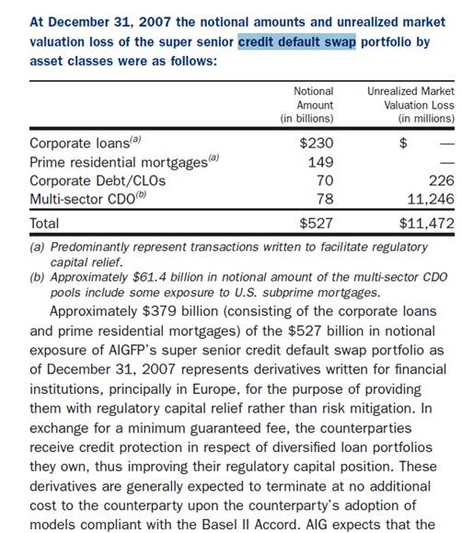
Banks allowed poorly capitalized insurance to grow

Slide 19
And deeper issues about regulation
The ultimate problem facing regulator is no longer (just) the protection of small, retail investors in securitized products
  This is why ratings-based securitization originally made sense
But the real issue now is seeking of tail risks by TBTF institutions
  Rating agencies are a part of the problem, but TBTF institutions can seek tail risks without help from rating agencies too (other “collusions”)
Fundamental issues with Basel risk-weights
  Individual bank risk vs Systemic risk (Acharya, 2001)
  Weakly- or un-regulated shadow banking system
  Systemic risk is endogenous to bank regulation
    Cannot favor AAA-MBS over AAA-corporates in indefinite quantities
  Predator vs Prey game lasts only if both “evolve” responses

Slide 20
We had been here before…
Goetzmann and Newman (2010) – “Securitization in the 1920s”
Issuance of CMBS financed most US skyscrapers in the 1920s
More office buildings >70m constructed in NY in 1922-31 than in any other decade before or after (also Chicago…), for maximizing rents with multiple tenants rather than for direct usage
“CMBS” (bonds) sold to retail investors: More than $4.1 bln raised from 1,090 bond offerings between 1919 and 1931
Led to creation of real estate securities exchange in 1929…
“Small investors relied on poor assertions of asset value from a few large intermediaries in a market with little centralization or regulatory oversight”
CMBS price declines preceded stock market crash and Depression
From 100.1, bond prices fell to a low of 24.75; 80% recovery for 1920-vintage but only 40% for 1928
CMBS was 23% of bonds in 1925 to 0.14% in 1934

