Slide 1
Tracking the Geographic Footprint of R&D: New National and State-Level Measures of R&D Production and Investment
Christian Awuku-Budu, Ledia Guci, Gabriel Medeiros, Dirk van Duym
Disclaimer: The views expressed in this presentation are those of the authors and do not necessarily reflect those of the Bureau of Economic Analysis or Department of Commerce.

Slide 2
Outline
R&D in BEA's Economic Accounts
  National: R&D investment in the NIPAs and R&D production in SUTs
  Regional: GDP by state
New R&D statistics
  Performance measures by state
    R&D value added, employment, and compensation
  Company-establishment adjustment research
R&D investment by state
  Geographical concepts
  Planned measurement approach
    Microdata for the business sector
    Attribute investment based on location of use of resulting R&D asset

Slide 3
R&D in BEA's Economic Accounts
Prior research focused on measuring national R&D investment and examining the effects of capitalizing R&D in BEA’s economic accounts (e.g., Robbins and Moylan 2007; Crawford et al. 2014)
Translated Frascati-based R&D expenditures to measures of economic activity within a national accounting framework (e.g., Robbins 2006)
  R&D gross output, investment, and capital stocks
  R&D price deflators and depreciation rates
  GDP impacts
R&D was treated as investment starting with the 2013 Comprehensive Update of the National and Regional Accounts, making its contribution to capital formation and economic growth more visible

Slide 4
New R&D Statistics
New research focuses on developing state-level measures of R&D production and investment
In partnership with NCSES/NSF, BEA has developed new national and state-level measures of R&D value added, employment, and compensation by sector/industry
  Aggregate national measures of R&D value added and compensation previously available only in the benchmark supply-use tables
National and state R&D statistics are available for 2012–2023, broken out by performing sector
  Business (with emphasis on R&D-intensive industries)
  Nonprofit institutions serving households (NPISHs)
  Government
https://www.bea.gov/data/special-topics/research-and-development

Slide 5
Source Data and General Approach
NCSES/NSF R&D Surveys | Other Sources
Business Enterprise R&D Survey | Economic Census, Census Bureau
Annual Business Survey | QCEW, Bureau of Labor Statistics
Higher Education R&D Survey | BEA national SUTs
Federally Funded R&D Centers Survey | BEA regional employment and compensation
Survey of State Government R&D
Federal Funds for R&D Survey
Survey of Nonprofit Research Activities
QCEW Quarterly Census of Employment and Wages
SUTs Supply use tables
R&D employment and compensation generally estimated using personnel information from each R&D survey
Value added estimated additively from income components (compensation of employees, gross operating surplus, taxes on production and imports less subsidies)

Slide 6
R&D Investment vs. R&D Value Added
NSF surveys report R&D expenditures by performance and source of funds
  R&D value added tracks performance
To measure national R&D investment, BEA tracks funding and attributes ownership to the funding sector
  For example, R&D funded by the federal government is considered federal R&D investment regardless of performer and funding mechanism (contracts or grants)
  The federal government plays a much larger role in investment compared with performance

Slide 7
R&D Investment vs. R&D Value Added
R&D Performing NIPA Sector | R&D Value Added 2023 | R&D Investment 2023* (NIPA)
 | [Millions of current dollars]
Research and development | 701,833 | 1,003,000
Private | 640,083 | 765,446
Business | 578,807 | 726,967
Nonprofit institutions serving households (NPISHs) | 52,276 | 38,478
Government | 61,750 | 237,475
Federal | 24,378 | 211,033
State and local | 37,372 | 26,422
*NIPA Table 5.6.5 and NIPA Table 5.9.5
  R&D value added excludes intermediate inputs; includes the value added of R&D exports; R&D investment includes intermediate inputs; excludes net R&D exports
  Business includes FFRDCs administered by businesses
  NPISHs include private non-profit universities and colleges and FFRDCs administered by private nonprofit institutions
  Government includes public universities and colleges

Slide 8
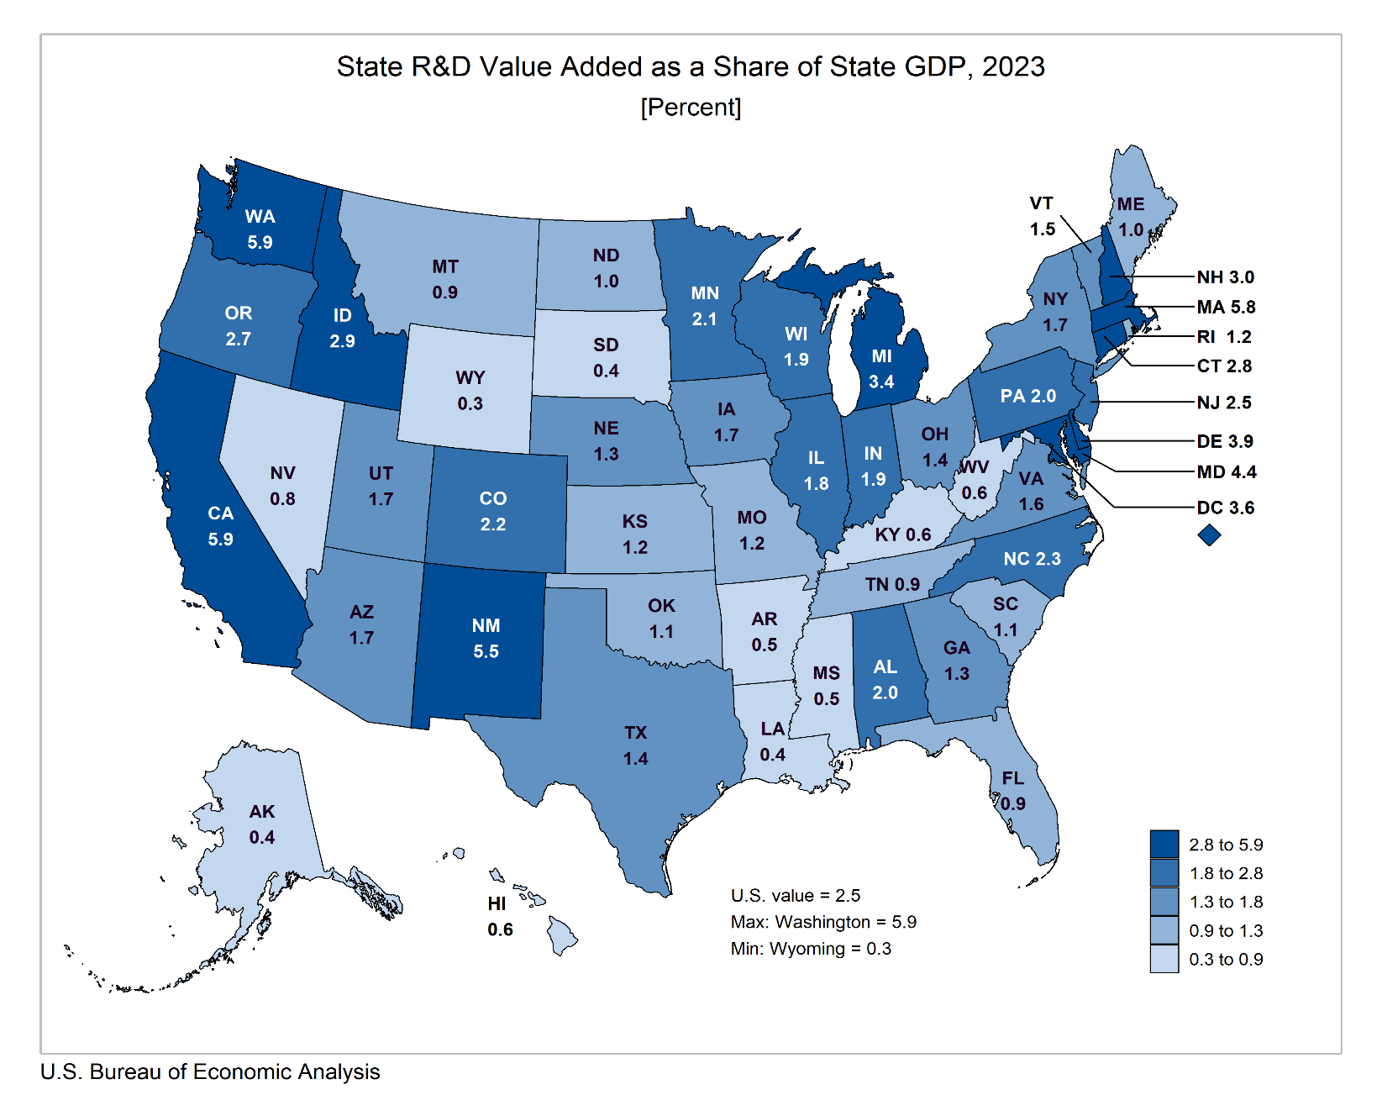
R&D Value Added as a Share of GDP

Slide 9
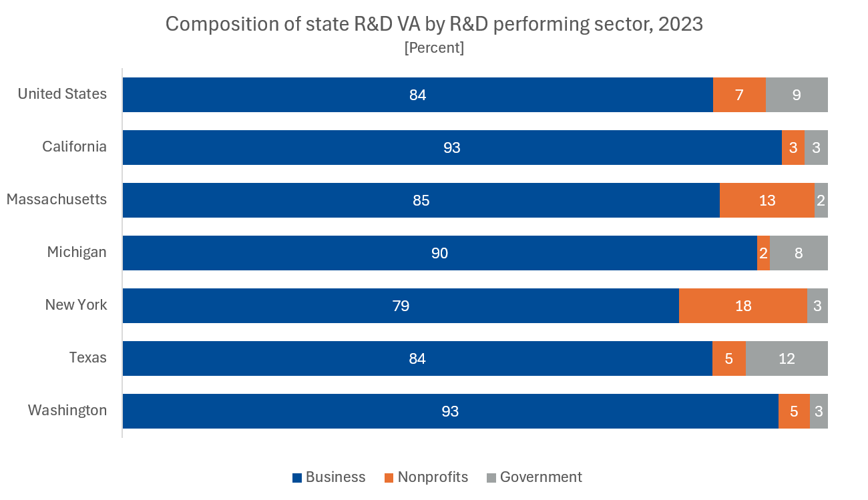
Selected R&D Performing States

Slide 10
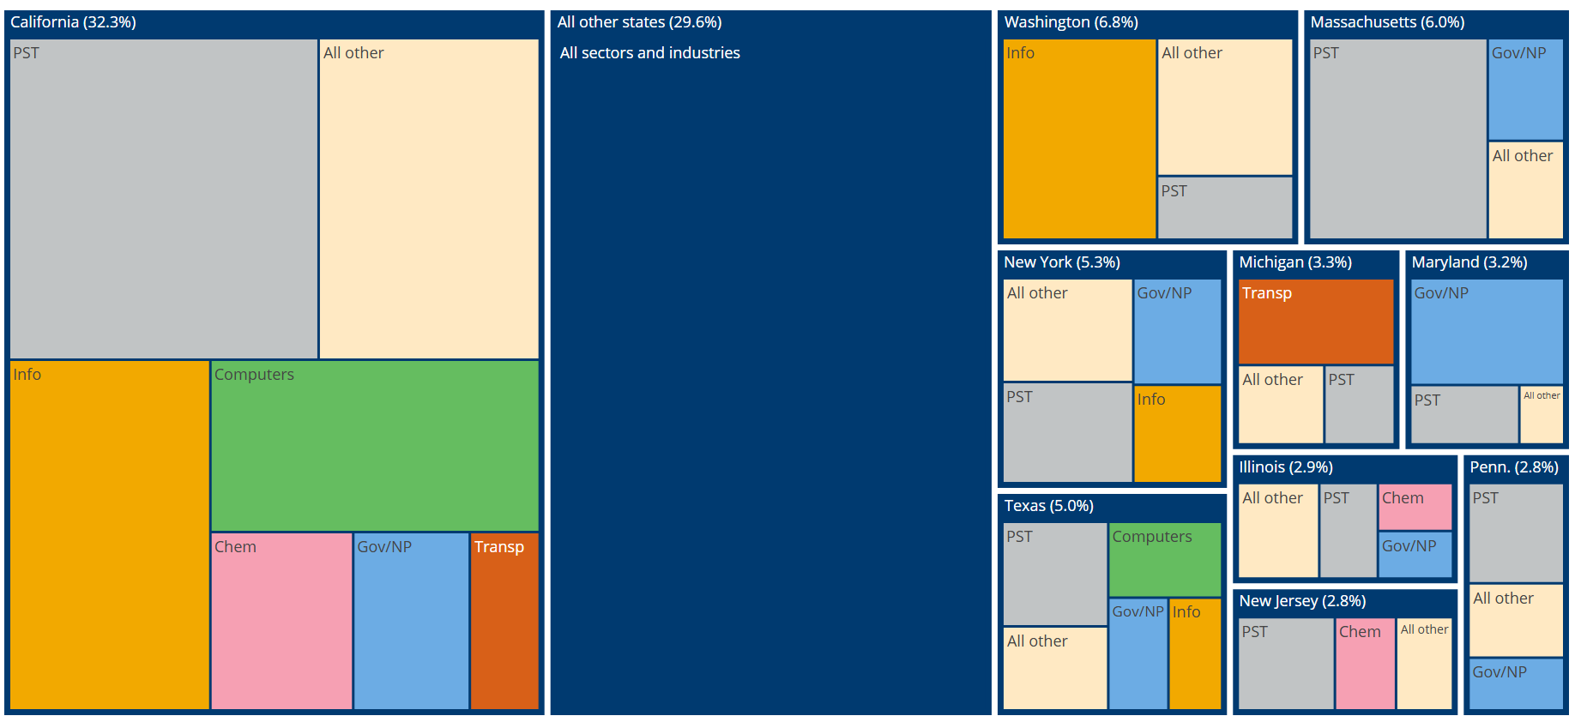
State Distribution of U.S. R&D Value Added, 2023

Slide 11
Linking Companies to Establishments (CoEst)
Goal: better measure the industry distribution of R&D performance
  Challenge: R&D is reported at the firm level, while economic activity needs to be attributed to establishments
  Firms report R&D under their primary industry (e.g., manufacturing) even for R&D performed in dedicated R&D labs
Current method applies a broad adjustment by benchmarking company-based R&D services data against establishment-based BLS QCEW data
  Adjustment ratios vary by state but not by industry
State x | BERD-based R&D employment (company basis) | QCEW-based employment (establishment basis) | CoEst Adj factor | BERD-based R&D employment (establishment basis)
Industry 1 | 600 |  |  | 360
Industry 2 | 400 |  |  | 240
NAICS 5417 | 200 | 600 |  | 600
Total | 1,200 |  | 0.4 | 1,200
QCEW Quarterly Census of Employment and Wages
BERD Business Enterprise R&D Survey

Slide 12
Improving the CoEst Adjustment
New methodology: towards better industry-level measures
  Link companies in BERD to Business Register establishments in the state of performance reported in the survey
  If NAICS 5417 establishments are present, reassign R&D from reported industry to NAICS 5417 (assuming establishment is large enough)
  If no 5417 establishments exist, retain the R&D in originally reported industry
  Estimate the share of R&D expenditures from each industry to be reclassified to NAICS 5417
Results not yet reviewed for release

Slide 13
R&D Investment by State
Geographic complexities
  Location of performance: location where R&D activity physically occurs
  Location of funding: location of headquarters or parent company that funds R&D
  Location of use: location where R&D is used as a productive asset
Complex firm structures create attribution challenges
  Firms operate multiple establishments across states and report R&D across multiple lines of business
  R&D may be performed in one state but used in production across multiple states
  Approaches to attribution:
    Apportion R&D across states and industries (rival view)
    Assign full R&D to multiple users (non-rival view)
    Productivity measurement versus accounting identities tradeoff

Slide 14
R&D Investment by State: Planned Approach
Business R&D investment (72.5% of total)
  Performed for own use (68.3% of total)
    Attribute to the location where the R&D is used in production (e.g., manufacturing of cars) using linked microdata
  Performed on behalf of other companies (4.2% of total)
    Attribute according to state value added shares of the funding industry
Federal R&D investment (21.0% of total)
  Use source data on funding agency and performing sector to determine likeliest location of use
State and local (S&L) government R&D investment (2.6% of total)
NPISHs R&D investment (3.8% of total)
  Attribute to states based on source data on state of performance, since use is likely in the same location

Slide 15
Microdata Hypothetical
From BERD:“ABC Inc.” reports spending $10M on R&D in CA under the business code pharmaceuticals
Linking to Census microdata, ABC Inc. has establishments in three different industries in four different states
Company | NAICS | State | Payroll ($M)
ABC Inc. | 3254 (manuf.) | AL | 20
ABC Inc. | 3254 (manuf.) | TN | 5
ABC Inc. | 5417 (R&D) | CA | 8
ABC Inc. | 551 (HQ) | NY | 10
Performance basis: $10M to CA; CoEst moves to NAICS 5417
Investment basis: prorated: $8M to AL, $2M to TN; both in NAICS 3254

Slide 16
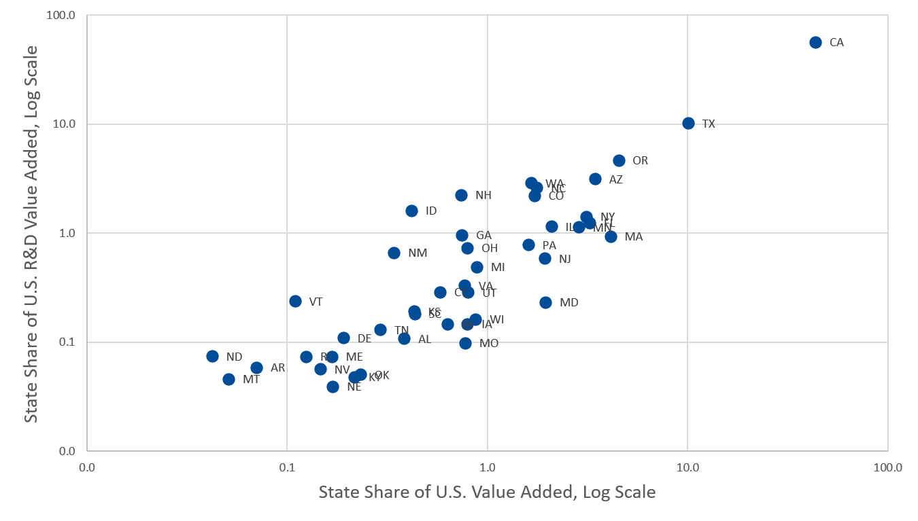
Computer and Electronic Products Mfg.
Overall, how much does state of performance vary from state of use?

Slide 17
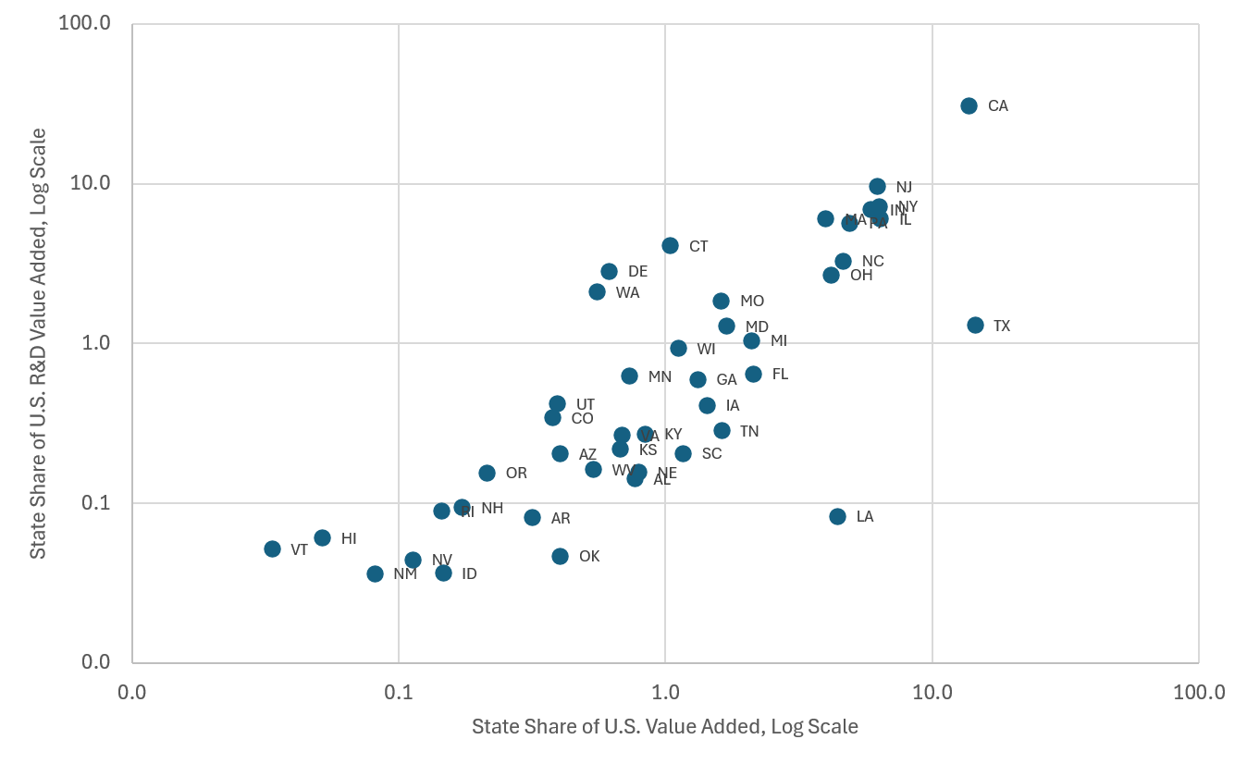
Chemical Manufacturing

Slide 18
Conclusion
R&D activity can have several economically relevant locations
We are researching how to measure investment in R&D and other asset types regionally, building on established national accounting concepts
Our measures are under development and important conceptual and data challenges remain
Your feedback is welcome and especially valuable at this stage as we refine the approach and develop these statistics

