Slide 1
Kumon Up:
Private Tutoring Centers and Student Achievement
Joshua Goodman
Samuel Nitkin
Boston University

Slide 2

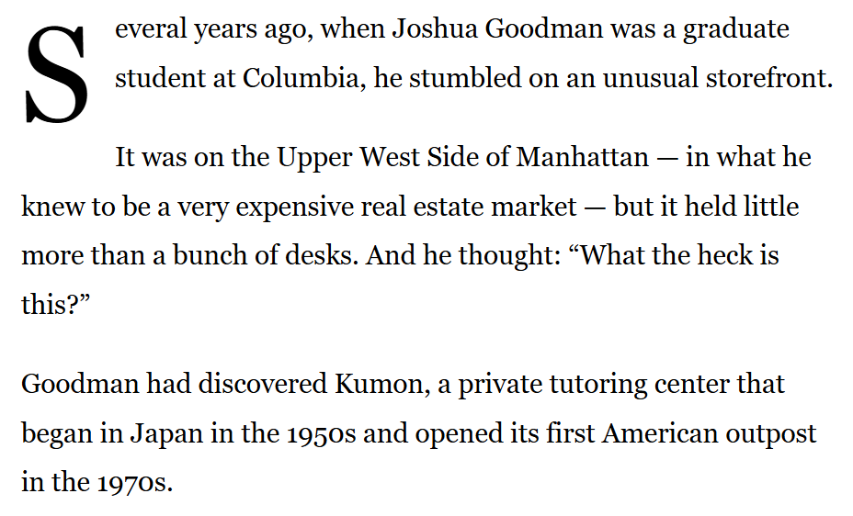
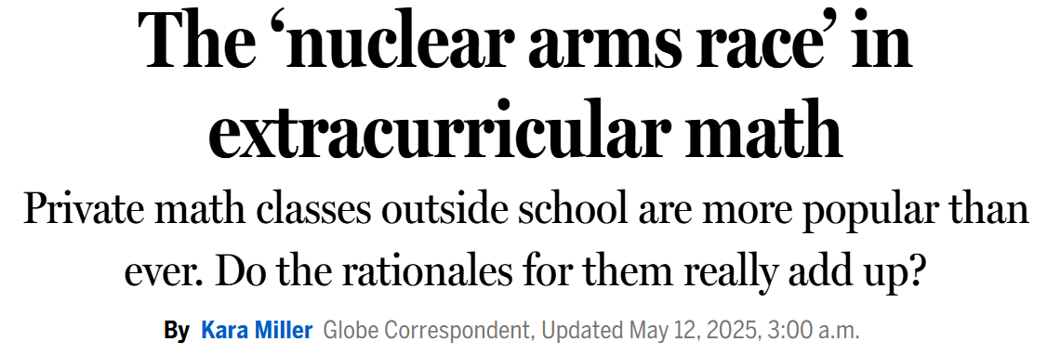



“What the heck is this?”

Slide 3

Paper in a
Motivation Private tutoring chains have expanded rapidly in recent decades.
Research questions Who uses these tutoring chain centers?
        How do such centers affect academic skills?
Data Business records (Data Axle) | HH spending (CEX) |District test scores (SEDA)
Method Staggered diff-in-diff based on school district’s first chain center opening
Results Nearly half of users are from the top income decile.
Asian (White) HHs are 5X (2X) more likely to use than Black/Hispanic HHs. First chain center raises district’s math (reading) scores by ~0.03 (0.015) SDs. Center entry widens racial achievement gaps, less so in racially integrated districts.
Tutoring chain centers appear very effective and cost effective.
Takeaways Tutoring centers satisfy unmet parental demand for individualized instruction. These private investments help their users while deepening educational inequality.

Slide 4

Related literature I
1) Impact of tutoring centers
Prior work shows rapid growth of tutoring centers in high-income/Asian areas (Kim et al. 2025)
Bangladesh RCT of Kumon approach → large math impacts (Sawada et al. 2024, Kawarazaki et al. 2023)
Chen (2026) - Contemporaneous JMP by UMD’s Marty Haoyuan Chen studies center expansion in Texas, finding access to tutoring centers
- Raises SAT/ACTs
- Shifts students toward more selective colleges
- Increases early-career earnings
- Effects driven by non-economically disadvantaged students
We complement this with national study of chain center impacts on primary grades skills.

Slide 5
Related literature II
2) Improving achievement through individualized instruction and increased instructional time
Small group and one-on-one tutoring efficacy
- RCTs (Escueta et al., 2020; Carlana & La Ferrara, 2025; Guryan et al., 2023; Kraft et al., 2022)
- Meta-analyses (Nickow et al., 2024; Fryer Jr, 2017)
Computer-assisted learning efficacy, likely due to individualization
- RCTs (Muralidharan et al., 2019; Bhatt et al., 2024; Oreopoulos et al., 2024)
Instructional time as key input into student achievement
- Student absences (Aucejo and Romano, 2016; Liu et al., 2021; Goodman, 2014)
- Changes to school calendars (Figlio et al., 2018; Thompson, 2021)
- International comparisons (Lavy, 2015; Rivkin and Schiman, 2015)
- Charter school practices (Angrist et al., 2013; Fryer, 2014)
Our estimates compare well to this lit → tutoring centers may be particularly effective.

Slide 6
Related literature III
3) Growing inequality in child development driven by unequal family investment
Ramey and Ramey (2010): Competition for college slots generates “rug rat race”, explaining why childcare time spent by US college-educated parents began rising dramatically in the mid-1990s.
Doepke and Zilibotti (2019): Increasing inequality has transformed parenting from hands-off model of 1960s/70s into helicopter model where kids get a full schedule of after-school activities.
Substantial economic and racial gaps in parental investments in children (Blazar et al. 2026 grew dramatically from the 1970s to 2000s (Kornrich and Furstenberg 2013) and are wider in US states with higher income inequality (Schneider et al. 2018).
Private tutoring centers are one channel for investment gaps to widen achievement gaps.

Slide 7
Understanding the treatment

Slide 8
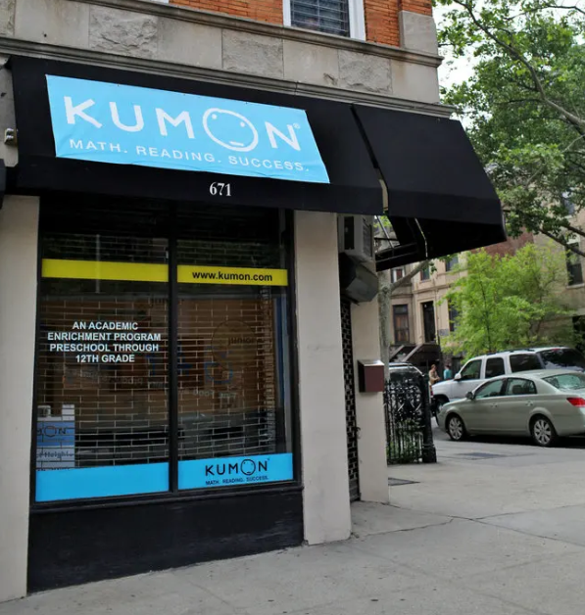
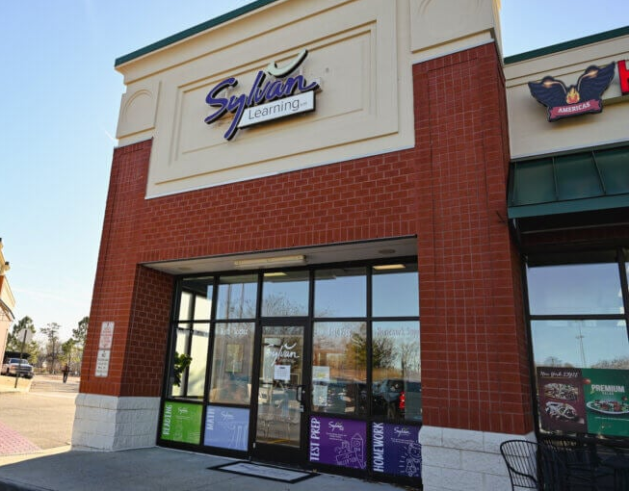
Corner stores and strip malls

Slide 9

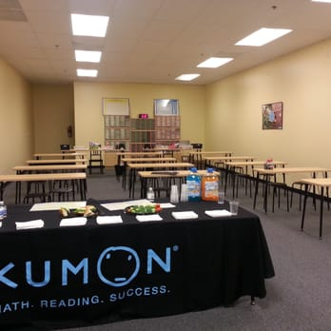
Tutoring chain instructional models
Kumon Instructors circulate, grade, monitor worksheet progress
Students work independently through worksheets at their level Daily homework packets

Slide 10

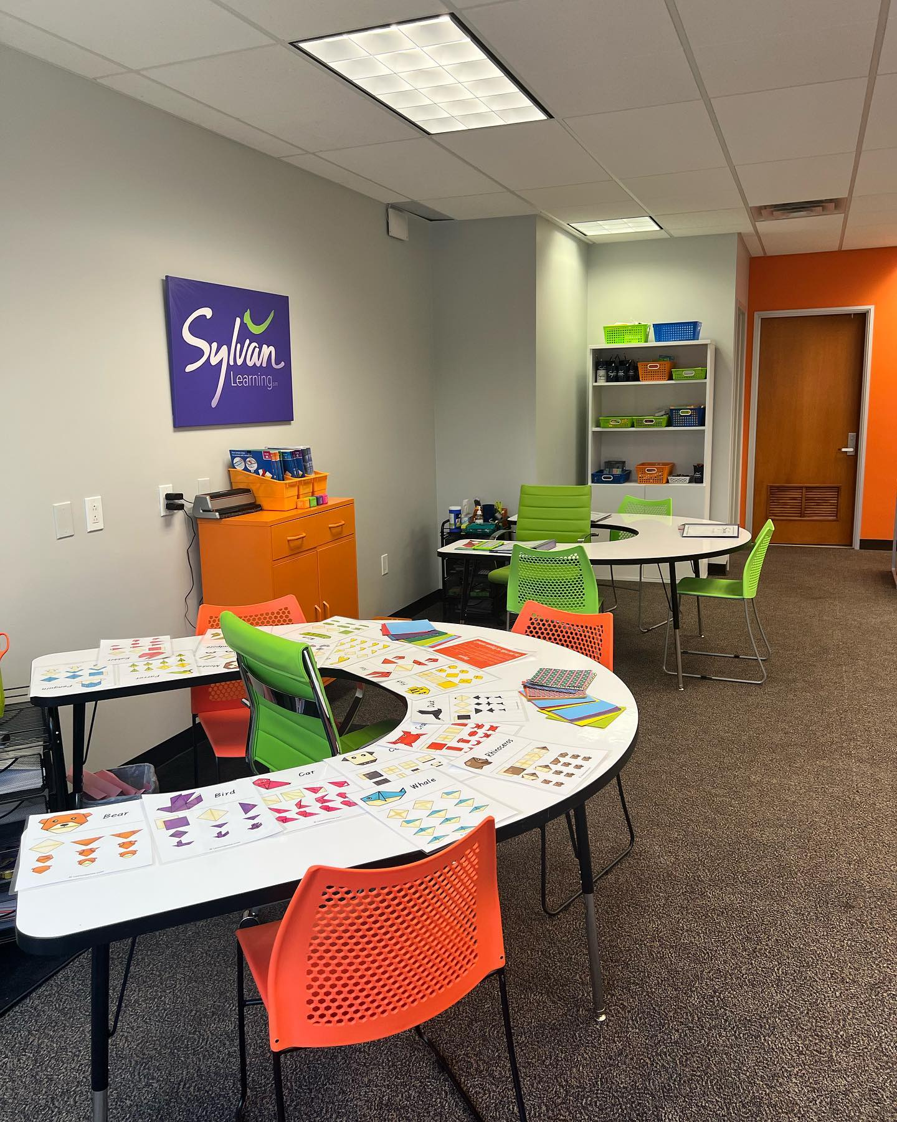
Tutoring chain instructional models
Kumon Instructors circulate, grade, monitor worksheet progress
Students work independently through worksheets at their level Daily homework packets
Instructors deliver direct instruction via proprietary curriculum
In groups of 2-3 students
Curriculum aligned to local schools (may talk with teachers)

Slide 11

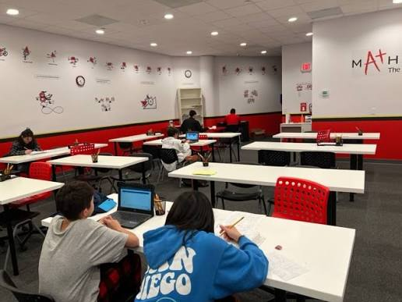
Tutoring chain instructional models
Kumon Instructors circulate, grade, monitor worksheet progress
Students work independently through worksheets at their level Daily homework packets
Instructors deliver direct instruction via proprietary curriculum
In groups of 2-3 students
Curriculum aligned to local schools (may talk with teachers)
Mathnasium Instructors deliver direct instruction via proprietary curriculum
To multiple students 1-1 (each w/ individual learning plan)
Discourages bringing schoolwork

Slide 12
Tutoring chain instructional models
Kumon Instructors circulate, grade, monitor worksheet progress
Students work independently through worksheets at their level Daily homework packets
Instructors deliver direct instruction via proprietary curriculum
In groups of 2-3 students
Curriculum aligned to local schools (may talk with teachers)
Mathnasium Instructors deliver direct instruction via proprietary curriculum
To multiple students 1-1 (each w/ individual learning plan)
Discourages bringing schoolwork
All Diagnostic assessments at intake
Individualized learning plans
Focus on math and/or reading
Franchisees hire/manage instructors under corporate curriculum

Slide 13
Center size, focus, time commitment
We lack direct “first stage” evidence on who is using each center and for what subject.
Our best guesses comes from franchise disclosure documents, press releases, and chatting with Kumon’s franchising executives.
  Typical center likely serves 100-130 students at a time
  ~2/3 of students study math | ~1/3 study reading (nearly all large chains offer both)
  Typical student spends 2-3 hours/week in center or on homework
  [Details in paper.]

Slide 14
Descriptive results:
How widespread are tutoring chains?

Slide 15
Data on Tutoring Centers
Data Axle’s Historical Business Data
  Info on businesses from: yellow pages, credit card data, phone verification, web research, news publications, etc.
  1997-2022: Each business’ name, address, industry code, longitudinal identifier.
Identifying tutoring centers
  Keep industry codes “Tutoring” (SIC Code 829909) or “Test Preparation Instruction” (SIC Code 874868).
  Exclude 5% where name indicates: college or graduate test prep, ESL, non-academic focus, etc.
  Define chains as 10+ unique locations sharing a parent company or name.
    Identify common names through our own inspection plus Claude Sonnet 4.6 to catch patterns we missed.
  Exclude chains that send tutors to homes (analyze separately)
  Of ~20,000 unique tutoring locations, 35% (~7,000) are identified as chains providing in-center tutoring.

Slide 16
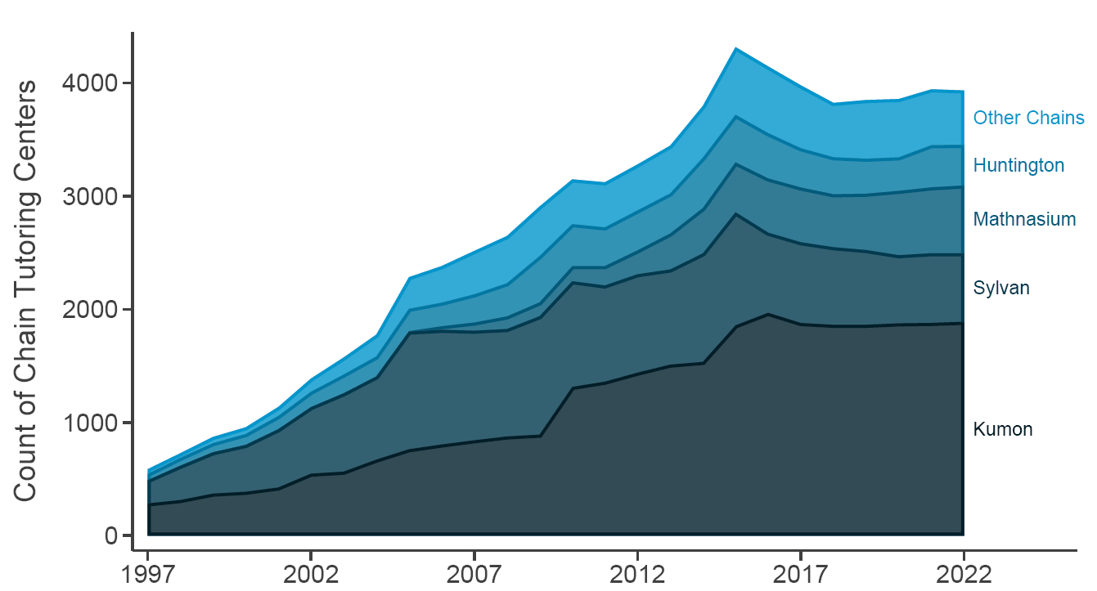
Tutoring chain center growth
Chain centers grew from ~500 in 1997 to ~4,000+ in 2010s, plateauing recently (online options?).
Kumon is largest & fastest growing, followed by Sylvan, Mathnasium, Huntington.

Slide 17
Descriptive results:
Who uses tutoring chain centers?

Slide 18
Data on tutoring usage
Consumer Expenditure Survey (CEX)
  National survey that tracks monthly household spending and characteristics.
  In 2009, CEX starts expenditure category for “Test preparation or tutoring services.”
Measuring tutoring usage
  With 2009-24 data, we construct:
    Indicator for HH reporting any spending on tutoring services in a month
    Amount spent on tutoring services, inflation-adjusted to 2015$
  Restrict to HHs with 1+ child aged 6-17
  Exclude summer months
  Note: These measures capture spending on all forms of tutoring (in-center, in-home, online)

Slide 19
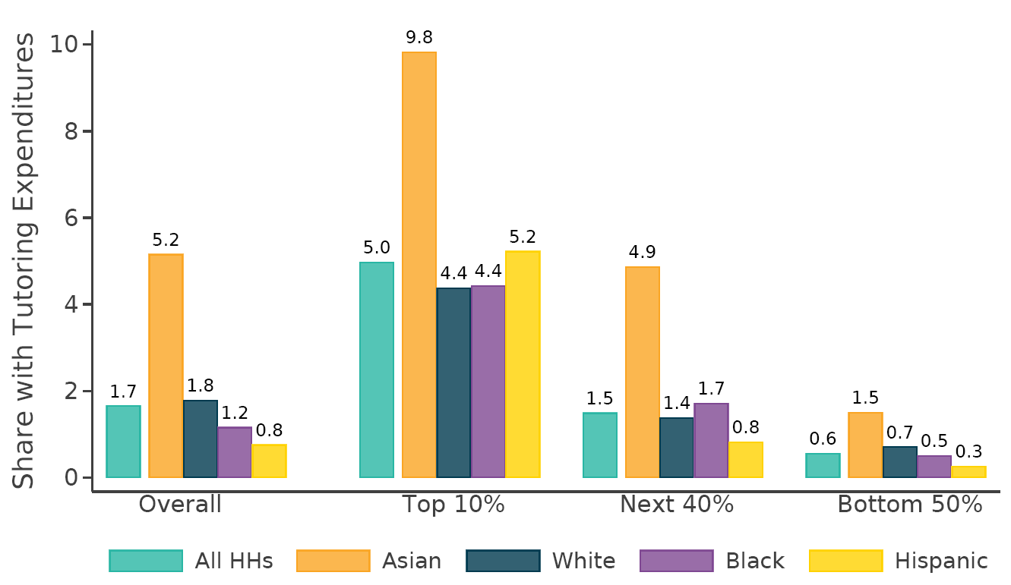
Who uses tutoring?
1.7% spend on tutoring in a given month (spending average of ~$300)
By race: Asian - 5.2% | White - 1.8% | Black - 1.2% | Hispanic – 0.8%
Nearly half (47%) of HHs spending on tutoring are in top income decile
Income explains much of racial differences, but not for Asian-Americans

Slide 20
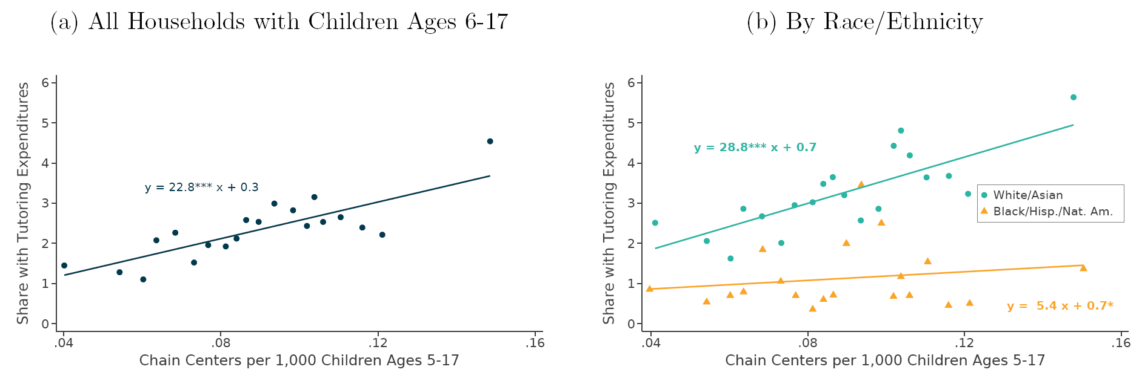
Spending data vs. chain center locations
At MSA-level, strong relation between chain density and share of HHs using tutoring.
Suggests CEX captures, at least partly, the use of physical tutoring centers.
Only for White/Asian (& higher inc) HHs, suggesting such HHs are more likely to use chain centers.

Slide 21
Causal method:
How to identify achievement impact of tutoring centers?

Slide 22
Data on test score outcomes
Stanford Education Data Archive (SEDA)
  District-level mean math/reading scores from 2009-19 (in nationally normed SDs)
  Reported for each grade 3-8, overall and by race, economic disadvantage status, and gender
Measuring tutoring center prevalence
  Match each tutoring center to a school district
  Merge center counts in calendar year to scores from spring of that year
    2014 center counts are matched to spring 2014 scores (from the 2013-14 school year)
    Ambiguous whether center opens before or after first spring’s exams (we omit year = 0 from treatment effects)

Slide 23
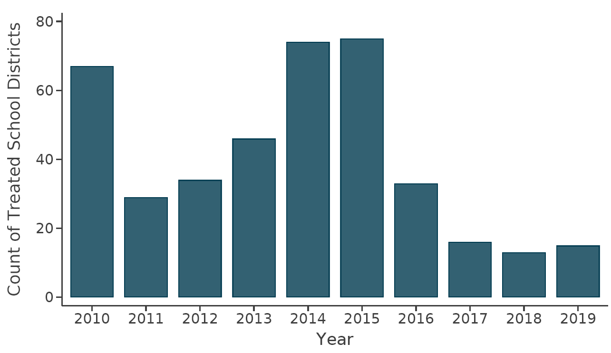
Identifying variation
Staggered difference-in-difference / event-study design
  Driven by 1st opening of any tutoring chain in a district.
  Plenty of variation in timing of entry.

Slide 24
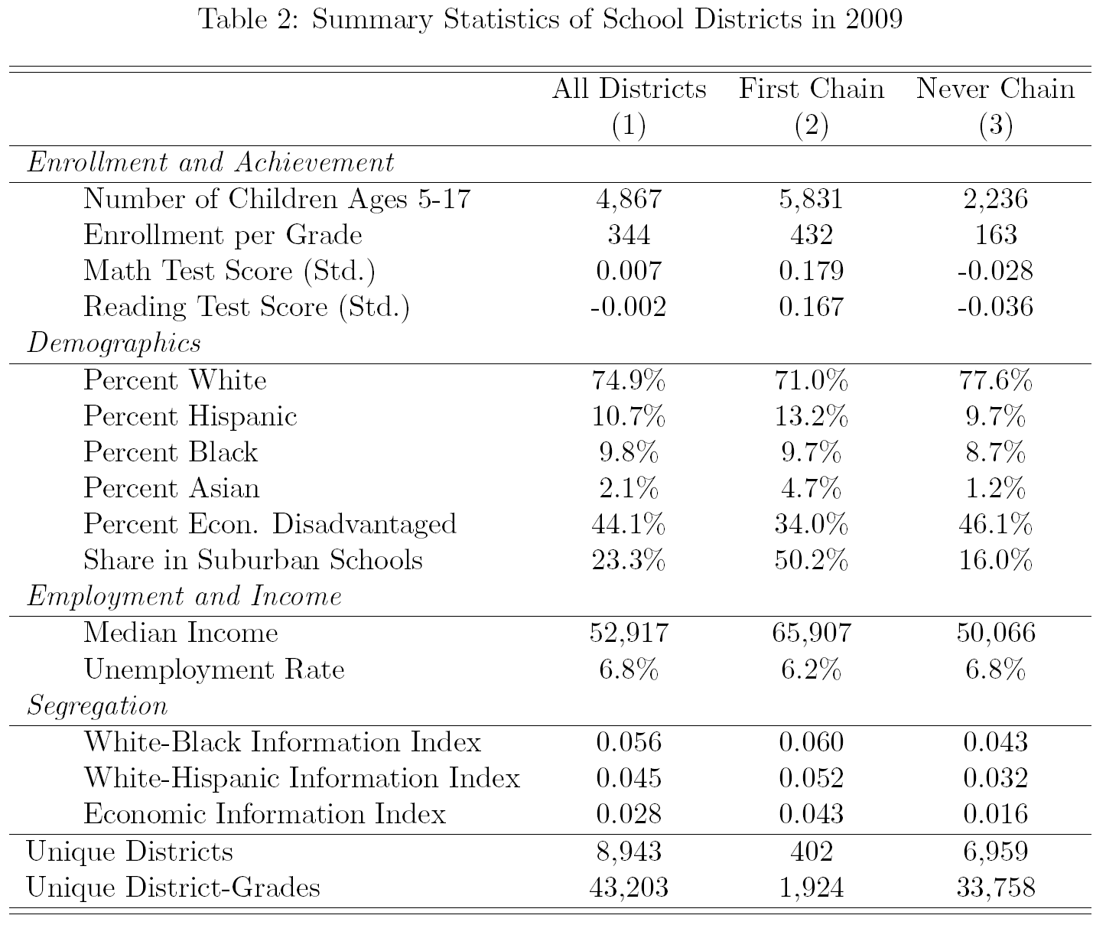
Which districts are treated?
402 treated districts get 1st chain in 2010-19.
  164 Kumon
  139 Sylvan
  35 Mathnasium
  16 Huntington
  49 Other chains
Controls: ~7,000 districts that never have chain
Relative to controls, treated districts are:
  Larger
  Higher scoring
  More Asian-American
  Higher income
  More suburban

Slide 25



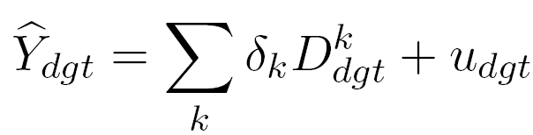
Empirical method
Standard TWFE fails because already-treated districts serve as controls for newly treated districts.
Two-stage DID event-study estimator proposed by Gardner et al. (2024):
  Stage 1: Use only never-treated and not-yet-treated obs
  Regress scores of district-grade dg in year t on district-grade and year FE
  Stage 2: With cleanly estimated FE, adjust scores for each obs
  Regress adjusted scores on event-time dummies
  Bootstrap SEs to correct for generated regressor problem; cluster by school district.

Slide 26
Interpretation of coefficients
Intent-to-treat (ITT) effects across all district students.
  Not treatment-on-treated (TOT) effects on those who use tutoring centers.
Parallel trends assumption
  Absent center opening, treated districts’ scores would have followed same trends as controls’.
  Threat is chains selecting into districts based on anticipated score gains.
  Two pieces of evidence against this:
    Flat, zero pre-trends
    Robustness to controls for student body composition and economic conditions

Slide 27
Causal results:
How do tutoring chain centers affect academic skills?

Slide 28
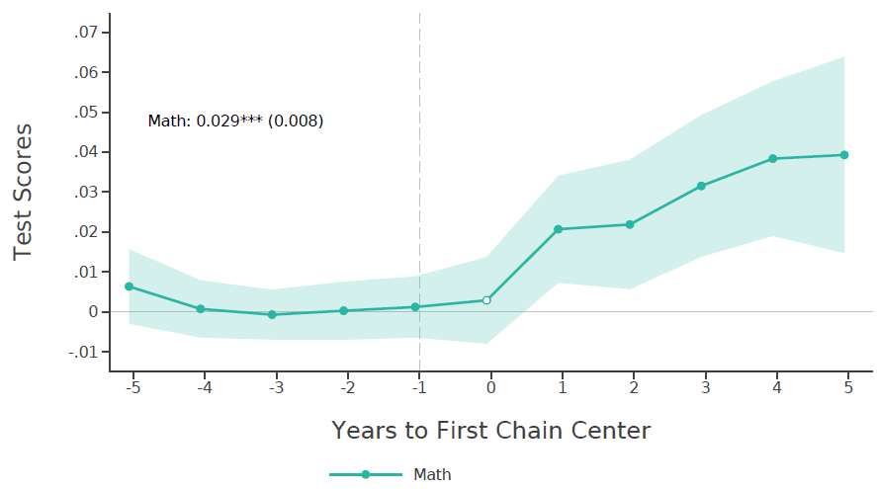
Positive, persistent impact on math
Pre-trends are flat, indistinguishable from zero.

Slide 29

Positive, persistent impact on math
Use pre and post period coefficient to calculate overall DiD estimate.
5 years post-treatment coefficients
(excluding t=0)
Post $−$ Pre $=$ DiD
5 years pre-treatment coefficients

Slide 30
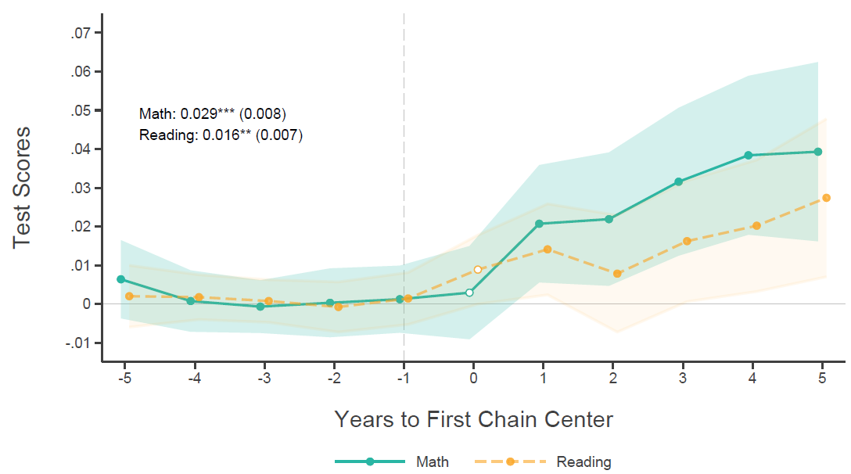
Positive, persistent impact on math and reading
First chain entry raises math by 0.029 SD and reading by 0.016 SD over first five years.
Ratio of effect sizes is proportional to usage rates.

Slide 31
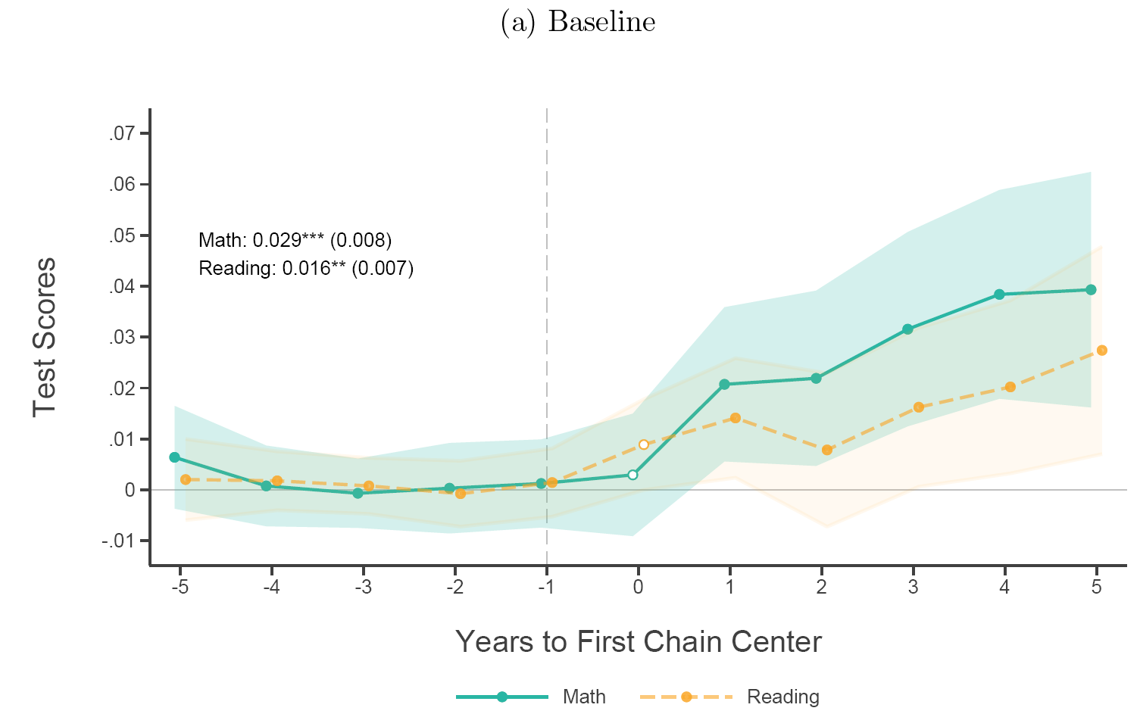
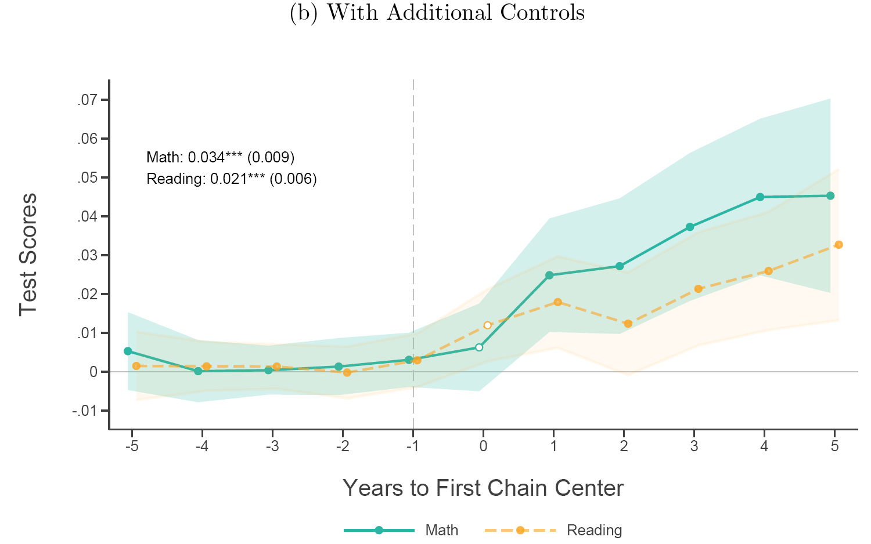
Positive, persistent impact on math and reading
Effects are robust to district-year controls for student body composition and economic conditions
  Total enrollment | racial composition of test-takers | average HH income in district | local unemployment rate

Slide 32
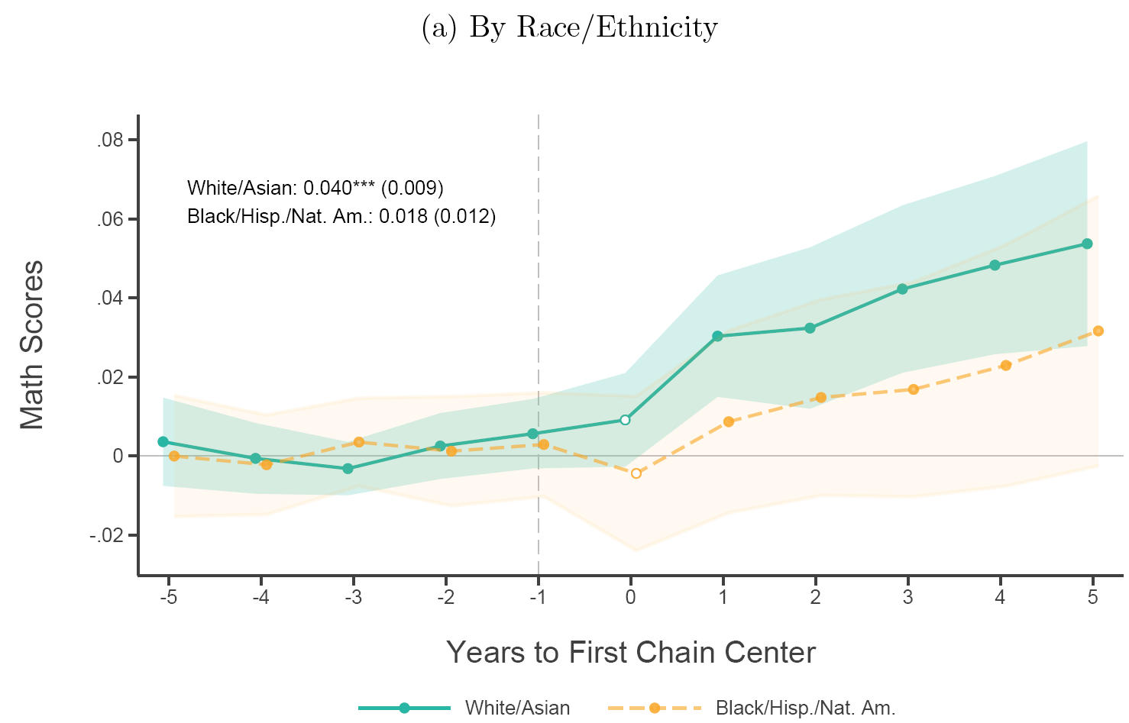
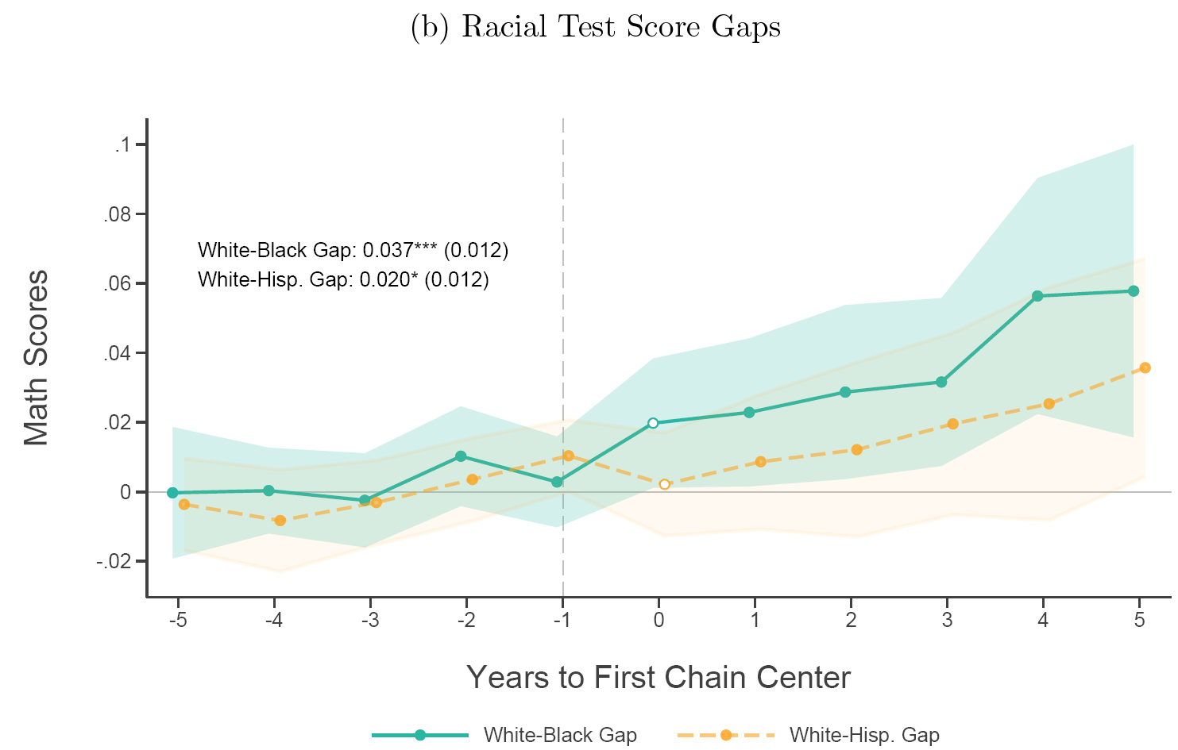
Heterogeneity by race
Consistent with usage, bigger math effects for White/Asian (0.040 SD) than Black/Hispanic (0.018 SD).
For math, chain entry increases within-district W-B gaps by 0.037 SD and W-H gaps by 0.020 SD.

Slide 33
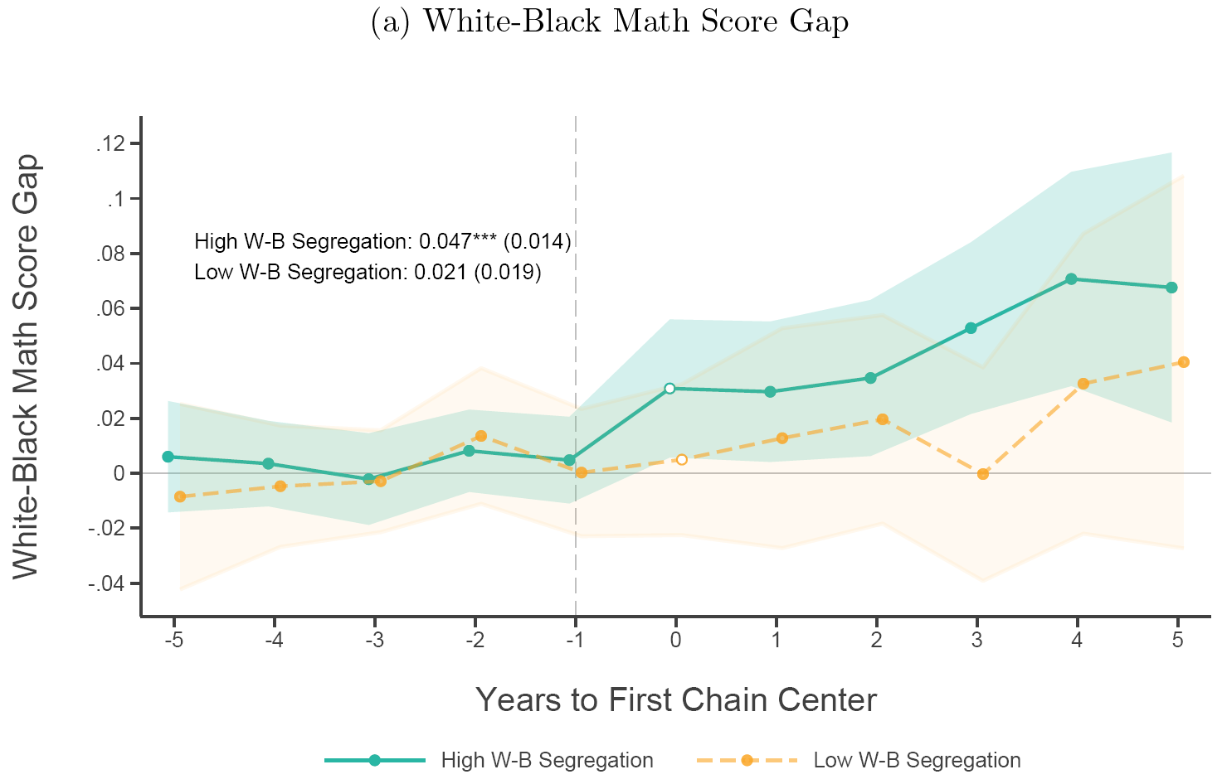
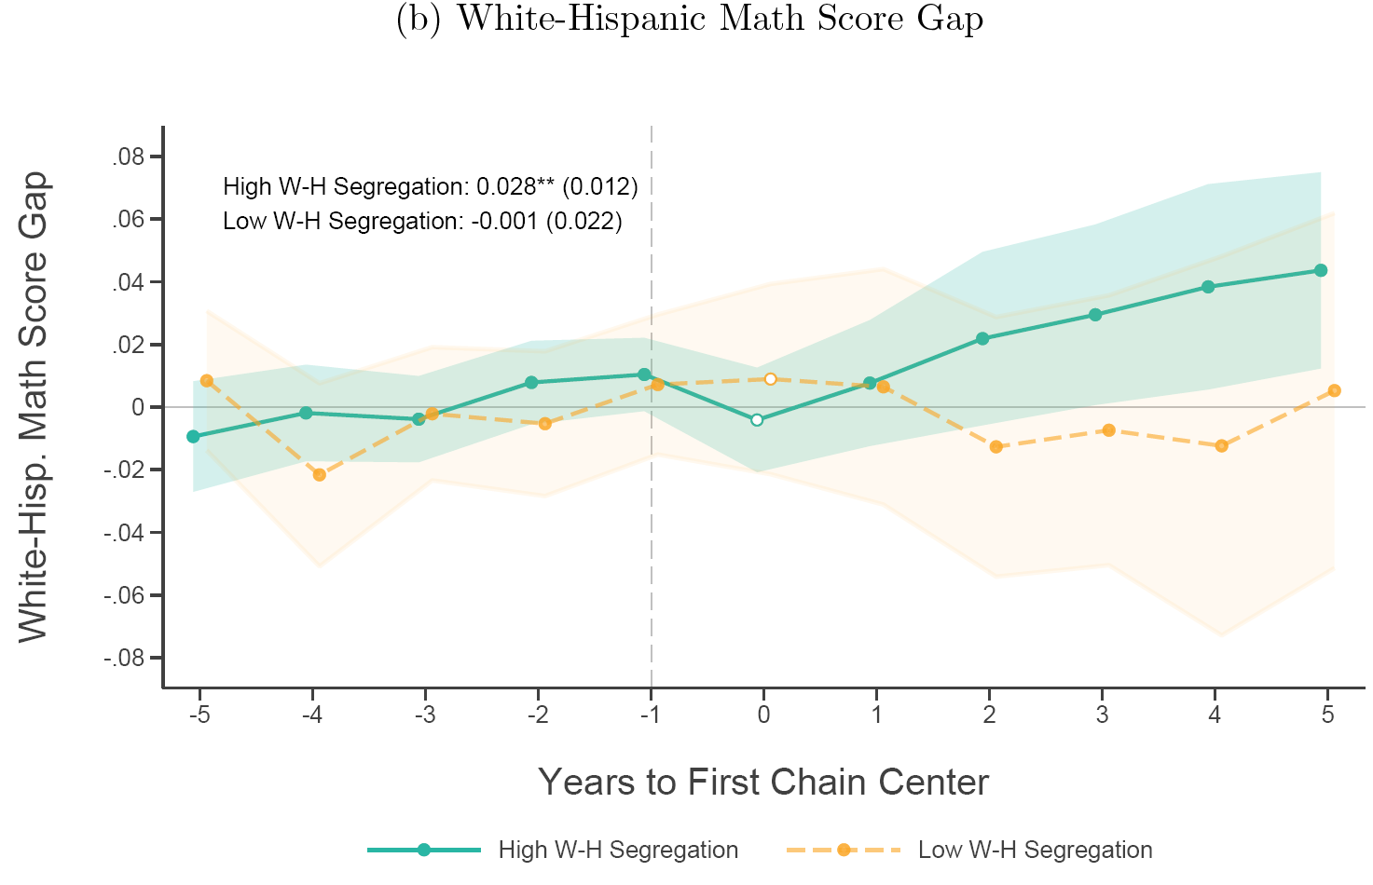
Segregation and spillover effects
Chain entry widen racial gaps more in districts with more racial segregation
No statistically significant impact in districts with below median segregation.
Potentially consistent with positive spillovers between students more vs. less likely to use centers.

Slide 34
Heterogeneity / robustness
Not all tutoring centers have the same impact.
  Diminishing returns to additional tutoring centers in larger districts with multiple centers.
  Weakly (noisy) suggestive evidence that Kumon is more effective than Sylvan.
  Non-chains (centers with ~unique names) have no measurable impact.
  Chains that send tutors to students’ homes also do nothing (geography is trickier here).
No clear heterogeneity by student gender or grade level (3-5 vs. 6-8).
Results overall and by race are robust to:
  Weighting by # of test-takers
  Including state-year FE (accounts for spatial/temporal clustering in chain expansion)
  Allowing panel to be less balanced (districts must appear in 10/11 years)

Slide 35
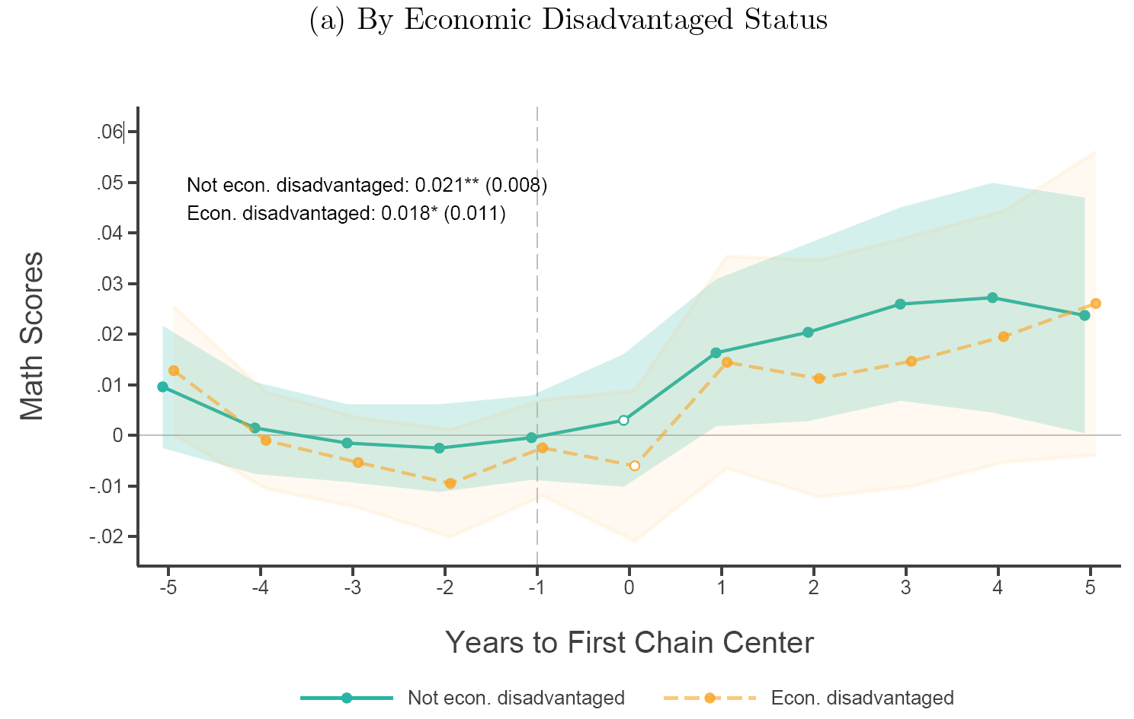
Heterogeneity by economic status
In baseline specification, no clear heterogeneity by student economic status
Potentially puzzling given expenditure patterns (but econ. disadvantage captures >40% of students)
Economic heterogeneity becomes clearer when:
  Weighting by number of test-takers
  Allowing panel to be less balanced
  Defining entry within 10-mile of district

Slide 36
Magnitudes:
How effective / cost-effective are tutoring centers?

Slide 37
Treatment effect magnitudes: Explaining trends
Center entry explains much of test score evolution in treated districts.
From 2009-19 in such districts, center entry explains:
  63% (53%) of overall math (reading) improvement
  48% (36%) of White/Asian math (reading) improvement
  44% (27%) of increased White-Black math (reading) gap
Private investments affect outcomes by which families and state accountability systems judge public schools.

Slide 38
Treatment effect magnitudes: ITT vs. TOT
How to turn ITT to TOT? Assuming no spillovers or lagged effects, scale by take-up rate.
Two ways to infer take-up, given first chain entry raises density by 0.27 centers per 1,000 kids:
  From CEX spending data:
    Each center per 1,000 kids raises usage by 31 pp → First chain increases take-up by 8.4 pp
    TOT = ITT/Take-up = .029 SD/.084 = 0.34 SD ≈ 0.4 SD tutoring estimate from Nickow et al. (2024)
  From franchise disclosure documents:
    Each center serves 100-130 kids
    Each center per 1,000 kids raises usage by 10-13 pp → First chain increases take-up by 2.7-3.5 pp
    TOT = .029/.035 - .029/.027 ≈ 0.8-1.1 SD Large, so spillovers or lags are likely important

Slide 39
Cost effectiveness
Tutoring centers appear strikingly cost-effective.
4 yrs of $1,000 per-pupil in public schools scores by 0.032 SD (Jackson & Mackevicius, 2024)
2.7-3.5% take-up rate * ~$2,600/school year (CEX) ➔ ~$70-90 per pupil across district
Our ITT of 0.029 SD is similar but at much lower cost
But tutoring gains accrue more to advantaged students, contra Jackson and Mackevicius (2024).
  Students who opt in have fewer challenges, more family help to complement tutoring.

Slide 40
Final thoughts
National, causal evidence on effects of private tutoring chains on student achievement.
  Usage is concentrated among Asian, White, and high-income HHs.
  District’s first chain center raises district-wide math and reading scores.
  Center entry widens racial achievement gaps, less so in racially integrated districts.
  Tutoring chain centers appear very effective and cost effective.
Could schools improve instruction by learning from chains?
  Chains’ approach (frequent low-stakes practice, rapid feedback, work calibrated to student’s level) aligns with best practices identified by tutoring lit, executed at scale/consistency schools may struggle with.
  If model depends on additional parental time investment, hard to expand to families who don’t opt in.
What demand do these tutoring centers satisfy?
  Center growth reveals gap between what schools offer and what some parents want.
  Relevant post-COVID, as public schools struggle to enroll high inc|Asian|White HHs (Francis & Goodman, 2025).
Thank you! Feedback: Josh Goodman (edecjosh@bu.edu) and Samuel Nitkin (snitkin@bu.edu)

