Slide 1
Medicare Coverage Decisions in the Presence of Dementia
Evidence from Medicare Part D
Brian McGarry
University of Rochester & NBER
July 18, 2026
The NBER Center on the Economics of Alzheimer’s Disease / ADRD is funded by the National Institute on Aging, part of the National Institutes of Health

Slide 2
Acknowledgement
Funding
  NIA 5K01AG078441
Coauthors
  Jiamin Yin
  Anton Porsteinsson
No conflicts of interest to disclose
Content does not reflect view of the funder
Notes:
Jiamin Yin – grad student at Rochester
Dr. Pors-tein-sson, geriatric psychiatrist and oversees memory care at UR

Slide 3
Motivation
Cognitive declines associated with ADRD place households at risk for adverse financial outcomes
  Nicholas et al. 2021; Gresenz et al. 2024, Li et al. 2023; Boyle et al. 2025
Less is known about effects on managing complex Medicare coverage decisions
  Medicare program encourages active management of coverage (open enrollment)
  Important implications for out-of-pocket medical spending, access to care, and risk protection
  Salient around time of dementia onset given increasing health and long-term care needs
Notes:
Give a very short overview of the motivation for this work:
We know from excellent work, much of it by people in this room, that ADRD can adversely affect financial outcomes including, missed credit payments and subprime credit scores (Nicholas et al. 2021; Gresenz et a. 2024), more rapid declines in financial wealth compared to matched controls (Li et al, 2023), increased susceptibility to financial fraud or scams (Boyle et al, 2025)
We know much less about how ADRD affects older adults’ ability to navigate the complex Medicare program
The Medicare program has lots of consumer choice built in, it assumes active management of coverage year-to-year through the open enrollment period, and these choices can have meaningful consequences for financial expenditures and access to care. Available evidence suggest that cognitively intact older adults struggle with the complexity of the program, so individuals with dementia may be especially at risk of adverse outcomes
We think this issue is especially salient in the context of dementia because changing health and LTC needs may raise the stakes of make timely changes to Medicare coverage

Slide 4
Current Paper
Use HRS linked with Medicare enrollment and claims
Focus on Medicare Part D Coverage
  Smaller adjustment costs associated with drug plan changes
  Primary approaches to symptom management for dementia are pharmacological
Estimate the effect of ADRD on:
  Medicare Part D plan switching
  Drug Spending
  Plan characteristics
  Specialty ADRD drug use
Notes:
So our paper seeks to fill some of this knowledge gap
Using HRS data linked with Medicare data
Focus on Part D for two reasons-
Fewer frictions to changing plans → easier to normatively interpret plan changes
Pharmacological approach to managing dementia through the use of cholinesterase inhibitors
Estimate the effect of ADRD on

Slide 5
Methods
2006-2024 waves of HRS
Stacked difference-in-differences
  Treated group: individuals incident dementia during study window
  Comparison group: households without dementia
    Matched on state, marital status, and gender
  Alternate comparison groups:
    Individuals without dementia diagnosed with a different chronic condition (AMI, cancer, glaucoma, rheumatoid arthritis, chronic kidney disease, hip fracture)
    “Not Yet” treated individuals with dementia
Event study models with person-by-cohort and year-by-cohort fixed effects

Slide 6
Primary Outcomes
Annual plan switching
  Any switching
  Active switches (remove plan changes that could be caused by a plan exiting the market, resulting in passive reassignment to a different plan)
Plan Quality
  5-star quality score
Total drug spending
  Plan premiums
  Out-of-pocket spending per supply-year
    National Drug Code (NDC) fixed effects
Notes:
Active switches means that we remove any changes in plan ID from one year to the next that correspond to a plan
Work by Keith Marzilli Ericson demonstrated that plans strategically increase premiums of a plan over its tenure while introducing new plans with lower premiums to attract new Part D enrollees. This tactic, referred to as an invest-then-harvest pricing strategy, is aimed at leveraging intert consumers who are unlikely to respond to the price increase.

Slide 7
Additional analyses
Compare outcomes around the time of clinical diagnosis
Heterogeneity by marital status
Explore relationship between plan switching and specialty ADRD drug use

Slide 8
Results

Slide 9
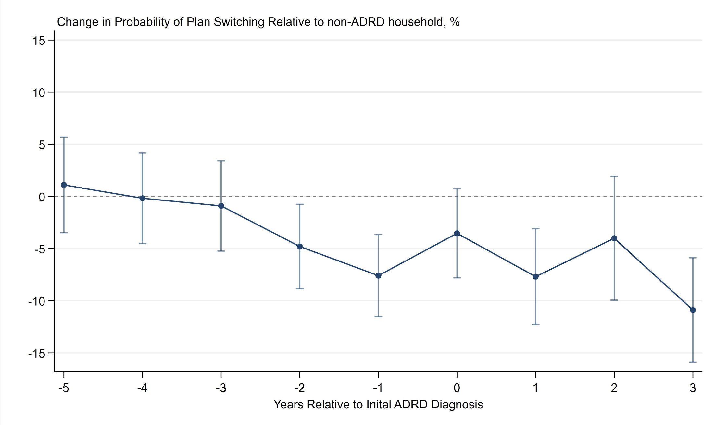
Individuals with ADRD are 5-6pp less likely to change plans annually (20% decrease) starting about 2 years before dementia onset
Sample Characteristics
Years Relative to Dementia Onset
Alternate Comparison Group
Notes:
Declines in the rate of plan switching that begin about 2 years prior to ADRD diagnosis, consistent with literature around financial decision making
Declines represent about a 20% decline in the likelihood of switching each year

Slide 10
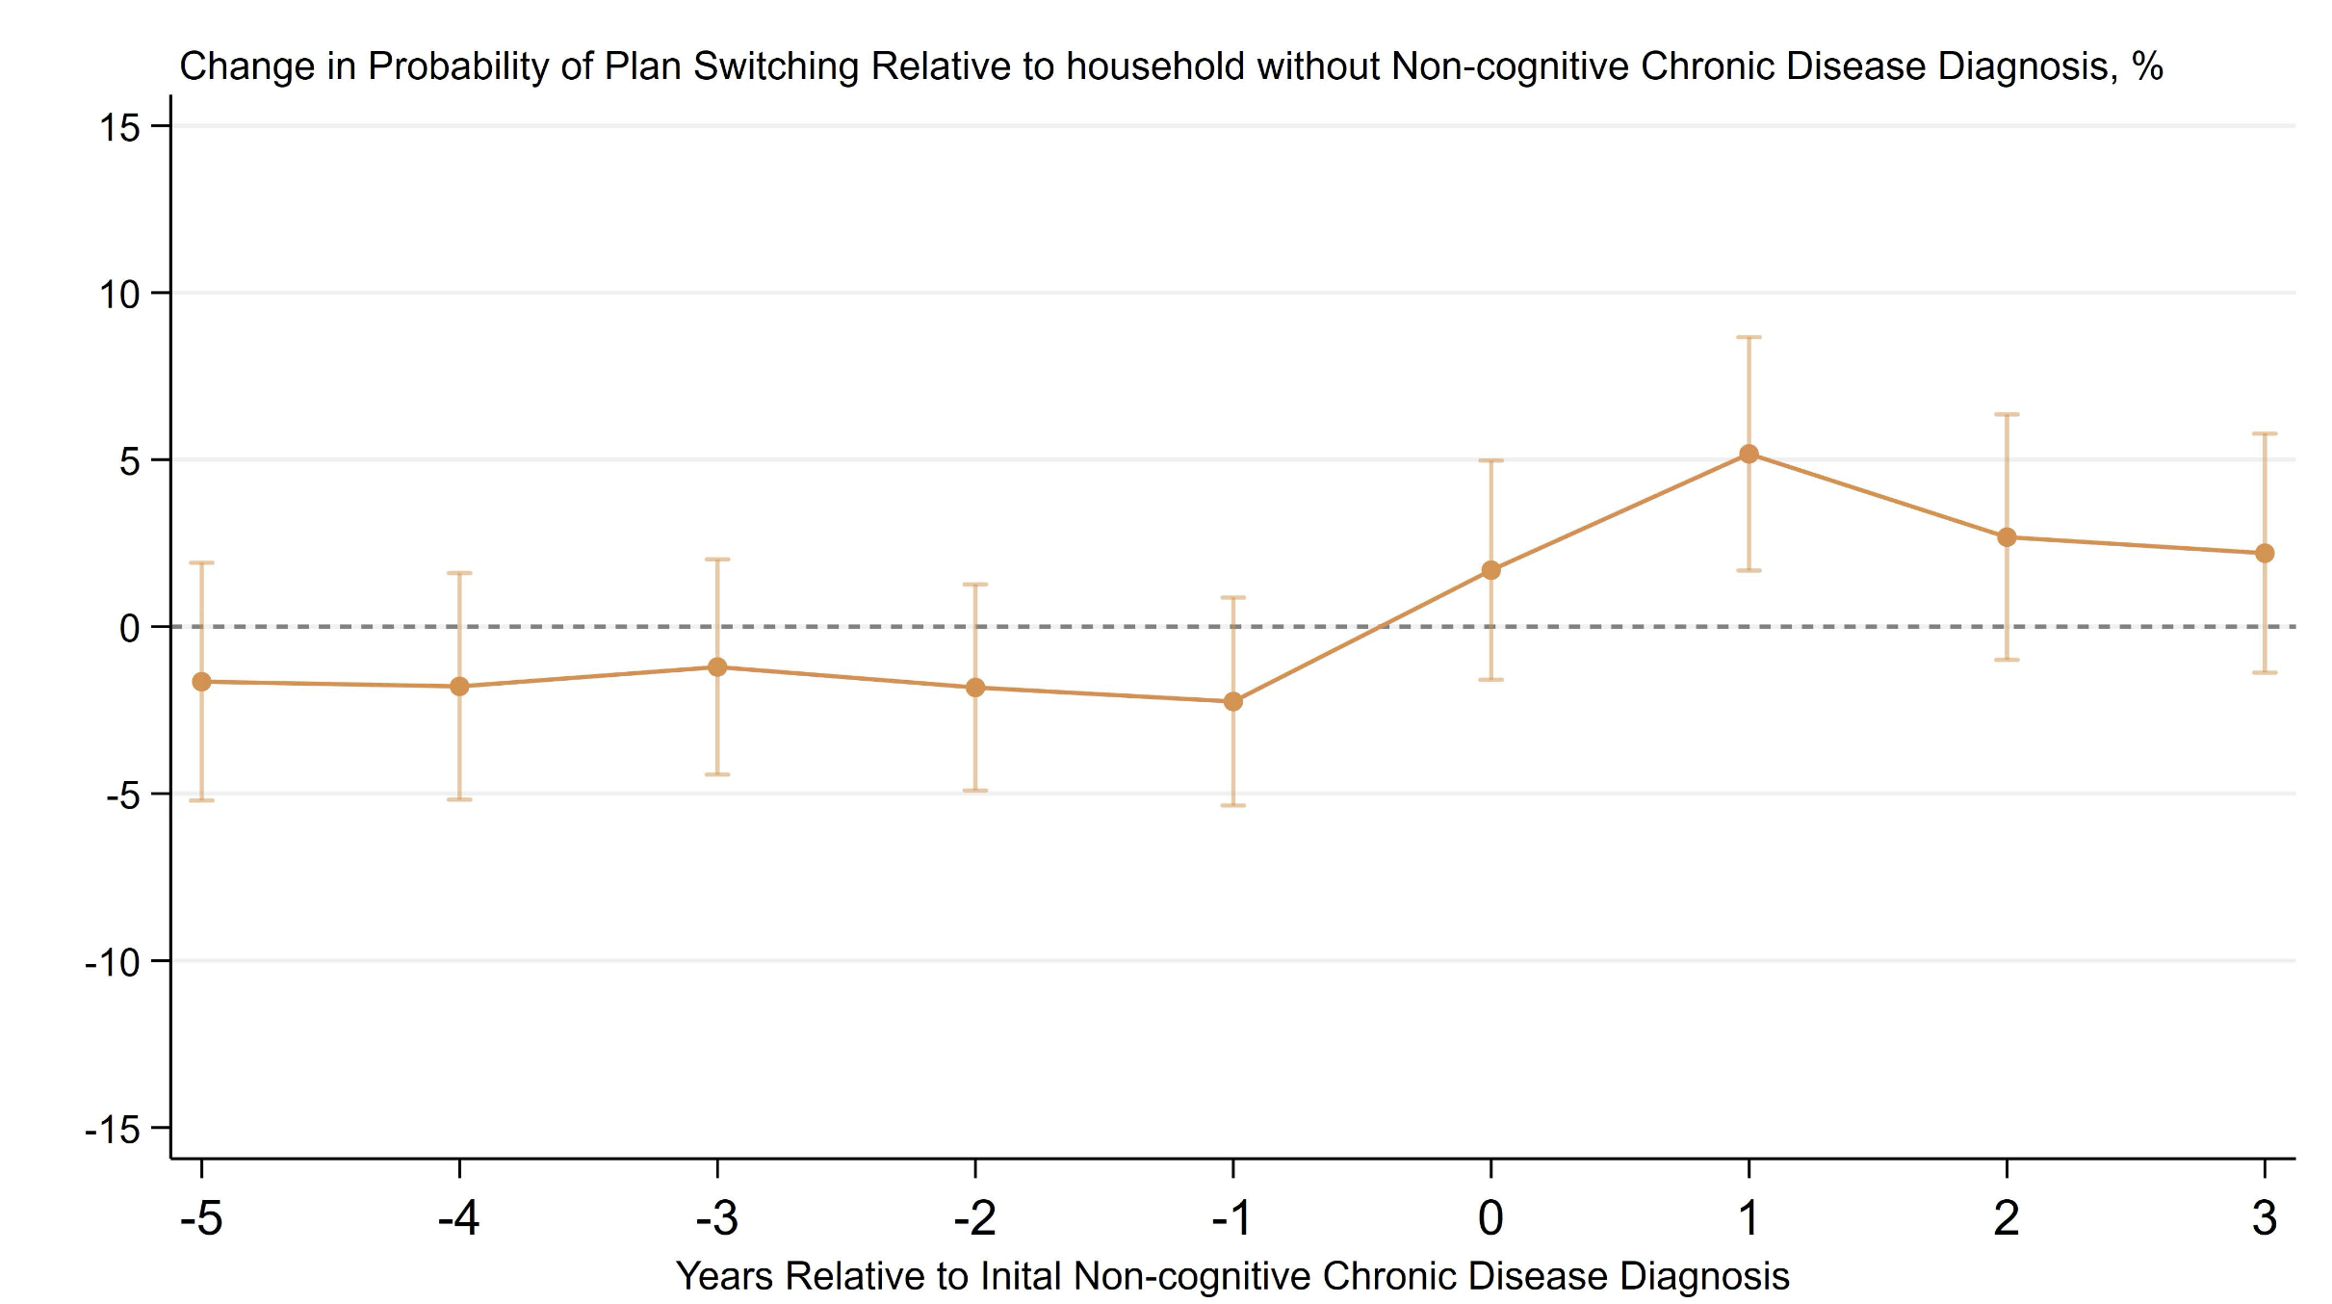
Other chronic disease diagnoses increase the likelihood of making plan switches
Notes:
Estimates obtained from similar stacked event study models- treated group are those with any of the non-cognitive chronic disease chronic conditions, control group is matched (marital status and state) households that didn’t have any chronic diseases or ADRD diagnoses.
Getting a non-cognitive chronic disease typically increases the likelihood of switching plans
AMI, cancer, glaucoma, rheumatoid arthritis, chronic kidney disease, osteoarthritis, hip fracture

Slide 11
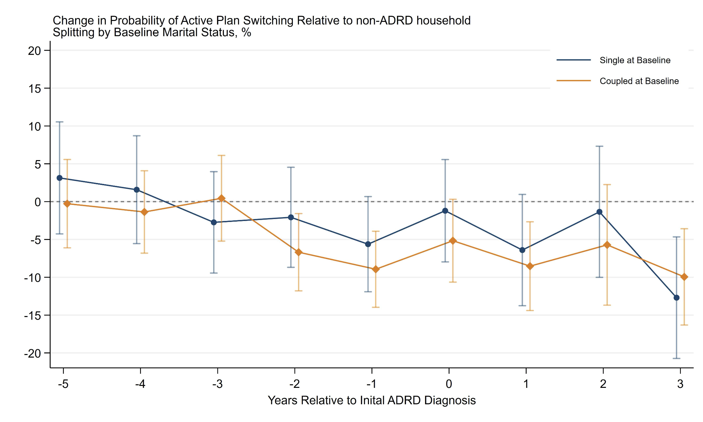
No clear evidence of differential effects by marital status
Years Relative to Dementia Onset
Notes:
Hypothesized that being married would be protective – spouse available to take over decision making, but not seeing evidence of that here.

Slide 12
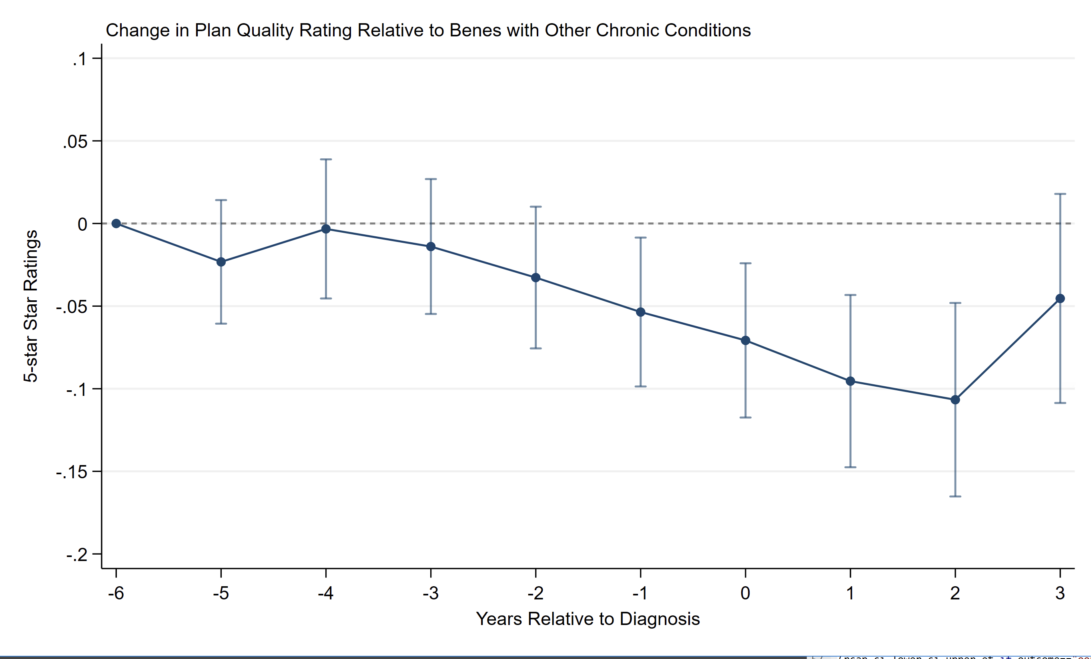
Compared to controls with other chronic conditions, individuals with ADRD experienced small reductions in plan quality
Notes:
Declines start around the estimated decline in plan switching, but effects here are modest – at most 1/10th of star (~5% relative to the mean)

Slide 13
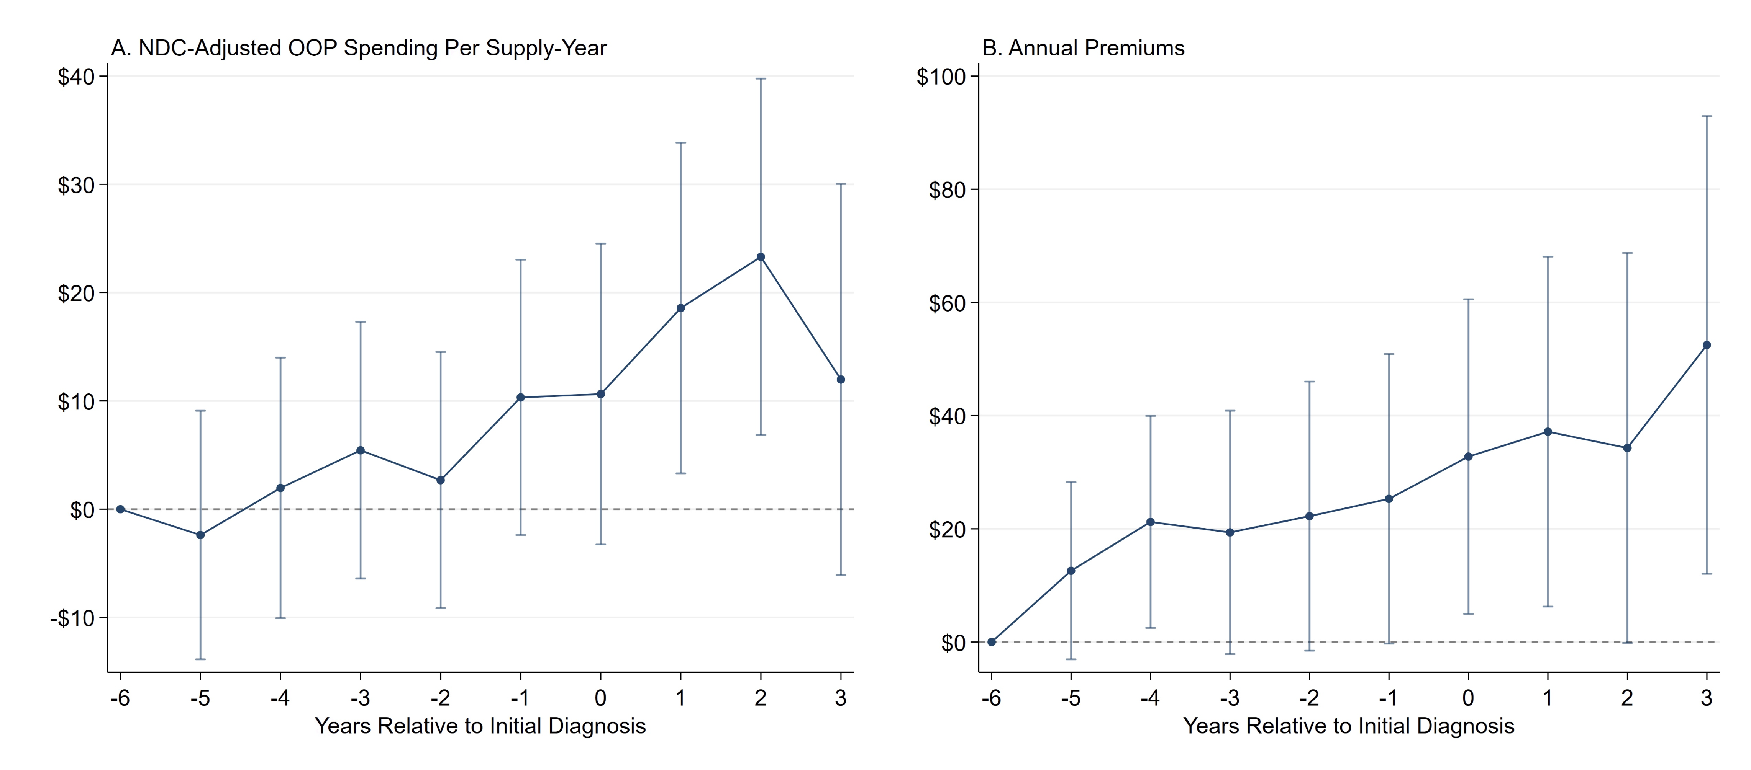
Compared to controls with other chronic conditions, individuals with ADRD experienced increases in plan premiums and OOP costs for the same class of drug
Notes:
- Spend about $10-20 more per drug per year, take an average of about 10 drugs so 100-200 more in spending per year
- Also paying relatively more in premiums, around $40 dollars more per year

Slide 14
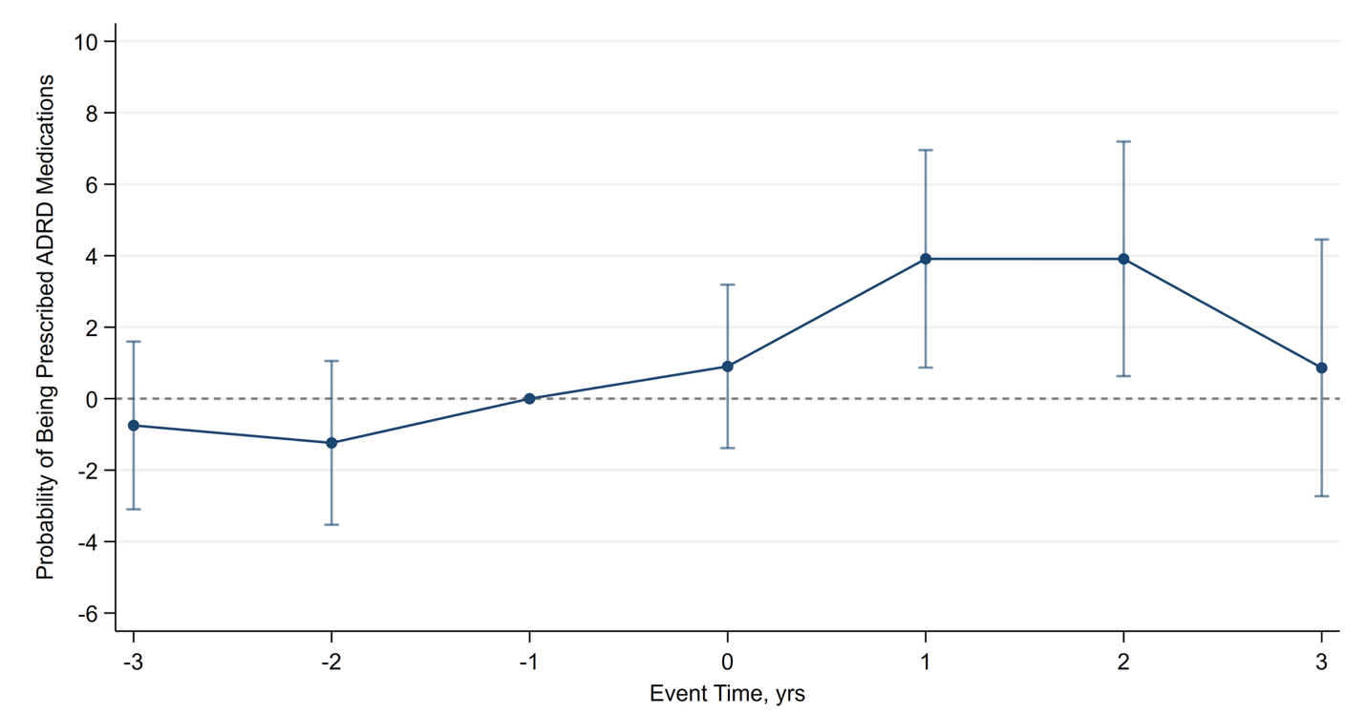
Plan switching may be important for accessing specialized drugs used to treat symptoms of ADRD
Years relative to plan switch
Notes:
Event study within our ADRD sample where event is defined as first switch around the time of an ADRD diagnosis and the comparison group is never switchers. Can see specialty drug use increases by about 4 percentage points (10% increase relative to mean use rate of about 40%)

Slide 15
Implications
Households with ADRD may need additional decision supports to ensure Part D coverage matches changing prescription drug needs
  Notification of cognitively intact family caregiver
  “Smart” defaults
  Standardized coverage of ADRD drugs
Similar dynamics may occur in other parts of Medicare
  MA plan switches, take-up of available subsidies (Medicaid, MSP, LIS)

Slide 16
Questions
Brian_mcgarry@urmc.rochester.edu

Slide 17
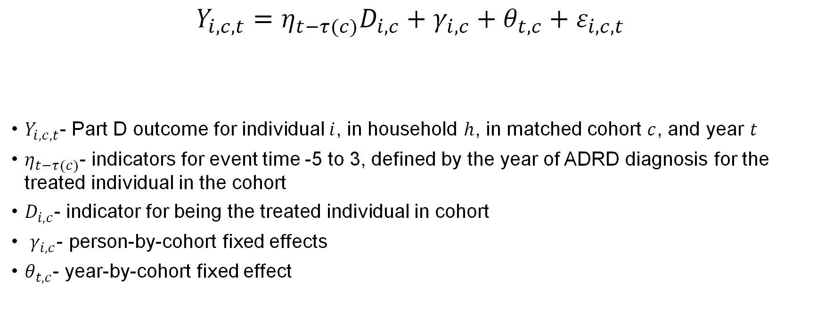
Analytic Approach
$$Y_{i,c,t}=η_{t−τ(c)}D_{i,c}+γ_{i,c}+θ_{t,c}+ε_{i,c,t}$$
$Y_{i,c,t}$- Part D outcome for individual $i$, in household $h$, in matched cohort $c$, and year $t$
$η_{t−τ(c)}$- indicators for event time -5 to 3, defined by the year of ADRD diagnosis for the treated individual in the cohort
$D_{i,c}$- indicator for being the treated individual in cohort
$γ_{i,c}$- person-by-cohort fixed effects
$θ_{t,c}$- year-by-cohort fixed effect

Slide 18
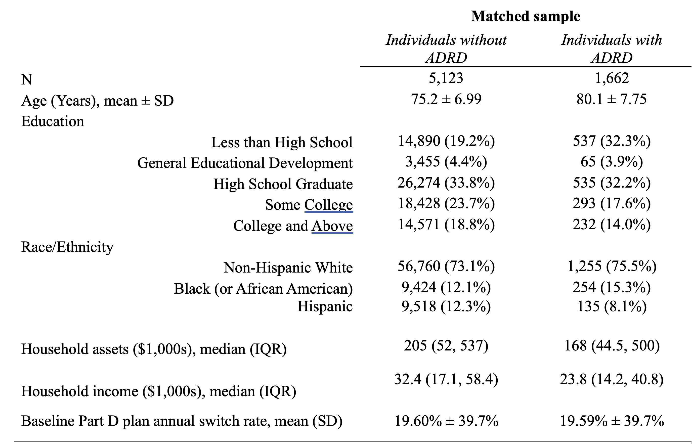
Matched Sample Characteristics
Notes:
Mean annual switch rate of about 20% in our sample; higher than previous studies that found switch rates of about 10-15%
ADRD sample is less educated, lower income, more likely female consistent with risk factors for dementia

Slide 19
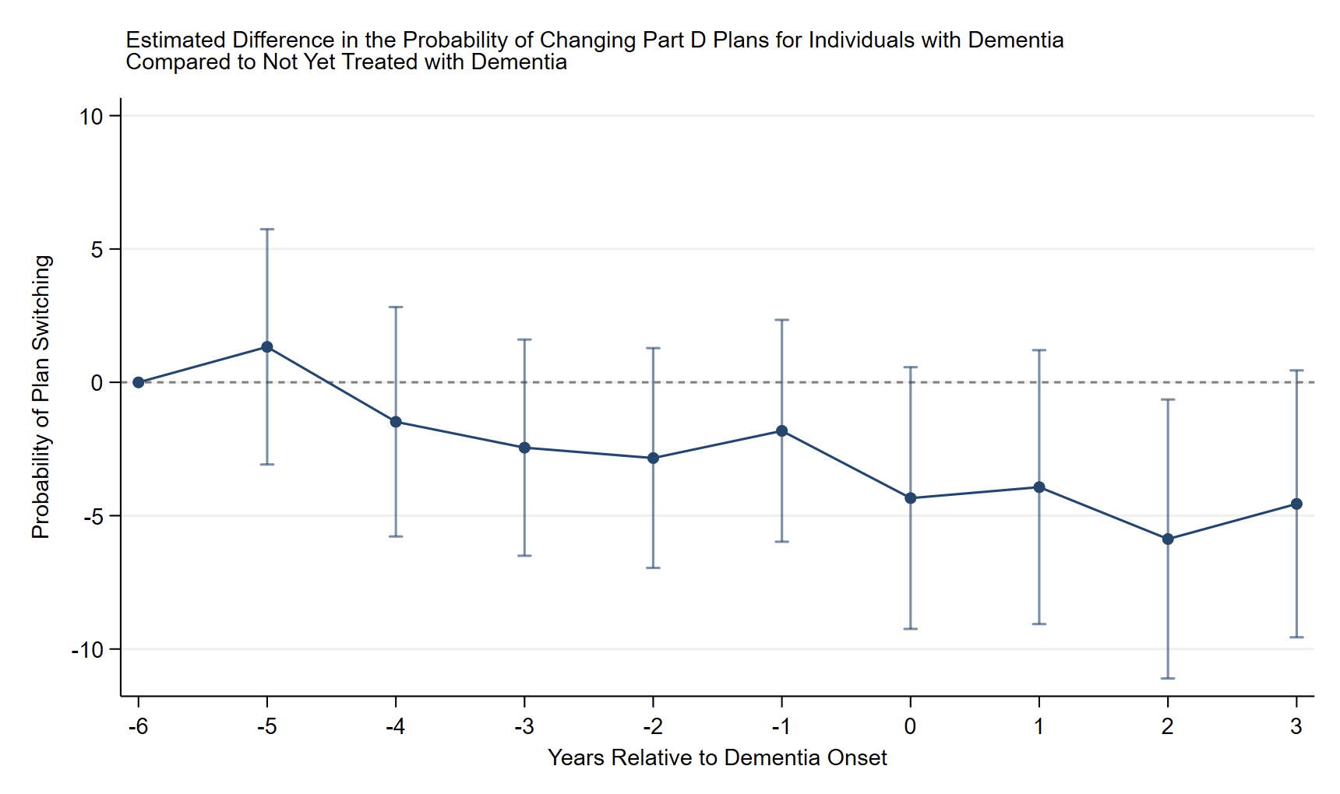

Slide 20
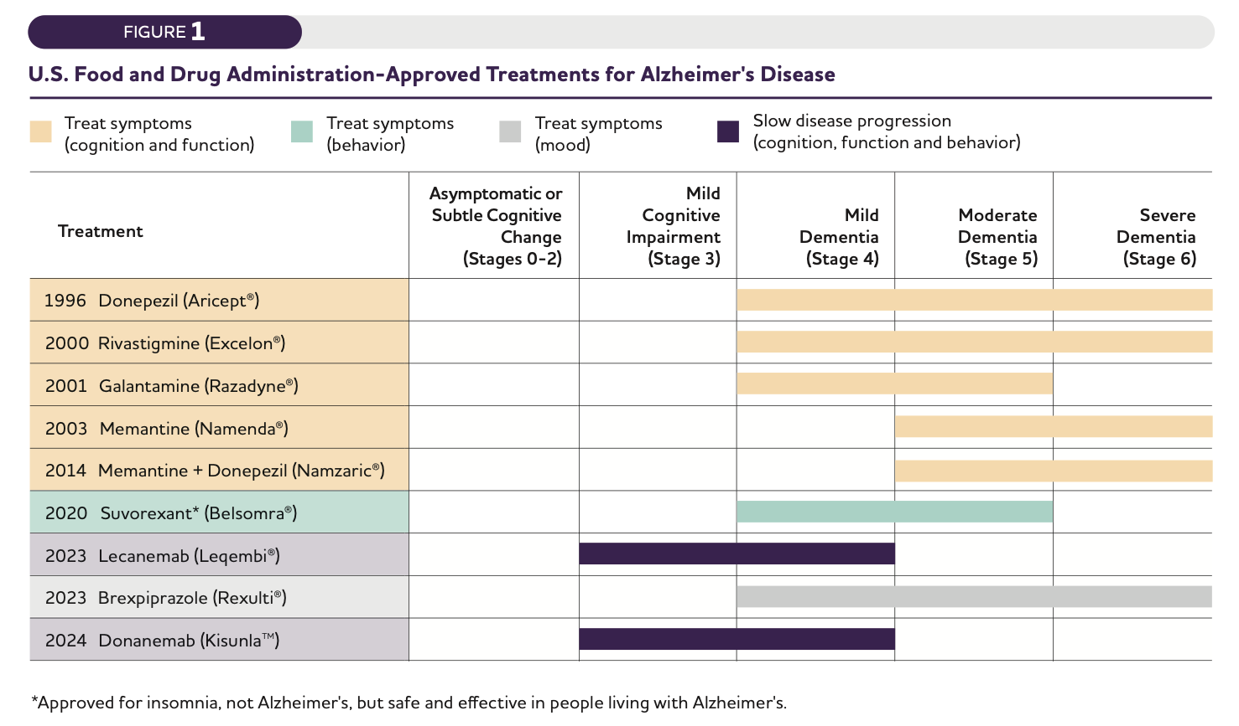
Alzheimer’s Association, 2025
Notes:
Use the Part D event file to identify filled prescriptions for the drugs approved in 2020 and earlier

Slide 21
Panel Discussion

