Slide 1
A Nonparametric Approach to the Measurement of Markups and Productivity
by Erwin Diewert
University of British Columbia and
University of New South Wales
Kevin Fox
University of New South Wales
The National Bureau of Economic Research and
The Conference on Research in Income and Wealth
Summer Institute, 2026
July 20-21, 2026
Cambridge MA

Slide 2
Introduction
The paper introduces a new nonparametric approach to the estimation of markups and the productivity of a production unit.
The nonparametric approach to production theory originated with Farrell (1957) and it constructs estimates for production functions (or for production possibilities sets) and associated measures of efficiency using only observed quantity data (and price data if available) without any econometric estimation.
This approach uses past vectors of inputs and outputs for the production unit under consideration to build up an approximation to the “true” underlying technology set at any point in time.
The approach is similar to the approach used by Diewert and Fox (2018a) except our new approach allows for markups and technology sets that can exhibit nonconstant returns to scale.

Slide 3
Introduction
We illustrate our new approach with an empirical example: the retail sector in Australia for the years 1994-2022.
The question of how big are markups has also been of academic interest due to the recent paper by de Loecker, Eeckhout and Unger (2020), who found huge markups on prices over marginal costs in the US that were in the 20-60 percent range.
Our costs are average costs (rather than marginal costs) which include returns to fixed factors so our estimated markups are much smaller.
Our markup growth estimates can be decomposed into contributions from output and input price changes, efficiency changes and the combined effects of technical progress and possible nonconstant returns to scale.
There are a number of limitations to our methodology:

Slide 4
Limitations of our Methodology
We do not obtain product by product markups; we only obtain an aggregate markup over all outputs in scope. In the case of a single output, our markup is a markup over average cost rather than marginal cost.
Our methodology applies to a production unit (establishment, firm, sector) where we can observe output and input prices and quantities over time.
Our methodology combines the effects of nonconstant returns to scale with the effects of technical progress.
Our measure of inefficiency is a measure of scale inefficiency and so some of our measured inefficiency could be due to decreasing returns to scale.
Our Maximum Markup Function is a hypothetical construct; market conditions may prevent the production unit from attaining the maximum markup that is possible when we ignore the demand side of the market.
The observed aggregate markup achieved by the production unit depends on exactly how the user costs for fixed assets was constructed: the choice of the unit’s cost of capital and the treatment of expected capital gains (or losses) on assets is important.

Slide 5
The Maximum Markup Function
We relax the constant returns to scale assumption and at the same time, we allow the firm or production unit to set output prices such that aggregate revenues exceed aggregate costs; i.e., we allow the production unit to make pure profits.
This means that we cannot apply the Jorgenson and Griliches (1967) approach to the measurement of Total Factor Productivity (TFP) which assumed a constant returns to scale technology set and competitive pricing of outputs and inputs so that the value of inputs used equaled the value of outputs produced during the accounting period.
When the value of outputs does not equal the value of inputs, Schreyer (2010; 14) asked the following questions:
How should TFP be conceptually defined, computed and interpreted?
How should growth accounting exercises be carried out?
How should measures of technical change be defined and evaluated?

Slide 6
The Maximum Markup Function
These same questions are addressed in this paper.
For the most part, we follow Balk’s (1998) (2001) (2003) (2010) methodological approach to the modelling of Total Factor Productivity (TFP) growth for a production unit when there are markups and his decomposition of TFP growth into explanatory factors. We also draw on Banker’s (1984) scale efficiency concept.
In particular, we will make use of Balk’s concept of profitability which we will interpret as the production unit’s aggregate markup factor.
What are the two most important factors that can explain TFP growth? Balk explains that these factors are technical change and changes in efficiency on the following slide:

Slide 7
The Maximum Markup Function
“In the old days one interpreted productivity change as completely due to and thus identical with technological change. Not so long ago one came to the insight that efficiency change is at least as important a factor. … The distinction between technological change and efficiency change can be made by conceiving the firm as operating in an exogenously determined environment, called the technology, which is the set of all at a given period feasible combinations of input and output quantities. A firm which operates on the boundary of this set is called technically efficient, whereas a firm which operates in the interior of this set is called technically inefficient. Technological change then means that the set of feasible combinations expands or contracts, while technical efficiency change means that the firm moves closer to or further away from the boundary. These two kinds of movement are clearly independent of each other: there can be technological change without efficiency change, and efficiency change without technological change. More usual, however, is a combination of both factors. But how to disentangle these factors in practice?” Bert Balk (2001; 160).

Slide 8
The Maximum Markup Function
We will disentangle these two factors by making use of a production unit’s Empirical Maximum Markup Function, which is defined below.
Suppose that in period t, a production unit produces combinations of J outputs, y^{t} ≡ [y₁^{t},...,y_{J}^{t}], using N inputs x^{t} ≡ [x₁^{t},...,x_{N}^{t}] > 0_{N}, while facing the strictly positive vector of net output prices p^{t} ≡ [p₁^{t},...,p_{J}^{t}] >> 0_{M} and the strictly positive vector of primary input prices w^{t} ≡ [w₁^{t},...,w_{N}^{t}] >> 0_{N}.
The value of primary inputs used by the sector during period t is then C^{t} ≡ w^{t}⋅x^{t} ≡ Σ_{n=1}^{N} w_{n}^{t}x_{n}^{t} > 0. Denote the period t production possibilities set for the production unit by S^{t}. We assume that period t value of gross output or revenue R^{t} ≡ p^{t}⋅y^{t} ≡ Σ_{j=1}^{J} p_{j}^{t}y_{j}^{t} is positive.
The production unit’s observed period t aggregate markup m^{t} and markup factor M^{t} are defined as follows for periods 1,2,…,T:
(1) M^{t} ≡ (1+m^{t}) ≡ p^{t}⋅y^{t}/w^{t}⋅x^{t} .

Slide 9
The Maximum Markup Function
The period t observed markup factor M^{t} is equal to unity if period t gross output p^{t}⋅y^{t} equals period t primary input cost w^{t}⋅x^{t}.
The actual period t markup is m^{t} and it is interpreted as the aggregate percentage by which revenues exceed costs in period t.
If M^{t} = (1+m^{t}) > 1, then the production unit is making pure profits at the rate m^{t} and if M^{t} < 1, then the unit is making a loss in period t; i.e., the unit is not making a high enough return on its fixed assets to cover the period t cost of capital r^{t} that is imbedded in the unit’s user costs for fixed assets.
Note that capital costs are included in the cost aggregate, w^{t}⋅x^{t}.
Note also that Balk defined M^{t} as period t profitability.

Slide 10
The Maximum Markup Function
Let S^{t} denote the production unit’s production possibilities set for t = 1,…,T and let p >> 0_{M} and w >> 0_{N} denote generic positive output and input price vectors. Then the production unit’s period t (Maximum) Markup (Factor) Function, μ^{t*}(p,w), is defined as follows:
(2) μ^{t*}(p,w) ≡ max _{y,x} {p⋅y/w⋅x : (y,x)∈S^{t}} ; t = 1,…,T.
For brevity, we will refer to the period t Maximum Markup Factor Function as the Markup function. Thus the Markup function is a function of the time period t and the two price vectors p and w. Since the observed period t output and input vectors (y^{t},x^{t}) belong to the period t production possibilities set, it will be the case that the observed period t markup factor M^{t} will satisfy the following inequality:
(3) M^{t} ≡ p^{t}⋅y^{t}/w^{t}⋅x^{t} ≤ μ^{t*}(p^{t},w^{t}) ; t = 1,…,T.

Slide 11
The Maximum Markup Function
If it turns out that M^{t} ≡ p^{t}⋅y^{t}/w^{t}⋅x^{t} = μ^{t*}(p^{t},w^{t}), then we say that the observed period t output-input vector (y^{t},x^{t}) is markup efficient or scale efficient.
This concept of efficiency is not quite the same as being at a point of maximum profits in period t and it is not the same as being technically efficient (i.e., on the boundary of the period t production possibilities set). It is a generalization of Banker’s (1984; 35) scale efficiency concept.
Our next assumption is that there is no technological regress in the technology of the production unit over time; i.e., we assume that:
(4) S¹⊂ S² ; S² ⊂ S³ ; … ; S^{T−1} ⊂ S^{T} .
Thus the production possibilities sets do not become smaller over time.

Slide 12
The Maximum Markup Function
We want to utilize the Markup function in the time series context without having to undertake econometric estimation of the production functions that could represent the various production possibilities sets S^{t}.
Thus we will approximate the period t production possibilities set S^{t} by the union of the observed output and input vectors for periods 1,2,…,t: (y¹,x¹), (y²,x²), …, (y^{t},x^{t}).
Using this very rough approximation to reality, the period t Empirical Maximum Markup Factor Function μ^{t}(p,w) becomes the following function:
(5) μ^{t}(p,w) ≡ max _{j} {p⋅y^{j}/w⋅x^{j} : j = 1,2,…,t}; t = 1,2,…,T.
We will refer to μ^{t}(p,w) as the period t markup function.
Definitions (5) imply that
μ¹(p,w) = p⋅y¹/w⋅x¹;
μ²(p,w) = max{p⋅y¹/w⋅x¹; p⋅y²/w⋅x²};
μ³(p,w) = max{p⋅y¹/w⋅x¹; p⋅y²/w⋅x²; p⋅y³/w⋅x³} and so on.

Slide 13
The Maximum Markup Function
We assume free disposability of inputs and outputs in the charts in section 3. Thus in the one input, one output situation, we are assuming that the underlying (approximate) production function for each period is a step function.
Our observable markup functions μ^{t}(p,w) defined by (5) are well defined for each period t and for each possible positive output and input price vector (p,w).
Thus in the one input, one output situation, we are assuming that the underlying (approximate) production function for each period is a step function.

Slide 14
The Maximum Markup Function
Note that the function μ^{t}(p,w) defines a hypothetical markup that is based solely on the underlying technology; i.e., it is not necessarily the case that the production unit would be able to sell its outputs at the hypothetical prices p but it would be able to produce the vector of outputs y^{j} using the vector of inputs x^{j} that attains the maximum in definition (5).
We will look at the rate of growth of the empirical markup functions, μ^{t}(p^{t},w^{t}), over time.
We want to decompose maximum markup factor growth, μ^{t}(p^{t},w^{t})/μ^{t−1}(p^{t−1},w^{t−1}), into the product of a term that represents changes in prices going from period t−1 to period t and a term that represents the combined effects of technical progress and changes in returns to scale.

Slide 15
The Maximum Markup Function Decompositions
The first decomposition is the following one for t = 2,3,…,T:
(6) μ^{t}(p^{t},w^{t})/μ^{t−1}(p^{t−1},w^{t−1}) =
[μ^{t}(p^{t},w^{t})/μ^{t−1}(p^{t},w^{t})][μ^{t−1}(p^{t},w^{t})/μ^{t−1}(p^{t−1},w^{t−1})] = τ_{P}^{t}α_{L}^{t}
where the period t Paasche type index of the combined effects of technical progress and returns to scale on markup factor growth holding prices constant, τ_{P}^{t}, is defined as follows:
(7) τ_{P}^{t} ≡ μ^{t}(p^{t},w^{t})/μ^{t−1}(p^{t},w^{t}) ≥ 1 ; t = 2,…,T.
The τ_{P}^{t} measure of markup factor change holds prices constant at their period t levels.
The numerator and denominator on the right hand side of (7) both calculate the maximum markup factor that is attainable by the production unit if it faces period t output and input prices but the numerator markup uses the period t technology while the denominator markup uses the period t-1 technology.

Slide 16
The Maximum Markup Function Decompositions
The period t Laspeyres type measure of the effect of output and input price change on markup factor growth going from period t−1 to period t is defined as:
(8) α_{L}^{t} ≡ μ^{t−1}(p^{t},w^{t})/μ^{t−1}(p^{t−1},w^{t−1}) ; t = 2,…,T.
We term (8) a Laspeyres type theoretical index of price change because we compare the maximum markup factor in period t to the maximum markup factor in period t−1 holding the technology constant at the period t−1 levels.
To summarize, our first decomposition of markup growth is:
(6) μ^{t}(p^{t},w^{t})/μ^{t−1}(p^{t−1},w^{t−1})
= [μ^{t}(p^{t},w^{t})/μ^{t−1}(p^{t},w^{t})][μ^{t−1}(p^{t},w^{t})/μ^{t−1}(p^{t−1},w^{t−1})]
= τ_{P}^{t}α_{L}^{t}.
Our second decomposition of markup growth is on the following slide.

Slide 17
The Maximum Markup Function Decompositions
The second decomposition is the following one for t = 2,…,T:
(9) μ^{t}(p^{t},w^{t})/μ^{t−1}(p^{t−1},w^{t−1})
= [μ^{t}(p^{t},w^{t})/μ^{t}(p^{t−1},w^{t−1})][μ^{t}(p^{t−1},w^{t−1})/μ^{t−1}(p^{t−1},w^{t−1}
= α_{P}^{t}τ_{L}^{t}
where the period t Laspeyres type index of the effects of technical progress and returns to scale on markup factor growth holding prices constant τ_{L}^{t} is defined as:
(10) τ_{L}^{t} ≡ μ^{t}(p^{t−1},w^{t−1})/μ^{t−1}(p^{t−1},w^{t−1}) ≥ 1 ; t = 2,…,T.
The period t Paasche type measure of the effect of price change on markup facto growth going from period t−1 to period t is defined as:
(11) α_{P}^{t} ≡ μ^{t}(p^{t},w^{t})/μ^{t}(p^{t−1},w^{t−1}) ; t = 2,…,T.

Slide 18
The Maximum Markup Function Decompositions
Since τ_{L}^{t} and τ_{P}^{t} are equally relevant measures of generalized technical progress between periods t−1 and t, we use their geometric mean τ^{t} as our final estimate of generalized technical progress going from period t−1 to period t:
(12) τ^{t} ≡ [τ_{L}^{t}τ_{P}^{t}]^{1/2} ; t = 2,…,T.
Similarly, since α_{L}^{t} and α_{P}^{t} are equally relevant measures of the effects of output and input price change going from period t−1 to t, we take their geometric mean, α_{L}^{t}, as our final measure of price change going from period t−1 to t:
(13) α^{t} ≡ [α_{L}^{t}α_{P}^{t}]^{1/2} ; t = 2,…,T.
Using the above definitions, it can be seen that we have the following decomposition for the rate of growth of the Markup function going from period t−1 to period t:
(14) μ^{t}(p^{t},w^{t})/μ^{t−1}(p^{t−1},w^{t−1}) = α^{t}τ^{t} ; t = 2,…,T.

Slide 19
The Maximum Markup Function Decompositions
Following the example of Balk (1998; 143), we define the scale efficiency of the production unit during period t, e^{t}, as follows:
(15) e^{t} ≡ [p^{t}⋅y^{t}/w^{t}⋅x^{t}]/M^{t}(p^{t},w^{t}) ≤ 1; t = 1,2,…,T
where the inequality in (15) follows from definitions (5).
Thus if e^{t} = 1, then production is scale efficient in period t and if e^{t} < 1, then production for the sector during period t is scale inefficient.
Note that the above definition of scale efficiency is a markup function counterpart to Farrell’s (1957; 255) cost based measure of overall efficiency which combined his measures of technical and (cost) allocative efficiency.
In definitions (15), we defined the period t and period t−1 scale efficiencies as e^{t} and e^{t−1}. In the following slide, we define an index of the change in scale efficiency ε^{t} for the production unit over the two periods as follows:

Slide 20
The Maximum Markup Function Decompositions
(16) ε^{t} ≡ e^{t}/e^{t−1} t = 2,…,T.
= [(p^{t}⋅y^{t}/w^{t}⋅y^{t})/μ^{t}(p^{t},w^{t})]/[(p^{t−1}⋅y^{t−1}/w^{t−1}⋅x^{t−1})/μ^{t−1}(p^{t−1},w^{t−1})] .
Thus if ε^{t} > 1, then scale efficiency (or markup efficiency) has improved going from period t−1 to t whereas it has fallen if ε^{t} < 1.
Using the above definitions, it can be shown that the following decomposition of observed markup factors going from period t−1 to t is valid:
(17) [R^{t}/C^{t}]/[R^{t−1}/C^{t−1}] = M^{t}/M^{t−1} = (1+m^{t})/(1+m^{t−1}) = ε^{t}α^{t}τ^{t} ;
t = 2,3,…,T.
Since R^{t} = p^{t}⋅y^{t} and C^{t} = w^{t}⋅x^{t}, equations (17) can be reorganized to give us the following growth accounting decomposition of nominal output growth, p^{t}⋅y^{t}/p^{t−1}⋅y^{t−1}, into explanatory factors:
(18) p^{t}⋅y^{t}/p^{t−1}⋅y^{t−1} = [w^{t}⋅x^{t}/w^{t−1}⋅x^{t−1}]ε^{t}α^{t}τ^{t} ; t = 2,3,…,T.

Slide 21
Total Factor Productivity Growth Decompositions
Define Total Factor Productivity Growth going from period t−1 to period t, π^{t}, as the product of efficiency growth ε^{t} times generalized technical progress τ^{t}:
(19) π^{t} ≡ ε^{t}τ^{t} ; t = 2,3,…,T.
Thus TFP growth π^{t} is decomposed into the product of efficiency growth ε^{t} times the combined effects of technical progress and possible nonconstant returns to scale, τ^{t}.
In the paper, we illustrate the above concepts with charts for the case of one output, one input technologies.
Our nonparametric approach to productivity measurement turns out to be very similar to the nonparametric approach taken by Diewert and Fox (2018a). The main difference is that the Diewert and Fox approach assumed a constant returns to scale technology with no markups. In our present approach, we relax these assumptions.

Slide 22
The One Output, Many Input Case
Our empirical example has only one output (and eight inputs).
The formula for the Empirical Markup function μ^{t}(p,w) simplifies in the case of one output.
In this case, the inner product p⋅y just becomes the product of the scalar output price p and the scalar output quantity y.
Using definition (5), the Empirical Markup function becomes:
(32) μ^{t}(p,w) ≡ max _{j} {py^{j}/w⋅x^{j} : j = 1,2,…,t}
= p max _{j} {y^{j}/w⋅x^{j} : j = 1,2,…,t}
= p max _{j} {1/w⋅(x^{j}/y^{j}) : j = 1,2,…,t}
= p/min _{j} {w⋅(x^{j}/y^{j}) : j = 1,2,…,t}
= p/c^{t}(w)
where c^{t}(w) is defined as follows:
(33) c^{t}(w) ≡ min _{j} {w⋅(x^{j}/y^{j}) : j = 1,2,…,t}.

Slide 23
The One Output, Many Input Case
The function c^{t}(w) is the period t empirical minimum average cost function for the production unit. Using assumption (4), it provides an approximation to the production unit’s period t true minimum average cost function in the one output case.
Define the production unit’s period t total cost function, C^{t}(y,w) for positive output level y and positive input price vector w as follows:
(34) C^{t}(y,w) ≡ min _{x} {w⋅x : (y,x)∈S^{t}}.
Define the production unit’s period t true minimum average cost function as follows:
(35) c^{t*}(w) ≡ min _{y} {C^{t}(y,w)/y : y > 0}.
As mentioned above, the empirical minimum average cost function, c^{t}(w) defined by (33) provides an approximation to the true minimum average cost function c^{t*}(w) defined by (35).

Slide 24
The One Output, Many Input Case
For the one output case, the decomposition of period t nominal output growth defined by (31) above can be replaced by a simpler decomposition that is defined by using the empirical average cost function c^{t}(w) defined by (33).
Using the fact that μ^{t}(p,w) is equal to p/c^{t}(w) in the one output case, we can establish the following relationships for t = 1,…,T:
(36) e^{t} ≡ [p^{t}y^{t}/w^{t}⋅x^{t}]/μ^{t}(p,w)
= [p^{t}y^{t}/w^{t}⋅x^{t}]/[p^{t}/c^{t}(w^{t})] = c^{t}(w^{t})/w^{t}⋅(x^{t}/y^{t}).
Make the following definitions for t = 2,…,T:
(37) ε^{t} ≡ e^{t}/e^{t−1} ;
(38) β^{t} ≡ p^{t}/p^{t−1} ;
(39) γ_{L}^{t} ≡ c^{t−1}(w^{t})/c^{t−1}(w^{t−1}) ; γ_{P}^{t} ≡ c^{t}(w^{t})/c^{t}(w^{t−1}) ; γ^{t} ≡ [γ_{L}^{t} γ_{P}^{t}]^{1/2} ;
(40) τ_{L}^{t} ≡ c^{t−1}(w^{t−1})/c^{t}(w^{t−1}) ; τ_{P}^{t} ≡ c^{t−1}(w^{t})/c^{t}(w^{t}) ; τ^{t} ≡ [τ_{L}^{t} τ_{P}^{t}]^{1/2} .
The technical progress measures are based on Salter (1960).

Slide 25
The One Output, Many Input Case
Using the above definitions, it can be verified that the following identities hold for t = 2,…,T:
(41) [p^{t}y^{t}/w^{t}⋅x^{t}]/[p^{t−1}y^{t−1}/w^{t−1}⋅x^{t−1}] = (1+m^{t})/(1+m^{t−1}) = β^{t}ε^{t}τ^{t}/γ^{t}.
Equations (41) tell us that (one plus) the rate of markup growth is equal to an output price index β^{t} times an efficiency growth index ε^{t} times an index of generalized technical progress τ^{t} divided by an input price index γ^{t}.
If we multiply both sides of (41) by w^{t}⋅x^{t}/w^{t−1}⋅x^{t−1}, we get the growth accounting identity (31) where the explanatory factors are now defined using p/c^{t}(w) instead of the more general empirical markup function μ^{t}(p,w).
As usual, our index of period t TFP growth is defined as π^{t} ≡ ε^{t}τ^{t}.
The above algebra is fairly simple for the one output case of our general methodology. In the following section, we will apply our one output decomposition to the Australian Retail Sector.

Slide 26
Application to the Australian Retail Sector
It is useful to rearrange (41).
Using the fact that β^{t} is equal to p^{t}/p^{t−1}, we can rewrite equations (41) as follows:
(42) y^{t}/y^{t−1} = ε^{t}τ^{t}[w^{t}⋅x^{t}/w^{t−1}⋅x^{t−1}]/γ^{t} ; t = 2,…,T
where γ^{t} is the bilateral input price index defined by (39).
Thus [w^{t}⋅x^{t}/w^{t−1}⋅x^{t−1}]/γ^{t} = X^{t}/X^{t−1} is a bilateral input quantity index X^{t}/X^{t−1} where X^{t} is the period t aggregate input level.
If we use this equation to eliminate γ^{t} from equations (42), we get the following growth decomposition:
(43) y^{t}/y^{t−1} = (X^{t}/X^{t−1})ε^{t}τ^{t} = (X^{t}/X^{t−1}) π^{t} t =2,…,T.
For purposes of comparison with other measures of TFP growth, it is useful to convert the TFP growth equations (43) into TFP levels equations.

Slide 27
One Output TFP Levels Decomposition
Define the level of aggregate input in period 1 as X¹ ≡ w¹⋅x¹.
Define the X^{t} for subsequent periods t ≥ 2 recursively using the equations X^{t} ≡ X^{t−1}[w^{t}⋅x^{t}/w^{t−1}⋅x^{t−1}]/γ^{t} where γ^{t} is defined by (39).
Define the corresponding aggregate input price levels by
W^{t} ≡ w^{t}⋅x^{t}/X^{t}.
Define the period 1 level of technical progress Τ¹ ≡ 1 and define the technical progress levels for periods t ≥ 2 recursively using the equations Τ^{t} ≡ Τ^{t−1}τ^{t} where τ^{t} is defined by (40).
Finally, define the period t Diewert Fox Nonparametric Level of Total Factor Productivity as Π^{t}:
(44) Π^{t} ≡ [y^{t}/y¹]/[X^{t}/X¹] = e^{t} Τ^{t} ; t = 1,…,T.
Thus the year t TFP level, Π^{t}, is defined as year t output divided by year 1 output, [y^{t}/y¹], divided by year t input divided by year 1 input, [y^{t}/y¹], and Π^{t} has the decomposition Π^{t} = e^{t} Τ^{t}.

Slide 28
Application to the Australian Retail Sector
In Appendix A, we explain how we used Australian Bureau of Statistics (ABS) data on Australia’s Retail Trade sector for the 29 years 1994-2022 in order to construct estimates for the annual gross output of the sector.
Year t price and quantity scalars are p^{t} and y^{t} respectively) and estimates for eight inputs (year t price and quantity vectors are w^{t} ≡ [w₁^{t},…,w₈^{t}] and x^{t} ≡ [x₁^{t},…,x₈^{t}] respectively.
The nine price series are listed in Table A11 and the nine quantity series are listed in Table A12 of the Appendix.
The eight inputs are:
(1) quality adjusted labour input,
(2) intermediate inputs,
(3) non-dwelling construction services (retail structures),
(4) machinery and equipment,
(5) research and development,
(6) computer software,
(7) inventory stocks and
(8) land.

Slide 29
Application to the Australian Retail Sector: User Costs
In Appendix A, we explain in some detail the problems in constructing user costs for the 6 capital stocks.
A user cost for an asset reflects the cost of purchasing an asset at the beginning of the accounting period (including the interest foregone by tying up financial capital during the accounting period), using the asset and then (hypothetically) selling the depreciated asset at the end of the accounting period.
The expected sale price at the end of the period depends on forecasts about depreciation rates and expected asset inflation rates.
Thus there are three important ingredients in forming a period t user cost: (i) the opportunity cost of financial capital at the beginning of the period (the interest rate r^{t}), the asset depreciation rate δ^{t} and the expected asset inflation rate i^{t}.
All three of these ingredients are subject to error.

Slide 30
Application to the Australian Retail Sector: User Costs
We use a variant of the user cost formula developed by Jorgenson and Griliches (1967) and Christensen and Jorgenson (1969). Jorgensonian user costs use ex post new asset inflation rates to determine the asset inflation rate i^{t} and r^{t} is the ex post rate of return earned by the production unit at the end of the accounting period.
This ex post rate of return is determined by using ex post asset inflation rates in the user cost formula and solving for the balancing rate of return r_{J}^{t} in each user cost that will make the sum of the user costs equal to the period t value of gross output less the values of labour and intermediate input services.
Using the Jorgenson methodology, the value of outputs equals the value of inputs in each period and markups m^{t} would be equal to 0.
Our markup methodology assumes that real rate of return to financial capital is equal to 7 per cent (somewhat arbitrary!).

Slide 31
Application to the Australian Retail Sector: User Costs
If we add one per cent to the 7 per cent, markups decline by 0.01 times the value of the beginning of the year capital stock.
This hypothetical computation shows that it is important to include the value of inventories and land in the list of assets if we want to measure the aggregate markup over average cost correctly.
We note that the Australian Bureau of Statistics did not include land and inventories in their list of assets when they computed TFP for the Retail Sector. We will show later that this makes a big difference to the estimates of TFP growth.
Our estimated markup factors, M^{t} ≡ 1+m^{t}, are listed in Table 2 and plotted in Chart 1. The average markup factor was 1.0407 but there is an increasing trend in the M^{t}, with a maximum of 10.9% in 2020.
The average was 2.6% per year in the period 1994-2007 and 5.5% for the period 2008-2022.

Slide 32
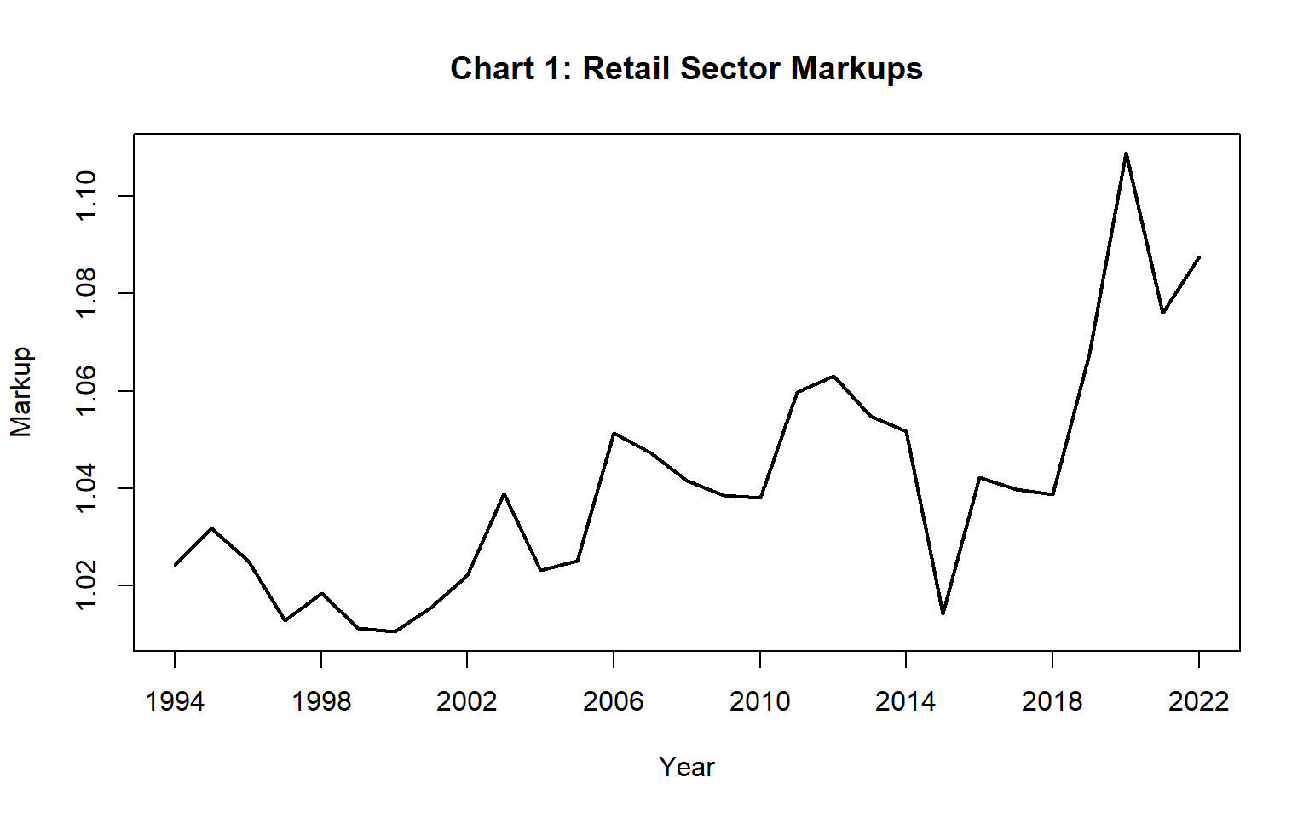
Markup Factors for the Australian Retail Sector

Slide 33
Markup Factors for the Australian Retail Sector
The absolute amount of markup profit in year t is p^{t}y^{t} − w^{t}⋅x^{t} = m^{t} w^{t}⋅x^{t}.
These estimated year t markup profits (m^{t} times the value of input costs w^{t}⋅x^{t}) are listed in Table 2 of the paper. They were very high in the last 3 years of our sample ($11.6 to $15.3 billion dollars).
The absolute amount of markup profits has grown from 1.3 billion Australian dollars in 1994 to 14.5 billion dollars in 2022.
……………
Recall the long term output growth decomposition (43):
(43) y^{t}/y^{t−1} = (X^{t}/X^{t−1})ε^{t}τ^{t} = (X^{t}/X^{t−1}) π^{t} t =2,…,T.
Also recall the long term TFP decomposition defined by (44):
(44) Π^{t} ≡ [y^{t}/y¹]/[X^{t}/X¹] = e^{t} Τ^{t} ; t = 1,…,T.
These decompositions for the Australian Retail Sector are illustrated on Chart 2 which follows.

Slide 34
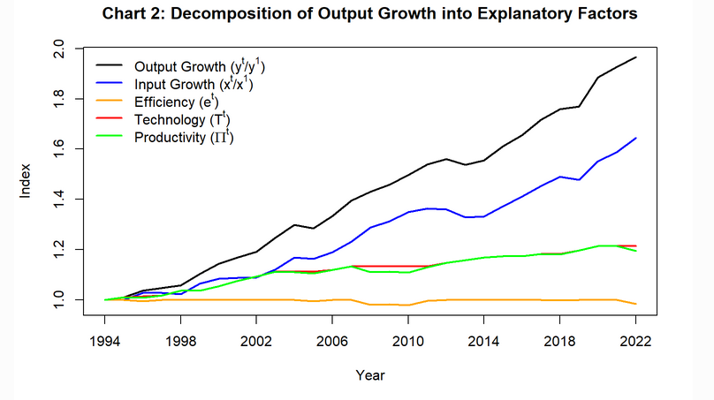
Long Term Output Growth and TFP Decompositions

Slide 35
Four Alternative TFP Measures
Π^{t} = New Diewert Fox Nonparametric TFP;
Uses exogeneous real rates of return; uses smoothed asset prices in
user costs;
Allows for nonconstant returns to scale and markups.
Π^{t*} = Old Diewert Fox (2018) Nonparametric TFP;
Uses endogenous rates of return, smoothed asset prices in user
costs;
Assumes constant returns to scale and no markups;
With only 1 output, uses chained Fisher indexes for inputs.
TFP_{J}^{t} = Jorgenson-Griliches (1967) TFP;
Uses endogenous rates of return, uses ex post asset prices in
user costs;
Assumes constant returns to scale and no markups;
Uses chained Tornqvist input indexes; see Diewert Morrison.
TFP_{ABS}^{t} = Same as TFP_{J}^{t} except the ABS used only 4 assets (no land and
no inventories).

Slide 36
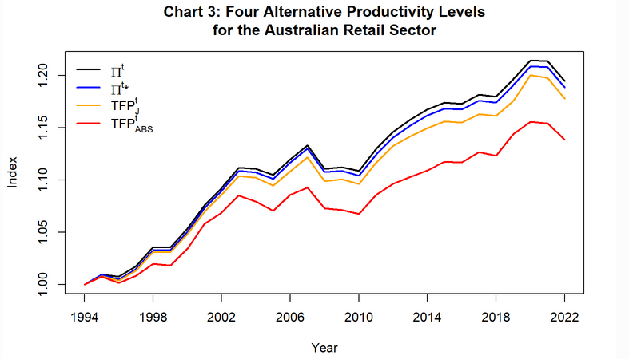
Four Alternative Measures of TFP

Slide 37
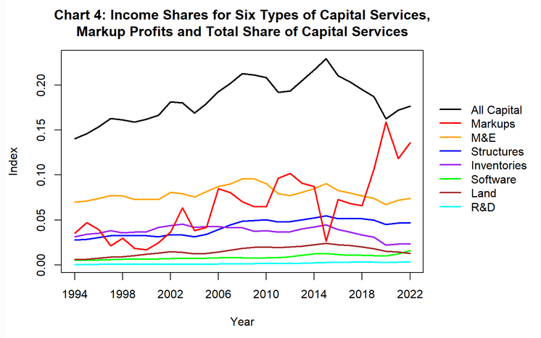
Capital Shares of Retail Sector Value Added

Slide 38
Labour, Capital and Markup Shares of Retail Sector Value Added

Slide 39
Labour, Capital and Markup Shares of Retail Sector Value Added
Labour’s share of Retail value added started at 0.824 in 1994 and steadily decreased to 0.696 in 2014 and then remained roughly constant to finish at 0.688 in 2022. Retail Trade is a labour intensive industry.
The capital services share of value added started at 0.140 in 1994 and increased steadily to 0.229 in 2015 and then decreased to finish at 0.176 in 2022.
The markup share of Retail Trade value added started at 0.035 in 1994 and increased (with volatility) to peak at 0.159 in 2020 and finished at 0.136 in 2022.
Overall, markups increased dramatically over the sample period.
Markups act in much the same way as taxes on outputs and inputs and these tax and markup wedges lead to deadweight losses.

Slide 40
Conclusion
We have suggested a very obvious method for measuring the aggregate markup of revenues over costs.
This method is reasonably robust but it does depend on what is assumed about the opportunity cost of financial capital. A higher opportunity cost will lead to a lower aggregate markup.
Thus attention shifts to the construction of user costs including the treatment of asset price changes in the user cost formula.
Including more assets in scope will also decrease the aggregate markup. For our particular example, including land and inventories as in scope assets led to higher estimates of TFP growth.
Appendix B explains the Diewert and Fox (2018a) nonparametric methodology when constant returns to scale is assumed and works out the implications of this approach when there is only one output.
Finally, Appendix C describes some alternative approaches to the measurement of markups and the problems associated with these approaches.

Slide 41
Selected References
Balk, B.M., (1998), Industrial Price, Quantity and Productivity Indices, Boston: Kluwer Academic Publishers.
Balk, B.M., (2001), “Scale Efficiency and Productivity Change”, Journal of Productivity Analysis 15, 159–183.
Balk, B.M., (2003), “The Residual: On Monitoring and Benchmarking Firms, Industries and Economies with Respect to Productivity”, Journal of Productivity Analysis 20, 5–47.
Balk, B.M. (2010), “An Assumption Free Framework for Measuring Productivity Change”, Review of Income and Wealth Special Issue 1, S224-S256.
Banker, R.D. (1984), “Estimating Most Productive Scale Size Using Data Envelopment Analysis”, European Journal of Operational Research 17, 35-44.
Christensen, LR. And D.W. Jorgenson (1969), “The Measurement of US Real Capital Input, 1929-1967”, Review of Income and Wealth 15, 293-320.
De Loecker, J, J. Eeckhout and G. Unger (2020), “The Rise of Market Power and the Macroeconomic Implications”, Quarterly Journal of Economics 135(2), 561–644.
Diewert, W.E. and K.J. Fox (2018a), “Decomposing Value Added Growth over Sectors into Explanatory Factors”, pp. 625-66 in The Oxford Handbook of Productivity Analysis, Emile Grifell-Tatje, C.A. Knox Lovell and Robin C. Sickles (eds)., Oxford: Oxford University Press.
Farrell, M.J. (1957), “The Measurement of Production Efficiency”, Journal of the Royal Statistical Society, Series A, 120, 253-278.
Jorgenson, D.W. and Z. Griliches (1967). “The Explanation of Productivity Change”, Review of Economic Studies 34, 249–283.
Salter, W. E. G. (1960), Productivity and Technical Change, Cambridge U.K.: Cambridge University Press.
Schreyer, P. (2010), “Measuring Multi-Factor Productivity when Rates of Return Are Exogenous,” chapter 2, pp. 13-40 in W.E. Diewert, B.M. Balk, D. Fixler, K.J. Fox and A.O. Nakamura (eds.), Price and Productivity Measurement, Victoria Canada: Trafford Press.

