Slide 1
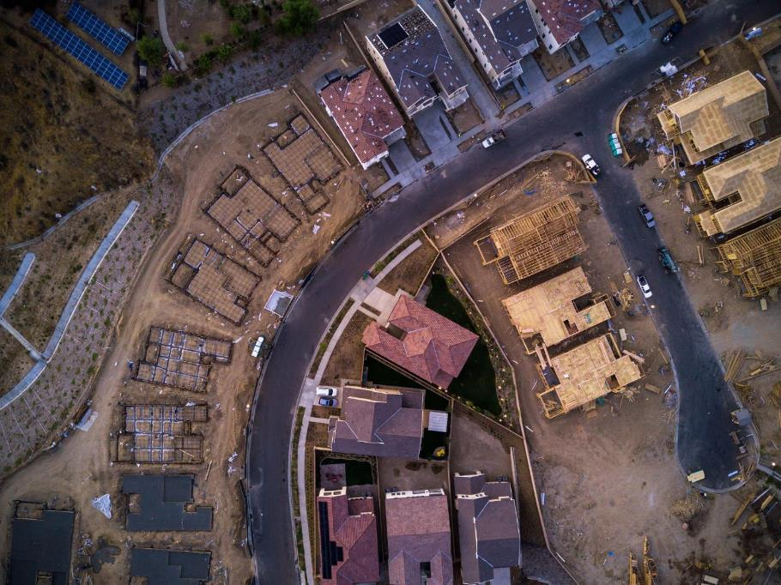
A Blended Data Approach to Measuring Monthly Housing Starts:
Satellite Imagery, Survey Data and More!
Nikki Czaplicki
U.S. Census Bureau
Any opinions and conclusions expressed herein are those of the authors and do not reflect the views of the U.S. Census Bureau.

Slide 2
Meet the team
U.S. Census Bureau
Nikki Czaplicki
Aidan Smith
Scott Springer
Reveal Global Consulting
Hector Ferronato
Dwarakh V. Nayam
Lei Peng
Colin Shevlin
Doren Walker

Slide 3




Re-engineering housing start estimation
Goal: Combine traditional survey collected data with estimates derived from satellite imagery to produce a hybrid estimate of monthly single-family housing starts
The Census Bureau has reviewed this product to ensure appropriate access, use, and disclosure avoidance protection of the confidential source data (Disclosure Review Board (DRB) approval number: CBDRB-FY25-0086).

Slide 4
Current Construction Indicator
New Residential Construction (NRC)
  commonly referred to as “Housing Starts”
  provides monthly national and regional estimates of housing units started, authorized but not started, under construction and completed.
  sources data from Survey of Construction (SOC)
    Sampling of building permits authorizing new, privately-owned residential construction
    Physical canvassing of areas not requiring building permits
Data Users
  BEA, Federal Reserve, Council of Economic Advisors, Department of Housing and Urban Development, Manufacturers, Insurance Companies, Financial Institutions

Slide 5


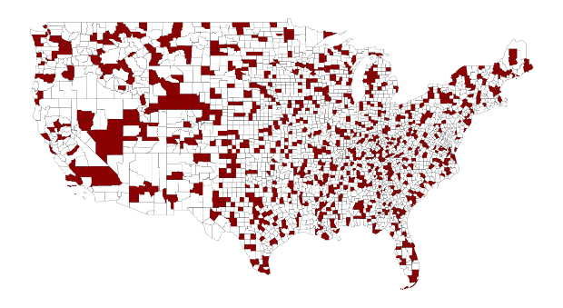




Three Stage Sampling
Selection of Permit/Non-Permit Areas
Subsample of Current Population Survey Primary Sampling Units (PSUs)
Monthly Selection of Permits
*Note: Map for illustrative purposes and does not reflect SOC sample

Slide 6
Observing Starts
Current | Re-engineered
Field representative interviews | Satellite imagery for selected places from the existing SOC sample. ML models identify construction activity. Field collection for remaining places.
Sampled permits only | All projects in the selected place can be observed (no longer sampling projects).
Burdensome for respondents - can require multiple interviews to get a start date for a project that does not start right away | Respondent contact no longer needed to capture the start

Slide 7
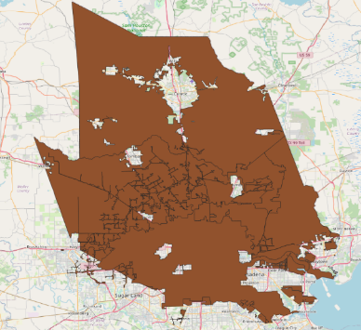
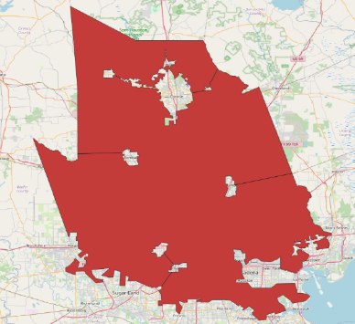
Satellite Areas of Interest (AOIs)
Select AOIs that are dense in new residential housing starts.
Identify boundaries using Census TIGER*/Line shapefiles.
Provide image broker with augmented shapefiles.
  Simplify
  Combine
  Exclude
Images captured in 10-day window (End of month ±5 days)
*Topologically Integrated Geographic Encoding and Referencing system

Slide 8
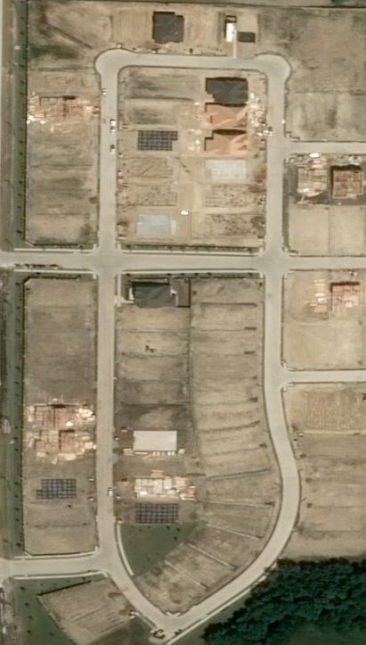

Developing a Construction Stage Model
Identify construction stages present in satellite imagery
Background
Land
Vegetation
Excavation
Foundation
Framing
Unfinished Roof
Finished Roof

Slide 9
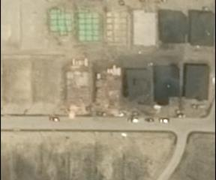
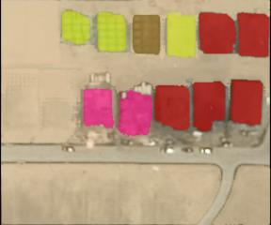
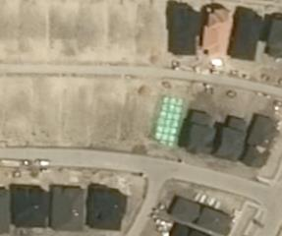
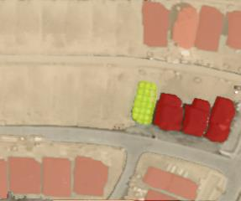
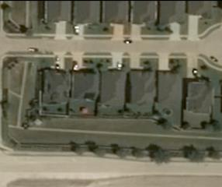
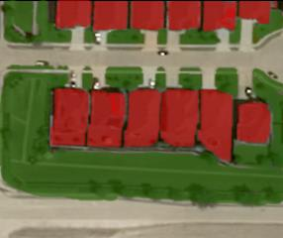
Construction Stage Labeling

Slide 10
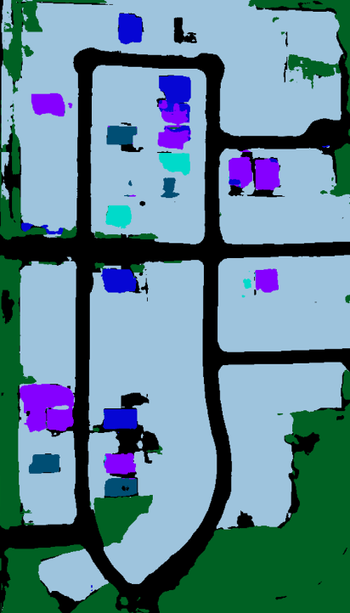


Construction Stage
Predictions
LAND
VEGETATION
EXCAVATION
FOUNDATION
FRAMING
ROOF

Slide 11
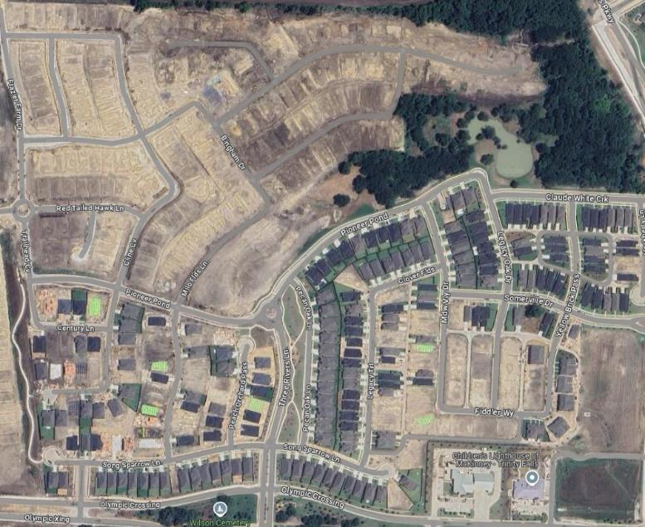
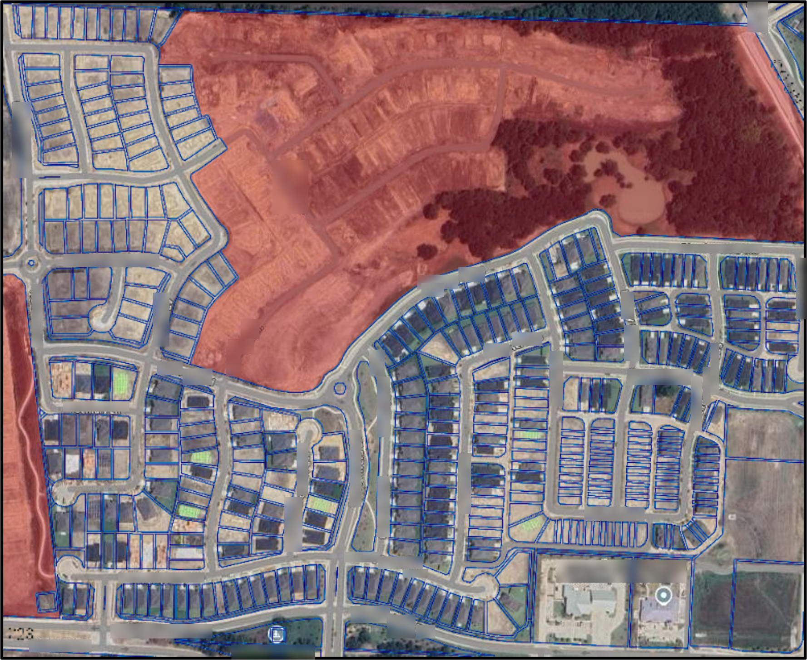
Parcel Limitations
Outdated geometry
Incomplete data
Inaccurate zoning information

Slide 12
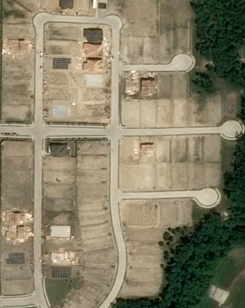
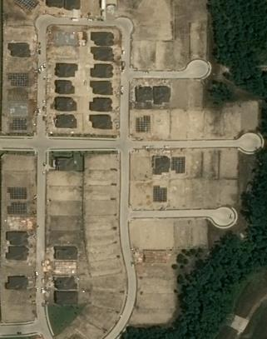
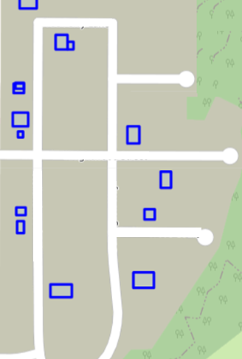
Identifying Starts Through Blob Search

Slide 13
Interpreting Starts With Business Rules
 |  | Current Month Prediction
 |  | Background | Land | Vegetation | Excavation | Foundation | Framing | Unfinished Roof | Roof
Previous Month Prediction | Background | Unknown | Land | Land | Start | Start | Start | Start | Start Completion
 | Land | Land | Land | Land | Start | Start | Start | Start | Start Completion
 | Vegetation | Land | Land | Land | Start | Start | Start | Start | Start Completion
 | Excavation | Image Error | Land | Land | In Progress | In Progress | In Progress | In Progress | Completion
 | Foundation | Image Error | Misclassified Backwards | Misclassified Backwards | In Progress | In Progress | In Progress | In Progress | Completion
 | Framing | Image Error | Misclassified Backwards | Misclassified Backwards | In Progress | In Progress | In Progress | In Progress | Completion
 | Unfinished Roof | Image Error | Misclassified Backwards | Misclassified Backwards | In Progress | In Progress | In Progress | In Progress | Completion
 | Roof | Image Error | Misclassified Backwards | Misclassified Backwards | Start Reconstruction | Start Reconstruction | Start Reconstruction | Start Reconstruction | Exist

Slide 14
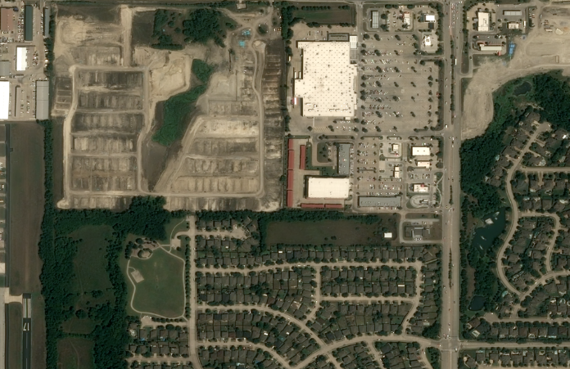
Developing a Building Type Model
Classify areas by likely building type
Single-family detached
Single-family attached
Multi-family
Non-residential
Background

Slide 15
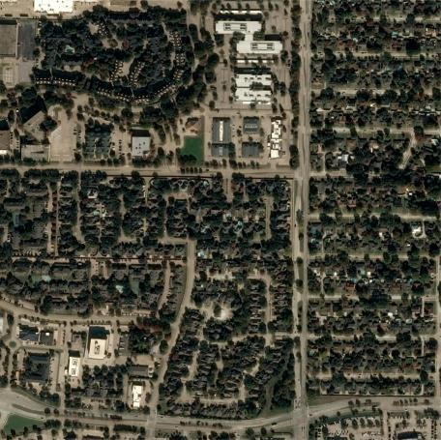
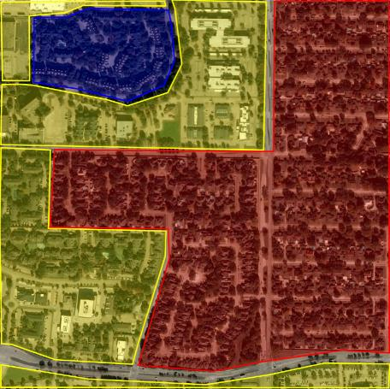
Building Type Labeling

Slide 16
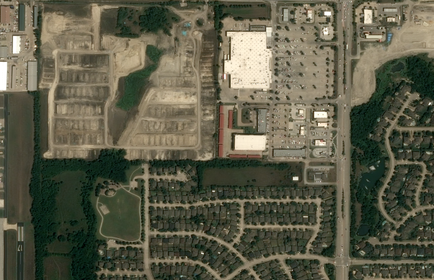


Building Type
Model Predictions
Background
Single Family Detached
Non-Single Family

Slide 17
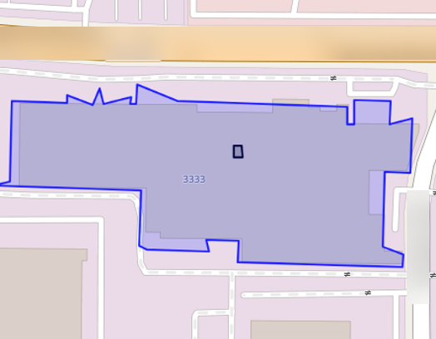
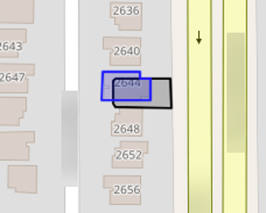
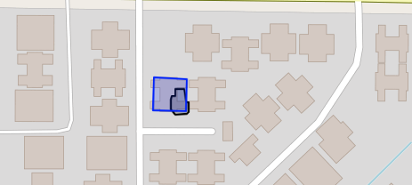
Building Footprint Exclusion
Utilize open-source building footprint data to reduce noise.
Overlay start blobs on footprint shapes and exclude overlaps as probable noise.
Similar procedure performed using TIGER/Line road data.
Blue shape indicates a building footprint
Black shape indicates a start prediction

Slide 18
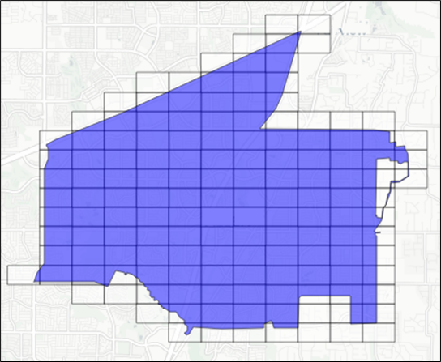
Imputation of satellite data
Missing data in the satellite image due to cloud cover
Construction is not evenly distributed across the AOI – place level missing data adjustment not appropriate
Divide the AOI into its component 7-character Geohashes (153m x153m) and impute/adjust at the Geohash level

Slide 19






Imputation – Scenario specific methods
Cloud Coverage < 50%
Cloud Coverage >= 50%
$$Total Starts=\frac{Observed Starts}{Proportion Geohash Observed}$$
$Total Starts=Max(Observed Starts, {Total Starts}_{prior}$)

Slide 20
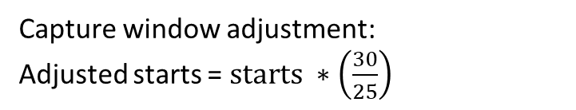
Capture Window Adjustment
Ideal scenario
Possible real-world scenario
April
Sun | Mon | Tue | Wed | Thu | Fri | Sat
31 | 1 | 2 | 3 | 4 | 5 | 6
7 | 8 | 9 | 10 | 11 | 12 | 13
14 | 15 | 16 | 17 | 18 | 19 | 20
21 | 22 | 23 | 24 | 25 | 26 | 27
28 | 29 | 30
April
Sun | Mon | Tue | Wed | Thu | Fri | Sat
31 | 1 | 2 | 3 | 4 | 5 | 6
7 | 8 | 9 | 10 | 11 | 12 | 13
14 | 15 | 16 | 17 | 18 | 19 | 20
21 | 22 | 23 | 24 | 25 | 26 | 27
28 | 29 | 30
30 days between images
25 days between images
Prior month image obtained
Capture window adjustment:
Adjusted starts = $starts ∗\left(\frac{30}{25}\right)$
Current month image obtained

Slide 21
Satellite data process flow
Obtain satellite images
Predict construction stages and building type
Include only areas predicted as single family by the building type model
Exclusions based on building and road footprint overlap
Imputation for obscured areas
Capture window adjustment
Final place level satellite estimate
$$s_{p,t}$$
Final place level satellite estimate
𝑠_(𝑝,𝑡)
Apply business rules to identify starts
Blob search

Slide 22
Survey Estimate
Satellite Estimate
Blended Estimate

Slide 23
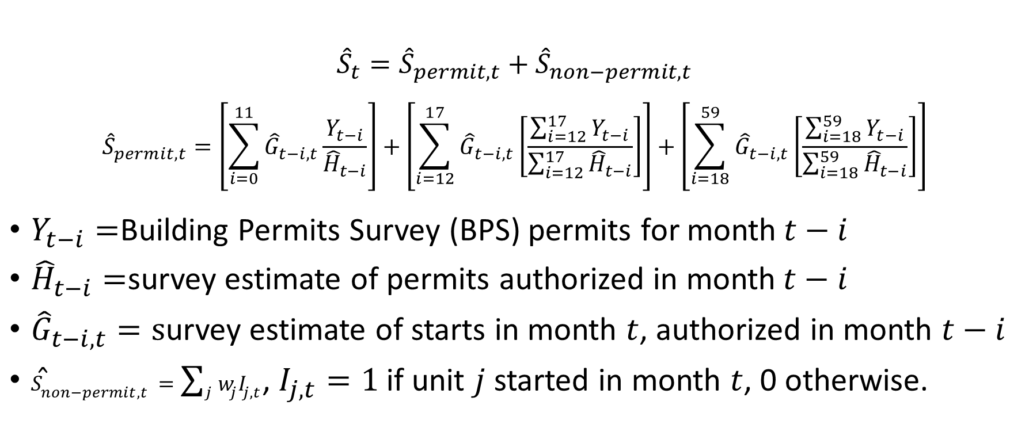
Estimation – current state
$${\hat{S}}_{t}={\hat{S}}_{permit,t}+{\hat{S}}_{non−permit,t}$$
$${\hat{S}}_{permit,t}=\left[\sum_{i=0}^{11}{{\hat{G}}_{t−i,t}\frac{Y_{t−i}}{{\hat{H}}_{t−i}}}\right]+\left[\sum_{i=12}^{17}{{\hat{G}}_{t−i,t}\left[\frac{\sum_{i=12}^{17}{Y_{t−i}}}{\sum_{i=12}^{17}{{\hat{H}}_{t−i}}}\right]}\right]+\left[\sum_{i=18}^{59}{{\hat{G}}_{t−i,t}\left[\frac{\sum_{i=18}^{59}{Y_{t−i}}}{\sum_{i=18}^{59}{{\hat{H}}_{t−i}}}\right]}\right]$$
$Y_{t−i}=$Building Permits Survey (BPS) permits for month$t−i$
${\hat{H}}_{t−i}=$survey estimate of permits authorized in month$t−i$
${\hat{G}}_{t−i,t}=s$urvey estimate of starts in month $t$, authorized in month $t−i$
${\hat{S}}_{non−permit,t}=\sum_{j}{w_{j}I_{j,t}}$, $I_{j,t}=1$ if unit $j$ started in month $t$, 0 otherwise.
https://www.census.gov/construction/soc/methodology.html

Slide 24
Current State: Sample of permits from a place
 | Authorization Month
Start Month | Jan | Feb | Mar | Apr | May | Jun | July
Feb | Starts: 50 Auths: 100 | Starts: 50 Auths: 150
Mar | Starts: 50 Auths: 100 |  | Starts: 100 Auths: 200
Apr |  | Starts: 50 Auths: 150
May |  |  | Starts: 100 Auths: 200 | Starts: 50 Auths: 50 | Starts: 50 Auths: 200
Jun |  |  |  |  | Starts: 100 Auths: 200 | Starts:100 Auths: 250
Jul |  | Starts:50 Auths: 150 |  |  |  | Starts: 150 Auths: 200
Aug |  |  |  |  | Starts:50 Auths: 200 |  | Starts: 50 Auths: 250

Slide 25
Satellite estimate of starts from a place
 | Authorization Month
Start Month | Jan | Feb | Mar | Apr | May | Jun | July | All Auth Months
Feb |  |  |  |  |  |  |  | 90
Mar |  |  |  |  |  |  |  | 160
Apr |  |  |  |  |  |  |  | 110
May |  |  |  |  |  |  |  | 250
Jun |  |  |  |  |  |  |  | 200
Jul |  |  |  |  |  |  |  | 190
Aug |  |  |  |  |  |  |  | 220

Slide 26
Survey based estimate
Satellite estimate
Total estimate

Slide 27
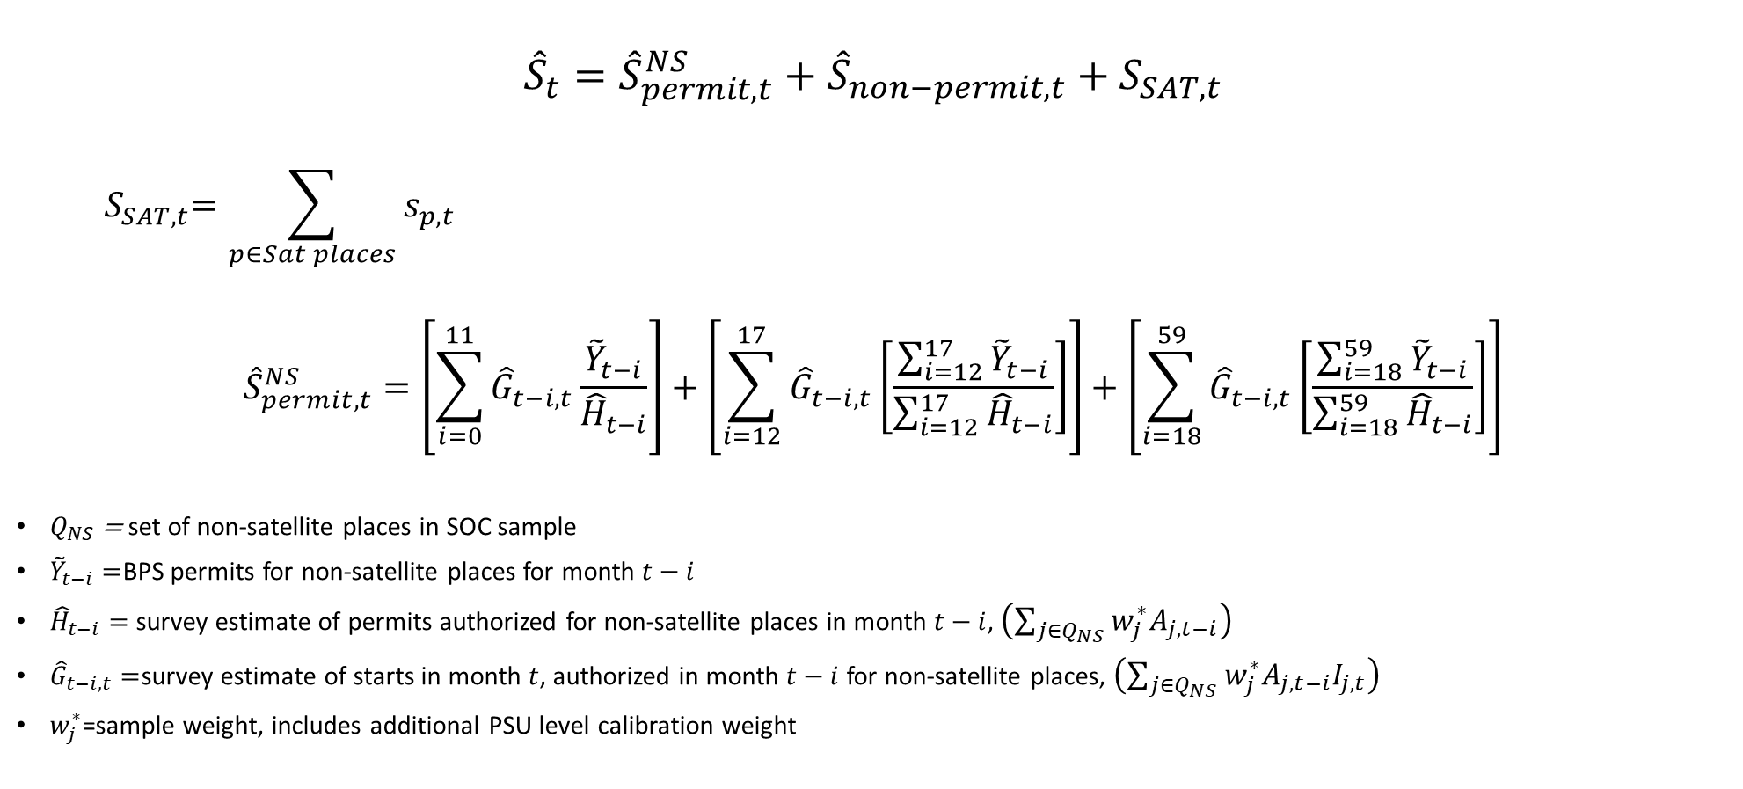
New estimator
$${\hat{S}}_{t}={\hat{S}}_{permit,t}^{NS}+{\hat{S}}_{non−permit,t}+S_{SAT,t}$$
$${ S}_{SAT,t}=\sum_{p∈Sat places}{s_{p,t}}$$
$${\hat{S}}_{permit,t}^{NS}=\left[\sum_{i=0}^{11}{{\hat{G}}_{t−i,t}\frac{{\tilde{Y}}_{t−i}}{{\hat{H}}_{t−i}}}\right]+\left[\sum_{i=12}^{17}{{\hat{G}}_{t−i,t}\left[\frac{\sum_{i=12}^{17}{{\tilde{Y}}_{t−i}}}{\sum_{i=12}^{17}{{\hat{H}}_{t−i}}}\right]}\right]+\left[\sum_{i=18}^{59}{{\hat{G}}_{t−i,t}\left[\frac{\sum_{i=18}^{59}{{\tilde{Y}}_{t−i}}}{\sum_{i=18}^{59}{{\hat{H}}_{t−i}}}\right]}\right]$$
$Q_{NS}$ = set of non-satellite places in SOC sample
${\tilde{Y}}_{t−i}=$BPS permits for non-satellite places for month $t−i$
${\hat{H}}_{t−i}=$ survey estimate of permits authorized for non-satellite places in month $t−i$, $\left(\sum_{j∈Q_{NS}}{w_{j}^{∗}A_{j,t−i}}\right)$
${\hat{G}}_{t−i,t}=$survey estimate of starts in month $t$, authorized in month $t−i$ for non-satellite places, $\left(\sum_{j∈Q_{NS}}{w_{j}^{∗}A_{j,t−i}I_{j,t}}\right)$
$w_{j}^{∗}$=sample weight, includes additional PSU level calibration weight
https://www.census.gov/construction/nrc/pdf/satellite_edp_methodology.pdf

Slide 28
Keep SOC methodology for non-satellite component
Nonresponse – compute nonresponse undercoverage adjustment factors (NUAFs) from the SOC data at the division level excluding satellite places
Variance estimation
  Continue to use modified half-sample to estimate sampling variance with a modification to the way replicate weights are assigned to permits from non-self-representing PSUs
  Satellite places we selected were self representing and do not contribute to the sampling variance estimate

Slide 29
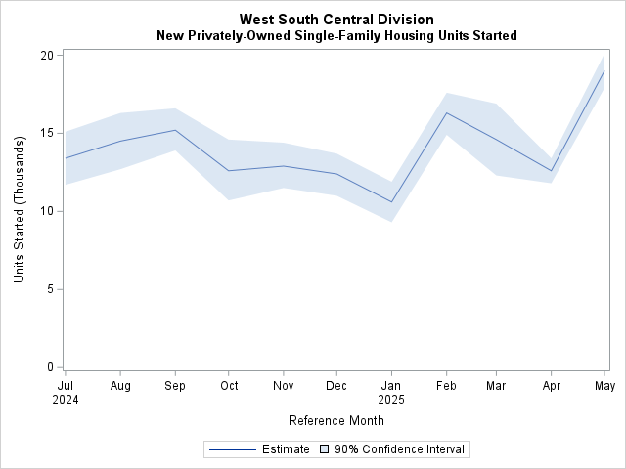
Published Estimates
Survey Month | Experimental Data Product Release 11:00 am
November 24 | December 19, 2024
December 24 | January 21, 2025
January 25 | February 20, 2025
February 25 | March 19, 2025
March 25 | April 18, 2025
April 25 | May 19, 2025
May 25 | June 20, 2025
June 25 | July 21, 2025
July 25 | August 20, 2025
August 25 | September 18, 2025
https://www.census.gov/construction/nrc/data/satellitestarts.html

Slide 30
Conclusions and next steps…
The experimental data product demonstrated that satellite imagery is a viable monthly data collection method for measuring housing starts
Developed methodology to blend satellite data and survey data into a division level estimate
However, given the costs, scalability was limited
Paused the experimental product to shift focus to developing methods that could be scalable

Slide 31
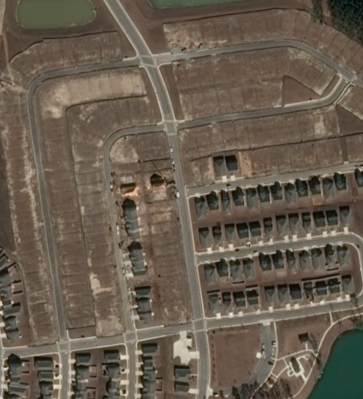
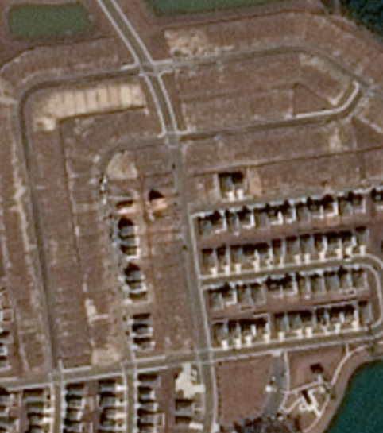
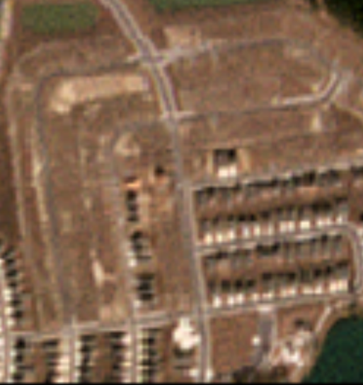
Assessing feasibility of lower resolution imagery
50cm
1.5 m
4.7m

Slide 32
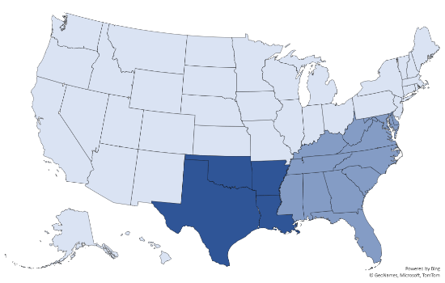

Research & Development
Geographic Expansion
Expanded satellite data collection with the goal to construct a South region estimate
Geographic Expansion
Developing methodology for estimating starts from a satellite only data collection

Slide 33


Research & Development
Develop techniques to better quantify single family attached vs detached starts.
Improve imputation methods to account for missing data due to cloud cover

Slide 34




Future Work
Starts
Multi-Family Construction
Additional SOC
Data Items
Under
Construction
Completions

Slide 35
Questions?
Contact us at:
Nicole.Czaplicki@census.gov
eid.nrc.satellite@census.gov

