Slide 1
Effects of Medicare Advantage (MA) Enrollment on Healthcare Use and Patient Outcomes Among Beneficiaries with Alzheimer’s Disease and Related Dementias (ADRD)
Victoria Shier, PhD
University of Southern California

Slide 2
Acknowledgements
No conflicts of interest to disclose
Supported by National Institute on Aging awards R01AG079216 (PI: Shier) and R01AG071731 (PI: Huckfeldt)
Content does not reflect views of funder

Slide 3
Collaborators
Peter Huckfeldt, PhD, University of Minnesota
Tyler Boese, PhD, University of Minnesota
Helen Parsons, PhD, University of Minnesota
Jose Escarce, MD, PhD, University of California, Los Angeles
Virat Agrawal, PhD, University of Southern California
Neeraj Sood, PhD, University of Southern California

Slide 4
Medicare beneficiaries with ADRD may benefit from greater coordination and support
Beneficiaries manage multiple chronic conditions in addition to ADRD
  70% have 5+ chronic conditions (vs. only 25% in beneficiaries without ADRD) (Varghese, et al. 2025)
Use more healthcare compared to beneficiaries without ADRD (Alzheimer’s Association 2025)
  More care transitions
  Higher use of outpatient services
  2x more likely to be hospitalized
  10x higher post-acute care spending
Cognitive impairment reduces adherence (Mehany, et al. 2026)
Notes:
Alzheimer’s Association. “2025 Alzheimer’s disease facts and figures.” Alzheimer’s and Dementia 21:e70235
Mehany et al. Multilevel Interventions to Improve Medication Adherence in Older Adults: A Systematic Review and Meta-Analysis of Cognitive, Digital, Behavioral, and Socioeconomic Strategies (2015–2025) J. Clin. Medicine.
https://www.mdpi.com/2077-0383/15/5/2069

Slide 5
Why examine the effect of Medicare Advantage (MA) for beneficiaries with ADRD?
> 50% of Medicare beneficiaries are enrolled in MA
MA may have opportunity to provide better disease management for beneficiaries with ADRD
  Financial incentive to manage comorbid conditions and avoid unnecessary health care
  Potentially better care coordination (KFF 2022)
  Encourage preventive care and offer supplemental benefits
Utilization management, and other MA features, may be difficult for beneficiaries with ADRD to navigate
  Higher MA disenrollment for enrollees with ADRD (Meyers et al. 2021)

Slide 6
Evidence on MA for beneficiaries with ADRD is inconclusive
Limited evidence on differences in outcomes and care in MA vs Traditional Medicare (TM) for beneficiaries with ADRD
  Lower self-reported healthcare use for ADRD in MA, with no difference in care satisfaction (Park, et al. 2020)
  Lower risks of 30-day readmission and frequent hospitalization in MA (Mahmoudi, et al. 2024)
  Lower increase in hospitalization and outpatient visits after ADRD diagnosis in MA (Jacobson, et al. 2023)
Key issue is favorable selection: MA enrollees are healthier (MedPAC)

Slide 7


This paper: Use state retiree benefit changes as natural experiment for MA enrollment
Examine 5 states (AL, AZ, CO, CT, NJ) shifting retiree health benefits from Supplement + Part D plan to MA plan 2017-2019
Identify state retirees enrolled in sponsored Part D plans in year prior to benefit change
Comparison group: Other TM + Part D enrollees in same state
How did outcomes and utilization change for state retiree vs. comparison group?
Notes:
Helps issue with selection – decision to enroll or disenroll in MA or TM could be related to underlying health conditions leading to healthier patients in MA
state retirees, while not representative of population, do represent a diverse cross-section of Medicare beneficiaries (varying occupations and SES/education)

Slide 8
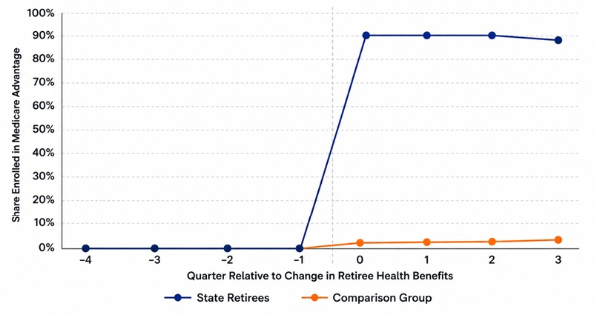
Enrollment in MA increased to 90%+ among state retirees after benefit change

Slide 9
State retirees are similar to comparison group, except for race and ethnicity
Baseline Characteristic | Retired State Employees (Treatment) N = 15,168 | Traditional Medicare (Comparison) N = 91,918
Demographics
Age (Mean (SD)) | 81.5 (7.5) | 82.5 (7.7)
Female (%) | 62.0% | 63.6%
White, non-Hispanic (%) | 86.1% | 91.1%
Black, non-Hispanic (%) | 10.4% | 3.7%
Baseline Patient Outcomes per Beneficiary per Quarter (Mean (SD))
Days Spent in Community | 82.7 (20.8) | 82.0 (21.4)
Inpatient Hospital Admissions | 0.14 (0.43) | 0.15 (0.44)

Slide 10
Study Outcomes & Analysis
Patient Health Outcomes
  Days in the Community
  Mortality
Healthcare Utilization
  Outpatient care
  Hospital and post-acute care
  Imaging and testing
Overall resource use
  Predicted total Medicare payments in TM as a function of observed healthcare use and patient characteristics using random forest machine learning model
Hierarchical Condition Category Risk Score (Intensity of diagnosis coding)
Analysis: “Stacked” event study and difference-in-difference models across states
Notes:
HCC – used to estimate a patient's expected healthcare costs and adjust provider reimbursements

Slide 11
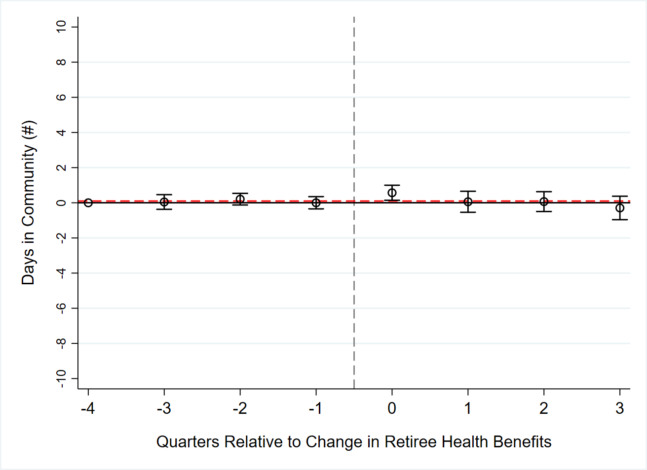
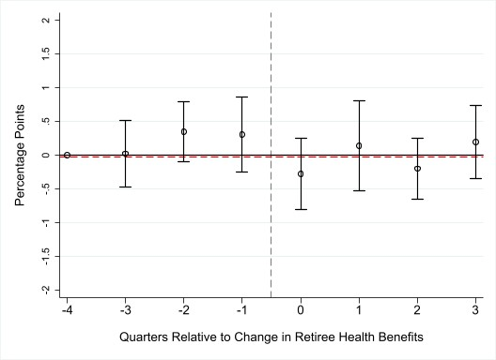
No effect of MA on patient outcomes
Days Spent in the Community
Mortality Rate (%)
Comparison Mean = 82.0 days
Comparison Mean = 5.3%
Average effect across quarters = 0.10; p=0.70
Average effect across quarters = -0.03%; p=0.88

Slide 12
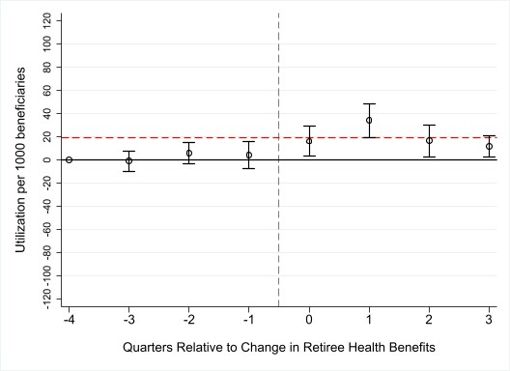
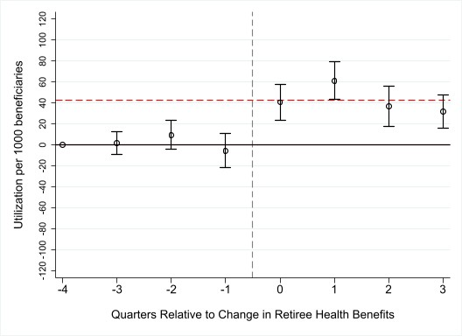
Increase in annual wellness visits & home visits
Annual Wellness Visits
Home Evaluation and Management Visits
Comparison Mean = 63.5 per 1000 benes
Comparison Mean = 197.1 per 1000 benes
Average effect across quarters = 19.7; p=0.001
Average effect across quarters = 42.7; p<0.001

Slide 13
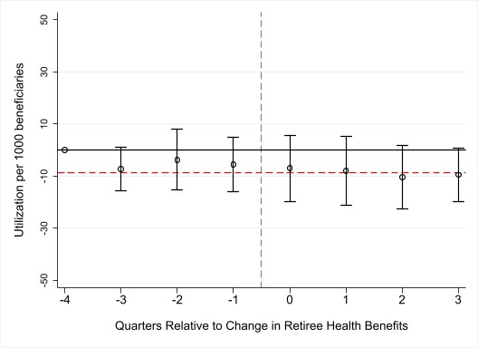
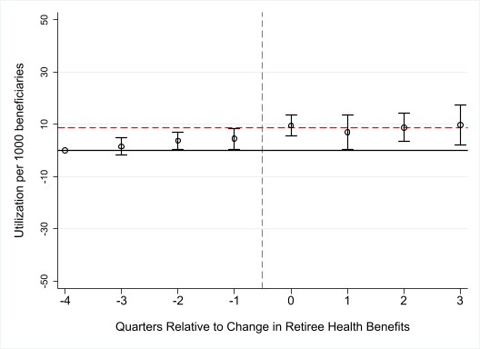
Substitution between hospital admission and observation status
Inpatient Admissions
Observation Status
Comparison Mean = 150.3 per 1000 benes
Comparison Mean = 30.3 per 1000 benes
Average effect across quarters = = -8.7; p=0.06
Average effect across quarters = 8.8; p=0.001

Slide 14
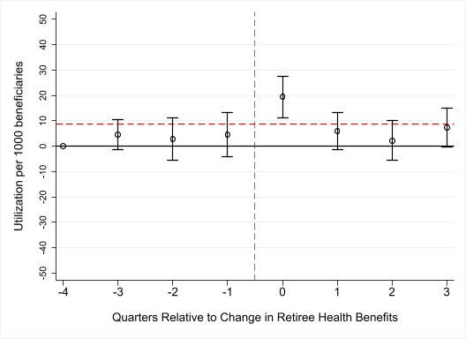
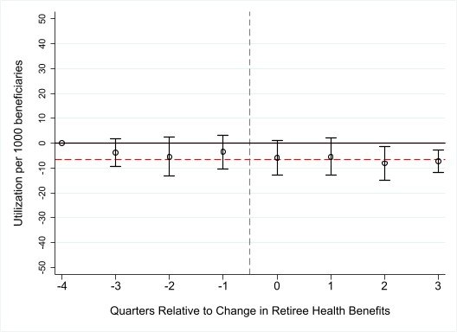
Shifting to home health instead of skilled nursing facility care
Home Health
Skilled Nursing Facility
Comparison Mean = 97.5 per 1000 benes
Comparison Mean = 56.7 per 1000 benes
Average effect across quarters = = 8.8; p=0.004
Average effect across quarters = -6.7; p=0.02

Slide 15
No effect of MA on overall resource use, but increase in risk score
Risk score effect: increase in diagnosis coding for state retirees relative to comparison group
 | Baseline mean | Difference-in-Differences estimate | 95% CI
Resource Use | $19,632 | $444 | -$111, $1000
Risk Score | 1.67 | 0.16 | 0.11, 0.20

Slide 16
Limitations
Generalizability
  Employer Group MA plans may be less restrictive than Individual MA plans
  State retirees had supplemental TM plans at baseline (but 87% of TM beneficiaries have some supplemental coverage)
Measurement & Pre-Trends
  Data do not capture patient quality of life, caregiver burden, patient satisfaction
  Completeness of encounter data
  Moderate pre-trends for some outcomes

Slide 17
Discussion
Beneficiaries with ADRD: more clinically severe and complex, benefits and harms of MA have higher stakes
No effect of MA on patient outcomes
Potentially beneficial changes in types of health care used
  Increase in home E&M visits
  Shift from hospital admissions to observation status
  Increase in home health episodes with decrease in SNF episodes
No change in resource use, but increase in risk score
  Higher risk score translates to higher payments in subsequent year, despite no change in resource use in current year
Retirees may receive supplemental benefits we do not observe in our data (e.g., transportation, in-home support)

Slide 18
Thank you!
vshier@usc.edu

