Slide 1
Job Conditions and Cognitive Health
Rebekah Carpenter, PhD - Claude Pepper Center, Florida State University (rcarpenter@fsu.edu)
Kay (Qiuchang) Cao, PhD - College of Social Work, Florida State University (qc22@fsu.edu)
Dawn Carr, PhD - Claude Pepper Center, Florida State University (dcarr@fsu.edu)

Slide 2
Disclosure
This project is supported by the National Bureau of Economic Research (U54AG090084). Subaward number: 42020.02.02.06.FSU.

Slide 3
Introduction

Slide 4
Background and Key Gaps
Alzheimer’s Disease and Related Dementias (ADRDs) are among the fastest-growing, most disabling, and most expensive health conditions affecting approximately seven million adults age 65+ in the United States (Alzheimer’s Association, 2024)
Work is a defining feature of the life course and occupies a large share of waking hours and plays a key role in shaping cognitive health across the life course (Bureau of Labor Statistics, 2024)
Occupational exposures, such as exposures to the physical and psychosocial conditions of work, are key determinants of cognitive health –shaping both protective (e.g., cognitive reserve) and harmful (e.g., neuroinflammation) cognitive health pathways (Bufano et al., 2024; Kim et al., 2020)
Key Gap: Prior research has not comprehensively assessed lifetime exposure to multiple job conditions (i.e., both protective and risky) using longitudinal, population-level data – limiting understanding of how work-related exposure shapes both midlife cognition and later-life decline

Slide 5
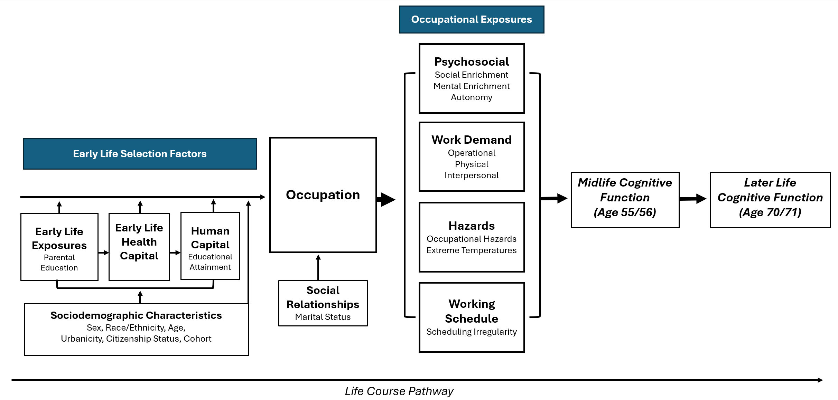
Occupational Exposures and Cognitive Health

Slide 6
Research Questions
How do average life-time occupational exposures associate with cognitive function in midlife (i.e., age 55 or 56)?
Which occupational exposures accelerate cognitive aging after midlife (i.e., age 70/71)?
Notes:
Which of these exposures accelerate cognitive function after midlife

Slide 7
Methods

Slide 8
Data and Sample
Data
  Health and Retirement Study (HRS) data linked to occupational exposure data from the Occupational Information Network (O*NET) using a recently developed O*NET to Census occupation crosswalk (Carpenter, 2025)
Sample Criteria
  Valid data on cognitive functioning in midlife (i.e., wave in which respondent is age 55/56)
  Valid O*NET-linked work history data at entry into the HRS study (i.e., respondent first study wave)
  Full data on all control and selection measures (wave in which respondent is age 55/56)
  Valid data on cognitive function at age 70/71 (RQ2 only)
Final Analytic Sample
  RQ1: 7,497 respondents
  RQ2: 1,742 respondents
Notes:
Subsample

Slide 9
Analytic Approach
Inverse Probability Weighted Regression Adjusted (IPWRA) Models
  RQ1: Evaluate cognitive function at age 55/56 (RQ1)
  RQ2: Evaluate cognitive function at age 70/71 (RQ2), accounting for cognitive function at age 55/56
Exposures evaluated as terciles
  Likely threshold effect: low or high exposure is uniquely cognitively protective or risky)
  Likely linear effect: each level is significantly different from the previous level in a linear fashion

Slide 10
Measures
Regression model covariates (time-varying collected at age 55/56)
  Sex
  Race/ethnicity
  Years of education
  Age
  Marital status
  Urbanicity
  Poverty ratio
  Depressive symptoms
  Self-rated health
  Working status
    Not working, working in a non-physically demanding job, working in a physically demanding job
  Early life factors
    Father’s education, childhood SES, childhood health

Slide 11
Measures cont.
Selection model variables
  Sex
  Race/ethnicity
  Years of education
  Urbanicity
  Childhood health
  Father’s education
  Marital status
  Cohort

Slide 12
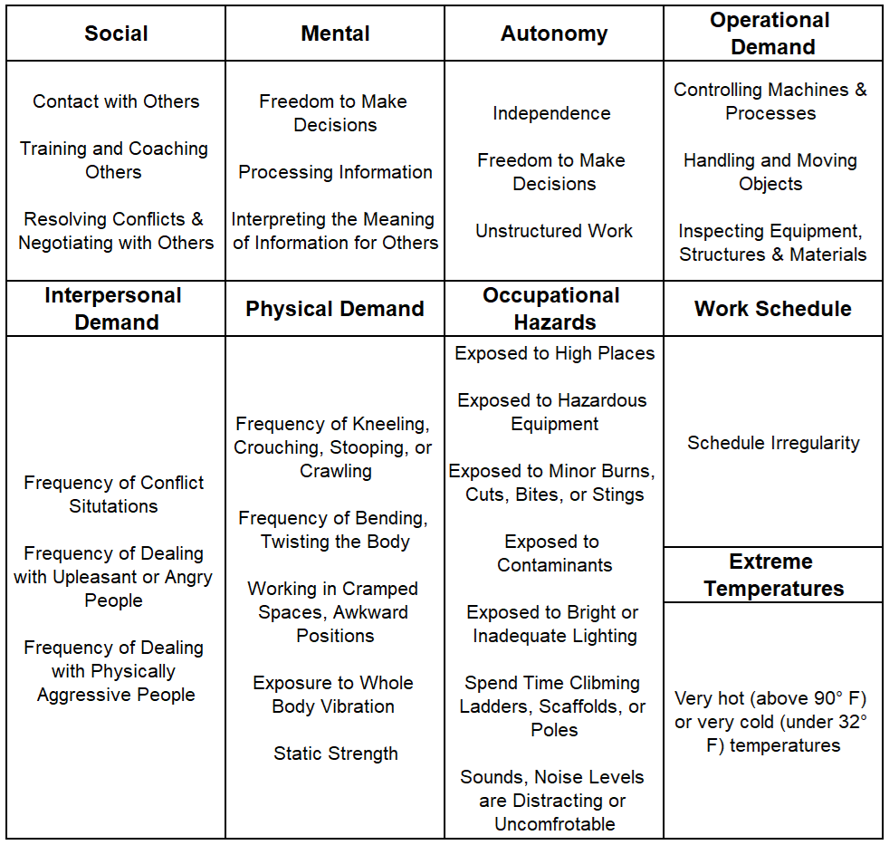
Occupational Exposures

Slide 13
Outcome Measures
Langa-Weir 27-Point Cognitive Function Measure
Based on three tasks:
  Serial 7s (numeracy)
  Immediate and delayed word recall (verbal fluency)
  Backward count task (mental processing)
Measured at both age 55/56 (RQ1) and age 70/71 (RQ2)
Notes:
Imputed for missing data among non-proxy respondents

Slide 14
Results

Slide 15
Results
 | Age 55 (RQ1) |  | Age 70 (RQ2)
Occupational Exposure Domain | High Risk Group | Linear? | High Risk Group | Linear?
Operational Demand | High | - | High | -
Occupational Hazards | High | - | Moderate, High | -
Mental Enrichment | Low | - | Low, Moderate | -
Autonomy | Low | - | - | -
Interpersonal Demand | Low | - | - | -
Social Enrichment | Low, Moderate | - | - | -
Physical Demand | - | Higher is Riskier | High | -
Extreme Temperatures | - | Higher is Riskier | - | -
Schedule Irregularity | - | - | - | -

Slide 16
Discussion
Lifetime average occupational exposures contribute to differences in midlife cognitive functioning
  Some show likely linear effects, others show potential threshold effects
Generally, occupational demands and hazards associate with accelerated cognitive aging after midlife
People with higher levels of average lifetime mental enrichment have better cognitive health at midlife and beyond
Limitations: Selection survival and observation at age 70, lifetime average exposure vs. cumulative exposure
Future Research: Cognitive impairment/dementia risks, other dimensions of job quality, timing of exposure

Slide 17
References
Alzheimer's Association. (2025). 2025 Alzheimer's Disease Facts and Figures. Alzheimer's & Dementia, 21(5), e70235. https://doi.org/10.1002/alz.70235
Bufano, P., Di Tecco, C., Fattori, A., Barnini, T., Comotti, A., Ciocan, C., ... & Bonzini, M. (2024). The effects of work on cognitive functions: a systematic review. Frontiers in psychology, 15, 1351625. https://doi.org/10.3389/fpsyg.2024.1351625
Carpenter, R. (2025). The “Occusome”: Work exposures as a social determinant of cardiometabolic health (Doctoral dissertation, Florida State University)
Fujishiro, K., Ahonen, E. Q., & Winkler, M. (2021). Poor-quality employment and health: How a welfare regime typology with a gender lens Illuminates a different work-health relationship for men and women. Social Science & Medicine, 291, 114484. doi:10.1016/j.socscimed.2021.114484
Kim, H. J., Min, J. Y., & Min, K. B. (2020). The association between longest-held lifetime occupation and late-life cognitive impairment: Korean longitudinal study of aging (2006–2016). International Journal of Environmental Research and Public Health, 17(17), 6270. https://doi.org/10.3390/ijerph17176270

