Slide 1

Impacts of Integrated Dual Eligible Special Needs Plans on Access to Medicaid Home and Community-Based Services among Adults with Alzheimer's
NBER Conference
Rockville, MD
June 18, 2026

Slide 2













Project Investigators & Collaborators
Eric Slade
Karen Shen
Quincy Samus
Dan Polsky
Tamar Rodney
Mark Meiselbach
Quan Qi
Acknowledgements
Source of funding: NIH/NIA R01AG089597-01
COI: The authors have no financial or other conflicts of interest to report

Slide 3
Overview
Dually Eligible Beneficiaries
  Special service needs in Alzheimer’s dementia and related dementias
  Medicare and Medicaid coverage among duals
Dually Eligible Special-Needs Plans
  Fully-Integrated D-SNPs (FIDEs) versus Coordination Only D-SNPs
Data and Sample
Results
Discussion

Slide 4
Dually Eligible Beneficiaries
Concurrently enrolled in both Medicare and Medicaid
    ~13 million in 2025
    Compared with other Medicare beneficiaries
      Lower average educational attainment
      Greater functional impairment
      More likely to live in an institution
      Higher Medicare and Medicaid expenses
    1 to 2 million “full” duals have an ADRD diagnosis

Slide 5
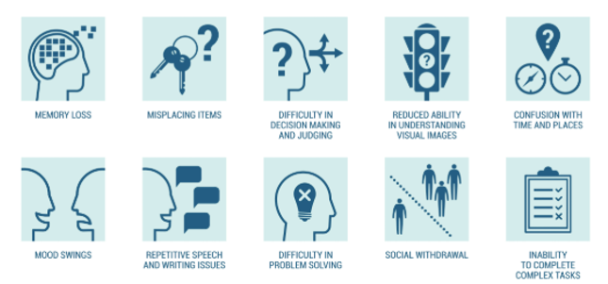
Persons with Alzheimer’s disease (AD) who are dually eligible typically have impairments in functioning that require Medicaid long-term services and supports (LTSS)
      Impairments in instrumental activities of daily living (IADLs)
        managing personal finances,
        planning medical appointments
        driving to/from a specified location
      Multimorbidity is typical >>> Impairments in activities of daily living (ADLs; e.g., climbing stairs, getting dressed)
Symptoms of Alzheimer’s Dementia. Ohio State University Brain Clinic, Understanding Alzheimer’s Disease | Alzheimer's Disease and Aging | OHSU

Slide 6
MEDICARE & MEDICAID COVERAGE AMONG DUALS
MEDICARE
(Federal)
Primary payer
Medical care
  Inpatient hospital & Emerg Dept
  Office & clinic visits
  Medications
  Short-term rehab
MEDICAID
(State)
Secondary payer
Long-term care supports and services
Traditional Medicare (FFS)
Medicare
Advantage
(Private Managed Care Plans)
Institutional Long-term Care
Home and Community Based Services (HCBS)
Dually Eligible Special Needs Plans (D-SNPs)
LTSS (Long Term Services & Supports)

Slide 7
Dually Eligible Special Needs Plans (D-SNPs)
  Medicare Advantage plans that only enroll duals
    First introduced by CMS in 2006
    Managed by a managed care organization (e.g., Centene, United Healthcare, Anthem, Humana)
    Most cover only Medicare benefits, not Medicaid
    Fully-Integrated D-SNPs (FIDEs) cover both Medicare and Medicaid
      First FIDE offered in 2011
      Major reforms implemented beginning in 2021

Slide 8
FIDEs versus Coordination Only D-SNPs
FIDEs/Integrated
Coordination-Only D-SNPs/Non-Integrated
Medicare D-SNP Contract
Medicare D-SNP Contract
Medicaid Contract
Full duals only
Exclusively aligned enrollment
Must cover Medicaid long-term care
~10% of all D-SNP enrollment nationally
Medicaid Managed Care Contract
  FINANCIAL INCENTIVES
  Incentives favor reducing unnecessary expenses, regardless of payer is Medicare or Medicaid
  Incentivized to coordinate needed Medicaid-financed community-based services and supports
Coordination-only D-SNP does not cover Medicaid long-term care
Limited financial incentive to coordinate with Medicaid around managing long-term care

Slide 9
Study Logic Model: Effects of Medicare-Medicaid Plan Integration
  Expanded Access to HCBS (Aim 1)
  Daily living supports (personal care/homemaker services, home-delivered meals)
  Non-medical transportation
  Home health devices, equipment, and modifications
  Skilled home healthcare
  Day/respite care
  Residential care
  Improved Health and Satisfaction (Aim 3)
  More days spent in the community and not in institutions
  Fewer fall-related injuries
  Fewer preventable ED visits and hospitalizations (e.g., delirium, dehydration)
  Lower mortality
  Lower D-SNP disenrollment rate
  Improved Care Process Quality (Aim 2)
  Management of care transitions
    Fewer institutional admissions
    Shorter inpatient length-of-stay
    Timely medication review/reconciliation following an inpatient stay
    Fewer readmissions
  Management of risky medication use
    One health care provider manages most prescriptions
    Managing prescription medication anticholinergic burden (ACB)

Slide 10
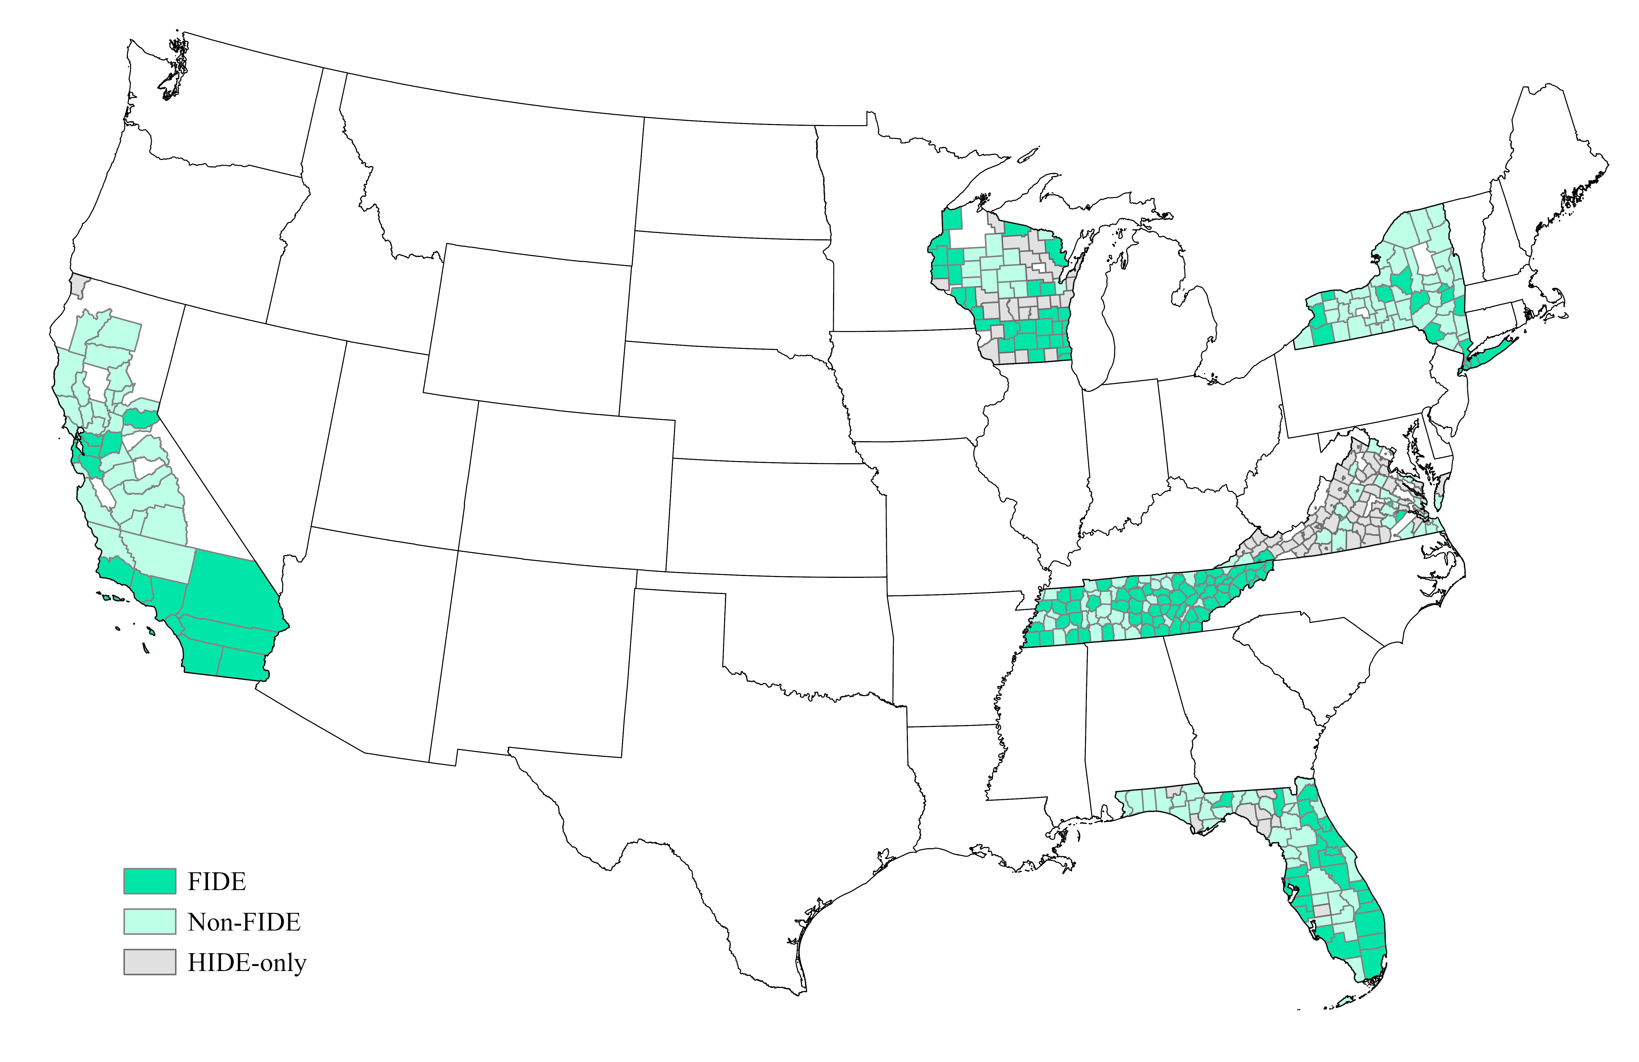
Figure 2. Sample D-SNP enrollment by county and type of plan, 2021

Slide 11
DATA and SAMPLE
  Linked Medicare and Medicaid administrative data for 2021
    Obtained under a data use agreement with CMS
    Sample based on a 20% Medicare sample
    Focus on 6 states that offer both FIDEs and Coordination-only D-SNPs (CA, FL, NY, TN, VA, WI)
    County characteristics from Area Health Resources File (AHRF), National Neighborhood Data Archive (NANDA), and CMS fee-for-service file counts
  Dual eligibility was obtained from the 2021 Medicare Master Beneficiary Summary File (MBSF)
  ADRD diagnosis indicator developed from the Chronic Conditions-27 file and Part C Encounters data
    At least 1 inpatient or at least 2 outpatient diagnoses (3-year lookback)
  Final sample contained N=15,279 with full dual eligibility and ADRD
    25 FIDEs (n=1615) and 72 CO D-SNPs (n=13664) and
    No enrollment in a FIDE plan during 2020
    Living in the community at the start of the plan year

Slide 12
Table 1. Sample characteristics (unweighted)
 | FIDEs |  | CO D-SNPs
 | N | % | N | %
Number of Observations | 1615 |  | 13664
Gender
Female | 1164 | 72.1% | 9041 | 66.2%
Male | 451 | 27.9% | 4623 | 33.8%
Age (years)
<65 | 66 | 4.1% | 1256 | 9.2%
65-74 | 351 | 21.7% | 3779 | 27.7%
75-84 | 602 | 37.3% | 4827 | 35.3%
>=85 | 596 | 36.9% | 3802 | 27.8%
Race
White | 279 | 17.3% | 3467 | 25.4%
Black | 271 | 16.8% | 2158 | 15.8%
Hispanic | 868 | 53.7% | 3802 | 27.8%
Other/unknown | 197 | 12.2% | 4237 | 31.0%
 | FIDE |  | CO D-SNPS
 | Mean | SD | Mean | SD
Number of Chronic Conditions (excluding ADRD) | 6.02 | 2.80 | 5.99 | 2.85
Condition | N | % | N | %
Hypertension | 2225 | 86.8% | 24383 | 84.9%
Hyperlipidemia | 1825 | 71.2% | 21400 | 74.5%
Chronic kidney | 1238 | 48.3% | 13801 | 48.0%
Depression | 1231 | 48.1% | 14232 | 49.5%
Rheumatoid/osteo arthritis | 1143 | 44.6% | 11463 | 39.9%
Anemia | 1052 | 41.1% | 11229 | 39.1%
lschemic heart | 989 | 38.6% | 11232 | 39.1%
Congestive heart failure | 825 | 32.2% | 8388 | 29.2%
COPD | 565 | 22.1% | 7195 | 25.0%
Osteoporosis | 379 | 14.8% | 5319 | 18.5%

Slide 13
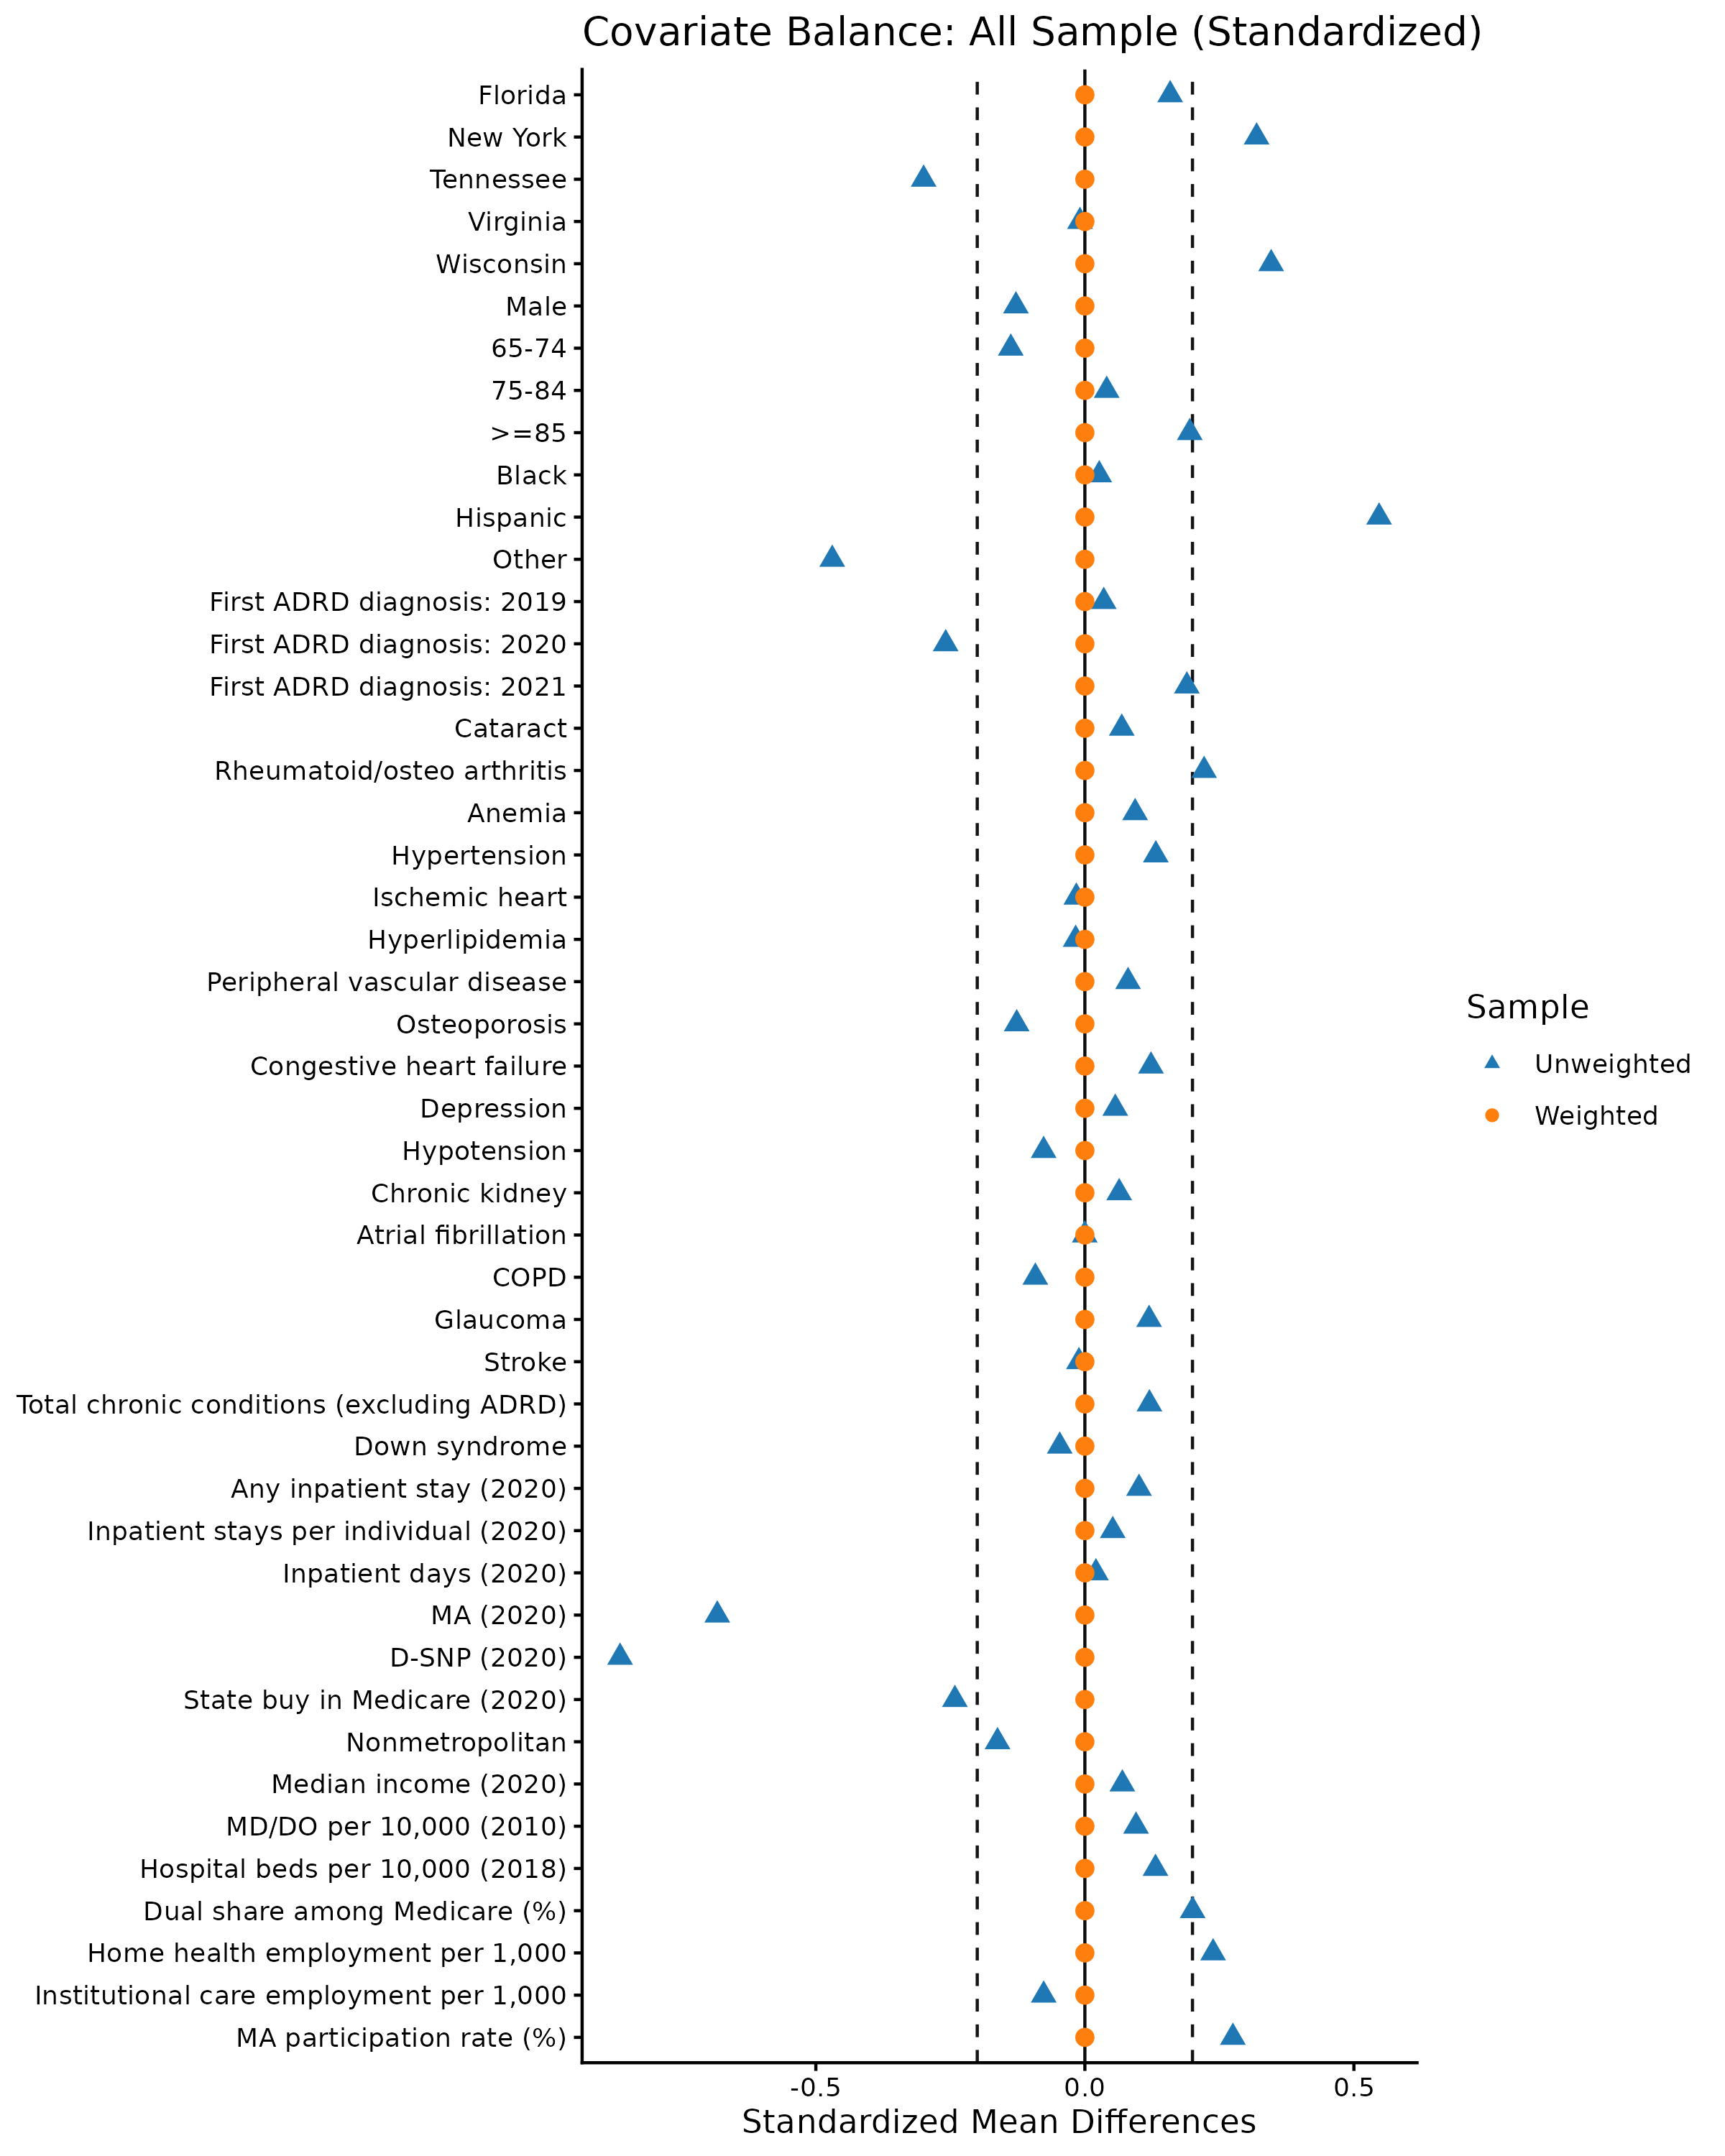

Slide 14
Table 2. Percentage use of HCBS by D-SNP type, 2021 (weighted N=1,615)
 | FIDE (n=1,615) | Coordination Only (n=13,664) | p-value
Any Medicaid Support for Community Living Service | 88.9% | 80.2% | 0.000
Daily living supports (personal care/homemaker services, home-delivered meals) | 76.9% | 67.6% | 0.000
Non-medical transportation | 35.6% | 28.5% | 0.000
Home health devices, equipment, and modifications | 49.8% | 32.3% | 0.000
Skilled home healthcare | 18.8% | 16.9% | 0.219
Day/respite care | 4.2% | 3.0% | 0.028
Residential care (assisted living/private residence) | 2.9% | 0.8% | 0.000

Slide 15
Table 3. FIDE vs. CO odds ratios: Medicaid HCBS service types*
 |  | Full Sample |  | Subsample: NY Excluded
 | n (%) | Odds Ratio (CI) | p | Odds Ratio (CI) | p
Any support for community living | 11486 (75.2%) | 2.60 (1.19, 5.64) | 0.016 | 1.20 (0.88, 1.61) | 0.236
Daily living supports (personal care/homemaker services, home-delivered meals) | 9860 (64.5%) | 2.13 (0.92, 4.91) | 0.077 | 0.74 (0.57, 0.95) | 0.021
Non-medical transportation | 3640 (23.8%) | 1.52 (1.19, 1.94) | 0.001 | 1.31 (0.85, 2.02) | 0.218
Home health devices, equipment, and modifications | 4137 (27.1%) | 2.25 (1.95, 2.59) | 0.000 | 3.29 (2.43, 4.45) | 0.000
Skilled home healthcare | 1621 (10.6%) | 1.22 (0.92, 1.60) | 0.163 | 1.00 (0.64, 1.55) | 0.991
Day/respite care | 801 (5.2%) | 1.49 (1.05, 2.11) | 0.025 | 1.66 (0.94, 2.93) | 0.079
Residential care | 291 (1.9%) | 3.66 (1.92, 6.96) | 0.000 | 2.58 (1.23, 5.36) | 0.011

Slide 16
Discussion Points
For most HCBS services, use of HCBS was greater in FIDE plans compared with Coordination-only D-SNPs
  First evidence that FIDE's (post-2021) affect access to HCBS among duals with ADRD
  No difference was found for skilled home health
State service context can make a big difference
  New York State has been invested in expanded access to HCBS
Limitations
  Data are from only 6 states
    Results for some HCBS categories were sensitive to the inclusion of data from New York
    Future analyses will use a more complete sample through 2023
  Some specific HCBS were not included because of low recorded use (e.g., case management)

Slide 17
References
REFERENCES
1. U.S. Department of Health and Human Services. National Plan to Address Alzheimer's Disease: 2025 Update. 2025.
2. Gianattasio KZ, Wachsmuth J, Murphy R, et al. Case definition for diagnosed Alzheimer disease and related dementias in Medicare. JAMA network open. 2024;7(9):e2427610.
3. Medicaid and CHIP Payment Access Commission, ed. Beneficiaries Dually Eligible for Medicare and Medicaid. Washington, D.C.: MEDPAC and MACPAC, https://www.macpac.gov/publication/data-book-beneficiaries-dually-eligible-for-medicare-and-medicaid-3/; 2025.
4. Kim H, Senders A, Simeon E, et al. Use of long‐term services and supports among dual‐eligible beneficiaries with Alzheimer's disease and related dementias. J Am Geriatr Soc. 2023;71(2):432–442.
5. ATI Advisory, ed. Enhancing Medicare-Medicaid Integration: Bringing Elements of the Financial Alignment Initiative into Dual-Eligible Special Needs Plans. ATI Advisory, https://atiadvisory.com/wp-content/uploads/2021/12/Enhancing-Medicare-Medicaid-Integration-Bringing-Elements-of-the-FAI-into-D-SNPs.pdf: ; 2021.
6. United States Government Accountability Office, Medicare and Medicaid: Alignment of Managed Care Plans for Dual-Eligible Beneficiaries (GAO-20-319). 2020.
7. Lakhmani EW, ed. Definitions of Different Medicare Advantage Dual Eligible Special Needs Plan (D-SNP) Types in 2023 and 2025. Integrated Care Resource Center, www.integratedcareresourcecenter.copm; 2022.
8. Yan D, Wang S, Temkin-Greener H, Cai S. The use patterns of Medicaid home and community based services among Medicare/Medicaid beneficiaries with dementia. Frontiers in Public Health. 2021;9:708402.
9. Li B, Layton TJ. Medicaid Managed Care: Substantial Shifts In Market Landscape And Acquisitions, 2006–20: Article examines Medicaid managed care, market shifts, and acquisitions. Health Aff. 2025;44(7):862–868.
10. Keohane LM, Zhou Z, Stevenson DG. Aligning Medicaid and Medicare Advantage managed care plans for dual-eligible beneficiaries. Medical Care Research and Review. 2022;79(2):207–217.
11. Centers for Medicare & Medicaid Services, ed. Fact Sheet: CY 2023 Medicare Advantage and Part D Final Rule (CMS-4192-F). https://www.cms.gov/newsroom/fact-sheets/cy-2023-medicare-advantage-and-part-d-final-rule-cms-4192-f: cms.gov; 2022.
12. Rizer A, ed. Medicaid-Capitated D-SNPs: An Innovative Path to Medicare-Medicaid
Integration. ATI Advisory, atiadvisory.com/resources/medicaid-capitated-d-snps-an-innovative-path-to-medicare-medicaid-integration/: ; 2020.
13. Lynch C, Engelhardt T. Medicare-Medicaid Integration and Unified Appeals and Grievance Requirements for State Medicaid Agency Contracts with Medicare Advantage Dual Eligible Special Needs Plans (D-SNPs) for Contract Year 2021. Accessed January 17, 2023.
14. Centers for Medicare & Medicaid Services (CMS), ed. Medicare Program; Contract Year 2023 Policy and Technical Changes to the Medicare Advantage and Medicare Prescription Drug Benefit Programs. Federal Register, https://www.govinfo.gov/content/pkg/FR-2022-05-09/pdf/2022-09375.pdf; 2022.
15. Feng Z, Wang J, Gadaska A, et al, eds. Comparing Outcomes for Dual Eligible Beneficiaries in Integrated Care: Final Report. U.S. Department of Health and Human Services, Office of Behavioral Health, Disability, and Aging Policy; 2021.
16. Kim H, Senders A, Sergi C, et al. Differences in healthcare utilization between enrollees of fully integrated dual eligible special needs plans versus non‐fully integrated plans. J Am Geriatr Soc. 2024.
17. Centers for Medicare and Medicaid Services. SNP Comprehensive Report. Accessed Dec. 12, 2024.
18. Hainmueller &, J., eds. Entropy Reweighting to Create Balanced Samples. CRAN.R-project.org/package=ebal: ; 2026.
19. Hainmueller J. Entropy balancing for causal effects: A multivariate reweighting method to produce balanced samples in observational studies. Political analysis. 2012;20(1):25–46.

Slide 18
Thank You!
Eric Slade
Professor
Johns Hopkins School of Nursing
eslade@jhu.edu
Notes:
Tip: There’s no need to include WWW or HTTPS in front of your URL.

