Slide 1
Who Enters and Who Exits Direct Care Jobs?
Krista Ruffini
Karen Shen
Yulya Truskinovsky
Georgetown University
Johns Hopkins University
Syracuse University
NBER ADRD Coordinating Center Annual Meeting
June 18, 2026

Slide 2
LTSS direct care workers care for a vulnerable population
Millions of older adults and people with disabilities need long-term care
  Help with ADLs (eating, bathing, dressing, mobility) and IADLs (meals, managing medication)
  Cognitive impairment is common — nearly 60% of long-stay nursing home residents have ADRD
This care is delivered by the LTSS direct care workforce, across two settings
  Nursing homes & other residential facilities: 2M+ residents, cared for by 1.2M direct care workers (PHI 2025)
  Home & community: 7.3M people, cared for by 3.2M home care workers (PHI 2025)
Staffing determines quality of care across settings
  More staffing → lower mortality and better resident health (Lin 2014; Friedrich & Hackmann 2021
  Consistent home care workers → fewer falls, functional improvement, fewer depressive symptoms (Reckrey et al. 2024)
1/21

Slide 3
The direct care workforce faces persistent challenges
Low pay: $19.34/hr (2024) vs. $32.66 private sector average
Understaffing: most nursing homes staff below clinical standards
  Geng et al. (2019); McGarry et al. (2020); Shen et al. (2022)
High turnover: avg. nursing facility loses 46% of nursing staff annually
  Only 12% of facilities have turnover under 30% (CMS 2026)
Demand for LTSS is rising with population aging
  CMS launching new training and recruitment efforts (CMS 2026)
3/21

Slide 4
This paper
Question: Where do direct care workers (CNAs) come from, and where do they go?
Why it matters
Effective recruitment/retention policy requires knowing the relevant labor market — which jobs compete for these workers
Helps identify whether LTSS CNAs leave for better jobs (wages, benefits) and what they're leaving from
Contribution
Nationally representative worker-flow evidence
Characterize entrants, stayers, and leavers on wages and benefits
4/21

Slide 5
Data
Monthly Current Population Survey, Jan 2010 – Dec 2025
  Demographics, industry, occupation
  Wages from the Outgoing Rotation Group (ORG)
Annual Social and Economic Supplement (ASEC), 2014–2025
  Access to employer-sponsored health insurance (ESI), pensions
  Calculated at the industry-occupation cell level (job-level rather than individual-level measure of benefits)
6/21

Slide 6
Defining direct care workers and their comparison groups
We classify every worker by occupation × industry:
LTSS CNAs: nursing assistants/aides in nursing homes or home health
  Occupation (Census 2010): 3600 nursing/psychiatric/home health aides, 4610 personal care aides
  Industry: nursing care facilities (8270); home health care services (8170), individual & family services (8370), private households (9290)
  Occupation-by-industry definition follows Frogner (2018), Dill et al. (2025), Kreider & Werner (2023)
Other CNAs: aides in hospitals, other settings
Nurses: LPNs and RNs
Other comparison groups: other health care, childcare & education, cleaning & domestic, other low-wage service, all workers
7/21

Slide 7
Constructing the year-over-year panel
CPS rotation: 4 months in, 8 months out, 4 months in
Each individual appears in the same months one year apart
We use this to track flows between year t and year t+1:
  Entrants: not LTSS CNA in t, is LTSS CNA in t+1
  Stayers: LTSS CNA in both t and t+1
  Leavers: LTSS CNA in t, not LTSS CNA in t+1
Note: cannot identify employer switches within same industry-occupation
  E.g., a CNA moving between two nursing homes is a "stayer"
8/21

Slide 8
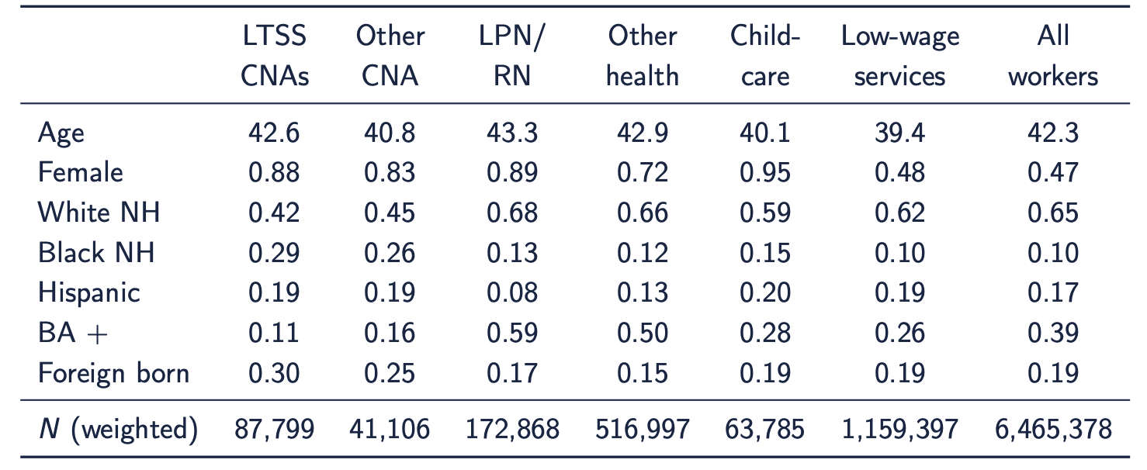
LTSS CNAs differ from the workforce — and from other low-wage work
LTSS CNAs are more female (88% vs. 48%), Black (29% vs. 10%), less educated (11% with BA vs 39%) foreign-born (30% vs. 19%)
9/21

Slide 9
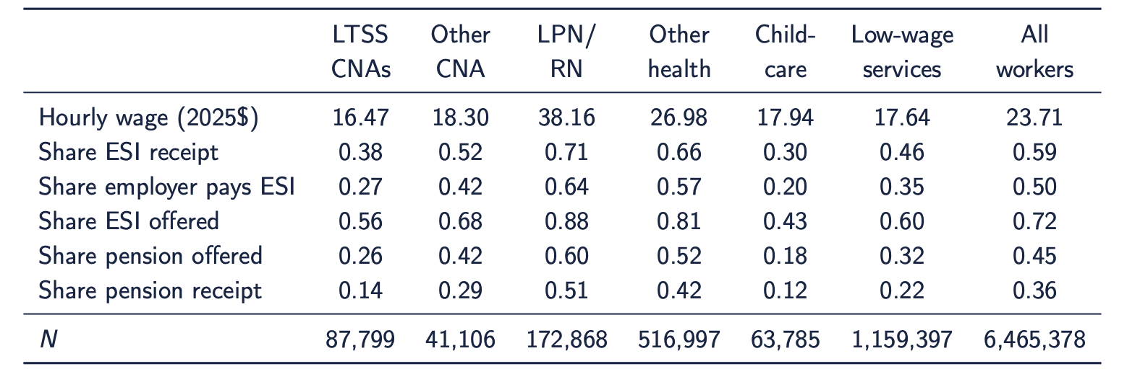
LTSS CNAs earn less and get fewer benefits — even vs. low-wage services
LTSS CNAs earn $16.47/hr — less than half of LPN/RN pay, and less than low-wage services ($17.64)
ESI receipt: 38% (LTSS) vs. 46% (low-wage svc) vs. 66–71% (other health/LPN)
Pension receipt: 14% (LTSS) vs. 22% (low-wage svc) vs. 42–51% (other health/LPN)
10/21

Slide 10
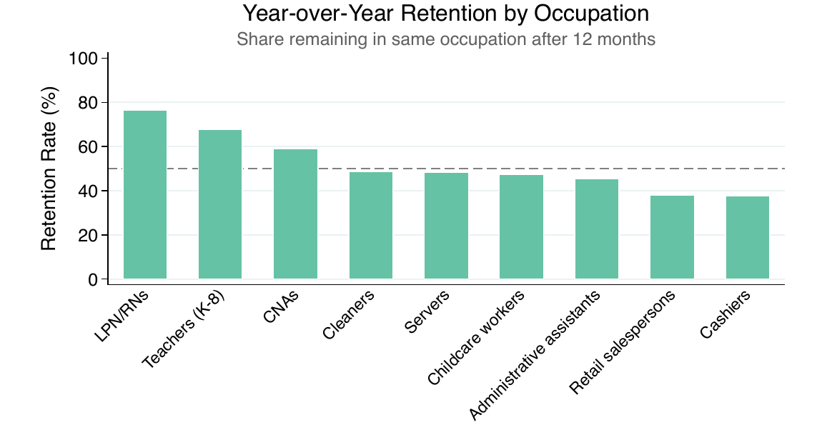
As an occupation, CNA retention not unusually low
CNAs (~59%) stay in-occupation more than cleaners, servers, retail, cashiers
But less than credentialed work (LPN/RN ~76%, teachers ~68%
11/21

Slide 11
Where do they come from and where do they go?
~51% remain LTSS CNAs year over year
The same pool of jobs feeds in and absorbs out
13/21

Slide 12
Among movers: other CNA settings and non-employment dominate
Other CNA work (~12–13%) and non-employment (~12%) dominate the flows
Other health care and other employment: ~5–6% each
Asymmetry: more come from other low-wage services than go to low-wage services
14/21

Slide 13
Symmetric flows mask asymmetric wage & benefit changes
Jobs entrants come from ≈ jobs leavers go to, but wage and benefit trajectories differ sharply
Compare three groups on the change from t to t+1:
  Entrants: previous job → LTSS CNA
  Stayers: LTSS CNA → LTSS CNA
  Leavers: LTSS CNA → next job
15/21

Slide 14
Stayers are a distinct, more-attached group
 | Entrants | Stayers | Leavers
Share female | 0.85 | 0.89 | 0.85
Average age | 41.1 | 43.2 | 40.9
Share HS/some college | 0.72 | 0.80 | 0.73
Share BA or higher | 0.14 | 0.09 | 0.14
Share foreign born | 0.25 | 0.33 | 0.27
Entrants and leavers look alike — consistent with symmetric flows
Stayers look different: more female, older, more foreign-born, less educated
The workers who remain have fewer outside options
16/21

Slide 15
Leavers gain wages; entrants take a cut
 | Entrants | Stayers | Leavers
Δ Hourly wage ($) | −0.95 | +0.46 | +2.05
Δ Full-time | +0.021 | +0.020 | +0.059
Δ Unstable schedule | −0.011 | −0.007 | −0.004
Δ Multiple jobs | −0.016 | −0.009 | −0.024
Entrants take a wage cut (−95¢) to become LTSS CNAs
Stayers gain modestly (+46¢)
Leavers gain $2.05/hr and more full-time, less moonlighting
17/21

Slide 16
Entering is a benefit downgrade; leaving, an upgrade
 | Entrants | Leavers
Δ ESI receipt | −0.137 | +0.141
Δ ESI employer paid | −0.147 | +0.152
Δ ESI offered | −0.107 | +0.112
Δ Pension offered | −0.112 | +0.119
Δ Pension receipt | −0.143 | +0.150
Entrants come from jobs with markedly better benefits (~11–15 pp more ESI, pension)
Leavers move to such jobs — gains nearly mirror the entry losses
18/21

Slide 17
Conclusions
Flows in and out of LTSS CNA are symmetric: entrants come from the same jobs leavers return to
  Many stay in CNA roles
  Movement up the credential ladder (to nurses) is rare (~4%)
LTSS CNA work is a wage and benefit downgrade
  Entrants give up ~11–15 pp of benefit access on the way in; leavers regain it on the way out
  Entrants take a 95¢ pay cut; leavers receive a $2.05 wage gain
Stayers look different than entrants and leavers: older, lower educational attainment, more female and foreign-born
19/21

Slide 18
Limitations and next steps
Limitations
Descriptive — selection drives part of the leaver wage gap
Can't separate employer vs. industry-occupation moves
Benefits imputed at industry × occupation cell, not individual level
CPS misses very-low-attachment workers; undercounts some immigrant groups
People are not very good at self-reporting their industry and occupation
Next steps
Link to admin data (LEHD) for employer-level flows
20/21

Slide 19
Thank you
ytruskin@syr.edu

