Slide 1
Setting

Slide 2
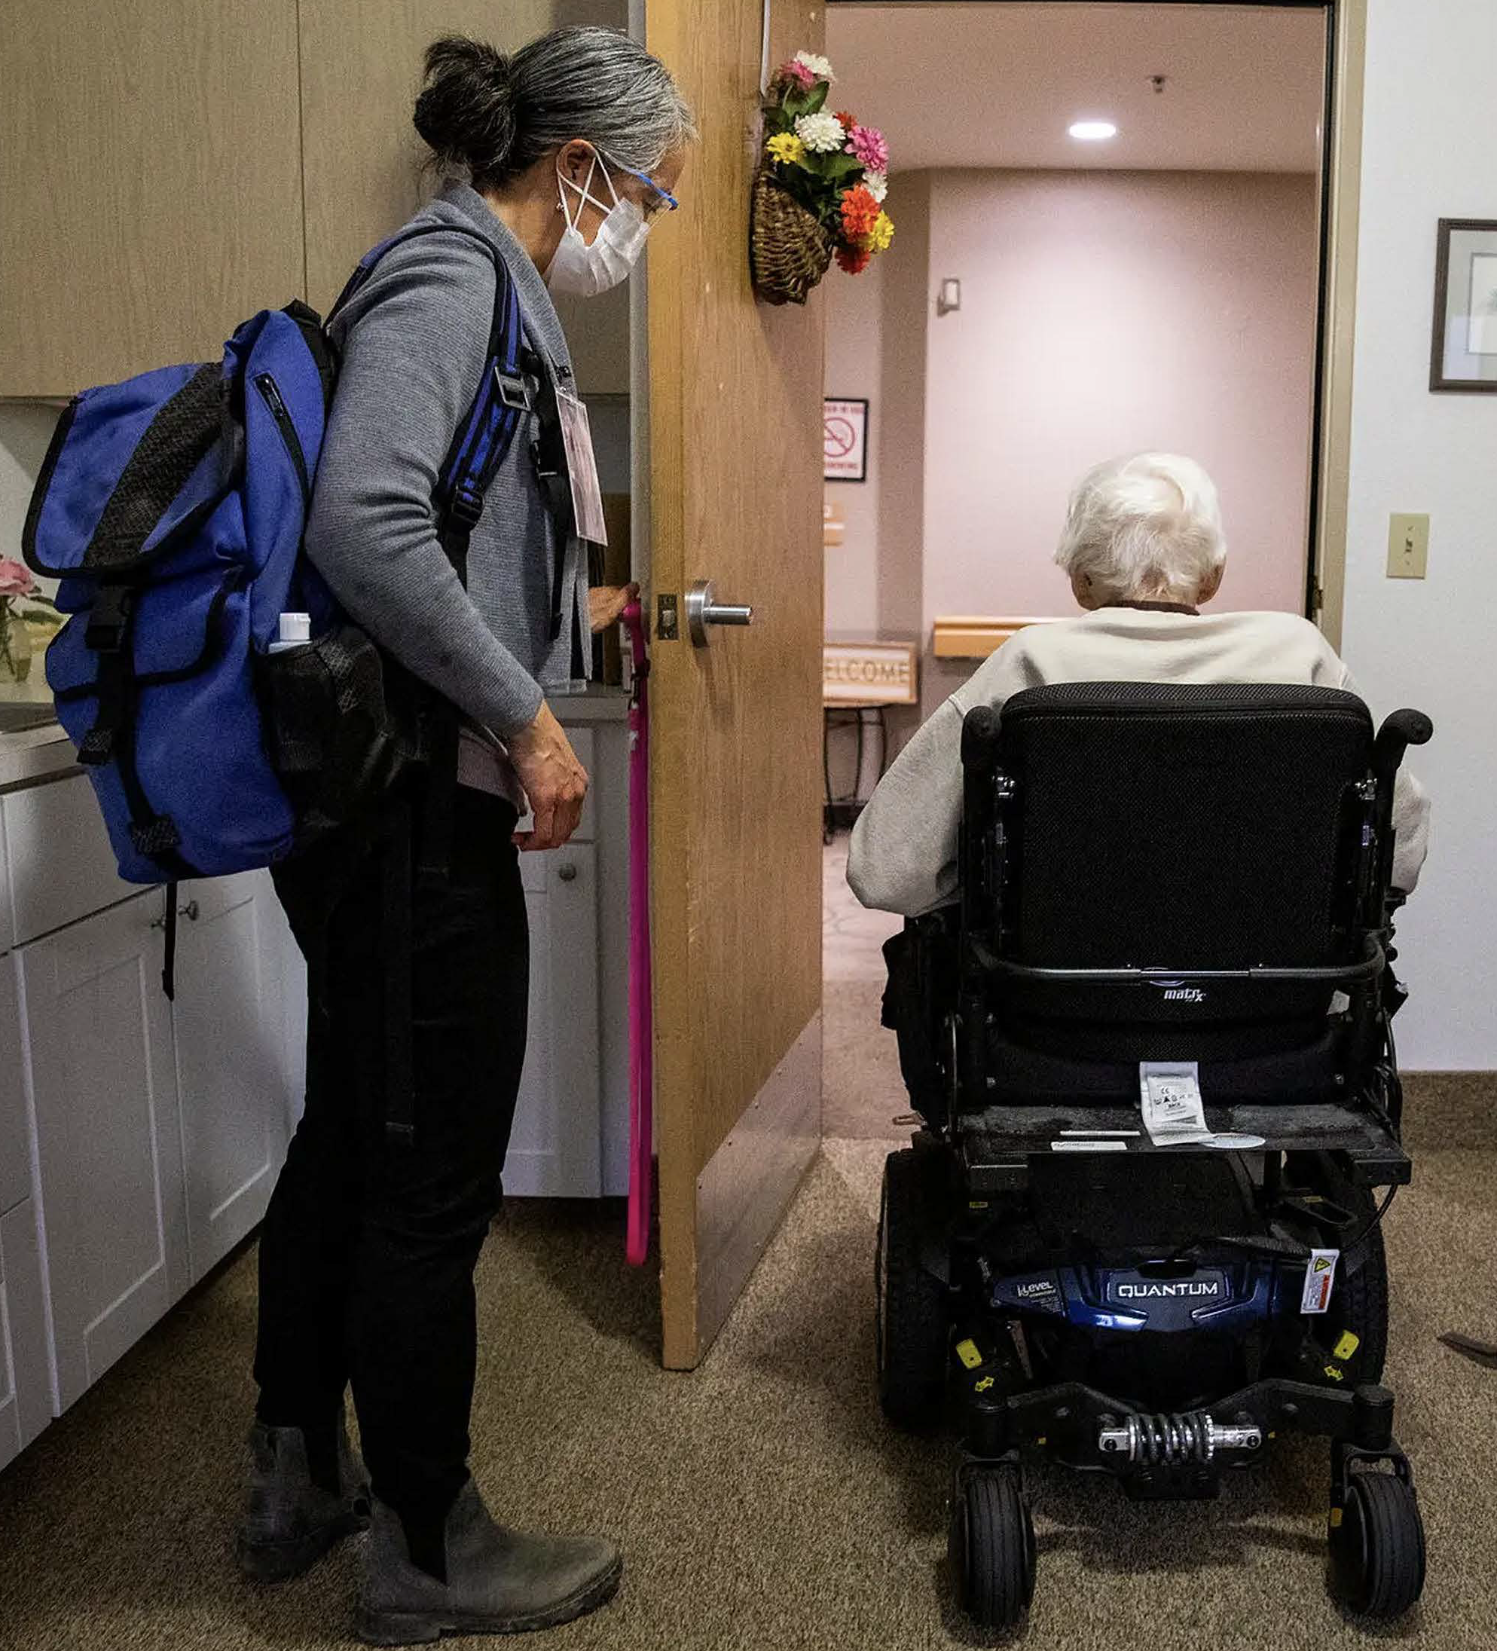
Hospice Care in the United States
▷ Eligibility:
▷ Physician-certified terminal illness (≤6 months)
▷ Must forgo curative treatment
Source: NYT, 2022
5

Slide 3
Hospice Care in the United States
▷ Eligibility:
▷ Physician-certified terminal illness (≤6 months)
▷ Must forgo curative treatment
▷ Services:
▷ Generally provided at the patient’s home
▷ Palliative medical care, symptom management, psychosocial support, medications, equipment, grief counseling, 24/7 on-call support
Source: NYT, 2022
5

Slide 4
Hospice Care in the United States
▷ Eligibility:
▷ Physician-certified terminal illness (≤6 months)
▷ Must forgo curative treatment
▷ Services:
▷ Generally provided at the patient’s home
▷ Palliative medical care, symptom management, psychosocial support, medications, equipment, grief counseling, 24/7 on-call support
▷ Financing:
▷ Financed mainly via Medicare Hospice Benefit (since 1983)
▷ Fixed per-diem payment covers all related services ($196 for routine home care in 2019)
Source: NYT, 2022
5

Slide 5
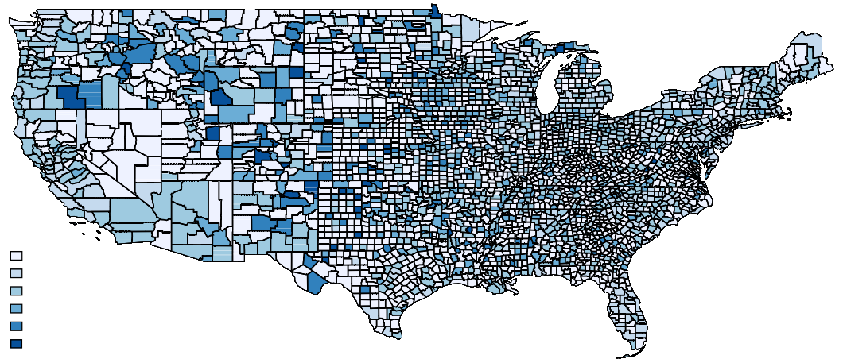
Hospice Agencies per 1,000 Beneficiaries by County in 1999
0
(0, 0.1)
[0.1, 0.25)
[0.25, 0.5)
[0.5, 1)
[1, 2.577]

Slide 6
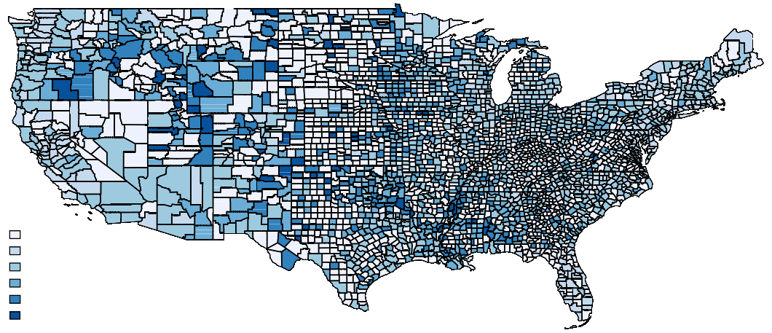
Hospice Agencies per 1,000 Beneficiaries by County in 2010
0
(0, 0.1)
[0.1, 0.25)
[0.25, 0.5)
[0.5, 1)
[1, 2.492]

Slide 7
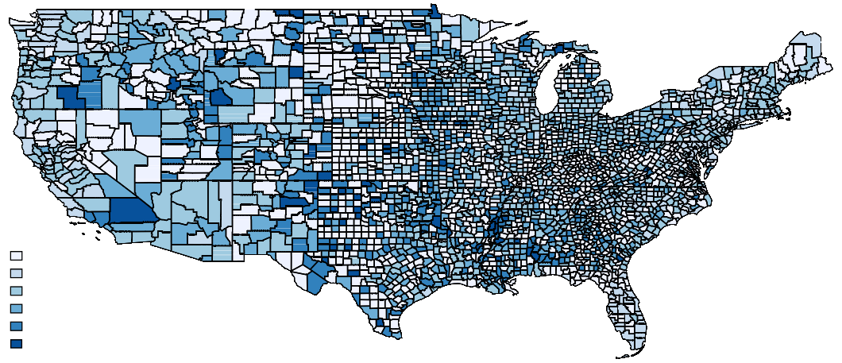
Hospice Agencies per 1,000 Beneficiaries by County in 2019
0
(0, 0.1)
[0.1, 0.25)
[0.25, 0.5)
[0.5, 1)
[1, 4.843]

Slide 8
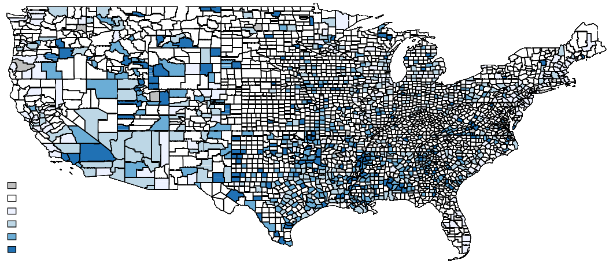
Hospice Agency Entries per 1,000 Beneficiaries 1999 to 2019
(-0.41, 0)
0
(0, 0.1)
[0.1, 0.25)
[0.25, 0.5)
[0.5, 2.42]
Change in hospice agencies per 1,000 beneficiaries, 1999–2019

Slide 9
Data and Sample

Slide 10
Data
▷ Medicare claims (1999–2019):
▷ Inpatient (IP), Outpatient (OP), Skilled Nursing Facility (SNF), Home Health Agency (HHA), Hospice (HOS), Carrier (physician visits), Part D drug events (PDE)
▷ Quarterly enrollment, demographics, and chronic conditions
▷ Sample restrictions: alive, enrolled in FFS Medicare at start of quarter
10

Slide 11
Data
▷ Medicare claims (1999–2019):
▷ Inpatient (IP), Outpatient (OP), Skilled Nursing Facility (SNF), Home Health Agency (HHA), Hospice (HOS), Carrier (physician visits), Part D drug events (PDE)
▷ Quarterly enrollment, demographics, and chronic conditions
▷ Sample restrictions: alive, enrolled in FFS Medicare at start of quarter
▷ Clinical assessments (1999-2019):
▷ Minimum Data Set (MDS) for all nursing home residents
▷ Measures: psychosocial and physical health status, functional limitations, service use
▷ Covers 40% of hospice patients in 2019
▷ Hospice facility data:
▷ Provider of Services (POS) file: facility characteristics (e.g., for-profit status, staffing)
10

Slide 12
Empirical Strategy

Slide 13
Stacked DiD Event Study with Matched Control
1,518 county-quarters with hospice agency entry
▷ For each treated county:
▷ Control counties drawn from set of ever-treated counties; no entry in treatment quarter
▷ Match 1-2 control counties on pre-entry Medicare beneficiary counts (levels and slopes)
▷ No agency entry in 4 quarters before treatment quarter
▷ Each treated county + the matched control counties define an “experiment”
▷ Balanced panel: require 1 year pre- and 5 years post-entry

Slide 14
Results: Spending

Slide 15
First Stage: Hospice Spending per Beneficiary-Quarter
Alzheimer’s Disease
ADRD
60
40
20
0
-20
-4 -3 -2 -1 0 1 2 3 4 5 6 7 8 9 10 11 12 13 14 15 16 17 18 19
60
40
20
0
-20
-4 -3 -2 -1 0 1 2 3 4 5 6 7 8 9 10 11 12 13 14 15 16 17 18 19
Coefficient
Coefficient
Quarters Since Facility Entry
Quarters Since Facility Entry
↑ $37.1 (7.2% of baseline)
↑ $28.3 (7.2% of baseline)

Slide 16
Hospice Expansion Reduces Total Spending for AD/ADRD Patients
 | Mean | Estimate % Change |  | Mean | Estimate | % Change
Hospice | 514 | 37.1∗∗∗ | 7.2% | 393 | 28.3∗∗∗ | 7.2%
Total Non-Hospice | 4412 | −48.1∗∗ | -1.1% | 4750 | −26.5† | -0.6%
Alzheimer’s Disease
ADRD
†p < 0.1 ∗p < 0.05 ∗∗p < 0.01 ∗∗∗p < 0.001
13

Slide 17
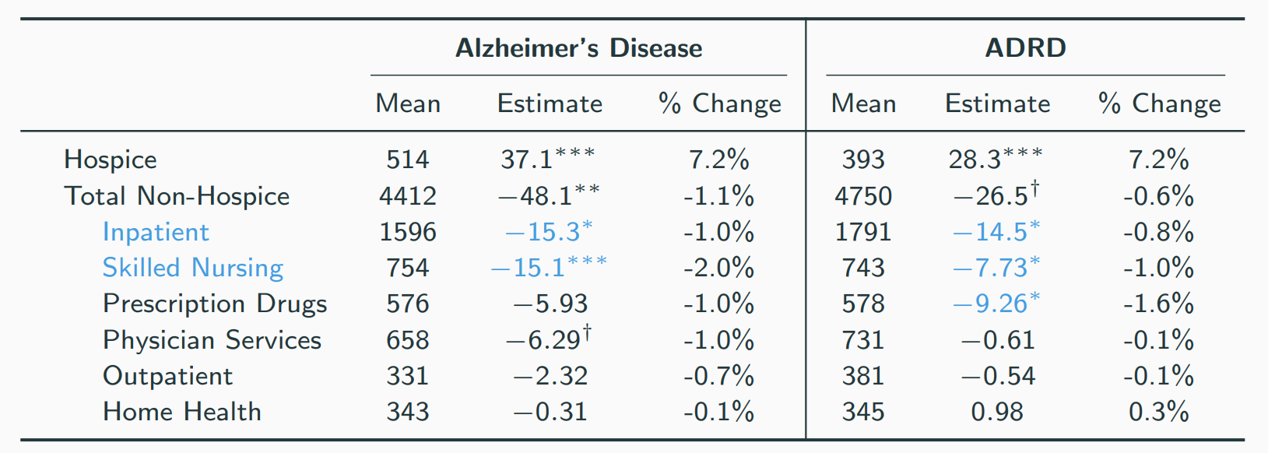
Hospice Expansion Reduces Total Spending for AD/ADRD Patients
†p < 0.1 ∗p < 0.05 ∗∗p < 0.01 ∗∗∗p < 0.001
13

Slide 18
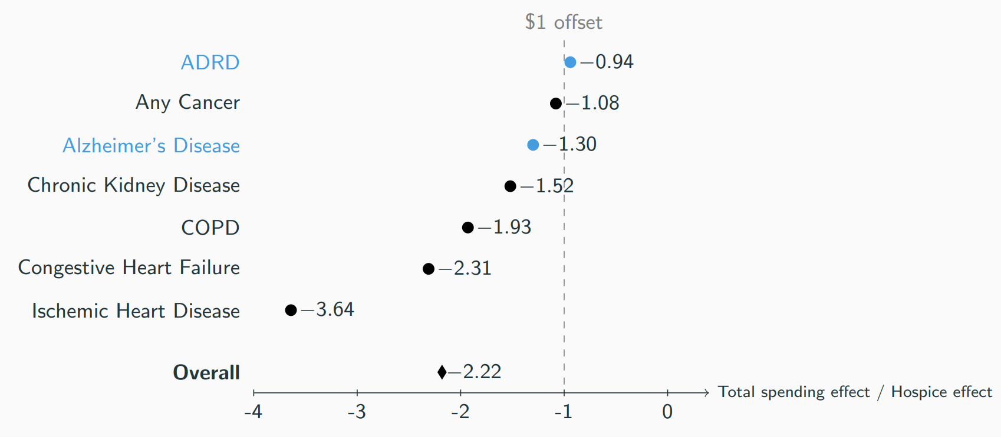
Net Spending Effects Vary by Condition

Slide 19
Results: Patient Well-being

Slide 20
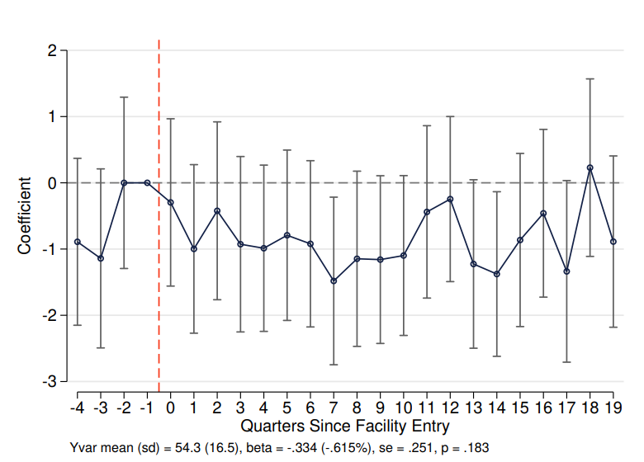
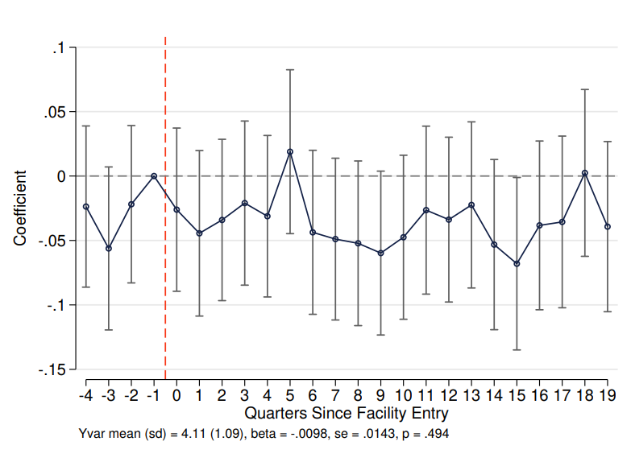
Hospice Use Does Not Affect Mortality
No significant change in quarterly deaths per 1,000 beneficiaries.
AD Alzheimer’s Disease

Slide 21
Hospice Shifts Place of Death for AD/ADRD Patients
Alzheimer’s Disease
0.53
0.5
0.25
0
−0.25
−0.5
Elasticity
0.15
−0.33
−0.27
−0.35
−0.46
ADRD
0.5
0.25
0
−0.25
−0.5
0.5
Elasticity
0.1
−0.21
−0.23
−0.16
−0.38
Institution Inpatient SNF Home w Hospice w/o Hospice
Elasticity of the share of deaths occurring in each location wrt hospice use: %∆Death Share/%∆Hospice Use.

Slide 22
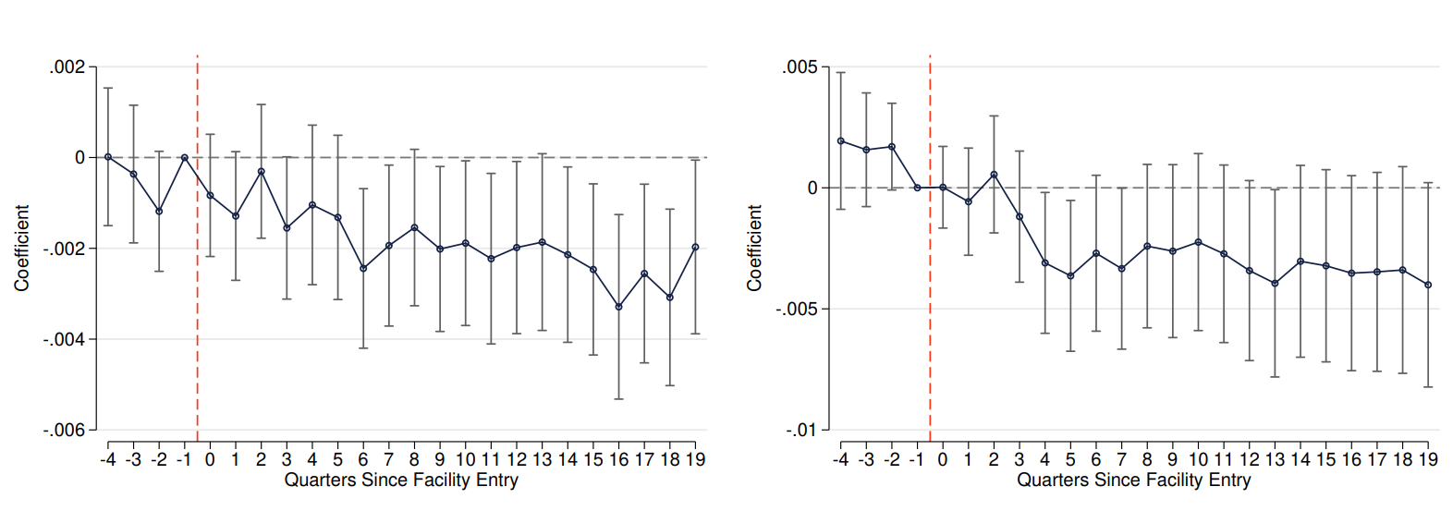
Reduced High-Intensity Interventions for ADRD Patients
Catheter
↓ 2.2% from baseline (6.8%)
Trunk Restraint
↓ 4.7% from baseline (8.3%)

Slide 23
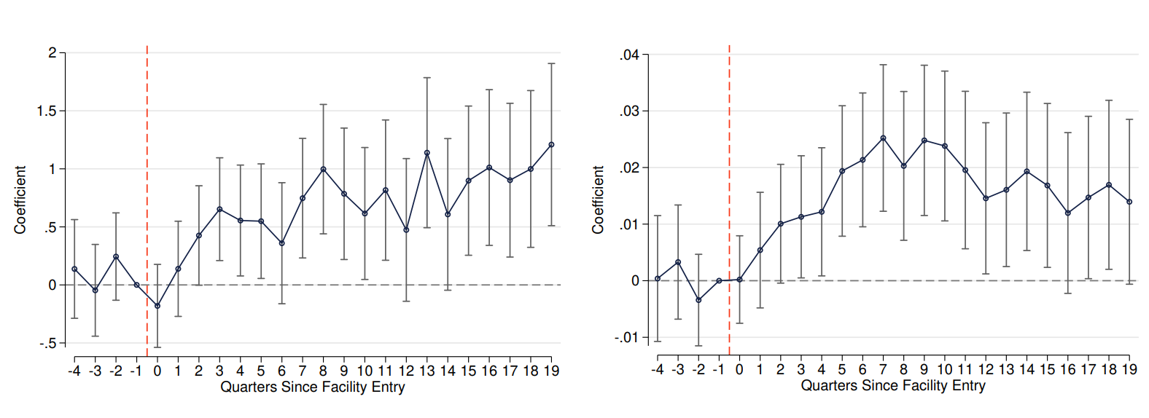
More Comfort Services for ADRD Patients
Speech Therapy (Swallowing), Minutes
↑ 3.9% from baseline (15.4)
Hypnotic Use, Days
↑ 6.2% from baseline (0.26)

Slide 24
Patients Across Conditions Benefit from Hospice
Percent Change
Alzheimer's Disease
.05763
.04993
.04224
.03454
.02684
.01915
.01145
.00375
-.00395
-.01164
-.01934
-.02704
-.03473
-.04243
-.05013
Alzheimer's and Related Dementias
Chronic Kidney Disease
Chronic Obstructive Pulmonary Disease
Congestive Heart Failure
Ischemic Heart Disease
Stroke or TIA
Has Catheter
Has Feeding Tube
Any Hypnotic Drug Use
Has Trunk Restraint
Days of Hypnotic Drug Use
Speech Therapy (Swallowing), Min

Slide 25
Other Outcomes
▷ Activities of Daily Living (ADLs): No significant changes in requiring assistance with mobility, transfers, dressing, or hygiene; small increase for eating (+0.43%, p < 0.05).
▷ Physical Health Outcomes: No changes in fractures, falls, pressure ulcers, continence, or weight loss; small reduction in weight gain (-2.7%, p < 0.05).
▷ Medication Use: No statistically significant changes in use of antidepressants, anxiolytics, antipsychotics, or diuretics.
▷ Mental Health & Cognition: No meaningful changes in reported pain, mood, memory, or inattention.

Slide 26
Conclusion
▷ For patients with AD/ADRD, higher hospice spending is largely offset by lower inpatient and skilled nursing spending.
▷ For the overall Medicare population, hospice expansion reduces total spending.
▷ Hospice increases comfort care without increasing mortality or worsening patient outcomes.
▷ Expanding access to hospice can improve end-of-life care at no net cost for the AD/ADRD population and generate savings for Medicare overall.
21

Slide 27
Thank You!
yunan.ji@georgetown.edu edk571@g.harvard.edu mayaroy@g.harvard.edu
21

