Slide 1

Cohort Replacement, Trajectory Heterogeneity,
and the Fiscal Architecture of Dementia Forecasting
Arseniy P. Yashkin | Galina Gorbunova | Eric Stallard
Biodemography of Aging Research Unit, Duke University

Slide 2
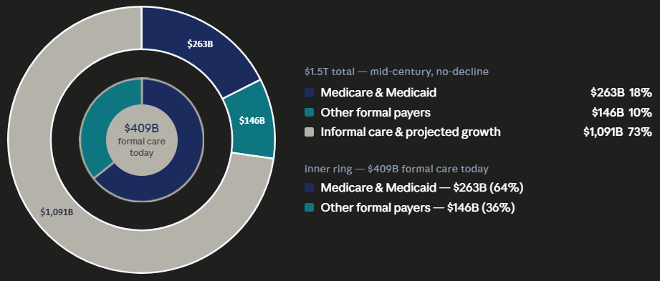
The Standard Forecast — and Its Assumptions
Assumption 1
Dementia risk is stable across birth cohorts — future generations will get dementia at the same rates as today's elderly
What Assumption 1 misses
Each successive birth cohort enters old age with lower age-specific dementia risk — a sustained, measurable trend invisible to cohort-stable models
Assumption 2
What Assumption 2 misses
People with the same diagnosis generate similar care use and spending — average per-case costs applied to broad disease stages
Survival timing, duration of institutional care, and service intensity vary enormously — compressing them into stage averages obscures long-term care tail risk

Slide 3
The Evidence: Dementia Risk Has Fallen Across Survey Years
43%
decline in severe cognitive
impairment, 1984–2004
(NLTCS)
≈67%
projected decline over
40 years if trend continues
(95% CI: 61–73%)
2.74%
annual rate of decline
in the NLTCS
(95% CI: 2.3–3.2%)
Source: Stallard, Ukraintseva & Doraiswamy, JAMA 2025. Age-standardized HIPAA cognitive impairment trigger, NLTCS.

Slide 4
The Evidence: Age-Specific Dementia Prevalence Has Fallen at Every Age
Annual decline rate by age band
65–69
3.13%/yr
47% total
70–74
3.67%/yr
52% total
75–79
2.74%/yr
43% total
80–84
3.03%/yr
46% total
85–89
2.55%/yr
40% total
90–94
2.60%/yr
41% total
Decline is pervasive — it occurs at every age band, not just the young-old. Each successive cohort enters each age with lower risk than its predecessor.

Slide 5
The Demographic Arithmetic: U.S. Population Aging Through 2050
30% more people — but each arriving cohort carries lower dementia risk than its predecessor. Exposure expands; hazard compresses.
Whether costs double or barely rise depends entirely on the rates those cohorts bring with them.
The fiscal risk is in the cohort risk structure, not the headcount.

Slide 6
What Explains the Cohort Decline? Age-Specific Risk Has Fallen
Why each cohort
arrives with lower risk
Smoking
30–50% higher dementia risk. Adult rates fell from 42% (1965) to 12% (2022) — already embedded in current 65+ cohorts
Cardiovascular
Hypertension, diabetes, and stroke management have improved markedly across successive cohorts
Education
Each cohort more educated than the last — one of the strongest protective factors against dementia onset
Technophysio evolution
Secular gains in body size, organ reserve, and chronic disease capacity across generations (Fogel & Costa)
Key point: these changes are already baked into cohorts now entering old age. They are structural demographic momentum — not contingent on future intervention.

Slide 7
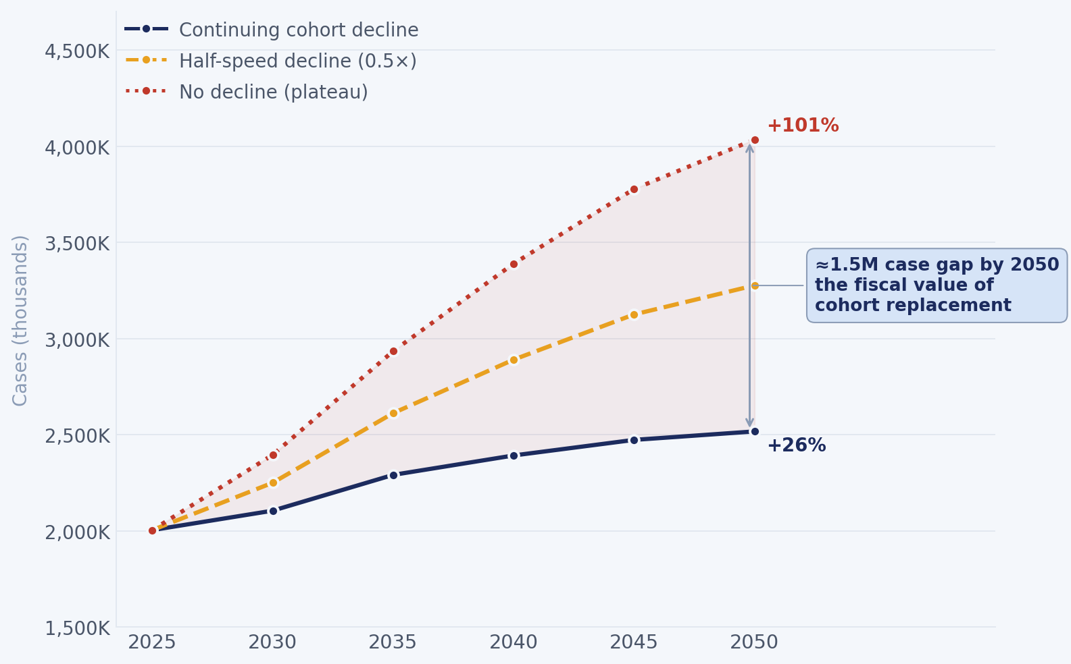
The Demographic Arithmetic: The Fiscal Value of Cohort Replacement

Slide 8
The Second Problem: Stage-Averaged Costing Compresses Heterogeneity
Current Approach
What Actually Drives Fiscal Exposure
Assign individuals to discrete disease stages
Onset timing — when decline begins relative to life expectancy
Apply average per-case expenditures to each stage
Duration — how long spent in high-cost care settings
Multiply stage prevalence × average cost
Institutionalization timing — not just whether it occurs
Sum across stages for aggregate forecast
Survival conditional on impairment — shapes lifetime liability
Sex differences alone illustrate the problem: NLTCS 2004 prevalence was 4.7% (men) vs. 8.1% (women). Averaging these compresses dispersion in duration, institutionalization risk, and service intensity — potentially understating long-term care tail risk.

Slide 9
Heterogeneity Is Not Random:
Sex Differences in Prevalence, Trajectory, and Fiscal Exposure
Fiscal
implications
2004 NLTCS
Age-Standardized
Prevalence
Women live longer
More years in nursing facility → higher Medicaid LTSS exposure per case
8.1%
Survival gap
Women
Women with dementia survive ~1–2 years longer — multiplying cumulative Medicare spend
4.7%
Stage-avg hides this
Per-case costing averages men & women — understating female long-run tail risk
Men
72% higher prevalence in women
Source: NLTCS 2004 — Stallard & Yashin, SOA LTC Morbidity Study (2016). Census Bureau (2023). Case projections apply sex-specific age-standardized rates under cohort-adjusted and no-decline scenarios.

Slide 10
Why The Decline Is Not Already In The Forecasts
Aggregate Prevalence Models (e.g., Global Burden of Disease [GBD])
Key limit:
Apply Bayesian meta-regression to aggregate rates. Model risk-factor trends but do not simulate individual disease trajectories — fiscal exposure derived by multiplying average per-case costs by projected prevalence totals.
No trajectory heterogeneity. No survival timing
Stage-Based Microsimulation (e.g., Future Elderly Model [FEM], Dynamic Simulation of Income Model [DYNASIM])
Key limit:
Estimate disease transitions and expenditure equations jointly within a single historical data environment. Fiscal outcomes are statistically embedded in discrete disease-state definitions.
Payment reform cannot be evaluated without redefining disease states. Heterogeneity averaged within stages.
Regression-Based Cost Models
Key limit:
Estimate average costs conditional on observed covariates and disease states. Assume stability in the relationship between health states and spending across time and policy regimes.
Cohort replacement not modeled. Structural breaks under policy reform invalidate projections.
In each case, disease progression and fiscal exposure are fused — payment reform cannot be evaluated independently of disease dynamics.

Slide 11
A Modular Alternative: The L-GoM Trajectory Framework
Cohort
Replacement
Continuous Compositional
Trajectories (L-GoM)
Fiscal
Mapping
Cohort-specific age-hazard schedules (NLTCS, HRS, NHATS)
Each person = continuous, time-evolving vector across 4 empirical subtypes
Medicare & Medicaid costs applied ex post to trajectories
Replaces cohort-stable prevalence assumption
Transition matrices estimated from longitudinal data
Uses existing CMS payment schedules as cost tables
Population exposure estimated without cost data
Mortality emerges endogenously — bounds lifetime fiscal exposure
Payment rules swappable without retraining disease model
vs. FEM/DYNASIM: disease progression and fiscal mapping are separate — payment reform evaluated without redefining disease states
vs. GBD/aggregate models: individual trajectories replace stage averages — heterogeneity is structural, not residual noise

Slide 12
L-GoM Continuous Compositional Trajectories
Every patient is a mixture
Health status is represented by partial membership across multiple latent disease subtypes rather than assignment to a single stage.
Disease progression is movement through latent space
Individuals move through the simplex as their subtype composition evolves over time.
Similar patients may have different futures
Patients with comparable symptoms today can occupy different latent positions and therefore experience different outcomes.
Forecasts emerge from estimated transition dynamics
Longitudinal transition matrices project future cognition, function, care needs, institutionalization, and survival.
Interpretable and scalable
Validated across multiple longitudinal aging cohorts and scalable to national administrative databases.
Forecasting emerges from how individuals move through a heterogeneous health space, not from assigning patients to fixed disease stages.

Slide 13
What This Architecture Enables: Policy-Sensitive Counterfactuals
Because disease trajectories are estimated independently of costs, we can hold the disease model fixed and vary the policy layer:
01
Delayed functional decline
02
Earlier palliative care entry
Shift subtype transition matrices to simulate a 6–12-month delay in functional dependence. Map same trajectories to Medicare/Medicaid payment schedules — estimate avoided institutional care costs.
Modify transition to terminal subtype to occur earlier. Estimate substitution from high-intensity hospital care to hospice. Isolate reimbursement effect from disease effect.
Medicare Part A + Medicaid LTSS savings
Medicare end-of-life spending
↳ Potential case: lecanemab & donanemab (FDA-approved 2023–24) slow progression ~25–30%
— L-GoM re-estimates transition matrices on treated cohorts to isolate the fiscal value of slowed decline from drug costs
03
Cohort-specific risk profiles
04
Payment reform scenarios
Apply 1935–39 cohort transition matrices to 1955–59 initial conditions. Estimate fiscal counterfactual: what spending looks like if decline continues vs. plateaus.
Hold all disease trajectories fixed. Swap in alternative reimbursement schedules (e.g., Medicare Advantage capitation vs. fee-for-service). Isolate pricing effect from biology.
Long-run Medicare + Medicaid liability
Policy-design fiscal impact

Slide 14
Economic Implications
01
Fiscal Value of Heterogeneity
02
The Generational Effect
Variability in trajectory timing translates into predictable differences in long-term Medicare and Medicaid costs — not noise to be averaged away
Documented cohort decline has a large, previously unquantified fiscal impact — challenging core assumptions of current federal forecasts
03
Leverage of Intervention Timing
04
Separability of Disease and Payment
Counterfactual simulations identify which clinical transitions are most fiscally sensitive — and quantify the system-level value of delaying them
Reimbursement reform, long-term care financing changes, and Medicare Advantage expansion can be evaluated against fixed disease trajectories
Together, these reorient how dementia-related fiscal risk is decomposed, simulated, and evaluated.

Slide 15
Conclusions
Standard AD/ADRD cost forecasts embed two structural assumptions — cohort-stable prevalence and stage-averaged costs — both of which may substantially overstate long-run fiscal exposure
Longitudinal evidence across NLTCS, HRS, and NHATS documents systematic cohort replacement: ~2.5–3.7% annual decline in age-specific risk, implying 10–25% aggregate prevalence growth by 2050 — not a doubling
Stage-averaged costing compresses heterogeneity in survival, institutionalization timing, and service intensity — including a 72% sex gap in age-standardized prevalence that standard models treat as noise
The L-GoM framework addresses both problems: disease progression, cohort structure, and fiscal mapping are analytically distinct, policy-modifiable modules
This architecture allows payment reform and intervention scenarios to be evaluated without redefining disease dynamics — including disease-modifying treatments like lecanemab and donanemab, where the trajectory itself is what changes
Biodemography of Aging Research Unit | Duke University

