Slide 1
From Cradle to Grave: Life-Cycle and Intergenerational Dynamics of Health
Martin Fischer
Lund University
Tim Halliday
University of Hawaii at Manoa and IZA
Martin Karlsson
CINCH, University of Duisburg-Essen
Adriana Lleras-Muney
UCLA and NBER
Bhash Mazumder
UC Irvine and NBER
NBER Children and Families Program Meeting, April 30 - May 1 2026
Notes:
This is joint work with….
In this paper we develop a new descriptive approach to characterizing health and health disparities by parental characteristics over the lifecycle, including intergenerational persistence in health
Early stage work, so looking to get feedback
See https://livetochkonsten.se/alderstrappan/ about the images
“The ages of the woman and the man” Also called The Staircase of Age .
The ages of the woman and the ages of the man
If you are not familiar with these images, they show a form of staircase with a number of steps up to the age of 50 and a number of steps down to the age of 100. On each step stands a woman or man of the respective age.
At each step there is also a bold rhyme that is meant to capture the essence of each decade. The text on “my” step reads: “She is, when forty has flown, In the happiness of children young again.”
These images seem to have been enormously popular during the first half of the 20th century. There are also older versions in a folk style.

Slide 2
Motivation
Socioeconomic disparities in health are well-documented and highly persistent (Kitagawa and Hauser, 1973; Currie and Stabile, 2003; Chetty et al., 2016; Kinge et al., 2019)
Health inequalities emerge early in life and often widen over the life course (Bhalotra et al., 2017; Case et al., 2003)
Moreover, a new body of work shows that health inequality is transmitted intergenerationally (e.g. Halliday et al., 2021; Bencsik et al., 2023; Andersen, 2021, Chang et al., 2024)
Notes:
To motivate our analysis we start with the well known disparities in health by various measures of SES including income, education and wealth
Moreover, we know that these start quite early in life and are highly persistent
One area I’ve worked on in recent years is estimating persistence in health across a variety of countries

Slide 3
Rank-rank slopes in Broad-Based Health
Notes: Denmark (Anderson, 2021), UK (Bencsik et al, 2023), Australia (Vera-Toscano and Brown, 2022), Taiwan (Chang et al, 2024), Germany (Graeber, 2023), US (Halliday et al (2021), Indonesia (Halliday et al, 2026)
Notes:
Here are a range of estimates of the degree of intergenerational persistence in health ranks using either survey or admin data

Slide 4
Motivation
Socioeconomic disparities in health are well-documented and highly persistent (Kitagawa and Hauser, 1973; Currie and Stabile, 2003; Chetty et al., 2016; Kinge et al., 2019)
Health inequalities emerge early in life and often widen over the life course (Bhalotra et al., 2017; Case et al., 2003)
Moreover, health inequality is transmitted intergenerationally (e.g. Halliday et al., 2021; Bencsik et al., 2023; Andersen, 2021, Chang et al., 2024)
But: how parents shape children’s health trajectories is not well understood (Halliday et al., 2020; Lleras-Muney and Moreau, 2022; Dal Bianco and Moro, 2024).
Notes:
How, exactly do parents shape health trajectories? Is it more about resources or parents own health? Does it differ at different stages?

Slide 5
Gaps in Knowledge
There is no unified framework linking parental circumstances to children’s health over the entire life cycle
Most studies rely on rough proxies for health such as birth weight or adult self-reported health (Currie and Stabile, 2003; Black et al., 2007; Halliday et al., 2021)
Studies both within a generation and across generations lack consistent health measurement, and complete coverage over the life course (Black et al., 2023; Halliday et al., 2020, Bencsik et al., 2023; Danesh et al., 2024)
Why does intergenerational persistence differ between health and SES?
Notes:
There are two prongs to this agenda:
A descriptive paper that looks at life-cycle descriptive information concerning health and mortality + their associations with parental SES and health
A 2PM or a hurdle model of health dynamics and mortality that allows us to better see how parental SES and health are associated with child health in a life-cycle context

Slide 6
Our Contribution
Use rich Swedish administrative data to track health from birth to death, and study two generations
Construct a consistent, longitudinal health index (including childhood) based on hospitalization and mortality records
Document the evolution of health over the life course and its intergenerational determinants
Quantify the relative importance of parental health vs. socioeconomic status at different stages of life
Work in progress: Develop a 3PM or hurdle model of health dynamics and mortality (w/competing risks) that allows us to better see how parental SES and health are associated with child health in a life-cycle context. Facilitates counterfactuals.

Slide 7
Data: Swedish Interdisciplinary Panel (SIP)
Administrative data from the Swedish Interdisciplinary Panel (SIP)
SIP links multiple registers via personal identifiers:
Multigenerational Register (family links)
Educational Register (1985–2012)
Swedish Censuses (1950, 1960, 1970)
Cause of Death Register (1961–2012)
Inpatient Hospitalization Register (1964–2015, soon to 2025)
Income and Tax Register (1968–2012)
Covers full population cohorts from 1930 onwards and their parents
Enables longitudinal analysis linking health, education, income across generations
Linked survey data from the Swedish Living Standards Survey (ULF):
Yearly repeated cross sections, 1980–2013
Self-reported health and health behaviors (e.g. smoking, obesity)
Used for validation of our health index against self-reported outcomes

Slide 8
Our Samples
Base population: individuals born 1963–85 with two known parents
Trade-off: more health data coverage over the life course vs. sample size:
Sample 1 (N=320,542):
Born after 1972 (birth outcomes available from Medical Birth Register)
Uninterrupted hospitalization data from birth onward
Sample 2 (N=424,356):
Born after 1963
Uninterrupted hospitalization data from birth onward
No birth outcome data available
Sample 3 (N=663,818):
Born after 1949
Region covered by hospitalization register at age 15
Uninterrupted hospitalization data from age 15 onward

Slide 9
Key Variables
Hospitalizations (National Patient Register):
Inpatient episodes from 1964 onward, nationwide from 1987
Data: admission/discharge dates, main and secondary ICD diagnoses.
Allows construction of longitudinal individual hospitalization histories
Mortality (Cause of Death Register):
Universe of deaths 1960– with date and cause (ICD-coded)
Near-universal coverage with low missing cause rates (1–2%)
Education (Educational Register):
Annual updates on highest attained education level (1985–2012)
Measure: years of education derived from qualifications
Earnings (Income and Taxation Register):
Annual individual earnings since 1968
Earnings adjusted over time (excluding pensions, ue benefits 1974-)

Slide 10
Challenges in Creating a Health Index
Summarize multidimensional register data into a scalar capturing both extensive (users vs. non-users) and intensive (varying care intensity) margins. (some studies ignore intensive margin)
Model plausible transitions between health states over time
Construct a health index with distributional properties consistent with economic models treating health as a latent variable (Lleras-Muney and Moreau, 2020)

Slide 11
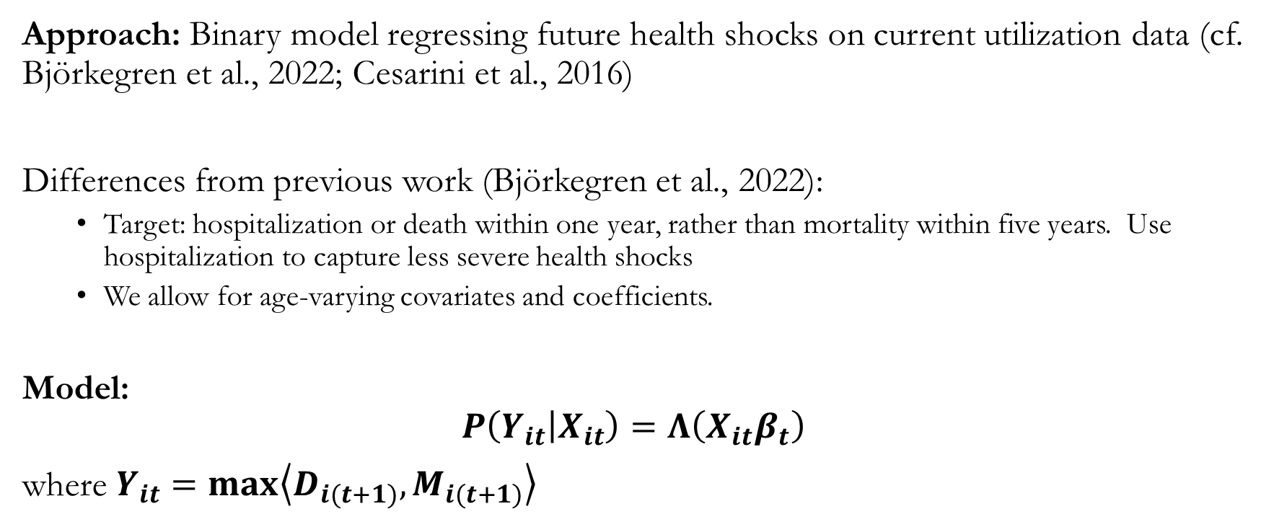
Constructing a Health Index (1)
Approach: Binary model regressing future health shocks on current utilization data (cf. Björkegren et al., 2022; Cesarini et al., 2016)
Differences from previous work (Björkegren et al., 2022):
Target: hospitalization or death within one year, rather than mortality within five years. Use hospitalization to capture less severe health shocks
We allow for age-varying covariates and coefficients.
Model:
$$P\left(Y_{it} | X_{it}\right)=Λ\left(X_{it}β_{t}\right)$$
where $Y_{it}=max\left\langle D_{i(t+1)},M_{i(t+1)}\right\rangle$
Notes:
Bjorkegren et al JHR:
We use a large sample of Swedish-born adoptees and their biological and adopting parents to decompose the persistence in health inequality across generations into pre-birth and post-birth components. We use three sets of measures for health outcomes in the second generation: mortality, measures based on data on hospitalization, and measures using birth outcomes for the third generation. The results show that all of the persistence in mortality is transmitted solely via pre-birth factors, while the results for the hospitalization measures suggest that at least three-quarters of the intergenerational persistence in health is attributable to the biological parents.
Cesarini et al (QJE):
We use administrative data on Swedish lottery players to estimate the causal impact of substantial wealth shocks on players’ own health and their children’s health and developmental outcomes. Our estimation sample is large, virtually free of attrition, and allows us to control for the factors conditional on which the prizes were randomly assigned. In adults, we find no evidence that wealth impacts mortality or health care utilization, with the possible exception of a small reduction in the consumption of mental health drugs. Our estimates allow us to rule out effects on 10-year mortality one sixth as large as the cross-sectional wealth-mortality gradient. In our intergenerational analyses, we find that wealth increases children’s health care utilization in the years following the lottery and may also reduce obesity risk. The effects on most other child outcomes, including drug consumption, scholastic performance, and skills, can usually be bounded to a tight interval around zero. Overall, our findings suggest that in affluent countries with extensive social safety nets, causal effects of wealth are not a major source of the wealth-mortality gradients, nor of the observed relationships between child developmental outcomes and household income.
The symbol
Λ() (capital lambda) is often used in statistics to represent the cumulative distribution function (CDF) of the standard logistic distribution. When written as Λ(x), it is also known as the inverse-logit or expit function, and is the inverse of the logit function.
Relationship between the logit and capital lambda functions
The logit and capital lambda functions are inverses of each other, defining the core of logistic regression.
The logit function The logit function transforms a probability value p (which lies between 0 and 1) into a continuous real number (from -∞ to +∞).
$$\text{logit}\left(p\right)=ln\left(\frac{p}{1−p}\right)$$
logit(𝑝)=ln𝑝1−𝑝
The capital lambda function The capital lambda function, Λ(x), is the inverse of the logit function. It converts a value x from the real number line back into a probability p (from 0 to 1). The formula is:
$$Λ\left(x\right)=\frac{e^{x}}{1+e^{x}}$$
Λ(𝑥)=𝑒𝑥1+𝑒𝑥
How they are used in logistic regression
In logistic regression, the relationship between the logit and capital lambda functions is used to model the probability of a binary outcome (e.g., success/failure, yes/no).
Modeling the log-odds: The core of logistic regression is to model the log-odds, or logit, as a linear combination of independent variables.
$$\text{logit}\left(p\right)=β_{0}+β_{1}x_{1}+…+β_{n}x_{n}$$
logit(𝑝)=𝛽0+𝛽1𝑥1+…+𝛽𝑛𝑥𝑛
Predicting the probability: To get a predicted probability p from this model, you take the inverse-logit of the linear combination, which is the capital lambda function.
$$p=Λ\left(β_{0}+β_{1}x_{1}+…+β_{n}x_{n}\right)=\frac{e^{β_{0}+β_{1}x_{1}+…+β_{n}x_{n}}}{1+e^{β_{0}+β_{1}x_{1}+…+β_{n}x_{n}}}$$
𝑝=Λ(𝛽0+𝛽1𝑥1+…+𝛽𝑛𝑥𝑛)=𝑒𝛽0+𝛽1𝑥1+…+𝛽𝑛𝑥𝑛1+𝑒𝛽0+𝛽1𝑥1+…+𝛽𝑛𝑥𝑛

Slide 12
Constructing a Health Index (2)
Covariates X_{it} include:
Cohort and sex dummies
Current hospitalization indicators M_{i,t}
Total hospital days
ICD group dummies and length of stay counts
Estimation is via logistic regression with variable selection (analog of LASSO) to identify predictive health signal

Slide 13
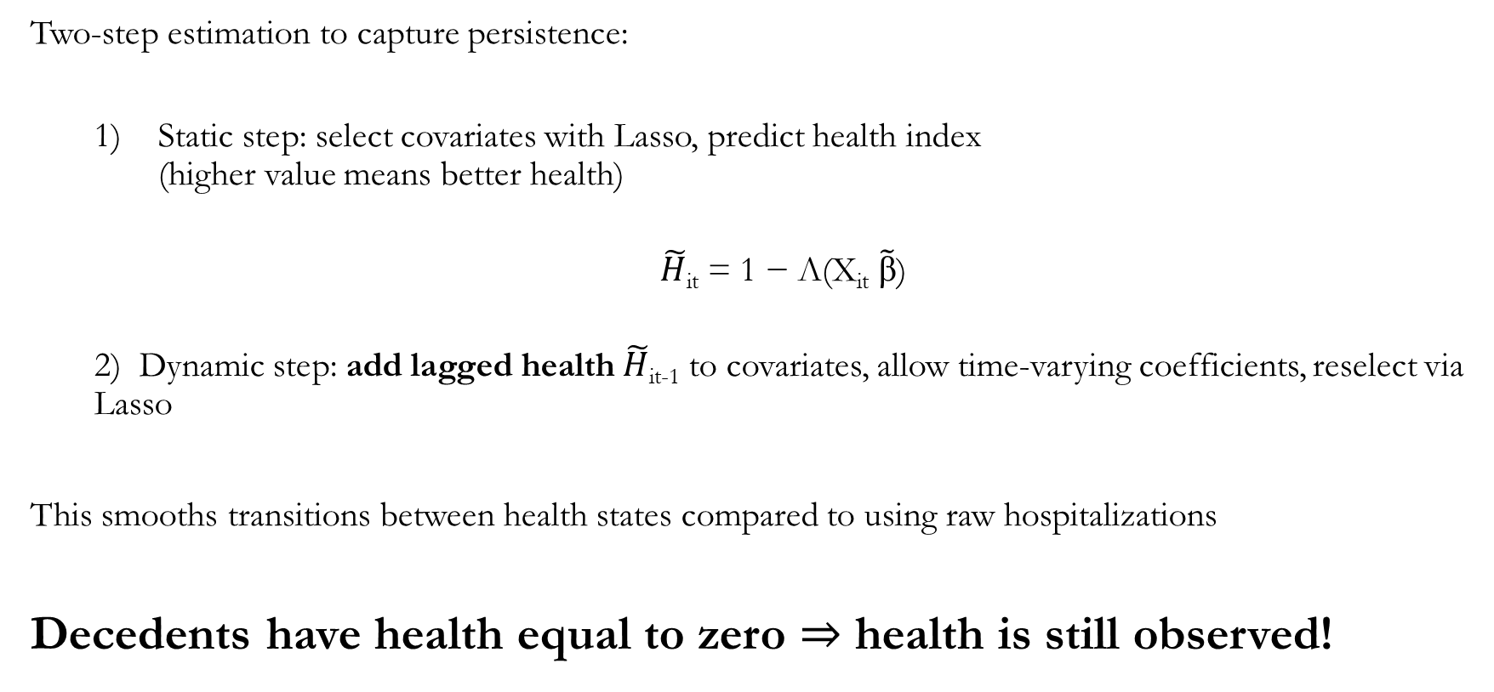
Modeling Health Dynamics
Two-step estimation to capture persistence:
Static step: select covariates with Lasso, predict health index (higher value means better health)
$\tilde{H}$_{it} = 1 − Λ(X_{it} $\tilde{ꞵ}$)
2) Dynamic step: add lagged health $\tilde{H}$_{it-1} to covariates, allow time-varying coefficients, reselect via Lasso
This smooths transitions between health states compared to using raw hospitalizations
Decedents have health equal to zero $⇒$ health is still observed!

Slide 14
Health Index and Mortality Over the Life Course

Slide 15
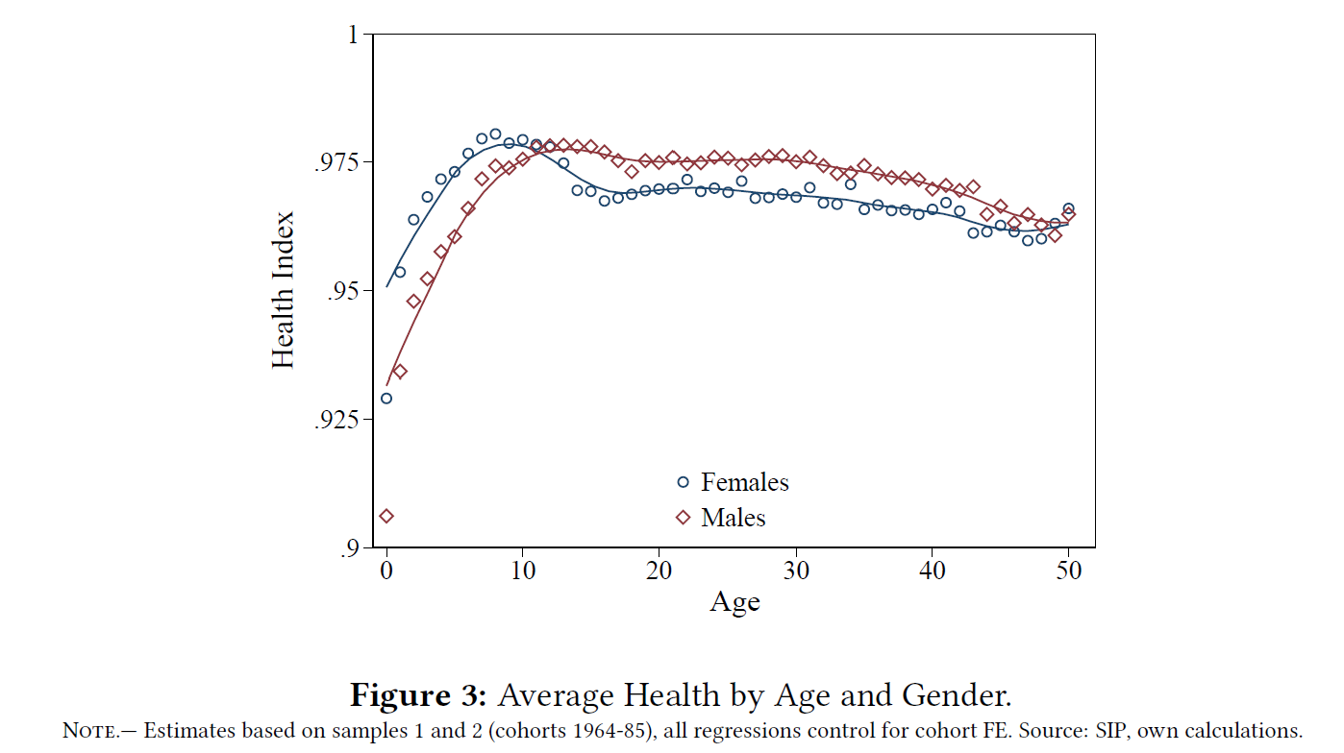
Age Profile of Health
Hump-shaped pattern as health increases sharply from age 1 to adolescence and then declines starting in early adolescence
This pattern during childhood is novel but consistent with Lleras-Muney and Moreau model
Gender differences change by age:
Females are healthier before adolescence
Males are healthier during reproductive ages (we remove childbirth from our index)
Gender differences are gone by middle age as men’s health worsens in 40s

Slide 16
Retrospective: Diverging Paths Well Before Death
We test the index’s predictive power over longer periods
Show trajectories for survivors and by age at death for two sets of cohorts
Up to 10, health patterns are roughly similar for all groups for 1961-66 cohorts
Those who die at 30-39: sharp decline after age 10
Similar declines 10 years before death for those who die at 40-49, 50-59
For 1967-76 cohorts gaps emerge by age 10
Survivors are able to sustain good health for decades
Notes:
In Panel (b), we do not look at age at death 50-59

Slide 17
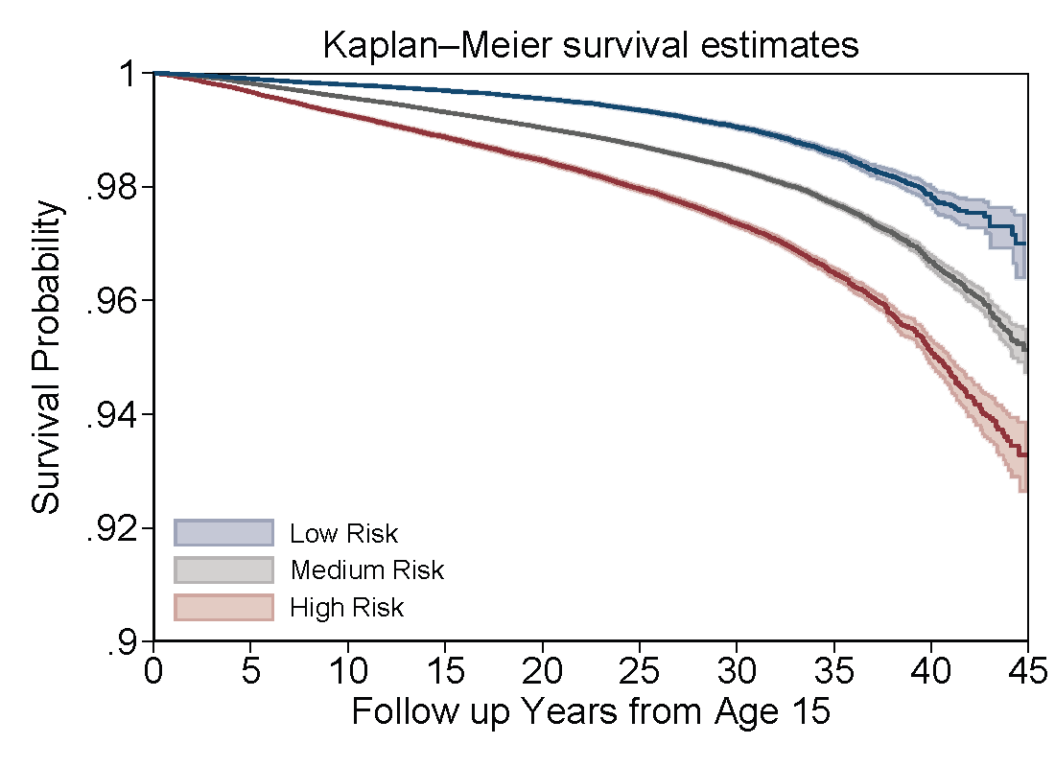
Prospective: Adolescent Health Predictive of Survival Rates NEW: UPDATED DATA THROUGH 2025!
We can also test the index’s power prospectively
Show trajectories for 3 different groups based on health at 15
We see sharp differences in survival probabilities in subsequent decades
Overall, health index captures dimensions of general health that are predictive of long-term mortality risk, well beyond the estimation window.
Health is highly persistent

Slide 18
Intergenerational Transmission over the life course

Slide 19
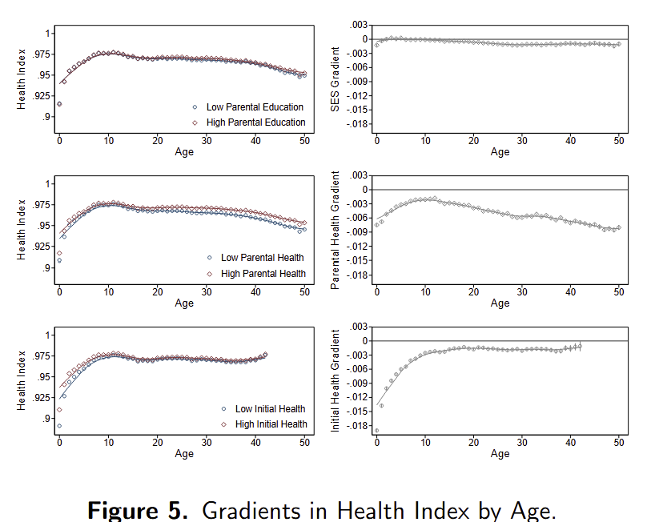
Health Gradients
Create lifetime measures of parent health (average over age 30 to 60)
Define poor parental health (middle) as having 1 parent below 10th percentile, affects 15% of sample
Unhealthy parents have children who are already less healthy at age 1
Gap improves until around age 10
But health begins to decline earlier for those with low parental health and gap worsens into adulthood
Much smaller gradient by parent education (top)
Gaps also emerge by own poor health at birth (bottom). But weaken over the life course

Slide 20
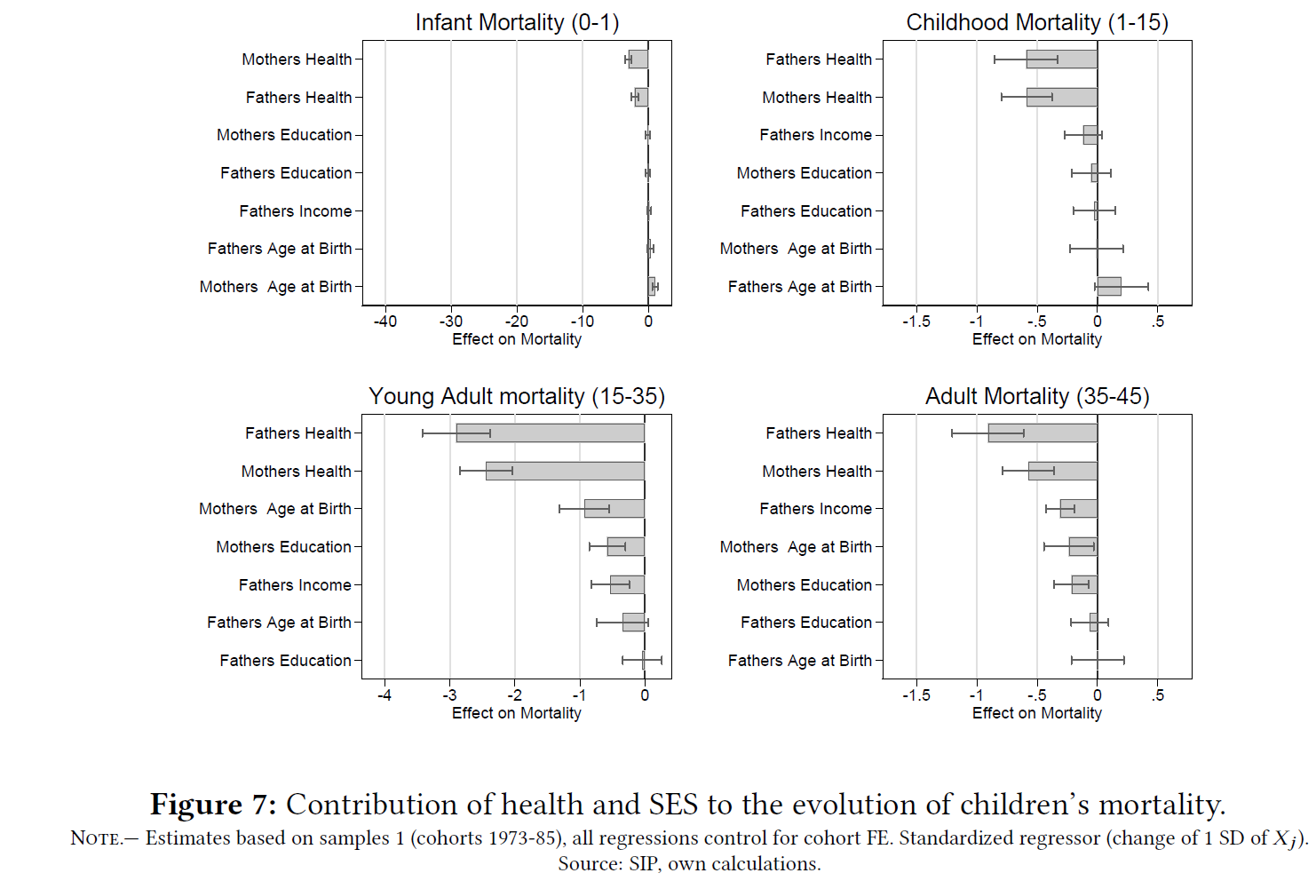
Parental Measures as Mortality Predictors
Now we include a set of parental measures simultaneously and look at 4 periods of the child’s lifecycle
Measures are shown in order of importance
Maternal health is best predictor of infant mortality. Paternal health also matters. Parental SES much less so
Maternal age also increases infant mortality
Later in life course, paternal health emerges as strongest predictor
Parental SES (esp paternal income) starts to matter

Slide 21
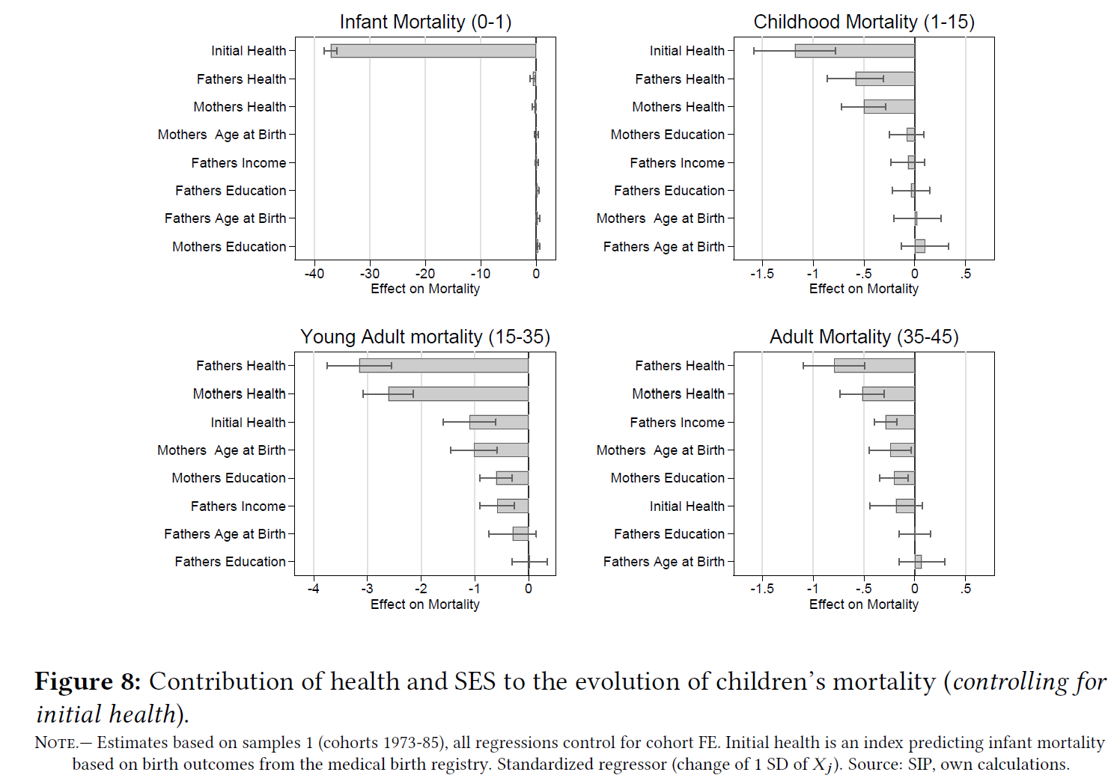
Parental Measures as Mortality Predictors (controlling for initial health)
Now we add child’s initial health based on birth outcomes for 1973-1985 cohorts (birthweight, gestational age, diagnosis at birth, complications during delivery, and the 1-minute APGAR score)
Initial health dwarfs parental variables for predicting infant mortality
But, initial health fades in importance as children age
Parental health measures emerge as key predictors as kids age, consistent with a model in which parental resources have cumulative effects over the lifetime

Slide 22
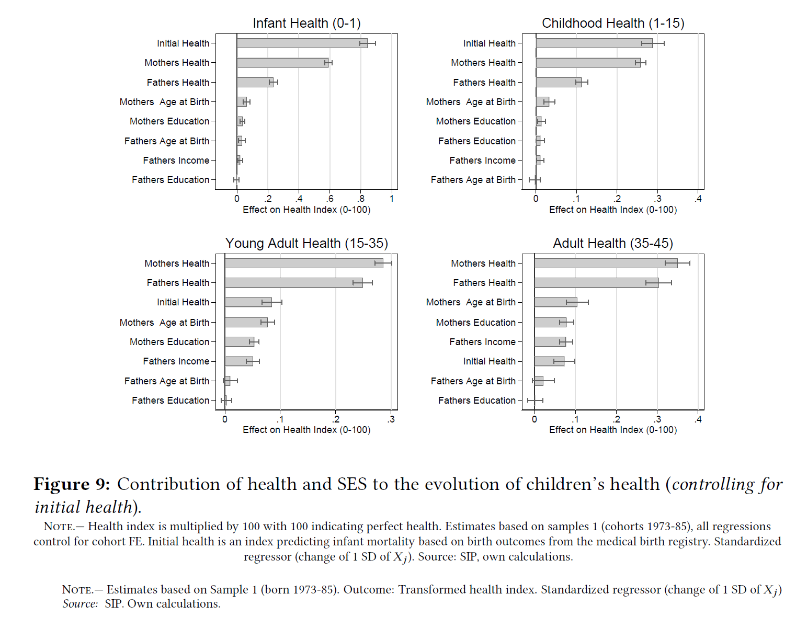
Parental Measures as Health Predictors (controlling for initial health)
Patterns broadly similar to what we see with mortality but more factors achieve statistical significance, particularly early in life
Again, we see initial health fade in importance over the lifecycle, while parental health measures dominate SES measures at all ages
Paternal education is never significant, though paternal income gains in importance as kids age
Maternal age is a significant predictor at all ages but paternal age is not

Slide 23
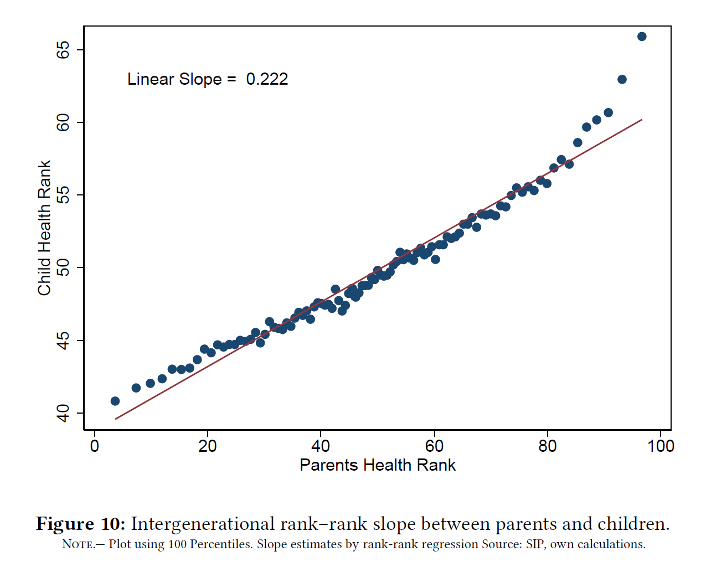
Intergenerational Rank-Rank Health Correlation
The rank-rank slope when pooling kids and combining both parents health is 0.222
Very similar to what we see for Taiwan which is 0.223 (Chang et al, 2024)
Some evidence of nonlinearities

Slide 24
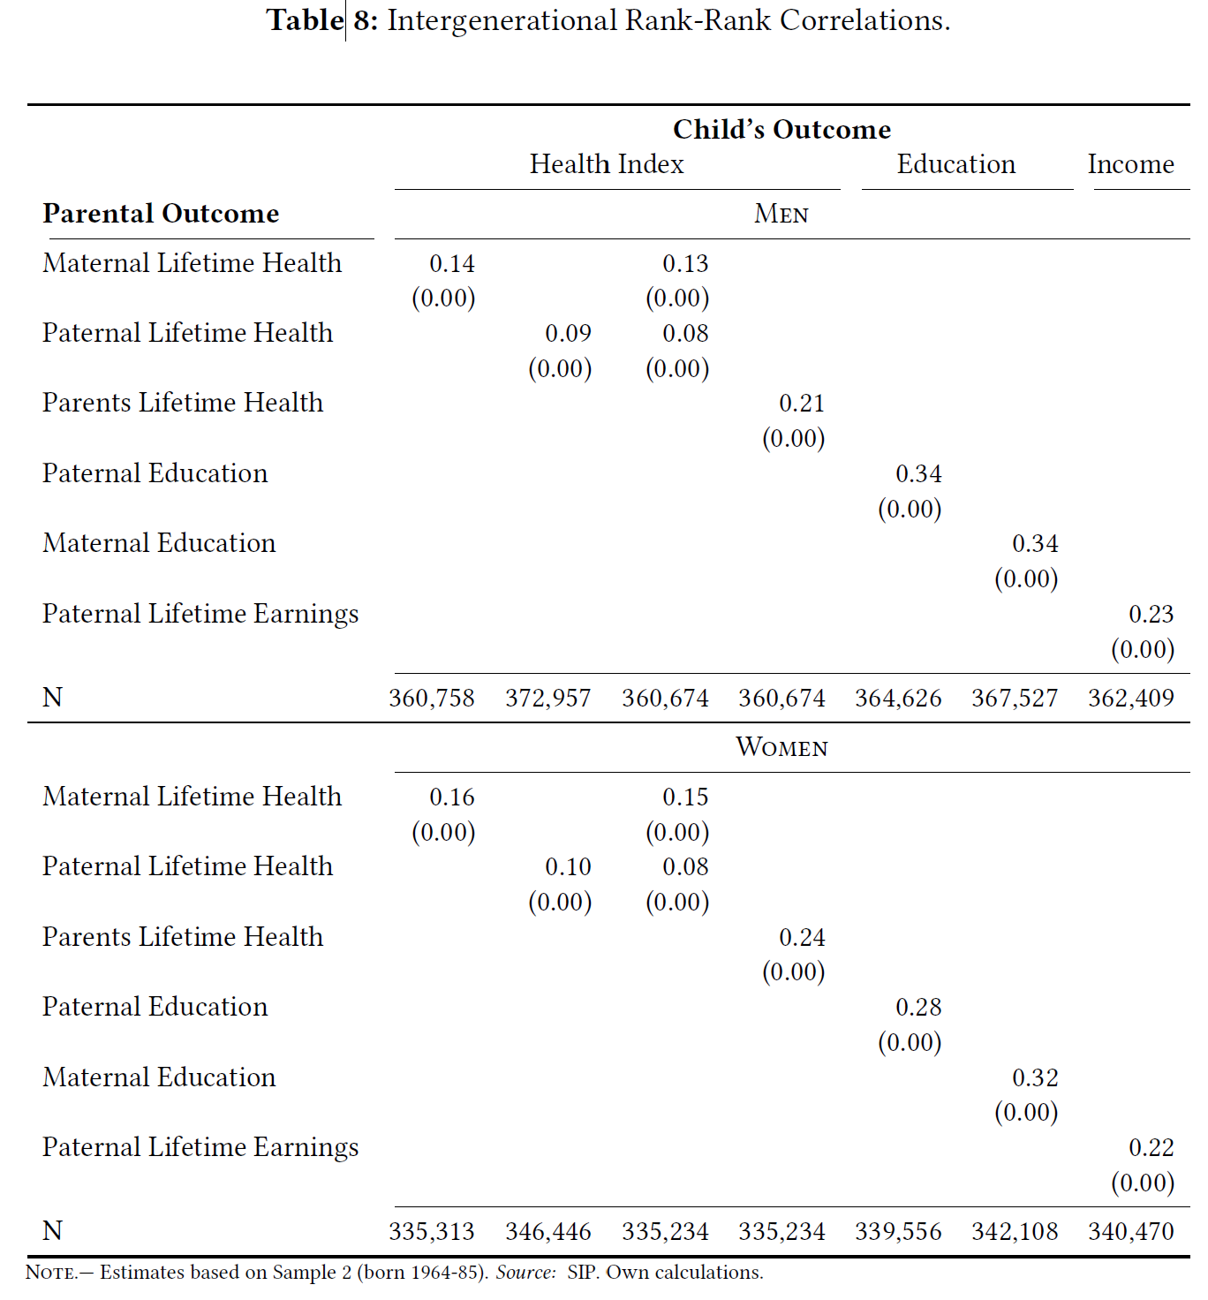
In contrast to many other countries, intergenerational rank-rank correlation in health is similar to income
Education correlations significantly higher
Health correlations higher for daughters

Slide 25
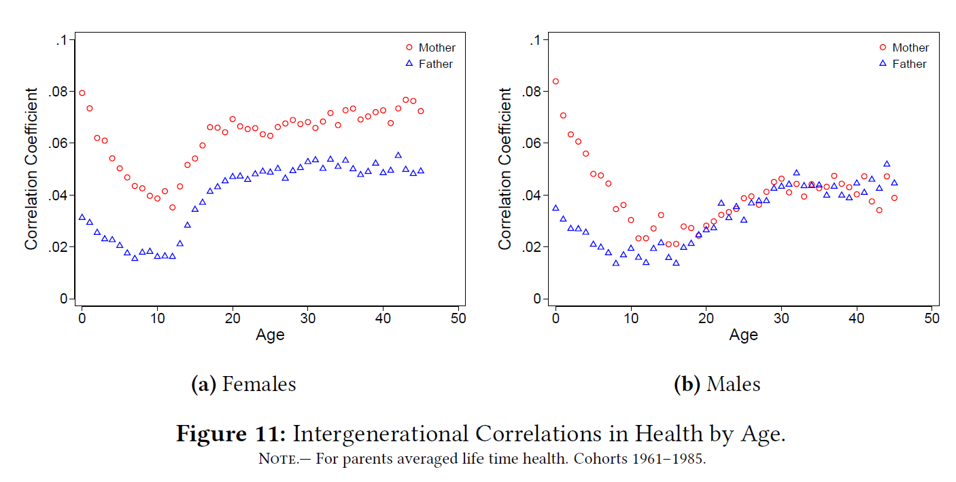
Intergeneration Health Level Correlations by Child Age
Pronounced U-shape pattern over child life course
Daughters have higher correlations than sons
Correlation between mothers and kids are higher than for fathers in childhood, thereafter patterns diverge by child gender

Slide 26
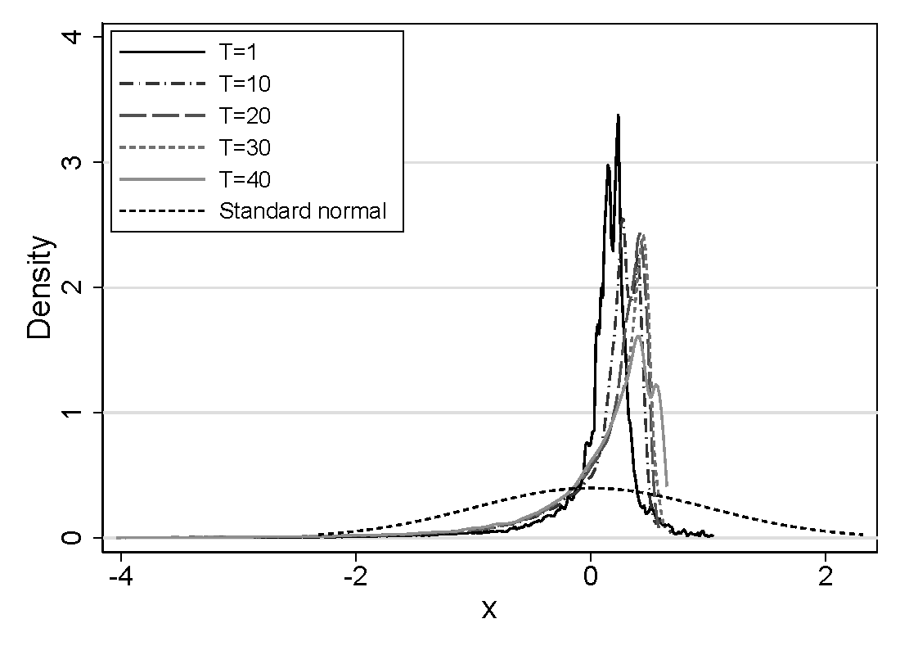
Kernel Density of Latent Health

Slide 27
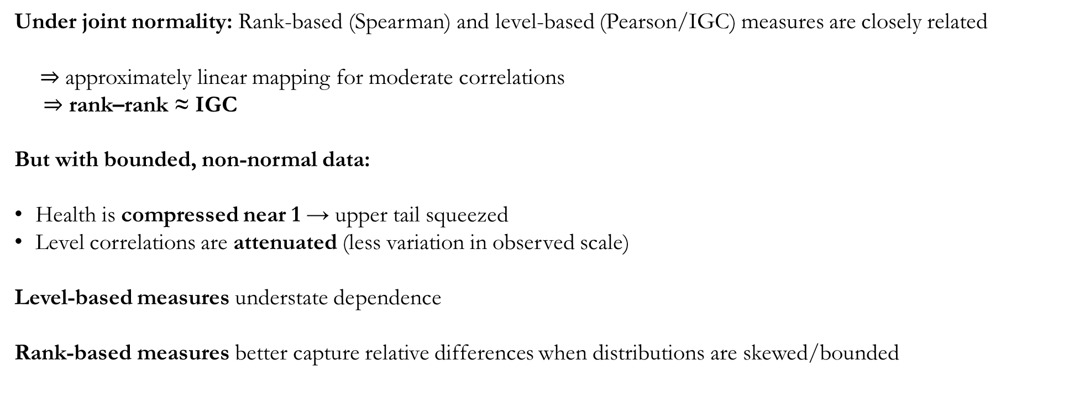
So, why focus on ranks?
Under joint normality: Rank-based (Spearman) and level-based (Pearson/IGC) measures are closely related
$⇒$ approximately linear mapping for moderate correlations $⇒$ rank–rank ≈ IGC
But with bounded, non-normal data:
Health is compressed near 1 → upper tail squeezed
Level correlations are attenuated (less variation in observed scale)
Level-based measures understate dependence
Rank-based measures better capture relative differences when distributions are skewed/bounded

Slide 28
Validation: How well does an index based on health utilization records measure up to alternatives?

Slide 29
Other Possible Health Measures
Studies often uses Self Reported Health Status (SRHS)
Powerful predictor of mortality
For infants and children this is often reported by parents or caregivers creating discontinuities and potential biases.
Surveys are also usually small and typically not linked to admin data
We can compare our measure to SRHS
Another choice is a frailty index based on difficulty with daily activities or functional limitations (Russo et al, 2025). But, not so relevant for children
Danesh et al (2024) use medication data to build an index of chronic disease and a health measure based on its ability to predict mortality . However, it is also not suited for tracking health early in the life cycle.

Slide 30
How Best to Combine Our Data?
Based on primary and secondary diagnoses of hospitalizations, we construct five alternative health indices:
PCA0: We apply PCA to all current information
PCA1: We apply PCA to all current and lagged information
PCAR: We compute a recursive PCA accounting for all information from the current and all previous periods. We then add the lagged index and to the info set and recompute.
LASRL: Recursive lasso logit predicting next-period hospitalization/death; all past periods contribute through lag.
LASRN: Non-parametric version of LASRL; lags captured via ventile dummies.

Slide 31
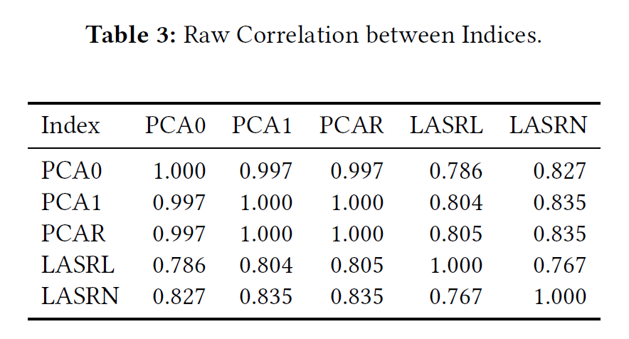
Raw Correlations

Slide 32
Validation Exercises
We assess the health indices using three complementary exercises:
Predictive performance: How well each index predicts SRHS and survival.
Metric: Area under the ROC curve (AUC)
Intuition: probability that a randomly chosen “healthy” individual is classified in good health by SRHS than a randomly chosen “sick” individual.
Preferred prediction metric due to scale invariance and insensitive to threshold choice
“Horserace” regressions: Regress SRHS on all indices simultaneously. Preferred index: positive, significant, and absorbs predictive power of alternatives
Empirical correlations with health behaviors: Examine whether indices show similar relationships to smoking and obesity as SAH Preferred index reflects known behavioral patterns
Our Index vs SRHS in predicting mortality

Slide 33
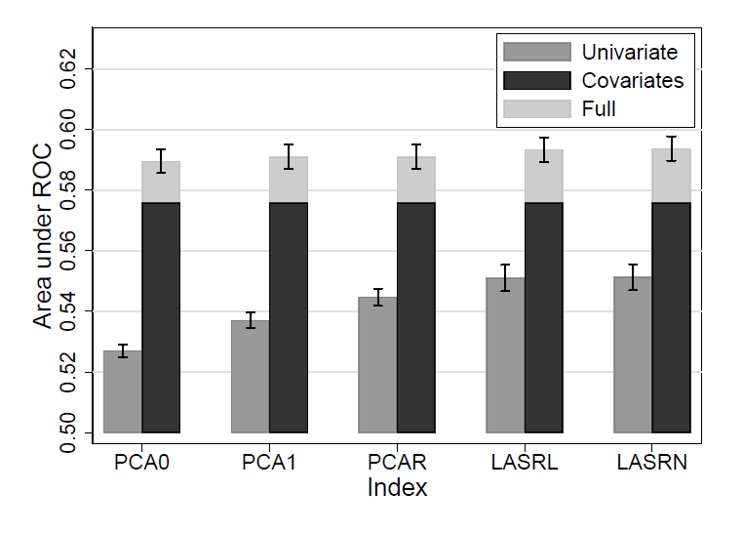
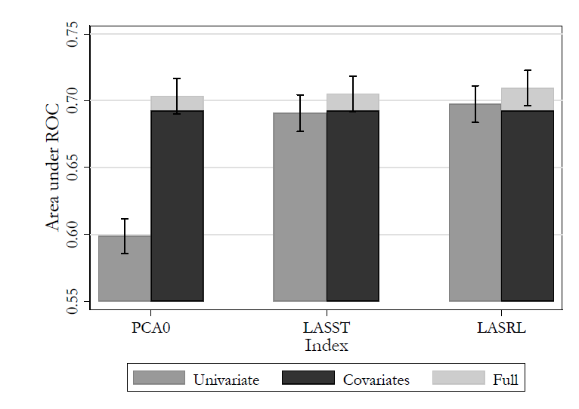
Validation 1: Predicting Survival, “Good” SRHS

Slide 34
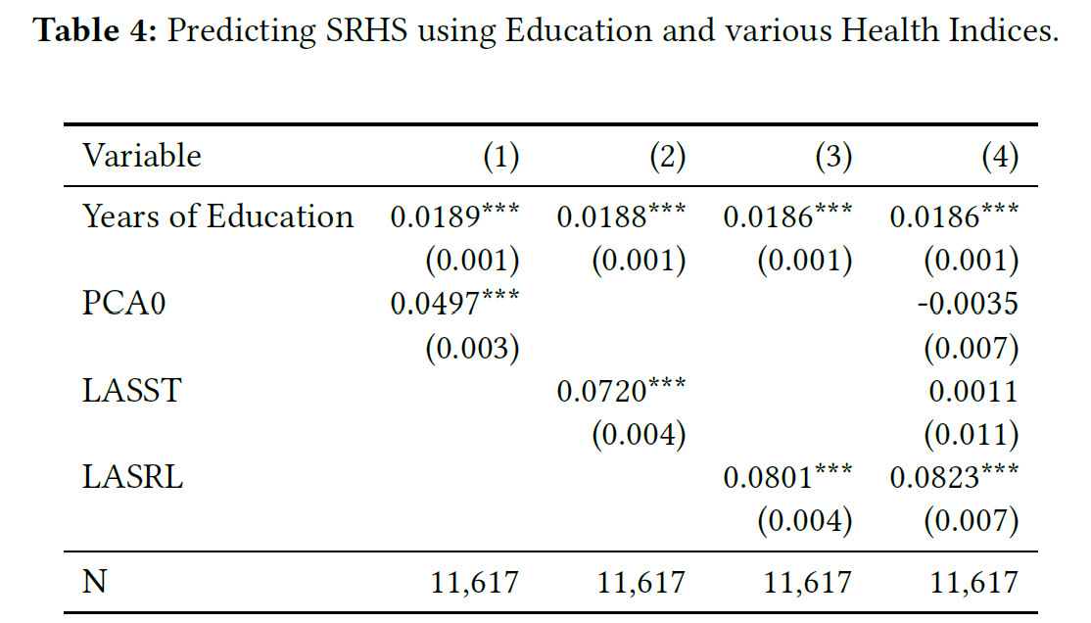
Validation 2: Horserace, Best Predictor of Good SRHS

Slide 35
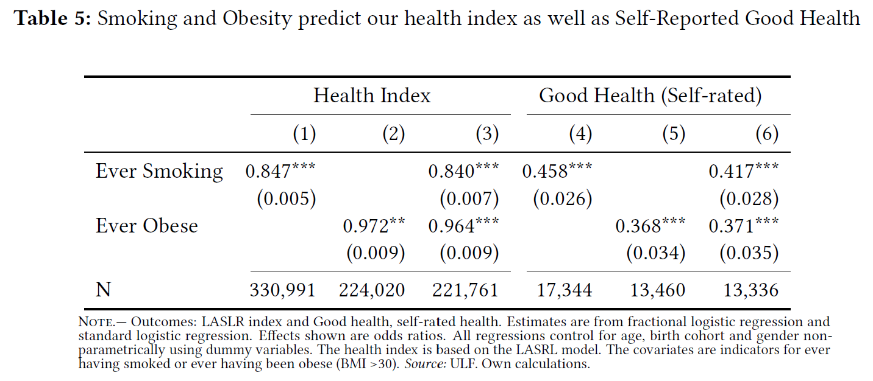
Validation 3: Correlated with Health Behaviors

Slide 36
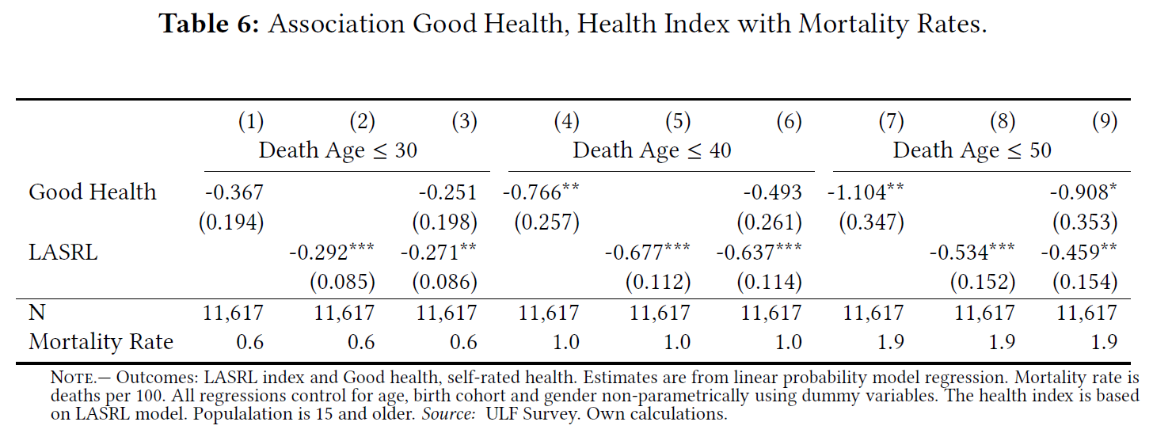
Validation 4: Index vs SRHS, Predicting Mortality

Slide 37
Wrap-Up
We develop a novel, dynamic health index using rich, linked Swedish administrative data to track health trajectories from birth to death and encompass two generations.
We integrate parental health, education, and income to analyze their evolving influence on children’s health over the life course.
The index is strongly validated: it predicts mortality, self-assessed health, and health behaviors, and outperforms standard utilization-based indices.
Our approach overcomes key limitations in prior work by providing a consistent health measure throughout life, enabling a comprehensive study of intergenerational health transmission.

Slide 38
Conclusions
Health follows a hump-shaped trajectory: improving in childhood, then declining; early deterioration for those born in poor health.
Parental health strongly shapes newborn health, especially maternal health, through biological mechanisms evident at birth.
The role of parental background differs across outcomes and as kids age:
Mortality: paternal health becomes leading predictor as kids age,
Health: maternal health dominates as kids age
SES becomes more important as kids age
These findings highlight the need to target health interventions not only by SES, but also parental health and early-life conditions.

Slide 39
Distributional Challenges of Health Measures
Health care utilization data are highly skewed, with heavy right tails: 50% of spending by sickest 5% (French and Kelly, 2016; Karlsson et al., 2016; Finkelstein, 2020)
Estimated health indices inherit skewness and extremely long left tails (Atal et al., 2025)
Skewness conflicts with economic models assuming near-normal health (Grossman, 1972; Lleras-Muney and Moreau, 2020; Dalgaard and Strulik, 2014)
Empirical health measures like birth weight and height tend to be approximately normal. Self-reported health also not as skewed as utilization
Simulate model in Lleras-Muney and Moreau, 2020 on our data and then use quantile normalization to reduce skewness and extreme values

Slide 40
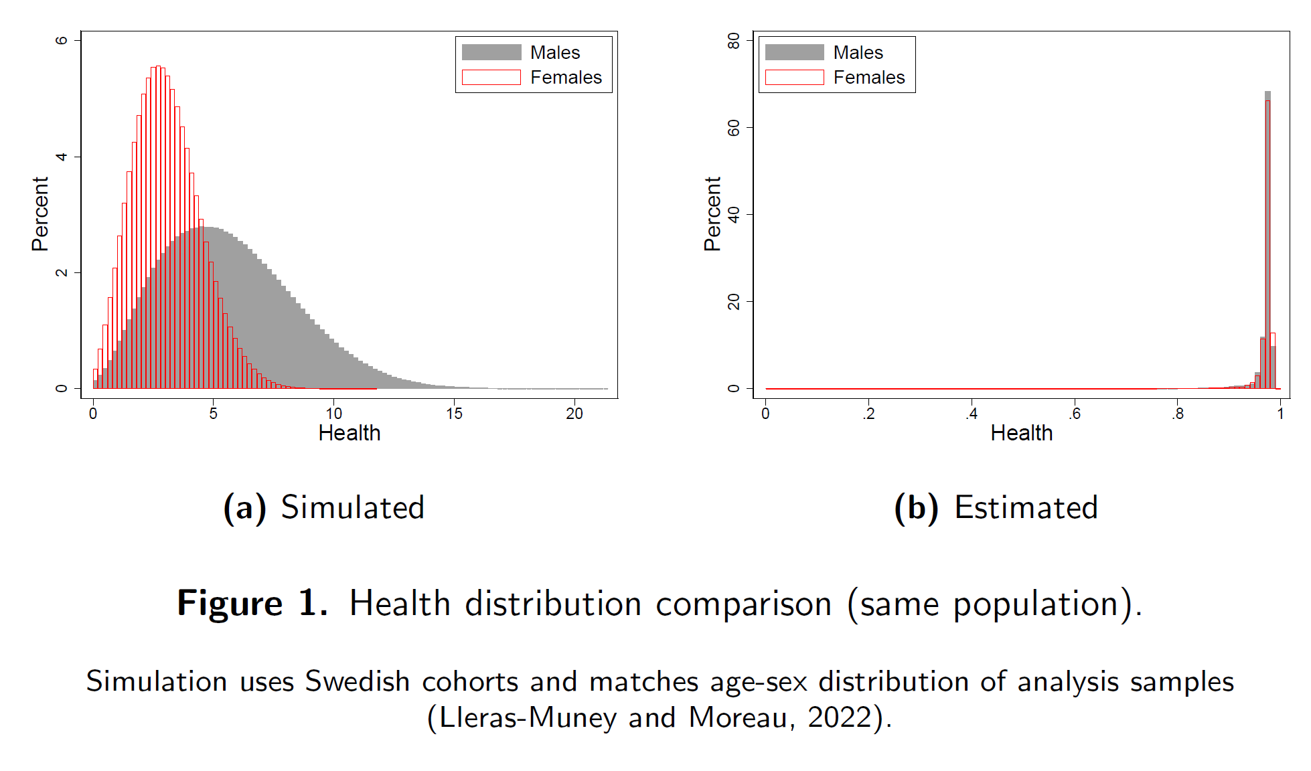
Simulated vs. Estimated Health Distributions

Slide 41
Rescaling Health to Match Theoretical Distribution
Use Lleras-Muney and Moreau (2022) model to simulate health distribution for Swedish birth cohorts.
Quantile normalization reduces skewness and extreme values, aligning health with structural economic modeling assumptions.
Transformed health variable loses interpretation as probability of imminent health shock.
Instead, it can be interpreted as the latent stock of health consistent with Lleras-Muney and Moreau (2020)
Future work: will check robustness to using untransformed measure or self-reported health
Back

