Slide 1
Medicaid Managed LTSS for ADRD: Evidence from Wisconsin
Lauren Bishop (University of Wisconsin – Madison) Laura Dague (Texas A&M University)
Corina Mommaerts (University of Wisconsin – Madison) Ari Ne’eman (Harvard University)
Yulya Truskinovsky (Syracuse University)
June 18, 2026
The NBER Coordinating Center on the Economics of Alzheimer’s Disease / ADRD is funded by the National Institute on Aging, part of the National Institutes of Health

Slide 2
Motivation
Medicaid is a key pillar of US social safety net, esp. for those with LTSS needs
  Largest funder of long-term supports and services (33% of budget but 6% of enrollees)
  Skyrocketing costs, limited access to home- and community-based services
States increasingly shifting to managed care models: 10% in 1990, 80% today
  In lieu of paying providers directly, pays MCOs fixed amount to manage enrollees’ care
  Much of early managed care growth focused on non-elderly, non-disabled pop
  More recently, 22 states have managed care programs for LTSS
Little evidence on its effects on LTSS population, esp. for individuals with ADRD
(Bhaumik Wallace Grabowski Schlesinger 25, Lee Rossin-Slater Staiger Su 26, Caswell Waidmann Wei Smith 25)
This paper: we study the gradual roll-out of managed care for Medicaid LTSS in Wisconsin over the past 20 years

Slide 3
This paper
Research questions:
Who selects into managed Medicaid LTSS?
  By demographics, ADRD, HCBS waitlist
What is the effect of managed Medicaid LTSS on service use? (today: nursing homes)
Descriptive: how do residential settings align with preferences?
Data and methods:
  Administrative Medicaid (+LTSS) claims + functional screen data from WI
    Residential setting, preferences, functional limitations, etc.
  Staggered county roll-out of voluntary managed LTSS program (“Family Care”) in Wisconsin from 2000–2018

Slide 4
Outline for Today
Our context: Family Care in Wisconsin
Policy variation and data
Empirical framework
Effects on managed care enrollment and nursing home use
How do setting preferences evolve for individuals in managed LTSS?

Slide 5
What is managed care for Medicaid LTSS?
LTSS: covers services and supports people may need when they have a chronic illness, disability, or aging-related condition that limits their ability to live independently
  It does not cover acute/primary care
Traditionally, Medicaid pays providers on a fee-for-service basis for enrollees
  Covers nursing home care but also some HCBS (through waivers)
Alternative to fee-for-service: Medicaid managed care
  Medicaid pays MCOs a fixed amount to absorb the financial risk of covering enrollee
  Managed care plans tend to emphasize care coordination, prioritize HCBS
  Concerns they have incentive to reduce services → negative quality and health impacts
  E.g., individuals with ADRD are predictably higher-cost enrollees, so plans may discourage participation by this population

Slide 6
Our context: Wisconsin’s Family Care program
Wisconsin Medicaid’s “Family Care” program provides a unique setting:
Voluntary managed care program for LTSS (alternative is a self-directed FFS plan)
Entitlement program: can enroll if meet income/asset limits & pass functional screen
Gradually rolled out across all counties between 2000 and 2018
Services provided:
HCBS: adult day care, home care, transportation, bathing services, financial management and medication management, home modifications, etc.
Medicaid card services related to LTSS: personal care, home health, PT/OT/speech therapy, durable medical equipment, mental health services, skilled nursing care
Case management by social worker / nurse team / case manager

Slide 7
A bit of history
1980s: 1st generation of Medicaid reforms for long-term care in WI
Used state Medicaid $ to fund HCBS, then also applied for federal HCBS waivers
But this was a fixed amount of funding, and resulted in waiting lists for HCBS
Late 1990s: 2nd generation of Medicaid reforms for long-term care in WI
Goal: a system with equal access to nursing homes and HCBS
Resulted in 5-county pilot of “Family Care”
Early program evaluations in the pilot counties pointed to success
Expanded choice and access, Medicaid cost savings of $452 per month
In response, Family Care expanded to an additional 51 counties by 2010, and statewide (to all 72 counties) by 2018 after legislative action in 2015.

Slide 8
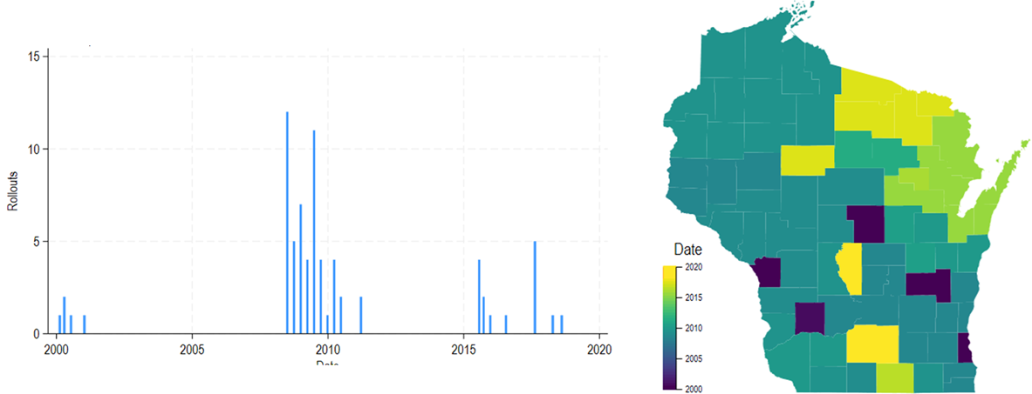
Policy variation: date of Family Care entry by county

Slide 9
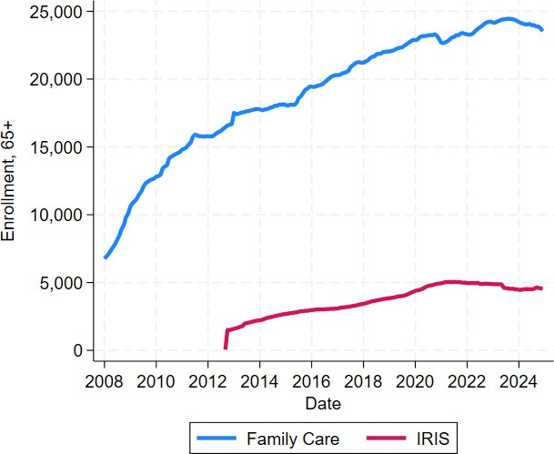
Family Care enrollment over time (aged 65+)

Slide 10
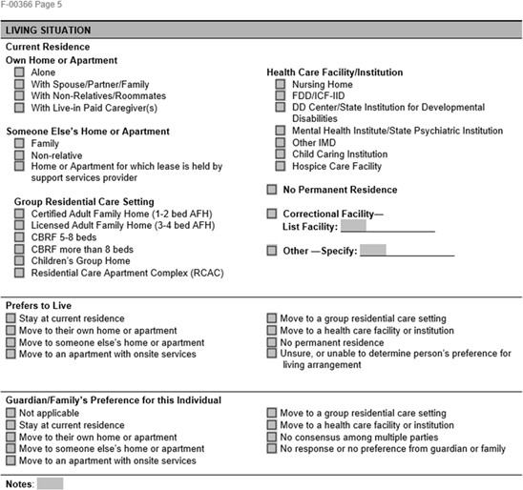
Wisconsin Medicaid Data 2008-2019
Medicaid enrollment and claims files
Detailed program eligibility, managed care enrollment, demographics, and Medicaid FFS claims
Medicaid-paid LTSS claims
Long-Term Care Functional Screen
Used to assess eligibility for services
Clinical and functional needs
Demographic and family information
Preferences over LTC setting

Slide 11
Our sample: Medicaid 65+
 | Full sample |  |  | Post Family Care rollout
 | Everyone |  | Everyone | Family Care | IRIS | Neither
Age | 77.19 | 76.96 |  | 79.18 | 75.59 | 75.96
Female | 0.66 | 0.66 |  | 0.69 | 0.67 | 0.65
White | 0.77 | 0.76 |  | 0.82 | 0.51 | 0.75
Black | 0.13 | 0.14 |  | 0.14 | 0.38 | 0.13
Hispanic | 0.06 | 0.07 |  | 0.04 | 0.06 | 0.08
Nursing home | 0.22 | 0.21 |  | 0.08 | 0.01 | 0.28
ADRD thus far | 0.24 | 0.24 |  | 0.33 | 0.21 | 0.19
Ever ADRD | 0.39 | 0.38 |  | 0.52 | 0.34 | 0.32
N | 13,604,382 | 12,220,656 |  | 3,852,670 | 544,207 | 7,832,405

Slide 12
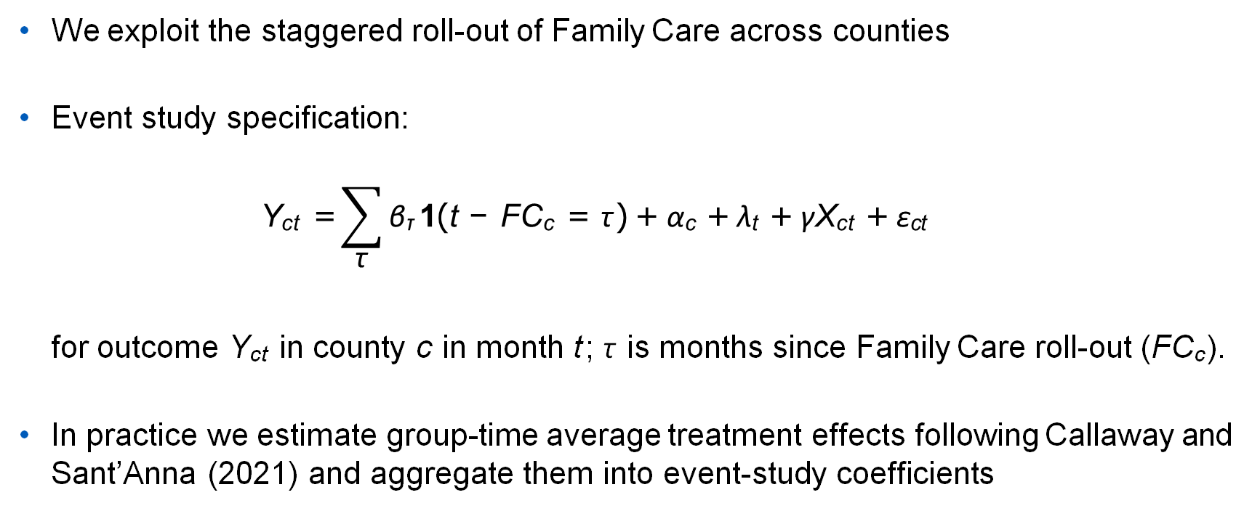
Estimating the effect of Medicaid managed care for LTSS
We exploit the staggered roll-out of Family Care across counties
Event study specification:
$$\text{Y}\text{ct} \text{=}\sum_{\text{τ}}{\text{β}\text{τ} \text{1}\text{(}\text{t} \text{−} \text{FC}\text{c} \text{=} \text{τ} \text{)} \text{+} \text{α}\text{c} \text{+} \text{λ}\text{t} \text{+} \text{γ}\text{X}\text{ct} \text{+} \text{ε}\text{ct}}$$
for outcome Y_{ct} in county c in month t ; τ is months since Family Care roll-out (FC_{c} ).
In practice we estimate group-time average treatment effects following Callaway and Sant’Anna (2021) and aggregate them into event-study coefficients

Slide 13
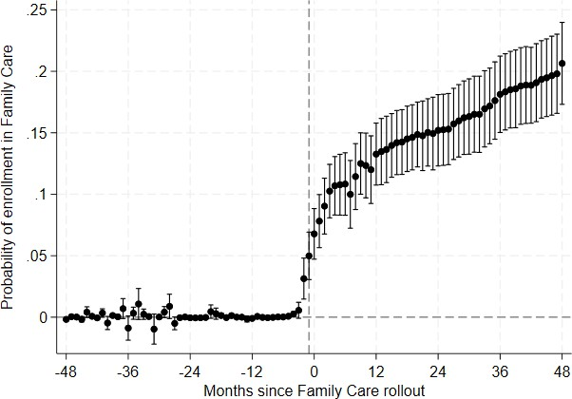
Effect of Family Care rollout on probability of enrollment in
Family Care
Family Care
Tr. effect
0.148∗∗∗ (0.014)
County-months
7,942
→ Over first four years after managed care rollout, probability of enrollment is 15%

Slide 14
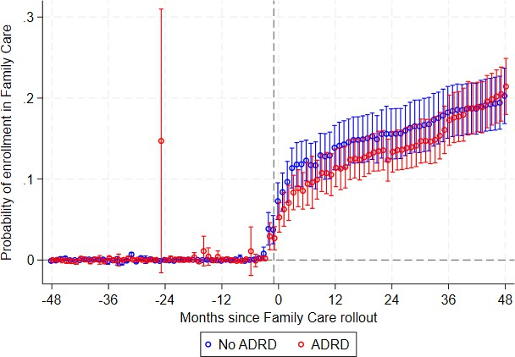
Who selects in? Enrollment effects by ADRD
Black
Female
Waitlist

Slide 15
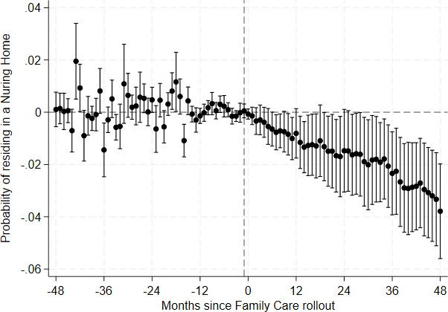
Effect of roll-out on probability of nursing home care
Nursing home
Tr. effect
-0.016∗∗∗ (0.006)
County-months
7,946
→ Over first 4 years after managed care rollout, nursing home use declines by 2pp

Slide 16
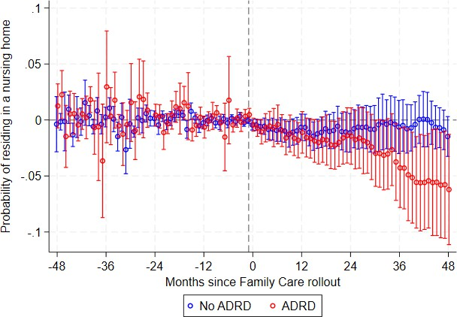
Effects on prob. nursing home care, by ADRD
Black
Female
Waitlist

Slide 17
Is lower nursing home use what people want?
A relatively unique aspect of our setting is that for people who want to enroll in Family Care, they have to fill out a functional screen:
  Current care setting
  Own preferences for care setting
  “Guardian/Family’s" preferences for care setting
  Detailed functional limitations
Functional screens updated every 12 months
So we can observe the evolution of preferences
→ Is lower nursing home use what people prefer?

Slide 18
Functional screen summary statistics
 | Full sample |  | Ever in Family Care
 | First Screen | All Screens |  | First Screen | All Screens
Alzheimers | 0.20 | 0.27 | 0.23 |  | 0.30
Ever Alzheimers | 0.39 | 0.41 | 0.47 |  | 0.45
Current residence
Own home | 0.64 | 0.50 | 0.59 |  | 0.45
Someone else’s home | 0.06 | 0.07 | 0.05 |  | 0.05
Group setting | 0.16 | 0.32 | 0.21 |  | 0.38
Institution | 0.12 | 0.10 | 0.13 |  | 0.11
Preference
Own home | 0.68 | 0.55 | 0.63 |  | 0.50
Group setting | 0.20 | 0.29 | 0.25 |  | 0.34
Institution | 0.01 | 0.03 | 0.01 |  | 0.03
Preferences Met (Imputed) | 0.76 | 0.82 | 0.73 |  | 0.81
Preferences Met (Form, 2021+) | 0.62 | 0.74 | 0.57 |  | 0.72
Number of Screens | 7.02 | 13.13 | 8.66 |  | 14.17
N | 157,062 | 1,112,303 | 98,054 |  | 850,823

Slide 19
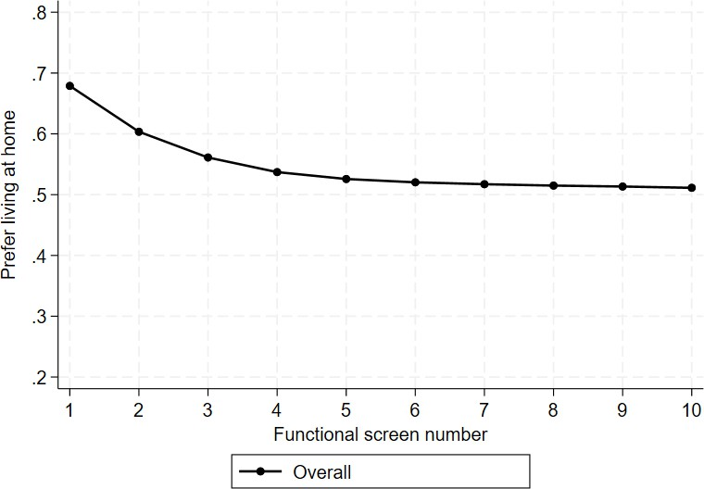
Evolution of residential preferences and mismatch
Guardian
Matrix
1. Most prefer living at home,
but this pref. declines over time (and pref. for NH increases)
2.
3.

Slide 20
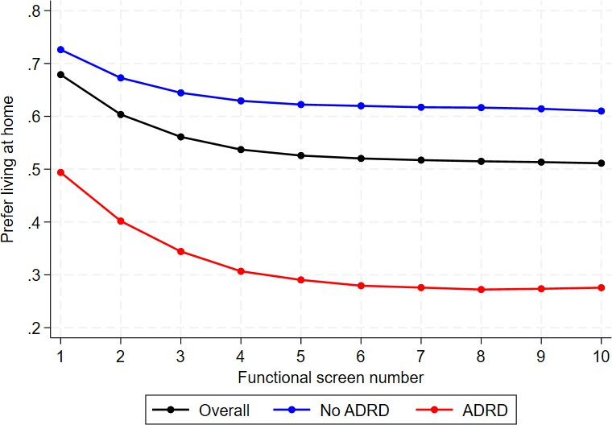
Evolution of residential preferences and mismatch
Guardian
Matrix
1. Most prefer living at home,
but this pref. declines over time (and pref. for NH increases)
2.
3.

Slide 21
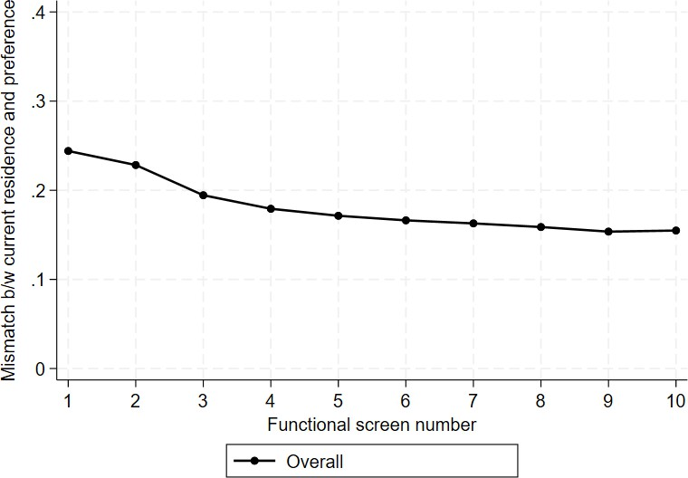
Evolution of residential preferences and mismatch
Guardian
Matrix
Most prefer living at home,
but this pref. declines over time (and pref. for NH increases)
Mismatch between current residence and preference of 25%, declines over time
3.

Slide 22
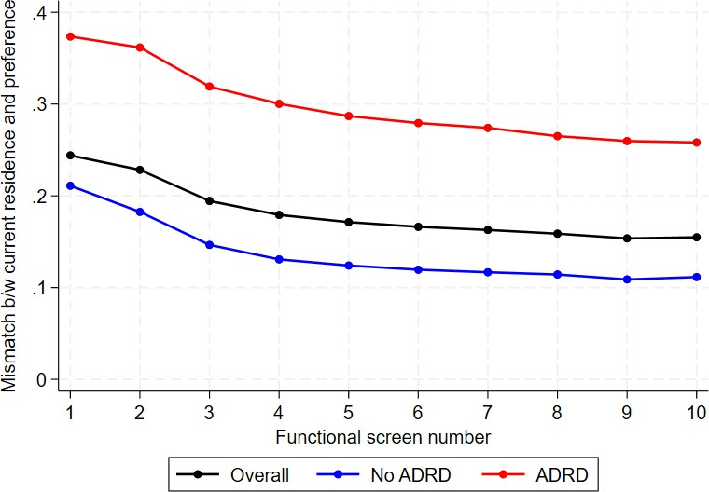
Evolution of residential preferences and mismatch
Guardian
Matrix
Most prefer living at home,
but this pref. declines over time (and pref. for NH increases)
Mismatch between current residence and preference of 25%, declines over time
More mismatch among ADRD population

Slide 23
Conclusion and next steps
Coverage of LTSS for low-income indiv. has evolved dramatically over past two decades
  Towards managed care models
  Towards home-based care
This project studies the effects of the gradual roll-out of Medicaid managed care for LTSS across counties in Wisconsin over the past 20 years
We find a shift away from institutionalized care, esp. for individuals with ADRD
  But individuals with ADRD still experience more mismatch of preferences
Next steps: other service outcomes, explore functional screen data further

Slide 24
Thank you!
cmommaerts@wisc.eu

