Slide 1

The Regulation of Shareholder Democracy
John G. Matsusaka (University of Southern California)
Oguzhan Ozbas (Bilkent University)
Chong Shu (University of Utah)
Irene Yi (University of Toronto)
NBER Law and Economics Program Meeting, Spring 2026

Slide 2
SEC’s Congress Charged Statutory Charges
“Since our founding in 1934 at the height of the Great Depression, we have stayed true to our mission of protecting investors, maintaining fair, orderly, and efficient markets, and facilitating capital formation.”
https://www.sec.gov/about/mission
How about social issues, such as climate change?

Slide 3
Our Paper
While a substantial body of scholarship has examined how shareholder democracy affects firm value, less research has focused on the regulatory scaffolding itself.
Our Focus
We study the effects of a controversial and unexpected SEC guideline change in 2021 (Staff Legal Bulletin 14L).
The new guideline made it significantly easier for investors to bring environmental proposals to a shareholder vote.
We estimate the effect of these new guidelines on firm value, carbon emissions, and managerial behavior.

Slide 4
Institutional and Legal Background
No-Action Process:
Companies can petition the SEC to exclude a shareholder proposal if they believe it violates Rule 14a-8.
SEC Rule 14a-8
Shareholder proposals are regulated through Rule 14a-8.
This rule sets the conditions under which a company must include a shareholder's proposal in its proxy statement.
The "Ordinary Business" Rule
A key condition, 14a-8(i)(7), allows companies to exclude proposals concerning "ordinary business" matters.
Subjective Interpretation
The definition of "ordinary business" can shifts based on the SEC's current political climate.
Staff Legal Bulletins
The SEC occasionally issue SLBs to clarify ambiguities, or advance new interpretations.

Slide 5
SEC Staff Legal Bulletins Related to Rule 14a-8
Bulletin | Date | Summary of Changes | Favored Party
14 | 7/13/2001 | Provides general explanation of the shareholder proposal rule. | N/A
14A | 7/12/2002 | Allows excluding proposals that materially dilute stock. | Shareholders
14B | 9/15/2004 | Prevents exclusion for objectionable language in support statements. | Shareholders
..........
14K | 10/16/2019 | Allows exclusion if company has already addressed in some manner the policy issue. | Management
14L | 11/3/2021 | Allows proposals on “significant social issues.” | Shareholders
14M | 2/12/2025 | Rescinds SLB 14L, reverting to previous standards. | Management

Slide 6
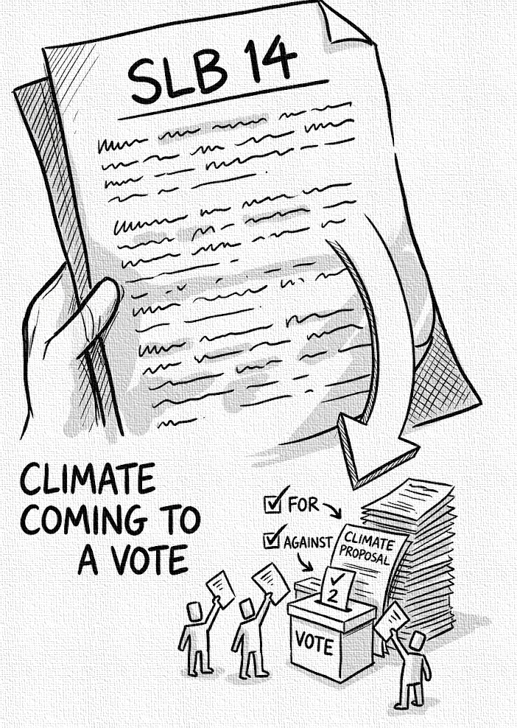
Key Elements of Staff Legal Bulletin 14L
A Surprise Announcement
On November 3, 2021, the SEC issued SLB 14L without going through the usual stakeholders meeting or preview the bulletin.
Impact on Climate Proposals
SLB 14L changed the enforcement of the "ordinary business" exclusion, making it no longer applicable to certain significant social policy issues, especially environmental ones.

Slide 7
Data Sources
Emissions
Greenhouse gas (Scope 1) emissions data from the EPA's Greenhouse Gas Reporting Program (GHGRP).
Scope 2 emissions from LSEG ESG.
Market Reaction
Cumulative abnormal returns (CARs) calculated using the Fama-French four-factor model; Data from CRSP.
Intraday stock prices from TAQ database.
Proposal and Pledge
Data on shareholder proposals and no-action letters from FactSet and ISS Voting Analytics.
Data on corporate pledges to reduce emissions from LSEG.
Financial
Company financial information such as assets, capital investment, and earnings from Compustat.

Slide 8
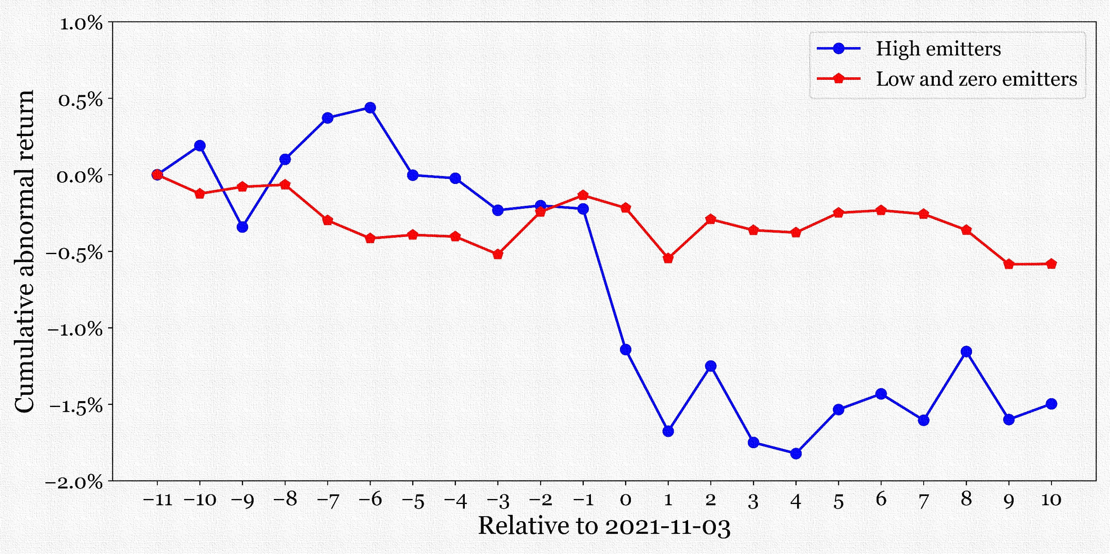
Market Response to SLB 14L
There are 62 high emitters and 1,083 low emitters and zero emitters.
High emitters accounted for about 95% of carbon emissions among publicly traded firms in the sample.
Results are similar if using other CAR specifications.

Slide 9
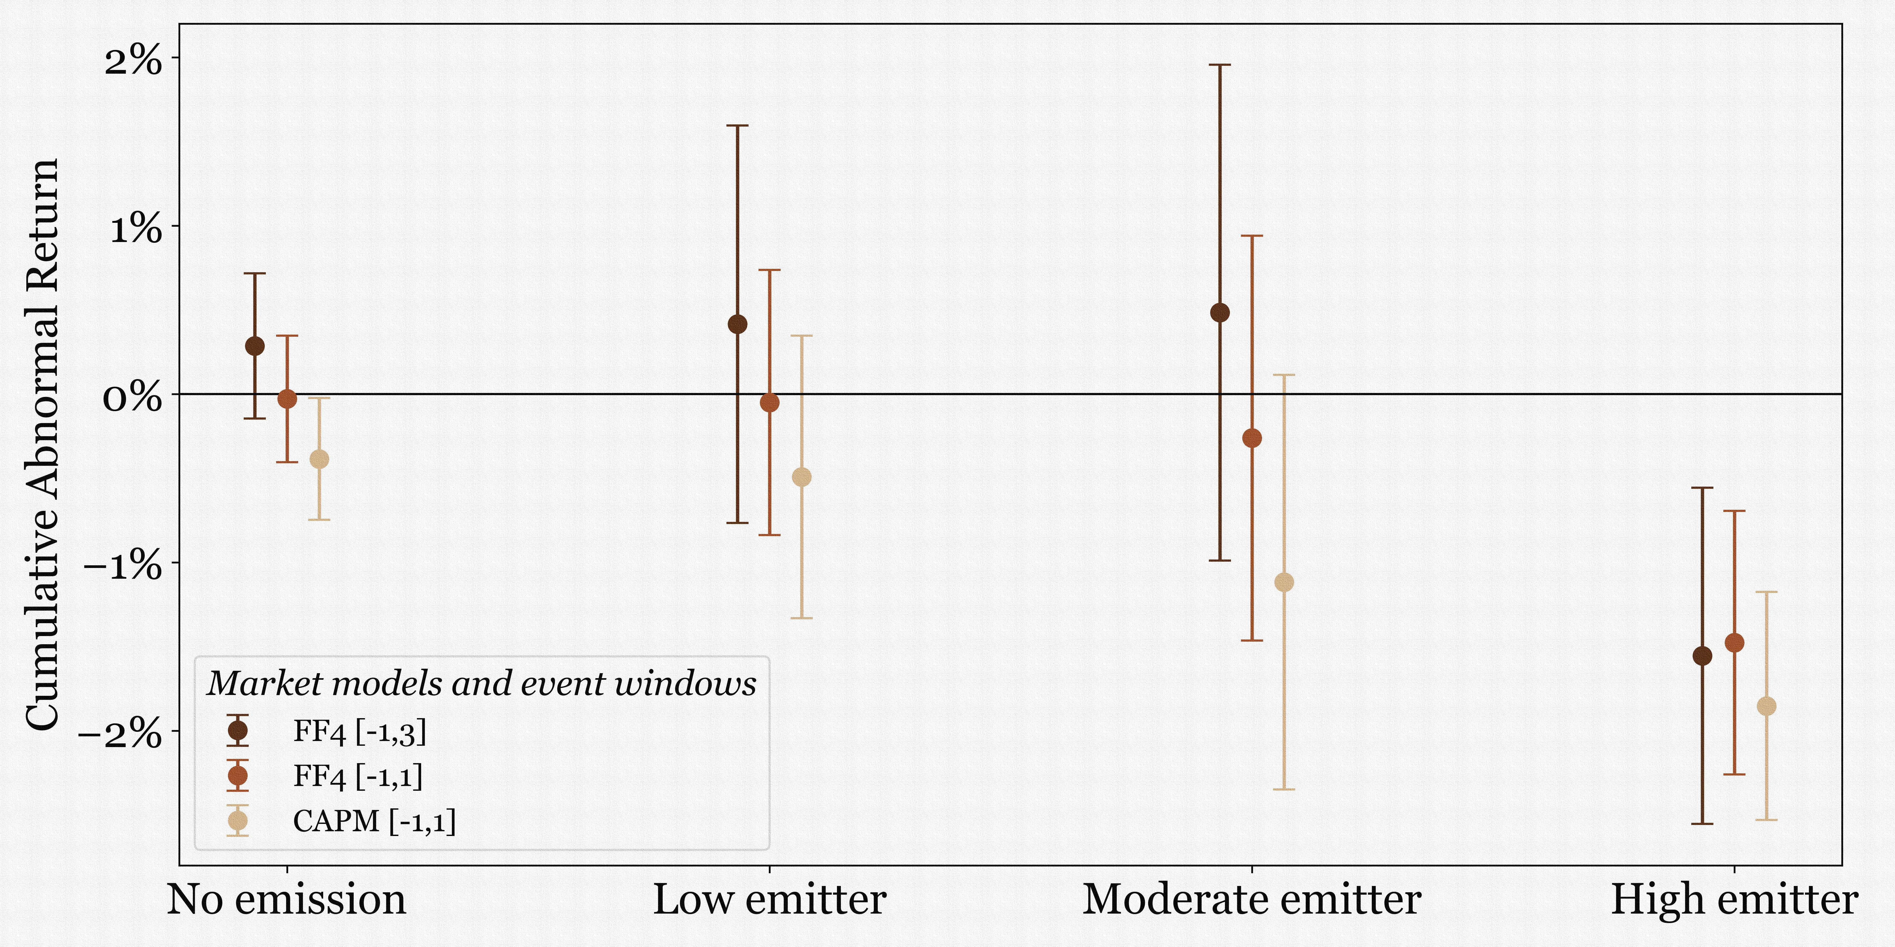
Market Response to SLB 14L
There are 62 high emitters and 1,083 low emitters and zero emitters.
High emitters accounted for about 95% of carbon emissions among publicly traded firms in the sample.
Results are similar if using other CAR specifications.

Slide 10
Regressions of CAR on Emissions
Dependent Variable: Cumulative abnormal return
Dummy = 1 if high emitter | -1.77**
 | (0.74)
Dummy = 1 if received climate proposal | ...
Dummy = 1 if high emitter & received climate proposal | ...
Emissions (log) | ...
R² | 0.01
Observations | 1,049
Controls:
  Firm assets
  Capital expenditure
  Profits.
  Concurrent events including earning announcement, stock buybacks, executive change, and others.

Slide 11
Regressions of CAR on Emissions
Dependent Variable: Cumulative abnormal return
Dummy = 1 if high emitter | -1.77** | 1.31
 | (0.74) | (1.46)
Dummy = 1 if received climate proposal | ... | 0.61
 |  | (0.43)
Dummy = 1 if high emitter & received climate proposal | ... | -4.36**
 |  | (1.70)
Emissions (log) | ... | ...
R² | 0.01 | 0.01
Observations | 1,049 | 1,049
Controls:
  Firm assets
  Capital expenditure
  Profits.
  Concurrent events including earning announcement, stock buybacks, executive change, and others.

Slide 12
Regressions of CAR on Emissions
(Emitters only)
Dependent Variable: Cumulative abnormal return
Dummy = 1 if high emitter | -1.77** | 1.31 | ...
 | (0.74) | (1.46)
Dummy = 1 if received climate proposal | ... | 0.61 | ...
 |  | (0.43)
Dummy = 1 if high emitter & received climate proposal | ... | -4.36** | ...
 |  | (1.70)
Emissions (log) | ... | ... | -1.25***
 |  |  | (0.32)
R² | 0.01 | 0.01 | 0.10
Observations | 1,049 | 1,049 | 184
Controls:
  Firm assets
  Capital expenditure
  Profits.
  Concurrent events including earning announcement, stock buybacks, executive change, and others.

Slide 13
Reaction to Biden's COP26 methane plan (2021/11/2) vs. SLB 14L (2021/11/3)?
Reasons for Doubt
Widely Anticipated: The key elements of the Methane Rule had been widely discussed for months and its impact was expected to be modest (Davis Polk, 2021).
Methane vs. Non-Methane Emitters: Low-methane firms had a more negative return (-2.13%) than high-methane firms (-0.54%).
Intraday Return: An intraday analysis can separate the effects.
A Confounding Event

Slide 14
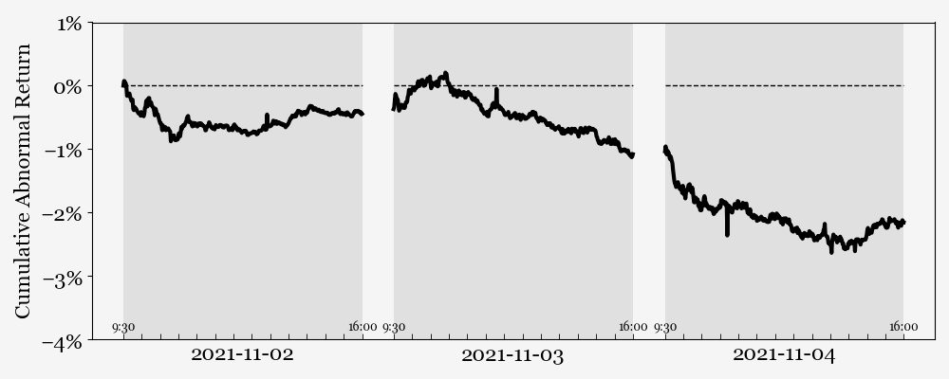
A Confounding Event: The Methane Rule
The Methane Rule was announced early on Nov 2.
SLB 14L was released late morning/early afternoon on Nov 3.
Minute-level excess return for high emitters

Slide 15
SEC’s Congress Charged Statutory Charges
“Since our founding in 1934 at the height of the Great Depression, we have stayed true to our mission of protecting investors, maintaining fair, orderly, and efficient markets, and facilitating capital formation.”
Destroying value certainly isn’t facilitating capital formation or making market more efficient. How about protecting investors?
“Human capital, human rights, climate change – these issues are fundamental to our markets, and investors want to and can help drive sustainable solutions on these issues. That’s why climate and ESG are front and center for the SEC.”
Acting SEC Chair Allison Herren Lee (March 15, 2021)

Slide 16
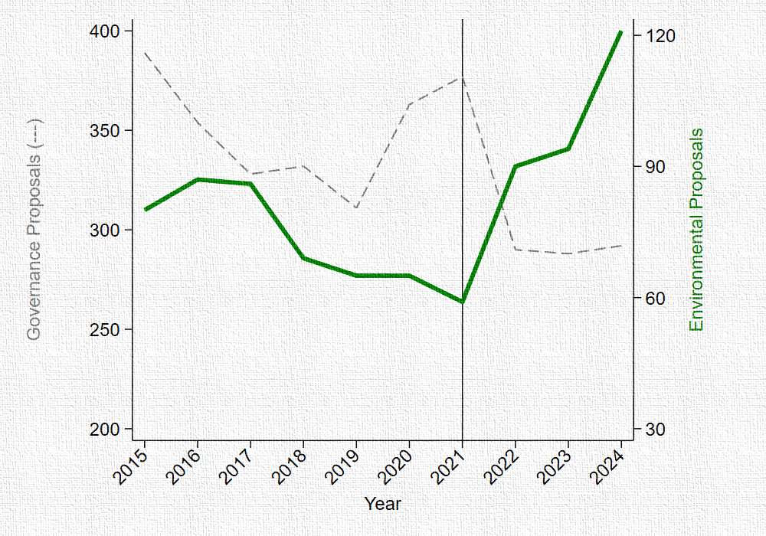
Negative Returns Are Not Necessarily Bad!
The Welfare Argument
Hart & Zingales (2017): shareholder welfare ≠ shareholder wealth.
Some investors accept lower financial returns to advance socially responsible goals.
If SLB 14L allows shareholders to force emissions cuts, the $26B wealth loss may be an acceptable price for climate benefits.
Finding 1:
Number of environmental proposals did increase.
What it requires
Reduction in GHG emissions.
It can be achieved by more meaningful environmental proposals that average shareholders support.

Slide 17
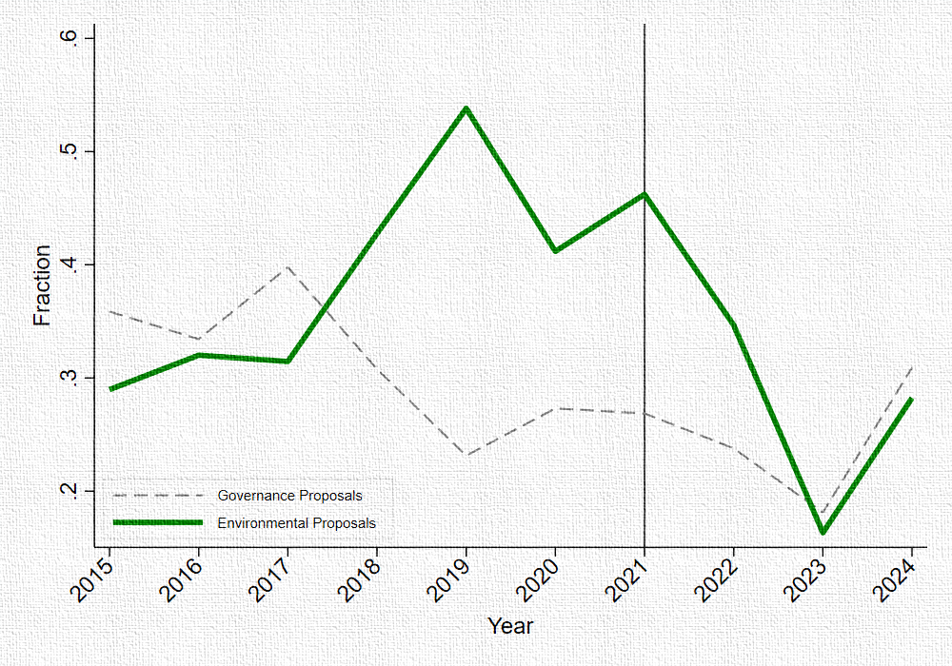
Negative Returns Are Not Necessarily Bad!
The Welfare Argument
Hart & Zingales (2017): shareholder welfare ≠ shareholder wealth.
Some investors accept lower financial returns to advance socially responsible goals.
If SLB 14L allows shareholders to force emissions cuts, the $26B wealth loss may be an acceptable price for climate benefits.
Finding 2:
However, these were not the proposals that shareholders support.
What it requires
Reduction in GHG emissions.
It can be achieved by more meaningful environmental proposals that average shareholders support.

Slide 18
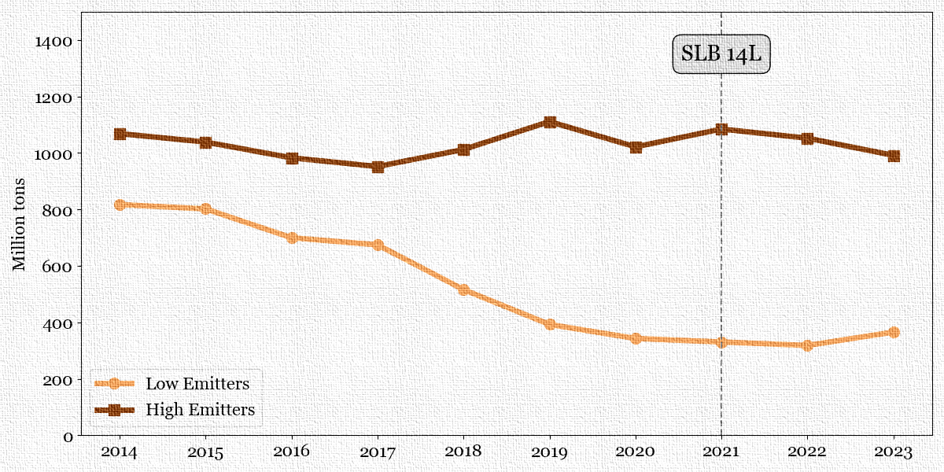
Negative Returns Are Not Necessarily Bad!
The Welfare Argument
Hart & Zingales (2017): shareholder welfare ≠ shareholder wealth.
Some investors accept lower financial returns to advance socially responsible goals.
If SLB 14L allows shareholders to force emissions cuts, the $26B wealth loss may be an acceptable price for climate benefits.
Finding 3:
Emissions of (targeted) high emitters did not decrease
What it requires
Reduction in GHG emissions.
It can be achieved by more meaningful environmental proposals that average shareholders support.

Slide 19
Did SLB 14L reduce GHG emissions?
We examine two dependent variables:
  Actual emissions in the future.
  Pledged emission reduction.
  Capital expenditure.
We examine two treatment variables:
  High emitters.
  Firms with negative CAR around SLB 14L.
We use Diff-and-diff specifications:
  Post = 1 if year >= 2022.
  Firm and year fixed effect.
  Standard error clustered at firm level.

Slide 20
Did SLB 14L reduce GHG emissions?
We examine two dependent variables:
  Actual emissions in the future.
  Pledged emission reduction.
  Capital expenditure.
We examine two treatment variables:
  High emitters.
  Firms with negative CAR around SLB 14L.
We use Diff-and-diff specifications:
  Post = 1 if year >= 2022.
  Firm and year fixed effect.
  Standard error clustered at firm level.
Dependent variable | Actual emissions
Treatment | High Emitter | CAR < 0
Treat X Post | -1.11 | -1.27
 | (1.39) | (0.84)
Observations | 2,437 | 2,437

Slide 21
Did SLB 14L reduce GHG emissions?
We examine three dependent variables:
  Actual emissions in the future.
  Pledged emission reduction.
  Capital expenditure.
We examine two treatment variables:
  High emitters.
  Firms with negative CAR around SLB 14L.
We use Diff-and-diff specifications:
  Post = 1 if year >= 2022.
  Firm and year fixed effect.
  Standard error clustered at firm level.
Dependent variable | Pledged emission reduction in %
Treatment | High Emitter | CAR < 0
Treat X Post | -5.8* | 1.96
 | (3.25) | (1.99)
Observations | 2,962 | 2,962

Slide 22
Did SLB 14L reduce GHG emissions?
We examine two dependent variables:
  Actual emissions in the future.
  Pledged emission reduction.
  Capital expenditure.
We examine two treatment variables:
  High emitters.
  Firms with negative CAR around SLB 14L.
We use Diff-and-diff specifications:
  Post = 1 if year >= 2022.
  Firm and year fixed effect.
  Standard error clustered at firm level.
Dependent variable | CAPX/Assets
Treatment | High Emitter | CAR < 0
Treat X Post | -0.003 | -0.005
 | (0.004) | (0.003)
Observations | 2,383 | 2,383

Slide 23
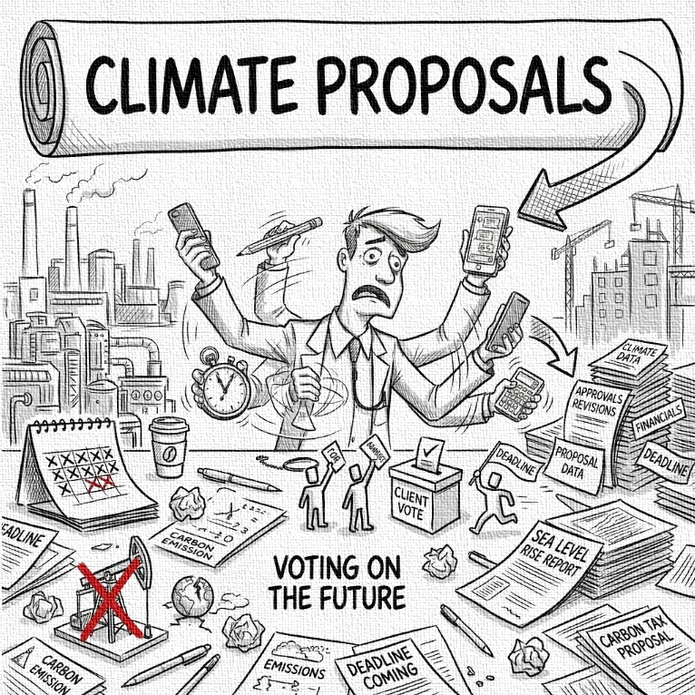
Why negative CAR? "Managerial Distraction" Hypothesis
Puzzle: If no costly emissions cuts, why did the market react so negatively?
Hypothesis: It forced management to divert time and resources away from core operations to deal with a larger number of shareholder proposals.
Anecdotes of Distraction
Companies complain that navigating the proposal process imposes a significant and unnecessary burden, diverting resources.
  “According to our member survey, nearly 20% of responding companies spend over $500,000 in external costs managing and responding to shareholder proposals in a typical season, including some small-cap firms.” Business Roundtable

Slide 24
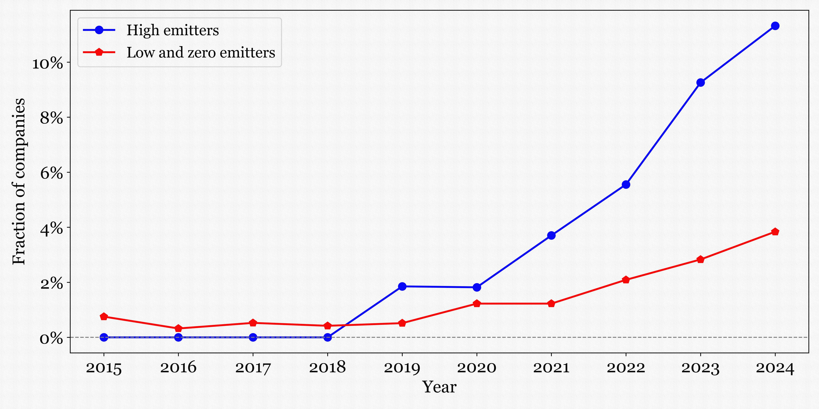
Evidence of Distraction
After SLB 14L, high-emitting firms dramatically increased the frequency with which they mentioned engagement with proposal proponents and stakeholders in their proxy statements.
Example: Engagement with proponents
“ExxonMobil shares society’s concerns about mismanaged plastic waste in the environment, as was explained during engagement with the proponent. As You Sow continues to push ‘supply reduction’ as the only path forward [and] back their belief with flawed, remote scenarios.”

Slide 25
Evidence of Distraction
After SLB 14L, high-emitting firms dramatically increased the frequency with which they mentioned engagement with proposal proponents and stakeholders in their proxy statements.
Example: Engagement with proponents
“ExxonMobil shares society’s concerns about mismanaged plastic waste in the environment, as was explained during engagement with the proponent. As You Sow continues to push ‘supply reduction’ as the only path forward [and] back their belief with flawed, remote scenarios.”
Dependent variable | Engagement with proponents
Treatment | High Emitter | CAR < 0
Treat X Post | 0.06* | 0.02**
 | (0.03) | (0.01)
Observations | 9,192 | 9,192

Slide 26
Evidence of Distraction
After SLB 14L, high-emitting firms dramatically increased the frequency with which they mentioned engagement with proposal proponents and stakeholders in their proxy statements.
Example: Engagement with stakeholders
“From how we manage our operations and engage with stakeholders to how we provide safe, reliable, affordable and clean power — we are committed to sustainability because the Company’s success is tied to the strength and health of the communities in which we operate and serve.”
Dependent variable | Engagement with proponents |  | Engagement with stakeholders
Treatment | High Emitter | CAR < 0 | High Emitter | CAR < 0
Treat X Post | 0.06* | 0.02** | 0.12*** | 0.02*
 | (0.03) | (0.01) | (0.04) | (0.01)
Observations | 9,192 | 9,192 | 9,192 | 9,192

Slide 27
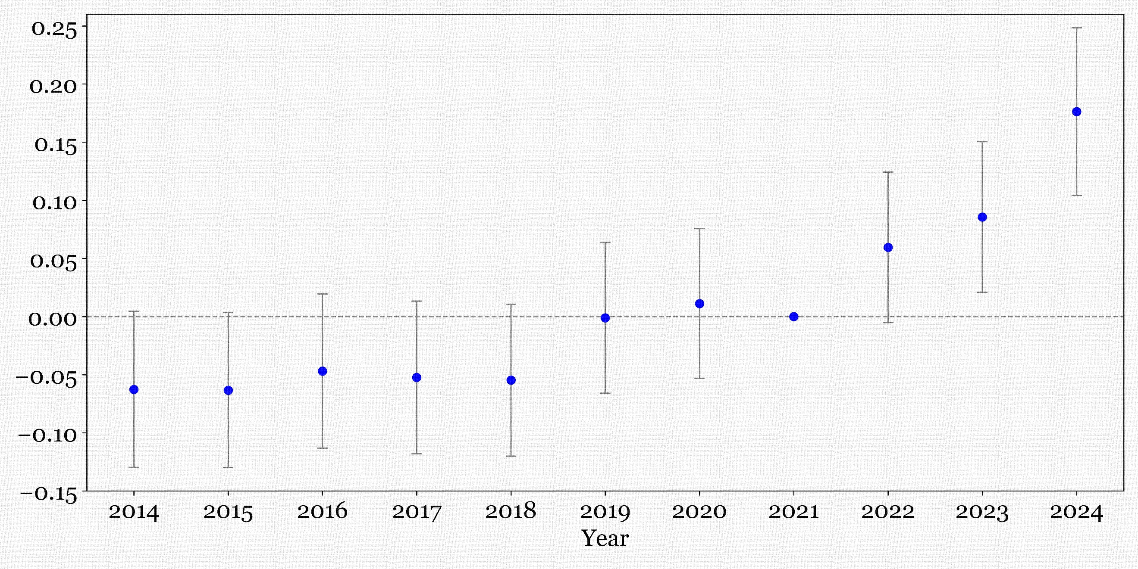
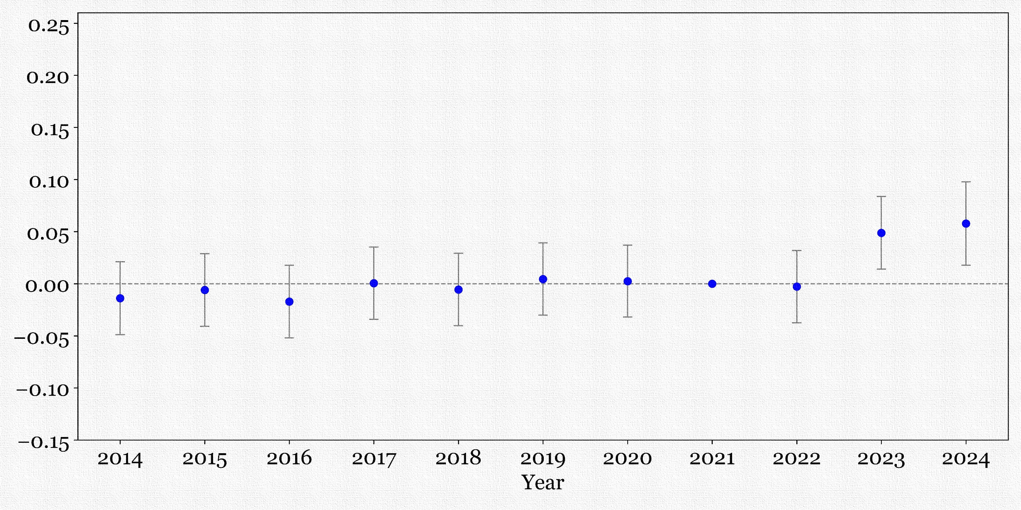
Evidence of Distraction
After SLB 14L, high-emitting firms dramatically increased the frequency with which they mentioned engagement with proposal proponents and stakeholders in their proxy statements.
Parallel Trends
Treat=1 if high emitters
Treat=1 if CAR < 0

Slide 28
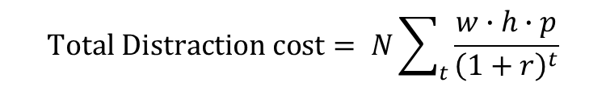
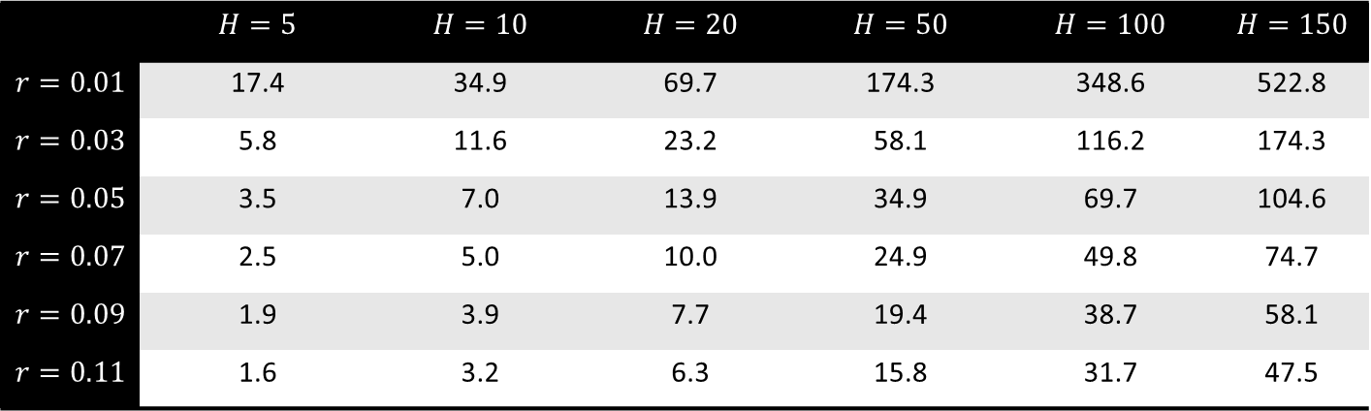
Back-of-the-Envelope For Distraction Costs
N Number of affected firms (62)
w Average hourly wage of top officers
h Hours of distraction per proposal
p Increased proposals per year (assume 1/3)
r Discount rate
$$Total Distraction cost= N\sum_{t}{\frac{w∙h∙p}{{\left(1+r\right)}^{t}}}$$
 | $$H=5$$ | $$H=10$$ | $$H=20$$ | $$H=50$$ | $$H=100$$ | $$H=150$$
$$r=0.01$$ | 17.4 | 34.9 | 69.7 | 174.3 | 348.6 | 522.8
$$r=0.03$$ | 5.8 | 11.6 | 23.2 | 58.1 | 116.2 | 174.3
$$r=0.05$$ | 3.5 | 7.0 | 13.9 | 34.9 | 69.7 | 104.6
$$r=0.07$$ | 2.5 | 5.0 | 10.0 | 24.9 | 49.8 | 74.7
$$r=0.09$$ | 1.9 | 3.9 | 7.7 | 19.4 | 38.7 | 58.1
$$r=0.11$$ | 1.6 | 3.2 | 6.3 | 15.8 | 31.7 | 47.5

Slide 29
Puzzles?
1
2
Puzzle 1: Why did value fall?
Puzzle 2: Why propose?
If firms didn't undertake costly abatement, why the negative CAR? Managerial distraction costs provide a partial explanation. Another is that investors may have interpreted SLB 14L as a harbinger of future, more costly SEC actions against high emitters.
If proposals don't affect emissions and reduce firm value, why do proponents introduce them? The answer may be that social activists, who have low financial stakes, value the publicity and attention from challenging a major corporation, regardless of the outcome.

Slide 30
SEC Advancing Social Goals: Mission Critical?
Mission Critical
The problem
Statutory Mandate
If social issues are what investors desire, the SEC fulfills its mandate of "protecting investors."
Subjective Tradeoffs
Reasonable investors disagree on how much economic efficiency should be sacrificed for social objectives.
Economic analysis
Formal rulemaking under the Administrative Procedure Act requires benefit-cost analysis and public notice..
Regulatory Volatility
Agencies can bypass APA procedures through informal guidance, enabling rapid policy swings.
Enfranchising Shareholders
Empowering shareholders to set corporate policy aligns with their social preferences.
Special Interest
Regulation can be captured by special interests, producing political rather than social outcomes

