Slide 1

Heaven or Earth?
The Evolving Role of Global Shocks for Domestic Monetary Policy
Kristin Forbes: MIT-Sloan School of Management, NBER & CEPR
Jongrim Ha: World Bank Prospects Group
M. Ayhan Kose: World Bank Prospects Group, Brookings Institution & CEPR
NBER IFM Fall Meetings
October 23, 2025
Views in this paper are those of the authors and do no represent those of any institutions with which they are affiliated

Slide 2
Motivation
... if you know Heaven and know Earth, you may make your victory complete...
Sun Tzu (5th century BC)
Chinese military strategist, philosopher and author of The Art of War
In this era of hyperglobalisation, are central banks still masters of their domestic monetary destinies? Or have they become slaves to global factors?
Mark Carney (2015)
Prime Minister of Canada, former Governor of BoE and BoC

Slide 3
Paper Overview
Two questions on whether the nature of the shocks driving monetary policy has changed
  Has the role of global vs. domestic shocks changed over time?
  Do global shocks have different characteristics (and generate different monetary policy responses) than domestic shocks?
Main methodology: new factor-augmented autoregressive model (FAVAR)
  Richer decomposition and more granular analysis than in past work
    Identifies distinct roles of 7 different shocks (4 global/3 domestic)
  13 advanced economies over 55 years (1970-2024)
  Focus: fluctuations in interest rates (additional results for inflation/output growth)
If the answer is “yes” to both questions, widespread implications for monetary policy
  Forecasting models:
    need to better differentiate between global/domestic sources of shocks
    allow for certain shocks to be nonlinear, asymmetric & more persistent
  Monetary policy frameworks & communication strategies may need to be adjusted to incorporate changing nature of shocks

Slide 4
Key Results
YES
Has the role of global shocks changed over time?
  Role has roughly tripled over time for interest rates
  To explain about half of variation in interest rates over 2020-24
  Role of global shocks has increased more for interest rates than inflation/growth
Are the characteristics of global shocks different than comparable domestic shocks?
  Source of shock
  Variance/size of shock (even controlling for source)
  Country sensitivity of rate adjustments to shock (even controlling for source & size)
  Asymmetry for tightening/easing monetary policy
  Central bank willingness to “look through” impact of supply shocks on inflation
Overall: Global shocks are different than domestic shocks on multiple dimensions, should better incorporate when setting monetary policy
YES, across all 5 dimensions examined

Slide 5
Related Literature
Growing role of global factors to domestic macroeconomic variables
  Miranda-Agrippino & Rey (2020), Forbes (2019), Ha, Kose & Ohnsorge (2019), Ciccarelli & Mojon (2010), Obstfeld & Taylor (2004), many others…
Identification & decomposition of sources of business cycles
  Harding & Pagan (2002), Madeira et al. (2023), Giannone & Primiceri (2024), many others….
  Literature rarely differentiates between global & domestic shocks
DSGE models of macro impact of different types of shocks
  Adolfoson et al. (2007), Monacelli (2004), Corsetti et al. (2010), many others…
  Shocks often modelled as linear and symmetric, despite recent evidence…
Debate on relative importance of demand and supply shocks to post-pandemic inflation
  Ball et al. (2022, 2025), Bernanke & Blanchard (2024), Coibion & Gorodnichenko (2024), Di Giovanni et al. (2023), Gagliardone & Gertler (2023), Ha et al. (2024)

Slide 6
Outline
Methodology and data
Has the role of global shocks for monetary policy changed over time?
Do these global shocks differ from domestic shocks across five dimensions?
  Source of shock
  Size/volatility
  Country sensitivity
  Asymmetries (direction for interest rates)
  “Looking through”
Extensions (if time): individual economies & robustness tests
Conclusions and implications for monetary policy

Slide 7

I. Methodology & Data

Slide 8
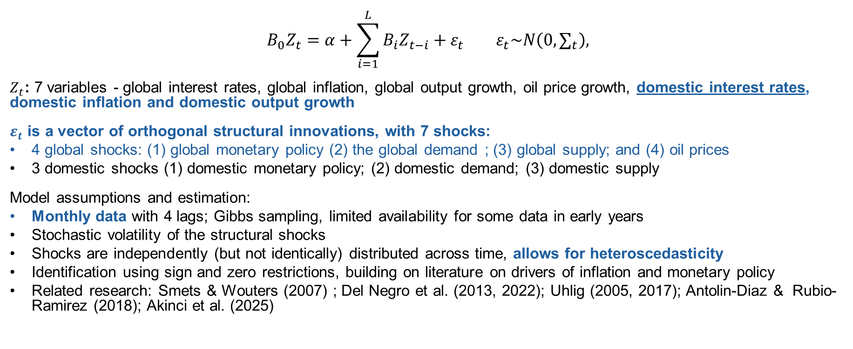
Factor-Augmented VAR (FAVAR) Model
$$B_{0}Z_{t}=α+\sum_{i=1}^{L}{B_{i}Z_{t−i}}+ε_{t} ε_{t}\sim N\left(0,∑_{t}\right),$$
$Z_{t}$: 7 variables - global interest rates, global inflation, global output growth, oil price growth, domestic interest rates, domestic inflation and domestic output growth
$ε_{t}$ is a vector of orthogonal structural innovations, with 7 shocks:
4 global shocks: (1) global monetary policy (2) the global demand ; (3) global supply; and (4) oil prices
3 domestic shocks (1) domestic monetary policy; (2) domestic demand; (3) domestic supply
Model assumptions and estimation:
Monthly data with 4 lags; Gibbs sampling, limited availability for some data in early years
Stochastic volatility of the structural shocks
Shocks are independently (but not identically) distributed across time, allows for heteroscedasticity
Identification using sign and zero restrictions, building on literature on drivers of inflation and monetary policy
Related research: Smets & Wouters (2007) ; Del Negro et al. (2013, 2022); Uhlig (2005, 2017); Antolin-Diaz & Rubio-Ramirez (2018); Akinci et al. (2025)

Slide 9
Identification
* = unrestricted initial response
Domestic shocks do not affect global variables contemporaneously
Global shocks can affect domestic variables without any sign or zero restrictions
Differentiate between oil price shocks (broadly defined) and other global supply shocks
Based on: Uhlig (2005, 2017); Madeira, Madeira & Monteiro (2023); Dees et al. (2010); Gerlach & Smets (1995); Ha et al. (2024); Melolinna (2015); Charnavoki & Dolado (2014)

Slide 10
Data
Monthly data for 1970 (Jan) through 2024 (Sept)
13 advanced economies (including euro area as 1 entity)
  Focus on averages across sample (individual results at end)
  Repeated analysis with 24 economies (including individual EA members)
Key data
  Interest rates: shadow rate (Krippner, 2013), backups: overnight rates, 3-month T-bill rates, policy rate
  Inflation: based on CPI price index
  Output: industrial production
  Oil prices: average of Dubai, West Texas Intermediate and Brent benchmarks
  All variables month-on-month, demeaned and stationary, focus on cyclical variation
  Source of above: Haver, OECD, World Bank
Also calculate global factors for interest rates, inflation and output growth

Slide 11
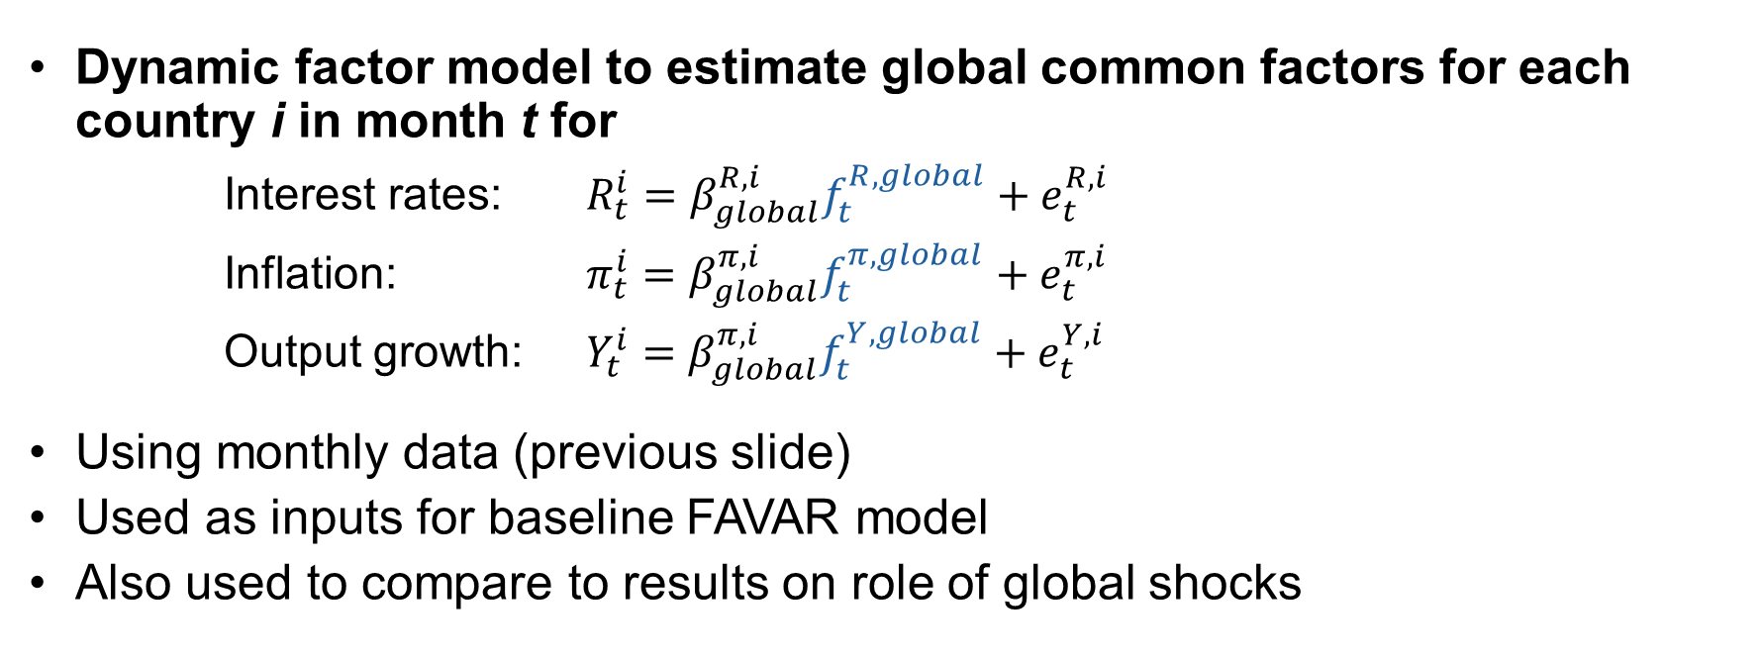
Global Factors
Dynamic factor model to estimate global common factors for each country i in month t for
      Interest rates: $R_{t}^{i}=β_{global}^{R,i}f_{t}^{R,global}+e_{t}^{R,i}$
      Inflation: $π_{t}^{i}=β_{global}^{π,i}f_{t}^{π,global}+e_{t}^{π,i}$
      Output growth: $Y_{t}^{i}=β_{global}^{π,i}f_{t}^{Y,global}+e_{t}^{Y,i}$
Using monthly data (previous slide)
Used as inputs for baseline FAVAR model
Also used to compare to results on role of global shocks

Slide 12
Windows for Analysis
Five long windows for baseline analysis
  1970-84: 2 global recessions; oil price shocks
  1985-98: 1991 global recessions and series of debt defaults and EM crises
  1999-07: ECB launches; tech bubble & 2001 global downturn, lead up to the 2008 GFC
  2008-19: GFC & global recession, EA debt crisis, and oil price collapse
  2020-24: COVID-19 pandemic and global recession, the Russian invasion of Ukraine and commodity price shock
Decades for some comparisons

Slide 13
II. Has the Role of Global Shocks for Monetary Policy Changed Over Time?

Slide 14
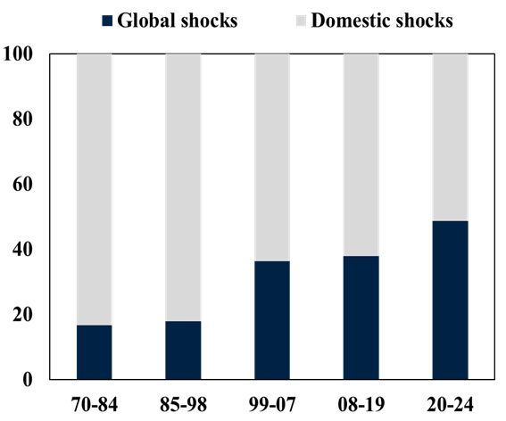
Has the Role of Global Shocks Changed over Time?
Results from FAVAR model
Contributions of Shocks to Interest Rate Variation
(% of variation, mean across 13 AEs)
YES
Role of global shocks has increased over time
Roughly tripled over sample
Over 2020-24:
Role of global ≅ domestic shocks
Role of global shocks >50% in many large AEs (Canada, EA, Japan, UK, US)

Slide 15
Does this Matter?
Maybe not….
Unless global shocks have different characteristics and/or different implications for monetary policy….

Slide 16
III. Do the Global Shocks Differ from Domestic Shocks along 5 Dimensions?

Slide 17
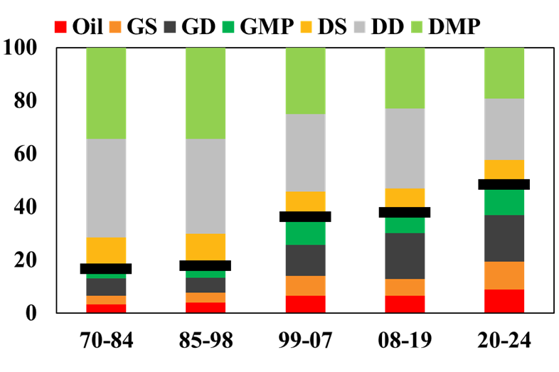
1 Different Sources? for Global vs. Domestic Shocks to Interest Rates
Contribution of 7 Shocks to Variation in Interest Rates
(% of variation, mean across 13 AEs)
YES
Larger role of supply in global shocks
Larger role for monetary policy in domestic shocks
Dominant role of demand for both

Slide 18
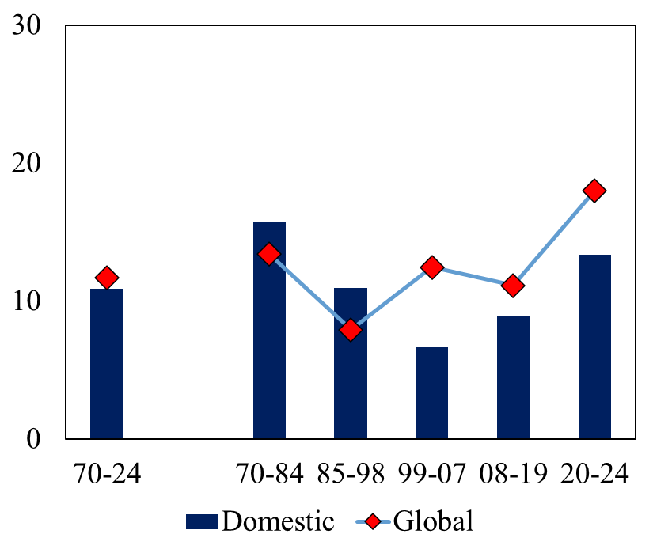
2 Different Size/Volatility over Time? of Global vs. Domestic Shocks to Interest Rates
Frequency of Large Shocks
(large defined as >1 standard deviation; mean across 13 AEs)
YES
More large shocks in 1970-84 (oil crises) and 2020-24 periods
More large global shocks than domestic shocks since 1998
Share of Large Shocks (in %)

Slide 19
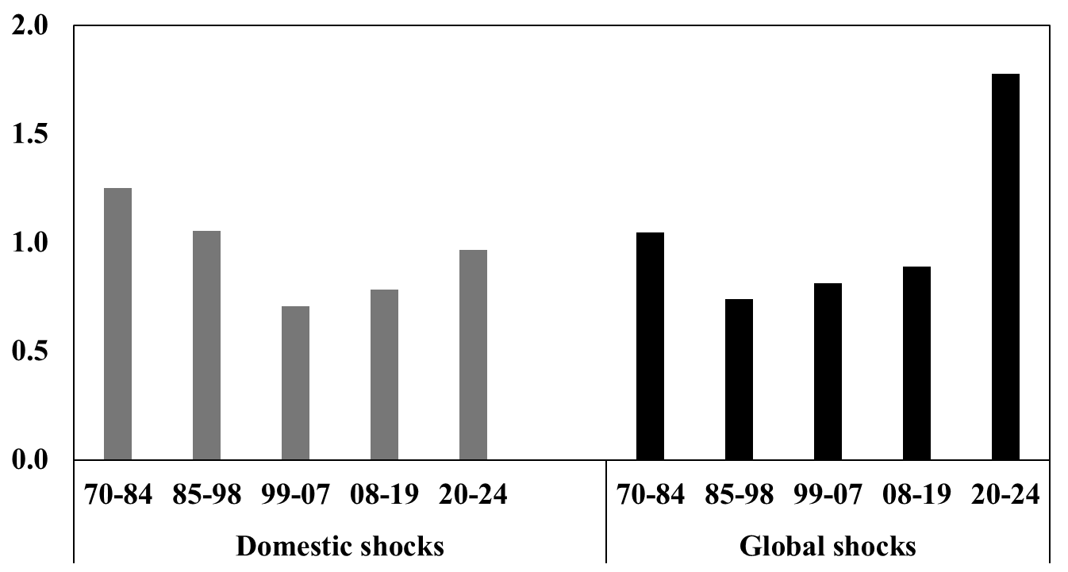
2 Different Volatility/Size over Time? of Global vs. Domestic Shocks to Interest Rates
Shock volatility
(mean across 13 AEs, long-term volatility = 1)
YES
Global shock volatility ↑ over time
  Higher than domestic shocks since 1999
But does this reflect different sources of global vs domestic shocks?

Slide 20
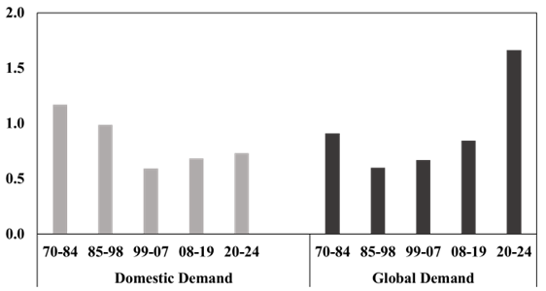
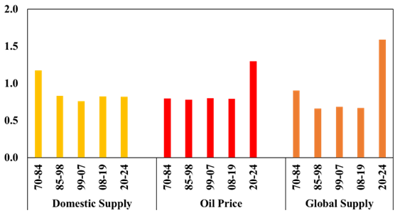
2 Different Volatility/Size over Time? of Global vs. Domestic Shocks to Interest Rates
Shock volatility
(mean across 13 AEs, long-term volatility = 1)
Demand shocks
Supply shocks
YES
Volatility larger for global than domestic shocks when controlling for source of shock
  For demand shocks since 2008
  For supply shocks over 2020-24
Note: may partly reflect idiosyncratic 2020-24 period

Slide 21
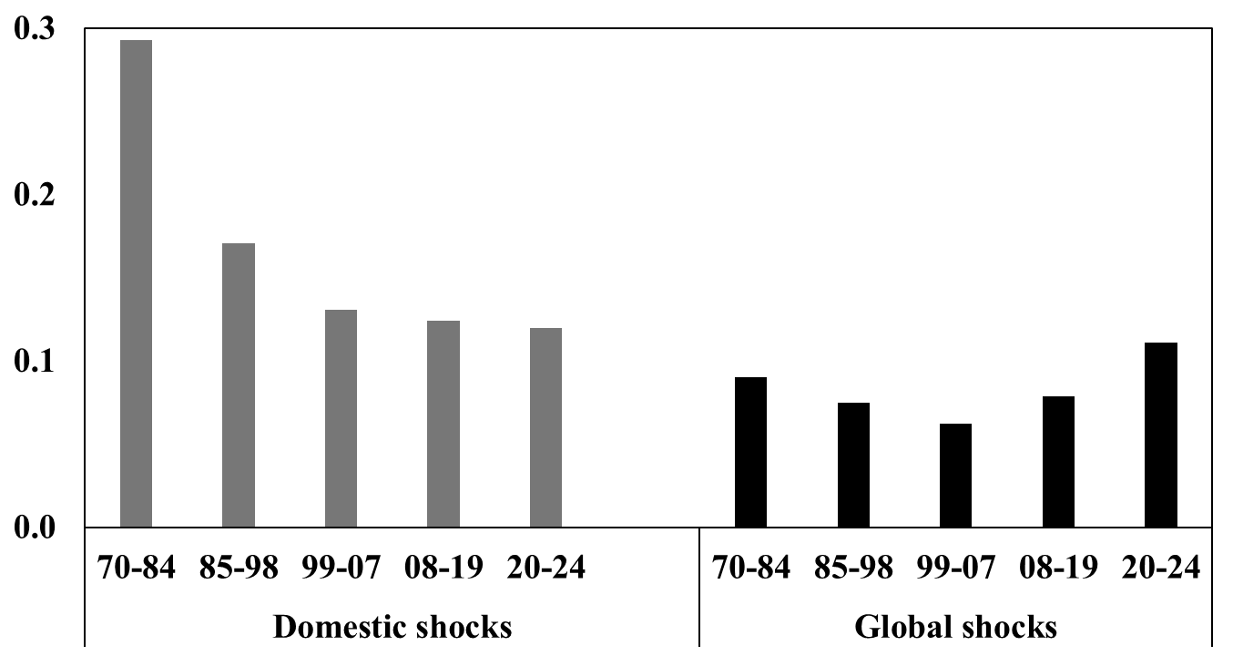
3 Different Rate Sensitivities? of Interest Rates to Global vs. Domestic Shocks
Sensitivity of Interest Rates to Different Shocks
(mean across 13 AEs, sensitivity to 1 std shocks)
YES
Sensitivity of interest rates to global shocks increasing since 2008
  Vs. decreasing over time for domestic shocks
But does this reflect different sources of global vs domestic shocks?

Slide 22
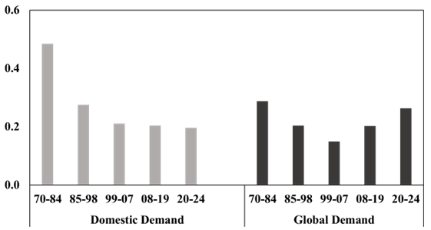
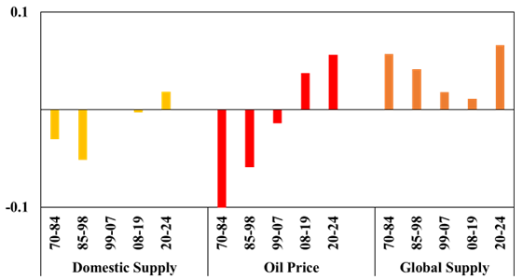
3 Different Rate Sensitivities? of Interest Rates to Global vs. Domestic Shocks
Sensitivity of Interest Rates to Different Shocks
(mean across 13 AEs, sensitivity to 1 std shocks)
Demand shocks
Supply shocks
YES
Sensitivity of interest rates to main global shocks (demand & supply)
higher over 2020-24
increased over time
directional change in response to oil shocks

Slide 23
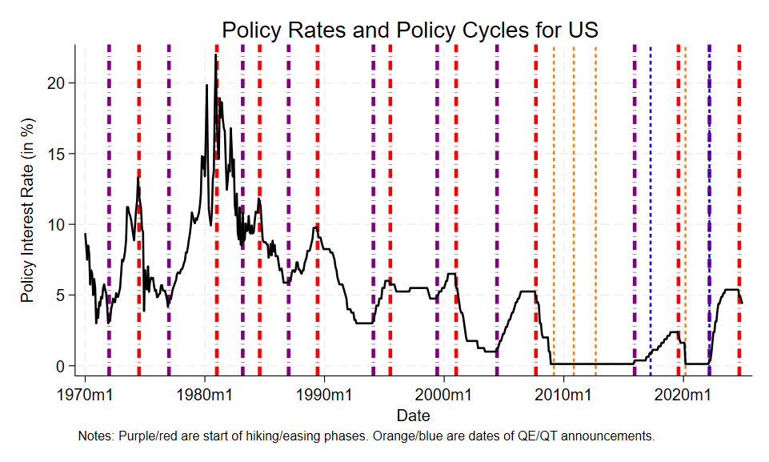
4 Asymmetric Effects on Rate Levels? in Contribution of Global vs. Domestic Shocks
U.S. Rate Cycles
Focus on periods of “tightening” versus “easing” of monetary policy
Uses new database on “Rate Cycles”
  Dates periods of tightening and easing for monetary policy from 1970-2024
  Comparable to dating of expansions and contractions for business cycles
  Based on policy interest rates and QE/QT
  From Forbes, Ha and Kose (2025), NBER WP #33825, dates, code & cycle characteristics available on NBER website: data.nber.org/data-appendix/w33825/

Slide 24
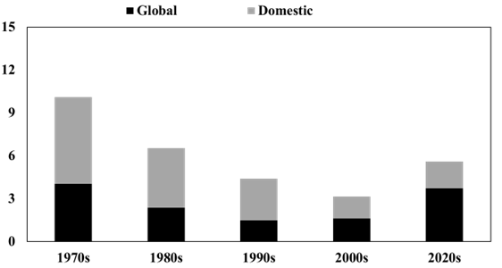
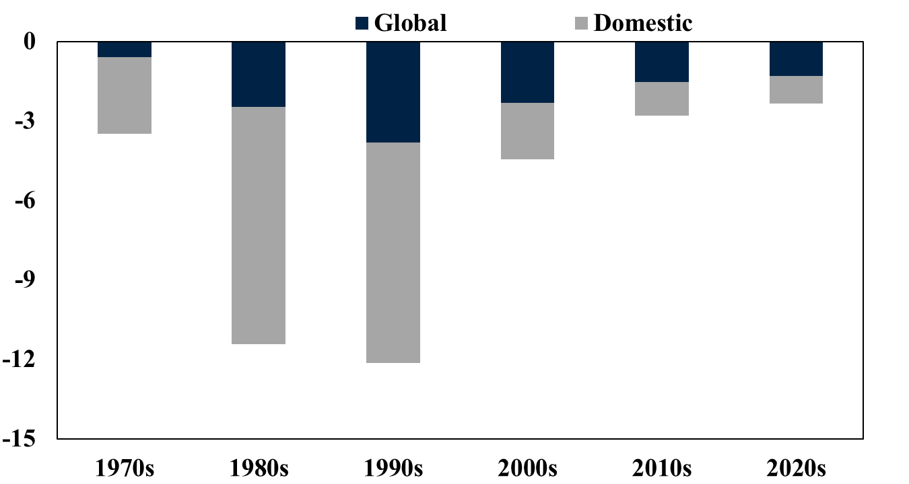
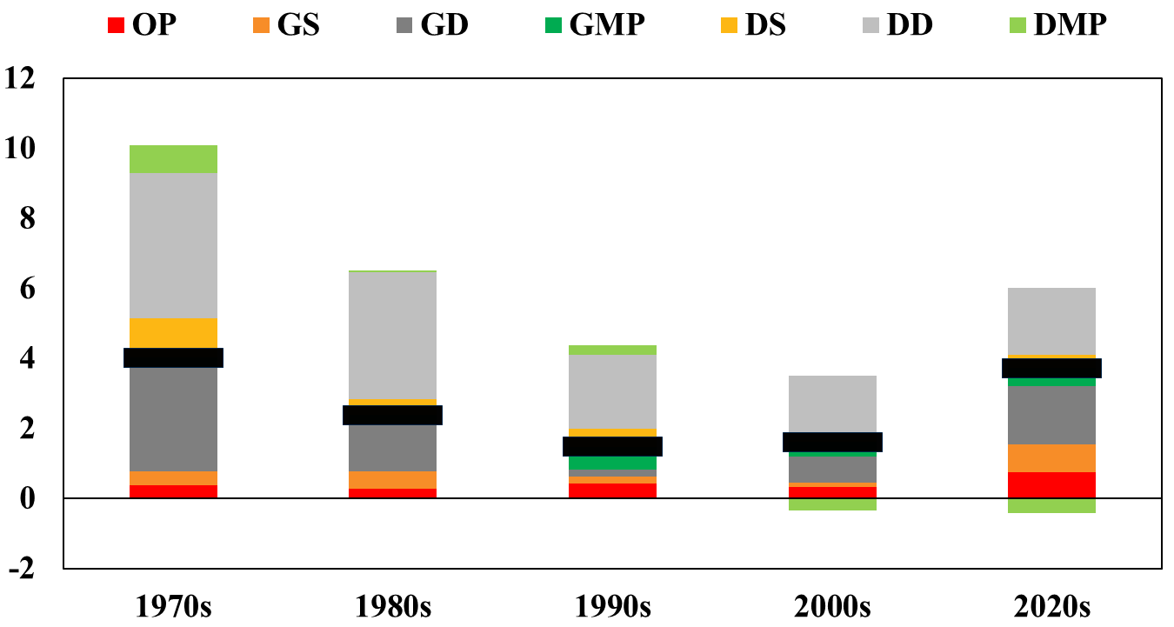
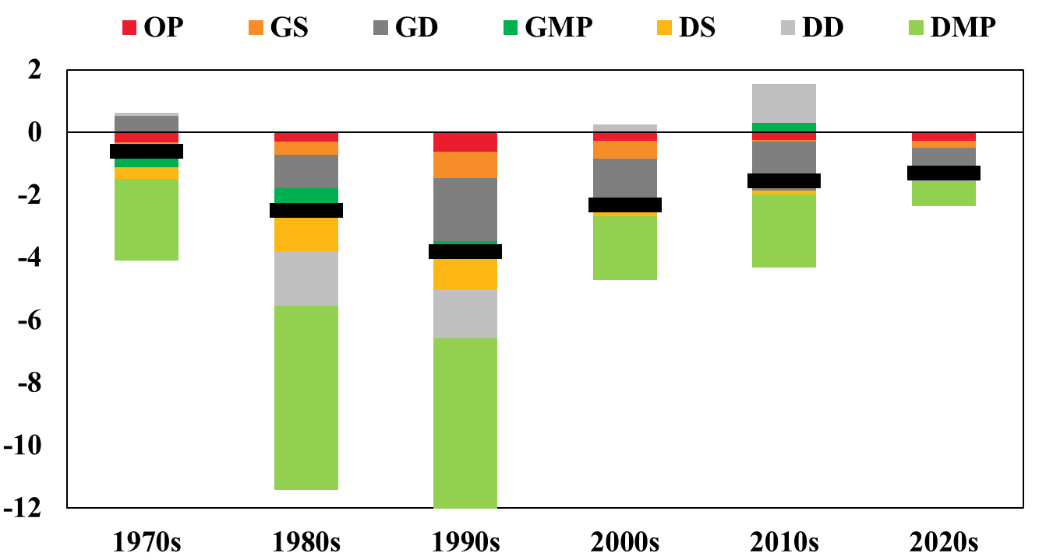
4 Asymmetric Effects on Rate Levels? in Contribution of Global vs. Domestic Shocks
Impact on Level of Interest Rates
(in percentage points, average across 13 AEs)
YES
Global shocks relatively more important for tightening monetary policy
Asymmetry by shock source:
  Global supply shocks more important for i↑
  Domestic monetary policy shocks for i↓
Tightening Episodes
Easing Episodes

Slide 25
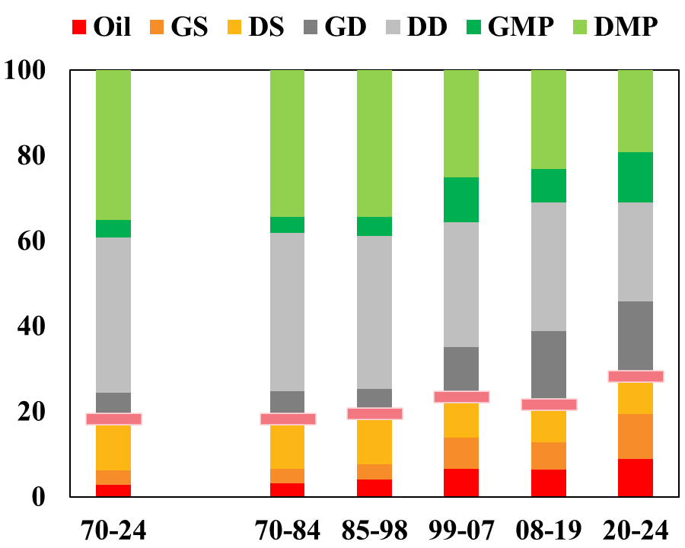
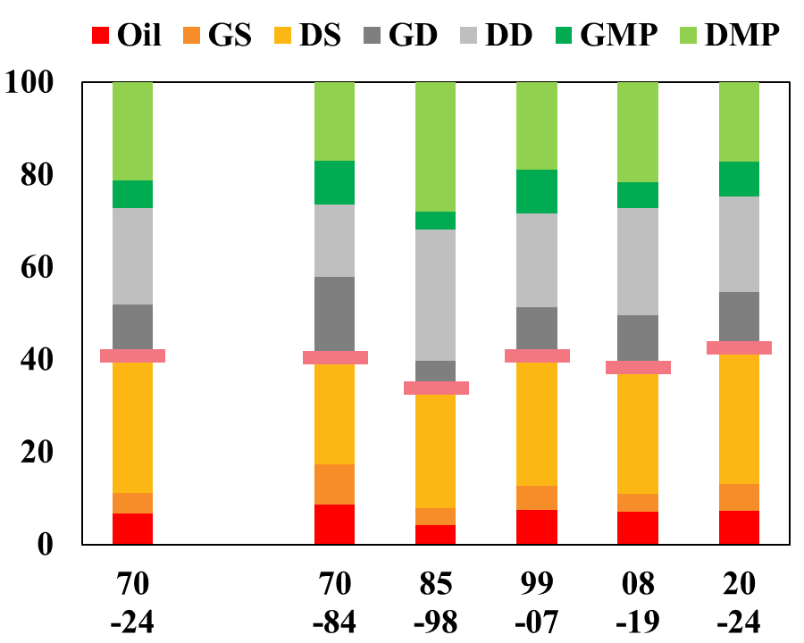
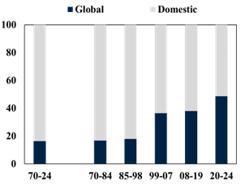
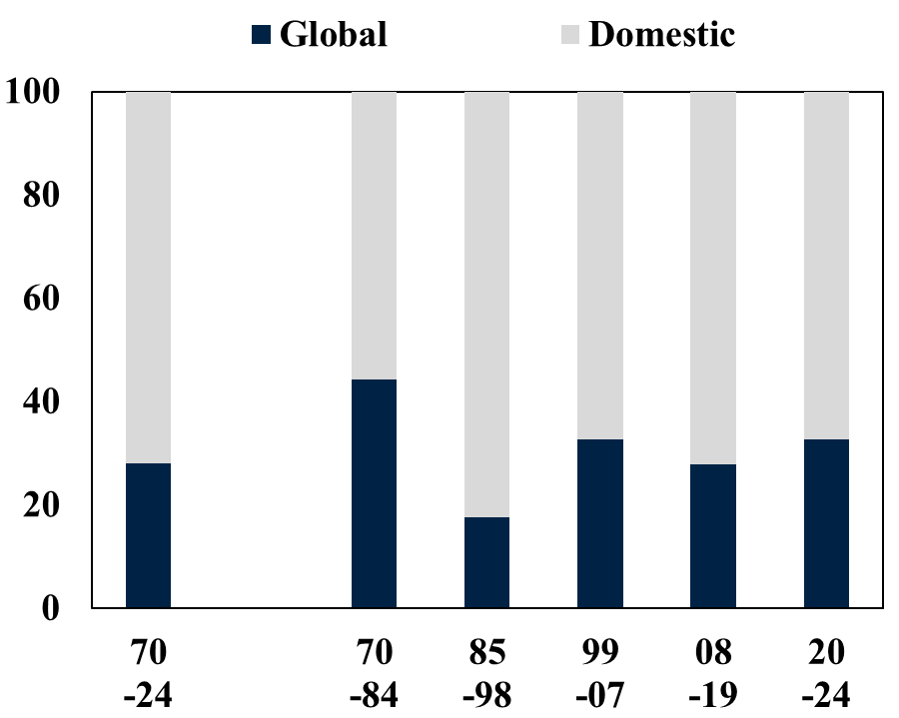
5 CB Willingness to “Look Through”?
Impact on Inflation from Global vs. Domestic Shocks
Contribution of 7 Shocks to Variation in Rates & Inflation
(% of variation, mean across 13 AEs)
YES
Full period: supply shocks to inflation “looked through”
Since 1998
  Similar pattern for domestic supply shocks
  Global shocks not looked through
  Global shocks more important for rates than inflation (or output growth)
Interest Rates
Inflation

Slide 26
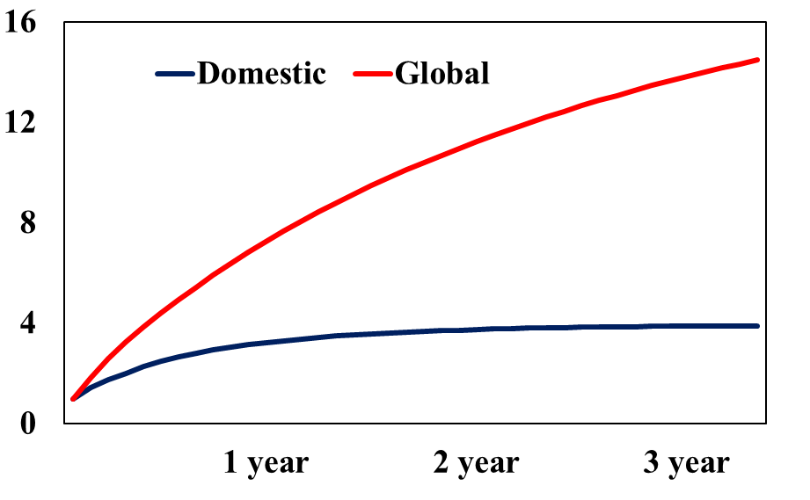
Why? Work in Progress….
Potential Explanations
Persistence of Shock Transmission
(mean across 13 AEs, initial impacts= 1, average across different structural shocks)
Why a stronger monetary policy response to global supply shocks recently?
Larger/nonlinear effects (pt #2)
More often drive increases than decreases in inflation (pt #4)
More persistent effects on inflation
Note: each supported by recent research
Impact on domestic inflation

Slide 27
IV. Extensions
Results for Individual Economies
Robustness Exercises

Slide 28
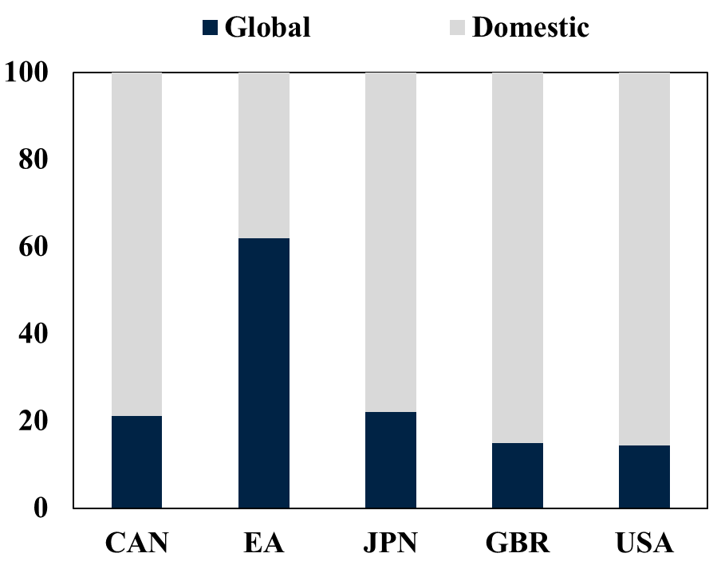
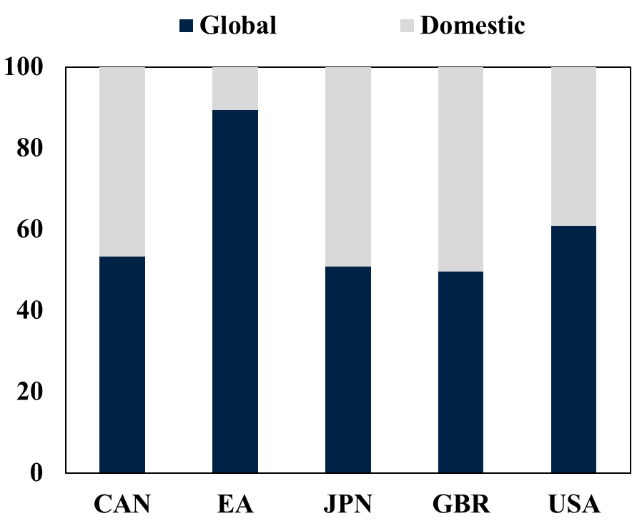
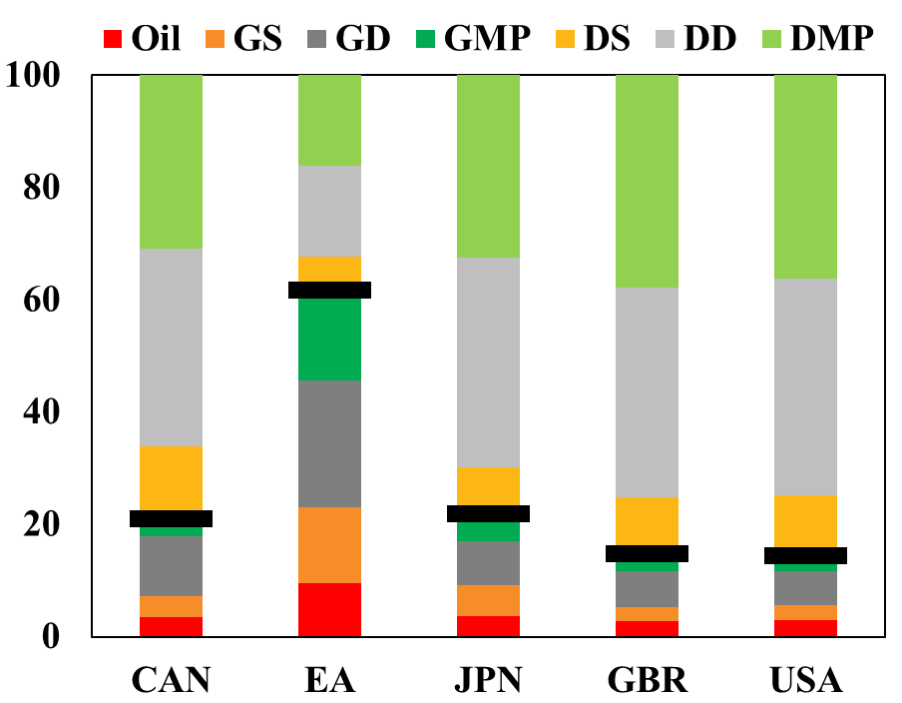
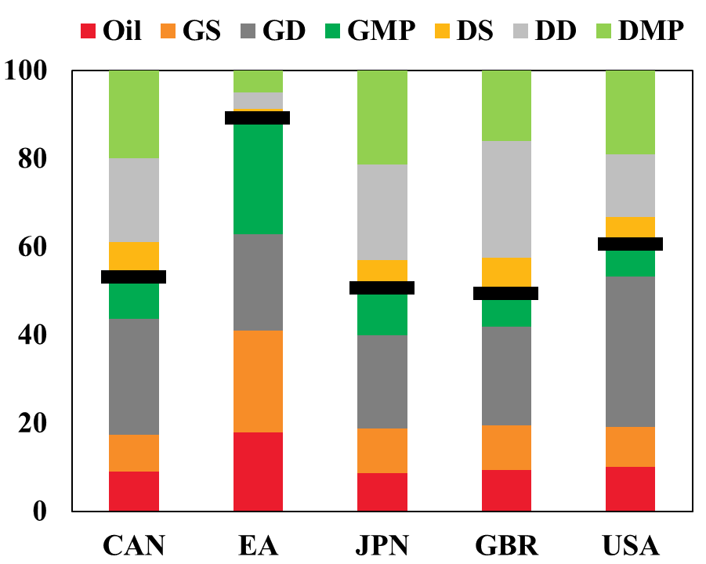
Results for Individual G-5
Contribution of Shocks to Interest Rate Variation
Contribution of 7 Shocks to Variation in Rates & Inflation
(% of variation)
Full Sample Period
Post-Pandemic Period
Meaningful differences across countries
Euro Area: greater role of global shocks
Euro area, greater role of global supply shocks

Slide 29
Robustness Exercises
Alternative definitions of key global and domestic variables
  Alternate measures for interest rates
Excluding largest economies
Excluding periods of heightened volatility
Alternative modelling specifications
  Time-varying coefficients
  Alternate identification assumptions
Key results robust
  Increased role of global shocks over time
  Five dimensions by which global shocks differ from domestic shocks

Slide 30
V. Conclusions

Slide 31
Summarizing the Answers
YES
Has the role of global shocks changed over time?
  Role has roughly tripled over time for interest rates
  To explain about half of variation in interest rates over 2020-24
Are the characteristics of global shocks different than comparable domestic shocks?
  Larger supply component
  Greater variance & more large shocks over time (even controlling for source of shock)
  Correspond to larger monetary policy responses (i.e., greater country sensitivity)
  Different asymmetries (greater role in tightening vs. easing in monetary policy)
  Central banks less willing to “look through” impact of global supply shocks on inflation
Overall: The nature of the shocks driving monetary policy has changed
  Need to better incorporate when setting monetary policy
YES, across all 5 dimensions examined

Slide 32
Implications for Monetary Policy
How to incorporate greater role of shocks from “heaven” (i.e., outside the control of individual central bank) in monetary policy?
Models:
  Better differentiate between global and domestic shocks
  Allow for asymmetries & non-linearities (with implications for “looking through”)
Frameworks:
  More humility in ability to meet narrow targets at any point in time
  Support more “forceful” response to certain types of shocks
Forecasting and communication:
  Incorporate greater uncertainty in global shocks through greater use of scenarios & risk considerations
Bottom line (from Sun Tzu): Must understand “heaven and earth” to design a successful battle strategy

Slide 33
EXTRA

Slide 34
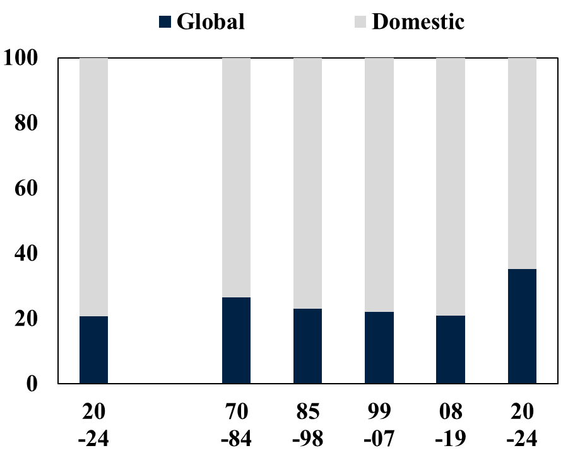
Rates vs. Inflation vs. Growth
Impact from Global vs. Domestic Shocks
Contribution of 7 Shocks to Variation in Macroeconomic Variables
(% of variation, mean across 13 AEs)
Interest Rates
Inflation
Output Growth

Slide 35
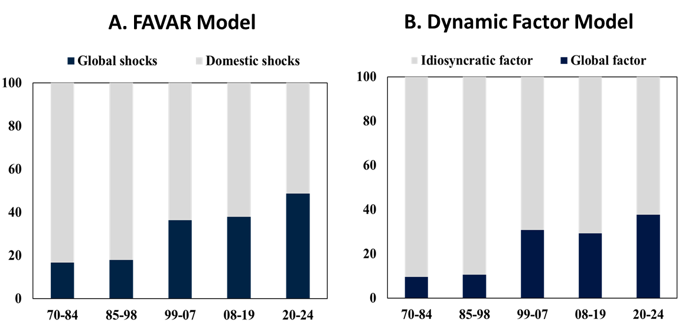
Similar Patterns for Global Factor
Contributions of Global Shocks and Global Factor to the Interest Rate Variation
(% of variation, mean across 13 AEs)
Very similar patterns
Role of global shocks/factor roughly triples over sample

Slide 36
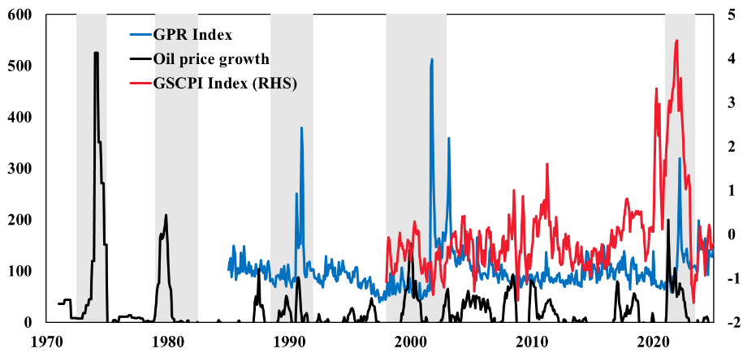
Which Global Supply Shocks?
Oil prices, geopolitical tensions, global supply disruptions
Focus on 3 measures
Oil prices (inc. other commodities)
Geopolitical risk
Global supply chain disruptions
Note: Limited time series for some measures
Sources: Federal Reserve of New York, Iacoviello (2022), World Bank (Pink sheet data). Note: GPR index = geopolitical risk index, GSCPI index = supply-disruption index. Oil price growth is based on year-on-year. Shaded areas indicate the periods with persistently positive contributions of supply shocks.

Slide 37
Which Global Supply Shocks?
Variance share of exogeneous global supply-driven shocks: Cholesky FAVAR (Percent of total variation)
Roles vary over time
“Oil” important (also captures other commodities)
Increased role of geopolitical risk and supply chain disruptions
Notes: “Oil” = oil price shock, “GPR”= geopolitical risk shock, “GSCPI”=global supply disruption shock, and “other shocks” = other structural shocks that drives the innovation in global inflation.

Slide 38
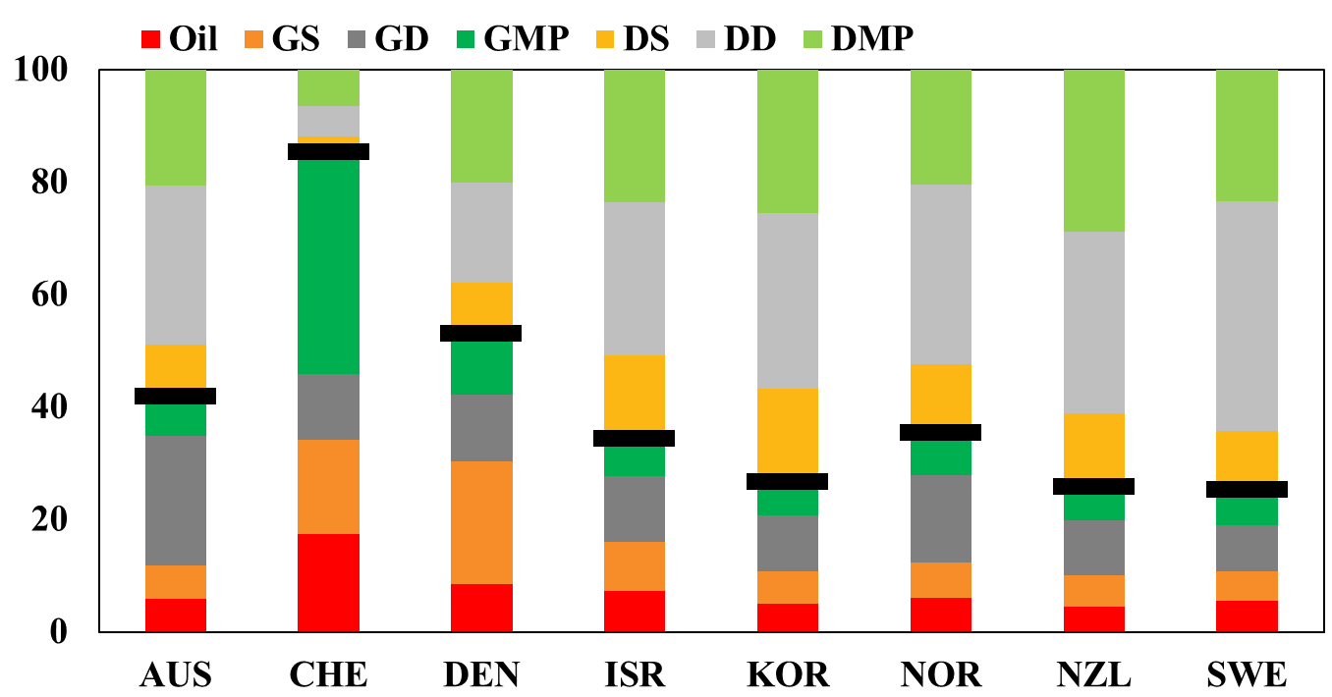
Results for Individual non G-5 AEs
Contribution of Shocks to Interest Rate Variation
Contribution of Shocks to Variation in Interest Rates
(% of total variation)
Full Sample Period (1970-2024)
Post-Pandemic Period (2020-24)

Slide 39
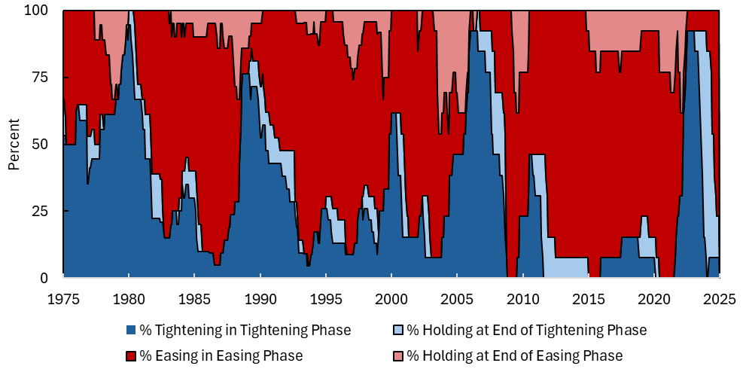
Share of Economies in Tightening & Easing Phases
For Monetary Policy
Based on rate cycles defined in Forbes, Ha and Kose (2024) based on data on changes in policy interest rates and QE/QT

