Slide 1
Biologics Patent Database
Melissa F. Wasserman (University of Texas School of Law)
Michael D. Frakes (Duke University, NBER)

Slide 2
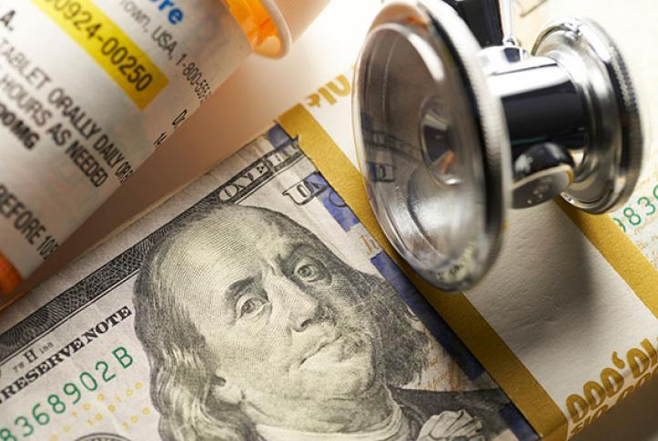
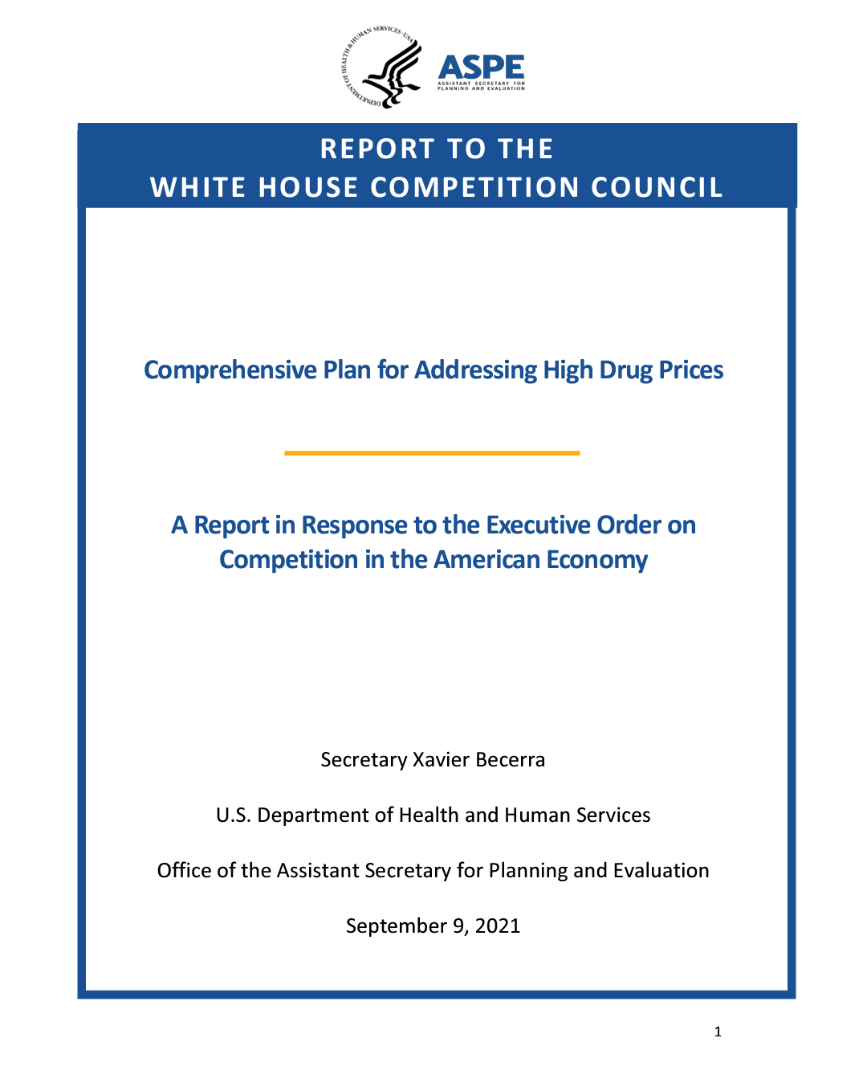
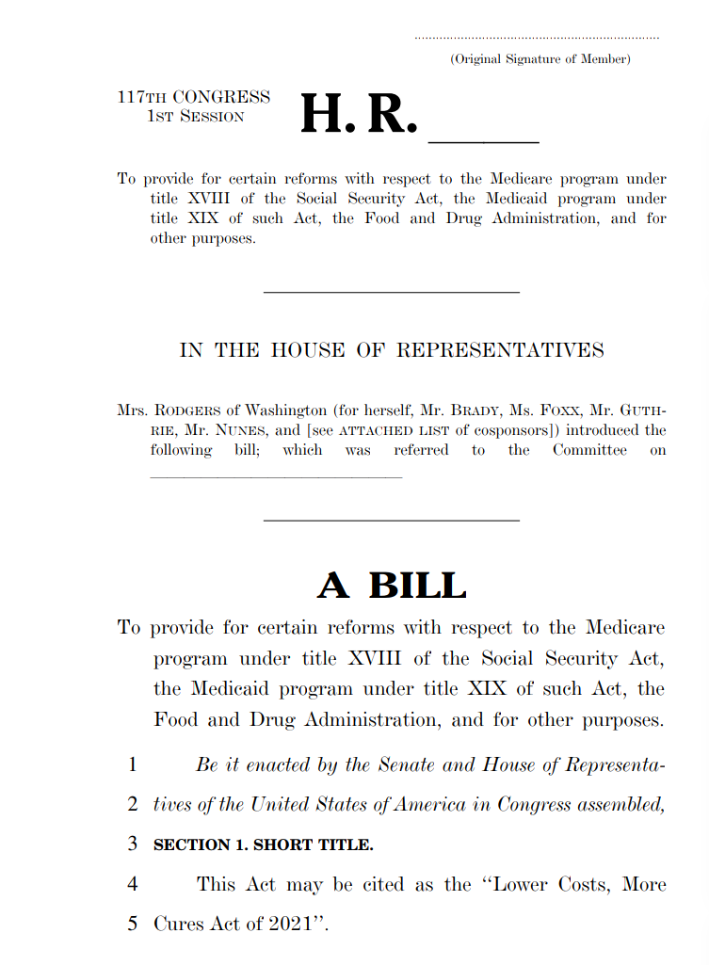
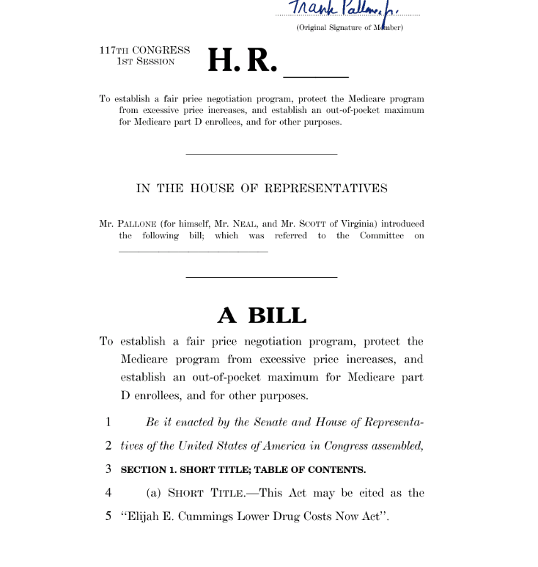
Motivation
Concerns with rising prescription drug prices

Slide 3
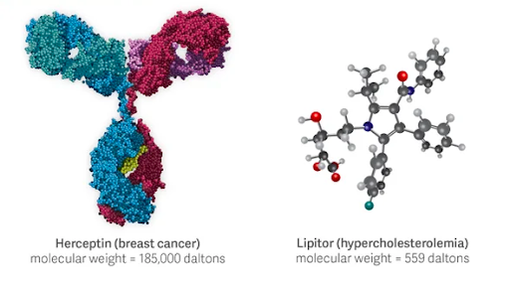
Large-Molecule (Biologics) Drugs vs Small-Molecule Drugs

Slide 4
Motivation
Pharmaceutical drug spending ~$700 billion annually in U.S.
Biologic drugs represent two percent of all U.S. prescriptions but close to fifty percent of net drug spending.
Biologics account for ninety-three percent of growth in prescription drug spending since 2014.

Slide 5
Patents
Patents are key determinant of drug prices
Promise of patent-induced monopoly rents play a key role in encouraging investments in R&D in first place, but
Growing concern that brand-name firms are strategically engaging in patent practices that allow them to engage in periods of exclusivity in excess of socially desirable levels

Slide 6
Patents
Pharmaceutical firms often seek and obtain multiple approved drug products for a single biologic.
Different dosages for a single biologic—high concentration biologic and low concentration biologic
Pharmaceutical firms often obtain a series of patents associated with a single approved drug
Primary patents → The first patent associated with a drug is filed early in the drug development process—i.e., typically before human clinical trials commence—and it may protect the biological compound.
Secondary patents → In early or later phases of drug development, pharmaceutical companies may file patents on peripheral features of the drug product
E.g., formulation patent (capsules, gels, tablets, injectables, controlled release, etc.)
E.g., method of use patents
E.g., manufacturing patents

Slide 7

What do we know about biologics patent landscape?

Slide 8
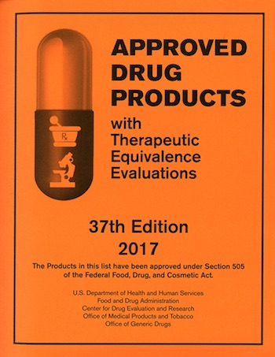
Patents Disclosure
Large Molecule Patent Database?

Slide 9
Building a Biologics Patent Database: Methodology
Inclusion criteria are patents that are likely to be infringed upon launch of a biosimilar
E.g., don’t include method of use patents for unapproved indications
Methodology
(1) identifying patents listed in the Purple Book;
(2) identify patents asserted in litigation;
(3) identify patents asserted in PTAB;
(4) identify patents receiving term extension under 35 USC §156
(5) conduct patent searches utilizing Orbit Intelligence (three-stage search process)
11,595 patent-drug pairs. 515 biologics

Slide 10
Methodology: Searches
1st: patents assigned to the corporate entity that filed the license for the biologic or is somehow associated manufacture/development of the biologic
(1) Trade name (i.e. Humira),
(2) the chemical name (i.e. adalimumab),
(3) internal identification code of the biologic (D2E7), and the
(4) drug class of the biologic (i.e. Tumor Necrosis Factor (TNF)).
The title, abstract, and claims of the patent documents.

Slide 11
Methodology: Searches
2nd: patents assigned to the corporate entity that filed the license for the biologic or is somehow associated with the manufacture/development of the biologic AND had device or delivery method in the claim.
(1) Trade name (i.e. Humira),
(2) the chemical name (i.e. adalimumab),
(3) internal identification code of the biologic (D2E7), and the
(4) drug class of the biologic (i.e. Tumor Necrosis Factor (TNF)).
Anywhere in the document

Slide 12
Methodology: Searches
3rd: no restriction on assignee
(1) Trade name (i.e. Humira),
(2) the chemical name (i.e. adalimumab), and
(3) internal identification code of the biologic (D2E7), the
The title, abstract, and claims of the patent documents.
4th: no restriction on the assignee
(1) Biosequence of the FDA approved biologic in the claims

Slide 13
Patent Types
1. Main Compound: A patent that claims a biological compound, including a specific amino acid sequence, a specific conjugate, or a specific post-translational modification to a protein or antibody.
2. Method of Treatment: A patent that claims the use of a biologic to treat an indication or group of indications. Method of treatment patents were included in our database only if the biologic was FDA approved for the claimed indication.
3. Method of Manufacturing: A patent that claims a process utilized to manufacture a biologic, including methods to chromatographically separate the biologic, methods to culture the biologic, or other methods involved in the biological manufacture process.
4. Formulation: A patent that claims the way a biologic is formulated and/or administered, including routes of administration, dosages, formulations including non-active additives, non-conjugated drug carriers, and extended release, etc.
5. Device: A patent that claims a specific device used in the administration or preparation of a biologic, including kits, injection devices, or other such objects.

Slide 14
Output Parameters
For each patent or patent application included in our patent database we also include over forty additional pieces of information which can be roughly grouped into five categories:
(1) patent information;
Application number for the U.S. patent/application, date which the patent application filed, the publication number for the U.S. patent/application, date that the patent is issued, expiration date of the patent, the title of the patent, the claims of the patent, and legal status
(2) assignee, inventor and representative information;
(3) patent technology type;
(4) citation information; and
(5) patent characteristics
The number of independent claims, the total words in each independent claim, the number of dependent claims, the total words in each dependent claim, total number of words in patent document, and total words in the patent specification, and the number of figures.

Slide 15
Number of Patents by Patent Type, Across Sample of Drug/Patent Pairs

Slide 16
Histogram of Number of Patents Per Drug Across FDA-Approved Biologics, with and without Overlay of Small-Molecule (Orange Book) Patents-Per-Drug Histogram

Slide 17
Histogram of Patents-Per-Drug across Large-Molecule Drugs, Separately by Patent Type

Slide 18
Histogram of Years Between Expiration of Drug’s First-Expiring Patent and Expiration of Focal Patent Across FDA-Approved Biologics, with and without Overlay of Small-Molecule (Orange Book) Histogram

Slide 19
Histogram of Difference in Years Between Drug’s First-Expiring Patent and Focal Patent, by Patent Type (Among Sample of Drug-Patent Pairs)

