Slide 1

Pigouvian Gun Taxation
Joseph G. Eisenhauer, Ph.D.
University of Detroit Mercy
Presentation at the NBER conference,
The Economics of Firearm Markets, Crime, and Gun Violence
October 10, 2025

Slide 2
Market with Negative Externalities
Price
Marginal Social
Cost
Marginal Private
Cost
Marginal
External
Cost
Deadweight
Loss
Marginal Benefit
Q₀
Quantity (millions)

Slide 3
Market with Negative Externalities and Taxes
Price
Marginal Social
Cost
Marginal Private
Cost
Marginal
External
Cost
Deadweight
Loss
P^{D}
Marginal Benefit
Existing Taxes
P^{S}
Q₁
Q₀
Quantity (millions)

Slide 4
Pigouvian Taxation with Negative Externalities
Price
Marginal Social
Cost
Marginal Private
Cost
Marginal
External
Cost
P^{D}
Deadweight
Loss
Pigouvian
Tax
Existing Taxes
Marginal Benefit
P^{S}
Q₂
Q₁
Q₀
Quantity (millions)

Slide 5



Assumptions
Price
Assume MB and MPC are isoelastic;
MSC is proportional to MPC.
$$MSC= λbQ^{γ}$$
$MPC=$ $bQ^{γ}$
Marginal
External
Cost
Deadweight
Loss
P^{D}
Existing Taxes
$$MB=aQ^{−α}$$
P^{S}
Q₂
Q₁
Q₀
Quantity (millions)

Slide 6
Gun Sales Estimates
Price
Following Brauer (2013), Brownlee (2025),
and others, use FBI’s NICS data to
estimate gun sales (Q₁).
$$MSC= λbQ^{γ}$$
$MPC=$ $bQ^{γ}$
Marginal
External
Cost
Deadweight
Loss
P^{D}
Existing Taxes
$$MB=aQ^{−α}$$
P^{S}
Q₂
15.885
Q₀
Quantity (millions)

Slide 7
Gun Price Estimates
Price
Use Marifian & Becker (2020), Moshary
et al. (2022) to estimate retail gun prices;
total n = 170,411.
$$MSC= λbQ^{γ}$$
$MPC=$ $bQ^{γ}$
Marginal
External
Cost
Deadweight
Loss
P^{D}
Existing Taxes
$$MB=aQ^{−α}$$
$1,038.45
Q₂
15.885
Q₀
Quantity (millions)

Slide 8
Estimate of Existing Tax Rate
Price
FAET 10% handguns, 11% long guns,
State sales taxes average 6.56%, so
existing tax rate ≈ 16.96%
$$MSC= λbQ^{γ}$$
$MPC=$ $bQ^{γ}$
Marginal
External
Cost
Deadweight
Loss
$1,214.57
Existing Taxes
$$MB=aQ^{−α}$$
$1,038.45
Q₂
15.885
Q₀
Quantity (millions)

Slide 9
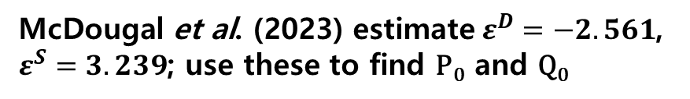
Price Elasticity Estimates & Equilibrium Estimation
McDougal et al. (2023) estimate$ε^{D}=−2.561$, $ε^{S}=3.239$; use these to find P₀ and Q₀
Price
$$MSC= λbQ^{γ}$$
$MPC=$ $bQ^{γ}$
Marginal
External
Cost
Deadweight
Loss
$1,214.57
Existing Taxes
$1,112.83
$$MB=aQ^{−α}$$
$1,038.45
Q₂
15.885
19.875
Quantity (millions)

Slide 10
Marginal External Cost Estimation
Regress gun-related homicides + accidental deaths
(NSC, 2024) on gun sales, controlling for population,
unemployment, depression; at the margin,
1 million more guns → ∿100 more deaths
Price
$$MSC= λbQ^{γ}$$
$MPC=$ $bQ^{γ}$
Marginal
External
Cost
Deadweight
Loss
$1,214.57
Existing Taxes
$1,112.83
$$MB=aQ^{−α}$$
$1,038.45
Q₂
15.885
19.875
Quantity (millions)

Slide 11




Marginal External Cost Estimation
Monetize marginal effect by Value of a Statistical Life
to get MEC₁. Then MSC₁ = MEC₁ + MPC₁,
and λ = MSC₁/MPC₁.
Price
$$MSC= λbQ^{γ}$$
$${MSC}_{0}≥$$
$\$$1,776.27
$MPC=$ $bQ^{γ}$
$${MSC}_{1}≥$$
$$\$1,657.55$$
$$λ≥1.596$$
$${MEC}_{1}≥$$
$$\$619.10$$
$1,214.57
Existing Taxes
$1,112.83
$$MB=aQ^{−α}$$
$1,038.45
Q₂
15.885
19.875
Quantity (millions)

Slide 12


Deadweight Loss Estimates
Price
Use elasticities to estimate Q₂ .
Integrate to get DWL₀ and DWL₁.
$$MSC= λbQ^{γ}$$
$${MSC}_{0}≥$$
$\$$1,776.27
$MPC=$ $bQ^{γ}$
$${MSC}_{1}≥$$
$$\$1,657.55$$
$$λ≥1.596$$
$${DWL}_{1}≥\$1.36b$$
$${DWL}_{0}≥\$3.585b$$
$1,214.57
Existing Taxes
$1,112.83
$$MB=aQ^{−α}$$
$1,038.45
10.18
15.885
19.875
Quantity (millions)

Slide 13

Estimates of Pigouvian Tax Rate and Revenue
Price
Calculate Pigouvian tax rate and tax revenue at Q₂.
$$MSC= λbQ^{γ}$$
$${MSC}_{0}≥$$
$\$$1,776.27
$MPC=$ $bQ^{γ}$
$${MSC}_{1}≥$$
$$\$1,657.55$$
$1,444.93
$$λ≥1.596$$
$${DWL}_{1}≥\$1.36b$$
TR ≥ $5.5b
Pigouvian
Tax ≥ 59.62%
$${DWL}_{0}≥\$3.585b$$
$1,214.57
Existing Taxes
$1,112.83
$$MB=aQ^{−α}$$
$1,038.45
$905.23
10.18
15.885
18.875
Quantity (millions)

Slide 14
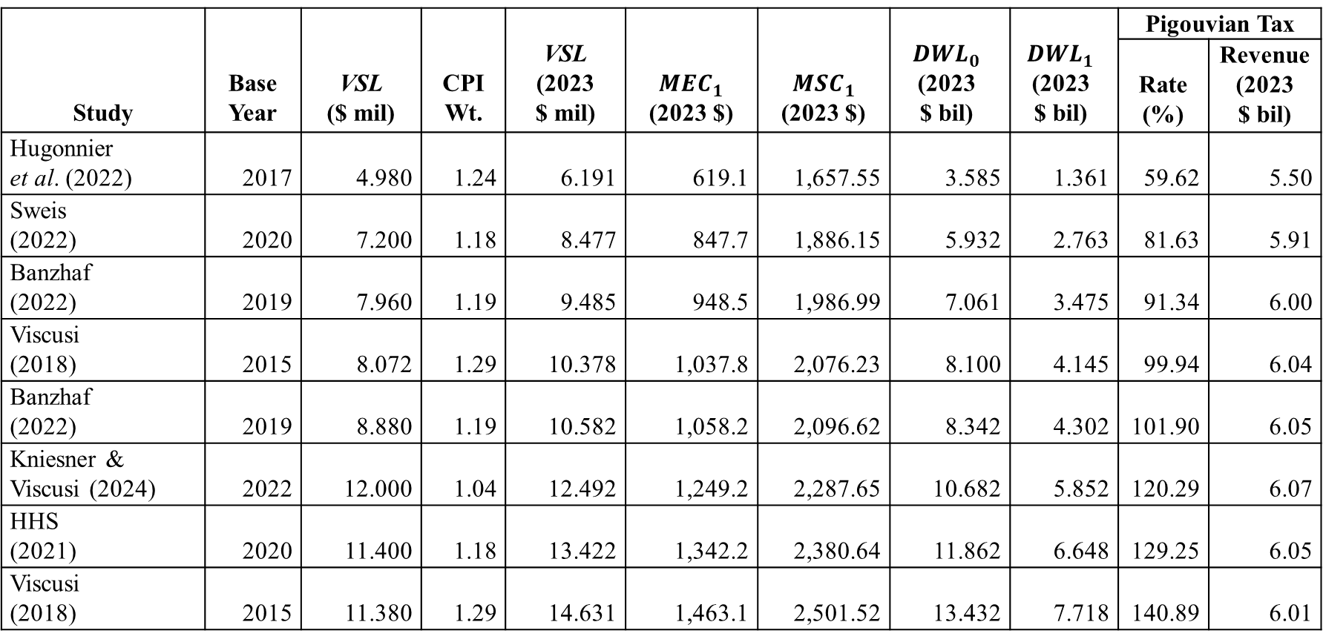
Value of a Statistical Life, Marginal External Cost, Deadweight Loss, and Pigouvian Tax
Study | Base Year | VSL ($ mil) | CPI Wt. | VSL (2023 $ mil) | $${MEC}_{1}$$ (2023 $) | $${MSC}_{1}$$ (2023 $) | $${DWL}_{0}$$ (2023 $ bil) | $${DWL}_{1}$$ (2023 $ bil) | Pigouvian Tax
 |  |  |  |  |  |  |  |  | Rate (%) | Revenue (2023 $ bil)
Hugonnier et al. (2022) | 2017 | 4.980 | 1.24 | 6.191 | 619.1 | 1,657.55 | 3.585 | 1.361 | 59.62 | 5.50
Sweis (2022) | 2020 | 7.200 | 1.18 | 8.477 | 847.7 | 1,886.15 | 5.932 | 2.763 | 81.63 | 5.91
Banzhaf (2022) | 2019 | 7.960 | 1.19 | 9.485 | 948.5 | 1,986.99 | 7.061 | 3.475 | 91.34 | 6.00
Viscusi (2018) | 2015 | 8.072 | 1.29 | 10.378 | 1,037.8 | 2,076.23 | 8.100 | 4.145 | 99.94 | 6.04
Banzhaf (2022) | 2019 | 8.880 | 1.19 | 10.582 | 1,058.2 | 2,096.62 | 8.342 | 4.302 | 101.90 | 6.05
Kniesner & Viscusi (2024) | 2022 | 12.000 | 1.04 | 12.492 | 1,249.2 | 2,287.65 | 10.682 | 5.852 | 120.29 | 6.07
HHS (2021) | 2020 | 11.400 | 1.18 | 13.422 | 1,342.2 | 2,380.64 | 11.862 | 6.648 | 129.25 | 6.05
Viscusi (2018) | 2015 | 11.380 | 1.29 | 14.631 | 1,463.1 | 2,501.52 | 13.432 | 7.718 | 140.89 | 6.01

Slide 15
Conclusions & Caveats
Conclusions 1. Current taxes erode at least $2.223 billion in deadweight loss annually.
At present, a deadweight loss of at least $1.361 billion remains.
Eliminating deadweight loss requires a Pigouvian tax of at least 59.62%.
Gun sales would decline from 15.885 million to 10.18 million per year.
Tax revenue would equal about $5.5 billion.
Caveats
Estimates are conservative:
* Nonfatal gun-related injuries were excluded
* Armed robberies, other crimes with guns were excluded
* Gun-related suicides were excluded
* Estimates use the lowest available VSL.
Buyer and seller preferences are taken as fixed.
There are practical limits to tax tolerance.

