Slide 1
Monetary Policy, Bank Regulation and the Secular Decline of Bank Balance Sheet Lending
Greg Buchak, Gregor Matvos, Tomasz Piskorski, Amit Seru
July 2025

Slide 2
Bank Balance Sheet Model of Financial Intermediation
Bank Balance Sheet Centrality:
    Bank balance sheets are primary way to connect savers and borrowers
      Bank issues deposits to savers and uses proceeds to lend to borrowers
Implications for monetary policy/costs of macroprudential regulation:
    If bank lending is not very substitutable,
    And/or bank balance sheets critical in facilitating non-bank lending:
    → Bank regulation impedes aggregate lending/financial activity
How central is bank balance sheet intermediation?
    Do impediments to bank balance sheet lending affect aggregate lending?
    How does this impact bank regulation and monetary policy pass-through?
This paper: Banks’ evolving role over last 60 years in the US
    Study potential reasons and regulatory/ monetary policy implications
    Approach: Macro and micro evidence & structural model of intermediation

Slide 3
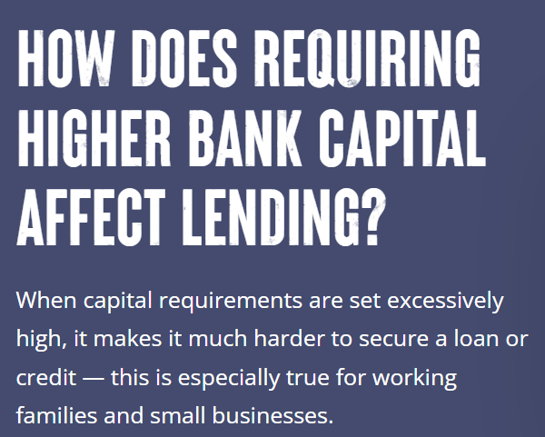

Bank Balance Sheet View

Slide 4
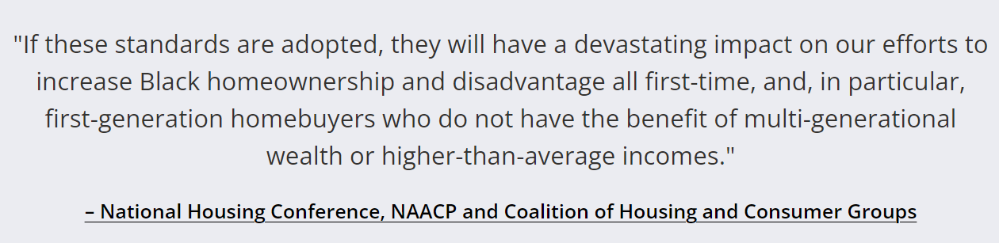

Bank Balance Sheet View
Jamie Dimon, Senate Committee on Banking, Housing, and Urban Affairs, December 6, 2023

Slide 5
Bank Balance Sheet Model of Financial Intermediation
Bank Balance Sheet Centrality:
    Bank balance sheets are primary way to connect savers and borrowers
      Bank issues deposits to savers and uses proceeds to lend to borrowers
Implications for monetary policy/costs of macroprudential regulation:
    If bank lending is not very substitutable,
    And/or bank balance sheets critical in facilitating non-bank lending:
    → Bank regulation impedes aggregate lending/financial activity
How central is bank balance sheet intermediation?
    Do impediments to bank balance sheet lending affect aggregate lending?
    How does this impact bank regulation and monetary policy pass-through?
This paper: Banks’ evolving role over last 60 years in the US
    Study potential reasons and regulatory/ monetary policy implications
    Approach: Macro and micro evidence & structural model of intermediation

Slide 6
Facts: Decline of Bank Balance Sheet Banking Since 1960
Fact 1 (Lending): Decline in “informationally sensitive” bank balance sheet leading
    55% to 35%
    Across all major segments (corporate loans, auto loans, credit cards, mortgages)
Fact 2 (Saving): Decline in deposits as a share of savings
    21% to 13%
Fact 3 (Banks): Decline in bank loan to asset ratio and tilt towards securities
    70% to 55%
Substitution towards OTD
“Debt Securities” & “Non-Deposit” Savings
Bank and OTD complementarities

Slide 7
Mechanisms and Suggestive Micro Evidence
Growing Demand/Tech/Regulations for Informationally Insensitive Lending
    Rise of GSEs → broadens what is financeable with debt securities
    Rise of CMOs, CDOs, ABS → relaxes information frictions in secondary markets
    Creation of FICO scores, bank IT → hard information, aids in securitization
    Changes in nature of investable projects (e.g., more intangible assets)
Shift in Preferences/Tech/Regulations toward Alternative Saving Technologies
    Liberalization of savings technologies → rise of non-deposit savings vehicles
    Increased wealth → less demand for transaction accounts
Regulatory Changes Reshaping Bank Balance Sheets
    Bank deregulation/re-regulation → bank incentives to own liquid securities vs loans
Impact of Unconventional Monetary Policies on Lending Trends
    Large purchases of MBS → reduces rates for informationally insensitive lending

Slide 8
Quantitative model of intermediation
1) Model Building Blocks
    Households & rest of world save; firms & households borrow
    Financial intermediation sector
      - Banks: Issue deposits, & info sensitive loans, and manage balance sheet
      - OTD lenders: informationally insensitive loans financed with debt securities
      (includes non-bank and OTD bank lending)
    Banks (1) partially fund OTD production and (2) purchase OTD debt securities
      → Banks act as a substitute AND complement for non-bank intermediation
      → Bank centric intermediation possible with large OTD sector
2) Separately identify structural shifts in intermediation demand and supply
    Borrower-driven (shift in demand curve for bank vs. non-bank loans)
    Saver-driven (shift in demand curve for deposits vs. other savings techs)
    Bank-driven (changing costs of bank balance sheet activities)
    Monetary policy (changes in conventional and unconventional policies)

Slide 9
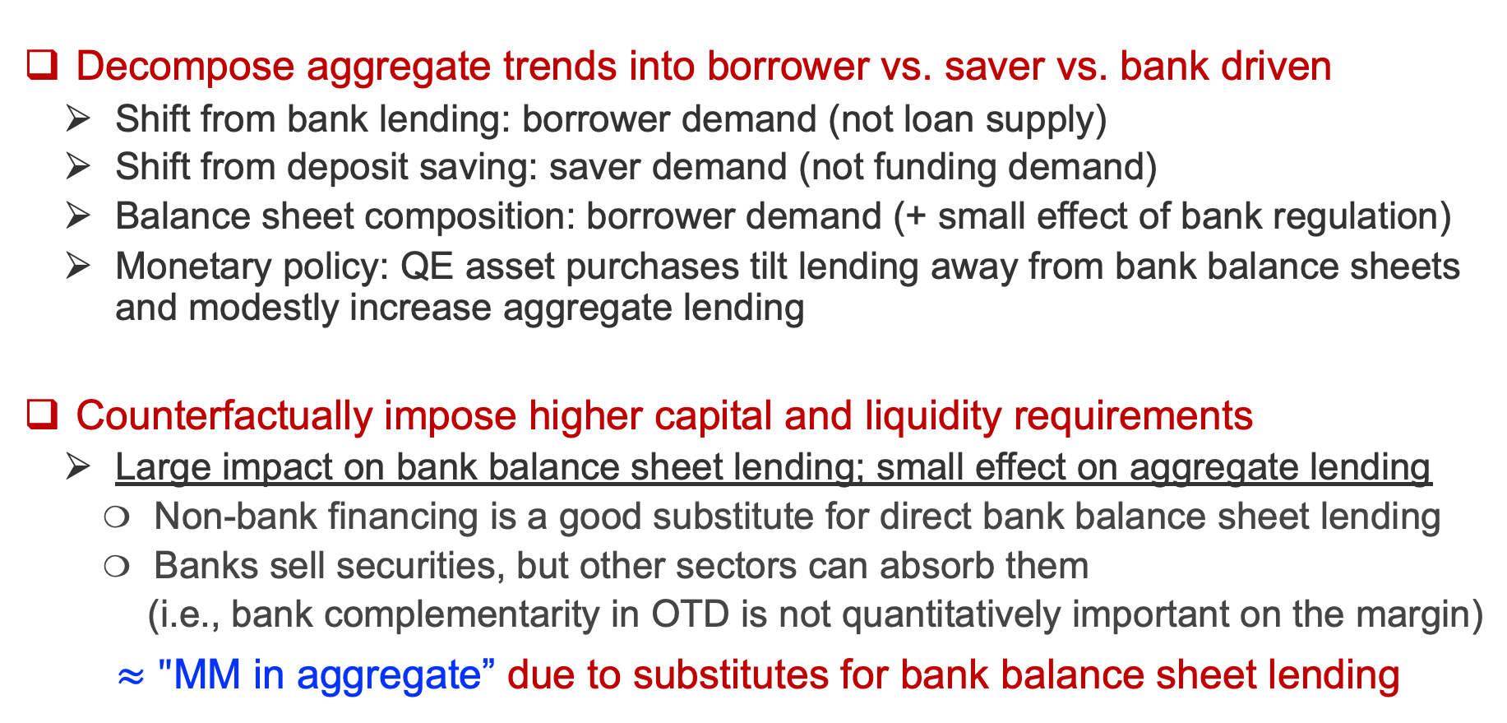
Use model to decompose trends & run counterfactuals
Decompose aggregate trends into borrower vs. saver vs. bank driven
  Shift from bank lending: borrower demand (not loan supply)
  Shift from deposit saving: saver demand (not funding demand)
  Balance sheet composition: borrower demand (+ small effect of bank regulation)
  Monetary policy: QE asset purchases tilt lending away from bank balance sheets and modestly increase aggregate lending
Counterfactually impose higher capital and liquidity requirements
  Large impact on bank balance sheet lending; small effect on aggregate lending
    Non-bank financing is a good substitute for direct bank balance sheet lending
    Banks sell securities, but other sectors can absorb them
    (i.e., bank complementarity in OTD is not quantitatively important on the margin)
$≈"$MM in aggregate” due to substitutes for bank balance sheet lending

Slide 10
Use model to decompose trends & run counterfactuals
Monetary policy pass-through
  Conventional policy (interest rate changes): Benchmark rate decrease
    Bank loans, deposit rates, and debt security yields decrease
    Bank, non-bank, (and therefore total) lending increases
  Unconventional policy: QE asset purchases (MBS)
    Main rate impact is on MBS rates (passed through to non-bank lending)
    Increase in non-bank lending
    Decrease in bank balance sheet lending
    Total lending increases
    → Measurement implications: wrong magnitude and wrong sign if
    only measuring bank lending

Slide 11
Data and Aggregate Trends

Slide 12
Total Lending and Market Segments
Data: Flow of Funds of the United States, Federal Reserve System
Total Lending: Outstanding debt of households and non-financial businesses
Lending Market Segments
  “Informationally sensitive” bank balance sheet lending
    Loans on balance sheets of depository institutions
    Requires bank screening/monitoring
      (Perhaps enabled by taking deposits, e.g., branch network, Diamond/Rajan 2001, etc.)
    Implicit qualitative assumption of bank specialness (data will tell us how special quantitatively)
  “Debt securities”: Total lending less “informationally sensitive” lending
    Government–affiliated lending (Lending through Agency/GSE MBS)
    Private debt lending (E.g., lending through corporate bonds, private debt)
    Exclude directly-on-government-balance sheet lending (e.g., federal student loans)

Slide 13
Stylized Flow of Funds
(Maps to data from Fed Flow of Funds)
Bank sector
Private borrower sector
Saver sector
Sensitive loans | Bank deposits
Other assets
Securities
Reserves | Bank equity
Borrower assets | Informationally sensitive loans
 | Informationally insensitive loans
Bank deposits | Saver net worth
Bank equity
Other assets
Securities
Informationally insensitive: marketable, due to, e.g., low information asymmetry between originator and potential buyer
Qualitative assumption of bank specialness
Quantify with data
OTD Lenders
Central Bank
Insensitive loans | Securities
 | Sensitive loans
Other assets | Reserves
Securities | Other liabilities

Slide 14
Fact 1: Bank Balance Sheet Share in Total Lending
55%
Technological/institutional changes in lending
First MBS securitizations: Ginnie (1970); Freddie (1971); Fannie (1981)
First private securitizations: residential mortgages (1970), CRE loans (1979), auto loans (1985), credit cards (1987)
First CLO, high-yield bonds, etc. (1987/1980s)
Computers & data processing capabilities (1980s); FICO score (1989)
33%

Slide 15
Consistent trends by borrower segment
Mortgages and Non-Mortgages
Business and Consumer Credit

Slide 16
Robustness
Including Unutilized (Bank) Credit Lines
Including Private Debt (Prequin)

Slide 17
Fact 2: Deposits Share of Financial Wealth
Deposits / Financial Wealth
21%
Technological/institutional changes
Money market funds (1970s)
Pension funds (ERISA 1974; Tax Reform Act 1986)
13%

Slide 18
Fact 3: Loan Share of Bank Assets
70%
55%
Regulatory costs/subsidies
S&L Crisis (1980s/90s)
Dodd-Frank/Basel II, III (2008 onwards)

Slide 19
Fact 3: Bank/Non-bank lending complementarities
Securities share of bank assets
Bank loans to non-banks / non-bank lending
Banks directly finance OTD sector
Banks own securities
produced by OTD sector

Slide 20
Fact 3: Bank/Non-bank lending complementarities
All-in Bank Financing Share

Slide 21
Stylized Flow of Funds
Bank sector
Private borrower sector
Saver sector
Sensitive loans | Bank deposits
Other assets
Securities
Reserves | Bank equity
Borrower assets | Informationally sensitive loans
 | Informationally insensitive loans
Bank deposits | Saver net worth
Bank equity
Other assets
Securities
OTD Lenders
Insensitive loans | Securities
 | Sensitive loans

Slide 22
Stylized Flow of Funds
Bank sector
Private borrower sector
Saver sector
Sensitive loans | Bank deposits
Other assets
Securities
Reserves | Bank equity
Borrower assets | Informationally sensitive loans
 | Informationally insensitive loans
Bank deposits | Saver net worth
Bank equity
Other assets
Securities
Fed assets and MBS holdings (in $T)
Reserve to asset ratio of banks (in %)
OTD Lenders
Central Bank
Insensitive loans | Securities
 | Sensitive loans
Other assets | Reserves
Securities | Other liabilities

Slide 23
Micro Evidence on Mechanisms
Non-exhaustive examples
Relaxation of GSE conforming limit → lending more amenable to securitization
  Exposed banks sell more loans, increase security holdings
Rise of MMF/non-deposit “money” and rise of retirement funds
  Shadow money share of saver financial assets rises
  Decline in deposit share of savings
Post GFC bank liquidity regulation
  Exposed banks increase securities holdings
Quantitative Easing polices
  Increased demand for info insensitive lending (debt securities)
  Shift away from info insensitive lending

Slide 24
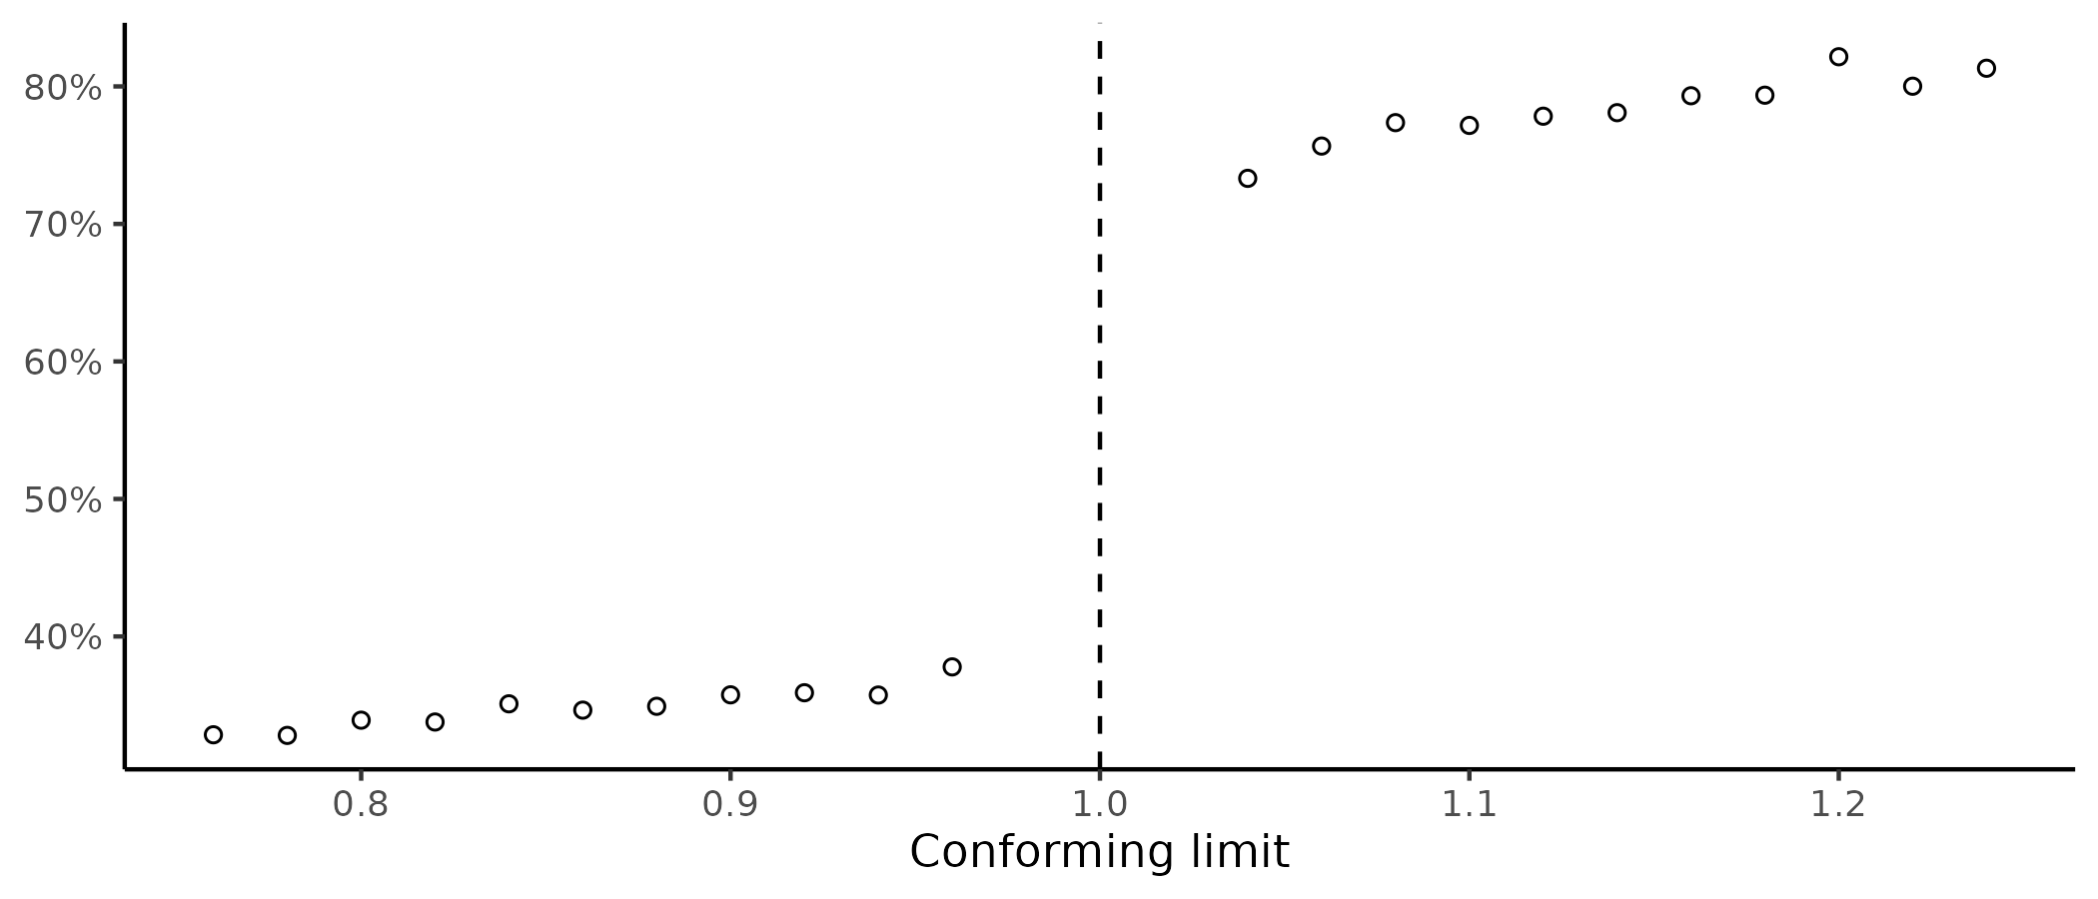
1. Borrower side: Tech/institutional expansion of informationally insensitive lending
Example: Introduction/expansion of MBS securitization
Access to OTD leads to a large decline in bank balance sheet lending share
Not securitizable mortgages
Requires screening/monitoring
Remain on bank balance sheets
Bank loan share
Securitizable mortgages
GSE credit guarantees
Sold into securitizations

Slide 25
1. Borrower side: Tech/institutional expansion of informationally insensitive lending
Exploit banks’ exposure to conforming loan limit changes
Banks with more securitization eligibility respond by:
Owning fewer loans
Owning more securities

Slide 26
2. Saver side: Rise of “shadow money”
Shadow money share
of saver financial assets
Shadow money financing share of private credit
Shadow money = MMF, closed-end funds, ETFs, mutual funds

Slide 27
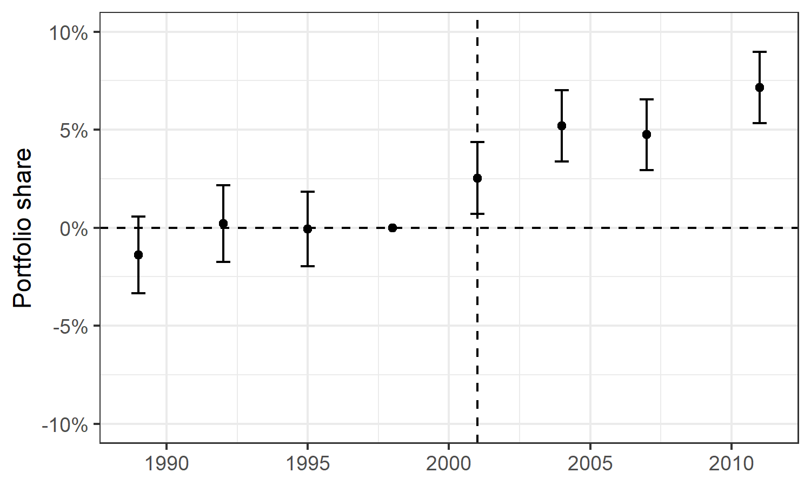
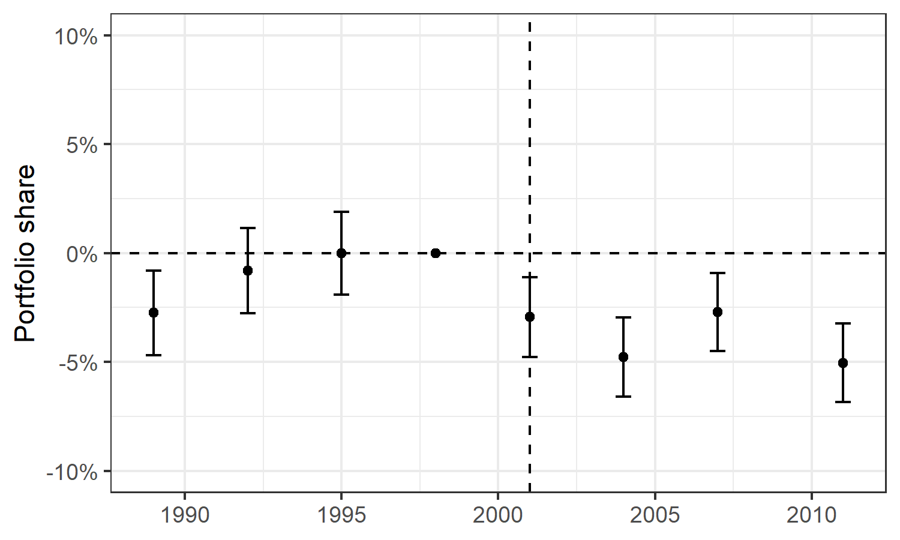
2. Saver side: Retirement funds → shifts in saving composition and decline in deposit share
Retirement account portfolio weight
Bank deposit portfolio weight
Decline in deposit portfolio share of households
2001: Economic Growth and Tax Relief Reconciliation Act
increased contribution limits on defined contribution plans

Slide 28
3. Regulatory requirements → shifts in bank business models
Basel III/Dodd-Frank liquidity requirements disadvantage holding loans (vs. securities)
Persistent impact on most affected (large banks)
→ relative decrease in loan-to-asset ratio

Slide 29
4. QE → shifts away from bank balance sheet lending
Fed financial assets and MBS holdings (in $T)
QE4
QE polices launched AFTER major decline in bank balance sheet lending that occurred during 1970-2000
So cannot account for most of it…
QE1
Fed MBS Holdings

Slide 30
4. QE → shifts away from bank balance sheet lending
QE focused on purchasing debt securities (MBS) increases bank loan sales and results in a decline in bank balance sheet lending share

Slide 31
4. QE → shifts away from bank balance sheet lending
Reserve to asset ratio of depository institutions (in %)
QE polices associated with tilt in composition of bank balance sheets towards reserves

Slide 32
4. QE → shifts away from bank balance sheet lending
QE focused on purchasing debt securities (MBS) changes composition of bank assets away from loans and debt securities towards reserves

Slide 33
Model Setup

Slide 34
Model Overview
Sectors:
  Savers: allocate savings among savings technologies
  Borrowers: borrow using lending technologies
  Financial intermediaries: produce savings and lending technologies
Setup: repeated static cross-sections
  Focus on secular trends (not business-cycle frequency)
  Simple consumption/savings decision but no dynamics (i.e., won’t have much to say on bank capital shocks)
  Not fully GE, i.e., risk-free rate given exogenously
Allow (but don’t impose) MM deviations: data informs importance of deviations
  E.g., deposits can be “special”/”deposit franchise” (but don’t have to be)
  E.g., banks can be special in lending (but don’t have to be)
  E.g., better capitalized banks can be more productive in lending (but don’t have to be)

Slide 35
Model Overview
Bank balance sheets and OTD
Can own securities
Joint production in securitization (e.g., bank monitor in CLO)
Bank sector
Private borrower sector
Saver sector
Sensitive loans | Bank deposits
Other assets
Securities
Reserves | Bank equity
Borrower assets | Sensitive loans
 | Insensitive loans
Bank deposits | Saver net worth
Bank equity
Other assets
Securities
CES demand for borrowing products
CES demand for liquid assets
Monopolistic competition to issue loans/deposits
Capital → lending efficiency
Liquidity (securities) → deposit issuance costs
Microfoundation
Some projects require bank screening/monitoring
CES demand for savings products
OTD Lenders
Insensitive loans | Securities
 | Sensitive loans
Microfoundation
Demand for liquidity
Saver demand

Slide 36
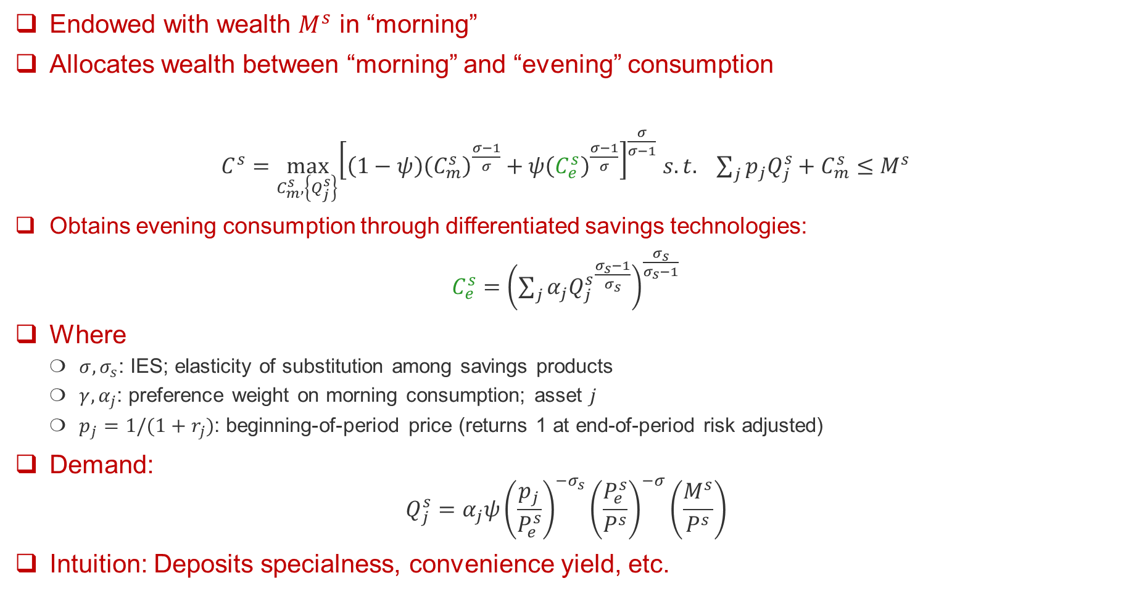
Savers
Endowed with wealth $M^{s}$ in “morning”
Allocates wealth between “morning” and “evening” consumption
$C^{s}=\max_{C_{m}^{s},\left\{Q_{j}^{s}\right\}}{{\left[\left(1−ψ\right){\left(C_{m}^{s}\right)}^{\frac{σ−1}{σ}}+ψ{\left(C_{e}^{s}\right)}^{\frac{σ−1}{σ}}\right]}^{\frac{σ}{σ−1}}}$ $s.t. \sum_{j}{p_{j}Q_{j}^{s}+C_{m}^{s}≤M^{s}}$
Obtains evening consumption through differentiated savings technologies:
$C_{e}^{s}=$ ${\left(\sum_{j}{α_{j}{Q_{j}^{s}}^{\frac{σ_{s}−1}{σ_{s}}}}\right)}^{\frac{σ_{s}}{σ_{s}−1}}$
Where
  $σ, σ_{s}$: IES; elasticity of substitution among savings products
  $γ, α_{j}$: preference weight on morning consumption; asset $j$
  $p_{j}=1/{(1+r}_{j})$: beginning-of-period price (returns 1 at end-of-period risk adjusted)
Demand:
$$Q_{j}^{s}=α_{j}ψ{\left(\frac{p_{j}}{P_{e}^{s}}\right)}^{−σ_{s}}{\left(\frac{P_{e}^{s}}{P^{s}}\right)}^{−σ}\left(\frac{M^{s}}{P^{s}}\right)$$
Intuition: Deposits specialness, convenience yield, etc.

Slide 37
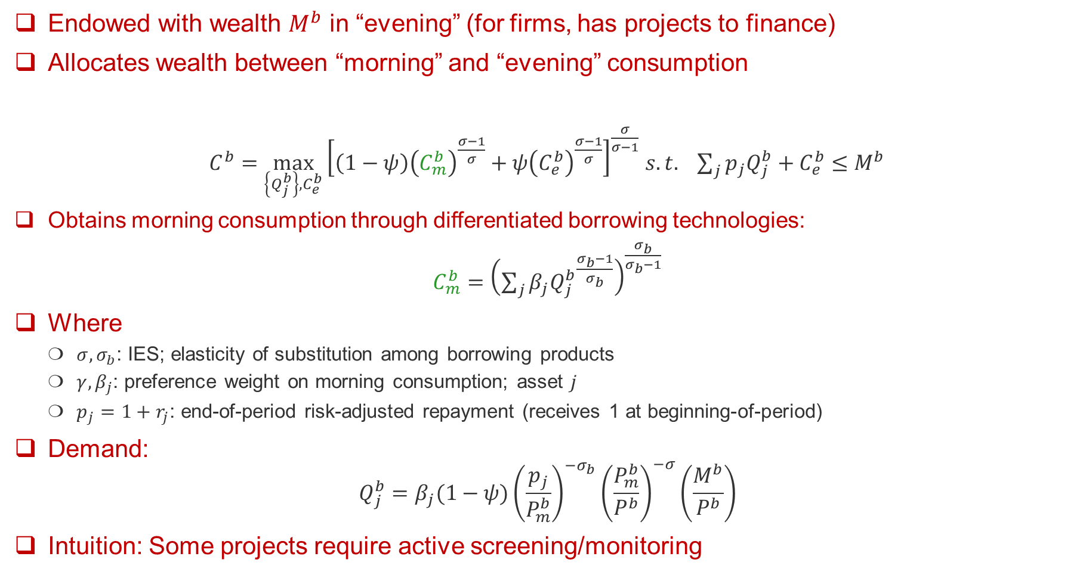
Borrowers
Endowed with wealth $M^{b}$ in “evening” (for firms, has projects to finance)
Allocates wealth between “morning” and “evening” consumption
$C^{b}=\max_{\left\{Q_{j}^{b}\right\},C_{e}^{b}}{{\left[\left(1−ψ\right){\left(C_{m}^{b}\right)}^{\frac{σ−1}{σ}}+ψ{\left(C_{e}^{b}\right)}^{\frac{σ−1}{σ}}\right]}^{\frac{σ}{σ−1}}}$ $s.t. \sum_{j}{p_{j}Q_{j}^{b}+C_{e}^{b}≤M^{b}}$
Obtains morning consumption through differentiated borrowing technologies:
$C_{m}^{b}=$ ${\left(\sum_{j}{β_{j}{Q_{j}^{b}}^{\frac{σ_{b}−1}{σ_{b}}}}\right)}^{\frac{σ_{b}}{σ_{b}−1}}$
Where
  $σ, σ_{b}$: IES; elasticity of substitution among borrowing products
  $γ, β_{j}$: preference weight on morning consumption; asset $j$
  $p_{j}=1+r_{j}$: end-of-period risk-adjusted repayment (receives 1 at beginning-of-period)
Demand:
$$Q_{j}^{b}=β_{j}(1−ψ){\left(\frac{p_{j}}{P_{m}^{b}}\right)}^{−σ_{b}}{\left(\frac{P_{m}^{b}}{P^{b}}\right)}^{−σ}\left(\frac{M^{b}}{P^{b}}\right)$$
Intuition: Some projects require active screening/monitoring

Slide 38
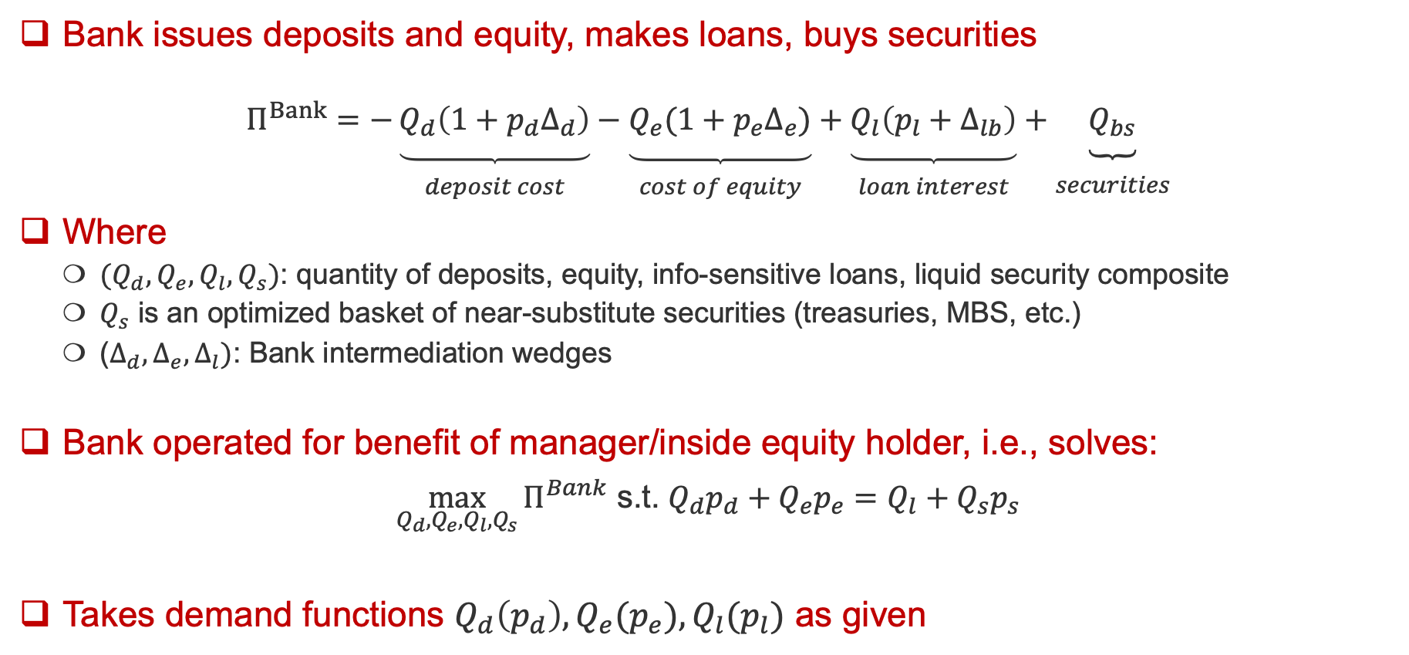
Bank Intermediaries
Bank issues deposits and equity, makes loans, buys securities
$$Π^{Bank}=−\underset{\begin{aligned} \\ deposit cost\end{aligned}}{\underbrace{Q_{d}\left(1+p_{d}Δ_{d}\right)}}−\underset{\begin{aligned} \\ cost of equity\end{aligned}}{\underbrace{Q_{e}(1+p_{e}Δ_{e})}}+\underset{\begin{aligned} \\ loan interest\end{aligned}}{\underbrace{Q_{l}\left(p_{l}+Δ_{lb}\right)}}+\underset{\begin{aligned} \\ securities\end{aligned}}{\underbrace{Q_{bs}}}$$
Where
  ${(Q}_{d},Q_{e},Q_{l},Q_{s})$: quantity of deposits, equity, info-sensitive loans, liquid security composite
  $Q_{s}$ is an optimized basket of near-substitute securities (treasuries, MBS, etc.)
  ($Δ_{d},Δ_{e},Δ_{l})$: Bank intermediation wedges
Bank operated for benefit of manager/inside equity holder, i.e., solves:
$\max_{Q_{d},Q_{e},Q_{l},Q_{s}}{Π^{Bank}}$ s.t. $Q_{d}p_{d}+Q_{e}p_{e}=Q_{l}+Q_{s}p_{s}$
Takes demand functions $Q_{d}\left(p_{d}\right),Q_{e}{(p}_{e}),Q_{l}(p_{l})$ as given

Slide 39
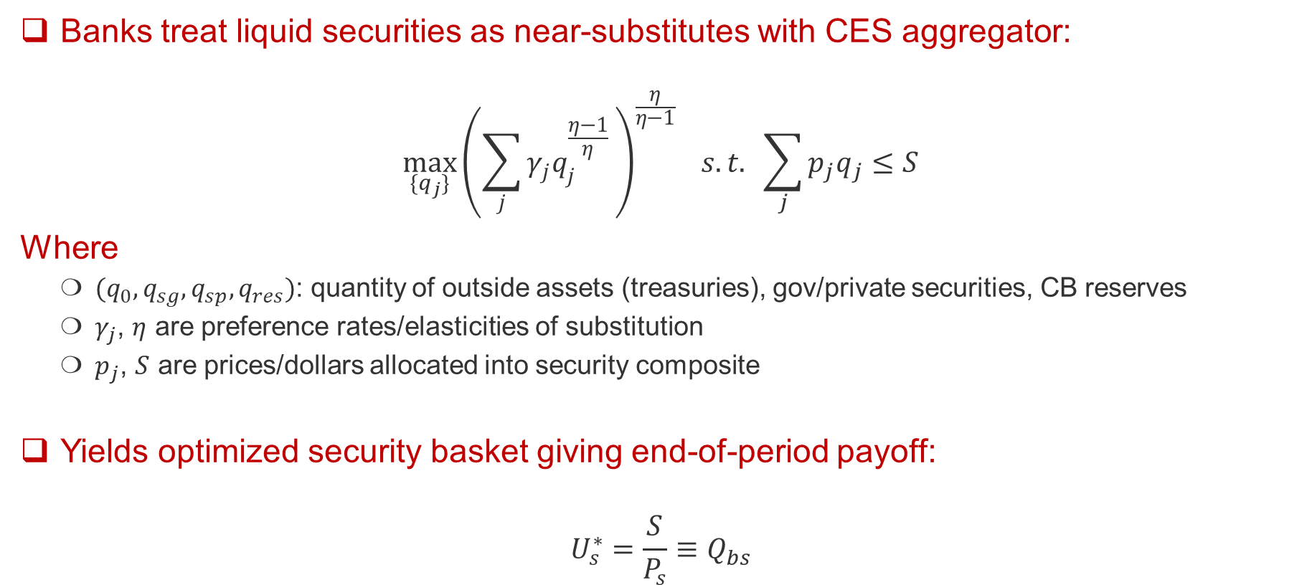
Bank Security Holdings
Banks treat liquid securities as near-substitutes with CES aggregator:
$$\max_{\{q_{j}\}}{{\left(\sum_{j}{γ_{j}q_{j}^{\frac{η−1}{η} }}\right)}^{\frac{η}{η−1}} } s.t. \sum_{j}{p_{j}q_{j}≤S}$$
Where
  ${(q}_{0},q_{sg},q_{sp},q_{res})$: quantity of outside assets (treasuries), gov/private securities, CB reserves
  $γ_{j}$, $η$ are preference rates/elasticities of substitution
  $p_{j}$, $S$ are prices/dollars allocated into security composite
Yields optimized security basket giving end-of-period payoff:
$$U_{s}^{∗}=\frac{S}{P_{s}}≡Q_{bs}$$

Slide 40
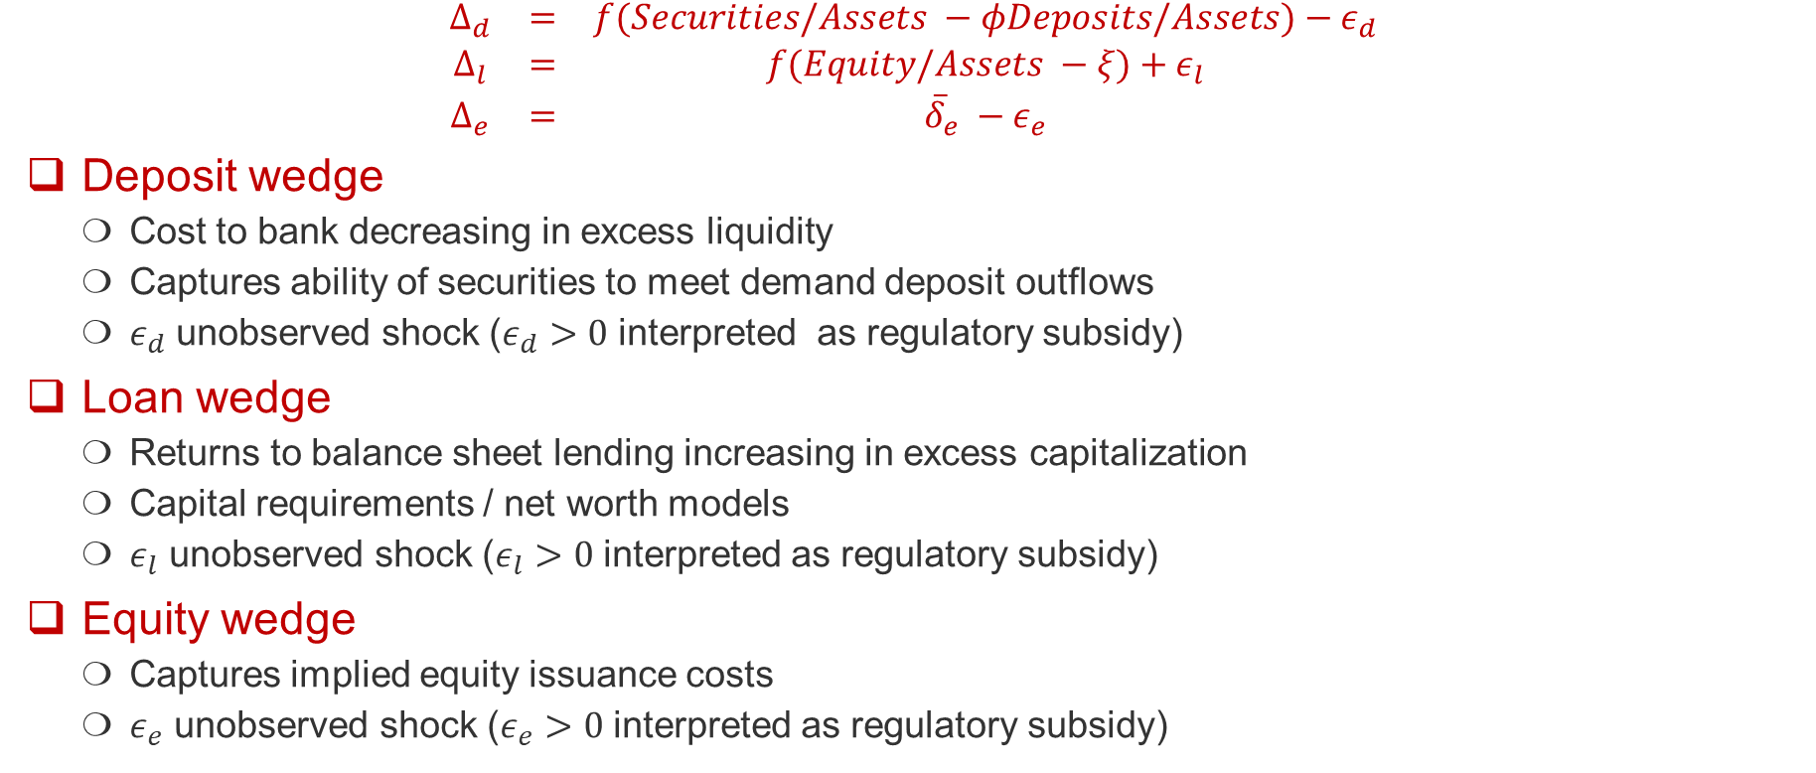
Bank Intermediation Wedges
$$\begin{matrix}Δ_{d} & = & f(Securities/Assets −φDeposits/Assets)−ε_{d} \\ Δ_{l} & = & f(Equity/Assets −ξ)+ε_{l} \\ Δ_{e} & = & {\overline{δ}}_{e} −ε_{e}\end{matrix}$$
Deposit wedge
  Cost to bank decreasing in excess liquidity
  Captures ability of securities to meet demand deposit outflows
  $ε_{d}$ unobserved shock ($ε_{d}>0$ interpreted as regulatory subsidy)
Loan wedge
  Returns to balance sheet lending increasing in excess capitalization
  Capital requirements / net worth models
  $ε_{l}$ unobserved shock ($ε_{l}>0$ interpreted as regulatory subsidy)
Equity wedge
  Captures implied equity issuance costs
  $ε_{e}$ unobserved shock ($ε_{e}>0$ interpreted as regulatory subsidy)

Slide 41
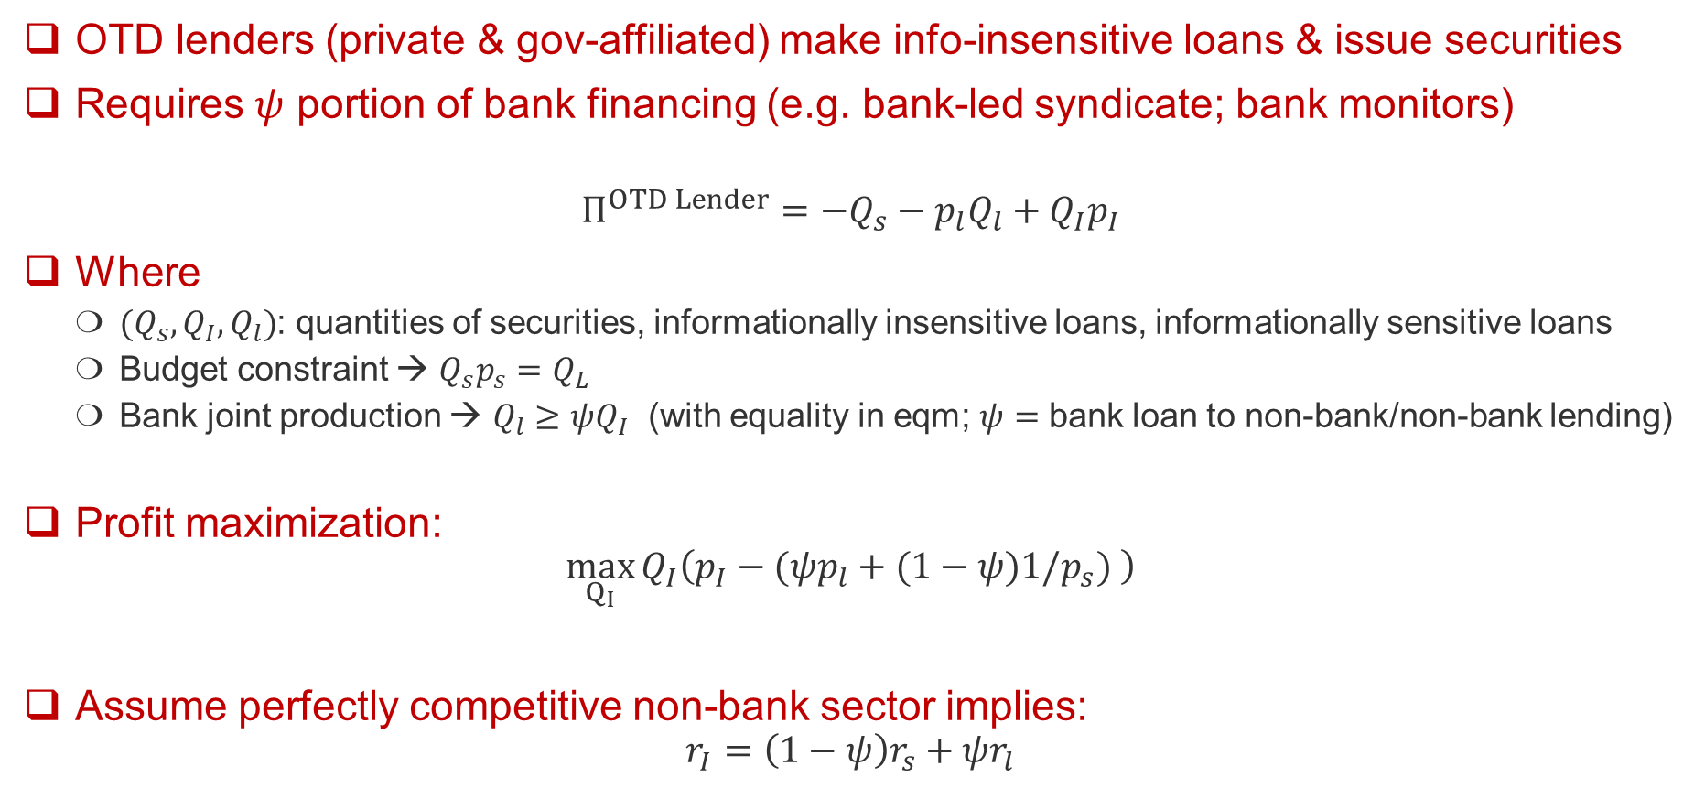
OTD Intermediaries (non-banks, OTD banks)
OTD lenders (private & gov-affiliated) make info-insensitive loans & issue securities
Requires $ψ$ portion of bank financing (e.g. bank-led syndicate; bank monitors)
$$Π^{OTD Lender}=−Q_{s}−p_{l}Q_{l}+Q_{I}p_{I}$$
Where
  ${(Q}_{s},Q_{I},Q_{l})$: quantities of securities, informationally insensitive loans, informationally sensitive loans
  Budget constraint → $Q_{s}p_{s}=Q_{L}$
  Bank joint production → $Q_{l}≥ψQ_{I}$ (with equality in eqm; $ψ=$ bank loan to non-bank/non-bank lending)
Profit maximization:
$$\max_{Q_{I}}{Q_{I}\left(p_{I}−(ψp_{l}+(1−ψ)1/p_{s}) \right)}$$
Assume perfectly competitive non-bank sector implies:
$$r_{I}=\left(1−ψ\right)r_{s}+ψr_{l}$$

Slide 42
Estimation & Interpretation

Slide 43
Estimation 1: Intermediary Demand for Liquid Assets
Bank liquid asset demand implies relationship between liquid asset shares and rates
Overidentified GMM to recover parameters
  Instrument rates with central bank asset holdings
Liquid assets are highly substitutable from banks’ perspective

Slide 44
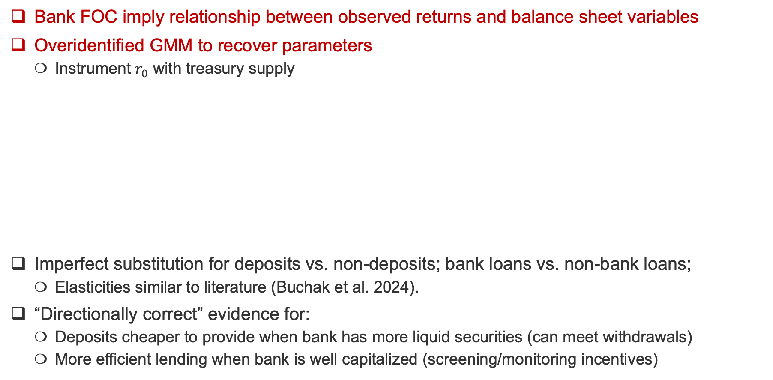
Estimation 2: Passthrough of Treasury Rates (IV)
Bank FOC imply relationship between observed returns and balance sheet variables
Overidentified GMM to recover parameters
  Instrument $r_{0}$ with treasury supply
Imperfect substitution for deposits vs. non-deposits; bank loans vs. non-bank loans;
  Elasticities similar to literature (Buchak et al. 2024).
“Directionally correct” evidence for:
  Deposits cheaper to provide when bank has more liquid securities (can meet withdrawals)
  More efficient lending when bank is well capitalized (screening/monitoring incentives)

Slide 45
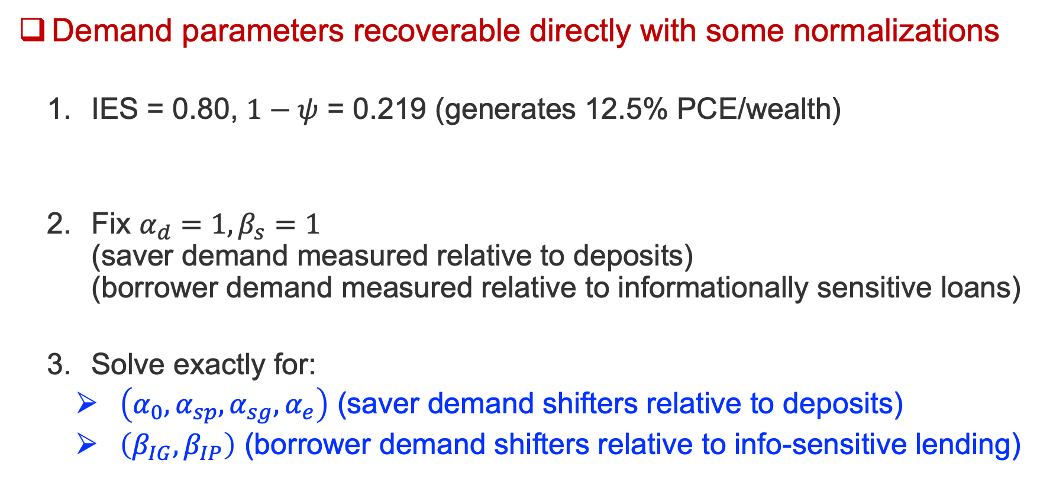
Estimation 3: Exactly-identified Demand Parameters
Demand parameters recoverable directly with some normalizations
  IES = 0.80, $1−ψ$ = 0.219 (generates 12.5% PCE/wealth)
  Fix $α_{d}=1, β_{s}=1$
  (saver demand measured relative to deposits)
  (borrower demand measured relative to informationally sensitive loans)
  Solve exactly for:
    $\left(α_{0},α_{sp},α_{sg},α_{e}\right)$ (saver demand shifters relative to deposits)
    $\left(β_{IG},β_{IP}\right)$ (borrower demand shifters relative to info-sensitive lending)

Slide 46
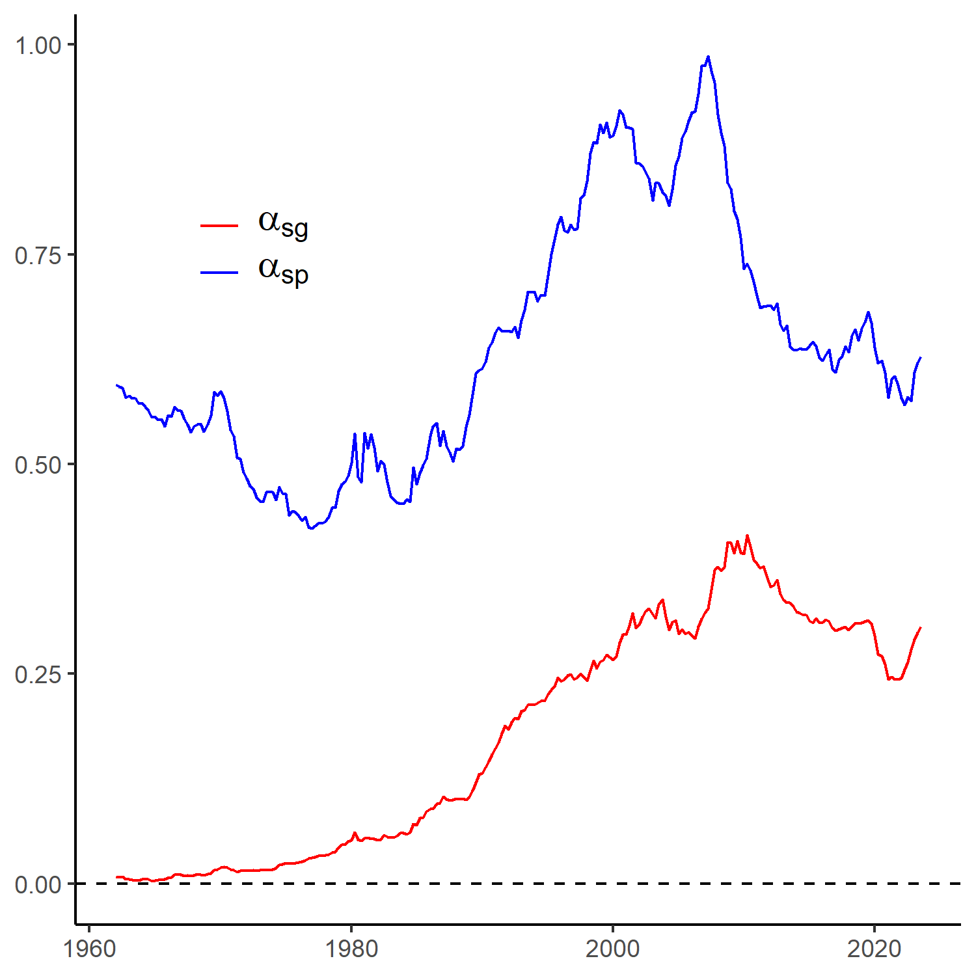
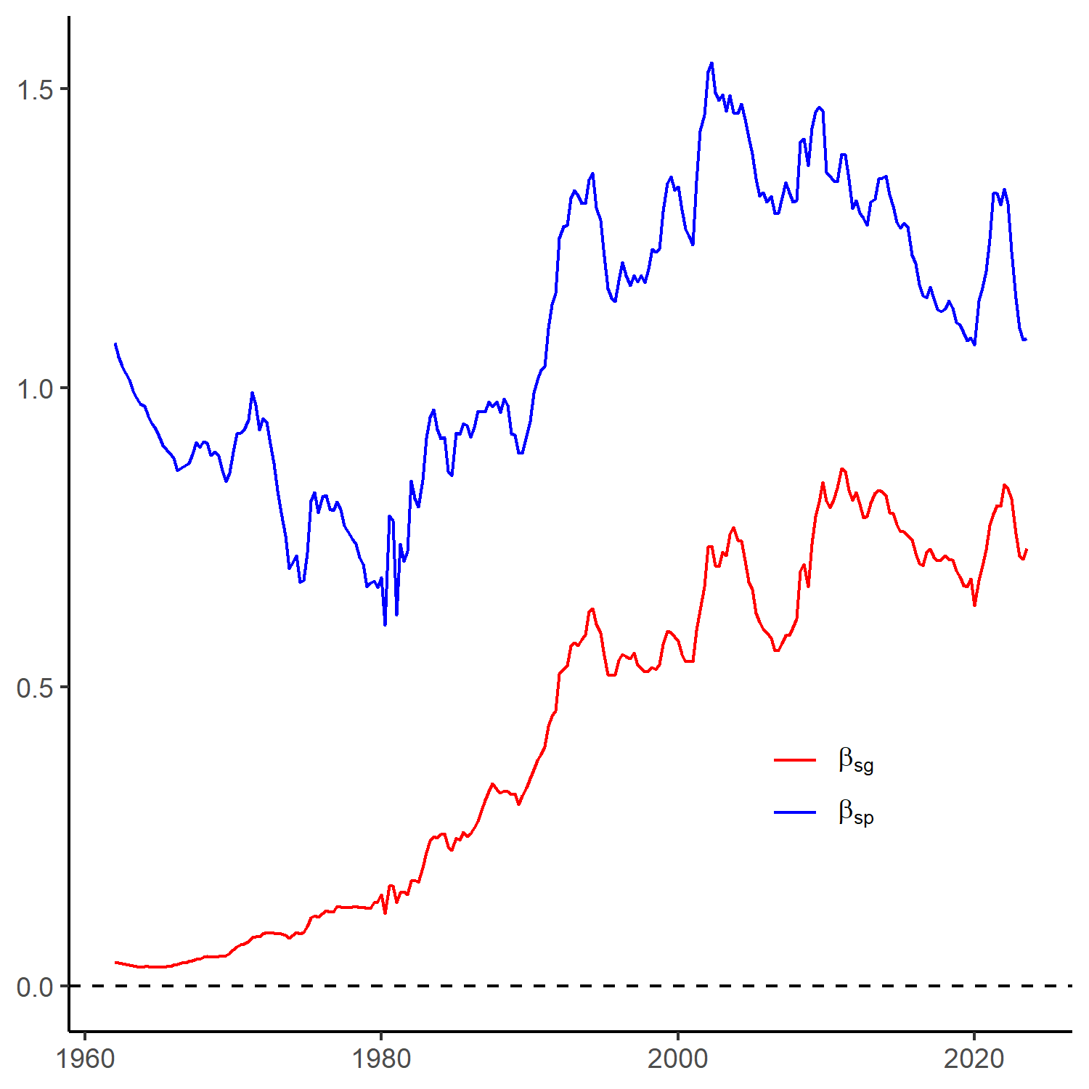
Estimation: Securitization Technology & Saver Preferences
Borrower demand shifters
Saver demand shifters

Slide 47
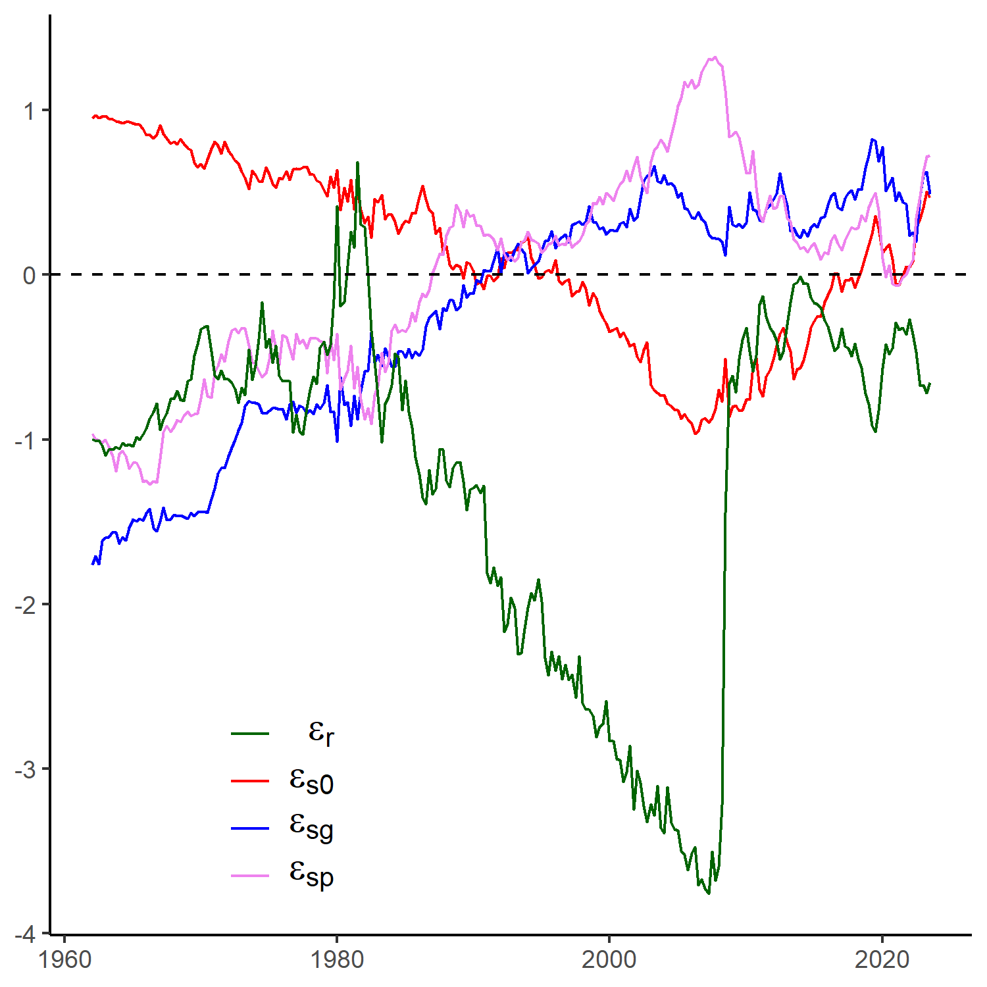
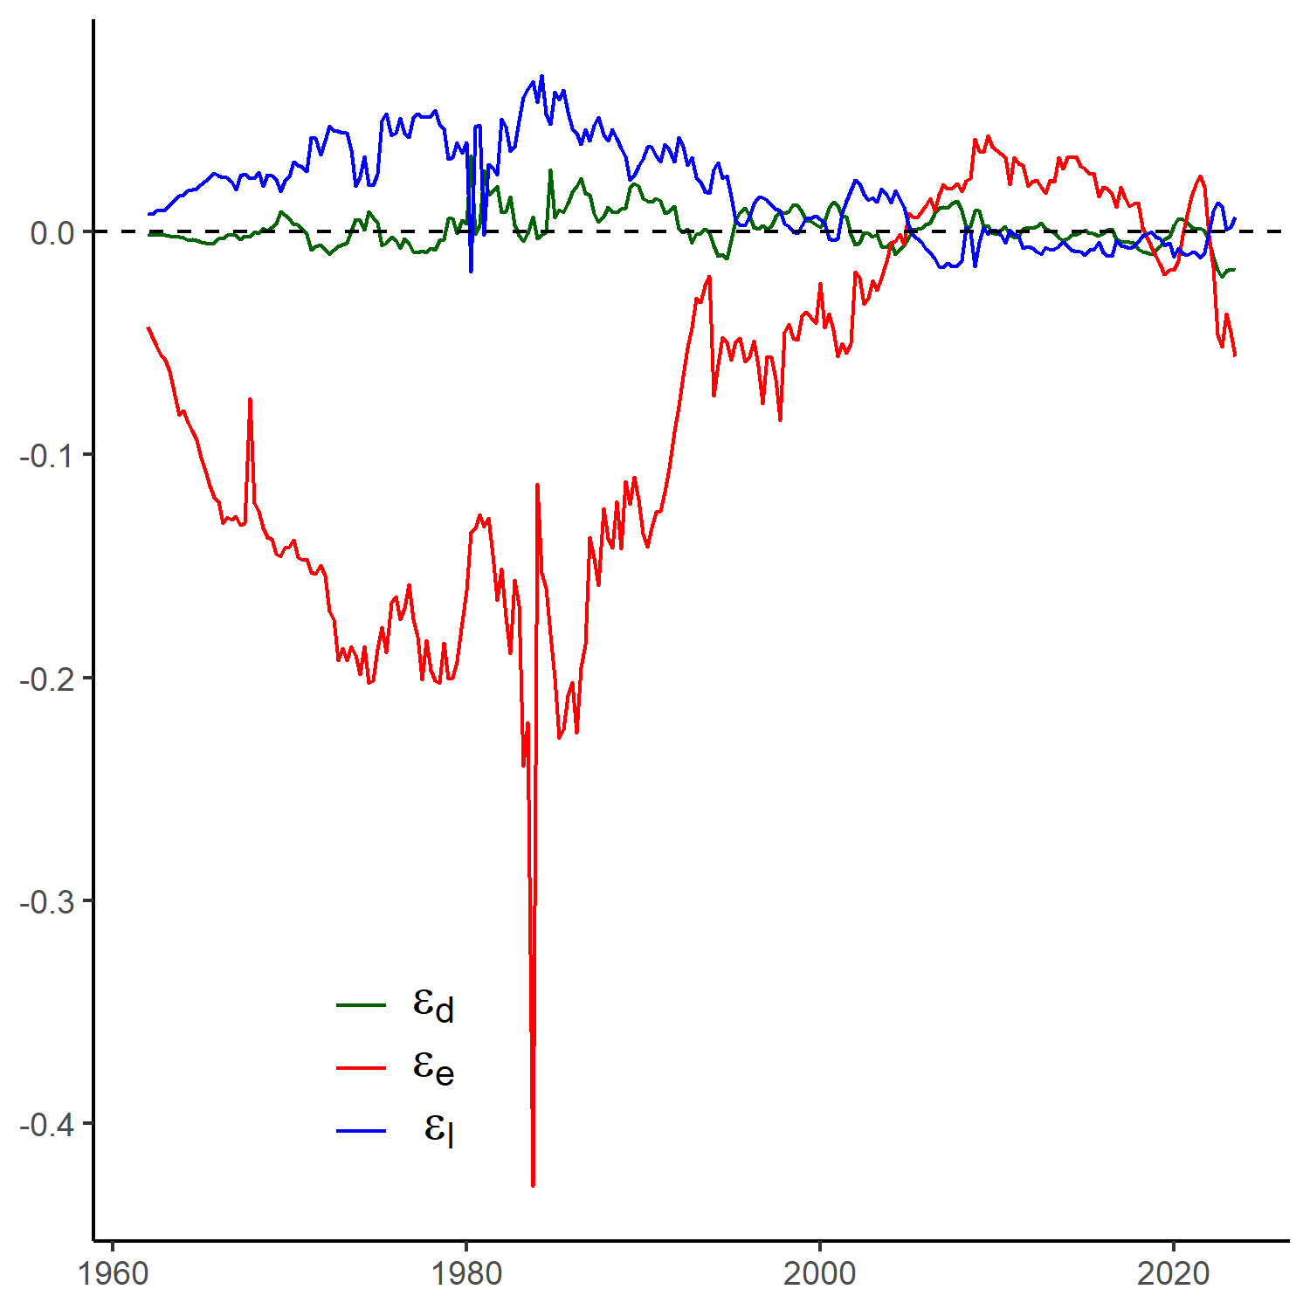
Estimation Results: Bank results
Bank liquid asset preferences
Intermediation return shocks

Slide 48
Interpreting demand shifters and epsilons
Saver and borrower demand shifters identified by:
  Observed quantities
  Observed prices
  Estimated demand elasticities
Interpret above by regressing on:
  “Regulation index:” Average of {0,1} indicators of regulatory changes, e.g.,
    Glass-Steagall, Dodd-Frank, Fannie/Freddie expansion, etc.
  “Technology index:” Average of {0,1} indicators of technological changes, e.g.,
  FICO score introduction, first CMBS, first MMF, ABCP, etc.
  Top 10% Wealth share (relevant for deposits)
  Real conforming loan limit (relevant for gov-backed securities)
  Intangibles & R&D expense / assets (relevant for private securities)

Slide 49
Interpreting demand shifters

Slide 50
Counterfactuals

Slide 51
Decomposing the secular decline of balance sheet lending
Compare world with
  1963 parameters
To world with
  2023 borrower demand shifters
  2023 saver demand shifters
  2023 subsidies/regulation
  2023 fed balance sheet
One-at-a-time and all together

Slide 52
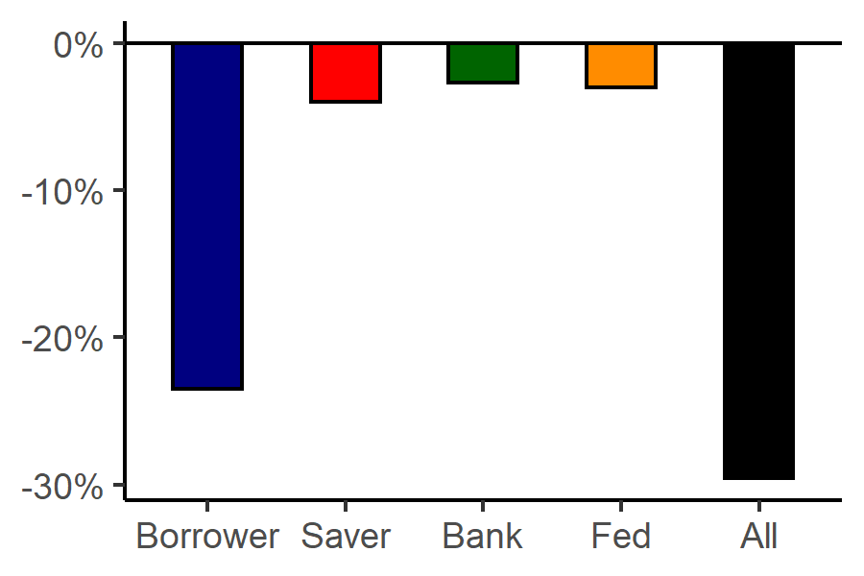
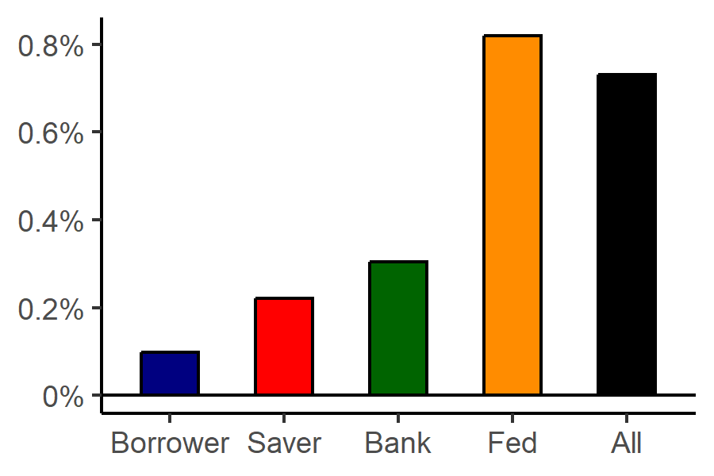
Decomposition: Bank balance sheet and total lending
Bank Balance Sheet Lending
Total Lending

Slide 53
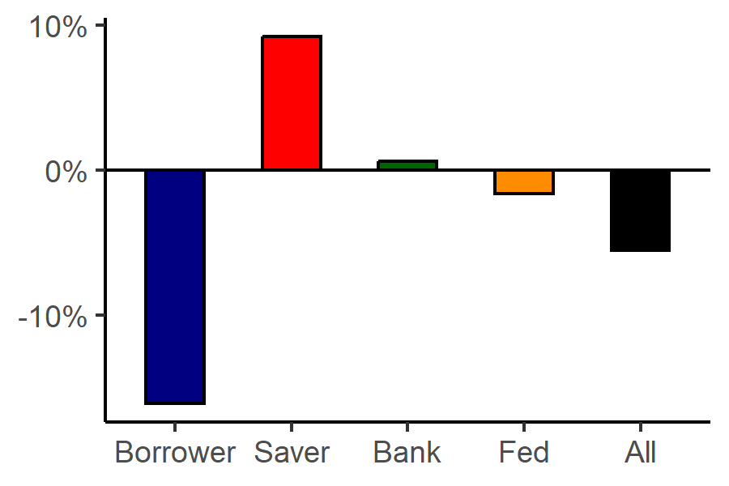
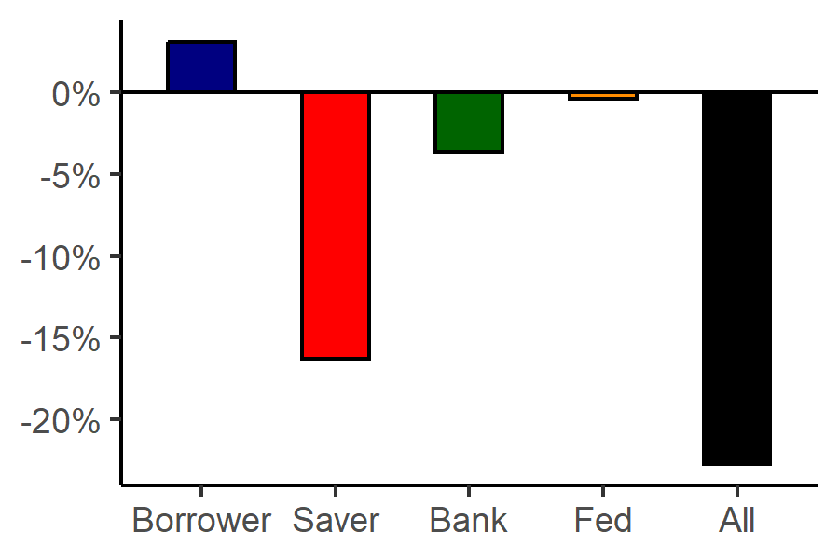
Decomposition: Bank balance sheet
Loan share of bank assets
Bank balance sheet size

Slide 54
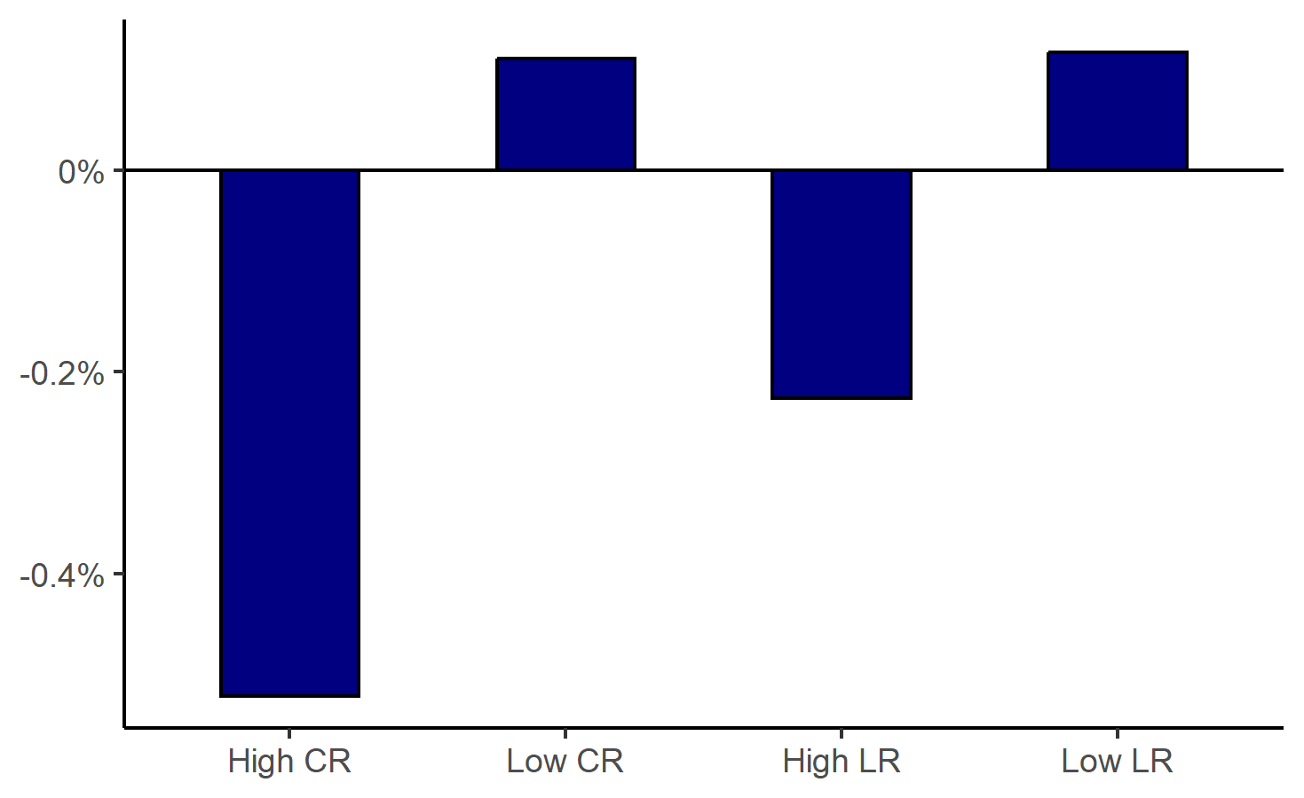
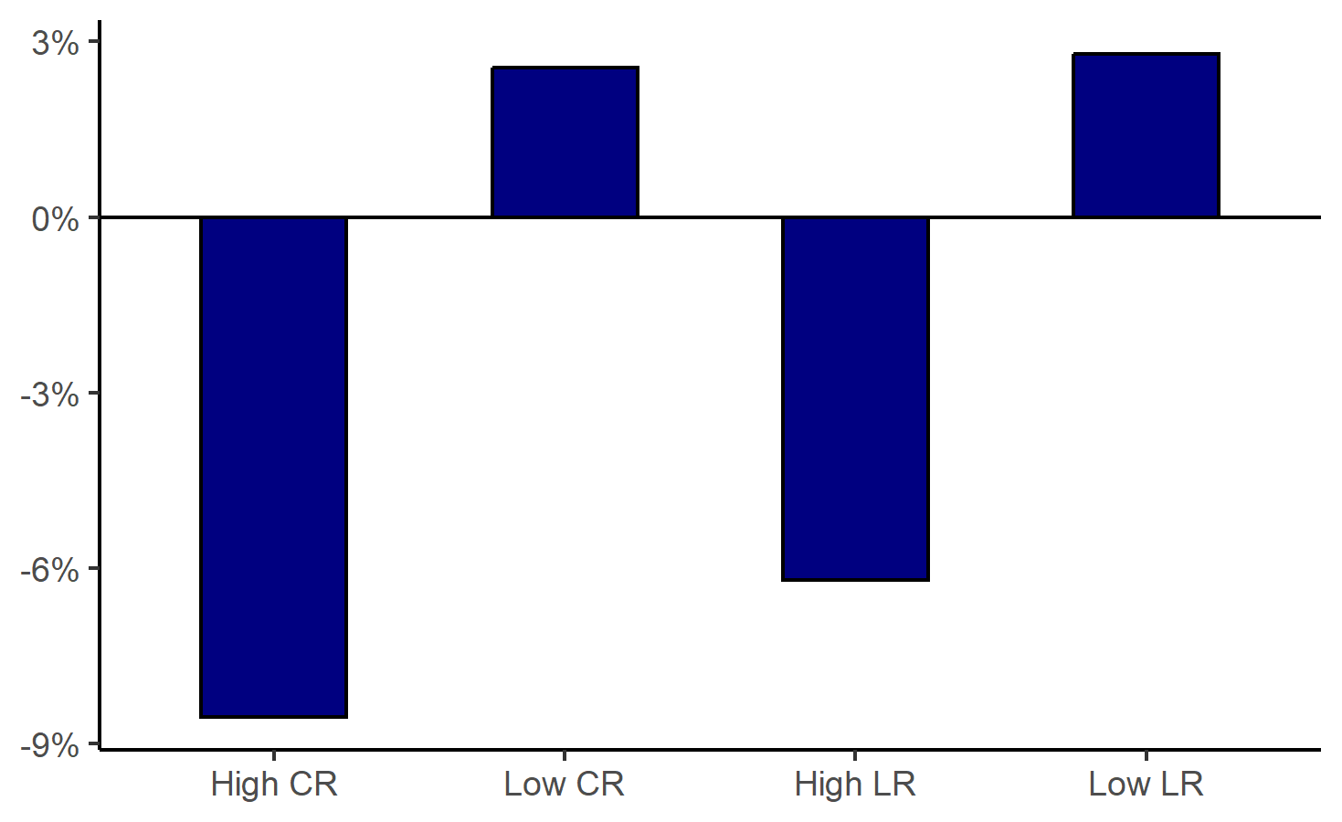
Counterfactual: Capital and Liquidity Requirements
Changes in total lending
Changes in bank balance sheet lending
~9% decline in bank balance sheet lending vs. 0.50% decline in total lending

Slide 55
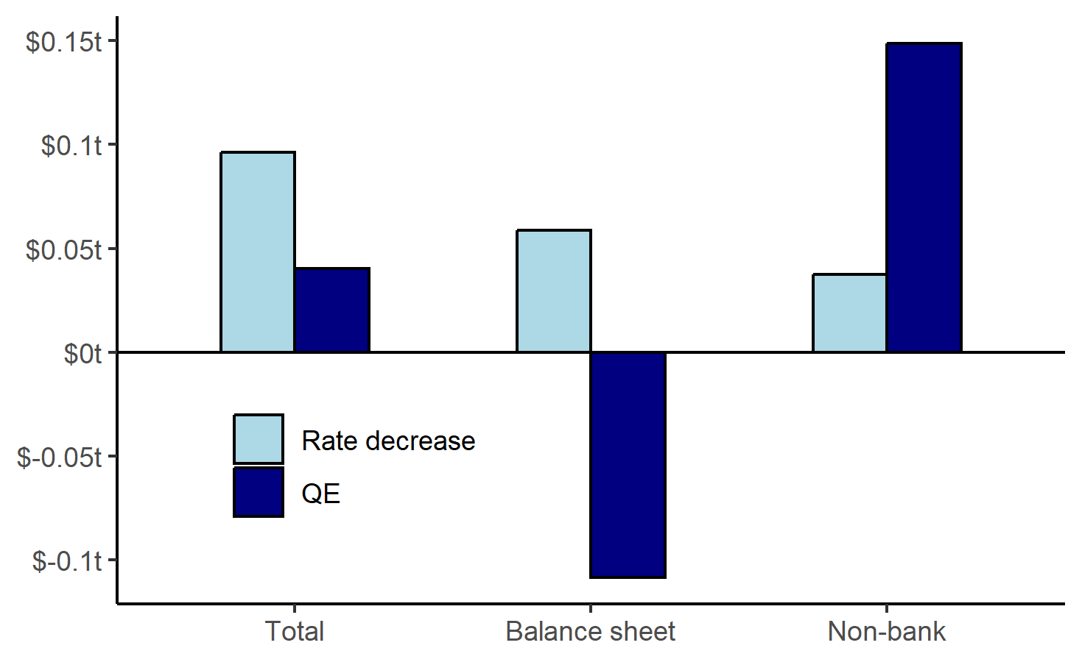
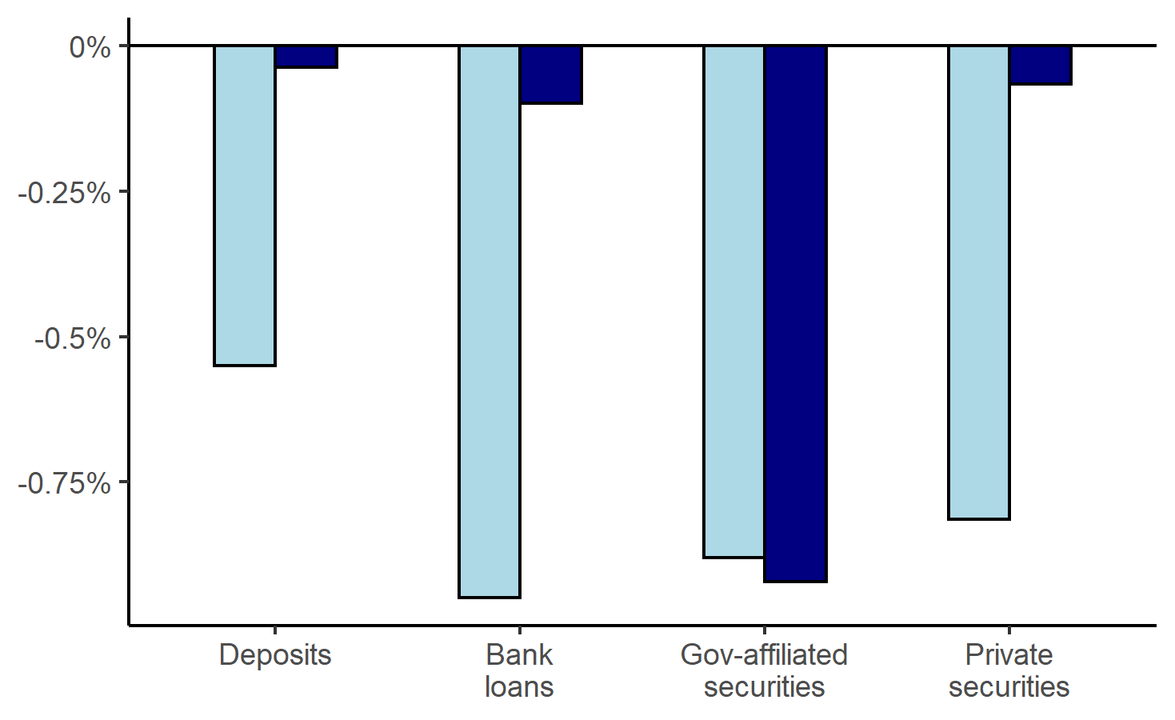
Mechanisms of Monetary Policy
Conventional: 1% rate decrease
Unconventional: $1.2tr Agency MBS purchase by Fed
Lending Quantities
Interest rates

Slide 56
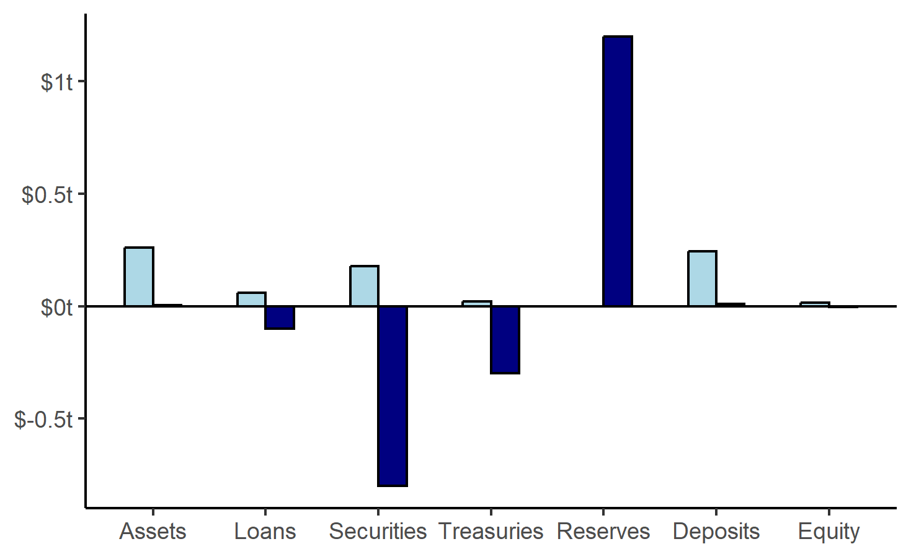
Mechanisms of Monetary Policy
Bank Balance Sheet Quantities

Slide 57
Conclusion
Declining importance of bank balance sheet lending (55% → 35%)
  Substantial transformation in the intermediation sector
  Implications for macroprudential policy and financial regulation
Increasing bank capital requirements → modest effects on aggregate lending
  Mainly just reallocation of credit…
  ...from bank balance sheets towards debt securities
  Bank substitution effect dominates bank complementarity effect
Modern financial intermediation and monetary policy pass-through
  Fed asset purchases reduce bank balance sheet lending and increase reserves
  Lending shifts away towards informationally insensitive credit (debt securities)
  Diminished bank role in screening may affect credit quality and stability
  QE influences not just lending volumes and rates, but also credit composition

Slide 58
Conclusion
Regulatory and monetary policy analysis should focus…
  …away from banks and on debt securities markets and non-bank lending to understand total lending…(”retention margin” and “migration margin”)
  …on measurement beyond banks: can get wrong magnitude or wrong sign!
  …on collecting data beyond balance sheet lending (beyond call reports)
  …on understanding IO of modern financial intermediation

