Slide 1
Learning by Evaluating: Evidence from 55 STEM journals
Charles Ayoubi¹, James M. Zumel Dumlao², Misha Teplitskiy²
¹ESSEC Business School
²University of Michigan School of Information
NBER SI Science of Science Funding
July 17, 2025

Slide 2
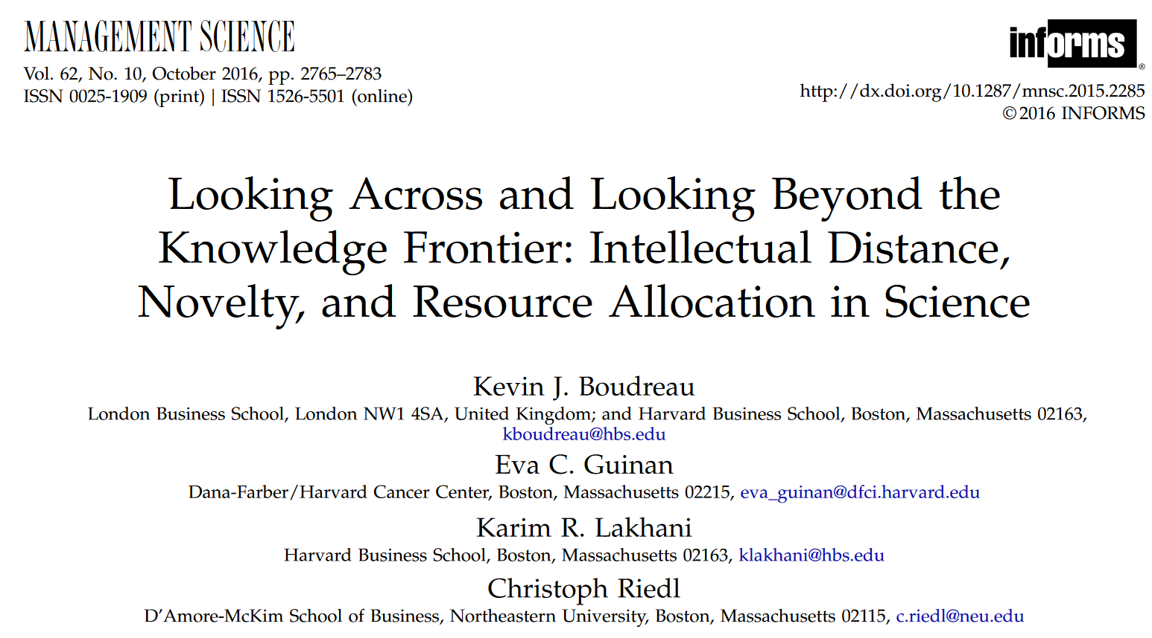
Evaluators play vital role in science and innovation
High-stakes decisions with far-reaching consequences
Scientific funding allocation shapes careers and knowledge production (Babina et al., 2023; Stephan, 2016; Jacob & Lefgren, 2011)
Resource allocation influences innovation trajectories (Wright et al., 2023; Franzoni et al., 2010; Ayoubi et al., 2020)
Design of expert evaluation systems affect decisions and outcomes
Notes:
Peer review directs ~65 million hours of expert attention annually
Over $2 billion worth in researcher time

Slide 3
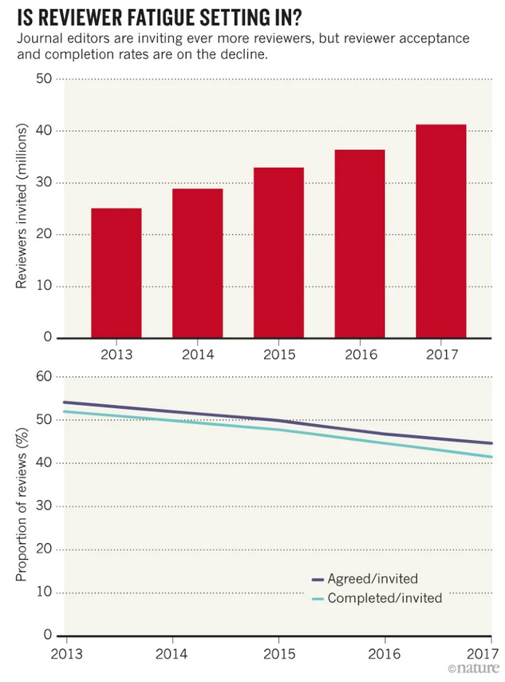
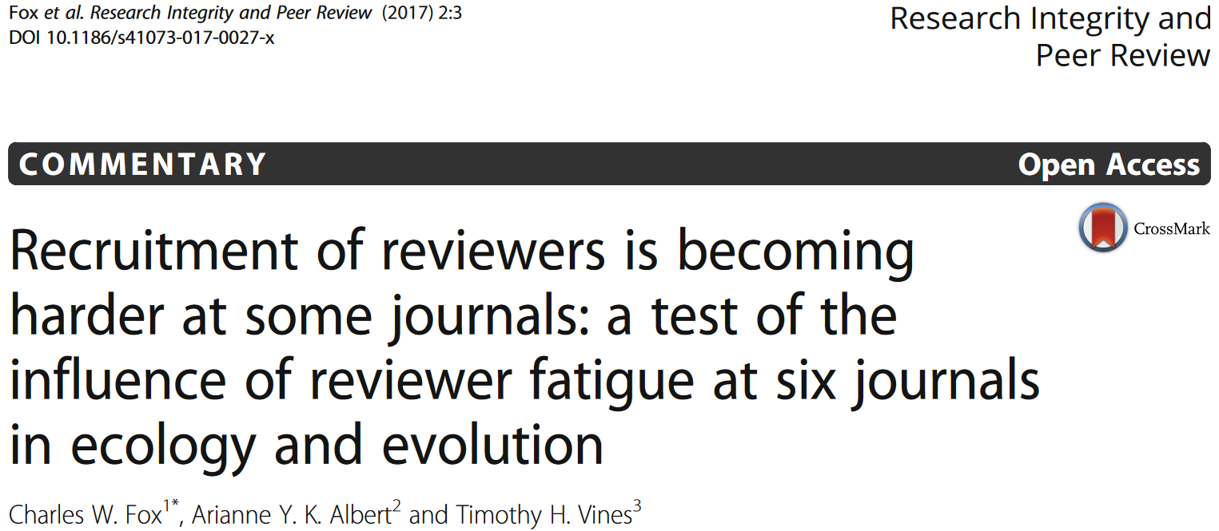
The Costs of Peer Review
Substantial system-level investment
Opportunity costs of expert time
Cognitive intensity and reviewer fatigue
Decision fatigue impacts judgement quality (Danziger et al., 2011)
Leading to potential biases (Criscuolo et al., 2021)
Vesper (2018)
NBER SI Science of Science Funding
3
Notes:
Peer review directs ~65 million hours of expert attention annually
Over $2 billion worth in researcher time
Evaluating requires substantial cognitive investment
Deep engagement with technical content
Critical assessment of methods and implications
Integration with existing knowledge frameworks

Slide 4
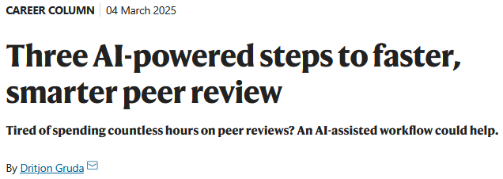
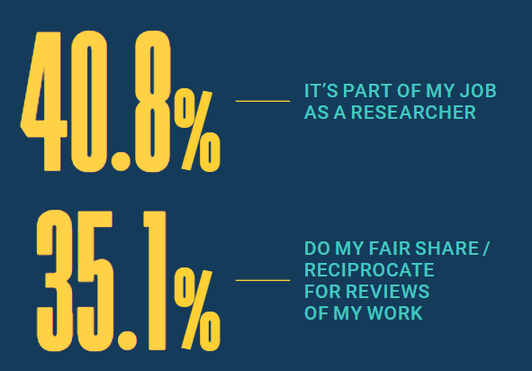
Peer Review Puzzle
Why do scientists participate in this seemingly under-incentivized activity?
Traditional explanations: reputation, relational contracting, pro-social motives
“Only 6% of reviewers noted… peer review enhanced their CV” (Walton, 2019)
Monetary incentives show limited effectiveness (Squazzoni et al., 2013; Else, 2025)
Publons (2018)
NBER SI Science of Science Funding
4
Notes:
Also from Walton “7% said it encouraged favourable views from editors”
We know all the costs, do we know the benefits?
We know benefits for submitters,
We know benefits for journals and the scientific system,
Seems only costly for reviewers, what are the benefits?
We think of reviewer benefit as indirect, second-order … altrusim

Slide 5
The Benefits of Peer Review
For submitting authors: Improved manuscripts (Garcia-Costa et al., 2022; Cobo et al., 2011)
For organizations: More efficient resource allocation (Boudreau et al., 2016; Li, 2017)
For science: Legitimation of new knowledge; setting research direction (Barbosu & Teodoridis, 2025)
For reviewers:
?
NBER SI Science of Science Funding
5
Notes:
Also from Walton “7% said it encouraged favourable views from editors”
We know all the costs, do we know the benefits?
We know benefits for submitters,
We know benefits for journals and the scientific system,
Seems only costly for reviewers, what are the benefits?
We think of reviewer benefit as indirect, second-order … altrusim

Slide 6
The Benefits of Peer Review
For submitting authors: Improved manuscripts (Garcia-Costa et al., 2022; Cobo et al., 2011)
For organizations: More efficient resource allocation (Boudreau et al., 2016; Li, 2017)
For science: Legitimation of new knowledge; setting research direction (Barbosu & Teodoridis, 2025)
For reviewers: Pro-social motives (indirect) + Learning?
Research Question: Do evaluators demonstrate learning through evaluating?
NBER SI Science of Science Funding
6
Notes:
Also from Walton “7% said it encouraged favourable views from editors”
We know all the costs, do we know the benefits?
We know benefits for submitters,
We know benefits for journals and the scientific system,
Seems only costly for reviewers, what are the benefits?
We think of reviewer benefit as indirect, second-order … altrusim

Slide 7
Theoretical Framework: What is Learning?
Learning requires three key elements (Argote, 2012; Argot & Ingram, 2000; Huber, 1991)
Peer review as structured commitment device, forces deep engagement (Bryan et al., 2010)
Evaluation requires active critical assessment, not passive consumption (i.e., integration)
Citations as evidence of knowledge deployment (Fleming, 2001; Schilling & Green, 2011; Lane et al., 2020)
NBER SI Science of Science Funding
7
Notes:
Also from Walton “7% said it encouraged favourable views from editors”

Slide 8
Empirical Setting & Approach
Data
Peer review metadata from Institute of Physics Publishing
All but full text of manuscripts and reviews
Matched to OpenAlex records
Analytic Sample
104,306 reviews
45,435 submissions (2018-2019)
Published in IOP or elsewhere
55 STEM journals
NBER SI Science of Science Funding
8
Notes:
Also from Walton “7% said it encouraged favourable views from editors”

Slide 9
Empirical Setting & Approach
“Treatment” Group
Accepted invitation and submitted evaluation
“Control” Group
Similarly qualified invited reviewers, responded “Declined-Unavailable”
Availability exogenous to learning/citation likelihood
Excluded reviewers who declined for other reasons (e.g., conflict of interest, out of field) or did not respond
Manuscript Fixed Effects
Comparing invited reviewers of same submission
Controlling between-submission variation
Quality, topic, team size, etc.
NBER SI Science of Science Funding
9
Notes:
Also from Walton “7% said it encouraged favourable views from editors”

Slide 10
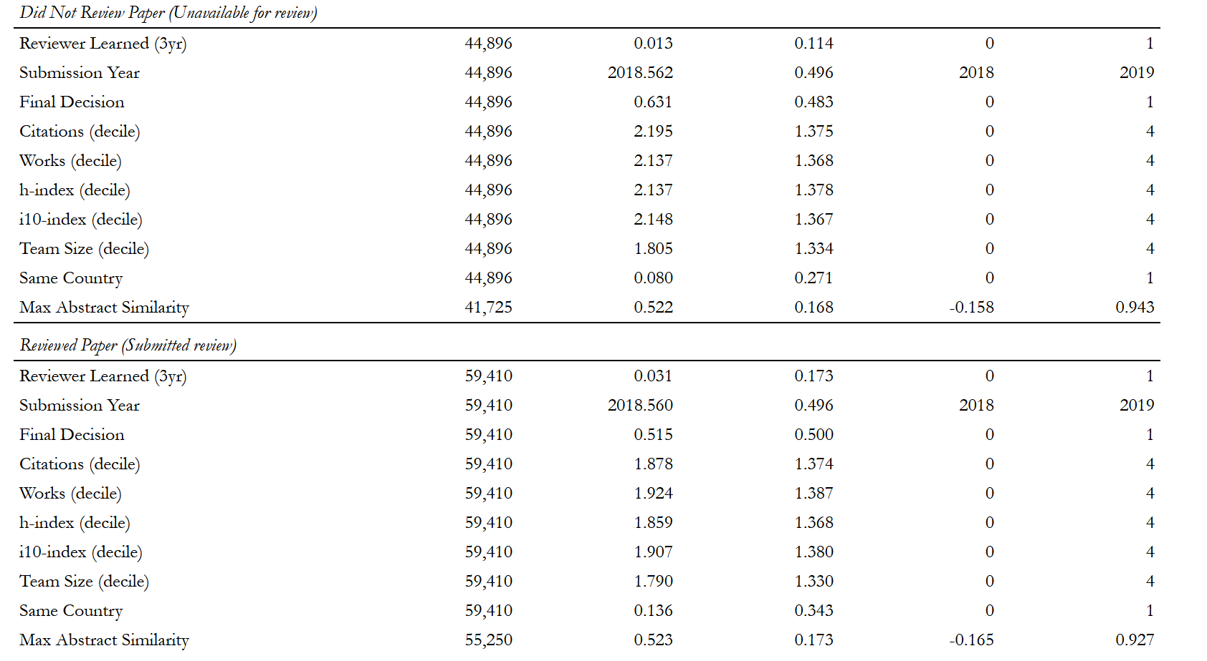
Empirical Setting & Approach
NBER SI Science of Science Funding
10
Notes:
Focus on extreme similarity in relevance (intellectual similarity)

Slide 11
Empirical Setting & Approach
Model Specifications
Main model:
3yrCite_{i} = β₀ + β₁ × Reviewed_{i} + Controls + ε_{i}
Geographic proximity interaction:
3yrCite_{i} = α₀ + α₁ × Reviewed_{i} + α₂ × SameCountry_{i}
+ α₃ × (Reviewed_{i} × SameCountry_{i} ) + Controls + ε_{i}
Intellectual proximity interaction:
3yrCite_{i} = γ₀ + γ₁ × Reviewed_{i} + γ₂ × MaxAbstractSimilarity_{i}
+ γ₃ × (Reviewed_{i} × MaxAbstractSimilarity_{i} ) + Controls + ε_{i}
NBER SI Science of Science Funding
11
Notes:
Also from Walton “7% said it encouraged favourable views from editors”

Slide 12
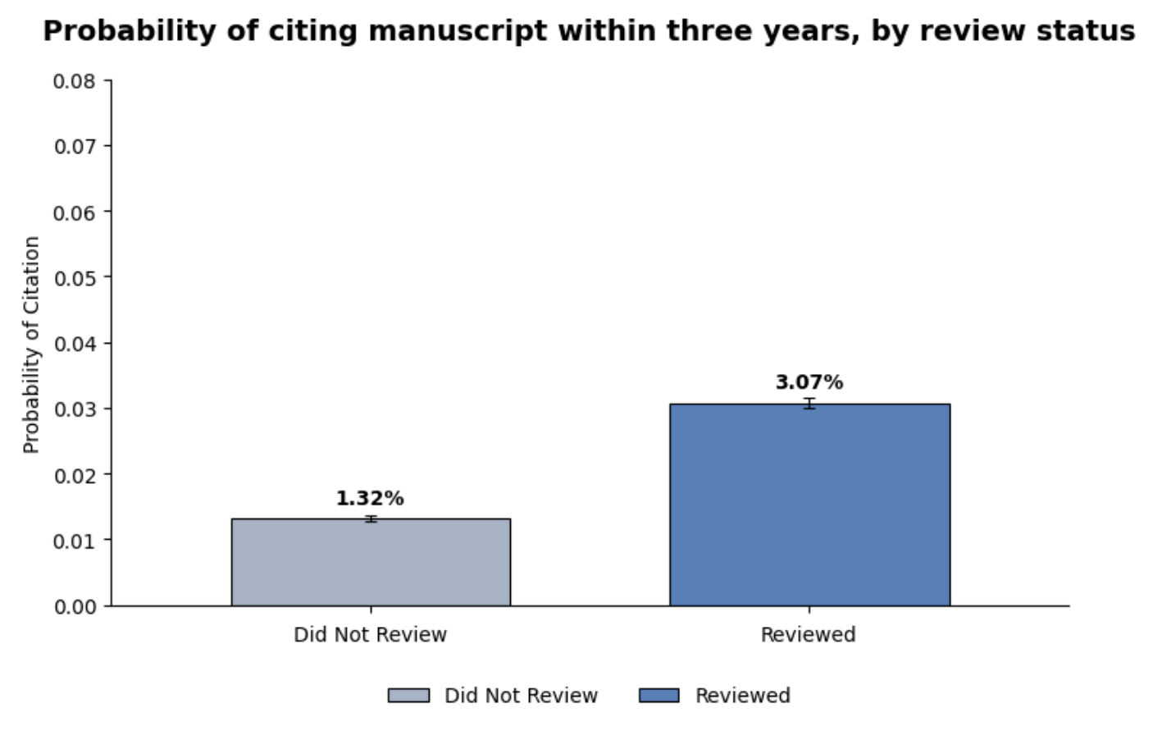
Results: H1 – Learning by Evaluating
Key Finding: Reviewing manuscript more than doubles likelihood of citation within 3 years (1.8 percentage point increase)
NBER SI Science of Science Funding
12
Notes:
(1.8pp increase)

Slide 13
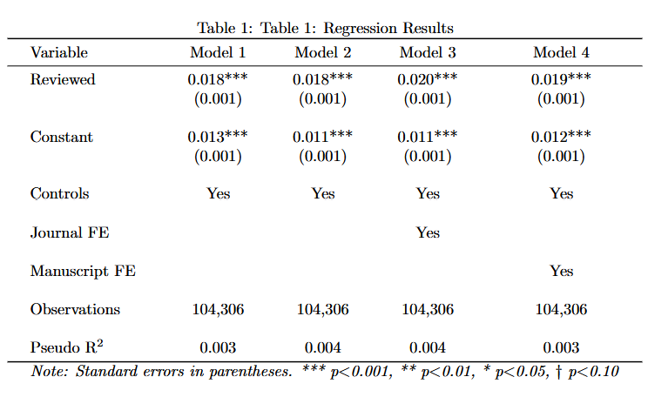
Results: H1 – Learning by Evaluating
Key Finding: Reviewing manuscript more than doubles likelihood of citation within 3 years (1.9 percentage point increase)
NBER SI Science of Science Funding
13
Notes:
(1.8pp increase)

Slide 14
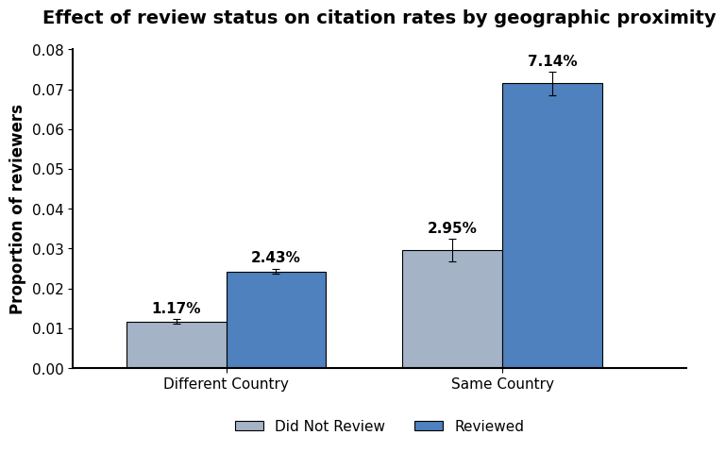
Results: H2 – Geographic Proximity Effect
Key Finding: Same-country reviewers show higher baseline citation rates, geographic proximity amplifies the reviewing effect
NBER SI Science of Science Funding
14
Notes:
We also see a similar citation likelihood between reviewers from different country and non-reviewers from same-country, suggesting peer review compensates for knowledge flow frictions from distance

Slide 15
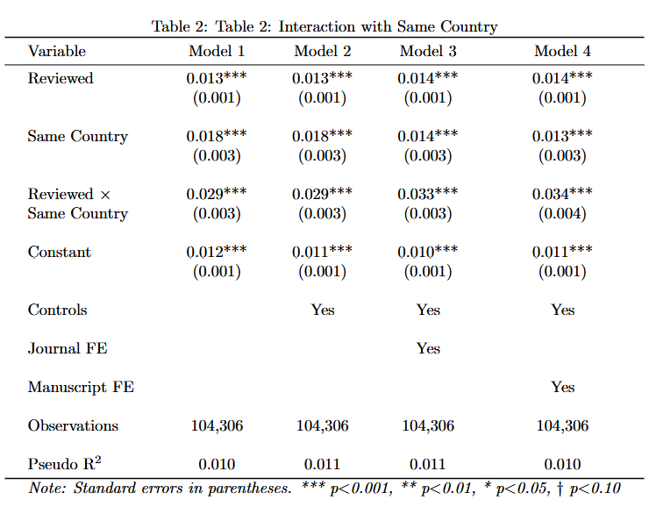
Results: H2 – Geographic Proximity Effect
Key Finding: Same-country reviewers show higher baseline citation rates, geographic proximity amplifies the reviewing effect
NBER SI Science of Science Funding
15
Notes:
We also see a similar citation likelihood between reviewers from different country and non-reviewers from same-country, suggesting peer review compensates for knowledge flow frictions from distance

Slide 16
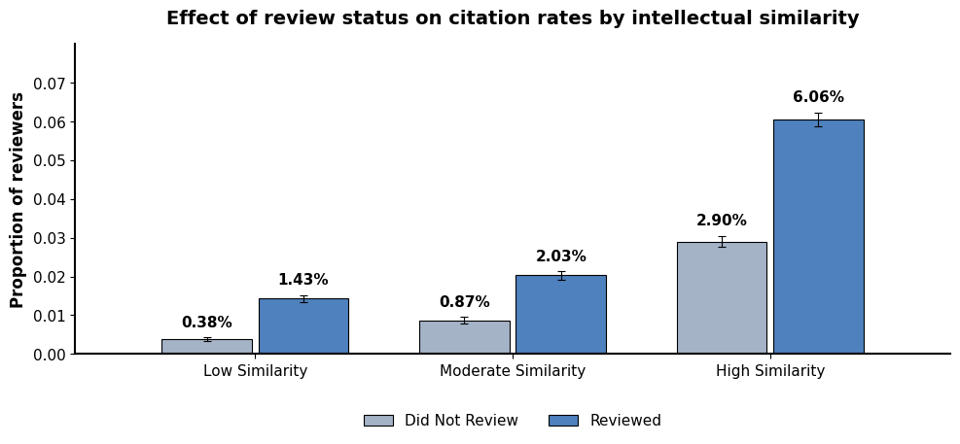
Results: H3 – Intellectual Proximity Effect
Key Finding: Higher intellectual similarity leads to stronger learning effects from review in absolute but not relative terms
NBER SI Science of Science Funding
16
Notes:
We also see a similar citation likelihood between reviewers from different country and non-reviewers from same-country, suggesting peer review compensates for knowledge flow frictions from distance

Slide 17
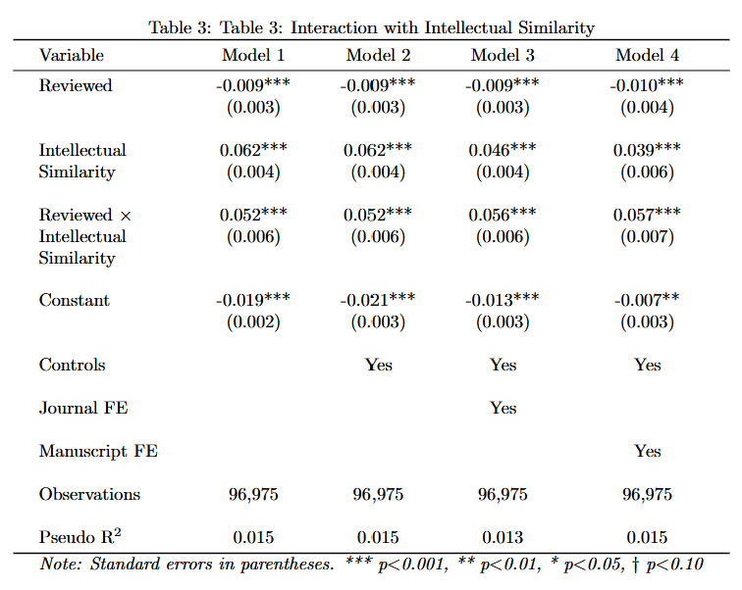
Results: H3 – Intellectual Proximity Effect
Key Finding: Higher intellectual similarity leads to stronger learning effects from review in absolute but not relative terms
NBER SI Science of Science Funding
17
Notes:
We also see a similar citation likelihood between reviewers from different country and non-reviewers from same-country, suggesting peer review compensates for knowledge flow frictions from distance

Slide 18
Robustness Checks
Results consistent across various operationalizations/specifications
2yr and unlimited citation windows instead of 3yr
Logistic regression instead of OLS
Citation count instead of binary
Expanded sample to include “Auto-Decline”
Average abstract similarity instead of maximum
Potential confounder: Post-review publication rate
NBER SI Science of Science Funding
18
Notes:
Since measure of learning (citation) is conditional on publication

Slide 19
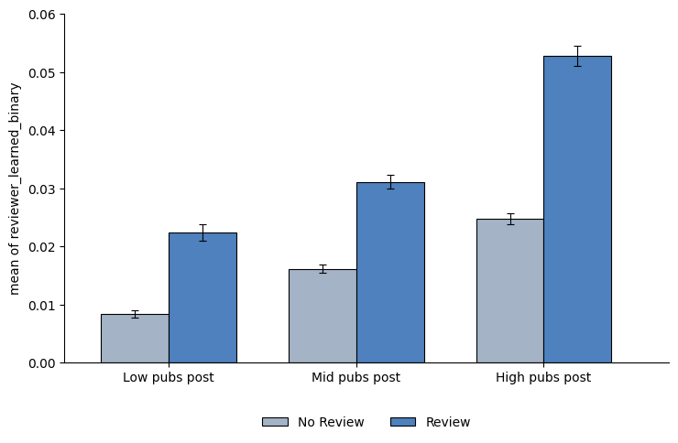
Robustness Checks: Post-review publication rate
NBER SI Science of Science Funding
19
Notes:
Since measure of learning (citation) is conditional on publication

Slide 20
Robustness Checks
Results consistent across various operationalizations/specifications
2yr and unlimited citation windows instead of 3yr
Logistic regression instead of OLS
Citation count instead of binary
Expanded sample to include “Auto-Decline”
Average abstract similarity instead of maximum
Potential confounder: Initial Interest - Does “Unavailable” mean unavailable?
Control for interest: Reviewer publications at inviting journal within 5 years prior
In progress: Identifying other controls for interest or IVs for exogenous availability
NBER SI Science of Science Funding
20
Notes:
Since measure of learning (citation) is conditional on publication

Slide 21
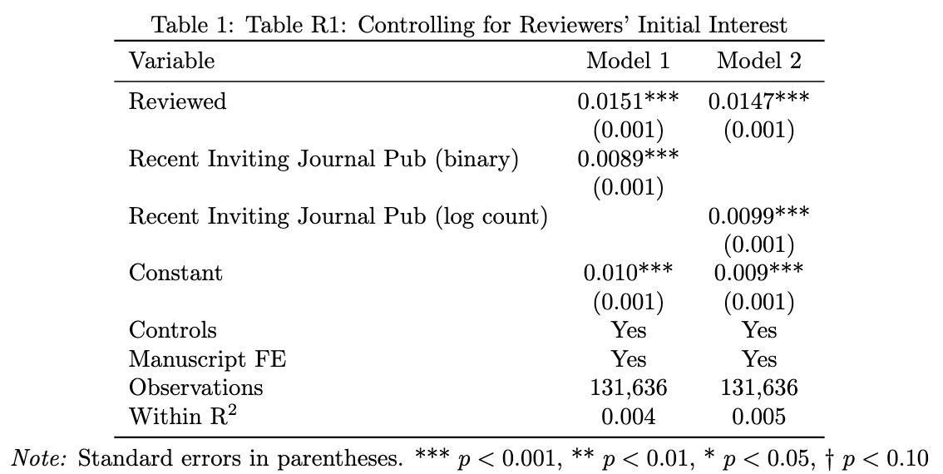
Robustness Checks: Invited reviewer “interest”
NBER SI Science of Science Funding
21
Notes:
Since measure of learning (citation) is conditional on publication

Slide 22
Robustness Checks
Results consistent across various operationalizations/specifications
2yr and unlimited citation windows instead of 3yr
Logistic regression instead of OLS
Citation count instead of binary
Expanded sample to include “Auto-Decline”
Average abstract similarity instead of maximum
Potential confounder: Post-review publication rate
Potential confounder: Initial Interest - Does “Unavailable” mean unavailable?
Control for interest: Reviewer publications at inviting journal within 5 years prior
Possible IVs: Invite “Bunching”, Academic Calendars
NBER SI Science of Science Funding
22
Notes:
Since measure of learning (citation) is conditional on publication

Slide 23
Takeaways
Private learning benefits of reviewing
Stronger when geographically and intellectually close, supporting absorptive capacity
Reviewing compensates for geographical distance
Helps explain “peer review puzzle” with behavioral measure of private motivation
Evaluation system serves dual function
Allocate resources
Knowledge dissemination
Practical/Policy Implications
In recruitment, emphasize private learning benefit
In decisions to automate, factor knowledge dissemination function
NBER SI Science of Science Funding
23
Notes:
Since measure of learning (citation) is conditional on publication

Slide 24
Thank you!
The Team
Charles Ayoubi
(ayoubi@essec.edu)
ESSEC Business School
James M. Zumel Dumlao
(jamesmzd@umich.edu)
University of Michigan
School of Information
Misha Teplitskiy
(tepl@umich.edu)
University of Michigan
School of Information
NBER SI Science of Science Funding
24
Notes:
Since measure of learning (citation) is conditional on publication

Slide 25
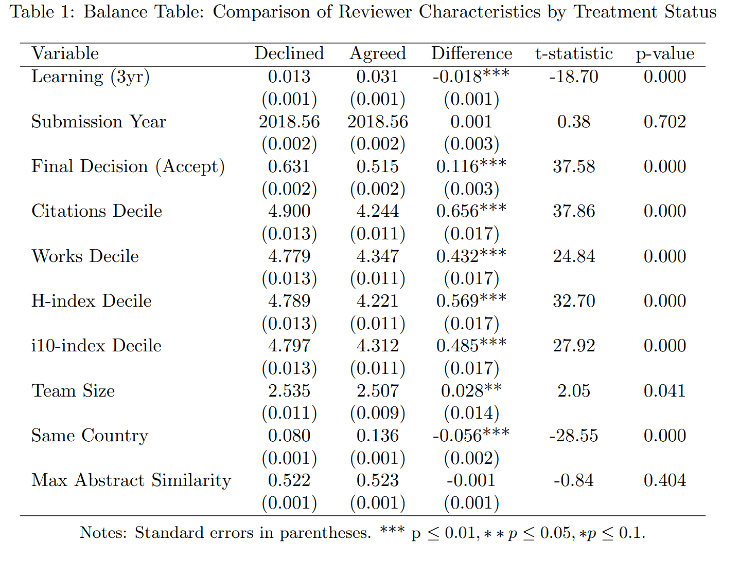
Appendix: Balance Table
NBER SI Science of Science Funding
25
Notes:
Since measure of learning (citation) is conditional on publication

