Slide 1


Tradeoffs over Rate Cycles:
Activity, Inflation and the Price Level
Kristin Forbes: MIT-Sloan School of Management, NBER & CEPR
Jongrim Ha: World Bank Prospects Group
M. Ayhan Kose: World Bank Prospects Group, Brookings Institution & CEPR
NBER IFM Data Session
Cambridge, MA
July 7, 2025
Paper prepared for 2025 NBER Macroeconomics Annual
Views in this paper are those of the authors and do no represent those of any institutions with which they are affiliated

Slide 2
New Database of “Rate Cycles”
Extensive literature on different types of cycles
Business cycles: dating, patterns & characteristics (Burns & Mitchell 1946, Harding & Pagan 2022)
Capital flow cycles and global financial cycle (Forbes & Warnock 2012, 2021, Rey 2015, Miranda-Agrippino & Rey 2020)
Interactions between business, credit and financial cycles (Stock & Watson 1999, Bernanke & Gertler 1989, Kiyotaki & Moore 1997, Claessens et al. 2012, Jordà et al. 2017)
Historical narratives of monetary policy decisions (Hartmann & Smets 2018, Romer & Romer 2023)
What’s missing in research on cycles?
Historical dating of “rate cycles” for monetary policy
Based on standardized framework across countries and time
Our work: creates new classification & database of “Rate Cycles”
Periods of tightening and easing for monetary policy
Comparable to dating of expansions and contractions for business cycles
Monthly data for 1970-2024, 24 advanced economies

Slide 3
Today
1. New database of “Rate Cycles”
2. Application #1: Characteristics of these Rate Cycles
Central bank strategies & macroeconomic developments
How do they vary over time & across countries?
How does the post-pandemic period compare to historical periods?
How do tightening phases vary from easing phases for monetary policy?
3. Application #2: Tradeoffs for central banks during tightening phases
Inflation, output gaps, Sacrifice Ratios and price level
Why these tradeoffs change over time and vary across countries?
4. Application #3 (if time): Understanding the underlying shocks
For interest rates, inflation and output growth
Role of 7 global and domestic shocks

Slide 4
Defining Rate Cycles
Initial development: “Rate Cycles” by Forbes, Ha and Kose, paper prepared for the 2024 ECB Forum on Central Banking in Sintra Portugal (July)
Updated and expanded: “Tradeoffs over Rate Cycles: Activity, Inflation, and the Price Level” by Forbes, Ha and Kose, paper prepared for 2025 NBER Macroeconomics Annual, in Cambridge (April)

Slide 5
Methodology and Data
Adapt business cycle methodology identifying local peaks/troughs
BBQ algorithm proposed by Bry and Boschan (1971), developed in Harding and Pagan (2002)
Apply algorithm to identify turning points for monetary policy
Based on domestic policy interest rates, key tool for adjusting policy today
Primary source: BIS data, “Long Series on Central Bank Policy Rates”
Augmented with information from Haver Analytics, FRED and the OECD
Also incorporate announcement of new QE & QT programs for govt. bonds
CGFS (2019), BIS (2019), English et al. (2021, 2024), Fratto et al. (2021), Du et al. (2024)
Key parameters and additional adjustments
Set key parameters to allow long cycles, but short phases
window of ≥18 months on each side of a local max and min; ≥ 36 months for a full cycle
window of at least 7 months for any individual phase of a cycle
Additional parameters for long periods with no change in policy rates
Ensure change in rate is meaningful & persists (classify “premature adjustments” separately)
Sample: 24 advanced economies, data from Jan 1970 – Dec 2024
Individual euro area countries through 1998, ECB from 1999

Slide 6
Resulting Database
Result: Database of “Rate Cycles”
Rate Cycle has a tightening and easing phase
223 distinct phases (112 tightening and 111 easing)
Dates, code & cycle characteristics available on NBER website for NBER WP #33825,
data.nber.org/data-appendix/w33825/
Strengths of database
Consistent measure across countries & time
Long time series (55 years) through pandemic, plus X-country allows panel analysis
Could help address wide range of questions
Dates and macroeconomic patterns largely correlate with previous business cycle dating & other work
Shortcomings of database
Does not incorporate changes in monetary policy tools & frameworks over time
Does not include information on why turning point occurred
Only advanced economies (no emerging markets)
Observations limited for certain types of regression analysis

Slide 7
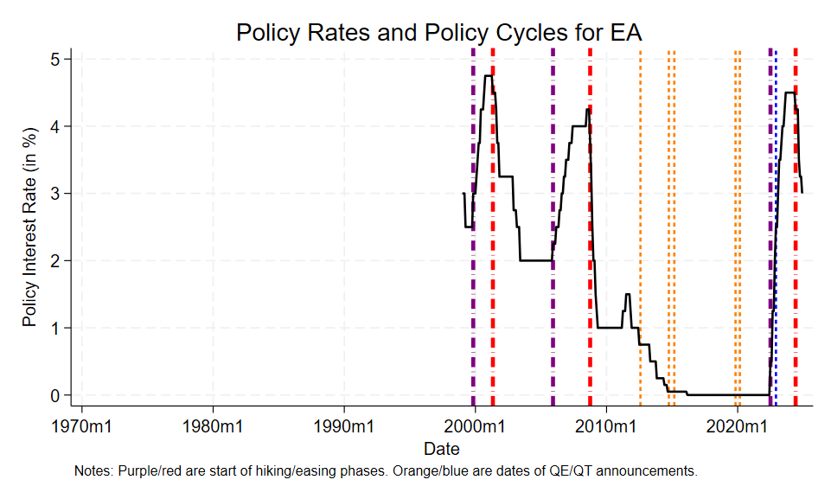
Rate Cycles in the Euro Area

Slide 8
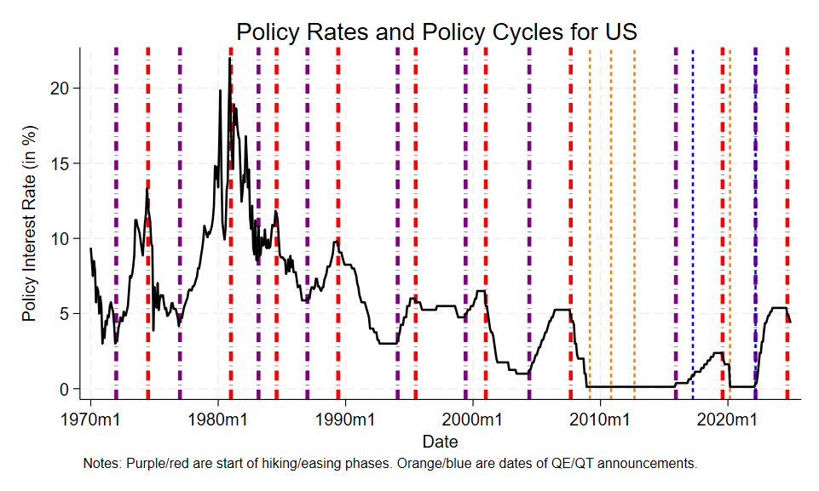
Rate Cycles in the US

Slide 9
Excerpt from Database

Slide 10
#1: Characteristics
of Rate Cycles

Slide 11
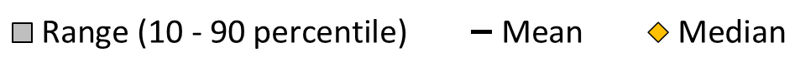
Characteristics of Rate Cycles
Statistics on central bank strategies
Duration: length of phase
Amplitude: total change in rates
Number of rate changes
Pace: average size of rate changes
Initial velocity: rate change over 1st 6 months
Holding period: length rates on hold at phase end
Many comparisons
Across countries, over time
Across easing & tightening phases

Slide 12
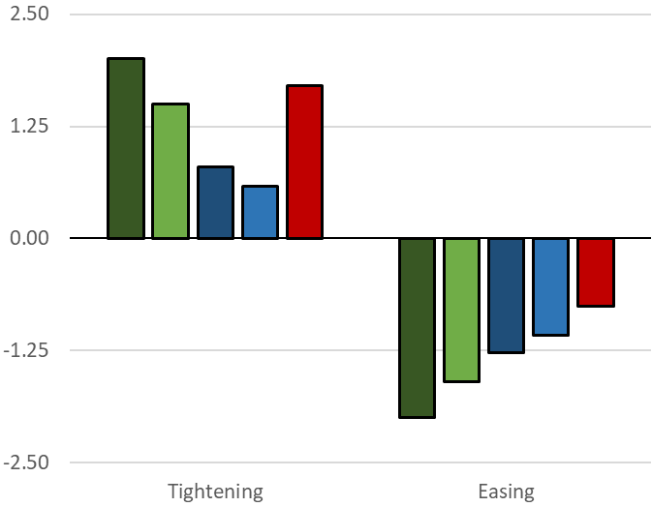
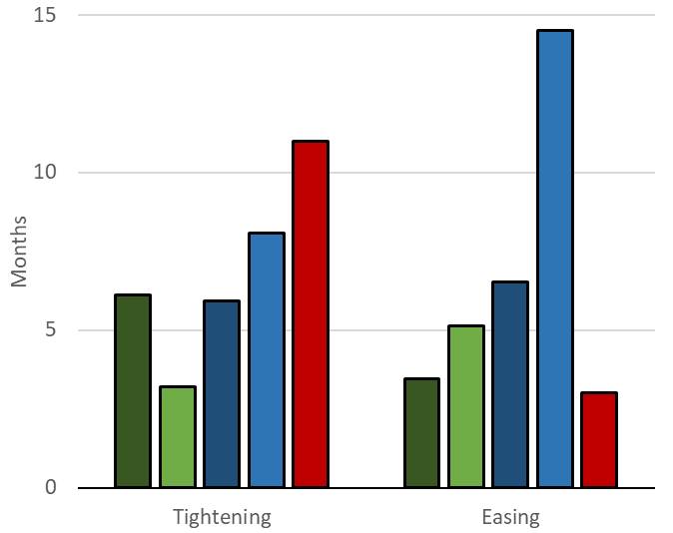
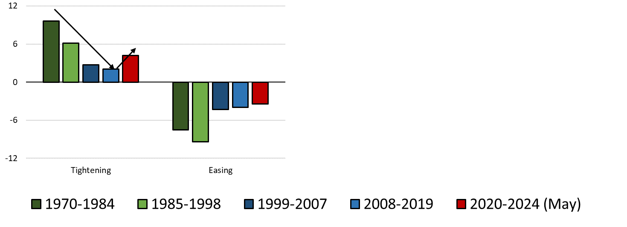
Cycle Characteristics over Different Subperiods
Initial Velocity
(rate change over 1st 6 months)
Duration of Holding Period (months)
Percentage points

Slide 13
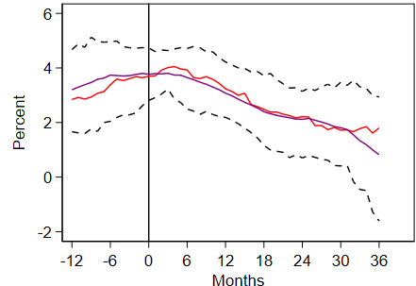
Activity and Inflation during Phases
Evolution of macro variables (12-month)
Activity: GDP growth & IP growth
Labor market: growth in employment & change in unemployment rate
Inflation: headline and core CPI (PCE for US)
Real GDP Growth
over Tightening Phases (yoy)
Unemployment Rate
over Tightening Phases (12m change, in pp)

Slide 14
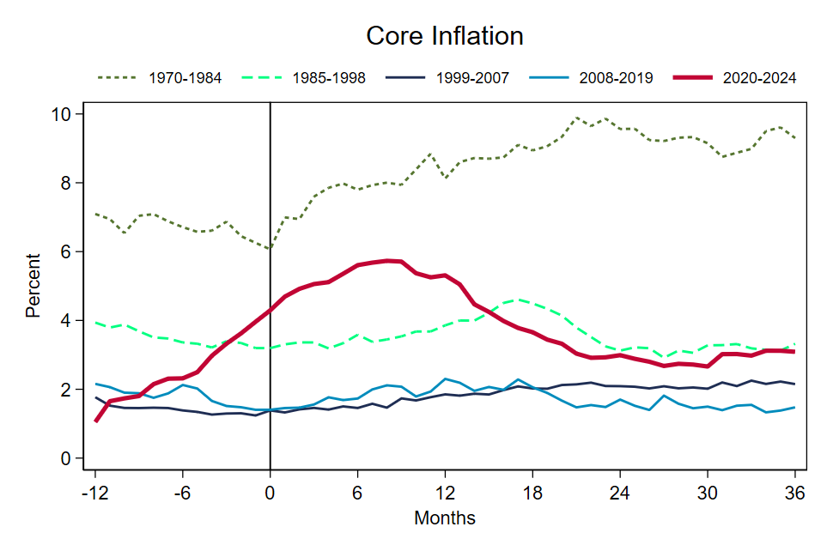
Policy Interest Rates over Subperiods of Tightening and Easing Phases
Median Policy Interest Rate During Different Subperiods

Slide 15
Activity and Inflation over Subperiods of Tightening Phases
Median Real GDP Growth
Median CPI (PCE) Inflation (yoy)

Slide 16
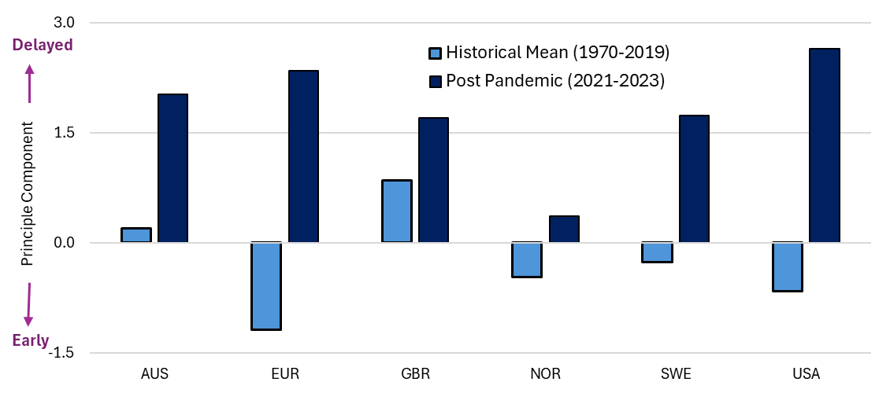
Timing of First Rate Hike: Combining the Statistics
Timing of First Rate Hike
(Relative to macroeconomic indicators)
Notes: A higher value of the index indicates a slower start to the tightening phase based on the underlying macroeconomic variables. This index is calculated as the first principal component of four macroeconomic indicators that can influence the timing of the first rate hike: headline inflation, core inflation, the unemployment gap, and output gap.

Slide 17
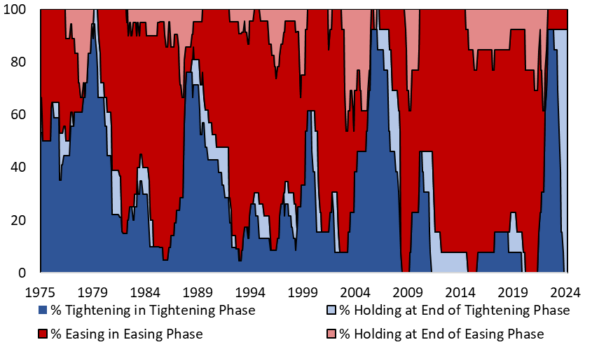
Synchronization of Rate Cycles
Percent of Sample

Slide 18
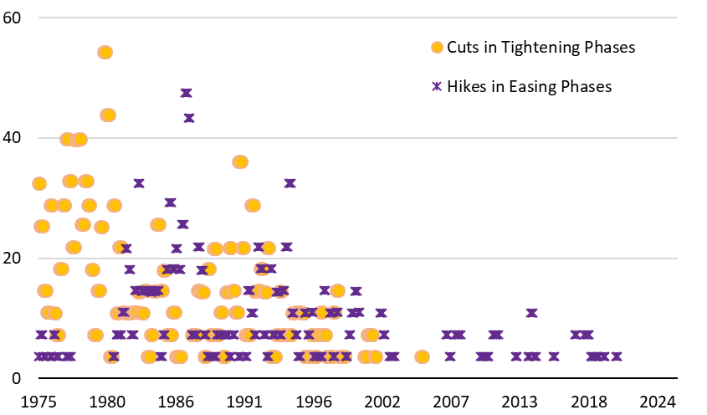
Premature Adjustments
Percent of Sample
* Premature adjustments are “out-of-sync” rate adjustments, i.e., raising rates during an easing cycle or cutting rates during a tightening cycle

Slide 19
Pandemic Cycle: Sample of Findings
2020-24 (“pandemic”) rate cycle was unprecedented in many dimensions
Largest swings in macroeconomic data over sample (since 1970)
Delayed monetary policy response to recovery, followed by unusually aggressive tightening and long holding period
Also important similarities to past cycles
Aggressive tightening post-pandemic a reversion to pre-2008 cycles
Macro variables largely “normalized” after 3 years compared to historical cycles
Continues longer-term trend of “waves” of highly synchronized easing/tightening

Slide 20
#2: Tradeoffs
over Tightening Phases

Slide 21
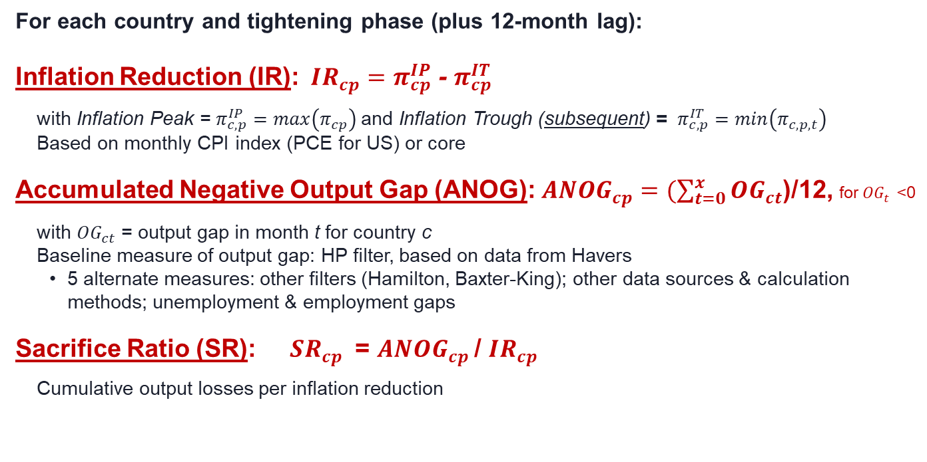
Sacrifice Ratios, Inflation & Negative Output Gaps
For each country and tightening phase (plus 12-month lag):
Inflation Reduction (IR): ${IR}_{cp}=π_{cp}^{IP}$ - $π_{cp}^{IT}$
with Inflation Peak = $π_{c,p}^{IP}=max\left(π_{cp}\right)$and Inflation Trough (subsequent) = $π_{c,p}^{IT}=min\left(π_{c,p,t}\right)$
Based on monthly CPI index (PCE for US) or core
Accumulated Negative Output Gap (ANOG): $AN{OG}_{cp}=(\sum_{t=0}^{x}{{OG}_{ct}}$)/12, for${OG}_{t}^{}$<0
with ${OG}_{ct}\text{ = }\text{output} \text{gap} \text{in} \text{month} \text{t} \text{for} \text{country} \text{c}$
Baseline measure of output gap: HP filter, based on data from Havers
5 alternate measures: other filters (Hamilton, Baxter-King); other data sources & calculation methods; unemployment & employment gaps
Sacrifice Ratio (SR): ${SR}_{cp}$ = ${ANOG}_{cp}$/ ${IR}_{cp}$
Cumulative output losses per inflation reduction

Slide 22
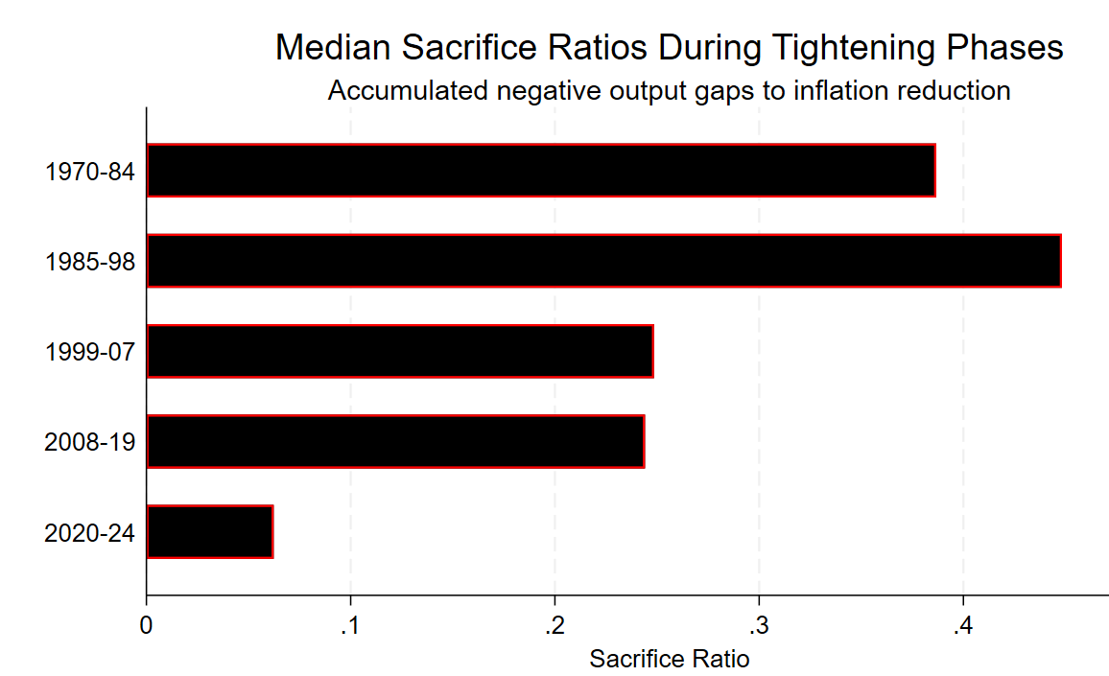
Median Sacrifice Ratios over Time
Pattern holds for core inflation & 6 measures of output gap
Notes: Sample of 24 advanced economies. Inflation is from peak to subsequent trough for CPI inflation (and PCE for US). Output gaps based on HP filter. Window is each country’s tightening phase plus a 12-month lag.

Slide 23
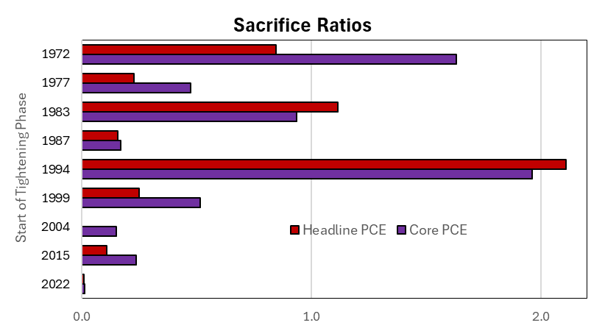
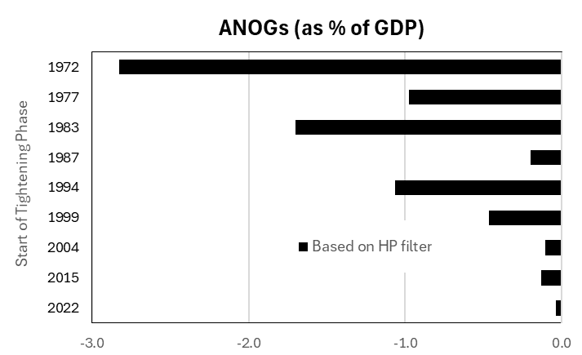
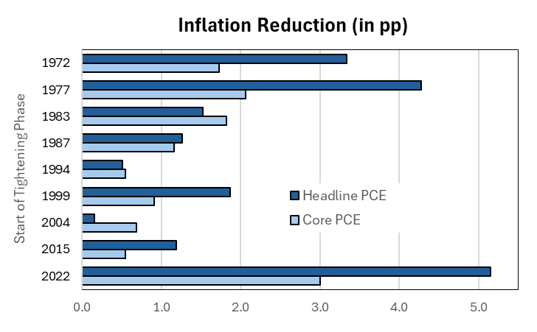
US in Historical Context
Unusually low “Sacrifice” after the pandemic ???

Slide 24
What’s Missing? Impact on the Price Level
What’s missing in discussion of tradeoffs? ∆ PRICE LEVEL
Accumulated change in inflation rates (above 2%)
“Successful” return of inflation to target can correspond to very different changes in price level
Recent research (and votes) highlights the importance of the price level for households, firms, politics….
Households believe inflation diminishes purchasing power and is “unfair”
Coibion et al 2023, Stantcheva 2024, Binetti et al 2024; Cournede & Moccero 2009, Honkapohja & Mita 2020
Elevated inflation→ voting gains for anti-system & populist parties
Federle, Mohr and Schularick (2024)
Non-linear effects of price shocks on wage and price setting: larger shocks cause more frequent price adjustments, more attentiveness to inflation
Khalil and Lewis 2024, Alvarez et al 2024, Burns et al 2021, Beaudry et al 2024
Can affect anchoring of inflation and transmission of monetary policy
Coibion and Gorodnichenko (2025)

Slide 25
What’s Missing? Impact on the Price Level
The Evolution of the US Price Level
Based on the PCE price index
Set at 100 at t = -1
Set at 100 at t = -1

Slide 26
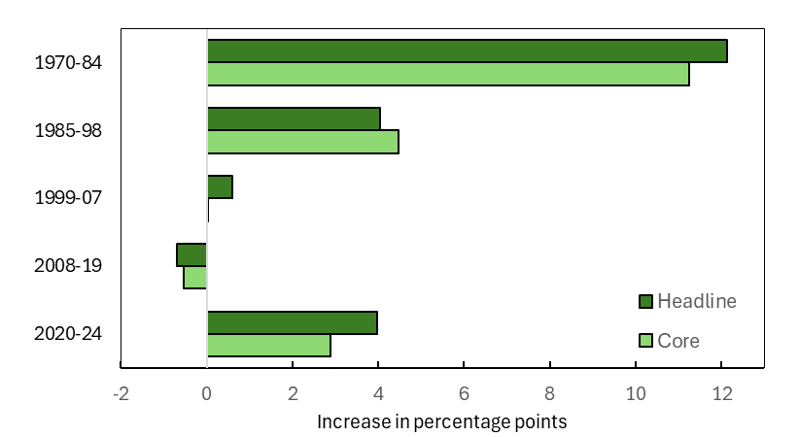
Impact on the Price Level: Across Countries
Median Accumulated Excess Price Level Change during Tightening Phases
(Annualized, in excess of inflation at 2%)
Percentage points
Notes: Median across the sample of 24 advanced economies. Excess price level change is calculated over each country-phase for tightening periods, starting from a 12-month lead before the first rate hike and ending after a 12-month lag after the tightening phase ends.

Slide 27
Explaining the Tradeoffs
Regression analysis: role of central bank strategy, shocks and country characteristics
Simulations: results supported by simulations with FRB/US model
Policy green/good, red/pain | Sacrifice Ratio | Output Losses (accumulated) | Inflation Reduction | Excess Price Level Change (accumulated)
Delayed liftoff
More aggressive hikes
Central bank credibility

Slide 28

#3: The Underlying Shocks
Heaven or Earth? The Evolving Role of Global Shocks for Domestic Monetary Policy
By Forbes, Ha and Kose (2025)

Slide 29
Modelling the Underlying Shocks
Contribution of Shocks to Variation in Interest Rates (based on FAVAR model)
FAVAR model with 7 shocks to decompose drivers of interest rates, inflation and output growth
Variation in interest rates increasingly driven by global shocks and supply shocks rather than domestic demand shocks prominent in earlier decades
Global shocks different from domestic shocks in several important ways
Notes: Forecast error variance decompositions of domestic policy interest rates based on the FAVAR model with 7 shocks listed below. Horizontal lines indicate the total contribution of global shocks. “Oil” = oil price shock, “GS” = global supply shock, “GD” = global demand shock, “GMP” = global monetary policy shock, “DS” = domestic supply shock, “DD” = domestic demand shock, “DMP” =domestic monetary policy shock.

Slide 30
Shock Contributions to Interest Rates (average across economies, in percentage points)
By Global and Domestic Shocks
By 7 Structural Shocks
Notes: Historical/actual contributions to the first moment from decompositions of domestic policy interest rates based on the FAVAR model with 7 shocks listed below. Horizontal lines indicate the total contribution of global shocks. “Oil” = oil price shock, “GS” = global supply shock, “GD” = global demand shock, “GMP” = global monetary policy shock, “DS” = domestic supply shock, “DD” = domestic demand shock, “DMP” =domestic monetary policy shock.

Slide 31
Summary

Slide 32
Summary
New database on “Rate Cycles”
Identifies tightening and easing phases for monetary policy
24 countries over 55 years
Useful to address range of questions
Provides wealth of statistics on characteristics of rate cycles
Monetary policy strategy
Macroeconomic developments
Cross-country synchronization
Additional applications (so far)
Tradeoffs for monetary policy over rate cycles
Shocks driving rate cycles
Hopefully many more applications to come!!

Slide 33
EXTRA

Slide 34
Impact on US Real Wages
The Evolution of US Real Wages
Set at 100 at t = -1
Set at 100 at t = -1

Slide 35
Impact on Real Wages in UK and Germany
UK Real Wages
Germany Real Wages

Slide 36
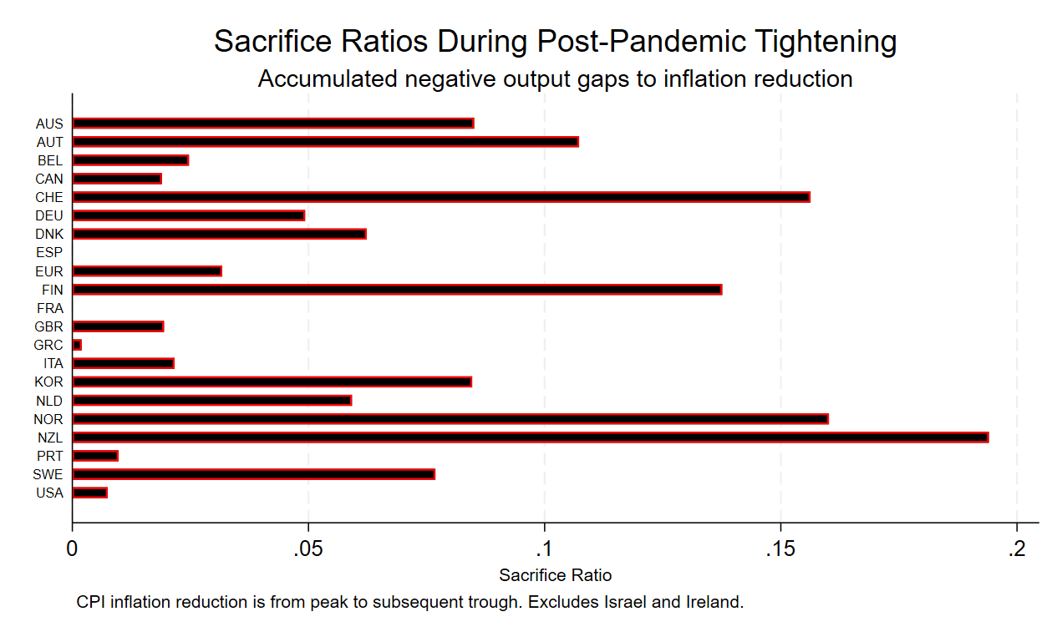
Sacrifice Ratios: Cross-Country Variation Post-Pandemic

