Slide 1
NAR Settlement, House Prices, and Consumer Welfare
Greg Buchak
Stanford and
NBER
Gregor Matvos
Northwestern and NBER
Tomasz Piskorski
Columbia and NBER
Amit Seru
Stanford and
NBER
NBER SI 2025

Slide 2
Motivation
Real estate commissions in the U.S. have remained a contentious issue for years, despite technological advancements in the housing market.
Commissions are typically split between the buyer’s and seller’s agents, but the total cost is usually borne by the home seller.
Despite platforms like Zillow reducing home search costs, commission fees remain high, typically ranging from 5-6% of the sale price.
Global Comparison: U.S. real estate commissions are among the highest worldwide, more than double the average in other developed nations.

Slide 3
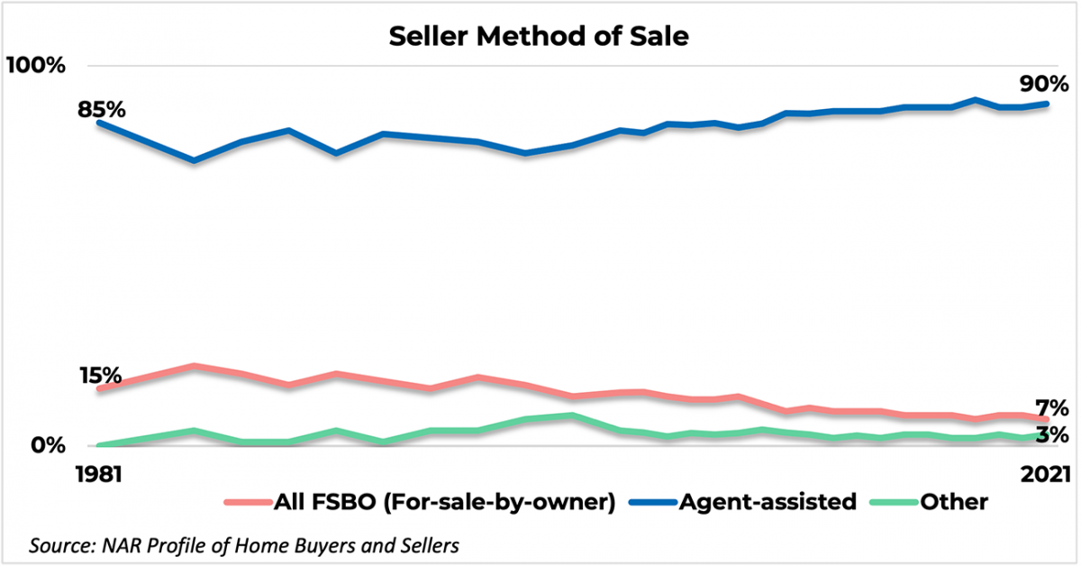

Real Estate Agents Dominate the US Market

Slide 4
Combined Buyer’s and Seller’s Agent Fee
(as % of Home Price)
Source: Real Trends, Medium, Premiere Property Group

Slide 5
Motivation
Real estate commissions in the U.S. have remained a contentious issue for years, despite technological advancements in the housing market.
Commissions are typically split between the buyer’s and seller’s agents, but the total cost is usually borne by the home seller.
Despite platforms like Zillow reducing home search costs, commission fees remain high, typically ranging from 5-6% of the sale price.
Global Comparison: U.S. real estate commissions are among the highest worldwide, more than double the average in other developed nations.

Slide 6
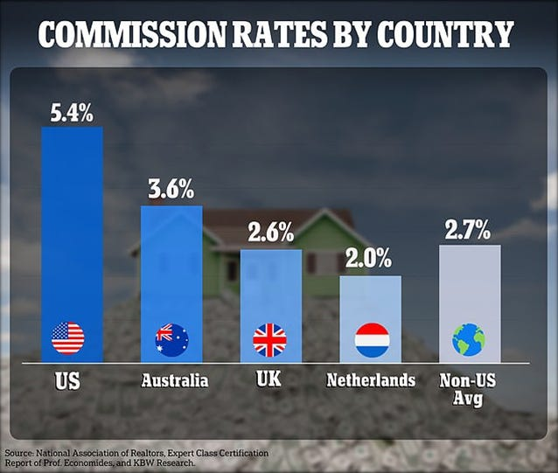
Agents’ Commissions by Country

Slide 7
NAR Settlement
Recent rulings aim to increase awareness and competition around buyer’s agent fees, challenging the existing commission structure.
Key Issue: The practice of marketing buyer agent services as “free” to home buyers, with sellers covering buyer agent fees may have obscured true costs and hindered market competition.
NAR Settlement (March 15, 2024): Resolved litigation on broker commissions with the National Association of Realtors (NAR)
  Implemented in August 17, 2024

Slide 8
NAR Settlement: Main Changes
Listing agents are no longer required to offer compensation to buyer’s agents, and MLSs must remove compensation-related fields.
Buyer’s agents must enter into written agreements with clients, clearly outlining compensation, which must be specific and negotiable.
Offering or accepting compensation for buyer’s agents will no longer be a requirement for MLS membership.
Expected Market Impact: Increased awareness of buyer agent fees, increased competition, reduction in the overall agent fees, particularly on the buyer’s side.

Slide 9
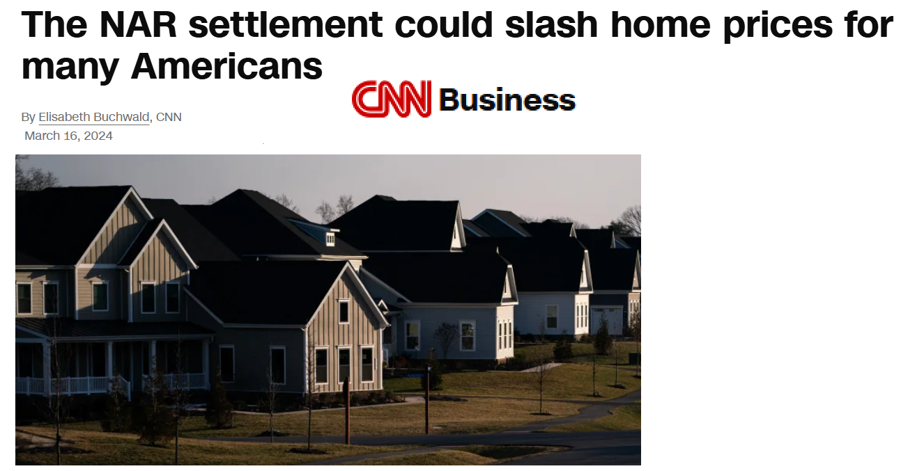
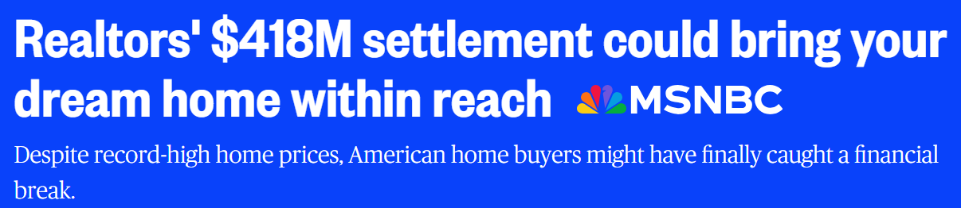
Significant Debate/Hope Regarding Its Effects

Slide 10
This Paper
Explore the potential consequences of reduced agent fees following the NAR Settlement, with a focus on house prices and consumer welfare.
Modeling Approach: A dynamic structural search model of the housing market
  Building on Buchak et al. (2022)
Main Analysis: The counterfactual scenarios assume a reduction in agent fees, particularly on the buyer’s side, to assess its economic impact.

Slide 11
Related Literature
Quantitative Search and Matching Models: Wheaton 1990; Genesove & Mayer 1997; Genesove & Han 2012; Ngai & Tenreyro 2014; Landvoigt et al. 2015; Guren 2018; Piazzesi et al. 2020; Guren & McQuade 2020; Rekkas et al. 2020; Andersen et al. 2022; Agarwal et al. 2024
Role of Intermediaries in Housing Markets: Levitt & Syverson 2008; Hendel et al. 2009; Barwick & Pathak 2015; Barwick et al. 2017, Buchak et al. 2022; Grochulski and Wang 2024; Kim 2025
Decentralized Trading in Asset Markets: Duffie et al. 2005; Atkeson et al. 2015; Gavazza 2016; Weill 2020
GE Models of Housing Market: Corbae & Quintin 2015; Berger et al. 2017; Favilukis et al. 2017; Beraja et al. 2019; Greenwald 2018
Policy Interventions in the Housing Market: Mayer et al. 2014; Agarwal et al. 2017; Di Maggio et al. 2017; Ganong & Noel 2020

Slide 12
Dynamic Structural Model of the Housing Market
Homeowners are initially matched with a house and receive a flow benefit (consumption value minus costs).
Moving Process: Homeowners may become unmatched and initiate the moving process, selling their current home before purchasing a new one.
Search Market: Sellers list homes and are randomly matched with buyers in a standard search framework.
Agent Compensation: In the baseline model, the seller pays a fixed percentage of the sale price to real estate agents (a transaction fee).
Model Extension: In extended versions, agents may play a more active role, enhancing the search process and influencing market dynamics.

Slide 13
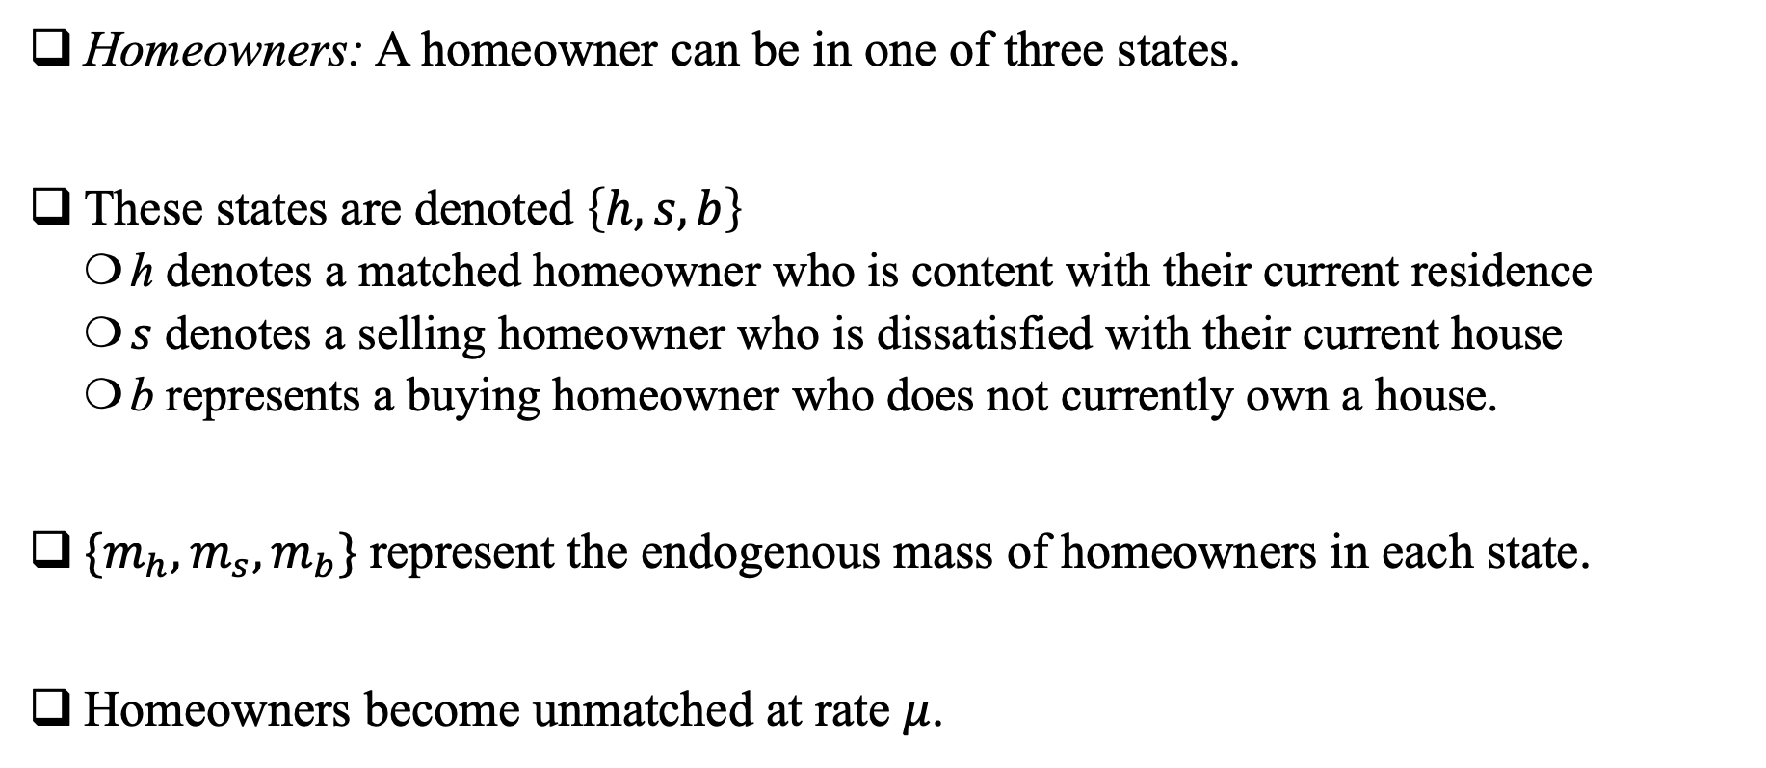
Homeowners
Homeowners: A homeowner can be in one of three states.
These states are denoted $\left\{h, s, b\right\}$
  h denotes a matched homeowner who is content with their current residence
  $s$ denotes a selling homeowner who is dissatisfied with their current house
  b represents a buying homeowner who does not currently own a house.
$\{m_{h},m_{s},m_{b}\}$ represent the endogenous mass of homeowners in each state.
Homeowners become unmatched at rate $μ$.

Slide 14
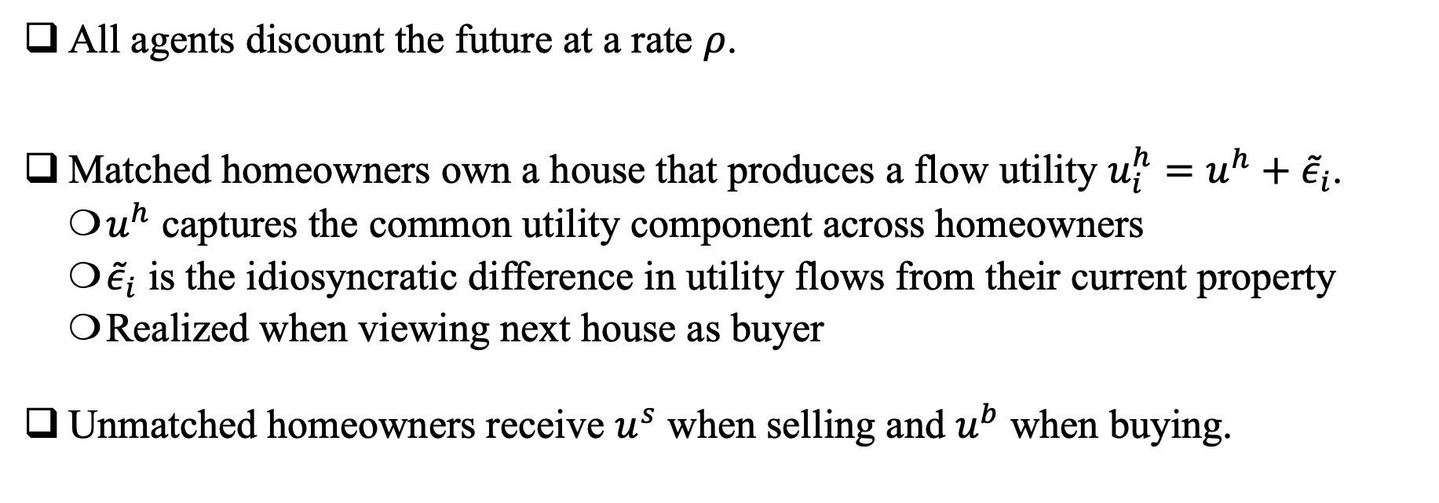
Preferences
All agents discount the future at a rate $ρ$.
Matched homeowners own a house that produces a flow utility $u_{i}^{h}=u^{h}+{\tilde{ε}}_{i}$.
  $u^{h}$ captures the common utility component across homeowners
  ${\tilde{ε}}_{i}$ is the idiosyncratic difference in utility flows from their current property
  Realized when viewing next house as buyer
Unmatched homeowners receive $u^{s}$ when selling and $u^{b}$ when buying.

Slide 15
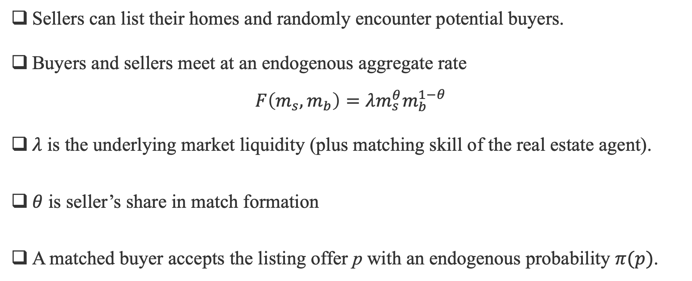
Housing Search and Listings
Sellers can list their homes and randomly encounter potential buyers.
Buyers and sellers meet at an endogenous aggregate rate
$F\left(m_{s},m_{b}\right)=λm_{s}^{θ}m_{b}^{1−θ}$​
$λ$ is the underlying market liquidity (plus matching skill of the real estate agent).
$θ$ is seller’s share in match formation
A matched buyer accepts the listing offer p with an endogenous probability $π(p)$.

Slide 16
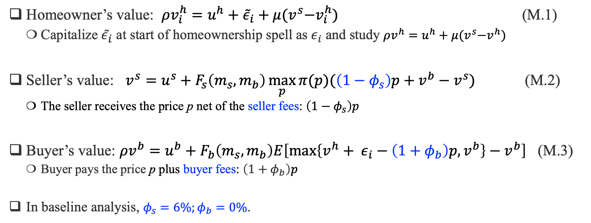
Value Functions
Homeowner’s value: $ρv_{i}^{h}=u^{h}+{\tilde{ε}}_{i}+μ{(v}^{s}−v_{i}^{h})$ (M.1)
  Capitalize ${\tilde{ε}}_{i}$ at start of homeownership spell as $ε_{i}$ and study $ρv^{h}=u^{h}+μ{(v}^{s}−v^{h})$
Seller’s value: $v^{s}=u^{s}+F_{s}\left(m_{s},m_{b}\right)\max_{p}{π(p)(\left(1−φ_{s}\right)p+v^{b}−v^{s})}$ (M.2)
  The seller receives the price p net of the seller fees: $\left(1−φ_{s}\right)p$
Buyer’s value: $ρv^{b}=u^{b}+F_{b}\left(m_{s},m_{b}\right)E\left[\max\left\{v^{h}+ ε_{i}−\left(1+φ_{b}\right)p,v^{b}\right\}−v^{b}\right]$ (M.3)
  Buyer pays the price p plus buyer fees: $\left(1+φ_{b}\right)p$
In baseline analysis, $φ_{s}=6\%;φ_{b}=0\%$.

Slide 17
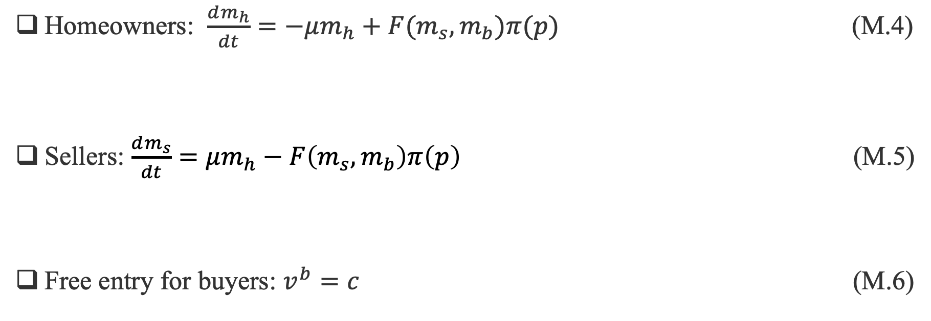
Population Dynamics
Homeowners: $\frac{dm_{h}}{dt}=−μm_{h}+F(m_{s},m_{b})π(p)$ (M.4)
Sellers: $\frac{dm_{s}}{dt}=μm_{h}−F\left(m_{s},m_{b}\right)π\left(p\right)$ (M.5)
Free entry for buyers: $v^{b}=c$ (M.6)

Slide 18
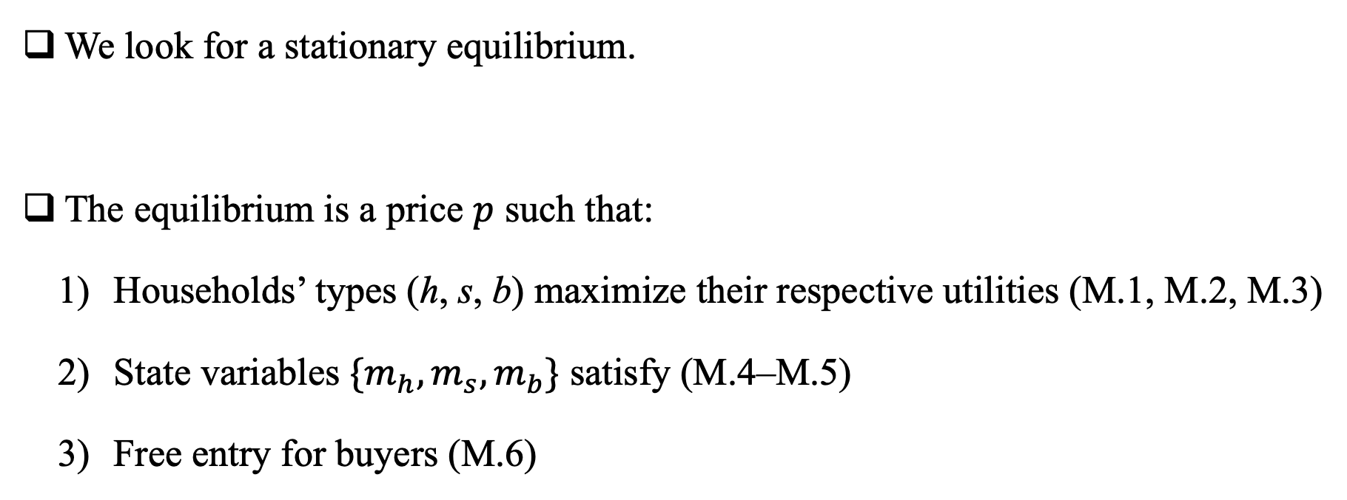
Market Equilibrium
We look for a stationary equilibrium.
The equilibrium is a price $p$ such that:
    Households’ types (h, s, b) maximize their respective utilities (M.1, M.2, M.3)
    State variables ${\{m}_{h},m_{s},m_{b}\}$ satisfy (M.4–M.5)
    Free entry for buyers (M.6)

Slide 19
Calibration
The model is calibrated following Buchak et al. (2022)
Normalizations and externally calibrated parameters
  Discount rate, unmatching rate, matching shares, population sizes, etc.
Simulated method of moments for other parameters
  Flow utilities, matching technology, buyer idiosyncratic preference shocks

Slide 20
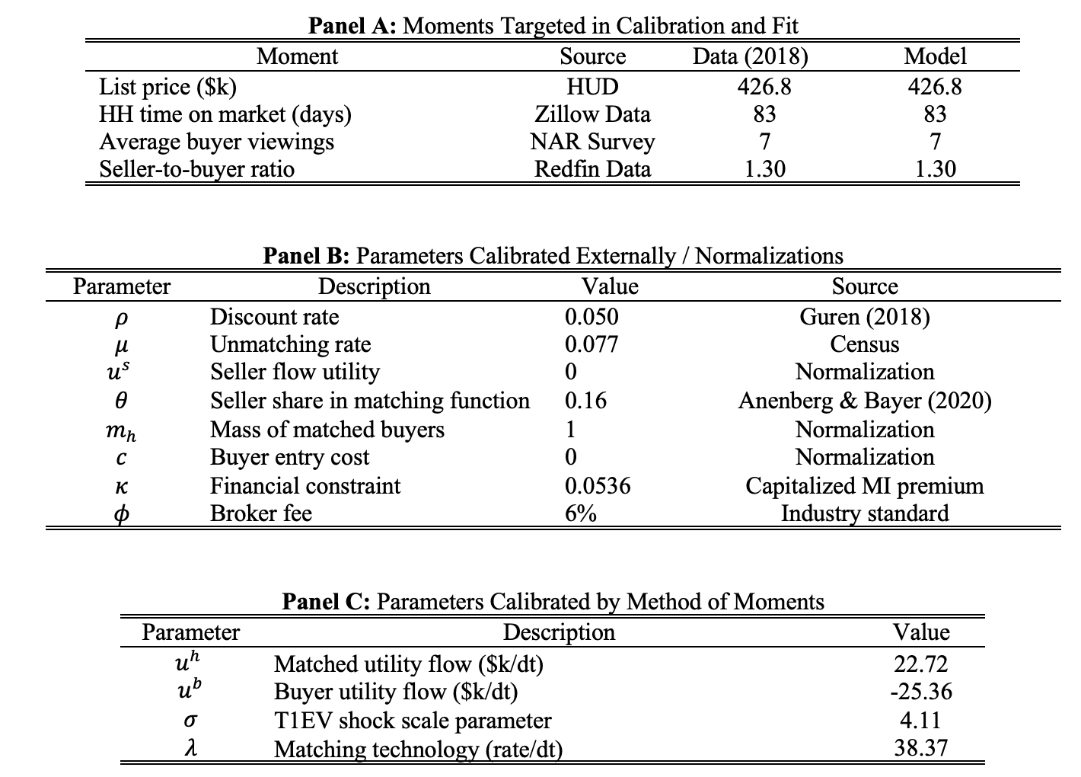

Slide 21
Counterfactuals
We quantify an “upper bound” on the effects of settlement
  Reduction in agents’ fees without affecting primitives of search process
Counterfactual I: Seller pays all fees
  Seller pays all fees, but they are reduced
  E.g., due to the decline in the buyer’s agent fees
Counterfactual II: Decoupling with lower buyer’s agent fees
  Buyer and seller pay their respective fees, the buyers agents fees are reduced
Counterfactual III: Agent skill necessary to justify fees?
  How much better must an agent be (or must a 6% versus a 3% incentivize an agent) to equalize consumer welfare?

Slide 22
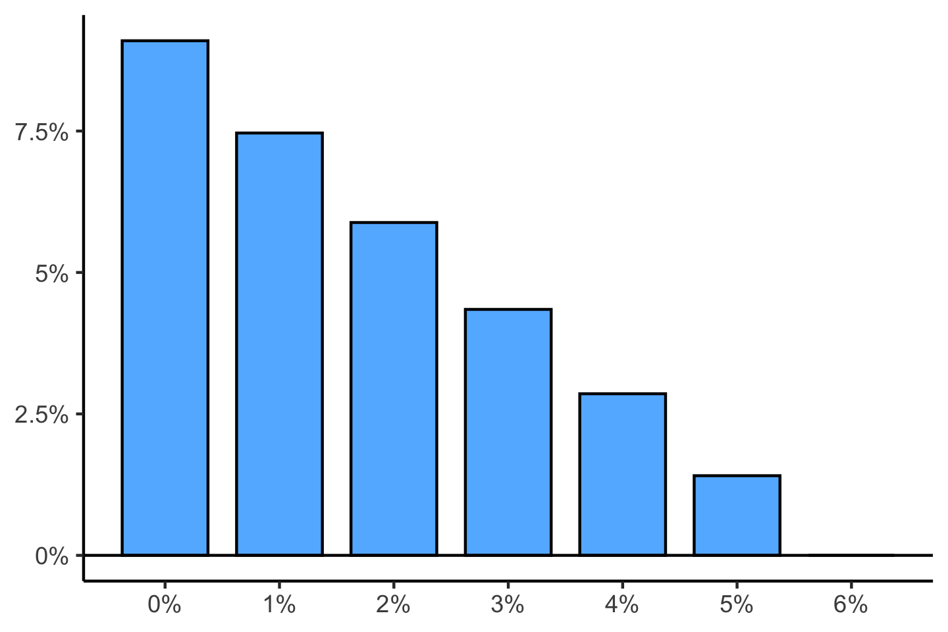
Seller Pays All Fees: House Price Change (in %)
Total Fee (%)

Slide 23
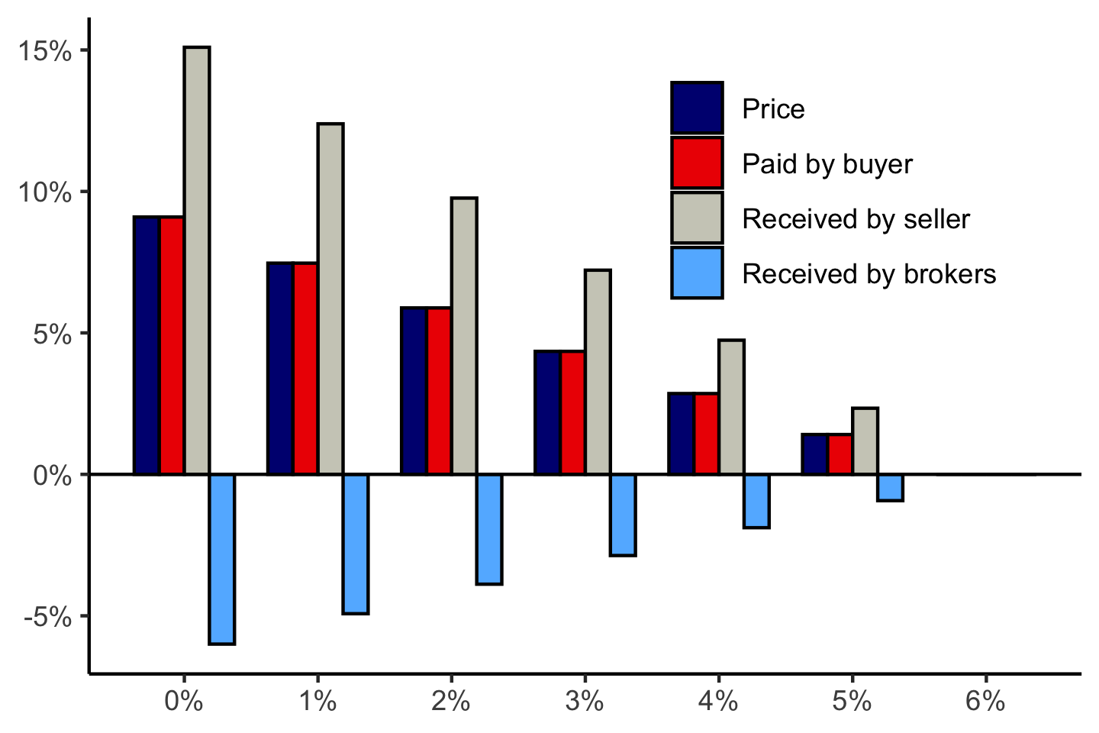
Seller Pays All Fees: Change in Payments
Total Fee (%)

Slide 24
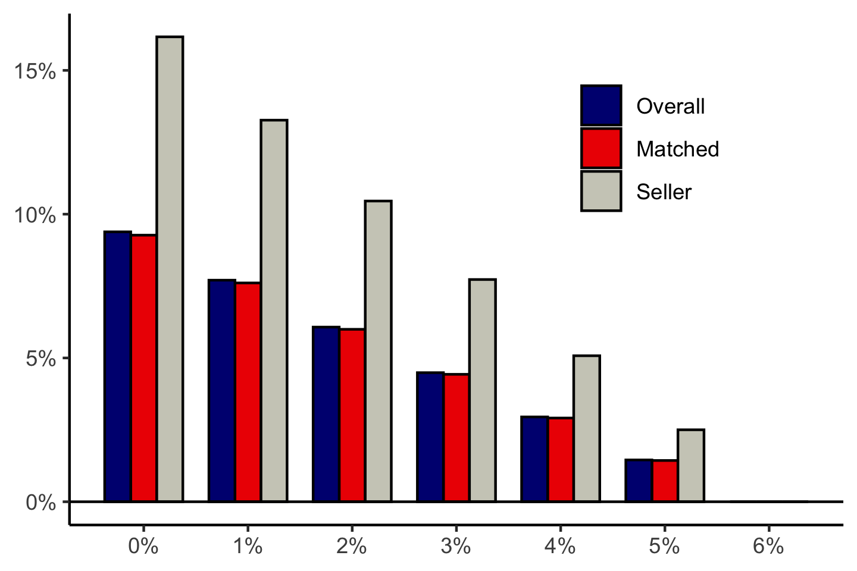
Seller Pays All Fees: Change in Welfare
Total Fee (%)

Slide 25
Intuition Behind the House Price Effect
If homes were sold only once, lower agent fees could reduce home prices
  In equilibrium the seller would pass some savings onto buyer
  Static “supply” effect
Homes are durable assets with multiple transactions over their lifetimes
  Lower agent fees reduce the future costs associated with reselling a home
  Reduced future transaction costs enhance the overall value of owning a home, so buyers are willing to pay more
  Dynamic “demand” effect
Similar effect to tax reductions: Lower agent fees, like reduced real estate taxes, decrease the cost of ownership, leading to higher home prices

Slide 26
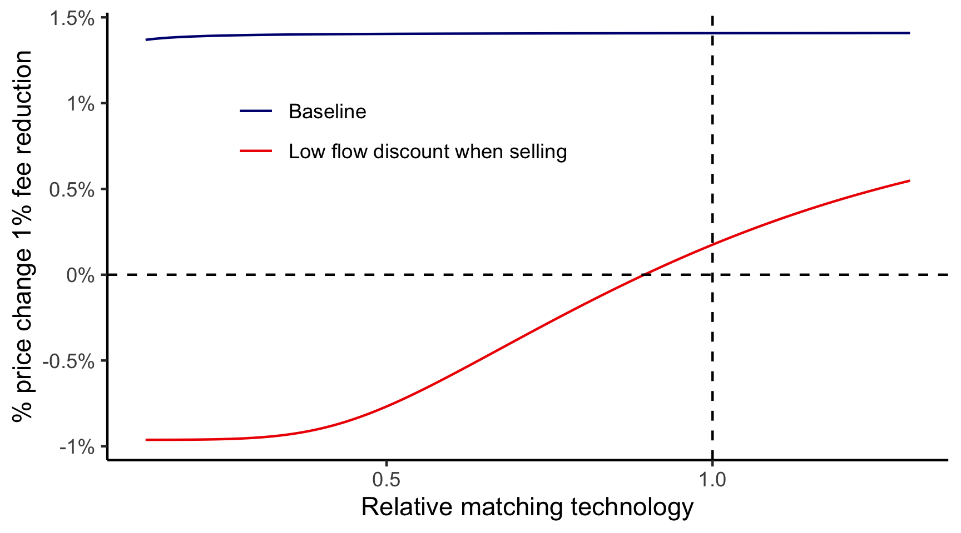

Can the model generate a negative price effect?
Make ”static effect large” by increasing effective marginal cost ($v^{s}−v^{b})$
Make dynamic effect small by making home resale more difficult

Slide 27
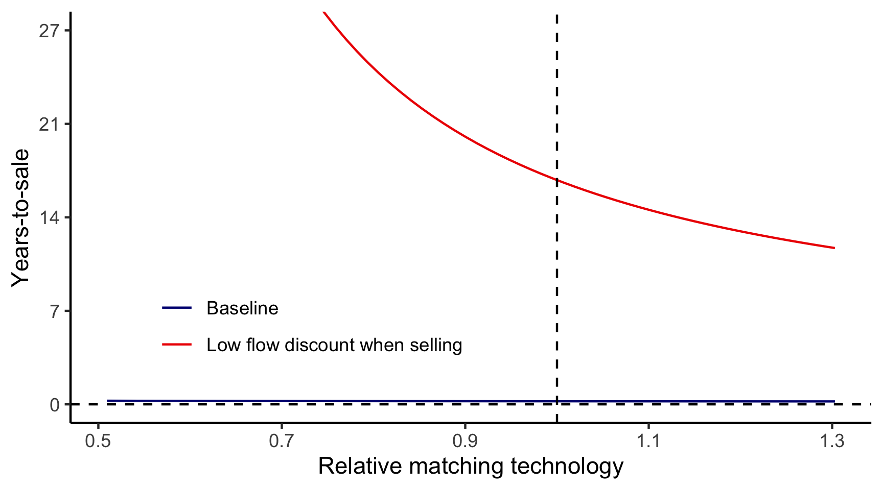
Can the model generate a negative price effect?
Requires extreme parameters that yield highly counterfactual predictions (e.g., takes 20 years to sell a house).
Lesson: Dynamic effect is robust

Slide 28
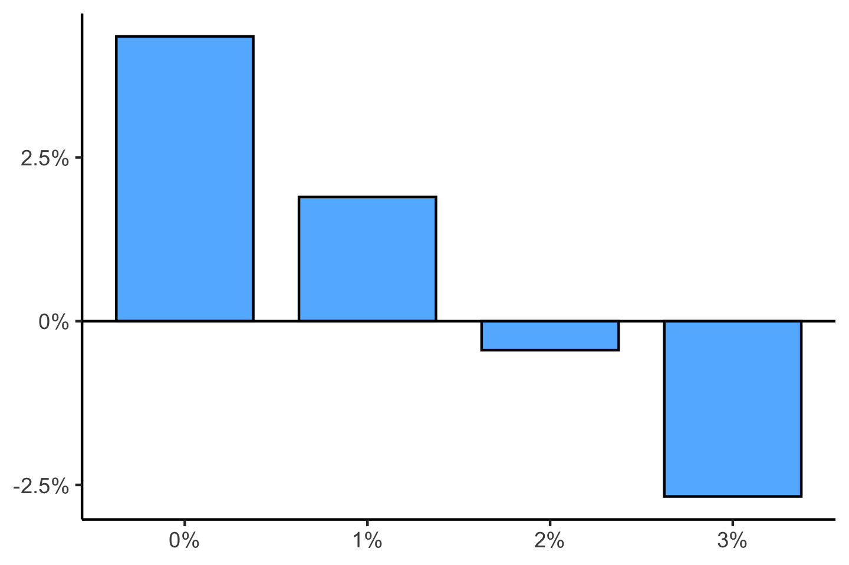
Seller’s Agent Fee = 3%
Fee Decoupling: House Price Change (in %)
Buyer’s Agent Fee

Slide 29
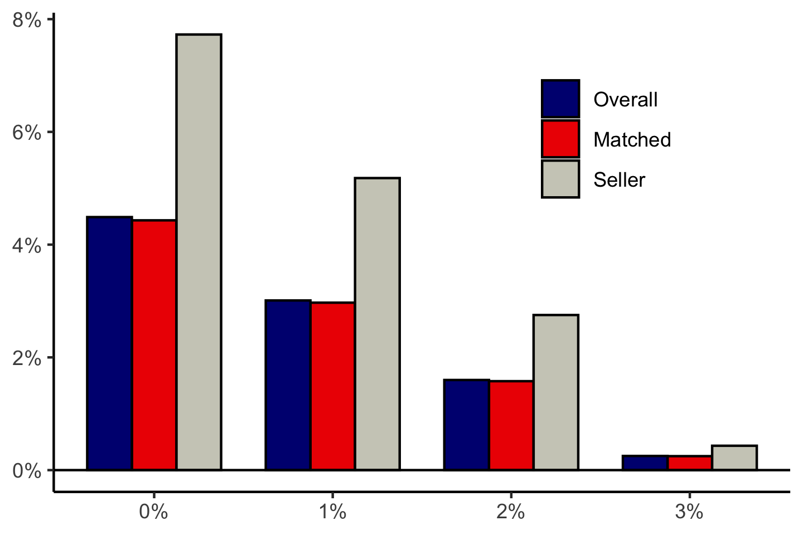
Seller’s Agent Fee = 3%
Fee Decoupling: Change in Consumer Welfare
Buyer’s Agent Fee

Slide 30
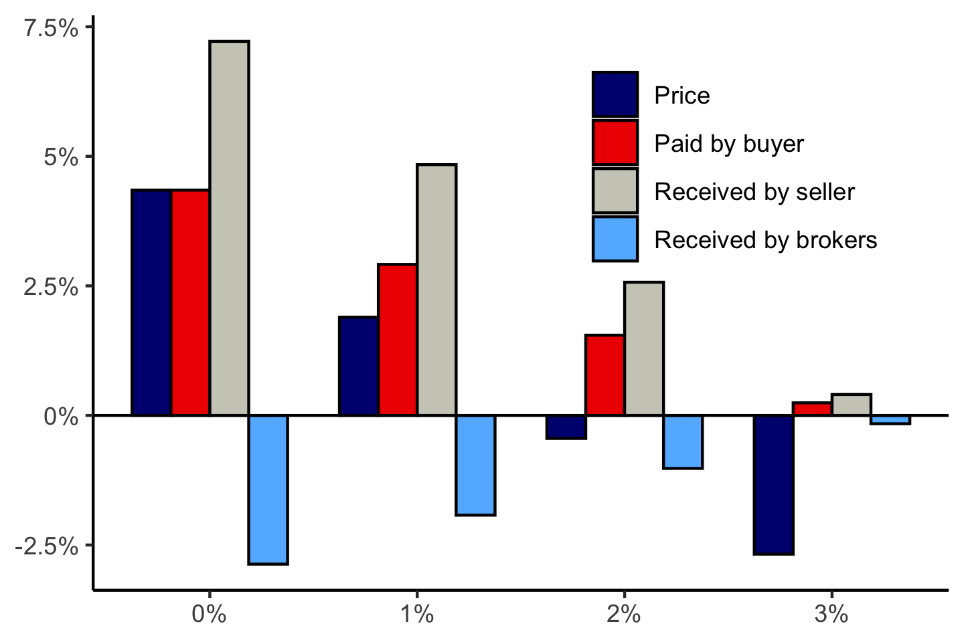
Seller’s Agent Fee = 3%
Fee Decoupling: Change in Payments
Buyer’s Agent Fee

Slide 31
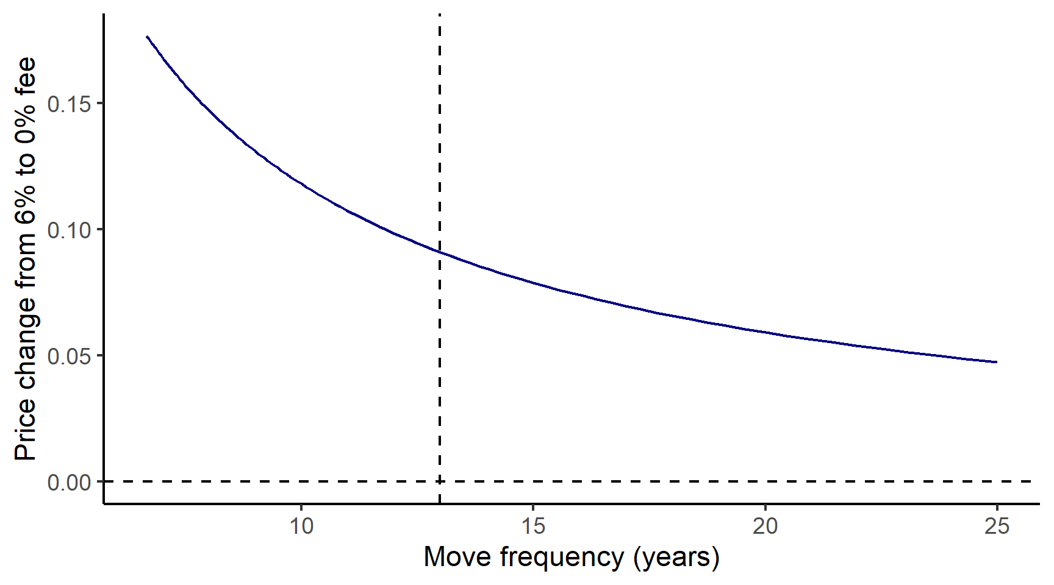
Sensitivity by holding length

Slide 32
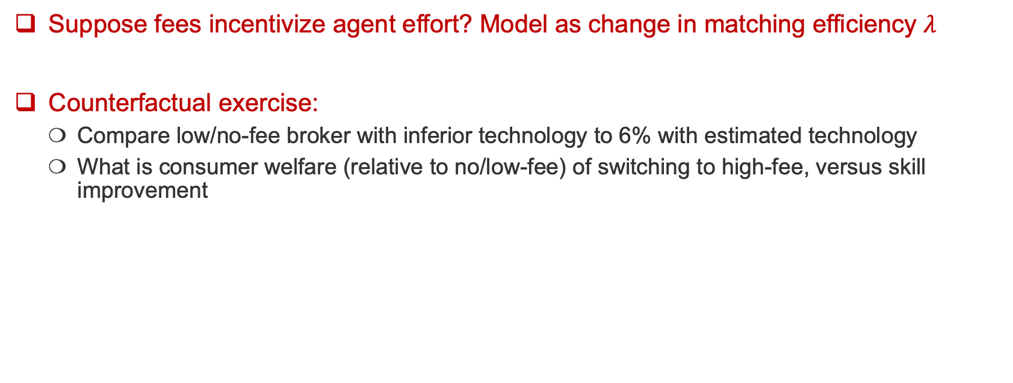
What if agent fees increase agent effort?
Suppose fees incentivize agent effort? Model as change in matching efficiency $λ$
Counterfactual exercise:
  Compare low/no-fee broker with inferior technology to 6% with estimated technology
  What is consumer welfare (relative to no/low-fee) of switching to high-fee, versus skill improvement

Slide 33
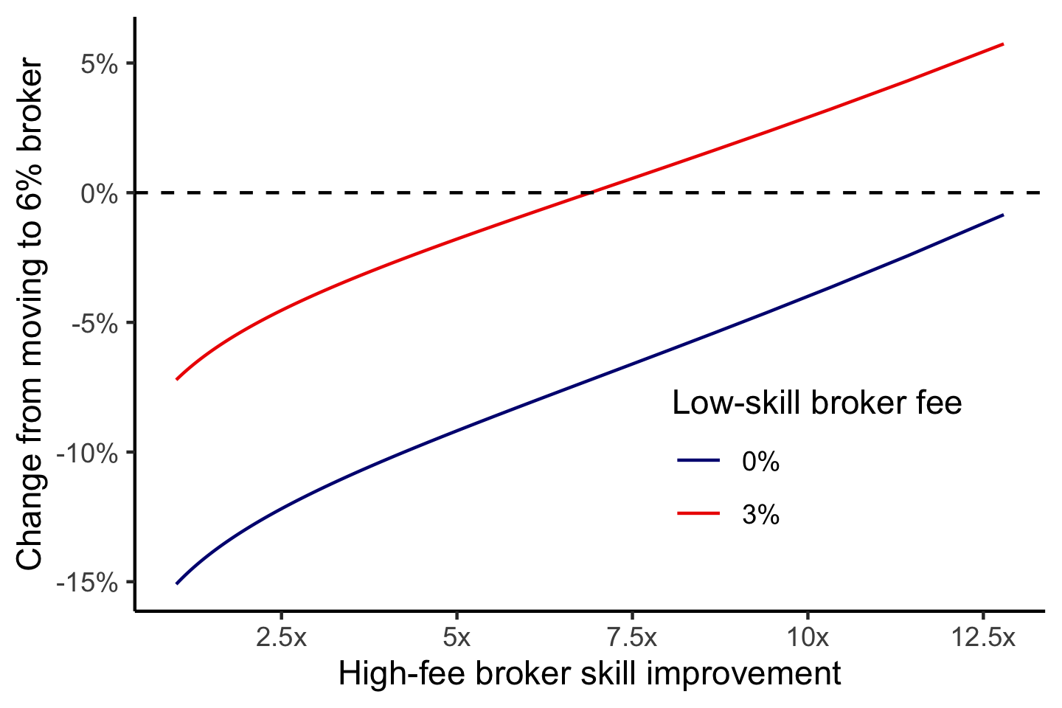
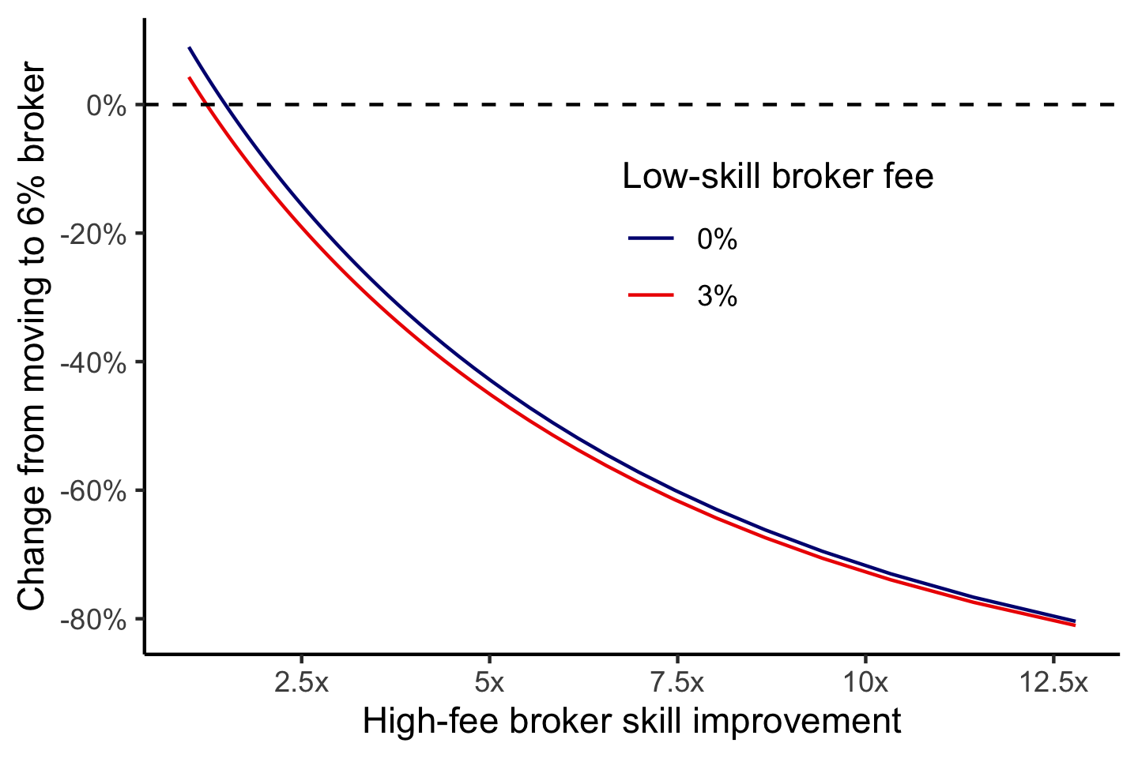
What if agent fees increase agent effort?
Payment to seller
Time to sale
Moving from no-fee broker to 6% fee broker with 5x better matching technology:
Reduces net payments to seller by 10%
Reduces time-to-sale by 40%

Slide 34
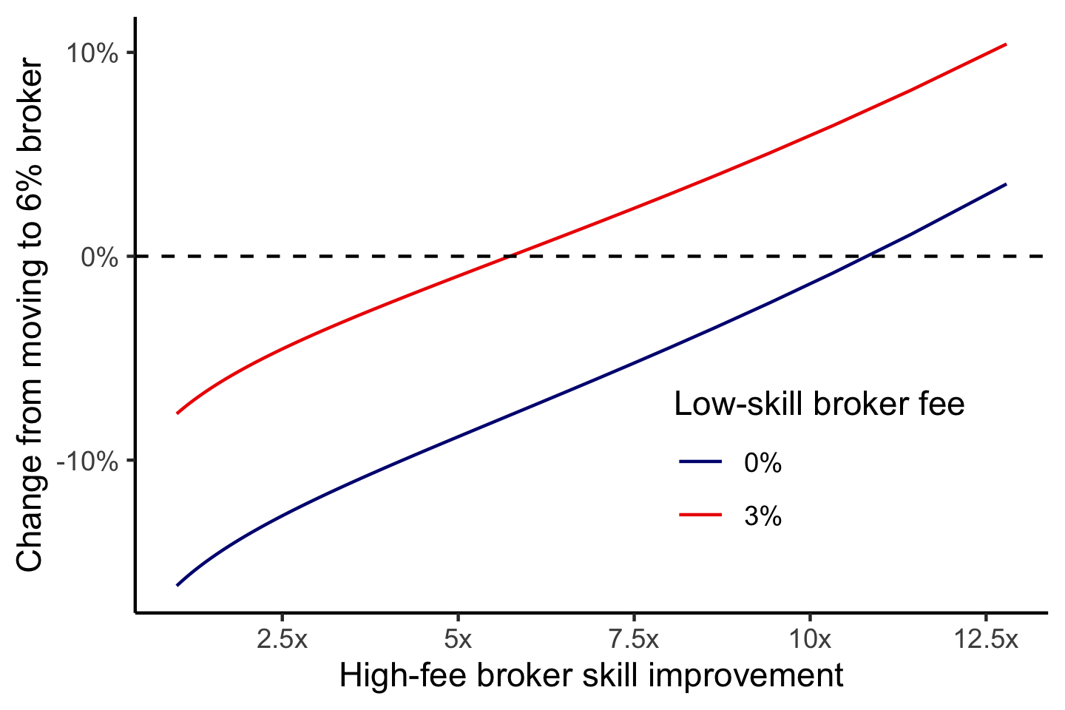
What if agent fees increase agent effort?
Seller welfare
6% fee broker must be ~11x more efficient in matching than no broker for seller to be indifferent

Slide 35
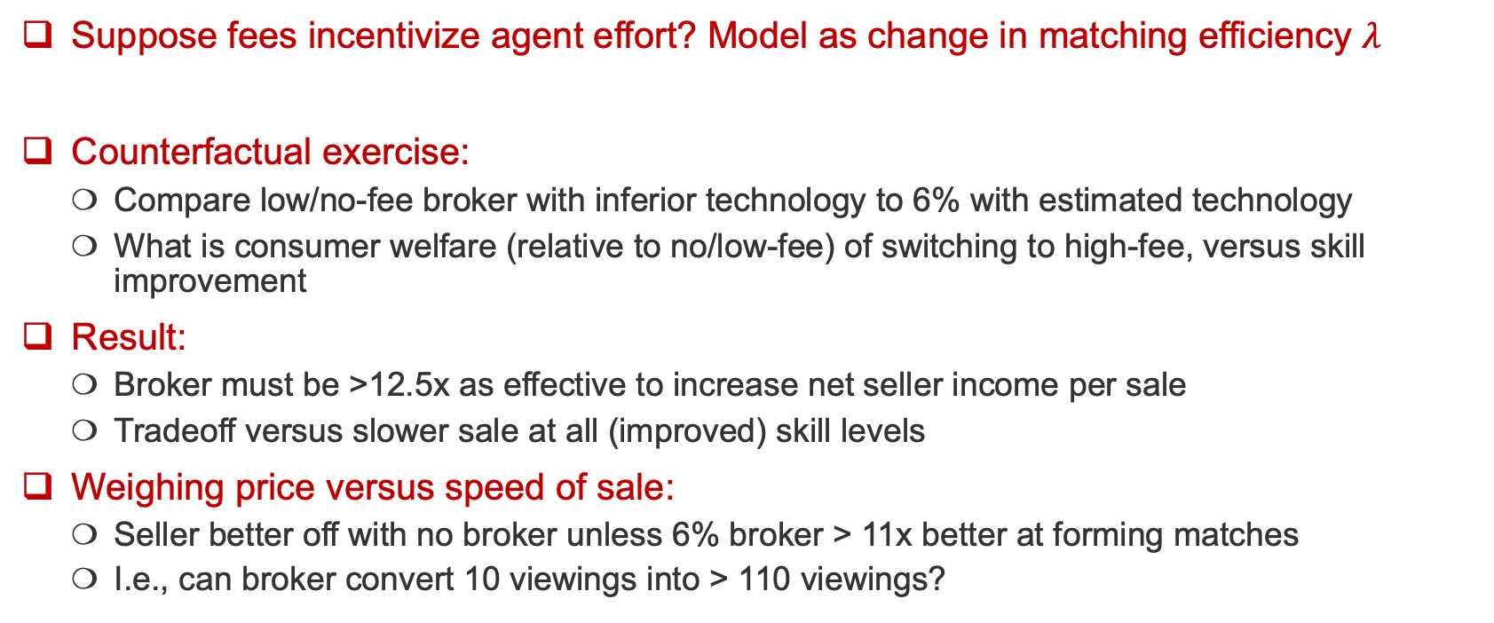
What if agent fees increase agent effort?
Suppose fees incentivize agent effort? Model as change in matching efficiency $λ$
Counterfactual exercise:
  Compare low/no-fee broker with inferior technology to 6% with estimated technology
  What is consumer welfare (relative to no/low-fee) of switching to high-fee, versus skill improvement
Result:
  Broker must be >12.5x as effective to increase net seller income per sale
  Tradeoff versus slower sale at all (improved) skill levels
Weighing price versus speed of sale:
  Seller better off with no broker unless 6% broker > 11x better at forming matches
  I.e., can broker convert 10 viewings into > 110 viewings?

Slide 36
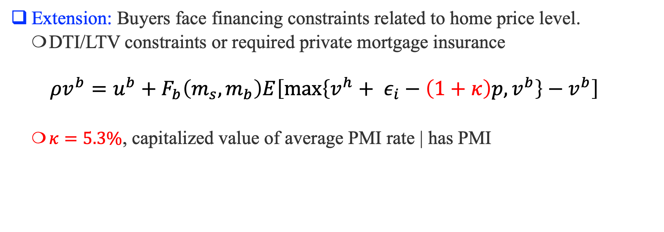
Extension: Financing Constraints
Extension: Buyers face financing constraints related to home price level.
  DTI/LTV constraints or required private mortgage insurance
  $$ρv^{b}=u^{b}+F_{b}\left(m_{s},m_{b}\right)E\left[\max\left\{v^{h}+ ε_{i}−\left(1+κ\right)p,v^{b}\right\}−v^{b}\right]$$
  $κ=5.3\%$, capitalized value of average PMI rate | has PMI

Slide 37
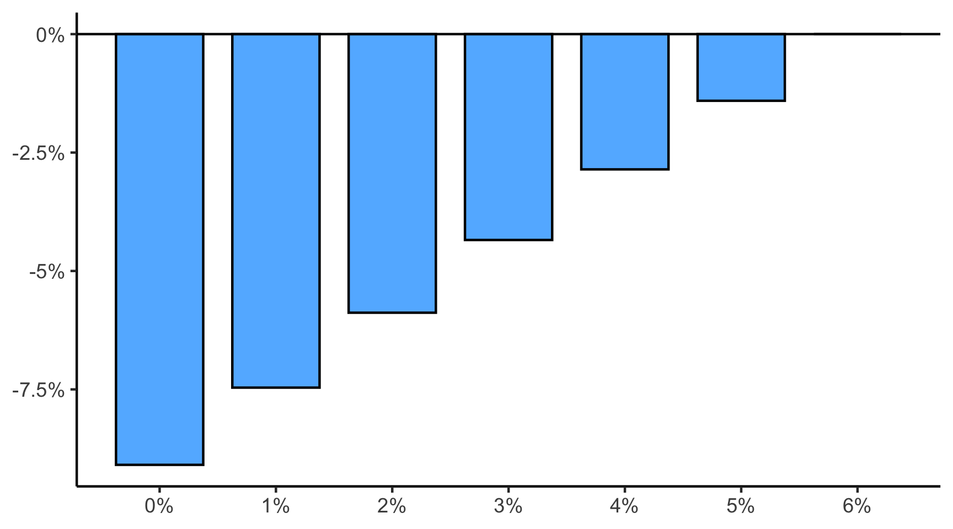
Extension: Financing Constraints
Change in financially constrained buyer’s welfare
Total Fee (%)

Slide 38
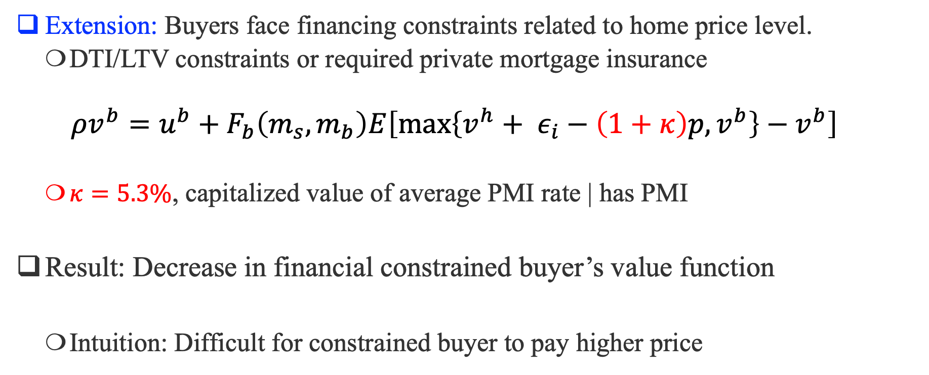
Extension: Financing Constraints
Extension: Buyers face financing constraints related to home price level.
  DTI/LTV constraints or required private mortgage insurance
  $$ρv^{b}=u^{b}+F_{b}\left(m_{s},m_{b}\right)E\left[\max\left\{v^{h}+ ε_{i}−\left(1+κ\right)p,v^{b}\right\}−v^{b}\right]$$
  $κ=5.3\%$, capitalized value of average PMI rate | has PMI
Result: Decrease in financial constrained buyer’s value function
  Intuition: Difficult for constrained buyer to pay higher price

Slide 39
Summary
Impact of Reduced Agent Fees
  Lower agent commissions lead to higher home prices, as reduced future transaction costs increase the value of housing as a durable asset.
  Lower fees enhance consumer welfare by reducing homeownership costs but mainly benefit current homeowners, not prospective buyers
  Extraordinary agent skill necessary to justify 6% fee from seller’s perspective
Affordability Concerns
  Even with a significant reduction in agent fees (e.g., from the NAR settlement), affordability for prospective buyers is unlikely to improve substantially.
  Financially constrained buyers may still struggle due to rising home prices, which can further limit their ability to qualify for credit.

