Slide 1
Flood Risk, Insurance and Housing in the United States
Suvy Qin
UC-Berkeley and US Census Bureau
John Voorheis
US Census Bureau
Any opinions and conclusions expressed herein are those of the authors and do not reflect the views of the U.S. Census Bureau. The Census Bureau has ensured appropriate access and use of confidential data and has reviewed these results for disclosure avoidance protection (Project 7505723: CBDRB-FY25-CES025-010)

Slide 2
Motivation
Flooding is among the most damaging perils facing households in the United States
  From 1980-2024, large flooding events caused $4.5 Billion in damage per year on average (NOAA Billion Dollar Disasters)
Flood risk is increasingly salient, but we know less about who bears the burden of this risk
  Flood risk – and realization of this risk – is a hyperlocal phenomenon that can vary even between adjacent housing units
In the US, robust public and private flood insurance markets exist
  However, concerns about access, cost and efficiency of insurance markets and subsidies abound

Slide 3
Roadmap
In this talk, we will lay out new facts about flood risk and insurance that we can glean using confidential Census data
Key Questions:
  Who is exposed to flood risk in the United States?
  Who has insurance against these risks?
Future work:
  What are the impacts of exposure to large flooding events?
  Are these impacts exacerbated by uninsurance?
  Better understanding these patterns via National Flood Insurance Program Microdata (acquisition in progress)

Slide 4
12 Facts about Flood Risk and Homeowners Insurance in the United States

Slide 5
Data
To measure the distribution of flood risk, we combine flood plain maps with individual-level Census data
Flood Risk data:
  FEMA National Flood Hazard Layer maps (focus for today)
  First Street Foundation’s FloodFactor maps
Individual Level data:
  Environmental Impacts Frame – individual level data on location, income, demographics and homeownership from 1999-2024
  American Community Survey – survey responses to questions on e.g. homeownership, homeowners insurance and income/demographics

Slide 6
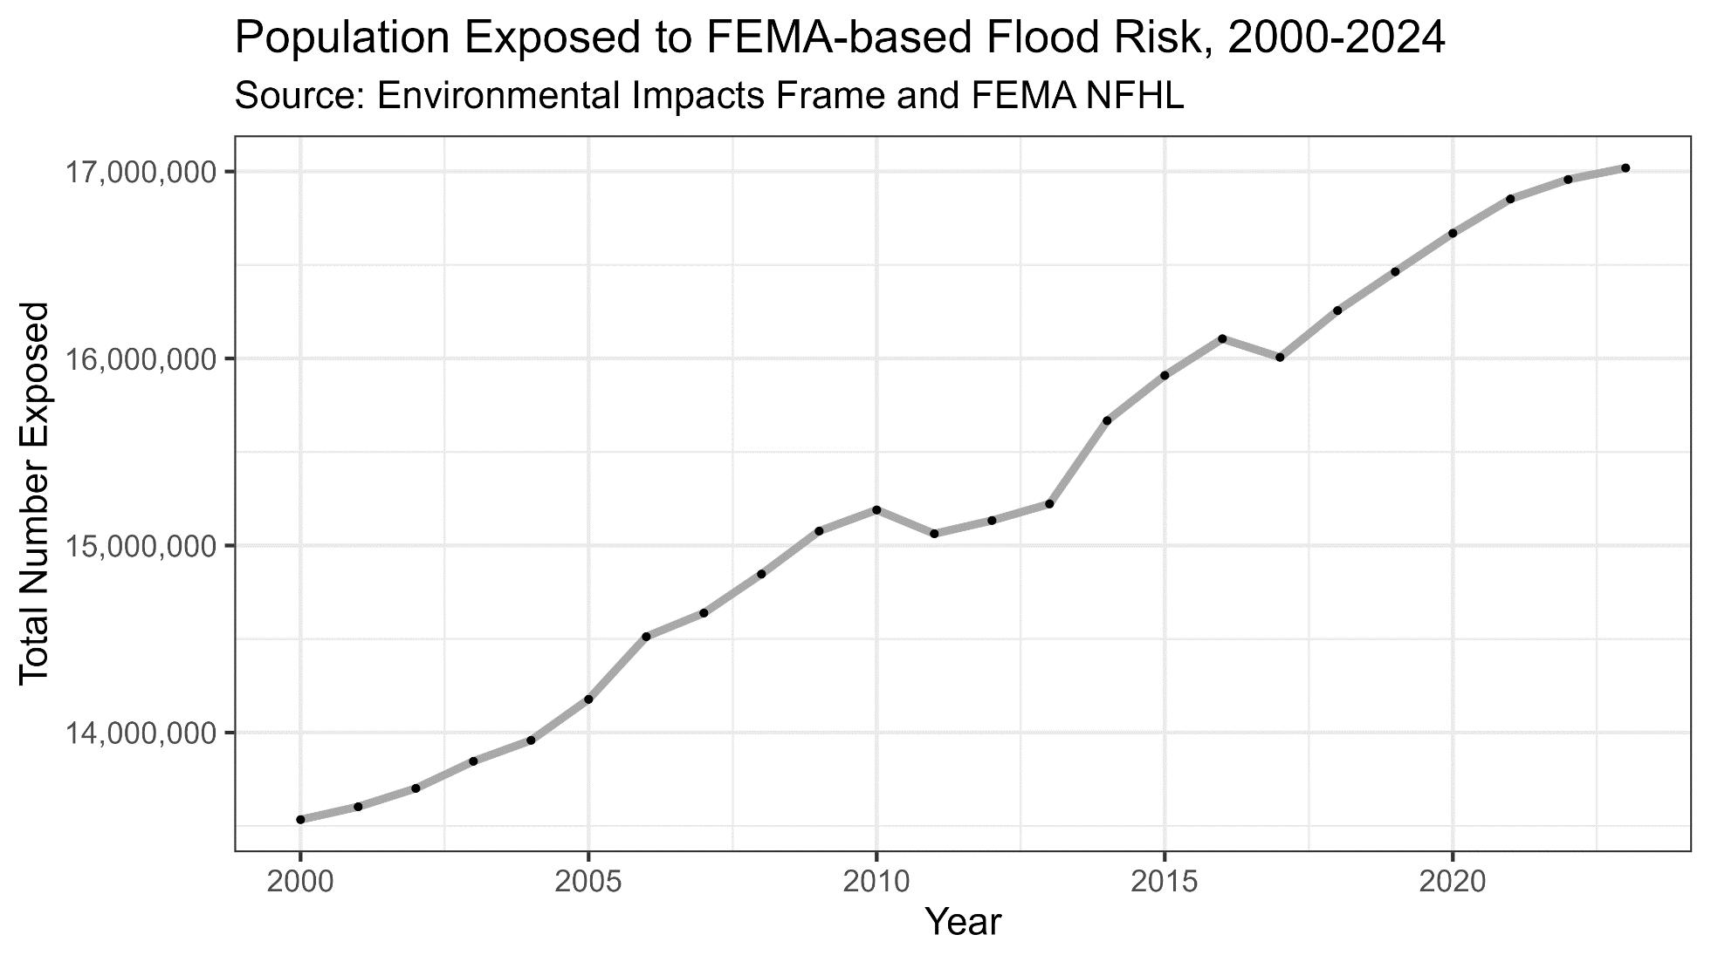
Fact 1: The Population Exposed to Flood Risk has Risen Over Time

Slide 7
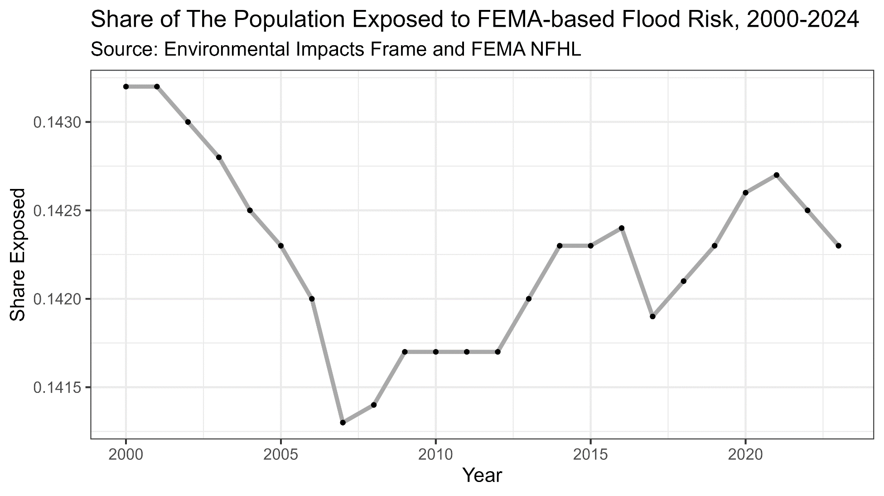
Fact 2: ….But The Share of The Population Exposed to Flood Risk Has Changed Little

Slide 8
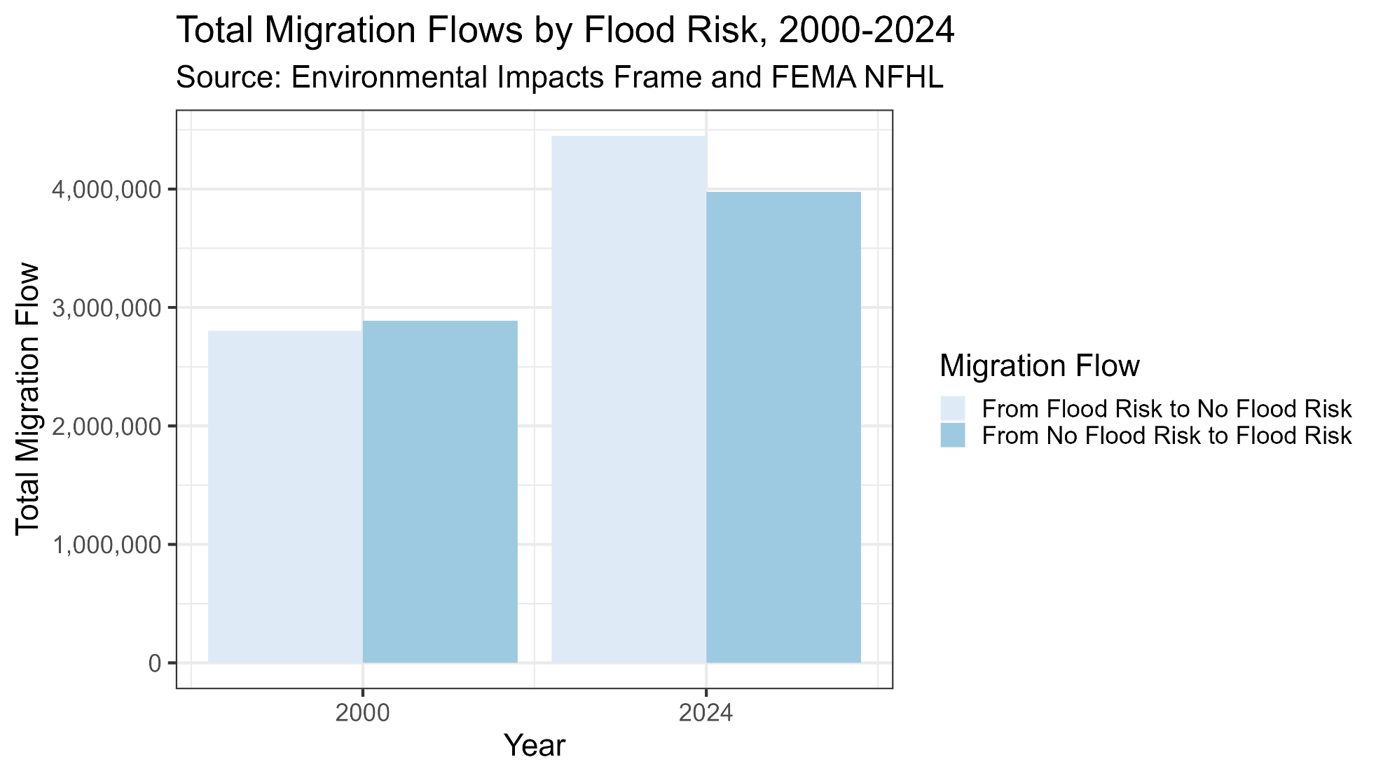
Fact 3: People Are Not (on Net) Moving to Flood-prone Areas

Slide 9
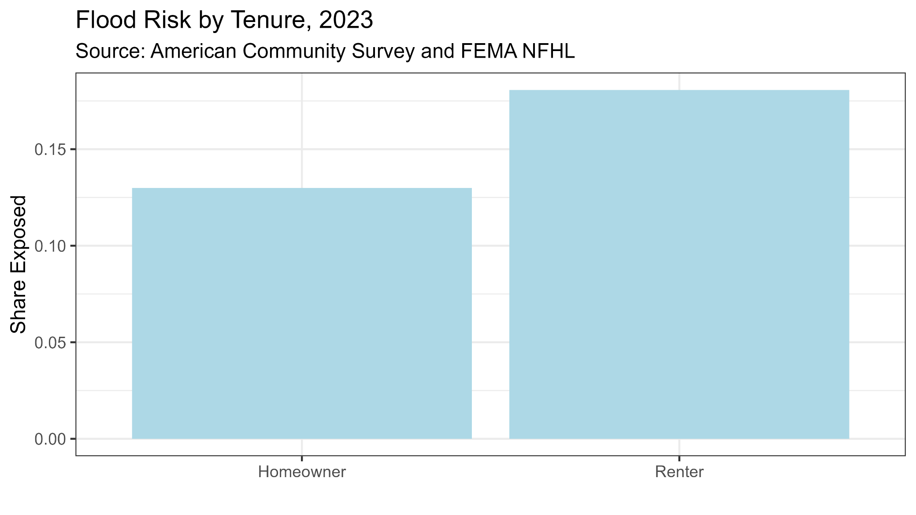
Fact 4: Renters Are Exposed To Higher Levels of Flood Risk than Homeowners

Slide 10
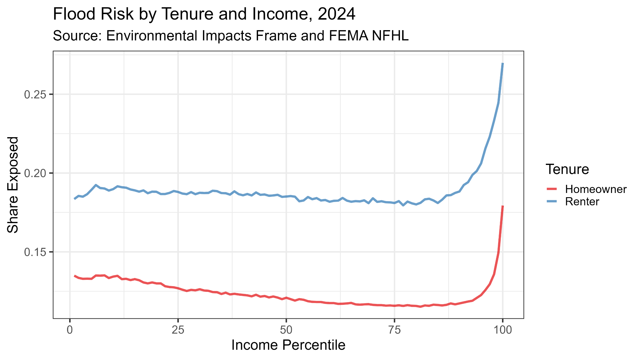
Fact 5: Very High Income Individuals Bear Disproportionate Flood Risk

Slide 11
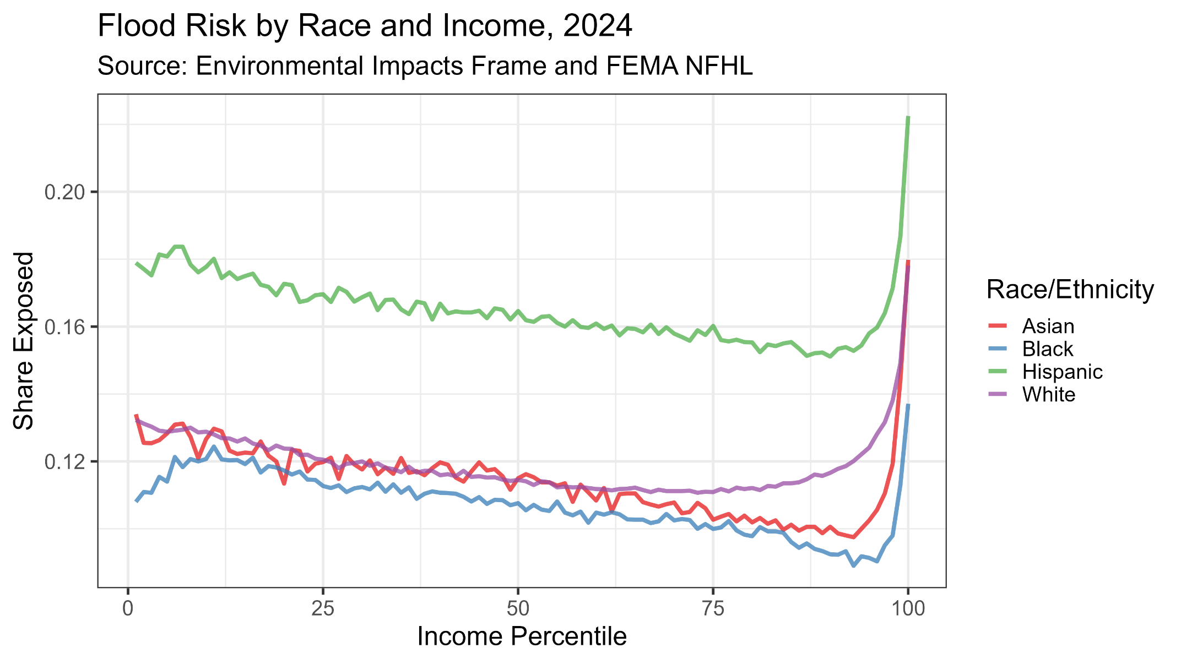
Fact 6: Hispanic Homeowners Are Exposed to the Most Flood Risk; Black Homeowners the Least

Slide 12
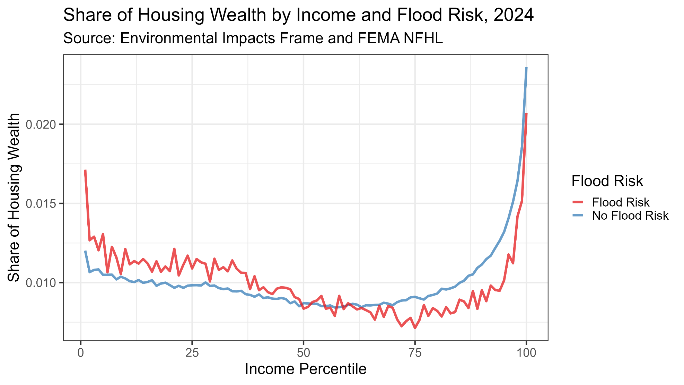
Fact 7: The Distribution of Owner-Occupied Housing Wealth is Similar Between Flood Prone and non-Flood Prone Areas

Slide 13
Importance of Second Homes
We’ve focused on owner-occupied and renter-occupied housing so far, but this ignores a third category: non-primary housing units (such as vacation homes)
We can identify these in the administrative records by combining ownership information from property tax records with the EIF
  We classify housing units owned by an individual that have not been recently occupied by anyone in the EIF as “second homes” owned by that individual
  We identify (approx. 8 million) such homes in 2024
How do second homes figure into flood risk?

Slide 14
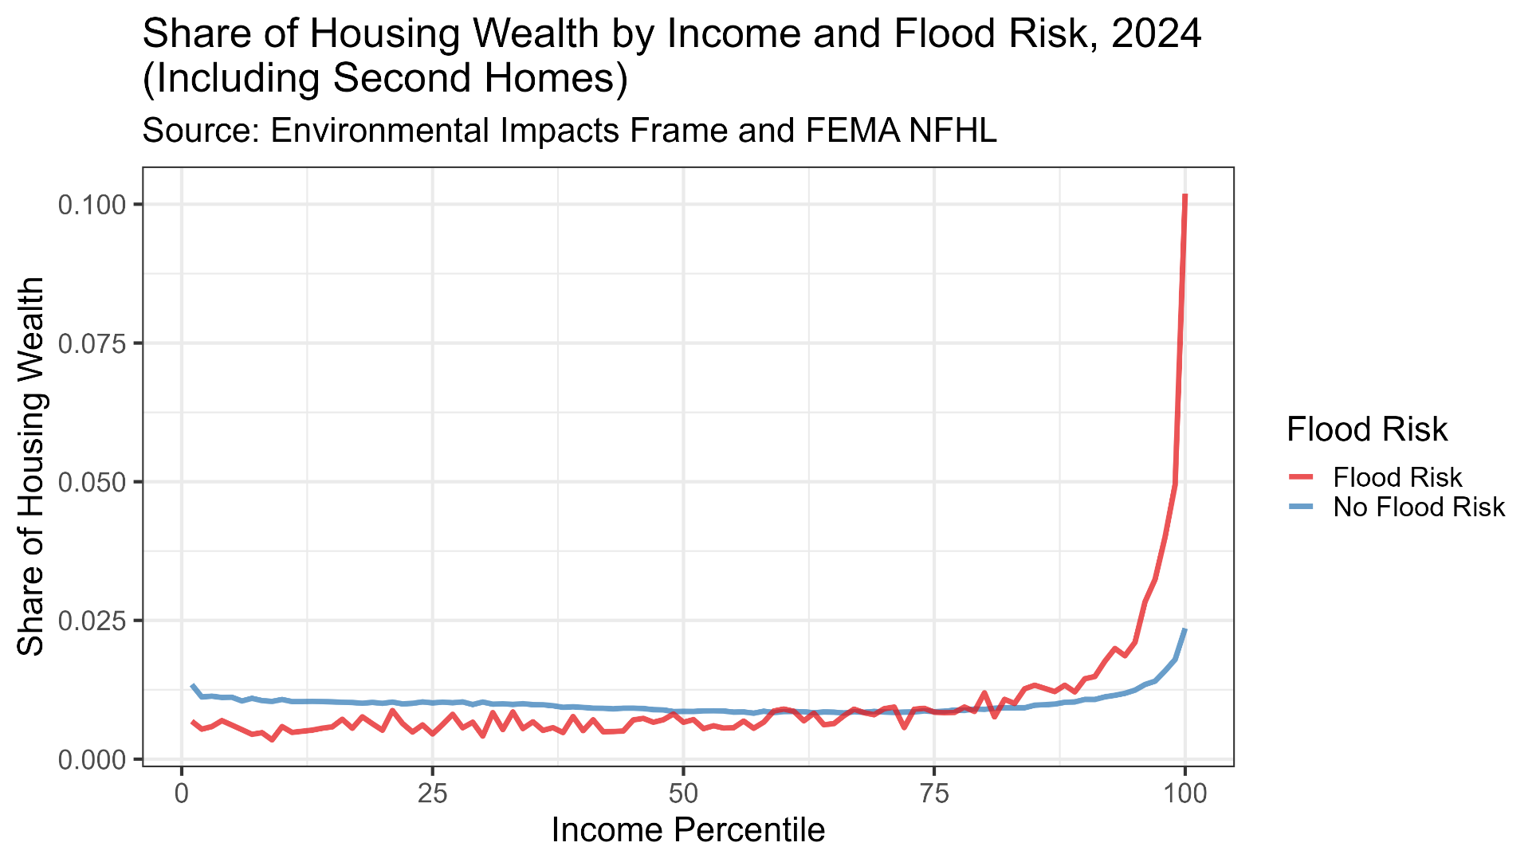
Fact 8: High Income Individuals Own a Disproportionate Share of the Total Housing Wealth in Flood Prone Areas

Slide 15
Homeowners Insurance and Flood Risk
The main way that homeowners can mitigate flood risk is via homeowners insurance.
  Homeowners insurance may have flood riders either provided by a private insurer or the National Flood Insurance Program (NFIP)
  Conventional mortgages for homes in FEMA floodplains are required to carry flood insurance
  Homeowners with a mortgage generally have little leeway to drop this insurance, however homeowners without a mortgage may choose to forego it
Flood insurance is not directly measured in current Census data
  However, overall homeowners insurance coverage and premiums paid are in the ACS (and 2000 Decennial Census long form)

Slide 16
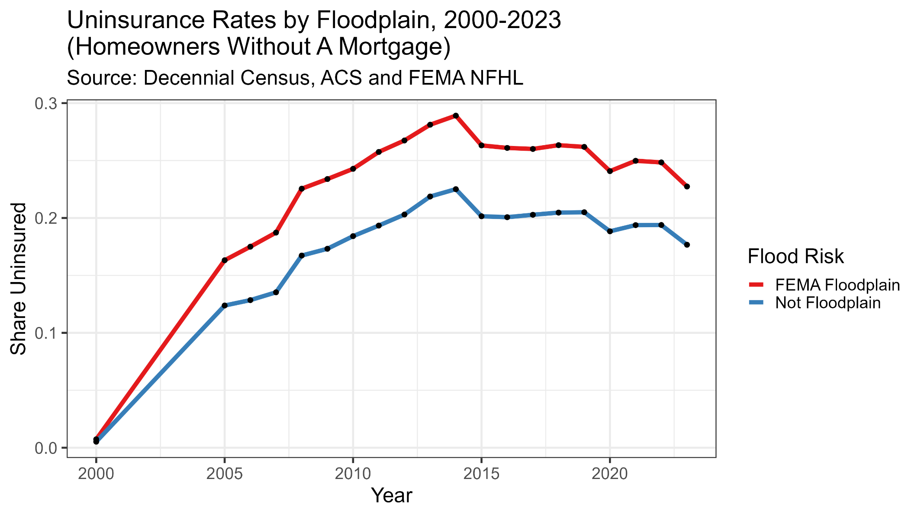
Fact 9: Uninsurance Rates are Higher in Flood-prone Areas

Slide 17
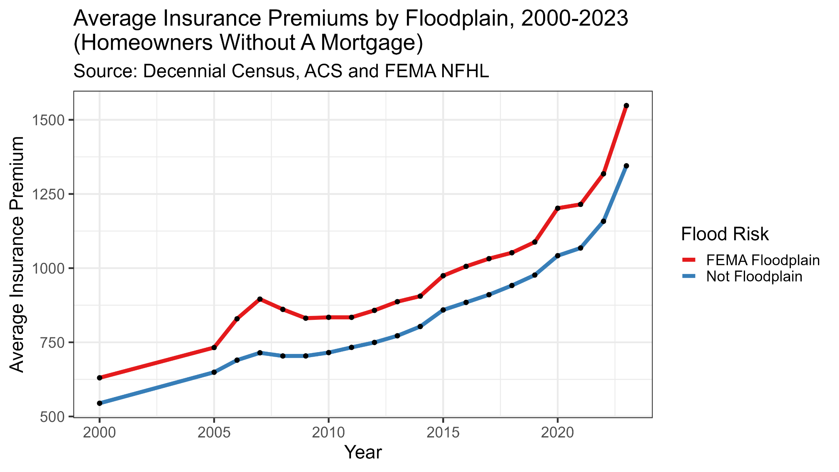
Fact 10: Homeowner Insurance Premiums Are Higher in Flood-prone Areas

Slide 18
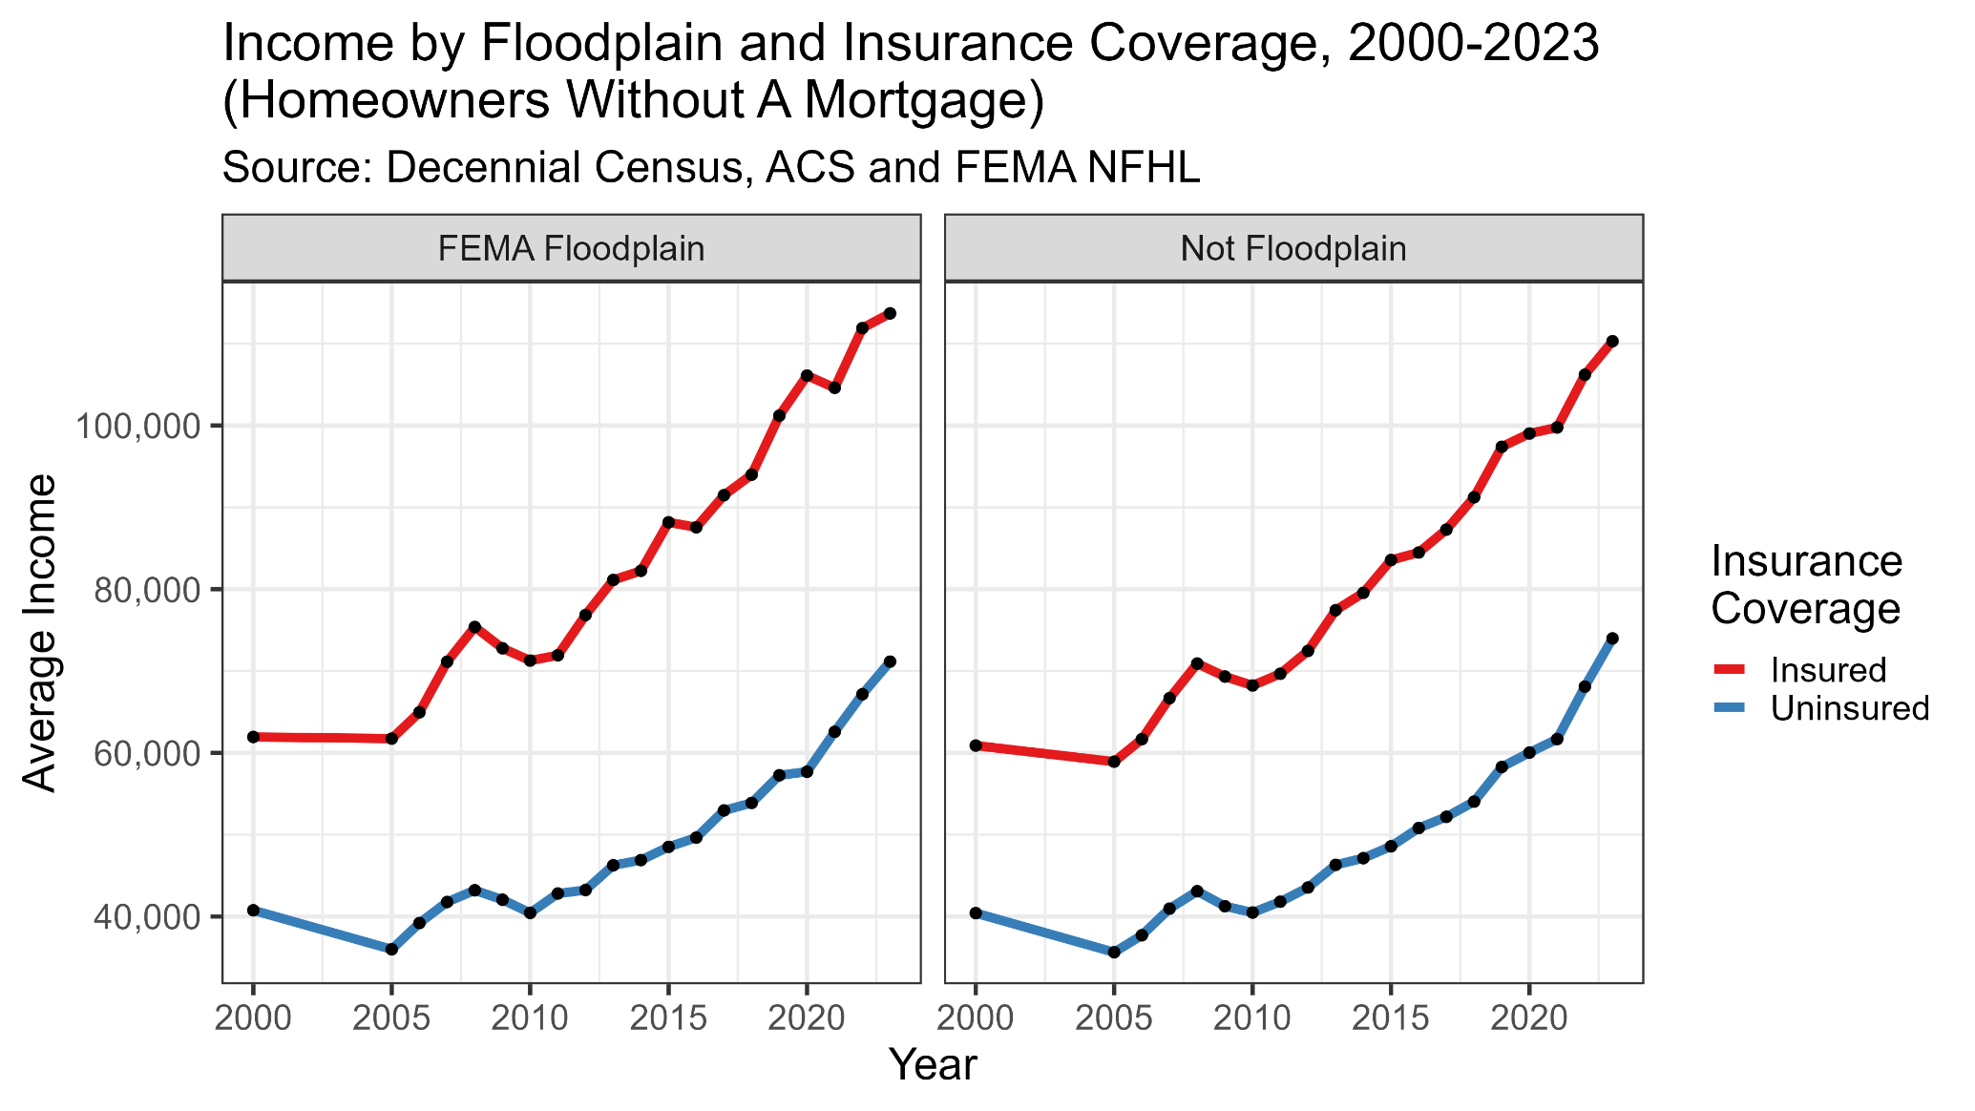
Fact 11: Uninsured Homeowners Are Lower Income Than Insured Homeowners

Slide 19
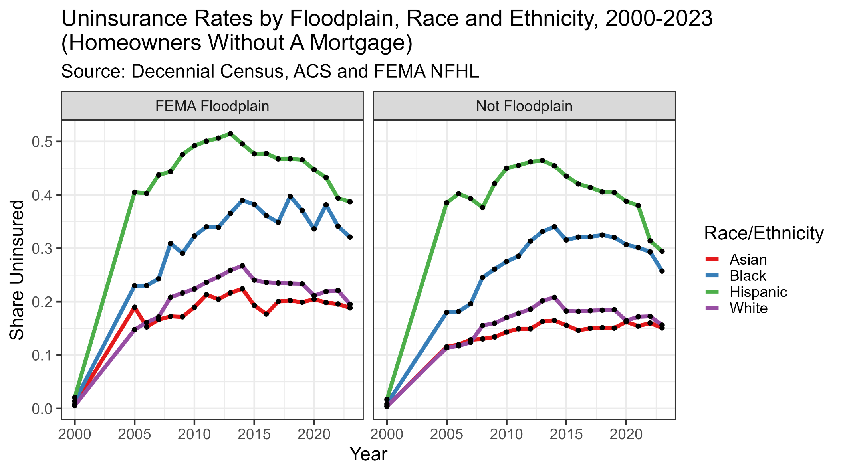
Fact 12: Black and Hispanic Homeowners Are More Likely to Be Uninsured

Slide 20
Synthesis
Distribution of flood risk is skewed towards high income, high wealth, less vulnerable individuals
  However, a vulnerable subpopulation – uninsured homeowners – exists within flood prone areas with limited ability to mitigate potential losses
  This subpopulation is lower income and more likely to be Hispanic or Black
Can think of a typology of four groups of people facing flood risk
  Renters
  Very rich (often multiple) homeowners
  Non-rich homeowners with insurance
  Non-rich homeowners without insurance
First three groups can mitigate flood risk, the last group may not

Slide 21
Where Do We Go From Here?

Slide 22
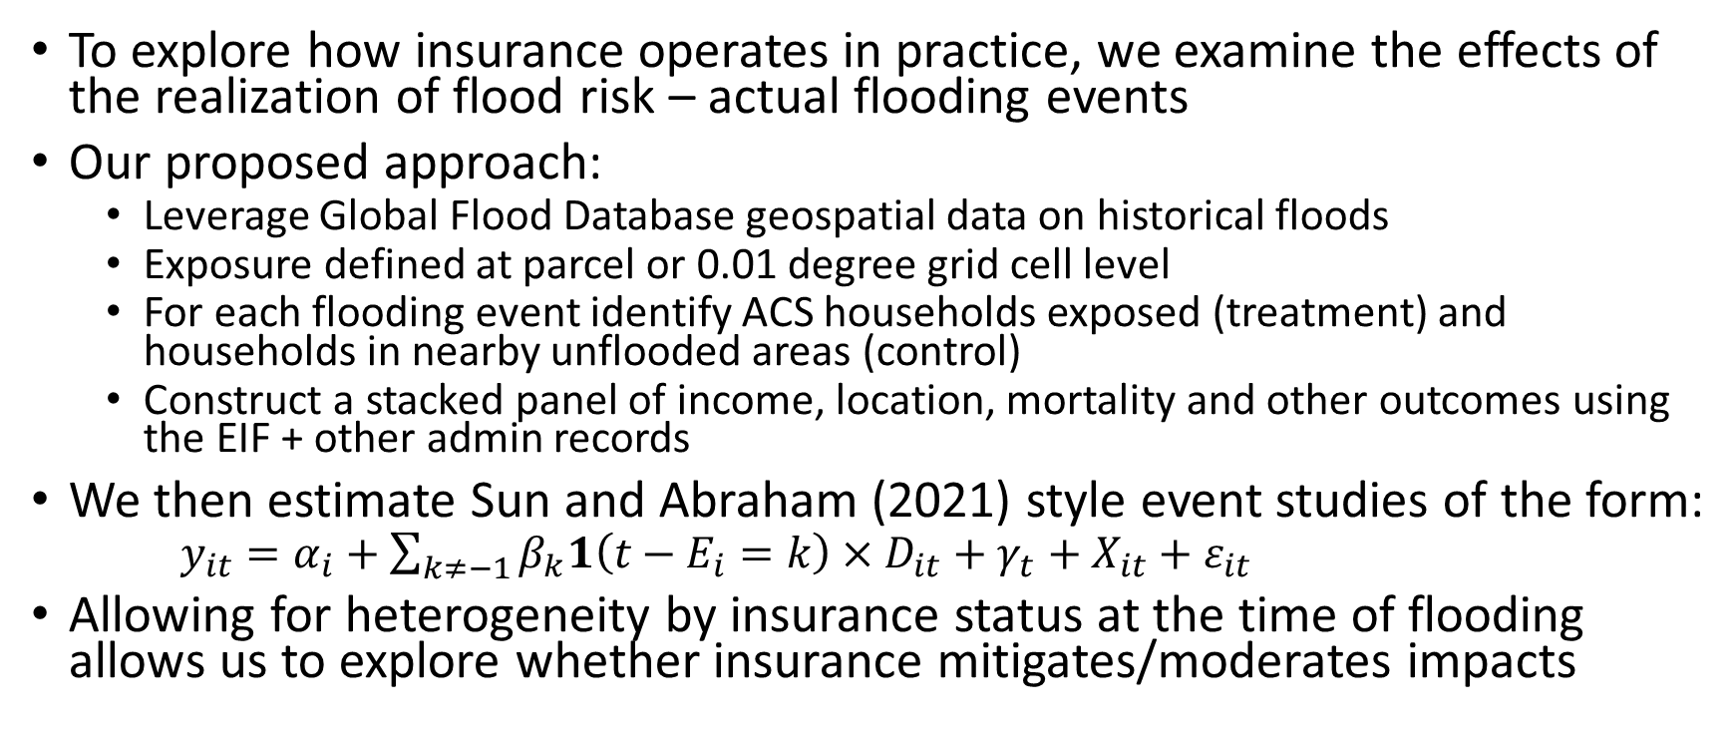
What Is The Impact of Exposure to Flooding?
To explore how insurance operates in practice, we examine the effects of the realization of flood risk – actual flooding events
Our proposed approach:
  Leverage Global Flood Database geospatial data on historical floods
  Exposure defined at parcel or 0.01 degree grid cell level
  For each flooding event identify ACS households exposed (treatment) and households in nearby unflooded areas (control)
  Construct a stacked panel of income, location, mortality and other outcomes using the EIF + other admin records
We then estimate Sun and Abraham (2021) style event studies of the form:
  $y_{it}=α_{i}+\sum_{k≠−1}{β_{k}1\left(t−E_{i}=k\right)×D_{it}}+γ_{t}+X_{it}+ε_{it}$
Allowing for heterogeneity by insurance status at the time of flooding allows us to explore whether insurance mitigates/moderates impacts

Slide 23
Incorporating Insights from NFIP Data
Largest provider of flood insurance in the US is the National Flood Insurance Program (NFIP), administered by FEMA
Administrative records from this program would allow us to further explore the intersection of vulnerability, resilience, flood risk, and insurance
Census and FEMA are in the process of making NFIP microdata available for use with the EIF and other Census data

Slide 24
Thanks!
Contact: john.l.voorheis@census.gov

Slide 25
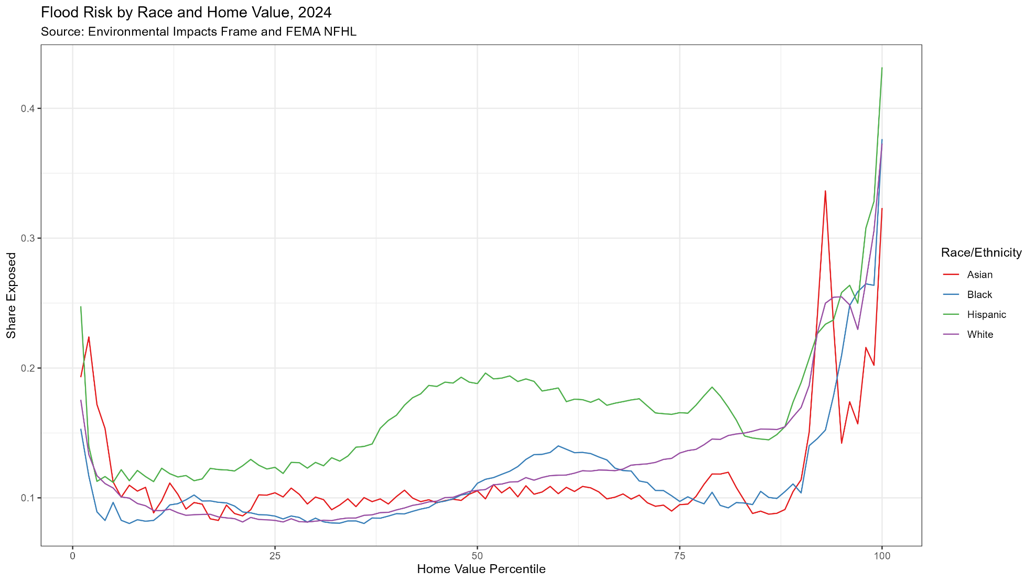
Fact A1: The Most Expensive Homes Are Disproportionately Exposed to Flood Risk

Slide 26
Appendix: What Is the Impact of Exposure to Flooding? (Preliminary)

Slide 27
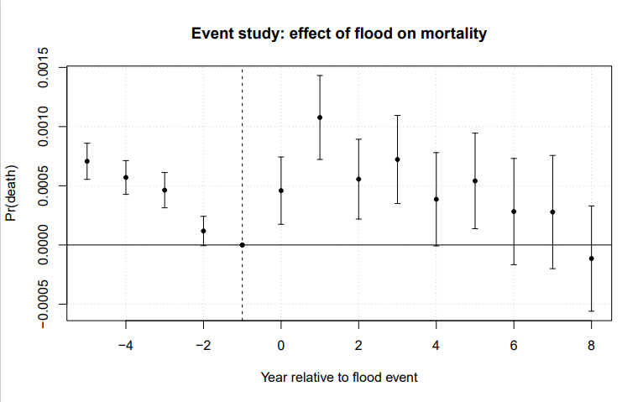
Effect of flooding on mortality

Slide 28
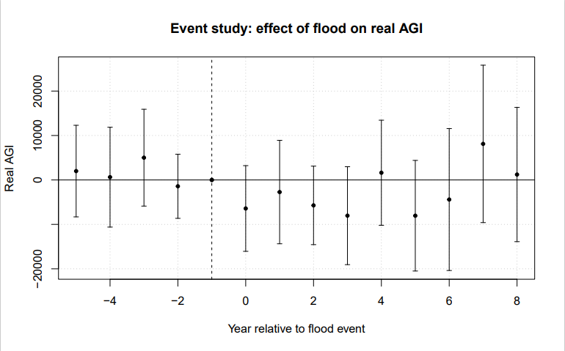
Effect of flooding on income

Slide 29
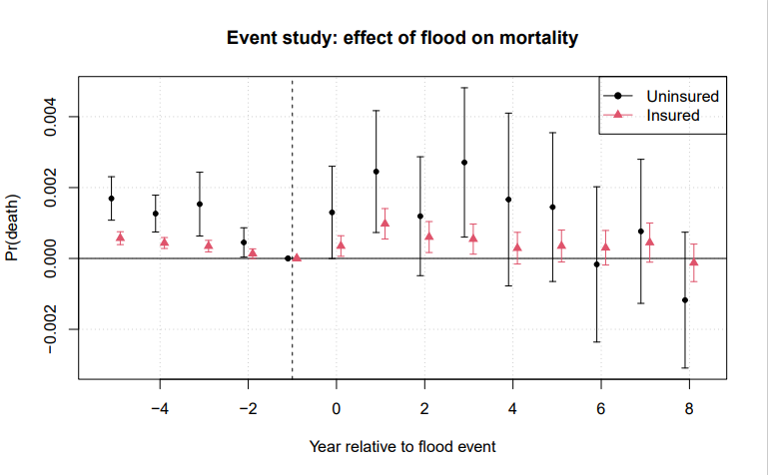
Heterogeneous effects by insurance status

Slide 30
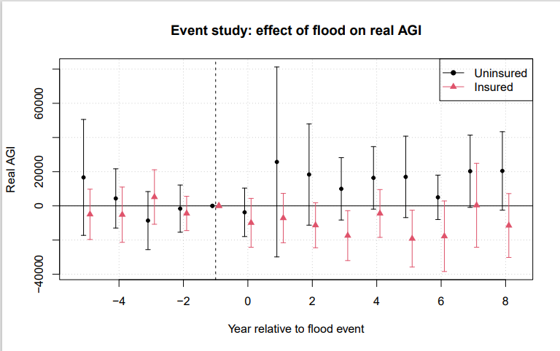
Heterogeneous effects by insurance status

