Slide 1
A Longer-Run Evaluation of the
Employment Effects of Opportunity Zones
Matthew Freedman
Noah Kouchekinia
David Neumark

Slide 2
Opportunity Zones
IRS: “Opportunity Zones are an economic development tool that allows people to invest in distressed areas in the United States. Their purpose is to spur economic growth and job creation in low-income communities while providing tax benefits to investors.”
Investors receive substantial tax advantages – capital gains tax reductions or eliminations – for investment in OZs
8,762 Census tracts designated in initial round
Estimated tax expenditures of $8.2 billion, 2020-24
Scale far surpasses prior comparable policies (e.g., ~$1 billion on federal Empowerment Zones and Enterprise Communities, 1994-2004
Renewed in recent legislation, sunsetting existing zones and designating new ones (20% fewer)

Slide 3
OZs in context
Key prior place-based policy is EZs, which directly target hiring of low-skill workers
  Job creation from EZs is spotty at best (Neumark and Simpson, 2015), and even in where there may have been job creation (federal EZs – Busso et al., 2013), benefits do not appear to go to low-income residents of targeted places (Reynolds and Rohlin, 2015)
Declining geographic mobility (Austin et al., 2018), evidence on importance of place in life outcomes (Chetty et al., 2014), and potential for place-based policies to complement other policies (Gaubert et al., 2021) may have spurred interest in new place-based policies

Slide 4
What might we have expected?
OZs fail to adopt “best practices” based on other research (Freedman and Neumark, forthcoming)
  Do not incentivize job creation, but instead investment, much going into real estate
  Targeting poorly designed, with evidence of favoritism, picking growing areas, etc. (e.g., Eldar and Garber, 2023)
  Targeting is granular, facilitating spillovers
  “By right” rather than discretionary – making windfalls likely (Corinth and Feldman, 2024)
Most closely-related program – NMTC – led to real-estate investment, but modest and costly poverty reductions (Freedman, 2012)

Slide 5
Prior evidence
Labor market:
  Limited/no evidence of gains in employment or earnings, or poverty reductions (Freedman et al., 2023), and selection of improving tracts
  Limited evidence of increases in online job postings (Atkins et al., 2023)
  No evidence of employment growth or small business formation (Shen, 2024)
  Sizable positive job growth effects (Arefeva et al., 2020; Rupasingha and Davis, 2024)
Mixed evidence on real estate markets (Wheeler, 2023; Corinth and Feldman, 2023; Sage et al., 2023; Glasner et al., 2025)

Slide 6
Contribution 1: extending the time horizon substantially
Generally weak effects in prior research could simply reflect short time horizon of most of that work (ending as early as 2019, 1st full year of implementation)
  We update substantially, data currently extending through 2023 and will go at least one year further
Ambiguous whether effects should grow over time
  If investments mainly spur construction, largest impact might be short-term construction jobs
  In longer run, property prices may rise and employment and real wages revert to equilibrium levels, or agglomeration/multiple equilibria might lead to persistent improvements
  Capital flows may have increased in later years

Slide 7
Contribution 2: more comprehensive look at employment effects
Effects on employment and other outcomes for OZ residents
  Focus on residents is first-order: major motivation for OZs is to improve outcomes for residents of distressed communities, as evidenced by LIC criteria (which are basis for nearly all designated zones)
Effects on jobs in OZs, whether held by residents or not
  …and distribution of OZ job gains by residential location (designated OZ, non-OZ LIC tracts, non-LIC tracts)
Distribution of job changes for OZ residents by workplace location (designated OZ, non-OZ LIC tracts, non-LIC tracts)
Spillovers to nearby LICs and nearby tracts generally

Slide 8
Key findings
Increased employment in OZs, but job gains favor residents of other, non-LIC tracts
Correspondingly, limited impacts on OZ resident employment rates, earnings, or poverty rates
A substantial part of the job gains among OZ residents are in other, non-LIC tracts
Newly-created jobs in OZs offset nearly 1-to-1 by job declines in nearby LICs
  And offset more than 1-to-1 by job declines in all nearby tracts

Slide 9
Data in brief
ACS data at census tract level, 2013-2023
  Will use confidential micro-data, analysis at annual level, with place of residence and place of work information
  Outcomes are overall employment among residents, employment/population, average earnings of employed residents, and poverty rate of residents
  For now, using public data, 5-year averages by tract, for 2013-2017 and 2019-2023 (2018 might be viewed as “partially treated”)
    Only simple two-period difference-in-difference for now
LODES data at census tract level, 2013-2022
  Derived from state UI records, cover near-universe of workers
  Measure resident jobs, workplace jobs, and commuting flow (primary jobs)
  Paralell two-period difference-in-difference as well as event study

Slide 10
Basic identification strategy
Most analysis focuses on changes in outcomes for designated vs. eligible tracts, all of which are LICs based on program criteria that are LICs (by program criteria)
  LIC: poverty rate ≥ 20% or median family income ≤ 80% of greater of metro area or state median family income
  A few other exceptions are eligible for designation (e.g., in Empowerment Zone, pop. < 2,000, adjacent to LIC)
Spillover analysis extends this
  Estimate effects on LICs adjacent to OZs, using non-adjacent LICs as controls
  Estimate effects on all tracts adjacent to OZs, using all tracts adjacent to non-OZ LICs as controls (less conventional)

Slide 11
OZ tracts have lower empl. and earnings and higher poverty than other LICs
 | Unweighted
 | Untreated (non-OZ LICs) |  | Treated (LIC OZs)
 | 2013-2017 | 2019-2023* | 2013-2017 | 2019-2023*
Panel A: ACS 5-Year Averages
Resident employment rate | 55.29% | 57.12% | 52.15% | 54.75%
 | (10.65%) | (10.85%) | (10.76%) | (11.01%)
Resident median earnings | $26,031 | $37,792 | $23,945 | $35,699
 | ($7,187) | ($11,149) | ($6,966) | ($10,691)
Resident poverty rate | 23.99% | 19.94% | 29.25% | 24.13%
 | (11.66%) | (11.35%) | (12.93%) | (12.44%)
Resident employment | 1,787 | 1,989 | 1,656 | 1,885
 | (923) | (1,114) | (910) | (1,111)
Panel B: Annual LODES Data
Resident employment | 1,571 | 1,611 | 1,487 | 1,542
 | (753) | (830) | (755) | (836)
Worksite employment | 1,586 | 1,637 | 2,696 | 2,723
 | (3,534) | (3,804) | (4,963) | (5,056)
Tracts | 23,211 | 22,629 | 7,580 | 7,369

Slide 12
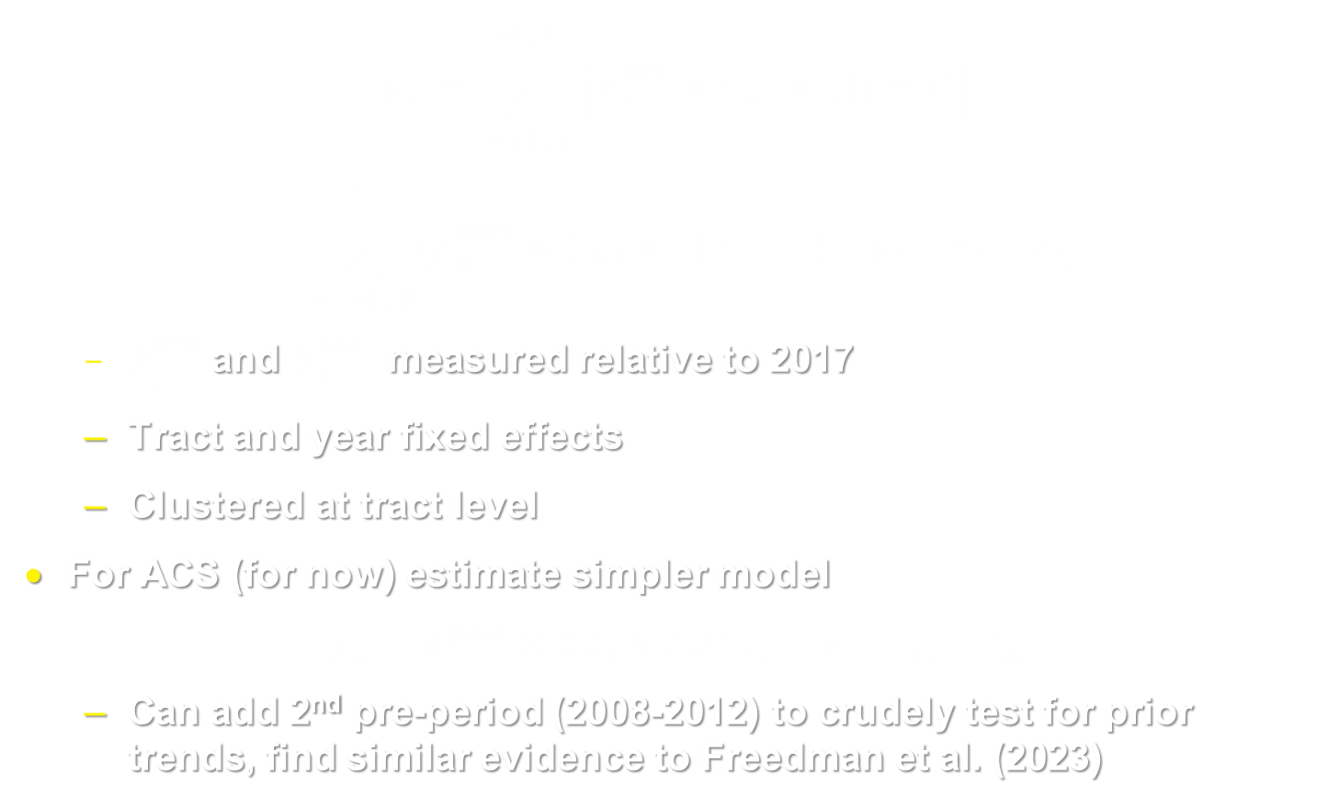
Core approach (event study with LODES, and later with ACS)
$$y_{it}=\sum_{j=2013}^{2016}{\left\{β_{j}^{pre}×OZ_{i}×1\left[j=t\right]\right\}}$$
$$+\sum_{k=2018}^{T}{\left\{β_{k}^{post}×OZ_{i}×1\left[k=t\right]\right\}}+γ_{i}+η_{t}+ε_{it}$$
  $β_{j}^{pre}$and $β_{k}^{post}$ measured relative to 2017
  Tract and year fixed effects
  Clustered at tract level
For ACS (for now) estimate simpler model
$$y_{it}=β^{post}×OZ_{i}×POST_{t}+γ_{i}+η_{t}+ε_{it}$$
  Can add 2nd pre-period (2008-2012) to crudely test for prior trends, find similar evidence to Freedman et al. (2023)

Slide 13

Selection and parallel trends
Our prior work pointed to strong violation of parallel trends that led to spurious evidence of beneficial effects of OZs on tract residents (in ACS data), e.g., for employment rate:

Slide 14
Selection and parallel trends
Approach 1: IPW
  Predict OZ designation based on each tract’s outcomes between 2013-2017
  Highest weight on non-treated tracts with highest estimated probability of being treated based on path of pre-treatment outcome
  Essentially makes the pre-treatment trajectories more comparable (except for ACS data we just match on 5-year levels)
  Also check adding state-by-year FEs (control for other policies/pandemic)
Approach 2: Doubly robust IPW (Sant’Anna and Zhao, 2020; Callaway and Sant’Anna, 2021)
  Predicts outcomes to estimate potential outcomes, using same covariates as for IPW, and using IPW weights

Slide 15
Naïve DD: OZs appear to increase employment and reduce poverty of residents
 | (i) | (ii) | (iii) | (iv) | (v) | (vi)
Data: | LODES | LODES | ACS | ACS | ACS | ACS
 | Log Resident Emp. | Log Workplace Emp. | Emp. Rate | Avg. Earnings | Poverty Rate | Log Resident Emp.
Opportunity Zone | 0.011*** | -0.006 | 0.009*** | 34.55 | -0.011*** | 0.024***
 | (0.002) | (0.004) | (0.001) | (108.4) | (0.001) | (0.004)
Tract FE | Y | Y | Y | Y | Y | Y
Year FE | Y | Y | Y | Y | Y | Y
Tracts | 30,973 | 30,975 | 30,875 | 30,847 | 30,870 | 30,870
Obs. | 275,557 | 275,557 | 61,443 | 61,268 | 61,425 | 61,423
Notes: Heteroskedasticity robust standard errors (in parentheses) are clustered on census tract. Stars indicate p-values: * p<0.05 ** p<0.01 *** p<0.001

Slide 16
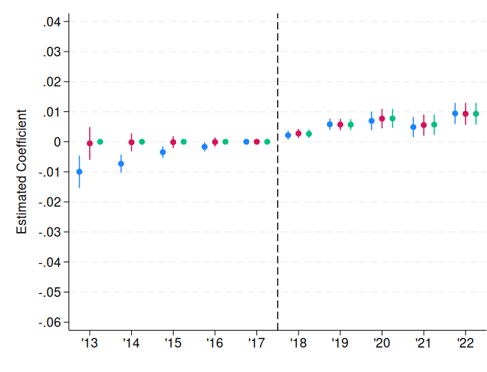
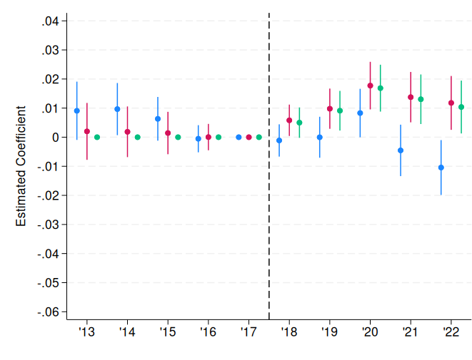
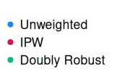
LODES employment
Log OZ resident employment
Log OZ workplace employment

Slide 17
IPW/doubly robust estimates wipe out empl./poverty rate gains; evidence of resident and workplace empl. gains
 | (i) | (ii) | (iii) | (iv) | (v) | (vi)
Data: | LODES | LODES | ACS | ACS | ACS | ACS
 | Log Resident Emp. | Log Workplace Emp. | Emp. Rate | Avg. Earnings | Poverty Rate | Log Resident Emp.
A. IPW Treatment on the Treated Estimates
Opportunity Zone | 0.007*** | 0.012** | 0.002 | 138.37 | 0.008*** | 0.018***
 | (0.002) | (0.004) | (0.001) | (108.74) | (0.002) | (0.004)
B. Regression-Adj. IPW Treatment on the Treated Estimates
Opportunity Zone | 0.007*** | 0.012*** | 0.002* | 136.17 | 0.005*** | 0.018***
 | (0.001) | (0.004) | (0.001) | (108.72) | (0.002) | (0.004)
Tract FE | Y | Y | Y | Y | Y | Y
Year FE | Y | Y | Y | Y | Y | Y
Tracts | 30,889 | 30,814 | 30,871 | 30,815 | 30,862 | 30,860
Larger estimated effect on residential employment with ACS may reflect inability to match on prior trajectory, so for now we take the LODES estimate as more credible
Positive effect on workplace employment parallel’s Arefeva et al. (2025) but our estimate is about ½ the size compared to their YourEconomy Time-Series estimate
Robust to state-by-year effects, winsorizing the weights
Increase in residential employment but not employment rate may reflect slight evidence we find of population growth (0.4%, not significant)

Slide 18
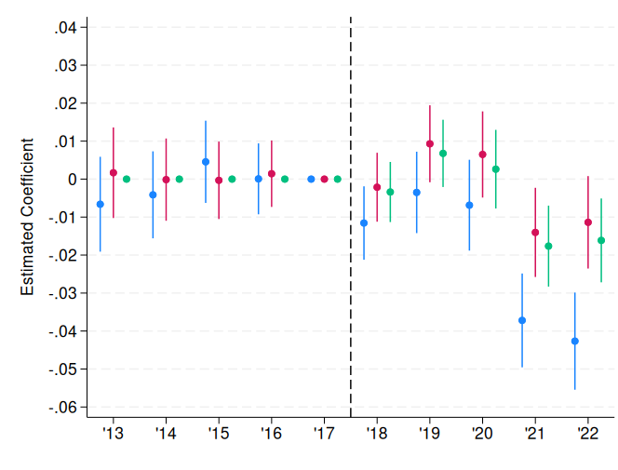
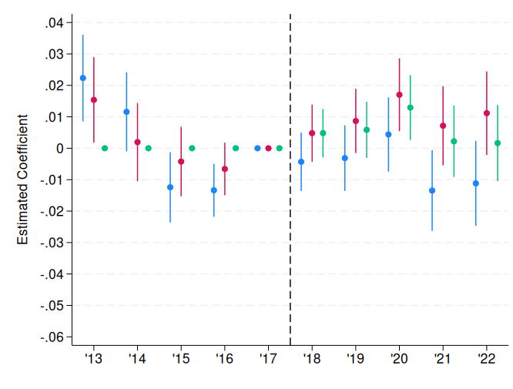
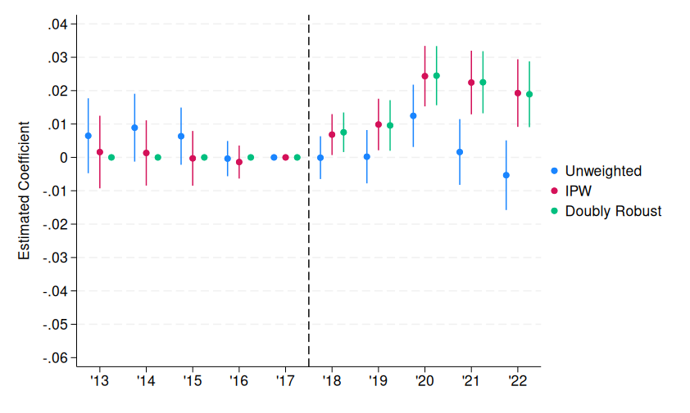
LODES workplace employment by residential location
Log OZ workplace employment, designated OZ
tract residents
Log OZ workplace empl., residents of non-OZ LIC tracts
Log OZ workplace empl., residents of non-LIC tracts

Slide 19
OZ workplace employment gains favor residents of other, non-LIC tracts
 | (i) | (ii) | (iii)
 | Log Workplace Jobs Held by Residents of
 | ...the same tract | ...non-OZ LIC tracts | ...non-LIC tracts
B. IPW Treatment on the Treated Estimates
Opportunity Zone | -0.003 | 0.010* | 0.018***
 | (0.004) | (0.005) | (0.005)
C. Regression-Adj. IPW Treatment on the Treated Estimates
Opportunity Zone | -0.006 | 0.006 | 0.019***
 | (0.004) | (0.005) | (0.003)
Tracts | 29,821 | 30,302 | 29,727
Notes: Data sourced from LODES. 2018 omitted. IPW based on outcome specific to each model.
Evidence that employment gains primarily benefit those not living in OZs parallels evidence that NMTC mainly benefitted higher-income, more-educated residents of tracts distant from those targeted (Freedman, 2015)
Coupled with evidence of increase in resident employment, results suggest some of the job growth in OZ resident employment occurs outside the OZ – next analysis

Slide 20
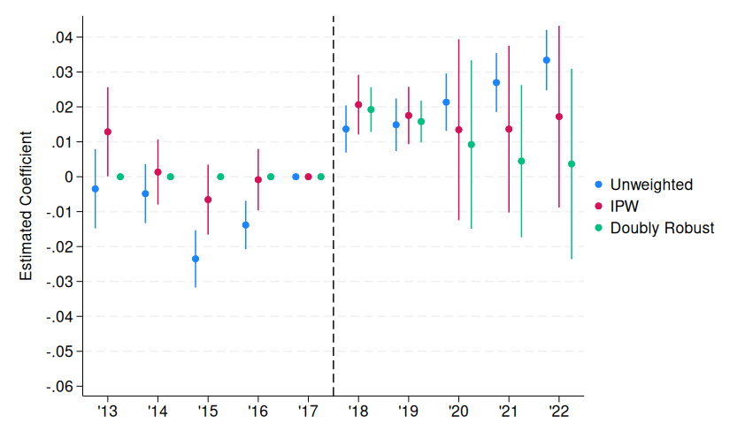

LODES residential employment by workplace location
Log OZ resident employment in designated OZ tract
Log OZ resident empl. in non-OZ LIC tracts
Log OZ resident employment in non-LIC tracts

Slide 21
OZ resident employment gains are mainly in non-LIC tracts
 | (i) | (ii) | (iii)
 | Log Resident Jobs at Workplaces in
 | ...the same tract | ...non-OZ LIC tracts | ...non-LIC tracts
B. IPW Treatment on the Treated Estimates
Opportunity Zone | -0.003 | 0.014 | 0.009***
 | (0.004) | (0.010) | (0.002)
C. Regression-Adj. IPW Treatment on the Treated Estimates
Opportunity Zone | -0.006 | 0.008 | 0.009***
 | (0.004) | (0.009) | (0.002)
Tracts | 29,821 | 30,302 | 29,727
To some extent, employment gains of OZ residents aren’t occurring in designated tract, but rather in non-LIC tracts
  Consistent with in-migration of less-disadvantaged people who work elsewhere, perhaps in response to housing investment

Slide 22
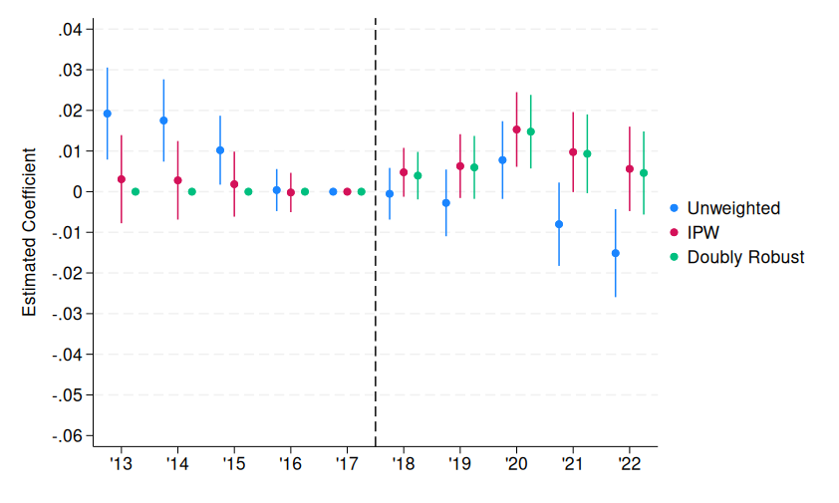
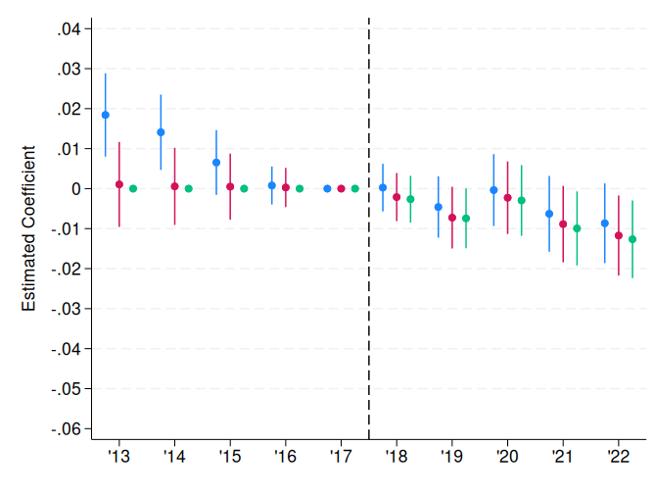
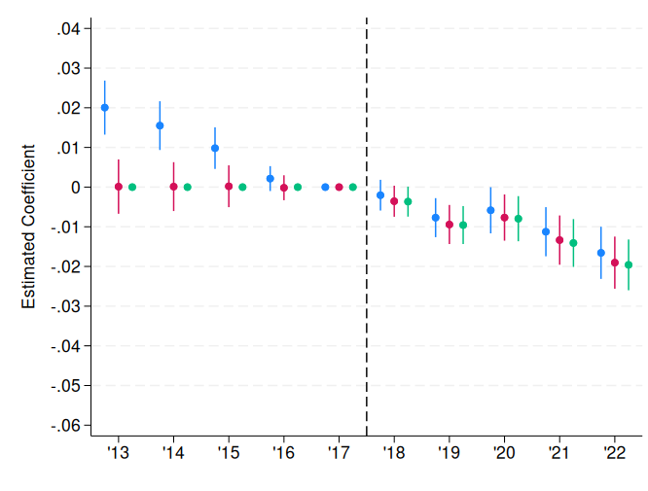
LODES workplace employment – OZs and adjacent tracts
Log OZ workplace empl. omitting adjacent
tract controls
Log workplace empl. in adjacent LICS, only
non-adjacent LICs as controls (same controls)
Log workplace empl. in all adjacent tracts, all tracts adjacent to LICs but not OZs as controls

Slide 23
Negative spillovers offset gains in OZs
 | (i) | (ii) | ‍(iii)
 | Log Workplace Jobs
B. IPW Treatment on the Treated Estimates
Opportunity Zone | 0.008
 | (0.005)
‍‍‍‍‍‍Near OZ |  | -0.008 | -0.012***‍
 |  | (0.004) | (0.003)‍
C. Regression-Adj. IPW Treatment on the Treated Estimates
Opportunity Zone | 0.009*
 | (0.004)
‍‍‍‍‍‍Near OZ |  | -0.008* | -0.013***‍
 |  | (0.004) | (0.003)‍
‍‍‍‍‍‍‍‍‍‍‍‍Treated tracts (N) | OZs (7,656) | LICs adjacent to OZs (12,228) | All tracts adjacent to OZ (22,492)‍
Control tracts (N) | LICs not adjacent to OZs (11,095) | LICs not adjacent to OZs (11,095) | Tracts adjacent to an LIC but not an OZ (26,029)‍
‍‍‍‍‍‍‍‍‍‍‍‍Total 2017 workplace jobs in treated tracts | 21,005,705 | 19,496,515 | 40,985,928‍
Col (i): estimates bigger having omitted adjacent LICs from controls, suggesting negative spillovers – consistent with col (ii) estimates
Negative spillovers on adjacent LICs roughly offset; negative spillovers on all adjacent tracts more than offset, but not as conventional a control group

Slide 24
Conclusions/interpretation
Earlier work pointed to limited gains for OZ residents, but some evidence of job growth in OZs
Results imply both may be true, with jobs created going to residents of more-advantaged neighborhoods
In addition, the job gains appear to be offset by negative spillovers
Negative spillovers do not necessarily negate beneficial distributional effects if OZs are especially disadvantaged compared to other LICs, or there are other complementarities
  But coupled with job gains concentrated among residents of more-advantaged neighborhoods, harder to argue for distributional gains

Slide 25
Housing program, not jobs program?
Recent EIG work suggests large housing supply response, which could be salutary if overall supply is increasing
  But … spillovers could be an issue, and may be less concentrated in nearby areas than job spillovers
Moving the goalposts?
  EIG’s recent work now touts OZs as a housing program:
    “The United States faces a deep and persistent housing shortage, particularly in low-income communities… Opportunity Zones (OZs) were designed to change that dynamic — channeling private capital into designated distressed areas…”
  vs. IRS (reminder from 1st slide)
    “Opportunity Zones are an economic development tool… Their purpose is to spur economic growth and job creation in low-income communities while providing tax benefits to investors.”

Slide 26
Thank you!

Slide 27
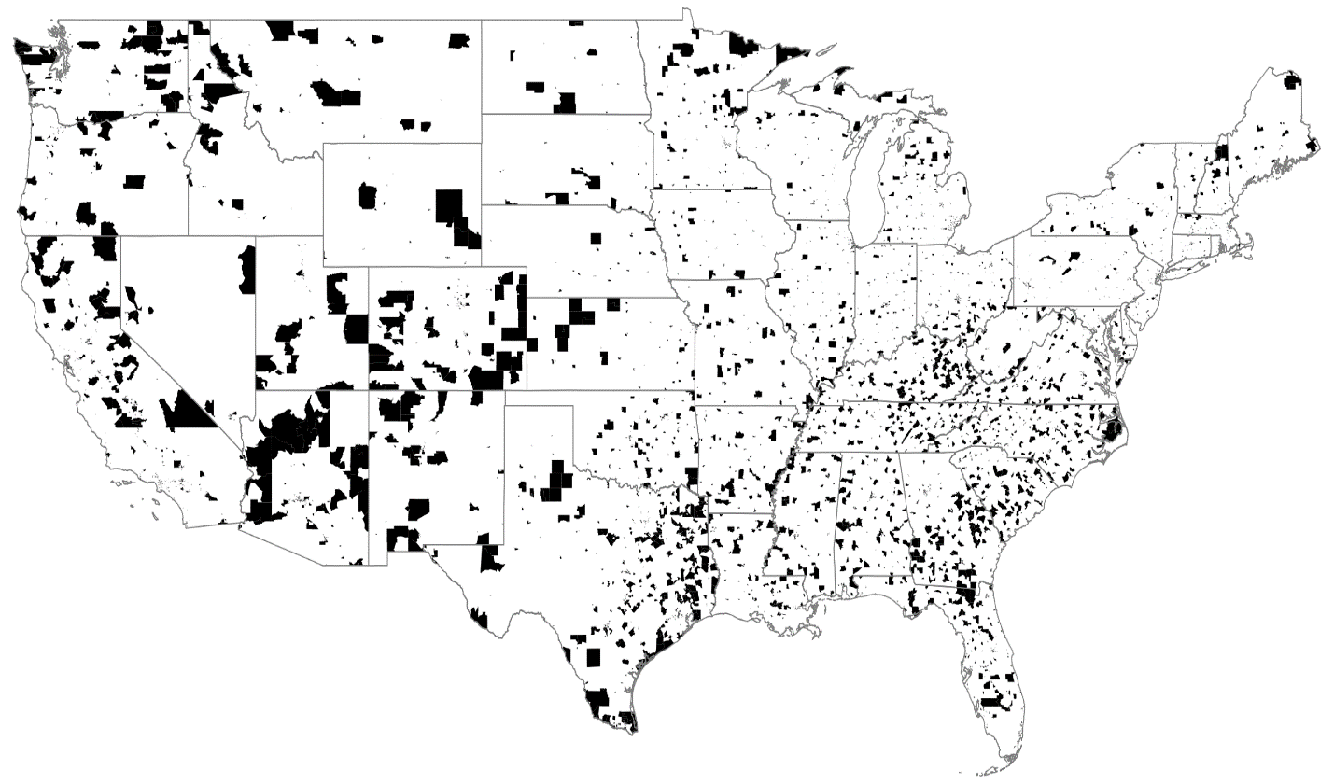
Opportunity Zones

